Slide 1
Tue. Feb. 10th
The 4th, CREST Workshop
Implementation of Fast Constant Potential Method for Hybrid MC/MD Reaction Simulation
Norio Takenaka^{1,2}
Graduate School of Information Science, Nagoya University¹,
Elements Strategy Initiative for Catalysts and Batteries (ESICB), Kyoto University²

Slide 2
Previous Constant Potential Method
In the previous constant potential method, the charges on the electrode are obtained by minimizing the following potential energy under the objective electric potential difference between anode and cathode ΔV (= V⁺－V⁻).
Cathode
Anode
electrolyte
,
Set electric potential
[1] S. K. Reed, O. J. Lanning, P. A. Madden, J. Chem. Phys., 126, 084704 (2007).
However, the calculation cost of previous constant potential method was very expensive for applying to the hybrid MC/MD reaction simulations because it requires the SCF procedure to calculate the electrode charges.

Slide 3
Fast Constant Potential Method
Considering the electrochemical cell composed of two parallel electrodes and electrolyte, the induced charges on the electrodes are theoretically obtained without SCF procedure.
Distance: D
Cathode
Anode
electrolyte
q_{LE}
q_{RE}
z axis considering non-periodic
A: surface area of electrode
ΔV: electric potential difference between anode and cathode
(EW3DC method)
[2] M. K. Petersen, R. Kumar, H. S. White, G. A. Voth, J. Phys. Chem. C, 116, 4903 (2012).
The present calculation cost is similar to that of the standard MD simulation.

Slide 4
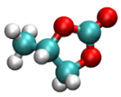

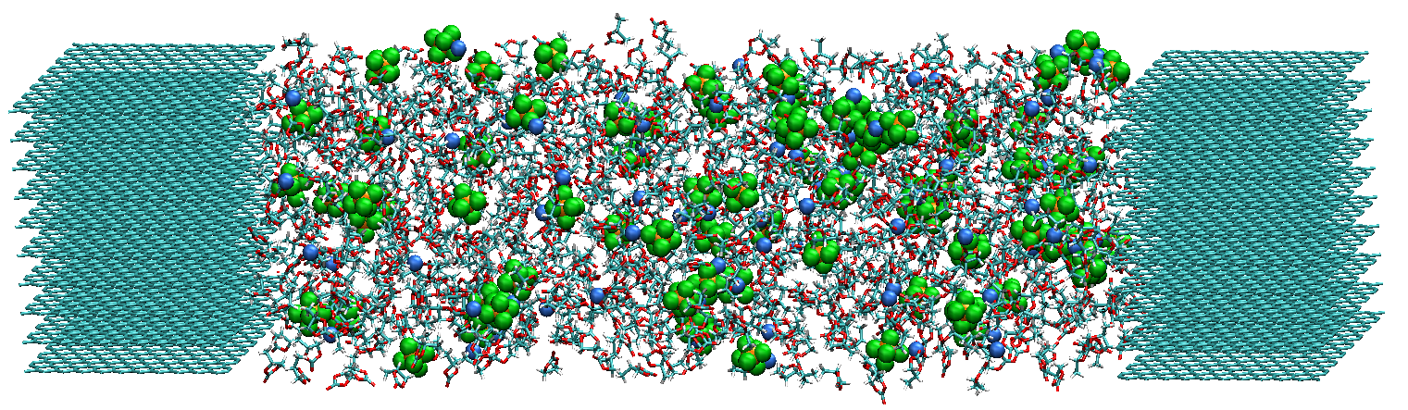

Test System (Graphite Electrode/PC-based Electrolyte)
PC: 850
Li⁺: 85
PF₆⁻: 85
Temperature: 450 K
PC
Li⁺
PF₆⁻
Cathode
128.2 Å
Anode
x
y
z
Graphite
Graphite
1.1 M LiPF₆ PC-based electrolyte
In the present simulations, the electrolyte was first equilibrated at 0 [V]. Then, by applying the electric voltage (4 [V]), the temporal change in the electrode charges were observed with the constant potential method.

Slide 5
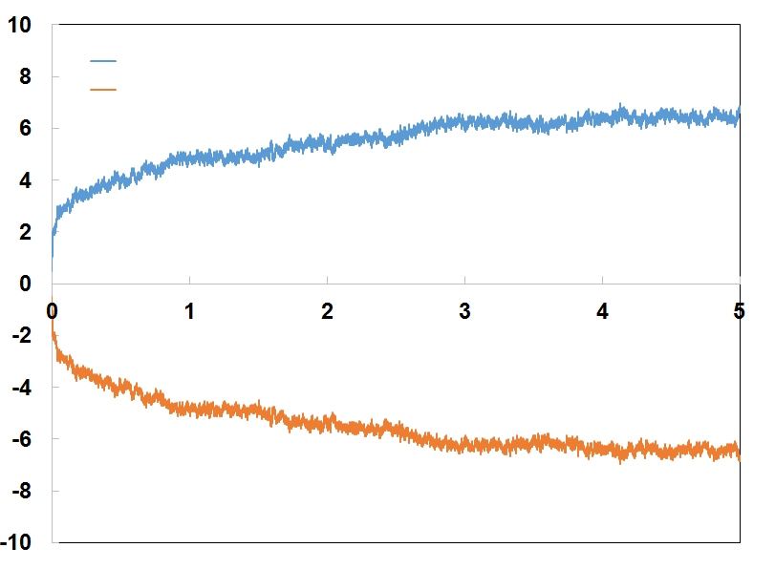
Temporal Change of Electrode Charges
cathode
anode
cathode
Charge [e]
anode
Time [ns]
In the first stage (t < ~100 ps), the charges drastically change because the orientation of solvent molecules should change quickly.
On the other hand, in the latter stage, the charge curves become loose due to the small ion diffusion.

Slide 6
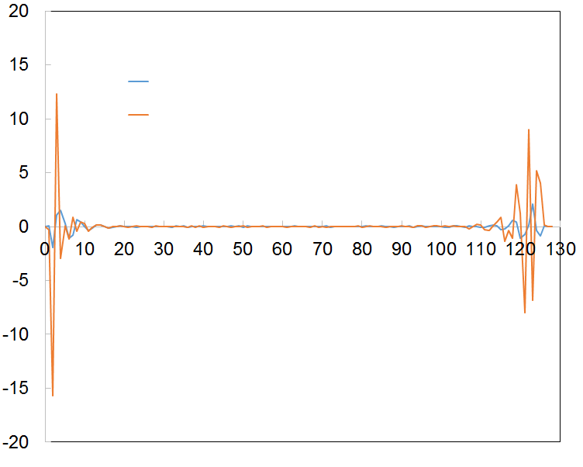
Charge Distribution on Z Axis
To estimate the electric potential difference, the charge distribution ρ(z) is calculated along z axis (z = 0 shows the cathode surface) by using 10 ns MD sampling under the constant voltage (0 or 4 V).
0 V
4 V
ρ(z) [e]
z [Å]

Slide 7
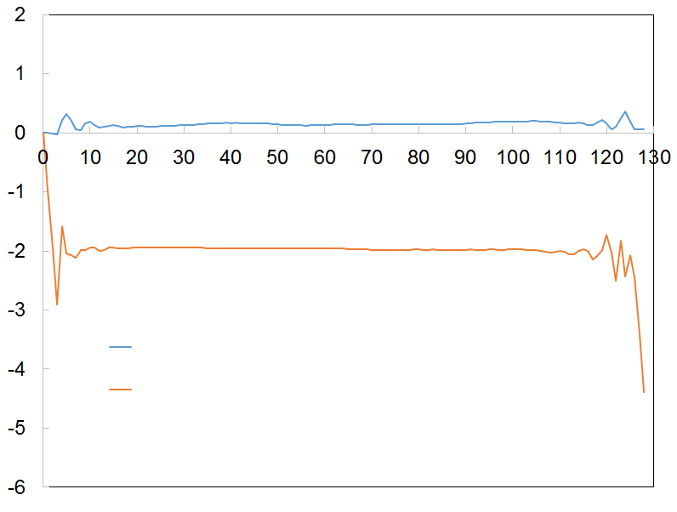
Electric Potential Change
Electric potential [V]
Poisson’s equation:
0 V
4 V
z [Å]
The calculated electric potential differences became set values (0 or 4 V).
The electric potential was constant in the bulk region, meaning that the electric field contributes only the molecules near the electrode.

Slide 8
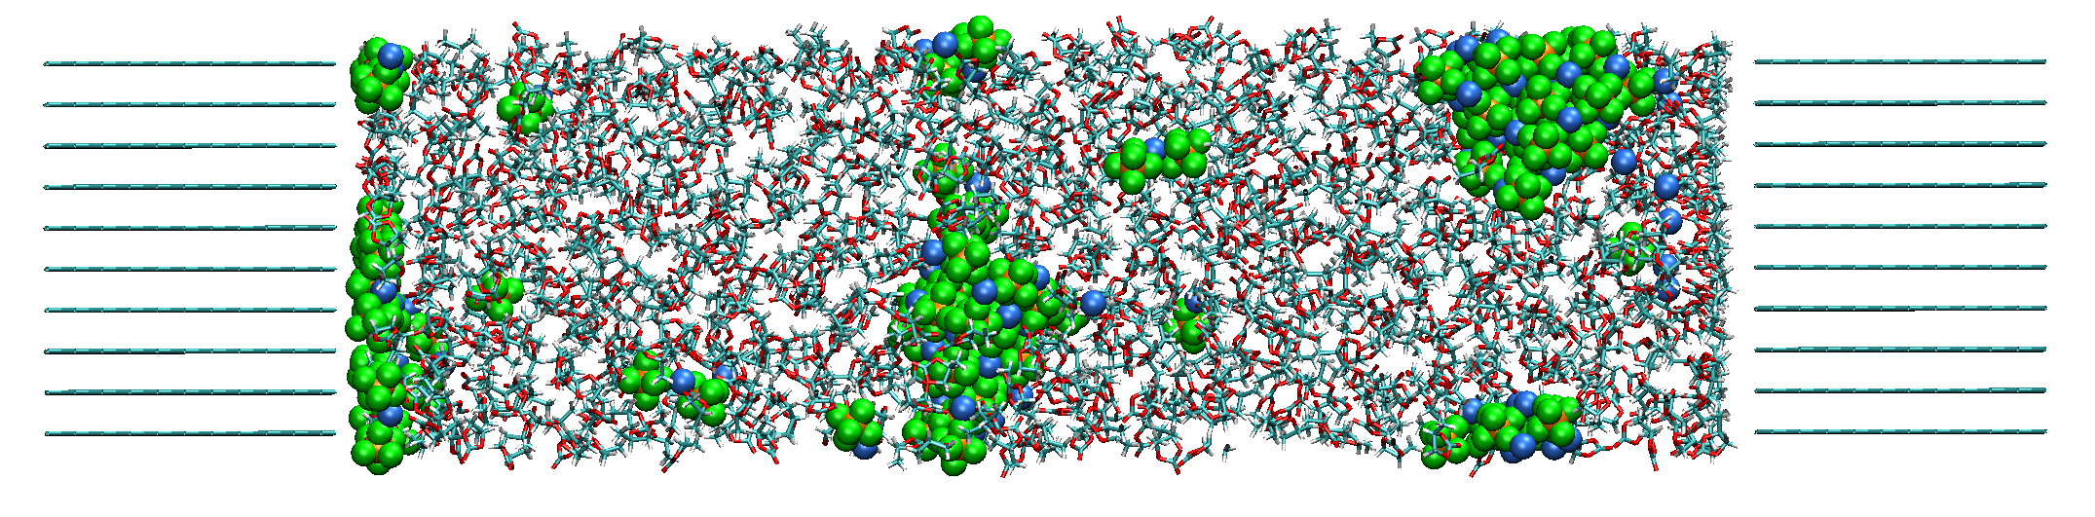
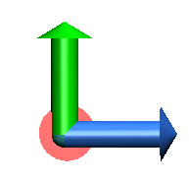
One of Problem in the Present Simulation
y
z
By executing the long-term MD simulation (t > 10 ns), the Li⁺ and PF₆⁻ aggregated, and they formed the large cluster.
Therefore, the present force filed should be modified so as to suppress such aggregation during the MD simulations.
One of the method is to reproduce correctly the experimental diffusion constant by changing the Lennard-Jones parameters.

Slide 9
Conclusion and Future Work
To apply the hybrid MC/MD reaction simulations, the fast constant potential method was implemented into AMBER program.
The present calculation cost was similar to the standard MD simulations because the charges are easily obtained by using the theoretical equations.
By using the present constant potential method, the electric potential differences became the set values.
However, to execute the long-term MD simulations, the Li⁺ and PF₆⁻ aggregated due to their inaccurate Lennard-Jones parameters.
I will optimize the Lennard-Jones parameters so as to suppress such aggregation, and execute the hybrid MC/MD reaction simulations by using the present constant potential method.

Slide 10
Thank you for your attention

