Slide 1
Application of hybrid MC/MD reaction method to the study of CALB catalyzed ring-opening polymerization of β -lactam
Chantal Barberot, Ikuo Kurisaki, Yuichi Suzuki, Masataka Nagaoka
Graduate School of Information Science,Nagoya University

Slide 2
Enzymatic polymerization
Increased interest in the area of in vitro enzyme-catalyzed organic reaction
Many families of enzyme can be used for transforming not only their natural substrates but a wide range of unnatural compounds
Using enzymes in organic synthesis have several advantages
High catalytic activity
Mild reaction conditions (solvent, temperature, pressure, pH)
Regio, stereo and enantio-selectivity
Non-toxic natural catalyst
In living system, polymers can be produced by enzymatic catalysis
Synthesis of polymers with enzymatic catalysis have more and more study
Production of biodegradable and biocompatible materials
Application in medicine, packaging industry
Lipase enzymes are widely used for enzymatic polymerization

Slide 3
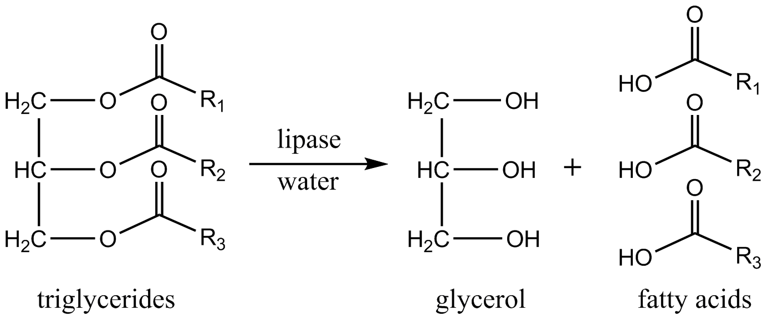
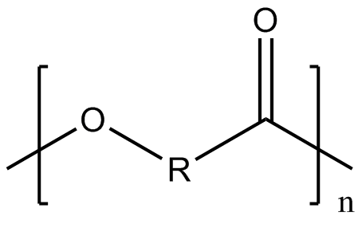
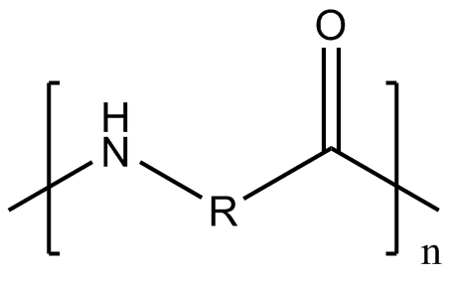
Enzymatic polymerization
In living system, lipase hydrolyze triglycerides into fatty acids and glycerol
In organic media, lipase can catalyze the reverse reaction (esterification)
The most commonly biocatalyst used in enzymatic polymerization is Candida Antartica Lipase B (CALB) come from yeast
High stability at elevated temperature
Good activity in organic solvent
Accept various substrate
polyester
polyamide

Slide 4
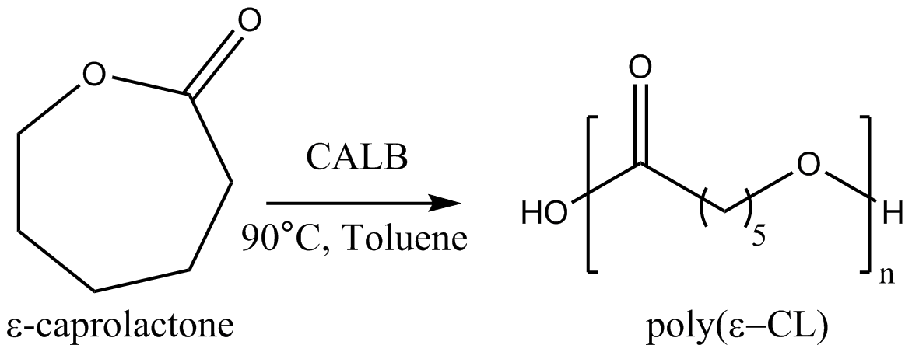
Example of CALB catalyzed polymerization
Ring-opening polymerization of β-Lactam
Reaction yield = 37%
Maximum degree of polymerization (DP) = 40 monomeric units
Average DP = 12 monomeric units
Ring-opening polymerization of ε-caprolactone (ε-CL)
Reaction yield = 65%
DPmax = 78 monomeric units
Average DP = 29 monomeric units
→ polymer size and the reaction yield dependent of the nature of starting material
K. Loos et al. Biomacromolecules 2014 15, 234-241

Slide 5
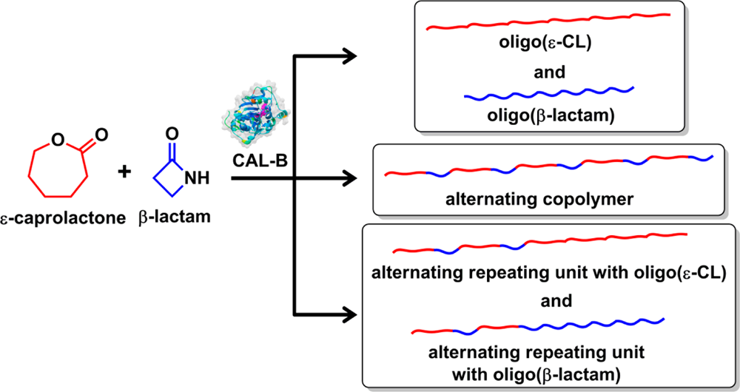
Example of CALB catalyzed polymerization
Ring-opening copolymerization of ε-CL and β-Lactam
Different feed ratios of ε-CL/β-lactam tested: 75:25, 50:50 and 25:75
DPmax = 12
9 different structures of poly(ε-CL-co-β-lactam) was observed with a ratio of 50:50 ε-CL/β-lactam
A better understanding of the polymerization process can allow to regulate the copolymer structure (molecular weight, nature)
Feed ratio |  | Conversion
ε-CL | β-Lactam | ε-CL | β-Lactam | Yield
0 | 100 |  |  | 37
25 | 75 | 72 | 57 | 12
50 | 50 | 73 | 90 | 50
75 | 25 | 78 | 95 | 44
100 | 0 |  |  | 65
K. Loos et al. Biomacromolecules 2014, 15, 234-241

Slide 6
Target goal
For the polymerization process, some mechanism were already proposed
Some mechanism based on experimental observations was given
A theoretical mechanism of β-Lactam polymerization catalyzed by CALB was proposed¹
They only model the polymerization process until the formation of the dimer
This mechanism do not explain the rate-determining step of the polymerization reaction
Simulation of the whole polymerization process seems to be important to clarify the CALB catalyzed copolymerization mechanism
We propose to simulate the CALB catalyzed copolymerization process by using the hybrid MC/MD reaction method²
First, we will study the CALB-catalyzed polymerization of β-Lactam and ε-Caprolactone process individually
¹G. Felds et al. ACS Catal. 2011, 1, 323-336
²M. Nagaoka et al. Chem. Phys. Letters 2013, 583, 80-86

Slide 7
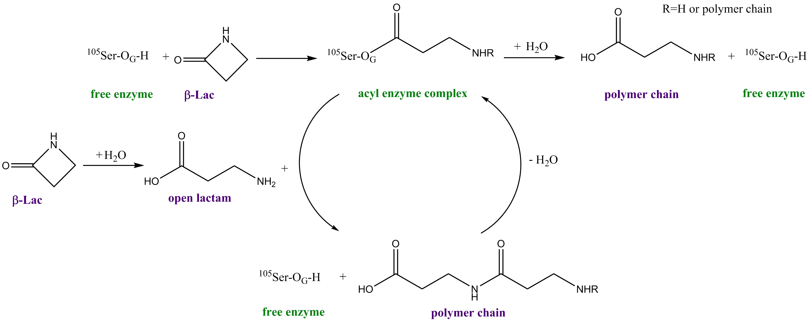
Hybrid MC/MD Reaction Simulation
Mechanism proposed for the hybrid MC/MD reaction process
initiation
propagation
Active site
- two bond breaking
- two bond formation
G. Felds et al. ACS Catal. 2011, 1, 323-336

Slide 8
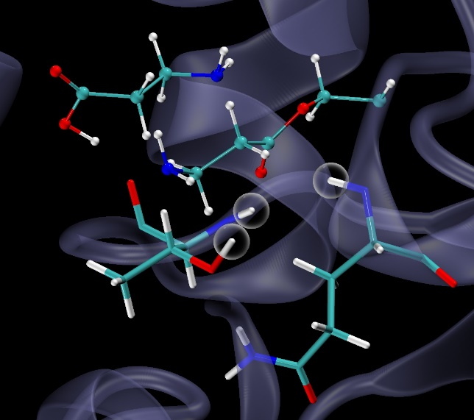
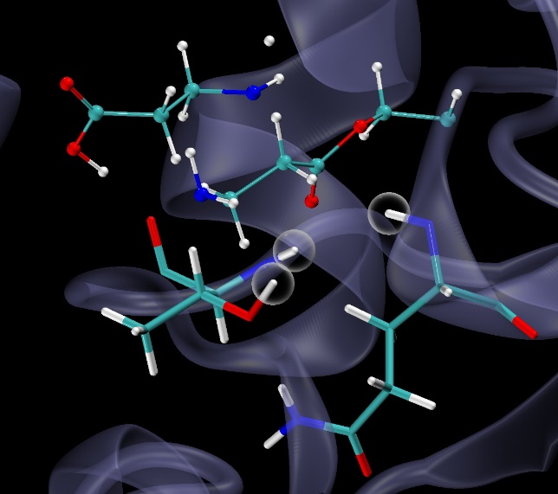
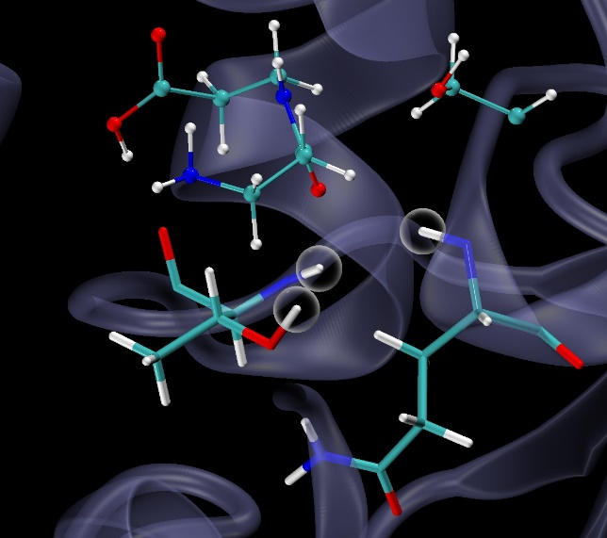
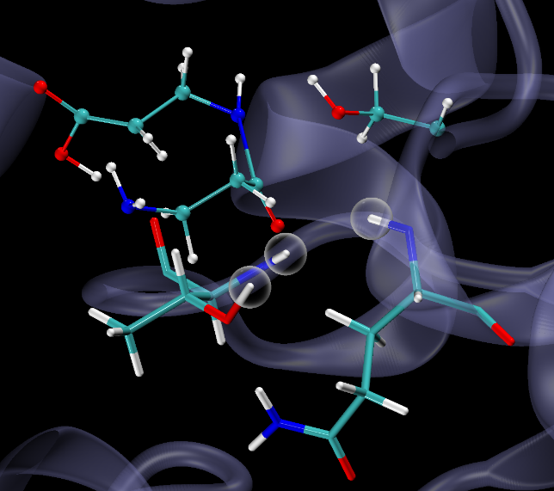
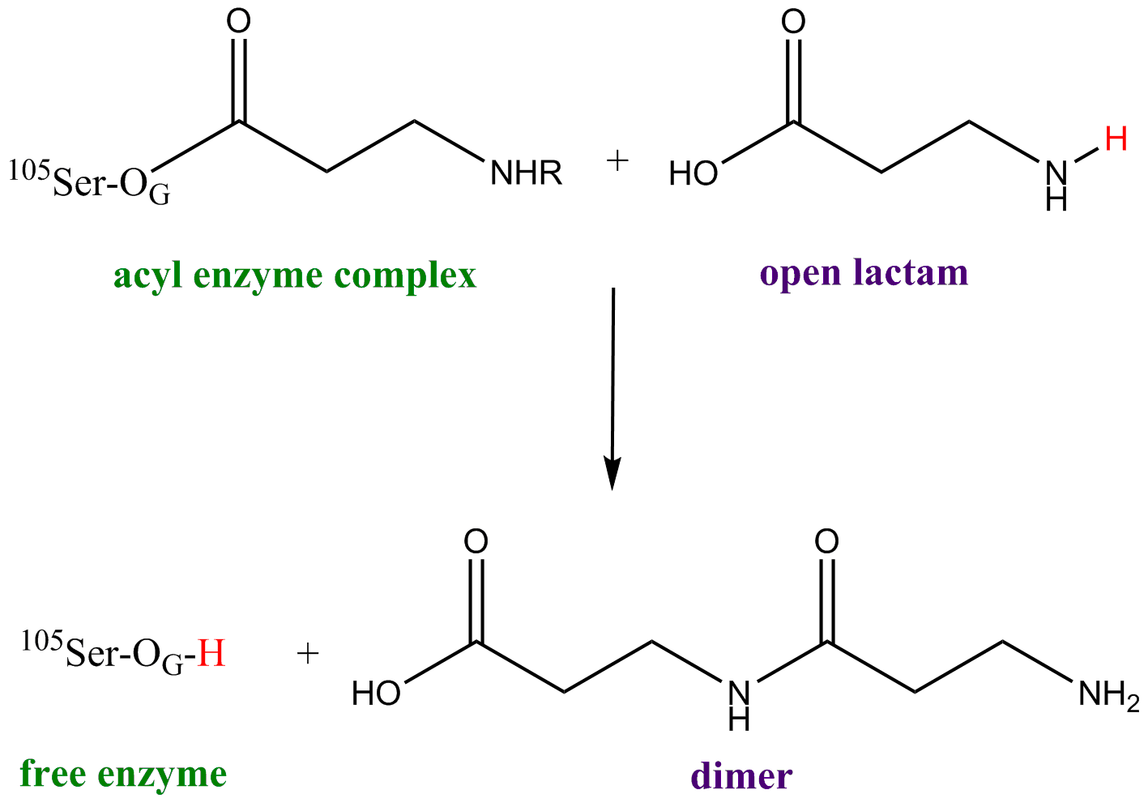
Adaptation of hybrid MC/MD Reaction simulation
Run MD simulation until satisfying necessary conditions
Virtually react and relax the whole system
Accept or reject the reaction under the Metropolis scheme
lactam
acylated serine
Thr40
Gln106
dimer
O_{G}
Ser105
oxyanion hole
Thr40
Gln106

Slide 9
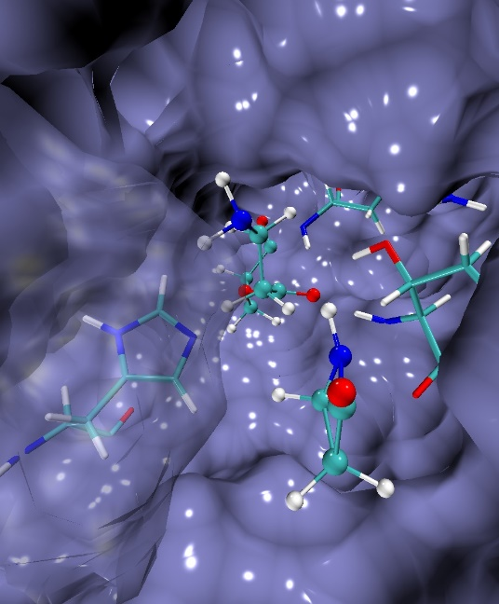
Simulation of the first polymerization process steps
Model system
Acylated Serine
One β–lactam in the active site
In a water box (Size box: 67*86*74 Å)
Force field: ff99SB and GAFF, RESP charge procedure
Periodic boundary condition
100 ps of heating up to the desired temperature (300 K) with a Langevin thermostat
1 ns of NPT-MD equilibration under a pressure of 1 bar and temperature of 300 K
NVT-MD time is 10 ps with a temperature of 300 K for each MC/MD cycle
SHAKE method used to constrain the bond involving hydrogen atom
Acylated Serine
His224
Thr40
Β-lactam

Slide 10
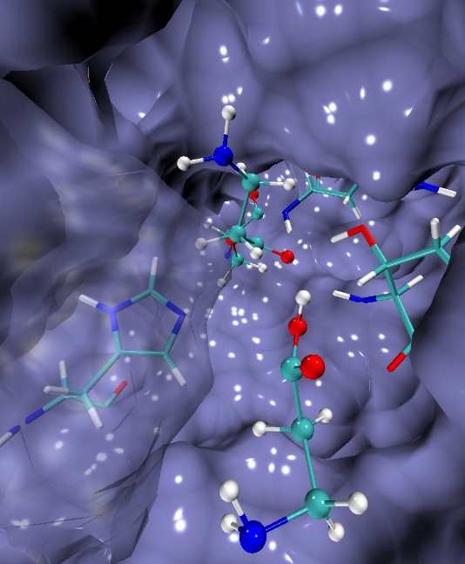
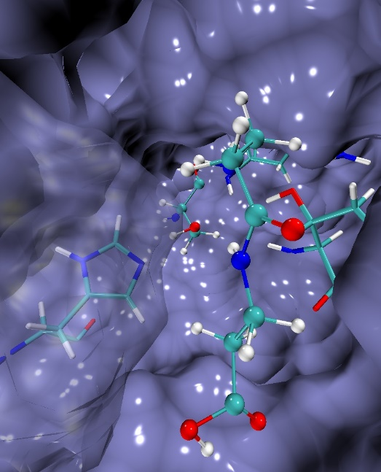
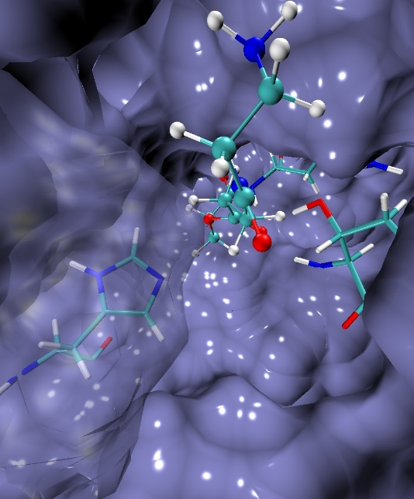
Simulation of the first polymerization process steps
Formation of acylated complexe
Lactam opening
Polymerization
Acylated Serine
Acylated Serine
Acylated Serine
Ser105
His224
His224
His224
His224
Thr40
Thr40
Thr40
Thr40
Β-lactam
Open latam
Dimer

Slide 11
Next implementation in the hybrid MC/MD reaction method
To realize the next step of polymerization process, another lactam molecule should approach and bind to the active site
Spontaneous lactam binding to the active site is time consuming with a standard MD simulation
Add a docking procedure to force the lactam to be bound to the active site

Slide 12
Conclusion
Modelisation of the first steps of the CALB catalyzed polymerization by the hybrid MC/MD approach shows that this method can be used to study enzymatic catalysis
After having successfully completes each step of the polymerization process, we will modelize the CALB-catalyzed polymerization of β-Lactam by varying the reaction condition (temperature, solvent)
Being able to use the hybrid MC/MD method for this complex reaction would allow us to extent its scope of study to other complex system

Slide 13
Thank you for your attention

