Slide 1
Fri. Apr. 17th
FY2015’s 1th, CREST Workshop
Hybrid MC/MD Reaction Simulation with Constant Potential Method
Norio Takenaka^{1,2}
Graduate School of Information Science, Nagoya University¹,
Elements Strategy Initiative for Catalysts and Batteries (ESICB), Kyoto University²

Slide 2

MEXT program
Elements Strategy Initiative for Catalysts and Batteries: Interplay Between Experimental and Theoretical Studies
Primary object is
・ To develop rare metals-free high performance catalysts and batteries
・ To understand the principle of material science
As one of specific targets,
we develop the rare metals-free secondary battery.
Li-ion battery
Na-ion battery
(Li = rare metal)
(Na = common metal)
2

Slide 3
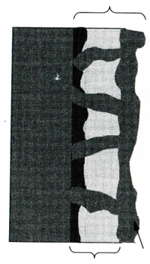

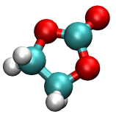
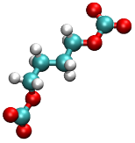


Background of present research①
Solid Electrolyte Interphase (SEI) Film
・During the initial charging cycles, the reductive reaction products of the electrolyte form a solid electrolyte interphase (SEI) film on the anode surface.
・The ideal SEI film can protect the electrolyte from the further reduction while maintaining Na⁺ exchange. Therefore, it is closely related to the lifetime of battery.
SEI Film
Exchange
Na⁺
Reduction of electrolyte
Block
Solvent
Na-ion battery
Inorganic Salts
(e.g. Na₂CO₃)
Organic Salts
(e.g. ROCO₂Na)
S. Komaba et al., Adv. Funct. Mater, 21, 3859 (2011).

Slide 4
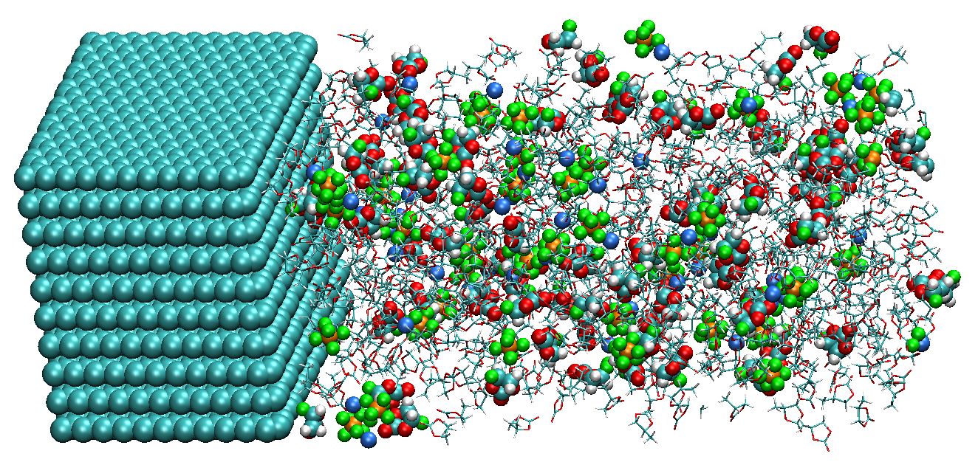
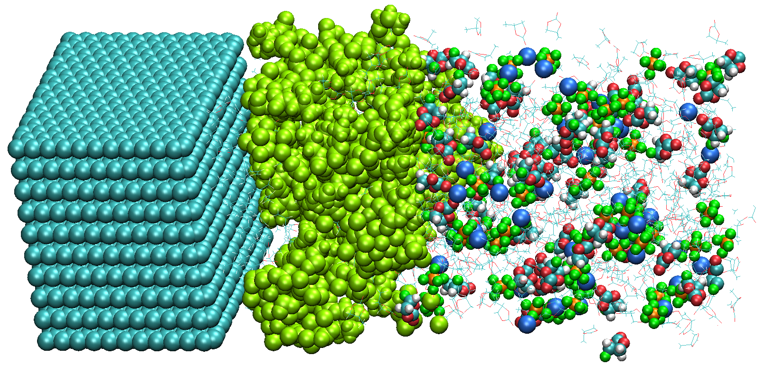
Background of present research②
Hybrid MC/MD reaction simulation
・ In the previous simulations, we have investigated the SEI film formation on the carbon anode surface with the hybrid Monte Calro (MC)/molecular dynamics (MD) reaction method [1,2].
・ In these simulations, the atomic charges on the anode surface was constant. However, in the real cell, such electrode charges can change according to the SEI film formation at the given voltage.
e⁻
Hybrid MC/MD
reaction simulation
Initial state
Final state
[1] M. Nagaoka, Y. Suzuki, T. Okamoto, NT, Chem. Phys. Lett., 583, 80 (2013).
[2] NT, Y. Suzuki, H. Sakai, M. Nagaoka, J. Phys. Chem. C, 118, 10874 (2014).

Slide 5
Purpose of this study
・ To improve the calculation accuracy of the previous SEI film formation simulations, I aim to realize the hybrid MC/MD reaction simulation under the constant electric voltage.
・ For this purpose, three methods have implemented into the AMBER program.
① Ewald summation method for the two dimensional system [3]
[3] A. Bródka, A. Grzybowski, J. Chem. Phys., 117, 8208 (2002).
② Constant electric potential method [4]
[4] M. K. Petersen, R. Kumar, H. S. White, G. A. Voth, J. Phys. Chem. C, 116, 4903 (2012).
③ Cation (Li⁺ or Na⁺) insertion method into the electrolyte

Slide 6
EW method for 2D system
・ In the two-dimensional (2D) system, the conventional three-dimensional (3D) Ewald summation method (EW3D) cannot be used. To improve the calculation accuracy, the use of EW3DC method [3] is very efficient.
[3] A. Bródka, A. Grzybowski, J. Chem. Phys., 117, 8208 (2002).
・ In the EW3DC method, the empty region is introduced along the non-periodic direction. Next, the correction term is added to the EW3D method.
Electrostatic potential
Electric field
MD simulation box
Empty (or vacuum) region
V_{c}: volume of the system
z: real space coordinate along the non-periodic direction
z axis considering non-periodic
→ The EW3DC method improves the electrostatic potential and electric field in 2D system.

Slide 7
Constant electric potential method
・ There are some methods to apply the constant voltage for the MD simulations.
Among them, the fastest method [4] is employed in the present study.
[4] M. K. Petersen, R. Kumar, H. S. White, G. A. Voth, J. Phys. Chem. C, 116, 4903 (2012).
・ In this method, considering the electrochemical cell composed of two parallel
electrodes and electrolyte, the induced charges on the electrodes are obtained:
Distance: D
Cathode
Anode
electrolyte
q_{LE}
q_{RE}
z axis considering non-periodic
A: surface area of electrode
ΔV: electric potential difference between anode and cathode

Slide 8
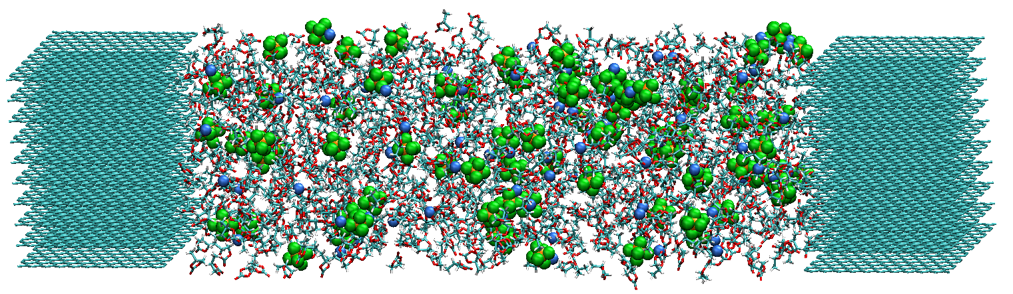
Cation insertion method into electrolyte
・ In the SEI film formation simulations, the same number of cations as that of injected electrons was additionally placed in the electrolyte to neutralize the whole system whenever the electrolyte molecules are reduced on the anode surface.
Li⁺ (or Na⁺)
e⁻
Li⁺ (or Na⁺)
e⁻
anode
anode
Half-cell system
(Previous)
(b) Full-cell system
(Present)
・ In contrast to the previous half-cell system, there is no empty region in the system to add cation. Therefore, such cation should be directly inserted by increasing gradually the interactions between the inserted cation and others.

Slide 9
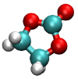

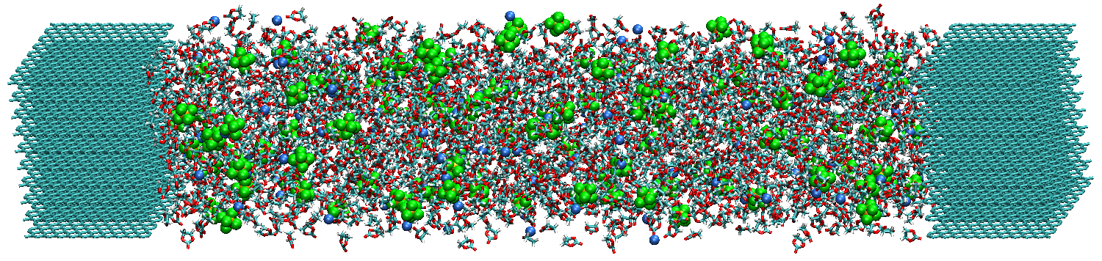
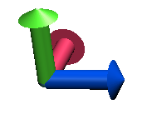
Calculation model
Temperature: 298 K
Voltage: 0 V or 4 V
EC: 1700
Li⁺: 134
PF₆⁻: 134
Li⁺
PF₆⁻
EC
The origin of z coordinate （z = 0) is taken at the cathode surface.
Cathode
164.2 Å
Anode
Graphite
1.1 M LiPF₆ EC-based electrolyte
Graphite
x
y
z

Slide 10

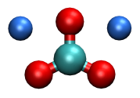
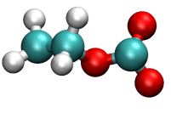

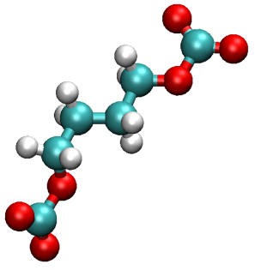
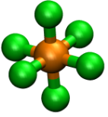


Elementary chemical reaction processes
In the present hybrid MC/MD reaction simulations, I employed the same elementary chemical reaction processes as the previous ones [2].
(EC)
+ e⁻, + Li⁺
+
+ e⁻, + Li⁺
C₂H₄
Li₂CO₃
EC
LiEC
+ LiEC
radical polymerization
(PF₆⁻)
(CH₂CH₂OCO₂Li)₂, Li₂BDC
(dilithium butylene dicarbonate)
+ 2e⁻, + 3Li⁺
+
3 ×
PF₆⁻
PF₃
[2] N. Takenaka, Y. Suzuki, Y. Sakai, M. Nagaoka, J. Phys. Chem. C, 118, 10874 (2014).

Slide 11
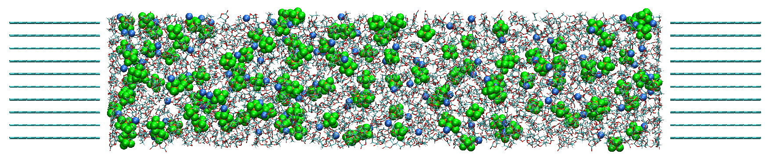
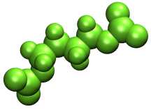
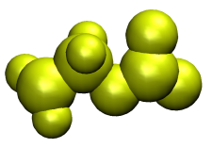


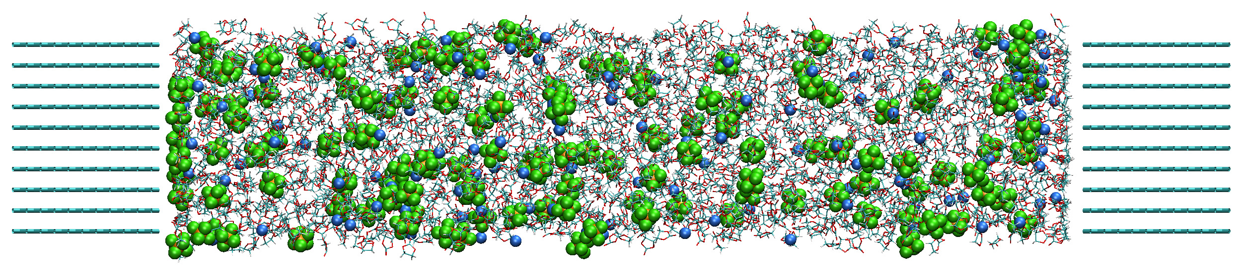
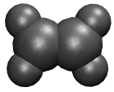

Snapshots of hybrid MC/MD reaction simulation
Initial State (0 MC/MD cycle)
(a) 0 V
cathode
anode
Reaction product
LiEC
Li₂BDC
(b) 4 V
cathode
anode
Li₂CO₃
LiF
C₂H₄
PF₃

Slide 12
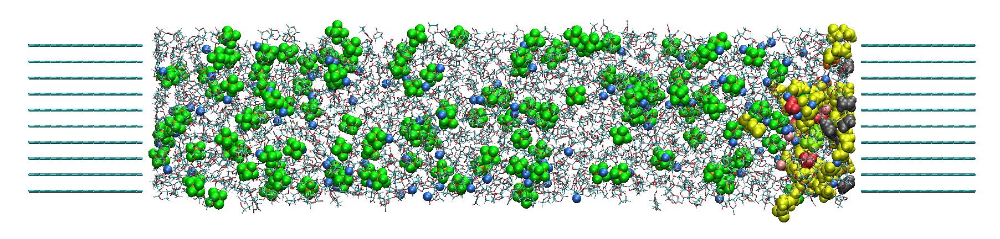
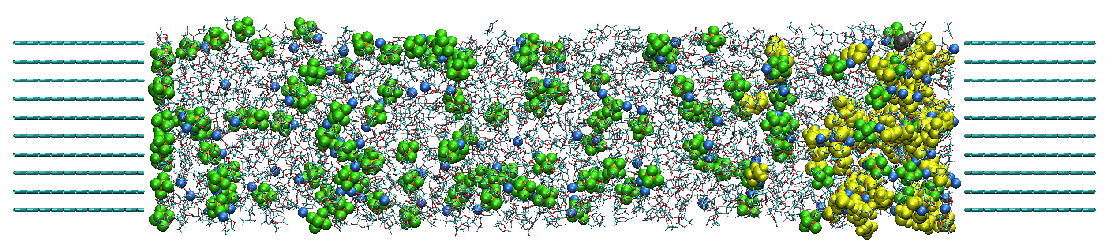
Snapshots of hybrid MC/MD reaction simulation
100 MC/MD cycle
(a) 0 V
cathode
anode
Reaction product
LiEC
Li₂BDC
(b) 4 V
cathode
anode
Li₂CO₃
LiF
C₂H₄
PF₃

Slide 13
Changes in the electrode charges
4 V
Cathode (0 V)
Relaxation time: 4 ps
Anode (0 V)
Cathode (4 V)
0 V
Anode (4 V)
Charge [e]
0 V
4 V
MC/MD Cycle
The electrode charges frequently changed depending on the reduction reactions so as to keep the voltage.
The electrode charges at 4 V (~±7.4 e) were larger than those at 0 V (±0.4 e). At 4 V, such large negative charge on the anode surface should enhance the dissolution of the reaction products.

Slide 14
Conclusion and future work
To realize the hybrid MC/MD reaction simulation at the given voltage, three methods have implemented to AMBER program.
By using the present program, we can simulate the complex chemical reaction processes on the anode surface under the constant electric potential.
During the present simulations, the electrode charges frequently changed so as to reproduce the set electric voltage in contrast to the previous simulation.
At the high voltage (4 V), the dissolution of the reaction products should be enhanced due to the strong electrostatic repulsions.
In future, by executing long-time MC/MD simulations, I will investigate the dependency of the SEI film formation on the voltage value.

Slide 15
Thank you for your attention

