Slide 1
CREST Workshop Uppula Purushotham
Mechanistic Study of the Opposite Influence of DiFluoro Ethylene Carbonate as Electrolyte Additive for Rechargeable Na Batteries : A Hybrid MC/MD Simulation Study

Slide 2
Background of Present Research
According to the experimental results[1], fluoroethylene carbonate (FEC) is the only an effective additive for Na-ion battery among the FEC, DFEC, VC and ES.
The FEC addition improved the cycle performance by decreasing the irreversible capacity to form the SEI film. In case of DFEC, performance is decreased by lowering reversible capacity.
In the present study we would like to investigate the origin of mechanism to form SEI film in DFEC additive PC electrolyte Na-ion battery.
In this regard we have planned to compare the MC/MD simulation results of DFEC additive with FEC additive and non additive PC electrolyte Na-ion battery.
Figure : Reversible capacity versus cycle number plot of PC electrolyte Na-ion battery.
[1] S. Komaba et al., ACS Appl. Mater. Interfaces, 3, 4165 (2011).

Slide 3
Di-Fluoro Ethylene Carbonate Reaction Route
To perform MC/MD simulation, I have prepared the reaction scheme which consists a list of elementary reactions involved in the formation of SEI film.
The reaction profile of DFEC has been modelled based to the FEC reaction scheme[2].
The reaction profile of DFEC modelled by using DFT methods.
+ e⁻
+ e⁻
+
DF1
DF2
DF3
CO₃
C₂F₂
Na₂CO₃
Reaction route_1
+ e⁻
+
+
CO₂
C₂H₂OF
NaF
C₂H₂O
DF_A
DF_F
DF_G
DF_H
Reaction route_2
[2] P. B. Balbuena et al. J. Electrochem. Soc. 161, A213 (2014).

Slide 4
Reaction Profile of DFEC
Gas phase : B3LYP/6-31+G(d)
Solvent phase: B3LYP/6-31+G(d)//B3LYP/6-31+G(d)
(Solvent: Propylene carbonate)
21.736
+ e⁻
Relative energy in kcal/mol
14.272
DFEC_Na
DFEC_Na_IN1
DFEC_Na_TS1
DFEC_Na_Pro
Reaction products
Figure: Computed reaction profile (kcal/mol) for Di-fluoro ethylene carbonate (DFEC) reaction route_1.

Slide 5
Reaction Profile of DFEC
Gas phase : B3LYP/6-31+G(d)
Solvent phase: B3LYP/6-31+G(d)//B3LYP/6-31+G(d)
(Solvent: Propylene carbonate)
7.212
39.595
DFEC_Na_TS4
DFEC_Na_TS3
Relative energy in kcal/mol
6.884
DFEC_Na_TS1
DFEC_CHO
DFEC_Na
DFEC_Na_IN3
47.523
DFEC_Na_IN1
DFEC_Na_TS2
DFEC_Na_IN2
+ Na⁺
DFEC_C2F_Na
DFEC_Na_C2F
Figure: Computed reaction profile for Di-fluoro ethylene carbonate reaction route_2.
Route_2 is more favorable than route_1, thus we have considered route_2 for MC/MD simulation.
Herein We have considered C₂H₂OF as a final product as the activation energy is very high for further decomposition.

Slide 6
Estimation of DFEC Volume
To calculate the partial volume of DFEC ions I have performed a NPT ensemble simulation on 500 DFEC molecules.
Total DFEC Volume = 61965.9829 Å³
Volume per 1 DFEC = 123.9319658 Å³
Number of DFEC molecules for 10% volume =
10 % of PC electrolyte volume/
Volume per 1 DFEC
= 14257.94551/123.9319658
= 115.046
Number of DFEC molecules for 10% volume
Experimental concentration of DFEC is 10% volume

Slide 7
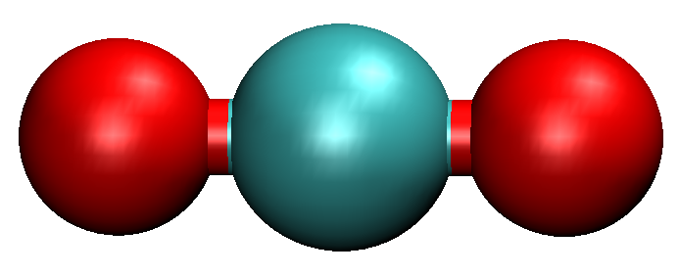
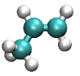
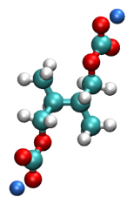
Simulation Model and Reaction Scheme
Carbon anode
NaPF₆ electrolyte with or without FEC
1.1M NaPF₆ PC electrolyte
(with 10 vol% DFEC)
PC: 850
Na⁺: 87
PF₆⁻: 85
DFEC: 115
x
y
z
+ e⁻, + Na⁺
+
+
DFEC
NaF
CO₂
C₂H₂FO
+ 2e⁻, + 3Na⁺
+
+
+
PF₆
PF₃
3NaF
+ e⁻, + Na⁺
+ e⁻, + Na⁺
+
Na₂CO₃
C₃H₆
PC
NaPC
+ NaPC
(CH₃CHCH₂OCO₂Na)₂
Na₂DMBDC

Slide 8
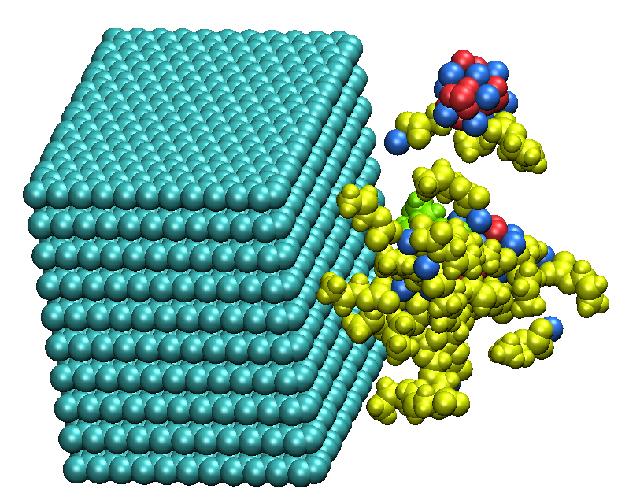
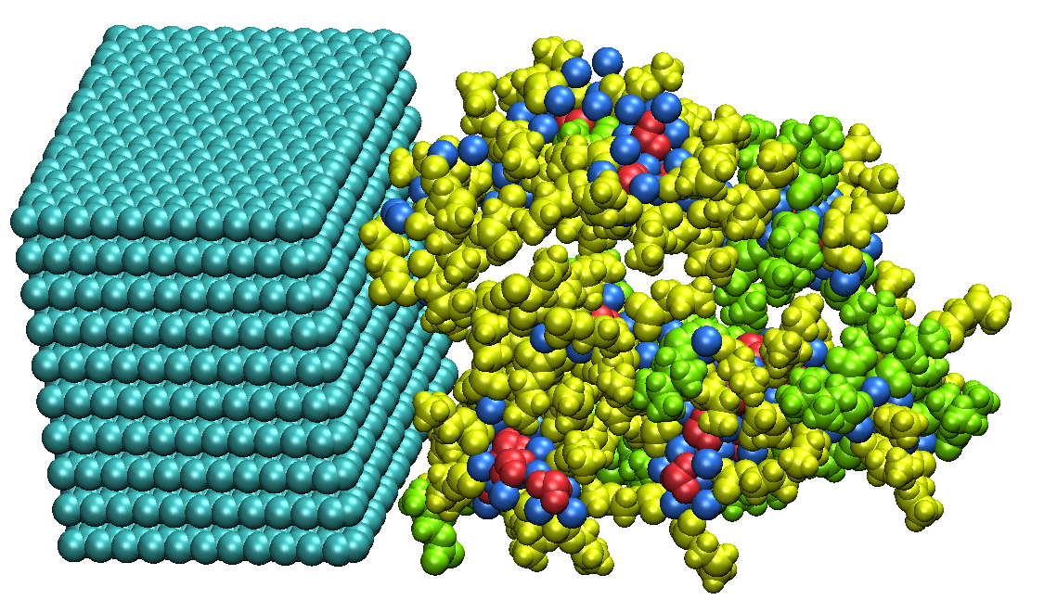
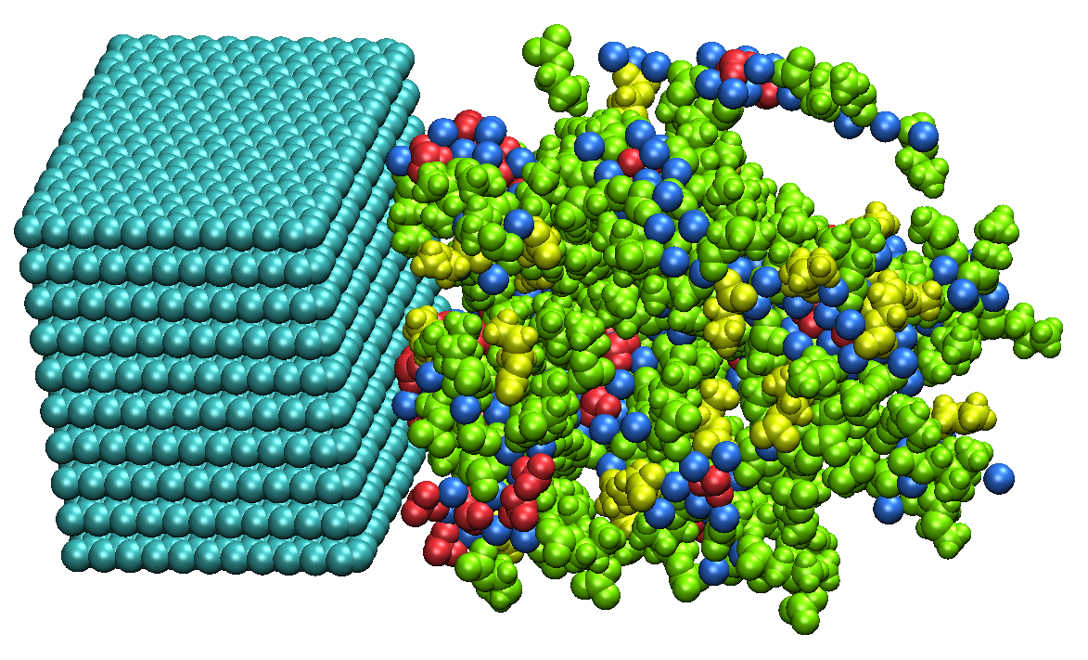
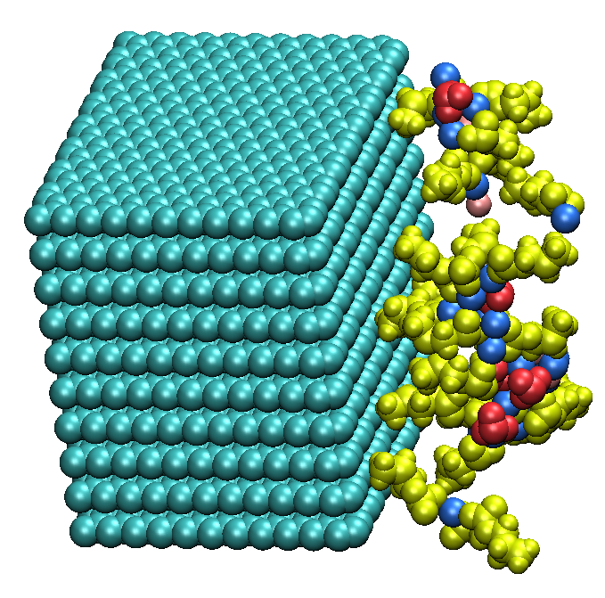
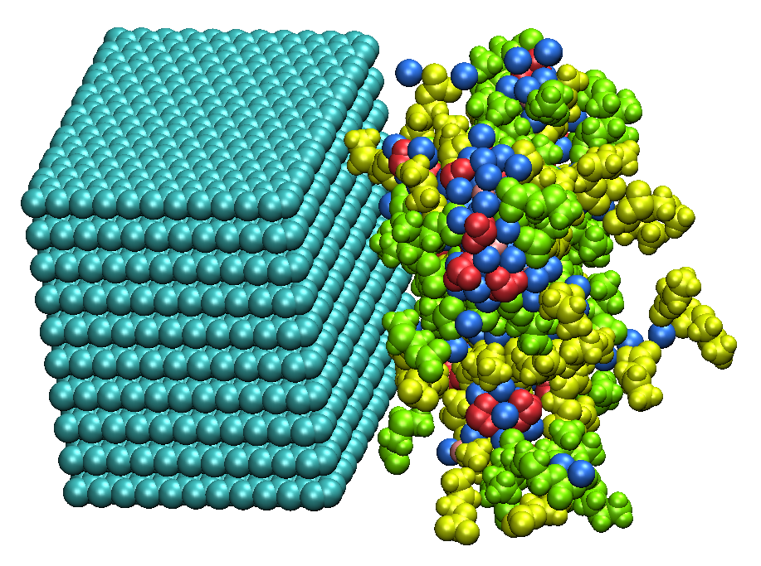
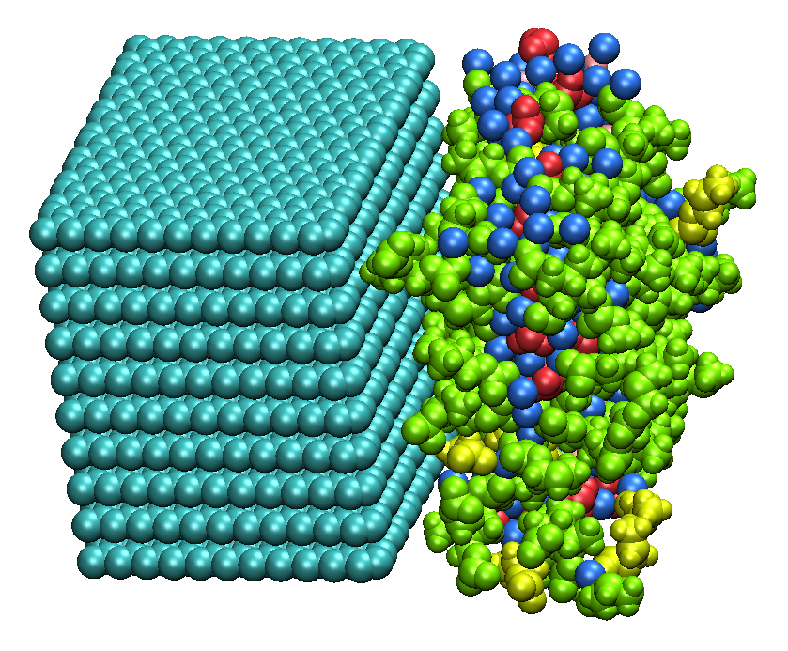
SEI Film Formation Processes
PC electrolyte
Species
(a) 100 cycle
(b) 500 cycle
(c) 1500 cycle
Na₂CO₃
NaF
FEC-added electrolyte
NaPC
(a) 100 cycle
(b) 500 cycle
(c) 1500 cycle
DFEC-added electrolyte
Na₂DMBDC
C₂H₂FO
(a) 100 cycle
(b) 500 cycle
(c) 1500 cycle
In all systems, the SEI film is formed by aggregating the reaction products of electrolyte via the hybrid MC/MD reaction simulations.

Slide 9
Change in Number Densities of Reaction Products
These results are obtained from ten different inputs
960
760
620
Na₂DMBDC
Na₂CO₃
NaPC
NaPC
PC
NaPC
NaF
Na₂DMBDC
Na₂DMBDC
FEC
DFEC
PC
[10⁻²Å⁻²]
[10⁻²Å⁻²]
Na₂CO₃
C₂H₂FO
Na₂CO₃
[10⁻²Å⁻²]
1.475
NaF
NaF
2.268
PC
2.300
1.650
MC/MD cycles
MC/MD cycles
MC/MD cycles
(a) PC
(b) With DFEC
(b) With FEC
Figure. Change in the concentration of the reductive products with the MC/MD cycles.
The composition ratio of the reaction products became almost unchanged in the final stage of the formation processes.
DFEC addition decreased the number of MC/MD cycles required to form SEI film.
Number density of NaF molecules in DFEC system is lower than FEC added system.
On the other hand, density of C₂H₂FO products is increased.

Slide 10
Mass Density Distributions of Reaction Products in SEI Film
These results are obtained from ten different inputs
57 Å
39 Å
33 Å
NaPC
NaPC
Na₂DMBDC
Na₂DMBDC
NaPC
Na₂CO₃
Na₂CO₃
Na₂DMBDC
NaF
NaF
Na₂CO₃
[gcm⁻³]
[gcm⁻³]
[gcm⁻³]
NaF
C₂H₂FO
z [Å]
z [Å]
z [Å]
(a) PC
(b) With FEC
(c) With DFEC
Figure. Mass density distribution of the reductive products in the SEI films.
The decrease of organic and inorganic products in mass density distribution results in less denser SEI film.
Addition of DFEC decreased the width of SEI film by 24Å and 6Å compare to PC electrolyte and FEC additive systems respectively.
Near the graphite density of C₂H₂FO molecules are more.
There are more number of C₂H₂FO molecules present inside the SEI film.

Slide 11
Cavity Size
The averaged fractional accessible volume (FAV) in the interface structure of DFEC added PC electrolyte is 0.40
Standard deviation is 0.01
The averaged FAV in the interface structure of DFEC added PC-based SEI films is considerably large compare with the van der Waals radius of Na⁺ 1.86Å.
Cavity size of DFEC added SEI film (0.40) is slightly larger than PC electrolyte SEI film (0.35).
However there is no significant difference appeared between DFEC (0.40) and FEC added systems (0.38).

Slide 12
Consumed Amount of Electrons to Form SEI Film
These results are obtained from ten different inputs
With DFEC
0.23
Consumed amount of electrons [eÅ⁻²]
0.17
Consumed amount of electrons [eÅ⁻²]
0.20
MC/MD cycles
MC/MD cycles
By counting the added electrons in each MC/MD cycle through the present simulations, we have estimated the integrated values per unit area of carbon anode.
The total consumed number of electrons per unit area of carbon anode in DFEC added system was obtained to be 0.17 [e Å⁻²], which is smaller than PC (0.23) and FEC additive (0.20) systems.

Slide 13
Stability of the SEI film
These results are obtained from ten different inputs
To estimate the stability of SEI film formed after 2000 MC/MD cycles, we have calculated potential energy of 0 ≤ z ≤ 20 Å depth SEI film.
Potential energy was estimated as the average of 10 different samples.
Presence of more electrostatic interactions in DFEC SEI film make it as more stable than other systems.
As a result the DFEC addition showed positive influence in the SEI film formation.
Average potential energy of SEI film kcal/mol
The electrolyte systems
Figure : The average potential energy of SEI films

Slide 14
Reduction Potential of FEC and DFEC
The reduction potential (E°) of DFEC and FEC electrolyte has been calculated as follows
E° =$\frac{\text{−}ΔG }{F}$
Compounds | Reduction potential
FEC_EA1 | 1.222
FEC_EA2 | 3.756
DFEC_EA1 | 1.974
DFEC_EA2 | 4.605
Where
ΔG = G(A⁻) – G(A) in eV
F = Faraday constant
All free energies (G) are calculated at B3LYP/6-31G(d) level of theory with propylene carbonate as solvent.
According to the reduction potential 2 electron reduction of DFEC is more favorable than 2 electron reduction of FEC.
J. Electrochem. Soc. 2004, 151, A178

Slide 15
Role of C₂H₂FO Product in the Formation of SEI Films
I have calculated the migration distance of the C₂H₂FO product in the SEI film.
Distance = $\sqrt{{(Xinitial−Xfinal)}^{2}+{(Yinitial−Yfinal)}^{2}+{(Zinitial−Zfinal)}^{2}}$
The migration distance of C₂H₂FO product in 1ns simulation = 7.663Å
The migration distance of C₃H₆ product in 1ns simulation = 12.161Å
C₂H₂FO
NaPC
Figure : Typical snapshot of SEI film formation process during 100 MC/MD cycle.
Migration distance of the gas molecules C₃H₆ are larger than C₂H₂FO molecules.
This observation clearly showed that C₂H₂FO is one of the components of SEI film.
In DFEC reaction the final product C₂H₂FO played a positive role in the formation of SEI film.
However, the final product C₂H₂O is not a component in the SEI film of FEC added system.

Slide 16
DFEC Reaction Scheme Route_3
+ 2e⁻
+
+
2
DFEC
C₂H₂O₂
CO
NaF
Further, I will focus on the above mechanism.
The 2e⁻ addition of the DFEC decomposed to C₂H₂O_{2,} CO and F⁻ upon geometry optimization at B3LYP/6-31G(d) level of theory.
Unlike C₂H₂FO, in route_3 final product C₂H₂O₂ is non-reactive.
I will estimate the reaction profile by using DFT methods.
I will perform MC/MD simulation by employing this reaction scheme.

Slide 17
Conclusions
In the present study, we have investigated the origin of mechanism to form SEI film in DFEC additive PC electrolyte Na-ion battery with hybrid MC/MD reaction method.
Addition of DFEC decreased the thickness of SEI film by decreasing the organic and inorganic products in mass density distribution, which resulted in less denser SEI film formation.
In DFEC reaction the final product C₂H₂FO played positive role in the formation of SEI film which is not the case in FEC added system.
The stability of the DFEC added PC electrolyte SEI film is higher than FEC added and PC electrolyte systems.
According to reduction potential 2 electron reduction of DFEC is more favorable than 2 electron reduction of FEC.

