Slide 1
Introduction of Semi-Empirical Quantum Description into the Constant pH Method
Yukichi Kitamura
Notes:
The title of my presentation is “”
Now, I’m developing the constant pH method employing the quantum mechanical methods.
And I’d like to talk some preliminary results.

Slide 2
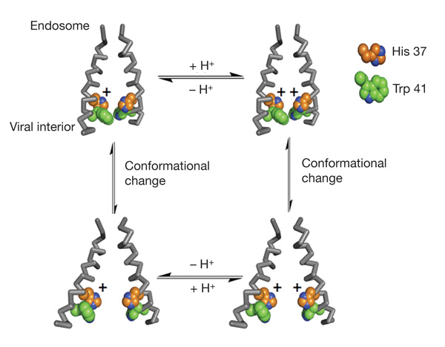
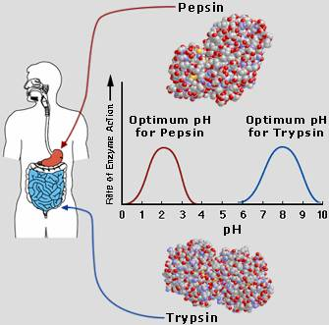
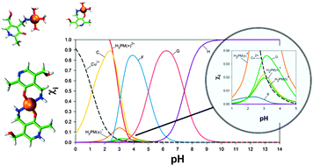
Background: pH dependent phenomena
The protonation equilibria have a strong influence on a variety of chemical reaction processes.
Biology: Ion channel [1], enzyme [2], Protein denature
Chemistry: Catalyst, Metal complex [3], Catalyst
Engineering: Pattern etching, Cleaning, Adsorbent, … etc.
The distribution diagram of pyridoxamine–copper(II) complexes in solution^{[3]}
Ion channel: two helices of the tetramer and one protonation event^{[1]}
Enzyme: the optimum pH for two digestive enzymes in human body^{[2]}
[1] A. L. Stouffer, et al., Nature 451 (2008) 596-599.
[2] Biology10thgrade: https://biology10thgrade.wikispaces.com/Enzymes
[3] R. Casasnovas, et al., Phys. Chem. Chem. Phys. 15 (2013) 16303.
Notes:
As you know, …

Slide 3
Background: Computational approach
For modeling and theoretical computation of pH effects, pH-related processes have been attracting interest.
A Quantum Mechanical Treatment
Direct estimation pK_{a} from thermodynamic cycle for deprotonation reaction in solution
Thermodynamic cycle for the pK_{a} calculation using the direct method ^{[4]}.
[4] F. Barroso daSilva, et al., Biophys. Rev., 9 (2017) 699.
Notes:
Essentially, the proton transfer events between solute and solvent should be treated quantum mechanics. Therefore, …

Slide 4
Background: Computational approach
A Quantum Mechanical Treatment
In some cases, these methods can predict pK_{a} values (accuracy: mean absolute deviations of 0.2 units [3]).
However, it is difficult to include the environmental conditions* from the point of view of computational costs.
(e.g., *ionic strength, molecular concentration, presence of other charged molecules, etc.)
Moreover, they give us a static property and cannot obtain the dynamical descriptions related to solution pH condition.

Slide 5
Background: Computational approach
A Classical Mechanical Treatment
To express change in the protonation state, the state transition depending on pH allows within classical force field framework, called constant pH (CpH) method.
Exchange of protonation state and equilibrium
Monte Carlo process
Conformation sampling
E_{r}
E_{p}
ΔE_{rp}=E_{p}-E_{r}
Notes:
The other approaches to treat pH-dependent behavior is based on a classical mechanical one.

Slide 6
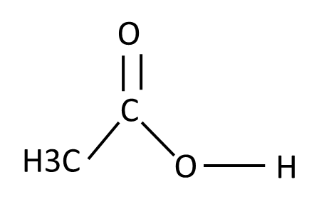
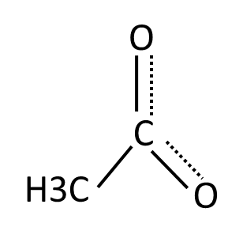
Background: CpH method
A Classical Mechanical Treatment
Energy Diagram via MM force field → Experimental energy compensation
(ΔG^{MM} and ΔG^{pH})
pH<pK_{a}
$$E_{λ_{i−1}}$$
$$−{ΔG}_{λ=0→1}^{MM}$$
$${−ΔG}_{pH}$$
$${ΔE}_{λ_{i−1}→λ_{i}}$$
pH=pK_{a}
$$E_{λ_{i}}$$
$$+{ΔG}_{pH}$$
pH>pK_{a}
⊖
Notes:
The first term is energy difference generated by MD simulation.
Of course, MM-based simulation cannot consider chemical bonding and breaking corresponding to protonation/deprotontation events.
Therefore, the energy difference by MM calculation will not reproduce the correct value.
In CpH method, the free energy compensation is introduced, which is estimated by MM-MD calculation.
And then, pH dependency is included by the third term.

Slide 7
Background: Computational approach
A Classical Mechanical Treatment
This could better access the protonation-conformation coupling within realistic computational time.
However, in some cases, it is difficult to describe the molecular modeling (such as the molecule having a abnormal chemical bonds and metal complex system).
Moreover, the inclusion of polarization is limited, though this handles ionized molecules in any system.

Slide 8
Contents of Today’s Workshop
In this workshop, I have developed new constant pH method combined with QM method.
I report that:
Implementation to calculate the free energy differences for MC trial between protonated and deprotonated state via quantum chemical method.
Estimate the population ratio of neutral/ionized molecule in model system.

Slide 9
Theory: Constant pH method
Constant pH method consists two parts:
MD: Equilibration and conformation sampling
MC: λ protonation state transition
START
The energy difference for MC trial, depending on pH condition, is constructed from three components.
20.0 ps
Equilibrium MD
Change the protonation state
Energy Minimization
Searching MD
20.0 ps
Rejected
Metropolis
Accepted
Update protonation state
Figure. Flowchart of CpH method
Notes:
First term is the instantaneous energy difference before and after transitions.
Second is the free energy difference estimated by MM force field.
Third is the free energy term depending on the pH value.

Slide 10
Theory: Calculation of free energy
For free energy estimation, the thermodynamic integration (TI) method was applied.
In previous MM-based CpH method, the ensemble in intermediate states (0<λ<1) is generated by the interpolation of force field parameters (atomic charges, Lennard-Johns and intramolecular ones).
But, the TI calculation employing QM method cannot follow same procedure.

Slide 11
Theory: Calculation of free energy
Therefore, I modified the original sander module with the simplest implementation.
This is necessary twice QM calculation (λ=0 and 1) per one MD step, and then linearly combined with energies and forces on all atoms depending on a certain λ value.

Slide 12
Theory: Calculation of free energy
For first trial, I adopted the acetic acid as a model compound for carboxylic acids, pK_{a} is 4.76.
PM3 Hamiltonian is employed for acetic acid.
And, for solvent, the generalized Born (GB) implicit solvation method to reduce the costs.
Protonated state
(λ=0, neutral form)
Deprotonated state
(λ=1, negative charged form)
Figure. Acid-based equilibrium of acetic acid

Slide 13
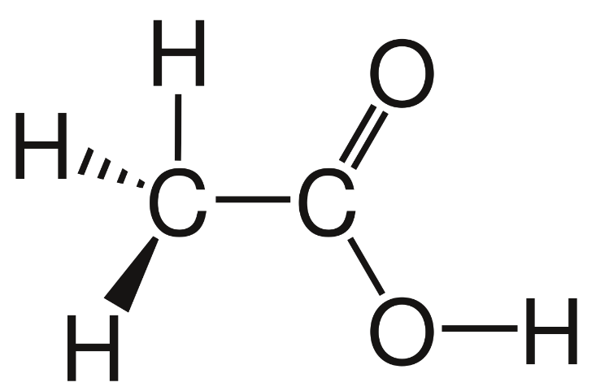
Theory: QM-MM partition
For λ=0, all atoms are treated as a QM atom.
For λ=1, a free proton generated by deprotonation reaction is not transferred explicitly to simulation box, which is treated as a non-interacting dummy particle for the deprotonated state.
No MM
MM
(Dummy H atom)
QM(PM3)
QM(PM3)
Protonated state
(λ=0, q=0 [e])
Deprotonated state (λ=1, q=-1 [e])
Figure. QM-MM partition for acetic acid

Slide 14
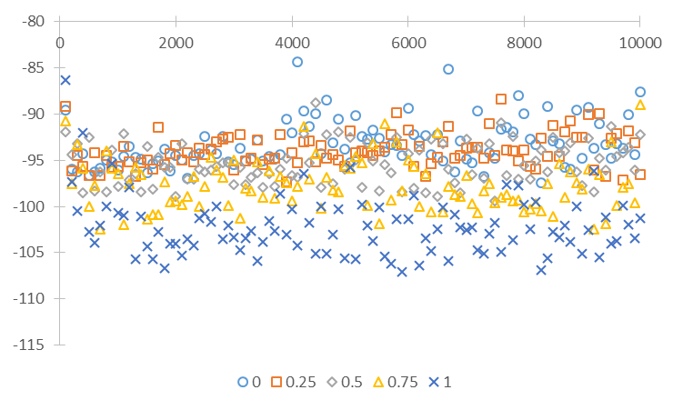
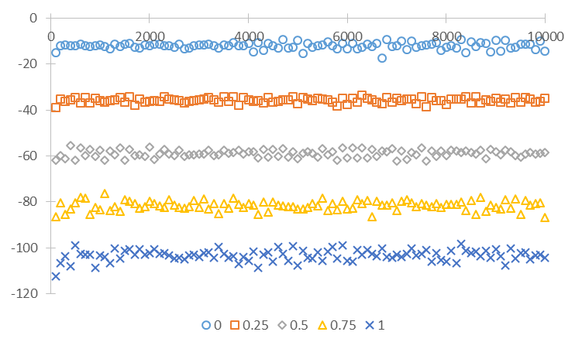
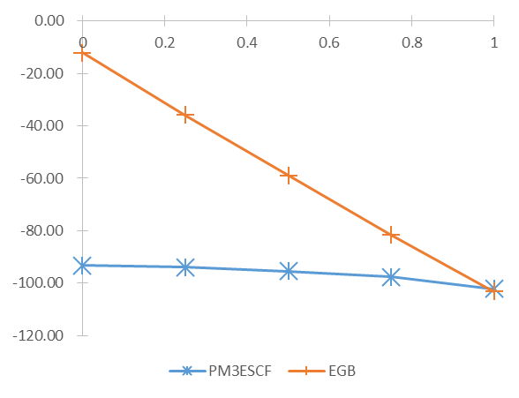
Time evolution of SCF(PM3) and GB
SCF Energy [kcal/mol]
GB Energy [kcal/mol]
MD time [fs]
MD time [fs]
Energy components were changed depending on protonation state λ.
Transition state (λ=0.0~1.0) between two end-state can be suitably simulated in our protocol.
Averaged Energy [kcal/mol]
Protonation state, λ
Notes:
To check whether interpolation work well, I investigated the time evolution of energy and coordinates.

Slide 15
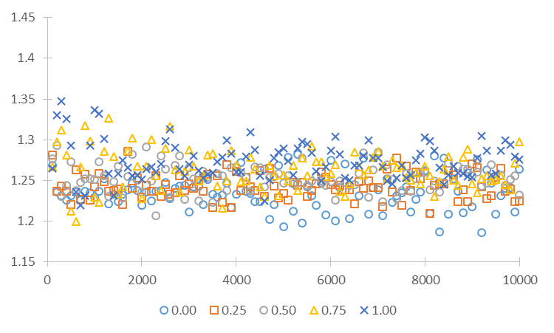
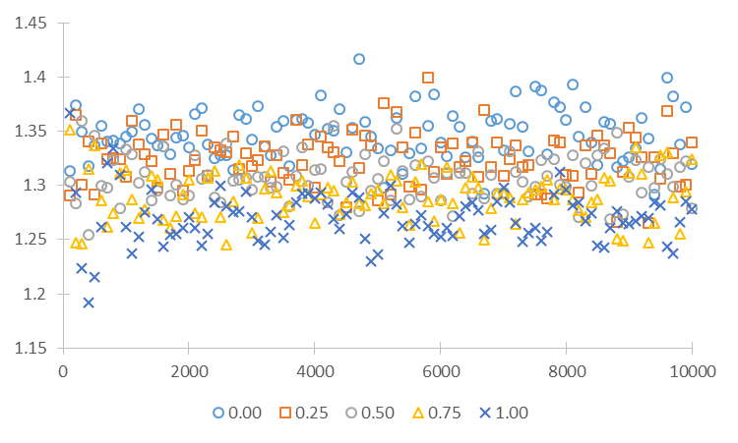
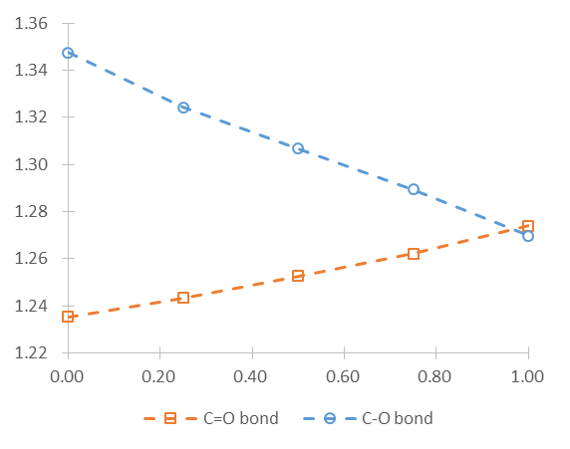
Time evolution of bond length
C=O bond length [Å]
C-O(H) bond length [Å]
MD time [fs]
MD time [fs]
Averaged bond lengths between C and O atoms were changed depending on protonation state λ.
As expected, C=O and C-O(H) bond are equivalent in deprotonated state (λ=1).
Averaged bond length [Å]
Protonation state, λ

Slide 16
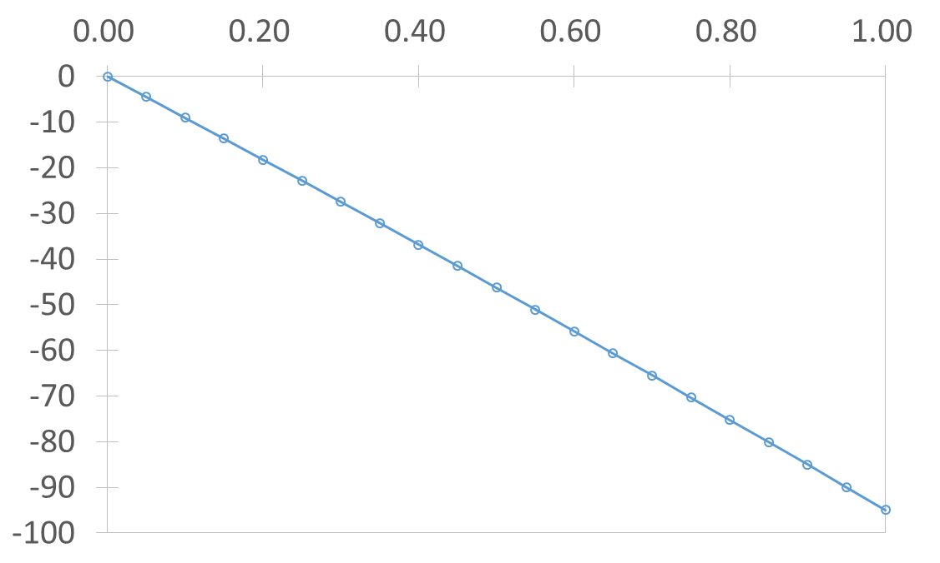
TI calculation for model system
I calculated free energy difference between two-end states for acetic acid system, 100 [ps] equilibration and 1 [ns] sampling for each λ values.
Final value is estimated by averaging of two values by forward reaction (λ=0→1) and reverse reaction(λ=1→0) .
Protonation state, λ
Entry | ΔG [kca/mol]
ΔG(0→1) | -94.9645
ΔG(1→0) | -95.4485
Average | -95.2065
Free energy [kcal/mol]

Slide 17
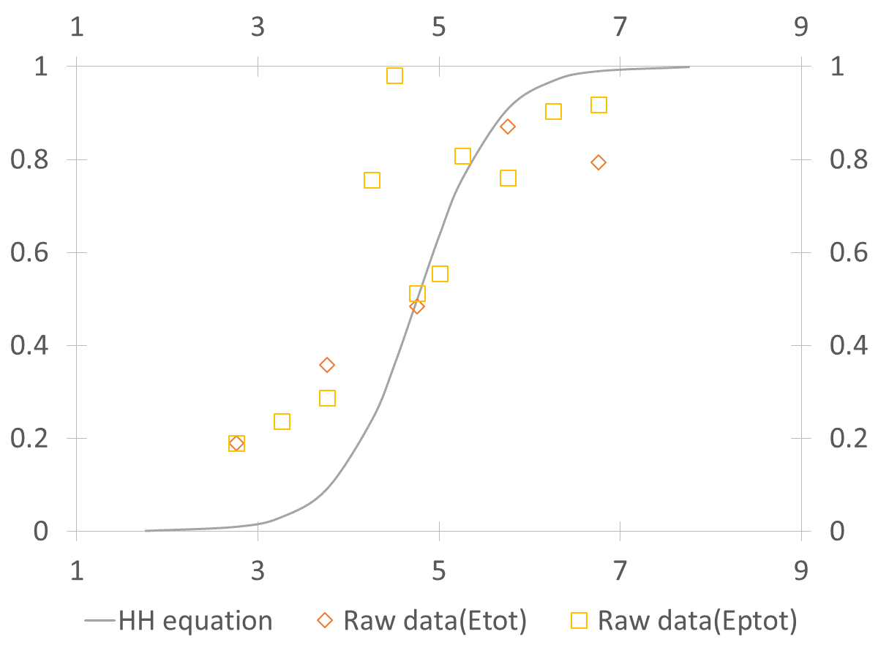
Method-I: simple CpH scheme
The titration curve is estimated by CpH method, but there are some overestimating data points.
pH
Henderson-Hasselbalch equation
Averaged deprotonation ratio <λ>
Figure I. Titration curve for acetic acid

Slide 18
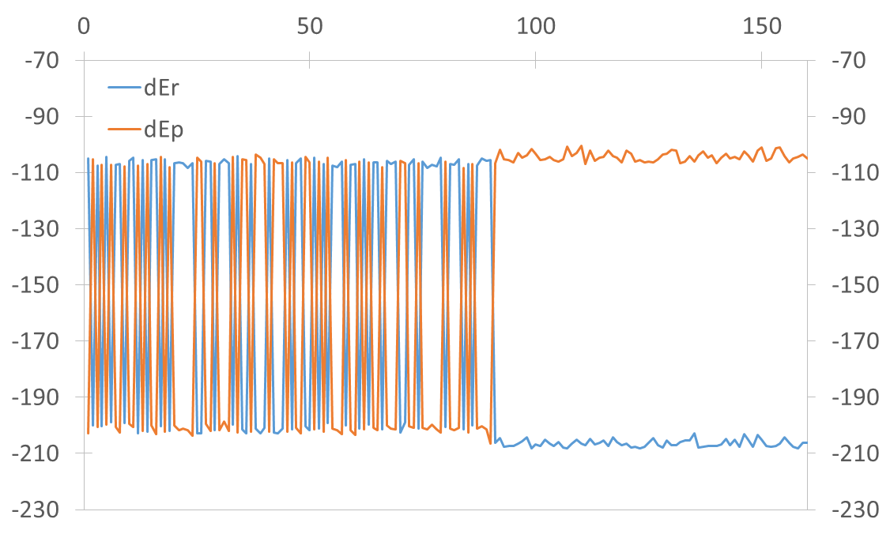
Unfordable state transition
In warning predicted point, the energy difference between reactant and product is overestimated, and did not occur the state transition (λ=1→0).
MC cycle
Energy (Reactant)
Energy (Product)
Energy [kcal/mol]

Slide 19
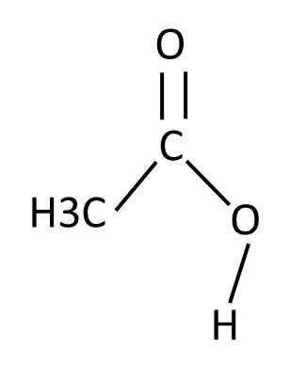
Unfordable state transition
The unstable conformer was observed in MD trajectory, which rotate the CCOH dihedral angle of ~0 degree.
ΔG= 100.8 [kcal/mol]
(φ(CCOH)=0°)
ΔE(=ΔE₀₁-ΔG₀₁) has larger value (~ca. 5 [kcal/mol])
O
C
⊖
H3C
ΔG= 95.2 [kcal/mol]
(φ(CCOH)=180°)
O
Large ΔE lead to rejection in MC and do not occur state transition.
Notes:
I checked the MD trajectory in problematic sampling.
As a result, it was found that …
roughly

Slide 20
Two ΔG offsets
O
⊖
ΔG₁= 95.2 [kcal/mol]
(φ(CCOH)=180°)
C
H3C
O・・・H(dummy)
O
ΔG₁= 100.8 [kcal/mol]
(φ(CCOH)=0°)
⊖
C
H3C
O
・・・
H(dummy)
Notes:
As the first offset scheme, I considered energy offsets using two energy components.
These are identified by dihedral angle of C-C-OH.

Slide 21
Four ΔG offsets
O
⊖
ΔG₁= 95.2 [kcal/mol]
(φ(CCOH)=180°)
C
H3C
O・・・H(dummy)
ΔG₃= 97.2 [kcal/mol]
(φ(CCOH)=180→0°)
O
ΔG₄= 97.5 [kcal/mol]
(φ(CCOH)=0→180°)
⊖
C
H3C
O
ΔG₂= 100.8 [kcal/mol]
(φ(CCOH)=0°)
・・・
H(dummy)
Notes:
As the second one, I considered energy offsets using four energy components.
In for offset scheme, the energy difference with conformation change during researching MD are also included.

Slide 22
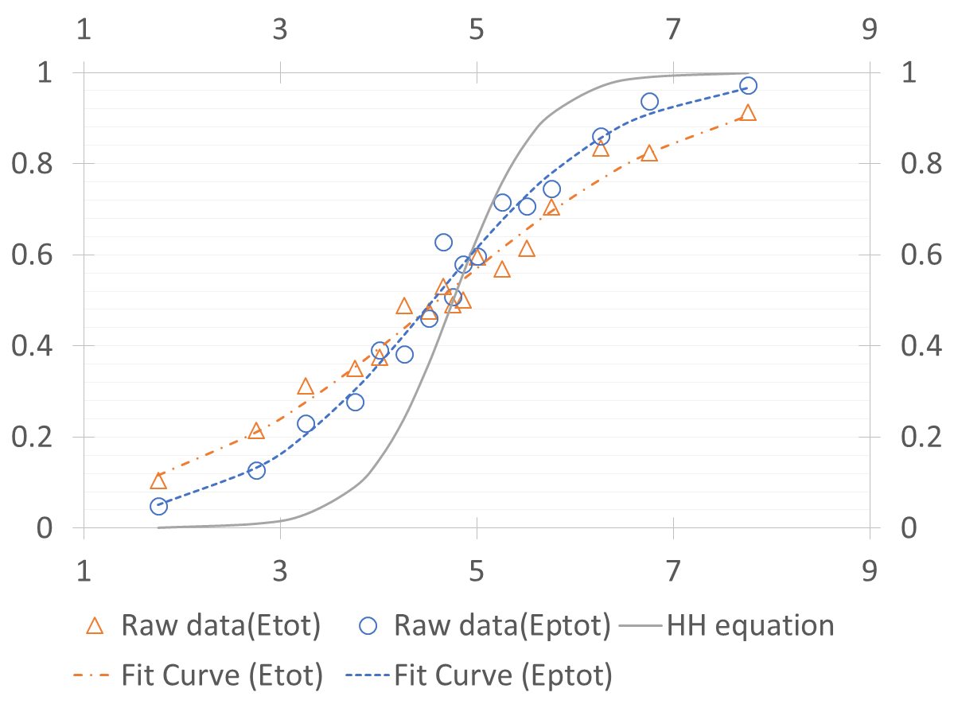
Method-II: conformation-dependent energetic offset scheme
By introduction of the conformation-dependent free energy offset term, the inconvenient convergence error could be reduced.
pH
ΔG for MC trial is switched depending on conformation.
Averaged deprotonation ratio <λ>
Figure II.
Titration curve for acetic acid with conformation-dependent ΔG scheme (two ΔG offsets).

Slide 23
Method-II: conformation-dependent energetic offset scheme
The large gap from theory curve (Henderson-Hasselbalch equation, HH equation in fig.) is not obserbed by introduction the conformation-dependent energy offset.
However, there is tendency that deprotonation ratio is
Underestimated in high pH
Overestimated in low pH

Slide 24
Method-II: conformation-dependent energetic offset scheme
In addition, as a energy difference ΔE between system before and after the switch, I investigated two functions: the total energy (Etot) and potential energy (Eptot).
In compared with the result using Etot and Eptot, the titration curve by Eptot is close to theory curve.
It is considered that this is originated in energy fluctuation, since the fluctuation of Etot (σ=2.3[kcal/mol]) is larger than one of Eptot (σ=1.5[kcal/mol]).

Slide 25
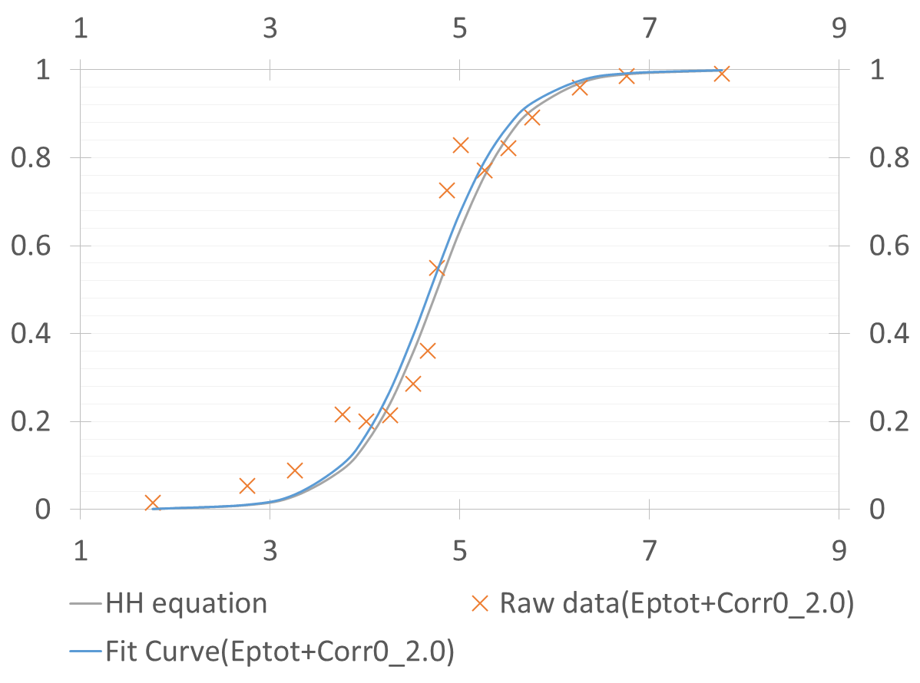
Method-III: Correction term
By introducing the correction term, titration curve become close to theory curve.
The Correction term is determined empirically based on the fluctuation.
Averaged deprotonation ratio <λ>
Figure III.
Titration curve for acetic acid with correction term

Slide 26
Summary
Method III was able to reproduce theory titration curve (with four offsets and correction term (C=2.0)).
Entry | Parameters | pK_{a} | Hill coefficient, n
Prediction by CpH method
I. Simple CpH | One ΔG offsets | 3.99 | 0.41
II. Modified ΔG | Two ΔG offsets | 4.56 | 0.45
 | Four ΔG offsets | 4.62 | 0.42
III. Modified ΔG (Four ΔG offsets) + Correction term | C=1.5 | 4.60 | 0.88
 | C=1.7 | 4.65 | 0.97
 | C=2.0 | 4.69 | 1.02
Theory |  | 4.76 | 1

Slide 27
Conclusion
I have developed new constant pH (CpH) method combined with semi-empirical quantum mechanics method, simple implementation and two variants.
Method-III showed best computational accuracy in the three methods, but is not perfectly.
<Next plan>
To enhance reproducibility of titration curve, pK_{a} and Hill coefficient, I will improve the CpH scheme.
After, I plan to apply it to more complex system, multi-titratable carboxylic acid.
Notes:
The number of MC trial in present simulation is not enough to converge.

Slide 28
Thank you for your attention.

