Slide 1
Fri. Feb. 16th
FY2017’s 4th, CREST Workshop
Theoretical analyses of hydrate melt on electrode surface in Li-ion batteries
Norio Takenaka^{1,2}
Graduate School of Information Science, Nagoya University¹,
Elements Strategy Initiative for Catalysts and Batteries (ESICB), Kyoto University²

Slide 2
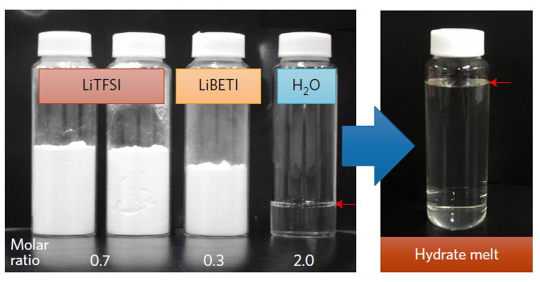
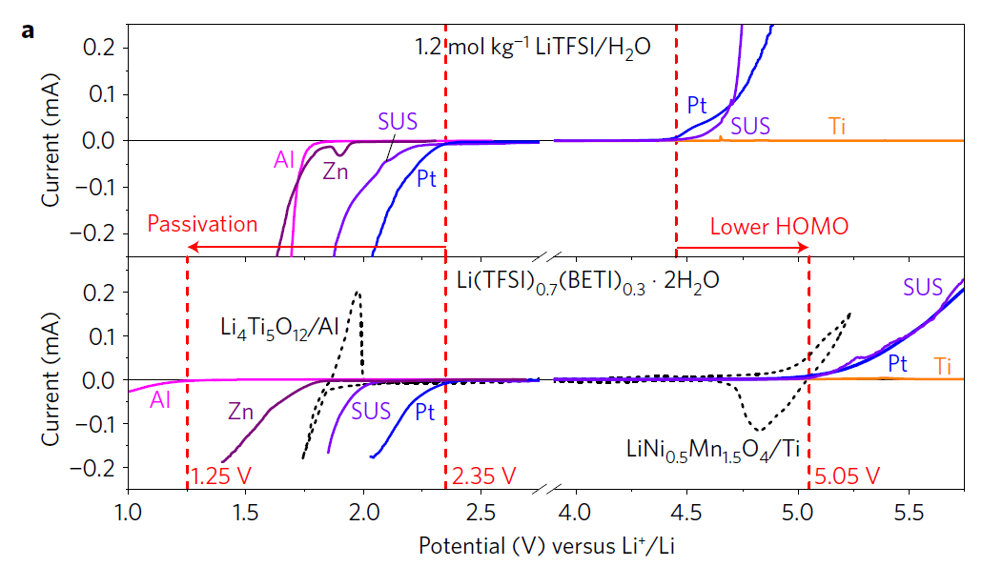
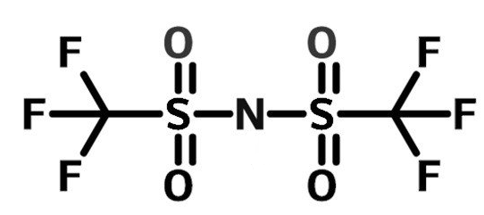
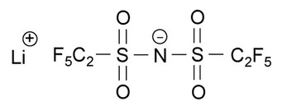
Background
LiTFSI
LiBETI
Fig. Potential window
By using a Li salt hydrate melt, Li(TFSI)_{0.7}(BETI)_{0.3}・2H₂O, the high performance aqueous Li-ion battery has been proposed [1].
[1] Y. Yamada, K. Usui, K. Sodeyama, S. Ko, Y. Tateyama and A. Yamada, Nature energy, 16129 (2016).
The SEI film has the important role to increase the electric voltage.

Slide 3
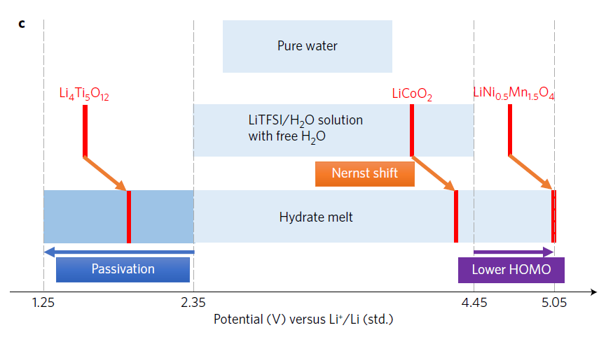
Battery operating mechanism
In a conventional aqueous electrolyte, the reaction potential of Li₄Ti₅O₁₂ (LTO) is completely outside the electrolyte’s potential window.
By contrast, in the hydrate-melt electrolyte, the anodic and cathodic potential limits are extended through a thermodynamic mechanism (lowered HOMO level) and a kinetic mechanism (anion-based passivation), respectively, which results in an extremely wide potential window with a maximum width of 3.8 V.
3

Slide 4
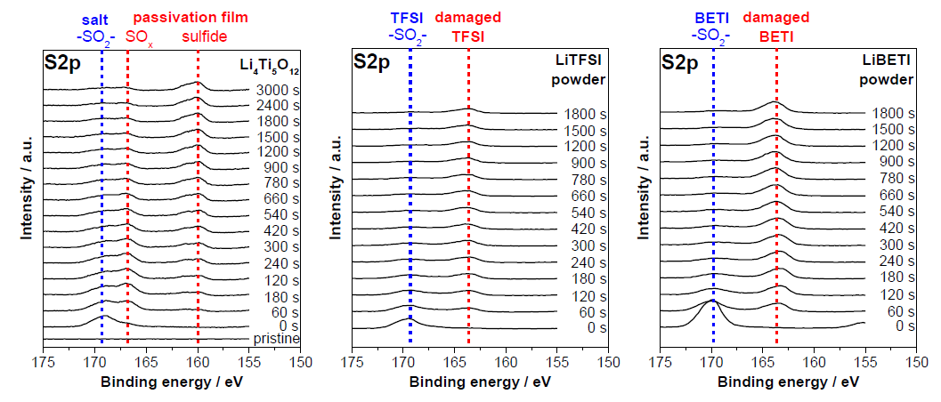
XPS spectra of S2p
Irradiation time
The SEI film can be formed by the reductive decomposition products of the TFSI and/or BETI anions.
The sulfur-based passivation film (SEI film) should play a key role in effectively suppressing parasitic hydrogen evolution.
4

Slide 5
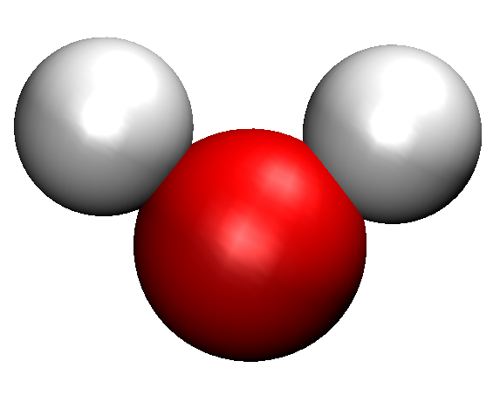
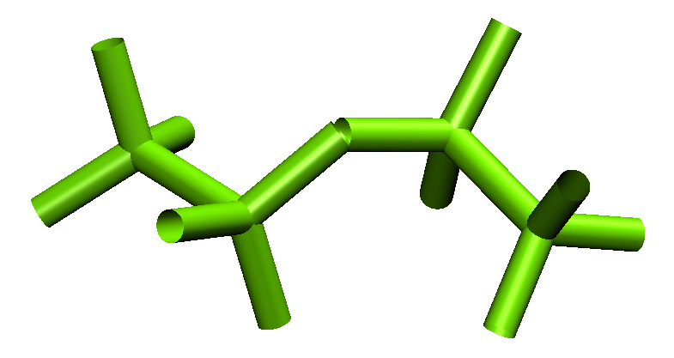
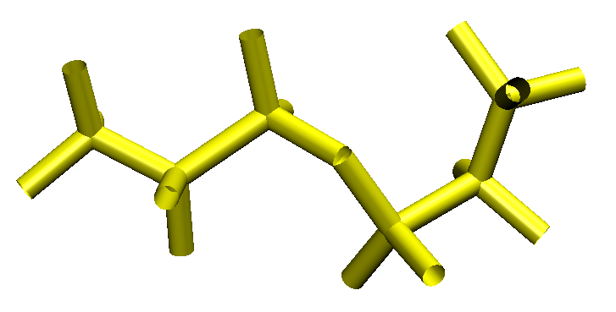
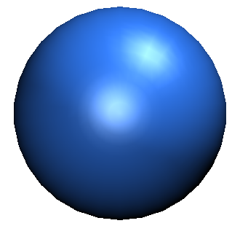
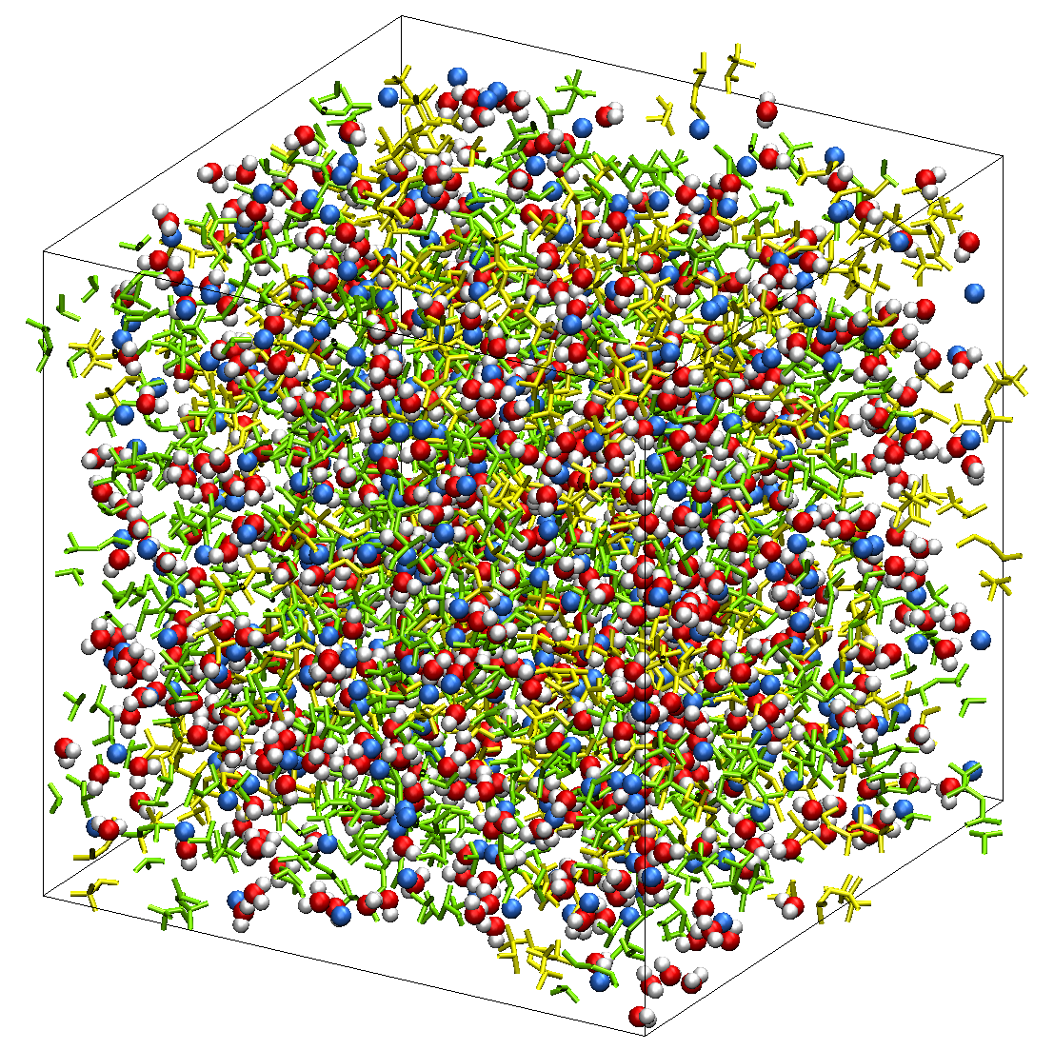
Preparing model system
: TFSI
: Li⁺
: H₂O
: BETI
10 ns NPT MD
Table. Mass density and ratio of free Li⁺
 | TIP3P | SPC/E | SPC/F | SPC/Fd | SPC/Fw | TIP3P/Fs
mass density [gcm⁻³] | 1.82 | 1.83 | 1.83 | 1.83 | 1.82 | 1.83
ratio of free Li⁺ [%] | 5.3 | 7.0 | 8.0 | 7.2 | 7.3 | 5.4
Mass densities were almost same in all water molecules, which are good agreement with the experimental value of 1.78 gcm⁻³.
(TFSI)_{0.7}(BETI)_{0.3}(H₂O)₂
As for ratio of free Li⁺ (not coordinate O atom in H₂O), TIP3P model showed the best result.
TFSI: 280
BETI: 120
H₂O: 800
Li⁺: 400
Number of molecules
TIP3P model was employed for the analyses.

Slide 6
Model system and calculation condition
: TFSI
: Li⁺
: H₂O
: BETI
Carbon electrode
Hydrate melt
Carbon electrode
y
Number of molecules
z
TFSI: 280, BETI: 120, H₂O: 800, Li⁺: 400
Temperature: 298 K
Time: 10 ns with 10 different initial configurations (1 ns equilibration)
Electrode potentials were controlled at 0 V, -2V and +2V with the constant potential method based on extended Lagrangian alotorithm by Dr. Inagaki.

Slide 7
Normalized density distributions at 0 V
The distributions were obtained by the center of mass of the chemical species.
0 V
Li⁺
H₂O
TFSI
BETI
ρ/ρ_{bulk}
z [Å]
At the PZC (potential of zero charge), the water molecules were found to be closer to the electrode surface than the salt anions.

Slide 8
Normalized density distributions at +2V
+2 V
Li⁺
H₂O
TFSI
BETI
ρ/ρ_{bulk}
z [Å]
By increasing the electrode potential from the PZC to +2 V, the peak height of TFSI anions increased due to the stronger electrostatic interactions.

Slide 9
Normalized density distributions at -2V
-2 V
Li⁺
H₂O
TFSI
BETI
ρ/ρ_{bulk}
z [Å]
When the electrode potential decreased to -2 V, the peak height of water molecules increased as the salt anions were expelled from the first interfacial layer.

Slide 10
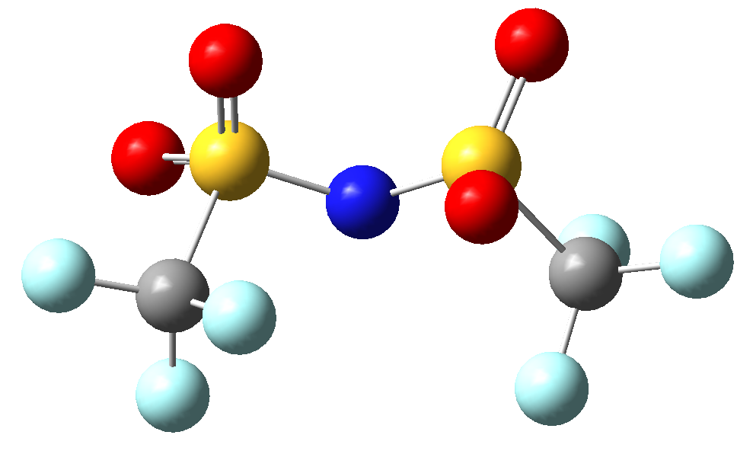
Distribution of TFSI near electrode surface
F (cyan): -0.129 e
O (red): -0.486 e
F
-2 V
F
0 V
F
+2 V
O
O
O
ρ/ρ_{bulk}
z [Å]
z [Å]
z [Å]
By increasing the electrode potential, the peak height increased. In all cases, the F(TFSI) were closer to the electrode surface than O(TFSI).

Slide 11
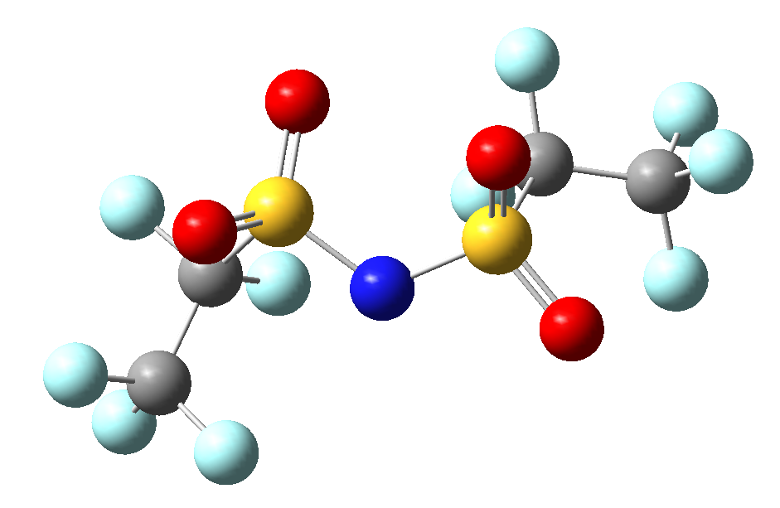
Distribution of BETI near electrode surface
F (cyan): -0.154 e (-CF₃), -0.105 e (-CF₂)
O (red): -0.478 e
F
-2 V
F
0 V
F
+2 V
O
O
O
ρ/ρ_{bulk}
z [Å]
z [Å]
z [Å]
Interestingly, the BETI anions indicates the opposite tendency to the TFSI anions. This is considered because that the decrease in the TFSI anions allows a space for the BETI anions with the larger molecular size.

Slide 12
Distribution of water near electrode surface
H (white): 0.417 e
O (red): -0.834 e
H
-2 V
H
0 V
H
+2 V
O
O
O
ρ/ρ_{bulk}
z [Å]
z [Å]
z [Å]
The peak height of H(water) clearly increases as the electrode potential decreases, changing their orientations near the electrode surface.

Slide 13
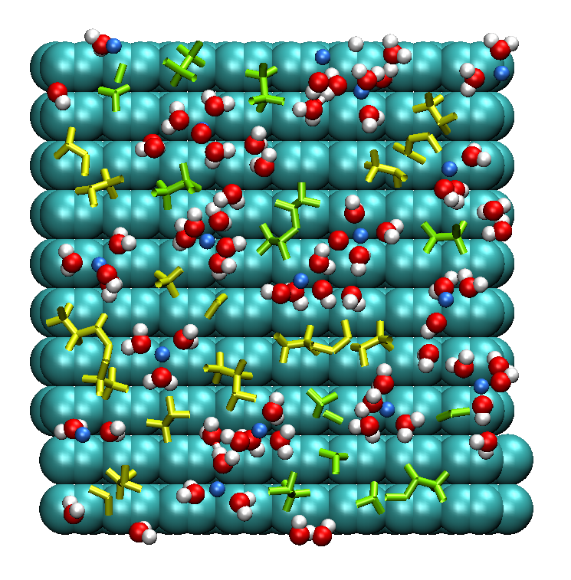
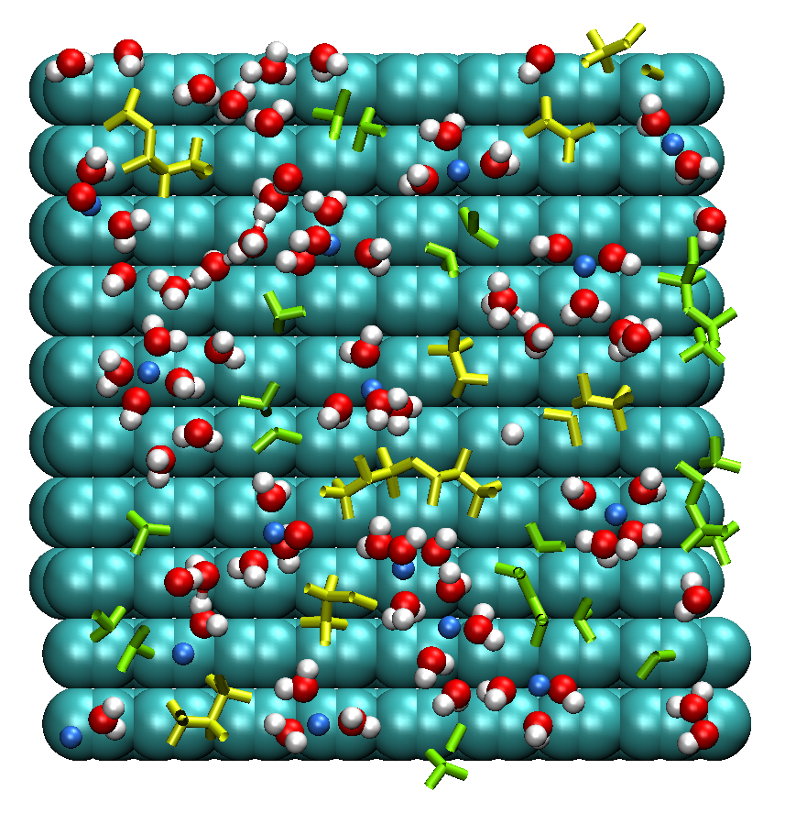
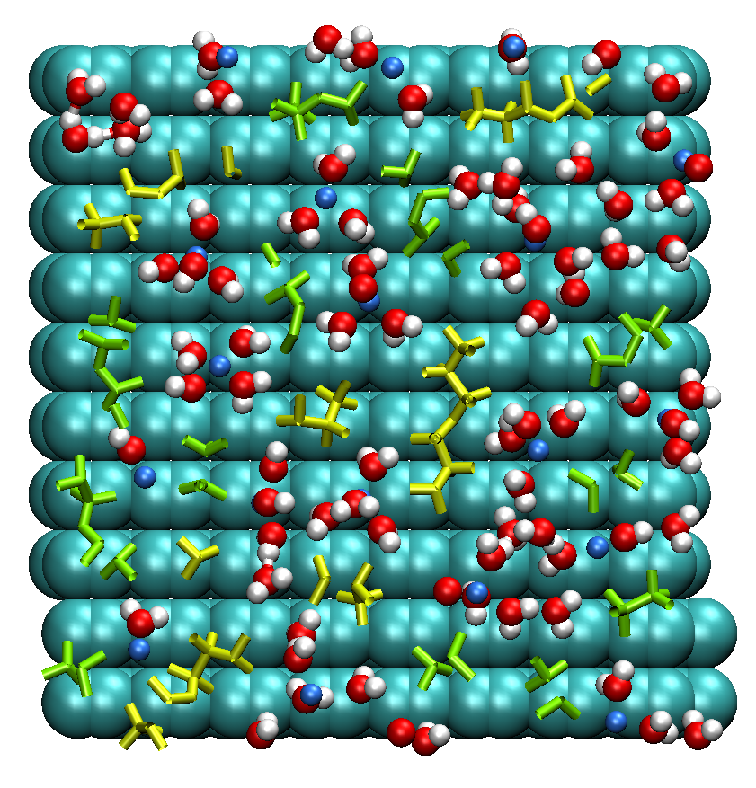
Formation of nanodomain at negative electrode
: TFSI
: Li⁺
: H₂O
: BETI
These species were extracted near the electrode surface within 6 Å.
As with the previous theoretical study on the water-in-salt electrolyte[*], the water molecules formed the nanodomains at the negative electrode. Such nanodomains should enhance the hydrogen evolution reaction.
[*] J. Vatamanu, O.Borodin, J. Phys. Chem. Lett., 8, 4362-4367 (2017).

Slide 14
Comparison with previous theoretical research
-2 V
0 V
+2 V
J. Vatamanu, O.Borodin, J. Phys. Chem. Lett., 8, 4362-4367 (2017).
The present simulation results showed the similar tendency as the previous study where the number of water molecules increases with the decrease in the electrode potential.
However, the water molecules remain near the positive electrode (see page 8). The short equilibration time (1 ns, 298 K) in this study may lead to this result in comparison to the previous study (3 ns, 363 K).

Slide 15
Summary and future research plan
In this study, the interfacial structures of the hydrate melt near the electrode surface were investigated by using the constant potential method.
By decreasing the electrode potential, the number of water molecules was found to increase, leading to the formation of water nanodomain. This tendency is consistent with the previous theoretical study on the water-in-salt electrolyte.
However, the present equilibration time (1 ns) may not be enough to obtain reasonably the distribution of the chemical species. Therefore, I will check whether the present simulation time is reasonable or not.
Further, I will investigate deeply the dependency on the electrode potential, e.g., increase in the sample points along the electrode potential.

