Slide 1
FY2016 The 9th CREST Workshop 2017, February 7
Development of hybrid MC/MD execution and helper programs
Masayoshi Takayanagi
Graduate School of Information Science, Nagoya University

Slide 2
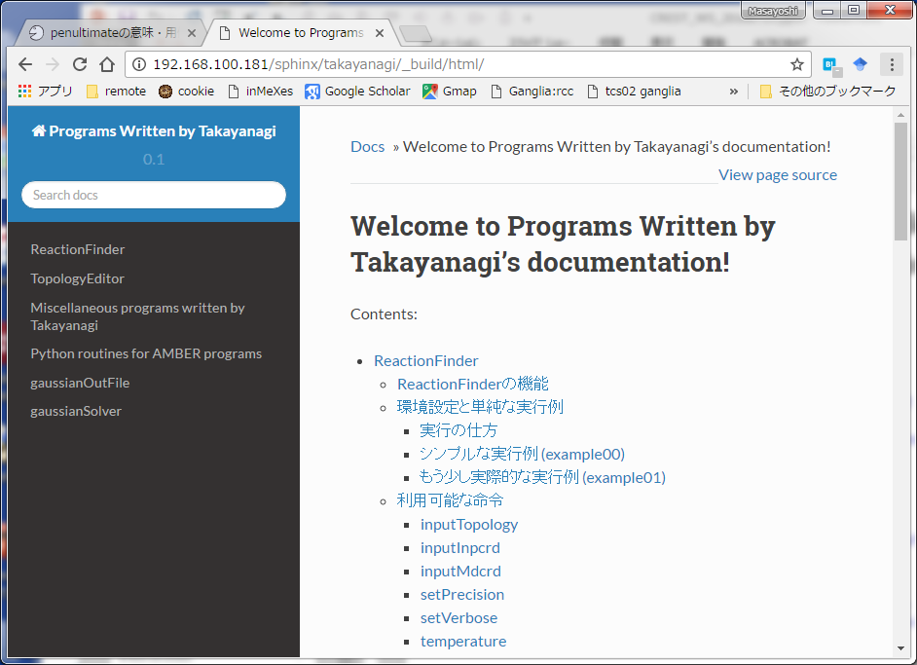
Manual of programs written by me
(in Japanese) http://192.168.100.181/sphinx/takayanagi/_build/html/
(in English, to be prepared in future)
Prepared by Sphinx

Slide 3
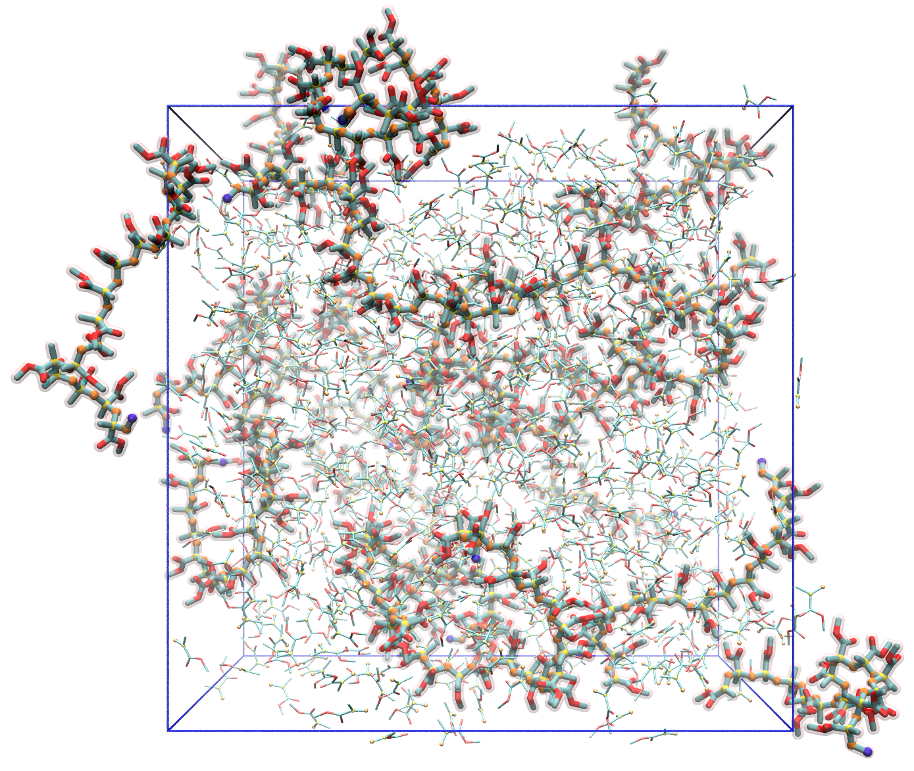
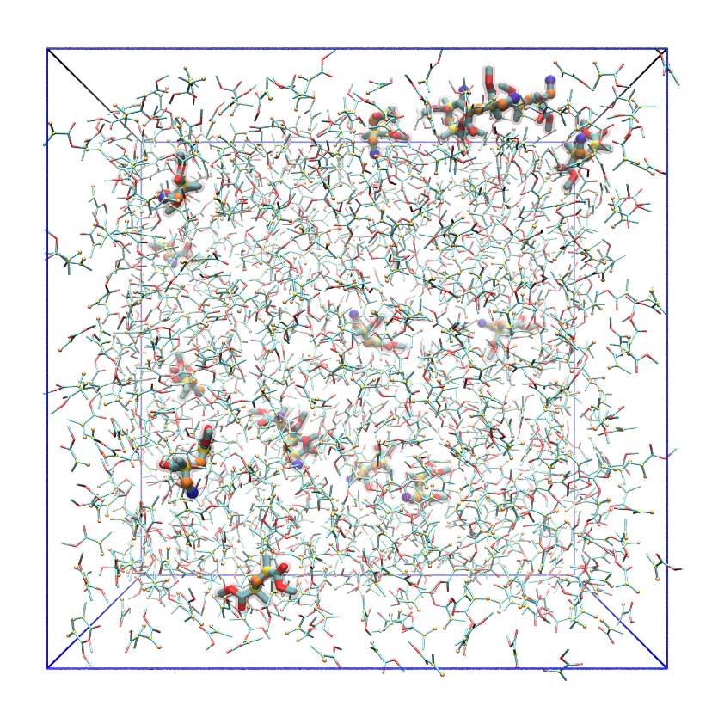
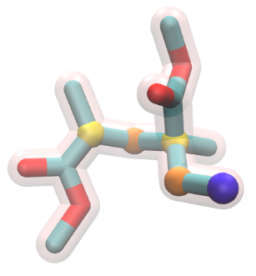
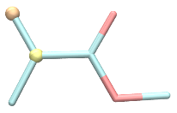
Example of MC/MD simulation (PMMA radical polymerization)
in /share5/takayana/MCMDexample/PMMApolymerization
・
Dimer radical × 16
MMA monomer × 1067

Slide 4
Input files
in /share5/takayana/MCMDexample/PMMApolymerization
job.py python program file
mdinput/ Initial topology & coordinate files prmtop inpcrd
FF/ Force field files gaff.dat GAFF force field (copied from AMBER directory) frcmod.mma Force field of MMA monomer frcmod.polymer Force field of PMMA polymer mmm.prepin Prepin file of :mmm mrd.prepin Prepin file of :mrd tmt.prepin Prepin file of :tmt
Execute: Copy PMMApolymerization directory and run python -u job.py | tee MCMD.log

Slide 5
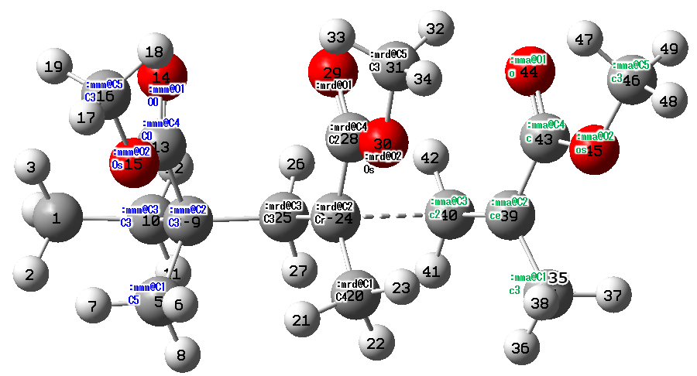
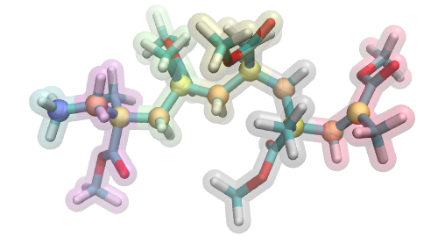
Atom type of PMMA radical model
cap methyl
MMA monomer
PMMA non-terminal part
radical terminal
:mmm
:mmm
:tmt
:mrd
:residueName@atomName
atomType
:mmm
:mmm

Slide 6
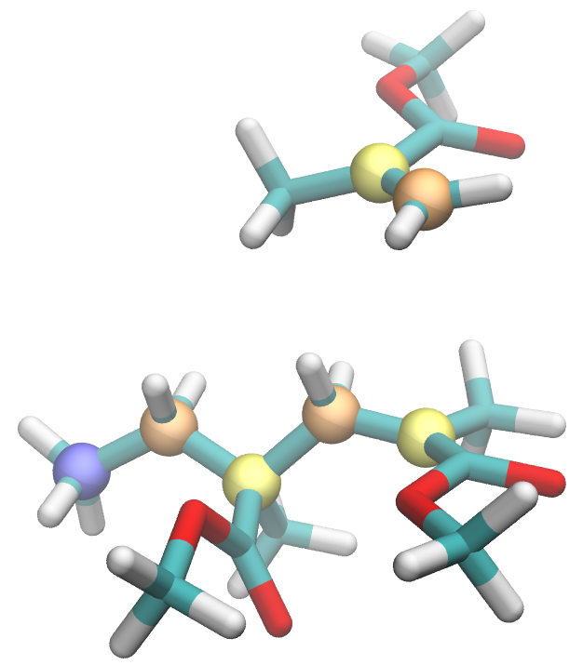
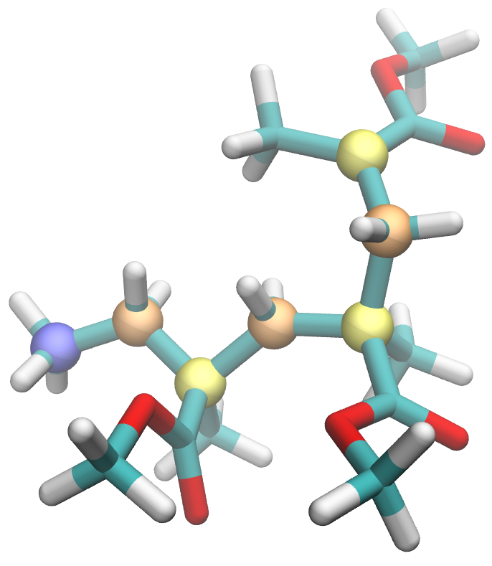
Radical polymerization condition
:mma
:mma
→ :mrd
α-carbon
:mma@C2
β-carbon
:mma@C3
new radical
angle < 120°
distance < 3.8 Å
new bond
:mrd@C3
:mrd@C2
radical
:mrd → :mmm
:mrd
Condition for the elongation reaction
distance(:mrd@C2; :mma@C3)<3.8 && angle(:mrd@C2; :mma@C3; :mma@C2)<120
Create bond & modify residue
createBond :mrd@C2 :mma@C3
ModifyResByPrepin :mrd FF/mmm.prepin
ModifyResByPrepin :mma FF/mrd.prepin
ReactionFinder
3.8 Å ~ vdW contact (vdW radius of both carbon atoms = 1.9080 Å)
Radical plane & MMA monomer plane should be parallel The angle must be ~ 90°
ToplogyEditor

Slide 7
MC/MD simulation cycle
Start
MC/MD simulation program (written in python) /home/takayana/pythonLibs/ver0.22/MCMDsolver.py
Based on AMBER 14
equilibration MD 1
equilibration MD 2
Image MD system
Several programs (written in C++) /home/takayana/scripts/* /home/takayana/scripts/ReactionFinder/ReactionFinder /home/takayana/scripts/TopologyEditor/TopologyEditor
Sampling MD
ReactionFinder
Candidate found?
No
MC/MD job file (written in python) job.py
Yes
Image MD system
job.py line 1-14
from AMBER_MDSolvers import AmberMDSolver, AmberMdin, ReactionFinder
from MCMDsolver import MCMDSolver
import os
jobdirName = "mcmd"
initPrmtop = "mdinput/prmtop"
initInpcrd = "mdinput/inpcrd"
numCycle = 300
MDsolver = "mpirun -np 36 pmemd.pbb.MPI -O"
quenchMDsolver = MDsolver
cpptrajBinary = "cpptraj"
ReactionFinderBinary = "/home/takayana/scripts/ReactionFinder/ReactionFinder"
TopologyEditorBinary = "/home/takayana/scripts/TopologyEditor/TopologyEditor"
TopologyEditor
Quenching MD
Relax MD
Accept
Monte Carlo
Reject
Cancel reaction

Slide 8
Equilibration MDs
Start
Before sampling MD, equilibrate the system.
Examples:
High temperature MD to enhance conformation change or diffusion (eqMD1) → Equilibrate at target temperature (eqMD2)
MD at high dielectric constant to enhance diffusion of ions (eqMD1) → Equilibrate at target temperature (eqMD2)
equilibration MD 1
equilibration MD 2
Image MD system
Sampling MD
ReactionFinder
Candidate found?
No
Yes
job.py line 46-55
# for 1st & 2nd equilibration MD condition (before MD).
# if you do not need this equilibration, set eq1MDstep = 0 or eq2MDstep = 0
eq1MDstep = 2500
eq1MDtemperature = 900
eq1MDdt = 0.0015
eq1MDensemble = 'NVT'
eq2MDstep = 1000
eq2MDtemperature = MDtemperature # MDtemperature = 343.0 (line 24)
eq2MDdt = 0.0015
eq2MDensemble = 'NVT'
Image MD system
TopologyEditor
equilibration MD 1 for 2500 steps at 900 K
Quenching MD
Relax MD
Accept
equilibration MD 2 for 1000 steps at 343 K
Monte Carlo
Reject
Enhance conformation change by the high temperature MD → Equilibrate at the target temperature
Cancel reaction

Slide 9
Sampling MD
Start
Sampling MD to find reaction candidates
equilibration MD 1
job.py line 21-29
MDstep = 2500
MDdt = 0.002
MDensemble = 'NPT'
MDtemperature = 343.0
MDntpr = 50
MDntwx = 50
MDntwr = MDstep
# When you encounter error "PMEMD does not support intermolecular PRFs!", set this setMergeNSP option True
setMergeNSP = True
equilibration MD 2
Image MD system
sampling MD for 2500 steps at 343 K
Output mdcrd every 50 steps, in total 50 snapshots
Sampling MD
ReactionFinder
Candidate found?
No
Yes
Image MD system
TopologyEditor
Quenching MD
Relax MD
Accept
Monte Carlo
Reject
Cancel reaction

Slide 10
ReactionFinder(1)
Start
Call "ReactionFinder" program to serach reaction candidate
Give final snapshot ("inpcrd") or multiple snapshots during the sampling MD simulation ("mdcrd START FINAL OFFSET")
equilibration MD 1
equilibration MD 2
job.py line 66-68
# ReactionFinder input "inpcrd" or "mdcrd START FINAL OFFSET"
#ReactionFinderInput = "inpcrd"
ReactionFinderInput = "mdcrd 1 999999 1"
Image MD system
Sampling MD
ReactionFinder
Give reaction conditions as "reactionEntries" array
Candidate found?
No
job.py line 74-82
reactionEntries = [
'ReactID=1 Ea=2.0 dE=0.0 \
"COND = distance(:mrd@C2; :mma@C3)<3.8 && angle(:mrd@C2; :mma@C3; :mma@C2)<120 && distance(:mmm@C2; :mrd@C3)<2.5 " \
"ACTION = \
setMergeNSP; \
createBond :mrd@C2 :mma@C3; \
ModifyResByPrepin :mrd '+curDir+'FF/mmm.prepin; \
ModifyResByPrepin :mma '+curDir+'FF/mrd.prepin" '
]
Yes
reaction conditions
Image MD system
TopologyEditor
Quenching MD
TopologyEditor script
Relax MD
Accept
Monte Carlo
In this case, only 1 condition is given.
You can give multiple conditions in reactionEntries
Reject
Cancel reaction

Slide 11
ReactionFinder(2)
Start
Input file for ReactionFinder: rf.script
setPrecision 4
setVerbose
temperature 343.0
inputTopology /share5/takayana/MCMDexample/b/mdinput/prmtop
inputMdcrd mdcrd 1 999999 1
byStructure ReactID=1 Ea=2.0 dE=0.0 "COND = distance(:mrd@C2; :mma@C3)<3.8 && angle(:mrd@C2; :mma@C3; :mma@C2)<120 && distance(:mmm@C2; :mrd@C3)<2.5 " "ACTION = setMergeNSP; createBond :mrd@C2 :mma@C3; ModifyResByPrepin :mrd /share5/takayana/MCMDexample/b/FF/mmm.prepin; ModifyResByPrepin :mma /share5/takayana/MCMDexample/b/FF/mrd.prepin"
__ENDscript__
rf.script is automatically created by the MC/MD program written in python.
equilibration MD 1
equilibration MD 2
Image MD system
Sampling MD
ReactionFinder
Candidate found?
No
Yes
Image MD system
TopologyEditor
Quenching MD
Relax MD
Accept
Monte Carlo
Reject
Cancel reaction

Slide 12
ReactionFinder(3)
Start
Console output of ReactionFinder: rf.out
*****************************************************
START ReactionFinder ver 0.1 written by M. Takayanagi
Read rfscript file [rf.script]
Temperature for candidate selection is 343.0000
Input prmtop file name is [/share5/takayana/MCMDexample/b/mdinput/prmtop]
Input mdcrd file name is [mdcrd]
byStructure ReactID=1 Ea=2.0 dE=0.0 "COND = distance(:mrd@C2; :mma...
JOB LIST {
bystructure ReactID=1 Ea=2.0 dE=0.0 COND = distance(:mrd@C2; :mma@C3)<3.8 && angle(:mrd@C2; :mma@C3; :mma@C2)<120 && distance(:mmm@C2; :mrd@C3)<2.5 ACTION = setMergeNSP; createBond :mrd@C2 :mma@C3; ModifyResByPrepin :mrd /share5/takayana/MCMDexample/b/FF/mmm.prepin; ModifyResByPrepin :mma /share5/takayana/MCMDexample/b/FF/mrd.prepin
} JOB LIST END
Read Topology [/share5/takayana/MCMDexample/b/mdinput/prmtop]
natom = 16549, nres = 1115, total charge = -0.0000
Read coordinates
Open mdcrd file [mdcrd] 1 999999 1
Read 50 steps
EXECUTE JOB LIST {
Search by structure
COND = distance(:mrd@C2; :mma@C3)<3.8 && angle(:mrd@C2; :mma@C3; :mma...
ACTION = setMergeNSP; createBond :mrd@C2 :mma@C3; ModifyRe...
Found 27 with ReactID=1
} END JOB EXECUTION (continue to next page)
equilibration MD 1
equilibration MD 2
Image MD system
Sampling MD
ReactionFinder
Candidate found?
No
Yes
Image MD system
TopologyEditor
Quenching MD
Read 50 snapshots for candidate search
Relax MD
Accept
Monte Carlo
Reject
Cancel reaction
Found 27 candidates by the condition

Slide 13
ReactionFinder(4)
Start
Console output of ReactionFinder: rf.out (continued)
Candidate selection with temperature = 343.0000 K
Ea_idx=1 Ea=2.0000 sEa=0.0000 Num=27 Num*(exp(-sEa/kT)/Z)=1.0000 Accum=1.0000 ***
rand=0.1850 Ea_idx=1 Cand_idx=5
End candidate selection
Write selected reaction as [selected.txt].
CandID=5 ReactID=1 Ea=2.000000 dE=0.000000
Write all found candidates as [satList.txt].
FINISH!
END ReactionFinder
*****************************************************
equilibration MD 1
equilibration MD 2
Select candidate by a random number
Image MD system
Sampling MD
ReactionFinder
Candidate found?
No
Yes
Selected candidate information: selected.txt
# ReactID=1 Ea=2.0000 dE=0.0000 t=7 (VMDframe=6) NumCand=27
# Values = 3.5497, 107.4548, 1.5587
# :mrd=18 :mma=922
# :mrd@C2=194 :mma@C3=13645
inputInpcrd out.inpcrd
setMergeNSP
createBond 194 13645
ModifyResByPrepin 18 /share5/takayana/MCMDexample/b/FF/mmm.prepin
ModifyResByPrepin 922 /share5/takayana/MCMDexample/b/FF/mrd.prepin
Image MD system
TopologyEditor
Distance, angle, ... values of the candidate
Quenching MD
residue and atom index
inpcrd file "out.inpcrd" is created for TopologyEditor
Relax MD
Accept
Monte Carlo
Reject
Cancel reaction
Molecule update commands for TopologyEditor

Slide 14
ReactionFinder(5)
Start
All of the found candidate information: satList.txt
# CandID=1 ReactID=1 Ea=2.0000 dE=0.0000 t=1 (VMDframe=0) selected=F
# Values = 3.3903, 94.5180, 1.5347
setMergeNSP
createBond 194 13645
ModifyResByPrepin 18 /share5/takayana/MCMDexample/b/FF/mmm.prepin
ModifyResByPrepin 922 /share5/takayana/MCMDexample/b/FF/mrd.prepin
# CandID=2 ReactID=1 Ea=2.0000 dE=0.0000 t=2 (VMDframe=1) selected=F
...
# CandID=5 ReactID=1 Ea=2.0000 dE=0.0000 t=7 (VMDframe=6) selected=T
# Values = 3.5497, 107.4548, 1.5587
setMergeNSP
createBond 194 13645
ModifyResByPrepin 18 /share5/takayana/MCMDexample/b/FF/mmm.prepin
ModifyResByPrepin 922 /share5/takayana/MCMDexample/b/FF/mrd.prepin
# CandID=6 ReactID=1 Ea=2.0000 dE=0.0000 t=8 (VMDframe=7) selected=F
...
# CandID=27 ReactID=1 Ea=2.0000 dE=0.0000 t=50 (VMDframe=49) selected=F
# Values = 3.5775, 109.0844, 1.5819
setMergeNSP
createBond 364 11395
ModifyResByPrepin 33 /share5/takayana/MCMDexample/b/FF/mmm.prepin
ModifyResByPrepin 772 /share5/takayana/MCMDexample/b/FF/mrd.prepin
equilibration MD 1
equilibration MD 2
Image MD system
Sampling MD
ReactionFinder
No
Selected candidate
Candidate found?
Yes
Image MD system
TopologyEditor
Quenching MD
Relax MD
Accept
Monte Carlo
Reject
Cancel reaction

Slide 15
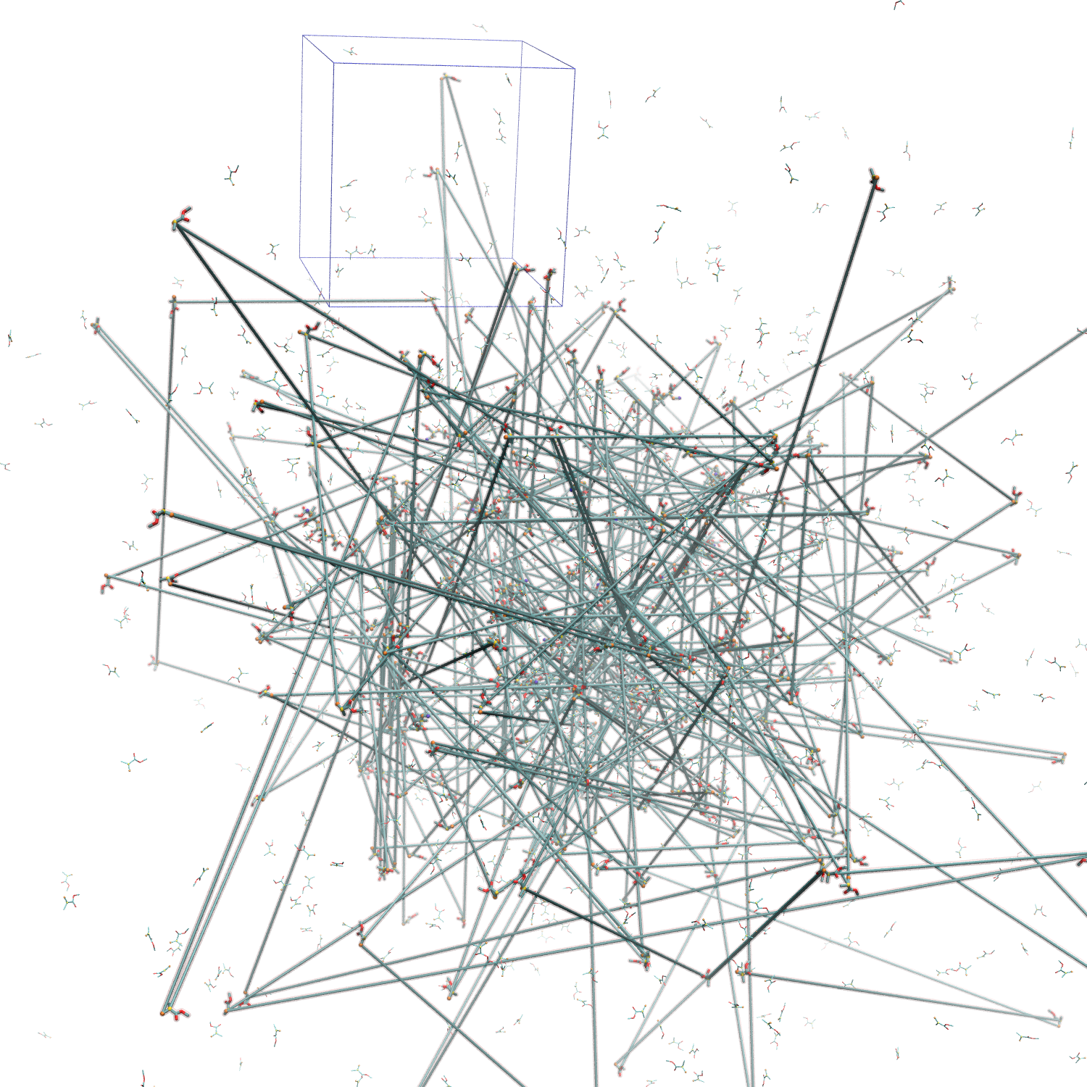
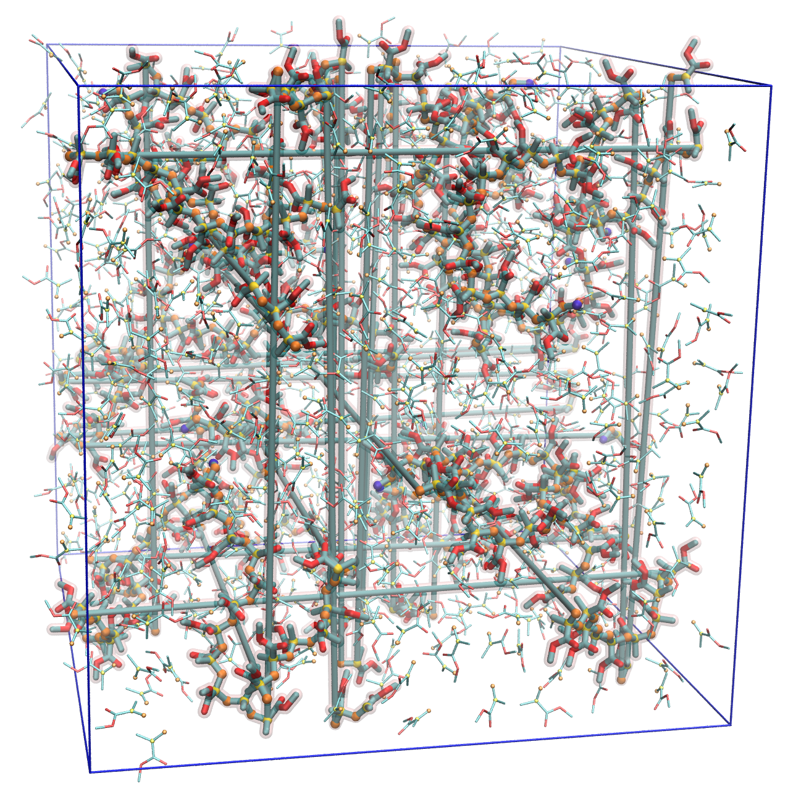
Image MD system
Start
job.py line 58-64
# RECOMMENDATION: imagingMode = "OnlySolvent", centeringMode = "ReactRes1"
# imaging mode "ALL", "OnlySolvent", "None"
imagingMode = "OnlySolvent"
# centering mode "ReactRes1" "None"
centeringMode = "ReactRes1"
# give solvent residue name (i.e. ":WAT", ":WAT,Cl-,Na+")
solventResname = ":mma"
equilibration MD 1
equilibration MD 2
Image MD system
Sampling MD
periodib boundary box (PBB)
ReactionFinder
No
Image by cpptraj
image byres
Candidate found?
Yes
Image MD system
TopologyEditor
Quenching MD
Relax MD
imaging mode = "None"
Accept
Monte Carlo
MC/MD simulation works without imaging, but diffusion of molecules result in the change of digits in mdcrd and trigger errors. (i.e. usual digit -123.456 → -1234.56, 8 letters for each data)
Reject
Cancel reaction

Slide 16
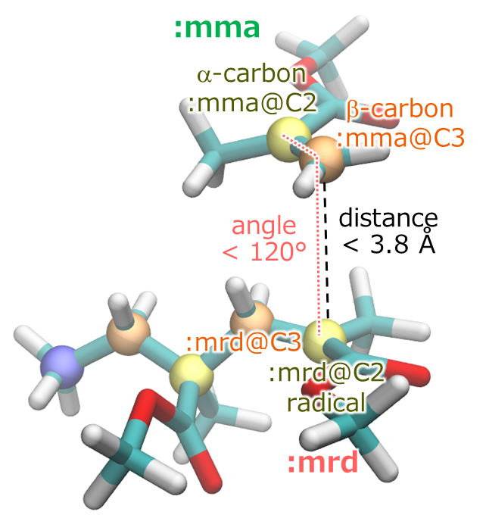
Imaging options
imagingMode = "None": no imaging
imagingMode = "ALL": image by cpptraj image byres
imagingMode = "OnlySolvent": for solvent molecules (1 molecule = 1 residue) specified as solventResname, image by cpptraj image $solventResname byres
centeringMode = "None": do nothing
centeringMode = "ReactRes1": translate the system to center the first residue appeared in the reaction condition
Centering is necessary when reaction occurs beyond the boundary of PBB
PBB
In this case, center residue :mrd
:mrd is the first residue appeared in the reaction condition
without centering
B
A
B
A
Bad for visualization
with centering
distance(:mrd@C2; :mma@C3)<3.8 && angle(:mrd@C2; :mma@C3; :mma@C2)<120
A
B
A
B
Good!

Slide 17
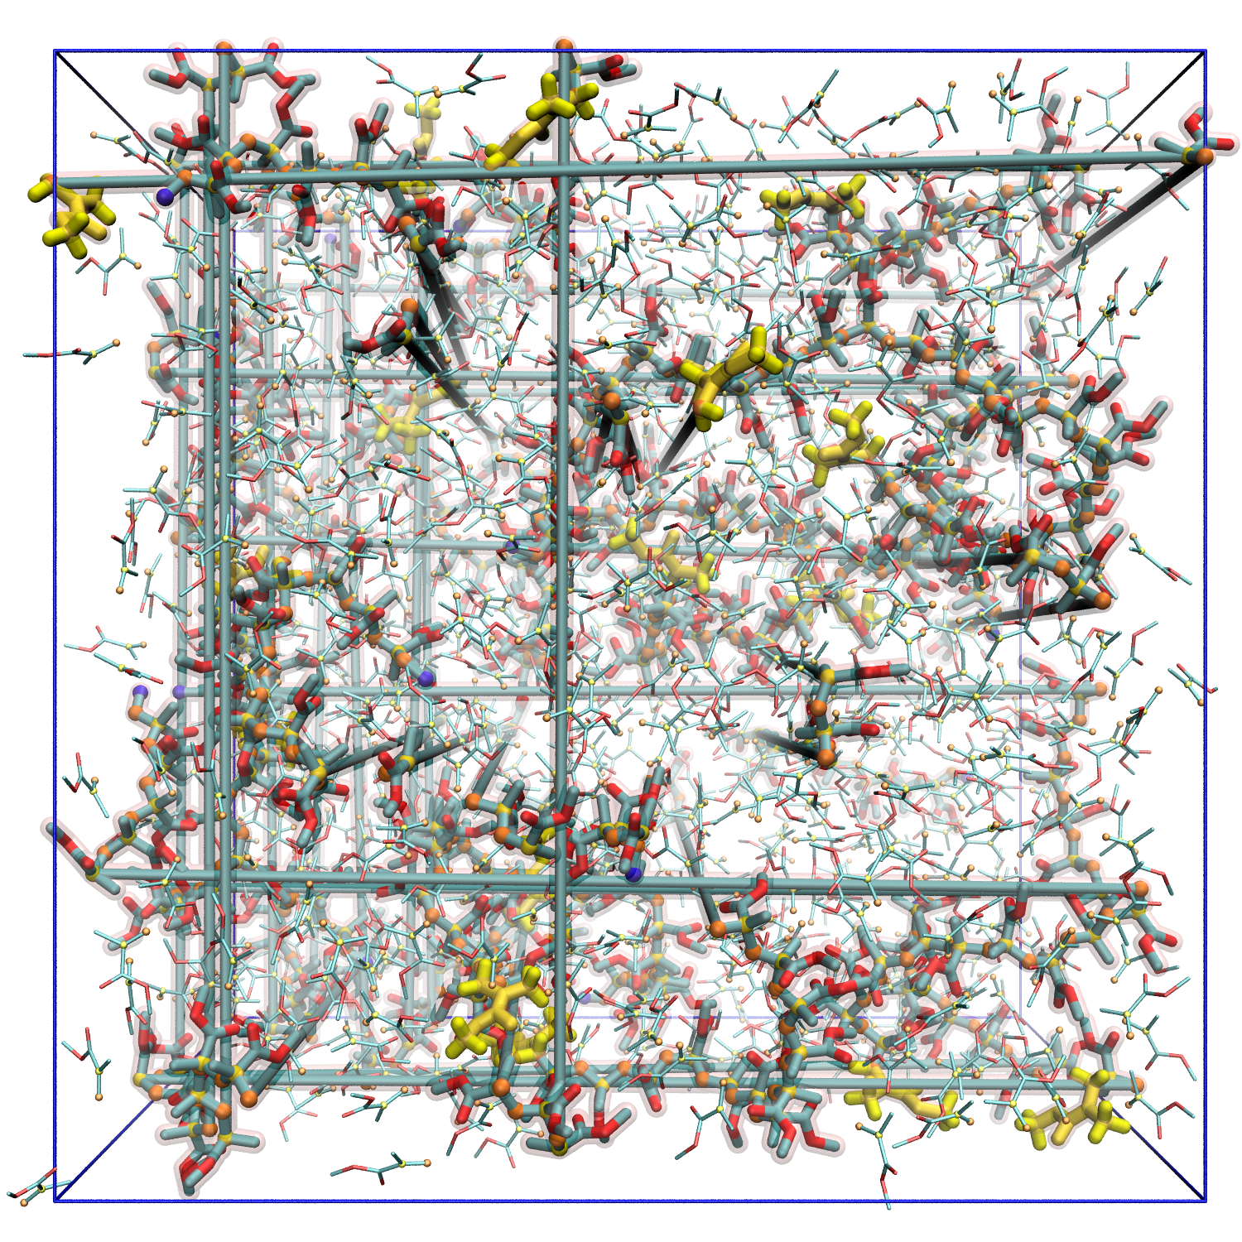
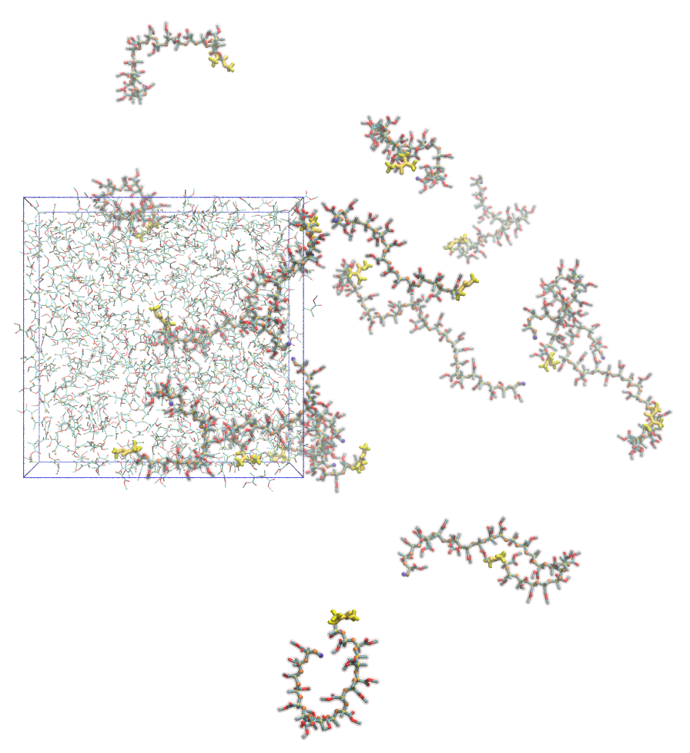
Image molecules into PBB
Result by the recommended imaging options: imagingMode = "OnlySolvent", centeringMode = "ReactRes1"
Image by cpptraj
image byres
Each molecule is separated beyond the boundaries of the PBB
Other options of cpptraj (bymol) does not work well for this system.
In AMBER, a "molecule" must be composed of sequential residues. (i.e. "molecule 1" is composed of "resid 1 2 3 4 5 ... 152 153")
In MC/MD simulations, a "molecule" is not composed of sequential residues. (i.e. "molecule 1" is composed of "resid 1 2 3 807 976 ... 147 580)
sander (pmemd) option "iwrap" also does not work well in MC/MD simulations because of this non-sequential residues in molecule

Slide 18
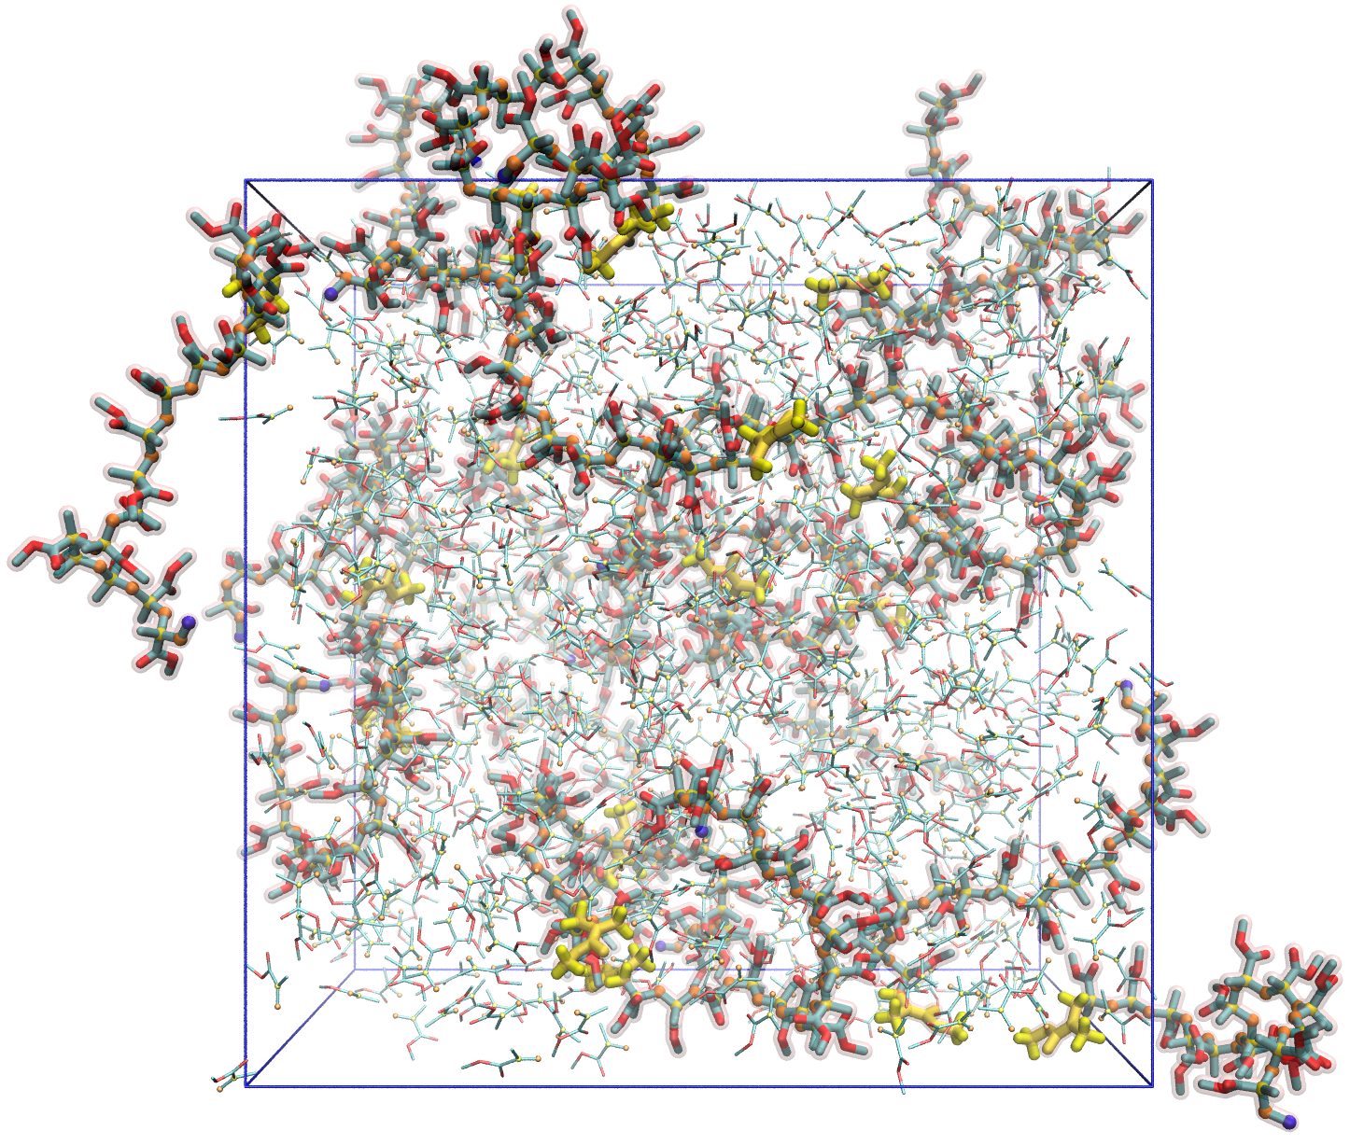
Image molecules into PBB by molImager
molImager \ prmtop inpcrd \ mrd \
imaged.inpcrd \ novel \ translate
Residues :mrd are imaged into the PBB
How to use:
molImager (input prmtop) (input inpcrd) (image target residue index or residue name) (output inpcrd) (optional, "vel (default)" or "novel" whether inpcrd includes velocity) (optional, "translate" to image target residue into PBB)
molImager will be included in the MC/MD program in near future

Slide 19
Spin off program: FindMoleculeByBond
How to use:
FindMoleculeByBond (input prmtop) (initial residue index)
Output is residue index of the molecule.
Example: FindMoleculeByBond prmtop 1
→ 1 2 3 807 976 1071 1006 747 840 974 730 926 787 652 839 724 864 261 770 522 283 147 580
FindMoleculeByBond finds a molecule connected by bonds starting from the "initial residue index" residue.
Algorithm: Depth-first search （深さ優先探索）

Slide 20
TopologyEditor(1)
Start
Call "TopologyEditor" program to edit topology file
Input script "tp.script" is automatically created by the python MC/MD program
equilibration MD 1
equilibration MD 2
Input file for TopologyEditor: tp.script
setPrecision 4
setVerbose
setMergeNSP
inputTopology /share5/takayana/MCMDexample/b/mdinput/prmtop
outputTopology out.prmtop
forceField /share5/takayana/MCMDexample/b/FF/gaff.dat
forceFieldMod /share5/takayana/MCMDexample/b/FF/frcmod.polymer
forceFieldMod /share5/takayana/MCMDexample/b/FF/frcmod.mma
# ReactID=1 Ea=2.0000 dE=0.0000 t=7 (VMDframe=6) NumCand=27
# Values = 3.5497, 107.4548, 1.5587
# :mrd=18 :mma=922
# :mrd@C2=194 :mma@C3=13645
inputInpcrd out.inpcrd
setMergeNSP
createBond 194 13645
ModifyResByPrepin 18 /share5/takayana/MCMDexample/b/FF/mmm.prepin
ModifyResByPrepin 922 /share5/takayana/MCMDexample/b/FF/mrd.prepin
Modified topology file "out.prmtop" is created
Image MD system
Sampling MD
ReactionFinder
Candidate found?
No
Yes
Image MD system
TopologyEditor
Copied from "selected.txt" (Prepared by ReactionFinder)
Quenching MD
Relax MD
Accept
Monte Carlo
Reject
Cancel reaction

Slide 21
TopologyEditor(2)
Start
Console output of TopologyEditor: tp.out
*****************************************************
START TopologyEditor ver 0.2 written by M. Takayanagi
Read tpscript file [tp.script]
...
Read Topology [/share5/takayana/MCMDexample/b/mdinput/prmtop]
natom = 16549, nres = 1115, total charge = -0.0000
Read ForceField [/share5/takayana/MCMDexample/b/FF/gaff.dat]
Read ForceFieldMod [/share5/takayana/MCMDexample/b/FF/frcmod.polymer]
Read ForceFieldMod [/share5/takayana/MCMDexample/b/FF/frcmod.mma]
Number of read parameters: 5796
EXECUTE JOB LIST {
Create bond between 194(:18@C2 ) and 13645(:922@C3 )
Create bond without H: 194(:18@C2 )_13645(:922@C3 )
Created 1 bond.
Create angle without H: 190(18@C1 )_194(18@C2 )_13645(922@C3 )
Create angle without H: 195(18@C3 )_194(18@C2 )_13645(922@C3 )
...
Create angle without H: 194(18@C2 )_13645(922@C3 )_13644(922@C2 )
Created 6 angles.
Create Dihedral with H: 190(18@C1 )_194(18@C2 )_13645(922@C3 )_13646(922@H31 )
Create Dihedral with H: 190(18@C1 )_194(18@C2 )_13645(922@C3 )_13647(922@H32 )
...
Create Dihedral without H: 200(18@O2 )_198(18@C4 )_194(18@C2 )_13645(922@C3 )
Created 19 dihedrals.
Create excluded list between 179(:17@C2 )_13645(:922@C3 )
Create excluded list between 190(:18@C1 )_13644(:922@C2 )
...
Create excluded list between 200(:18@O2 )_13645(:922@C3 )
Created 26 excluded lists.
Atom type update: old Cr -c2 , new KEEP-KEEP
Modify residue 18(mrd ) by prepin file /share5/takayana/MCMDexample/b/FF/mmm.prepin
New residue name mmm
Modify residue 922(mma ) by prepin file /share5/takayana/MCMDexample/b/FF/mrd.prepin
New residue name mrd
...
equilibration MD 1
equilibration MD 2
Image MD system
Sampling MD
ReactionFinder
Candidate found?
No
Yes
Image MD system
TopologyEditor
Quenching MD
Relax MD
Accept
Monte Carlo
Reject
Cancel reaction

Slide 22
Quenching & Relax MDs
Start
job.py line 31-44
quenchMDstep = 500
quenchMDdt = 0.0002
Q_ntpr = 100
Q_ntwx = 0
Q_ntwr = quenchMDstep
Q_temperature = MDtemperature
Q_restraint_wt = 10
relaxMDstep = 2500
relaxMDntpr = 500
relaxMDntwx = 500
relaxMDtemperature = MDtemperature
relaxMDensemble = 'NPT'
# other relaxMD conditions are identical to MD
equilibration MD 1
equilibration MD 2
Quenching MD conditions
Image MD system
Sampling MD
ReactionFinder
Relax MD conditions
Candidate found?
No
Yes
Image MD system
TopologyEditor
Quenching MD: Relax only reacted part of the system. (Purpose is identical to energy minimization)
Reacted part = residues appeared in the reaction condition written in selected.txt as # :mrd=18 :mma=922
Harmonic constraint by ntr=1,restraint_wt = 10, restraintmask='!:18,922'
Quenching MD
Relax MD
Accept
Monte Carlo
Reject
Cancel reaction

Slide 23
Monte Carlo judgement
Start
job.py line 16-19
# jobType = "noMC_MD", "MC_MD"
jobType = "MC_MD"
# MC_energy = "AllEP", "AllEtot"
MC_energy = "AllEP"
equilibration MD 1
when jobType="noMC_MD", the MC procedure is omitted
equilibration MD 2
MC_energy = "AllEP": Judge by total potential energy
MC_energy = "AllEtot": Judge by total energy (potential + kinetic energy)
Image MD system
Sampling MD
ReactionFinder
Console output of job.py for MC part
MC with condition [AllEP]
EP(reactant)=33486.8238, EP(product)=33352.298, dE(ReactID=1)=0.0, T=343.0
EP(product) - EP(reactant) + dE = -134.5258 <= 0, ACCEPT
MC: Update to new prmtop file
Compare energy between the snapshot in Sampling MD chosen by ReactionFinder
and
the final snapshot of the Relax MD
When reject, prmtop file is back to that before TopologyEditor inpcrd file is back to the final snapshot of the Sampling MD
Candidate found?
No
Yes
Image MD system
TopologyEditor
Quenching MD
Relax MD
Accept
Monte Carlo
Reject
Cancel reaction

Slide 24
MC/MD job log file
START job in [/share5/takayana/MCMDexample/b/mcmd/mcmd] at 170204-23:29:16 - rcc601
Type=MC_MD NCycle=300
Temperature=343.0
Cycle 00001 at 170204-23:29:16
prmtop = /share5/takayana/MCMDexample/b/mdinput/prmtop
inpcrd = /share5/takayana/MCMDexample/b/mdinput/inpcrd
eq1 : START [mpirun -np 36 pmemd.pbb.MPI -O] at 23:29:16 in /share5/takayana/MCMDexample/b/mcmd/eq1MDs/eq1_00001
eq1 : FINISH [mpirun -np 36 pmemd.pbb.MPI -O] at 23:29:23, elapsed 0:00:07.229078
eq2 : START [mpirun -np 36 pmemd.pbb.MPI -O] at 23:29:23 in /share5/takayana/MCMDexample/b/mcmd/eq2MDs/eq2_00001
eq2 : FINISH [mpirun -np 36 pmemd.pbb.MPI -O] at 23:29:26, elapsed 0:00:03.027562
IMAGE & CENTER molecules
MD: START [mpirun -np 36 pmemd.pbb.MPI -O] at 23:29:26 in /share5/takayana/MCMDexample/b/mcmd/MDs/MD00001
MD: FINISH [mpirun -np 36 pmemd.pbb.MPI -O] at 23:29:33, elapsed 0:00:07.335472
ReactionFinder at 23:29:33 in /share5/takayana/MCMDexample/b/mcmd/MDs/MD00001
found candidate, ReactID=1, residues :mrd=18 :mma=922 , CrdStep=7, NumCand=27
Values = 3.5497, 107.4548, 1.5587
IMAGE & CENTER molecules
TopologyEditor at 23:29:34 in /share5/takayana/MCMDexample/b/mcmd/MDs/MD00001 at
Create prmtop file /share5/takayana/MCMDexample/b/mdinput/prmtop
Q : START [mpirun -np 36 pmemd.pbb.MPI -O] at 23:29:35 in /share5/takayana/MCMDexample/b/mcmd/qMDs/Q00001
Q : FINISH [mpirun -np 36 pmemd.pbb.MPI -O] at 23:29:37, elapsed 0:00:02.075460
R : START [mpirun -np 36 pmemd.pbb.MPI -O] at 23:29:37 in /share5/takayana/MCMDexample/b/mcmd/rMDs/R00001
R : FINISH [mpirun -np 36 pmemd.pbb.MPI -O] at 23:29:44, elapsed 0:00:06.926954
MC with condition [AllEP]
EP(reactant)=33486.8238, EP(product)=33352.298, dE(ReactID=1)=0.0, T=343.0
EP(product) - EP(reactant) + dE = -134.5258 <= 0, ACCEPT
MC: Update to new prmtop file
Cycle 00002 at 170204-23:29:44
prmtop = /share5/takayana/MCMDexample/b/mcmd/MDs/MD00001/out.prmtop
inpcrd = /share5/takayana/MCMDexample/b/mcmd/rMDs/R00001/restrt
eq1 : START [mpirun -np 36 pmemd.pbb.MPI -O] at 23:29:44 in /share5/takayana/MCMDexample/b/mcmd/eq1MDs/eq1_00002
...

