Slide 1
Developments of molecular simulation method depending on the environment pH conditions: An extension to the multi protonation site systems II
Yukichi Kitamura

Slide 2
Contents of Today’s Workshop
In the last CREST workshop, I have proposed the update scheme for energy distribution combined with the micro constant pH MS method.
It was found that the sufficient longer equilibrium step (T_{1st} > 10 [ps]) have to consider on the estimation of the energy.
By the proper computational setting, our developed method could succeed in reproduction of exact distribution.
In this workshop, I have applied the our simulation method to di-peptide system.

Slide 3
Micro Constant pH MS method
1 MC trial is consisted by 4 steps.
1 MC Trial
MC
1st stage MD
Change state and minimization
2nd stage MD with Gaussian filtering scheme
Gaussian filtering scheme
(1) After the 1st stage MD, the protonate state is randomly exchanged, and execute minimization.
(2) execute the 2nd stage MD with new state and check the energy difference ∆E at every step before MC trial.
(3) if ∆E is sufficiently small, the MD run is stopped and switches to next MC part (Gaussian filtering), .
Notes:
Our method is constructed by MC and MD part.
MD is executed the conformation sampling. On the other hand, MC is employed for protonation transition.
In 1st stage of MD, the conventional MD is executed.

Slide 4
Micro Constant pH MS method
The energy difference for MC is constructed from three components.
The contribution of ΔG_{pH} is smaller than first and second components because of the large thermal fluctuations. → Gaussian filtering scheme and correction term.
Notes:
First term is the instantaneous energy difference before and after transitions.
Second is the mean value of energy difference estimated by MM force field.
Third is the free energy term depending on the pH value.
The magnitude of energy fluctuation is forty to fifty kilocalories per mole.
On the other hand, this is 1.4 kilocalorie per 1 pH unit.
This will bring about the inefficiency of MC sampling.
To avoid such problem, we introduced the Gaussian filtering scheme and correction term.

Slide 5
Numerical Test: Model system
Model system
pKa=10.34 (G. Platzer, et al., J. Biomol. NMR 60, 109-129 (2014))
For neutralization, one counter ion (coupled with λ of solute molecule) was included.
<λ=0>
<λ=1>
Acetyl-Gly-Lys-Gly-amide
(with Cl anion)
Acetyl-Gly-Lyn-Gly-amide
(with Cl neutral LJ particle)
Notes:
As a model system, I adopted the tri-peptide including one lysine residue.
This has one protonation site and the pKa value is 10.34.
For neutralization, one counter ion was considered.

Slide 6
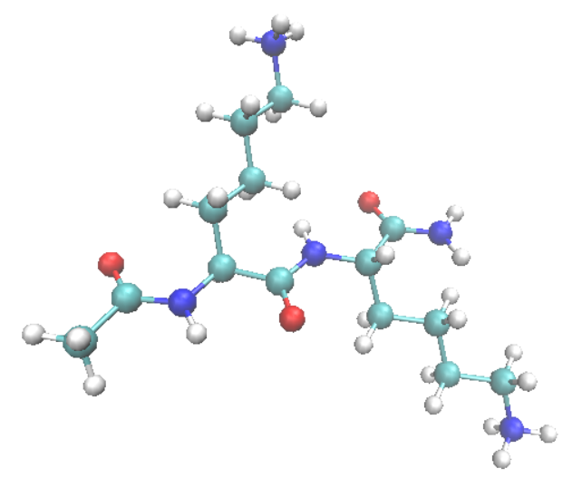
Numerical Test: Dipeptide system
Di-peptide system
<λ=[0,0]>
Acetyl-Lys-Lys-amide
(with 2 Cl anion)
[*] J. Makowska, et al., J. Solution. Chem. 41, 1738-1746 (2012)
Notes:
I adopted the lysine based dipeptide molecule to check the numerical performance.
This is included the two titration sites and can be modeled by the two stepwise dissociation reaction.
From experimental research, the 1st pKa value is 5.95 and the 2nd one is 8.66.
The two pKa values are lower than that of model system.

Slide 7
Calculation setting
Simulation setting
Estimation of energy distribution
Total 100 [ns] MD for each molecules
Constant pH simulation
1st stage NPT-MD run: 20 [ps]
Minimization run: 1000 step for solute and surrounding water molecule (within 4.0 Å, which corresponds to water molecule in 1st solvent shell)
2nd stage NPT-MD run: 50 [ps]
Total 200 MC (approximately) for each setting pH value
No. of cpu: 392
pH values were set at an interval of 0.5 pH unit (pH=5.0~11.5)
Notes:
These are shown the simulation settings.
To estimate the energy distribution, I executed the 100 [ns] conventional MD.
In the present calculation, about 200 MC is executed by using 392 cpus.

Slide 8
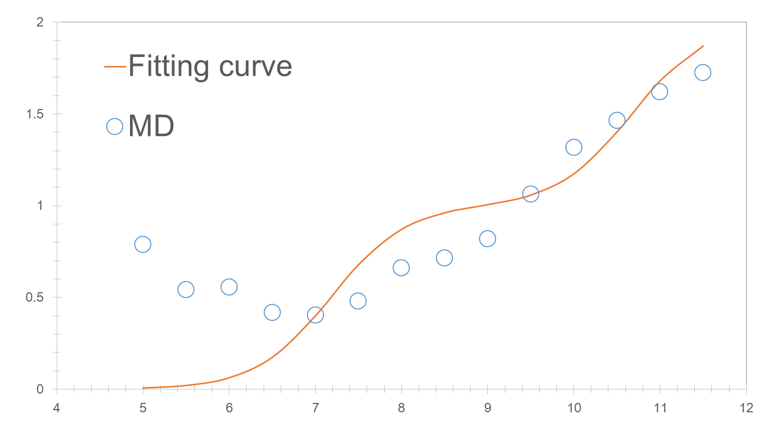
Numerical Result
Deprotonation ratio
Deprotonation ratio is increased in spite of acidic condition!
pH
Fig. Predicted titration curve of lysine dipeptide in water.
The result showed the strange behavior in low pH region and we cannot obtain the proper titration curve by our simulation method.
Notes:
This is the predicted titration curve of lysine dipeptide.
The blue circles are predicted one.
The orange line is fitting curve.
As you can see, the ratio is overestimated in spite of acidic condition and it is abnormal behavior.

Slide 9
Numerical problem
To solve the problem on titration curve in low pH region, I checked the implementation of schemes, calculation setting and so on.
I did not detect a critical defect according to them.
But, I noticed the correction term may introduce the problem because this is empirically determined by comparison with theoretical titration curve and simulation result in narrow pH region (pKa±2.0).
Notes:
By update and update, the correct energy distribution must be obtained.

Slide 10
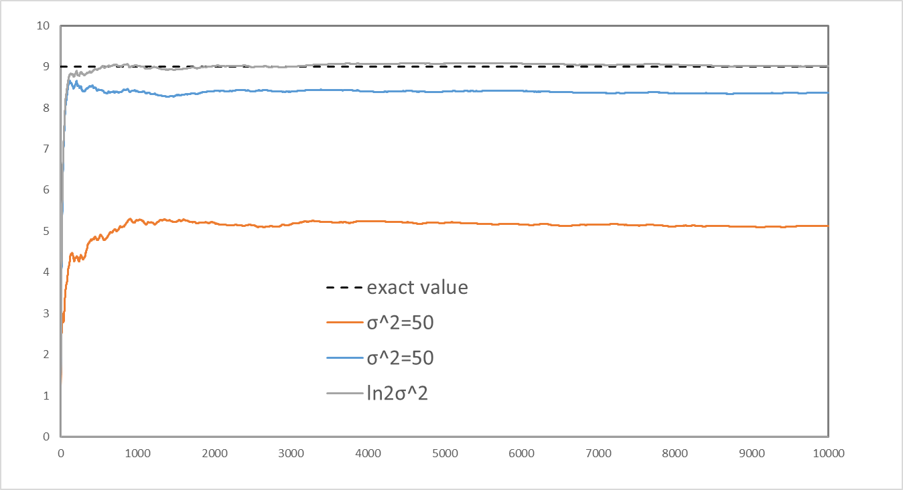
Correction term
The correction term is added into the energy difference by using MC procedure.
Averaged deprotonation ratio
Without Gaussian Filter
With Gaussian Filter (σ²=k_{B}T)
With Gaussian Filter (σ²=k_{B}T) + correction term (C=0.693k_{B}T)
Total MC trial
Figure. Change in the averaged deprotonated ratio as a function of sampling MD step
Notes:
By combination with the Gaussian filter and correction term, we could reproduce the exact value.

Slide 11
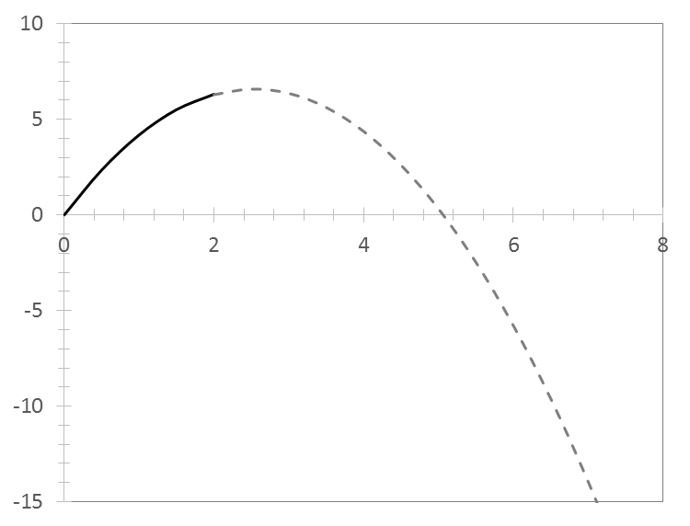
Correction term
In the larger ΔpH region (>2), the extrapolated value is used as the correction term.
Correction term C(σ²) [kcal/mol]
Correct?
This function is determined by using the simulation results from pH=0 to 2.0.
pH-pK_{a}
Notes:
This is the function to estimate the correction term.
I suspected that the problem in low pH region was caused by the their values of function.
I have revised the function with a wide pH region.

Slide 12
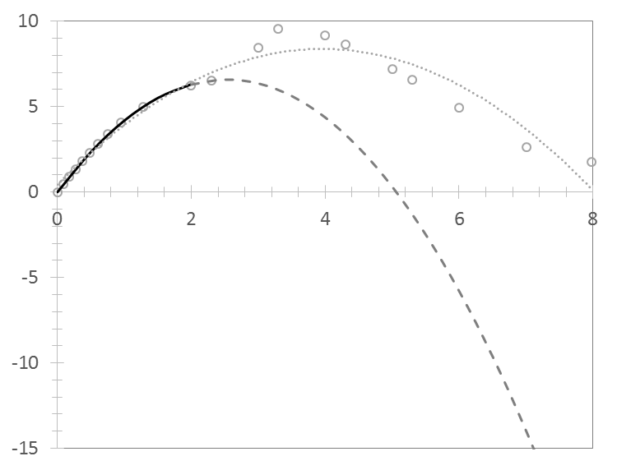
Revised correction term
The two functions are similar within ΔpH<2 and previous one is underestimated in larger ΔpH region.
Correction term C(σ²) [kcal/mol]
The improper curve in low pH region is caused by such underestimation of correction term.
pH-pK_{a}
Notes:
The dot line is revised correction function.

Slide 13
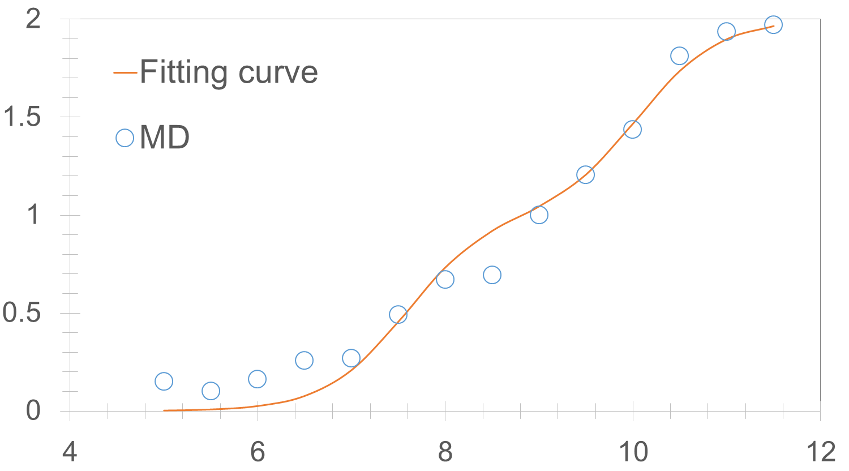
Numerical Result with revised function
Deprotonation ratio
The ratios were small values in acidic region.
pH
Fig. Predicted titration curve of lysine dipeptide in water.
The predicted curve became a general form for two titration system.
Notes:
This is the predicted titration curve of lysine dipeptide with revised function.
The blue circles are predicted one.
The orange line is fitting curve.

Slide 14
Numerical Result with revised function
Table. Predicted pK_{a} values and pK_{a} shifts for lysine dipeptide in water.
 | Exp [*] | Present
pK_{a1} | 5.95 (-4.39) | 7.58 (-2.76)
pK_{a2} | 8.66 (-1.68) | 10.05 (-0.29)
pK_{a2}-pK_{a1} | 2.71 | 2.47
[*] J. Makowska, et al., J. Solution. Chem. 41, 1738-1746 (2012)
Predicted pK_{a} values were larger value than that of experiment.
The shift and difference (pK_{a2}-pK_{a1}) were qualitatively consistent with experimental values.

Slide 15
Conclusion
I have applied the our simulation method to di-peptides system.
Previous function for correction term is insufficiently and was revised in wide pH region.
By revision of correction term, our method can execute cpH-MD simulations for multi-protonation system showing a large pK_{a} shift.
<Next research plan>
Execute the longer sampling
Analyze the energy change by transition and their conformation to clarify the origin of pK_{a} shift.
Notes:
The number of MC trial in present simulation is not enough to converge.

Slide 16
Thank you for your attention.

