Slide 1
Mechanistic study of CAL-B catalyzed ring-opening polymerization of β-lactam
Chantal Barberot
Graduate School of Information Science, Nagoya University

Slide 2
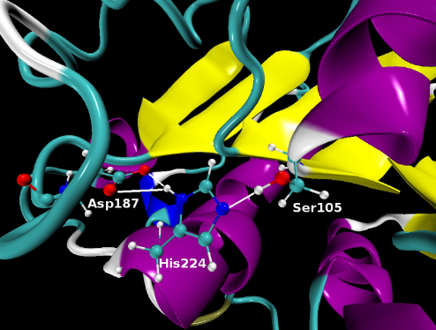
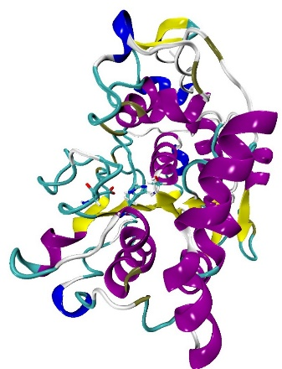
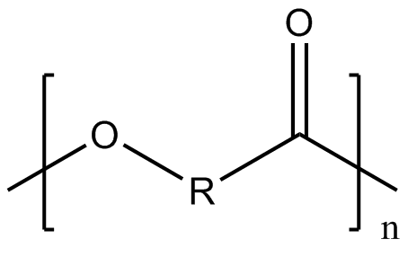
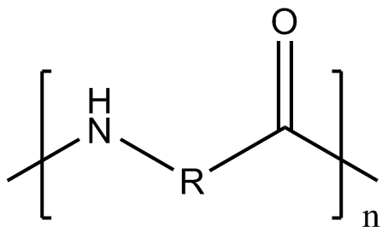
Enzymatic polymerization
Candida Antarica Lipase B (CAL-B) enzyme is an α/β-hydrolase based on a catalytic triad (Asp-His-Ser)
CAL-B is a useful catalyst for polymerization of amide or ester
Catalytic site
PDBID: 4K6G
polyester
polyamide
K. Loos et al. Macromol Rapid. Commun. 2008, 29, 794-797

Slide 3
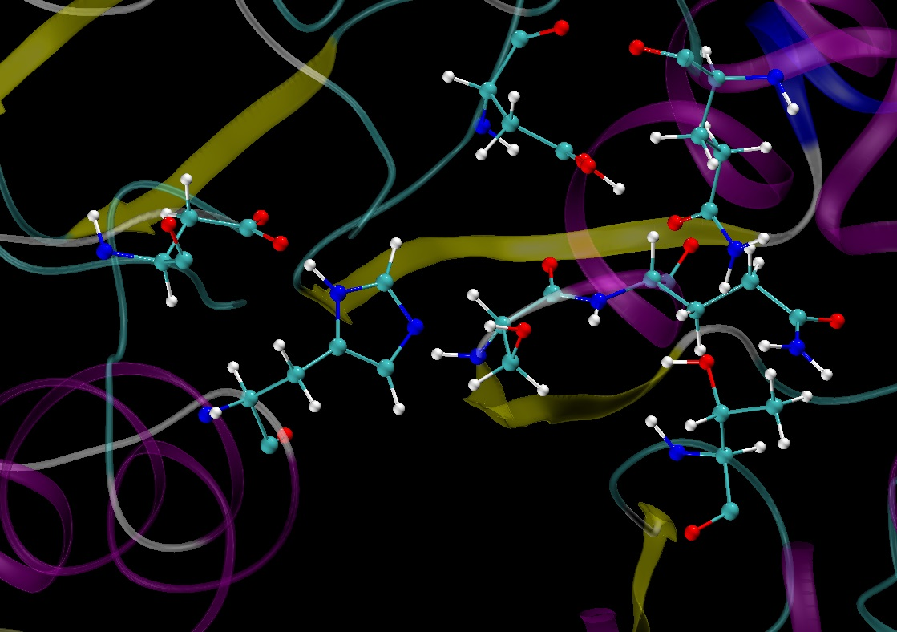
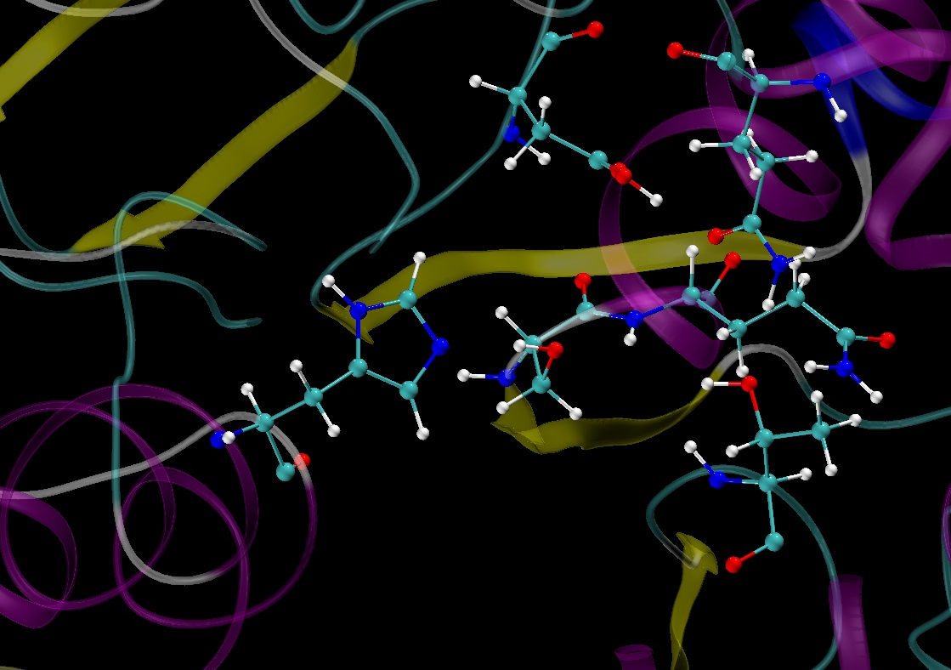
Mechanistic study of the ROP
The ring-opening polymerization of β-lactam was studied by G. Fels¹ by a QM/MM study
The residues listed below were part of the QM region:
Catalytic residue (Ser105, His224)
Oxyanion hole (Gln106,Thr40)
β-lactam (or polymer chain) and water molecule
Residue important for the stabilization of the oxyanion hole (Asp134, Gln157)
Asp134
Gln157
Gln106
Ser105
His224
Oxyanion hole
Thr40
1. G. Fels et al. ACS Catal. 2011, 1, 323-336

Slide 4
Mechanistic study of the ROP
The ring-opening polymerization of β-lactam was studied by G. Fels¹ by a QM/MM study
The residues listed below were part of the QM region:
Catalytic residue (Ser105, His224)
Oxyanion hole (Gln106,Thr40)
β-lactam (or polymer chain) and water molecule
Residue important for the stabilization of the oxyanion hole (Asp134, Gln157)
The Asp187 are not considered in the QM region (catalytic triad)
QM/MM calculation: B3LYP (Ahlrichs-p-VDZ)/amber99FF
Asp134
Gln157
Asp187
Gln106
Ser105
His224
Oxyanion hole
Thr40
1. G. Fels et al. ACS Catal. 2011, 1, 323-336

Slide 5
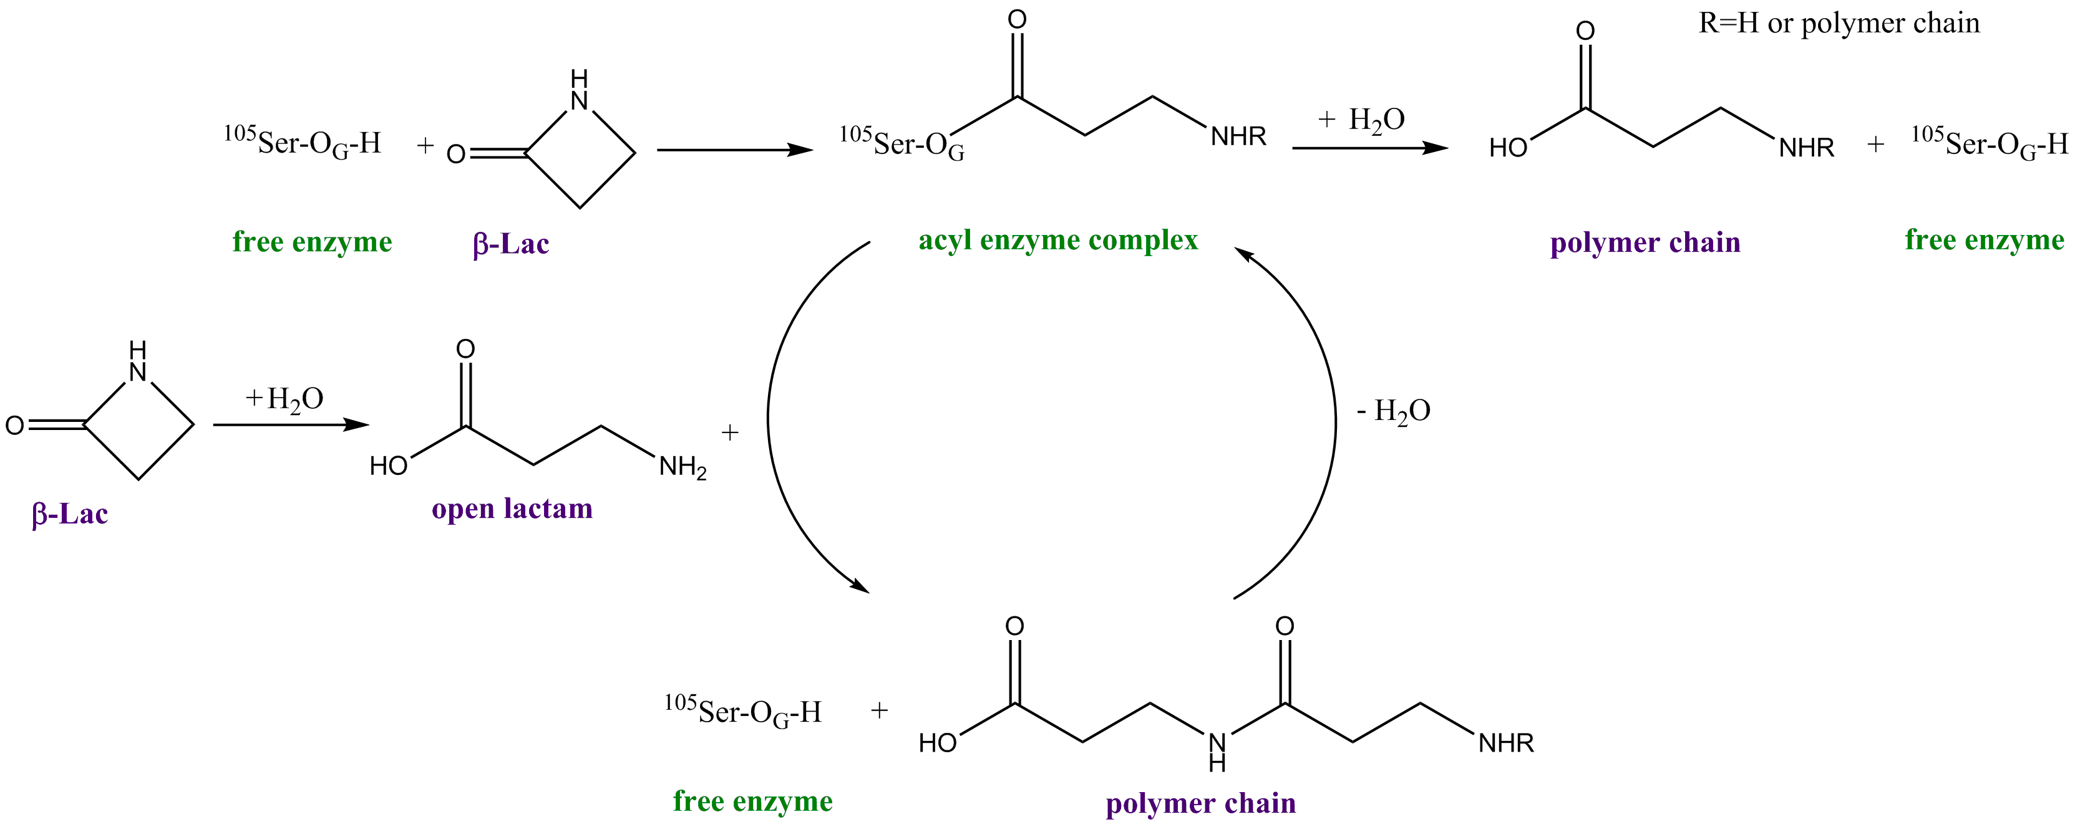
Mechanistic study of the ROP
Sequential mechanism proposed by G. Fels¹
Formation of an acyl complex
Release of the polymer chain
Active site
Elongation of the polymer chain
Formation of an acyl complex
In situ β–lactam ring opening
1. G. Fels et al. ACS Catal. 2011, 1, 323-336
2. M. Nagaoka et al. Chem. Phys. Letters 2013, 583, 80-86

Slide 6
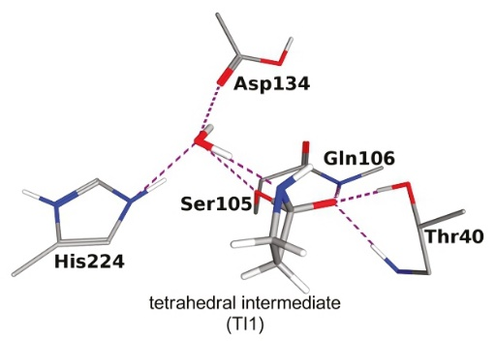
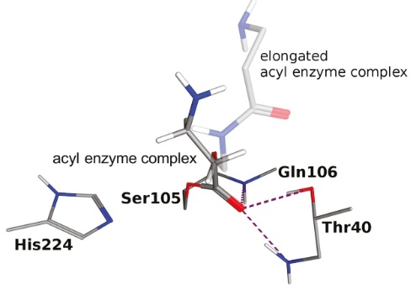
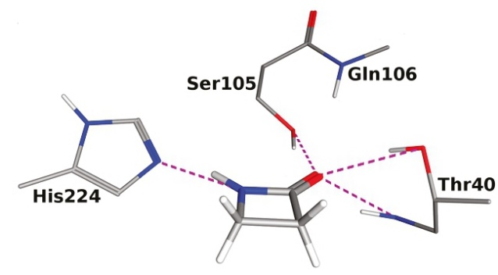
Mechanistic study of the ROP
Formation of the acyl complex:
For the formation of the acyl complex, they observed that
The R conformation of the tetrahedral intermediate is essential for continuing of the reaction
A water molecule is necessary to transfer a hydrogen from the protonated histidine to the formatted β-lactam complex^{1,2}
free enzyme
acyl enzyme complex
G. Fels et al. ACS Catal. 2011, 1, 323-336
S. Parks et al. Adv. Synth. Catal.2003, 345, 986-995
I. Lavandera et al. ChemBioChem.2006, 6, 1381-1390

Slide 7
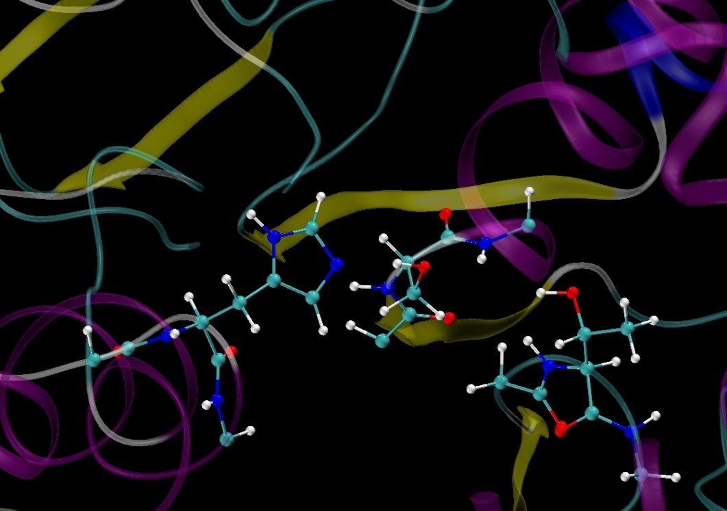
Computational details
From molecular dynamic simulation, the reactive atoms was extracted
The reactive system is composed by:
Catalytic residue (His224 and Ser106)
Oxyanion hole (Thr40 and a part of Gln106
The QM calculations were computed using DFT method (B3LYP/6-31G(d)) in gas phase
For the formation of the acyl complex, three pathways were obtained
Gln106
Ser105
Oxyanion hole
His224
Thr40

Slide 8
Formation of the acyl complex
Three possible paths:
With water assistance (Path 1)
Without water assistance (Path 2)
With water assistance for TS2 (Path 3)

Slide 9
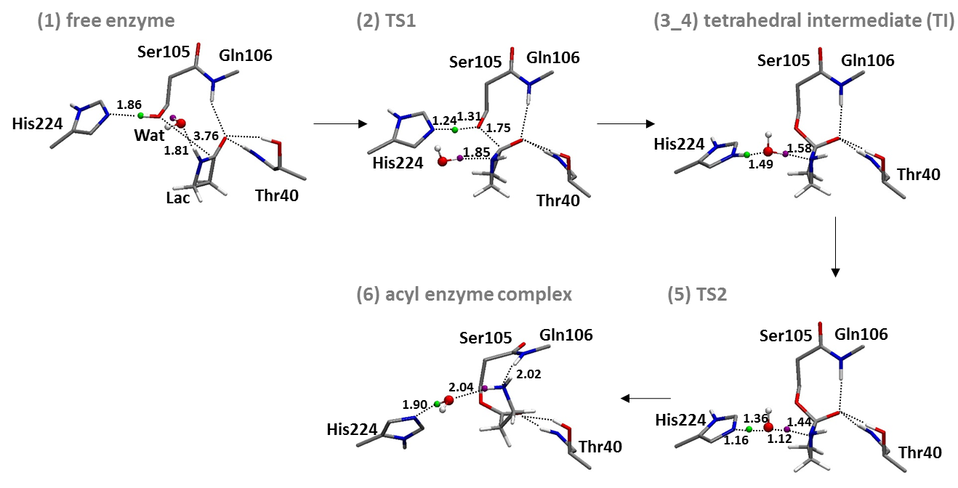
Formation of the acyl complex
With water assistance for TS2 (Path 3)
The distance are reported in Å

Slide 10
Formation of the acyl complex
Energetic profile
The path 2 do not lead to the acyl enzyme complex
For the path 1 and 3, the energetic profile is similar and the structure of the transition state 2 are identical
 | Relative Free Energy (kcal.mol⁻¹) in Gas Phase, B3LYP/6-31G(d)
State | With water assistance (Path 1) | Without water assistance (Path 2) | With water assistance for TS2 (Path 3)
(1) RC (Free enzyme) | 0.00 | 0.00 | 0.00
(2) TS1 | 38.35 | 44.00 | 38.06
(3) TI_1 | 38.09 | 43.52 | 27.57
(4) TI_2 | 28.34
(5) TS2 | 27.62 |  | 27.09
(6) PC (Acyl enzyme complex) | -12.77 |  | -13.53

Slide 11
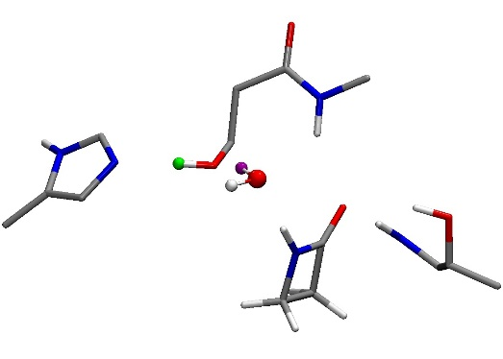
Formation of the acyl complex
Energetic profile
 | Relative Free Energy (kcal.mol⁻¹) in Gas Phase, B3LYP/6-31G(d)
State | With water assistance (Path 1) | Without water assistance (Path 2) | With water assistance for TS2 (Path 3)
(1) RC (Free enzyme) | 0.00 | 0.00 | 0.00
(2) TS1 | 38.35 | 44.00 | 38.06
(3) TI_1 | 38.09 | 43.52 | 27.57
(4) TI_2 | 28.34
(5) TS2 | 27.62 |  | 27.09
(6) PC (Acyl enzyme complex) | -12.77 |  | -13.53
Ser105
Gln106
His224
Wat
- H(Ser106)-N(His226)
- H(Ser106)-O(Lac)
• Water molecule between H(Ser106) and N(His224)
Lac
Thr40

Slide 12
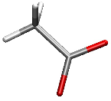
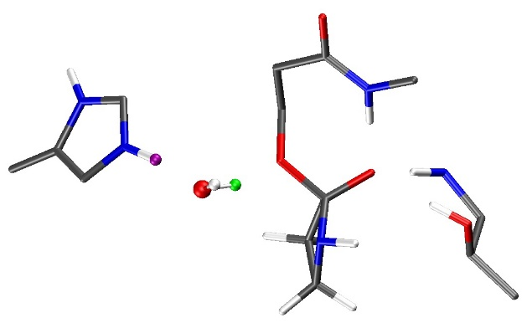
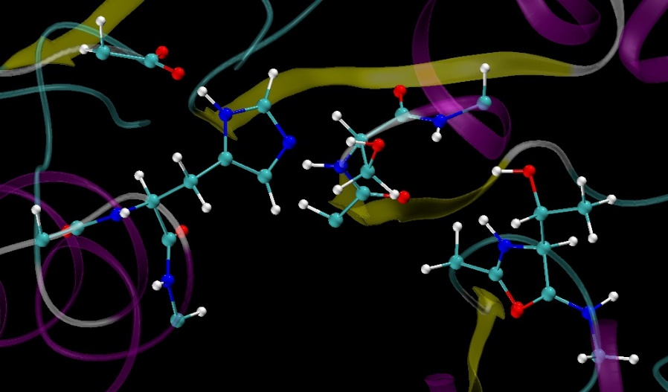
Influence of the aspartate residue in the QM model
The inclusion of the aspartate residue (catalytic triad) in the QM model can:
Stabilize the tetrahedral intermediate¹
Decrease the activation barrier^{1,2}
Addition of Asp187 in the QM model
Stabilize the positive charge of the histidine in the intermediate state
Decrease the activation energy
Maintain the histidine residue inside the protein orientation
Asp187
-
Ser105
+
-
His224
Thr40
tetrahedral intermediate
Ser106
Asp187
Oxyanion hole
His224
²M. Topf et al. JACS. 2004, 126, 14631-14641
¹C.-H. Hu et al. International Journal of Quantum Chemistry. 1998, 69, 89-103

Slide 13
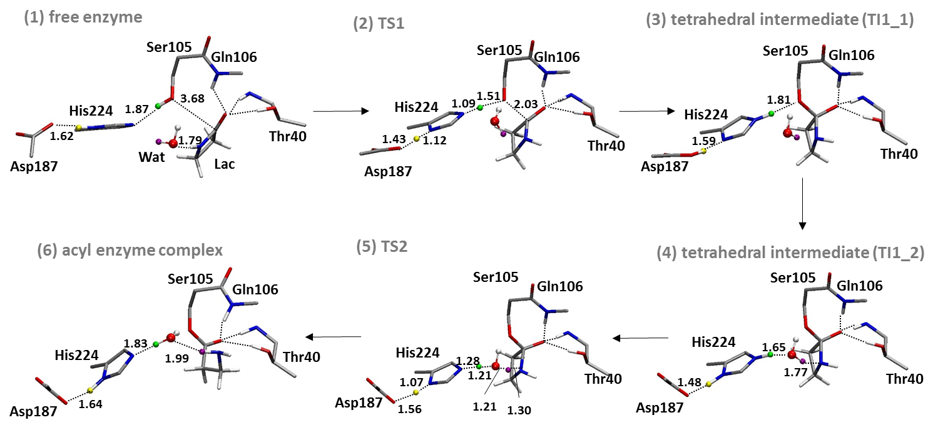
Influence of the aspartate residue in the QM model
Reaction scheme

Slide 14
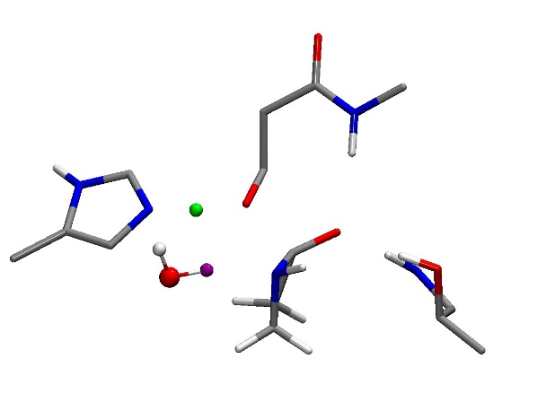
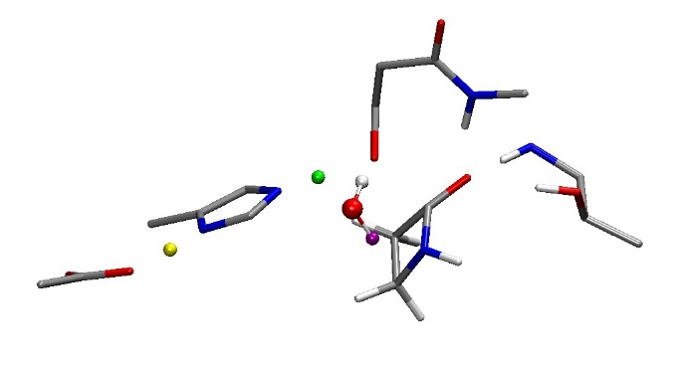
Influence of the aspartate residue in the QM model
Transition state 1
Without Asp
With Asp
Ser105
Gln106
Ser105
Gln106
1.31
1.51
1.24
1.75
His224
1.09
2.03
His224
1.85
1.43
1.12
Thr40
Thr40
Asp187
 | TI – Oxyanion hole
 | O(TI) – NH (Gln106) |  | O(TI) – NH (Thr40) |  | O(TI) – OH (Thr41)
 | Without | With | Without | With | Without | With
Distance (Å) | 2.89 | 2.95 | 2.90 | 2.96 | 2.75 | 2.80
Angle (deg.) | 178.3 | 165.7 | 163.4 | 162.0 | 170.6 | 168.1
 | β-lactam
 | C(Lac)-O(Lac) |  | C(Lac)-N(Lac) |  | Charge O(Lac) MK
 | Without | With | Without | With | Without | With
Distance (Å) | 1.29 | 1.25 | 1.46 | 1.42 | -0.662 | -0.589

Slide 15
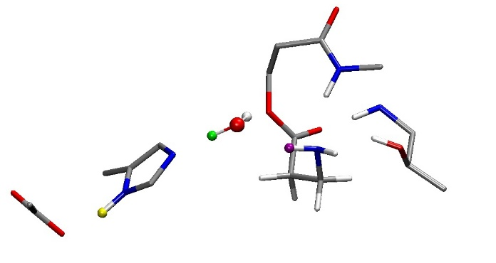
Influence of the aspartate residue in the QM model
Energetic profile of the two model systems:
The activation energy is strongly stabilized by the addition of the aspartate residue in the model system
The tetrahedral intermediate is stabilized
The acyl enzyme complex is not stabilized with the aspartate
 | Relative Free Energy (kcal.mol⁻¹) in Gas Phase B3LYP/6-31G(d)
State | Without Asp 187 | With Asp187
(1) RC (Free enzyme) | 0.00 | 0.00
(2) TS1 | 38.06 | 30.73
(3) TI_1 | 27.57 | 21.82
(4) TI_2 |  | 25.19
(5) TS2 | 27.09 | 27.05
(6) PC (Acyl enzyme complex) | -13.53 | 3.23
Ser105
Gln106
His224
Thr40
Asp187

Slide 16
Basis set comparison
Asp187
Ser105
-
+
-
Taking in account polarization functions for the hydrogen, stabilized each step
The addition of diffuse functions change the atomic charge and destabilized the system
The basis set could influence the energetic profile and the structure of the transition state
His224
Thr40
 | Relative Free Energy (kcal.mol⁻¹) in Gas Phase B3LYP
Basis set | 6-31G(d) | 6-31G(d,p) | 6-31+G(d)
(1) RC (Free enzyme) | 0.00 | 0.00 | 0.00
(2) TS1 | 30.73 | 26.43 | 33.16
(3) TI_1 | 21.82 | 18.62
(4) TI_2 | 25.19 | 21.24 | 30.52
(5) TS2 | 27.05 | 26.06 | 36.07
(6) PC (Acyl enzyme complex) | 3.23 | 4.92

Slide 17
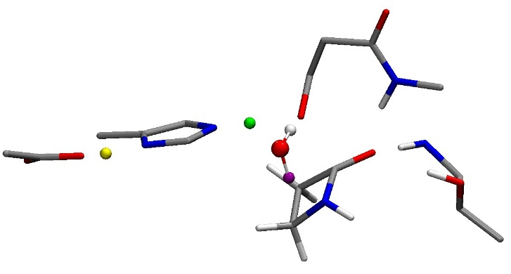
Basis set comparison
Addition of polarization functions on the hydrogen atom change the structure of the TS1 (interaction Asp187-His224)
The addition of diffuse functions change the charge of the oxyanion but do not influence the structure
Ser105
Gln106
Atom pair | 6-31G(d) | 6-31G(d,p) | 6-31+G(d)
O(Asp186)-HN(His224) (Å) | 1.43 | 1.07 | 1.47
H (His224)-N(His224) (Å) | 1.12 | 1.50 | 1.10
His224
1.08
1.54
2.05
1.07
1.50
Asp187
Thr40
6-31G(d,p) result
Atomic charge | 6-31G(d) | 6-31G(d,p) | 6-31+G(d)
O(Lac) | -0.589 | -0.593 | -0.714
HN(Gln106) | 0.407 | 0.318 | 0.521
HN(Thr41) | 0.373 | 0.293 | 0.493
HO(Thr41) | 0.430 | 0.355 | 0.611
Ser105
Gln106
His224
1.09
1.51
2.03
1.43
1.12
Thr40
Atom pair | 6-31G(d) | 6-31G(d,p) | 6-31+G(d)
O(TI)-NH(Gln106) (Å) | 2.95 | 2.96 | 2.93
O(TI)-NH(Thr41) (Å) | 2.96 | 2.95 | 2.95
O(TI)-OH(Thr41) (Å) | 2.80 | 2.79 | 2.81
Asp187
6-31G(d) result

Slide 18
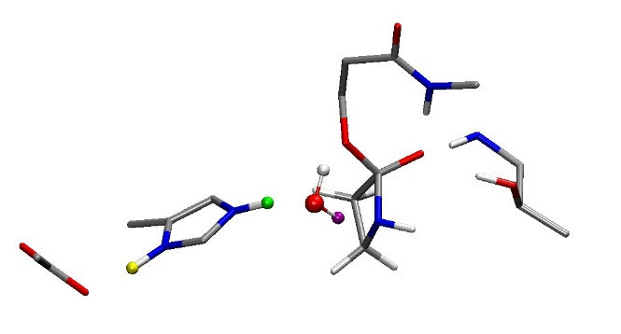
Basis set comparison
The optimized structure for other steps are similar for all tested basis set (the difference for distance are less than 0.1 Å)
 | Relative Free Energy (kcal.mol⁻¹) in Gas Phase B3LYP
Basis set | 6-31G(d) | 6-31G(d,p) | 6-31+G(d)
(1) RC (Free enzyme) | 0.00 | 0.00 | 0.00
(2) TS1 | 30.73 | 26.43 | 33.16
(3) TI_1 | 21.82 | 18.62
(4) TI_2 | 25.19 | 21.24 | 30.52
(5) TS2 | 27.05 | 26.06 | 36.07
(6) PC (Acyl enzyme complex) | 3.23 | 4.92
Ser105
Gln106
His224
Thr40
Asp187

Slide 19
Solvation effect
For taking account of the protein environment, a continuum model was employed
No structural difference were observed comparing gas phase calculation and PCM ones
The energetic profile do not change for the continuum model
We can expect that the energetic profile and the structure of each step will not change a lot when the protein environment is included
 | Relative Free Energy (kcal.mol⁻¹) in Gas Phase B3LYP/6-31G(d)
 | Gas phase | PCM (ε=4)
(1) RC (Free enzyme) | 0.00 | 0.00
(2) TS1 | 30.73 | 27.53
(3) TI_1 | 21.82 | 21.90
(4) TI_2 | 25.19 | 29.91
(5) TS2 | 27.05 | 30.06
(6) PC (Acyl enzyme complex) | 3.23 | 3.29

Slide 20
Conclusion
Taking in account the Asp187 in the QM system model allow to:
Decrease the activation energy for the first step of the acylation process
Stabilized intermediate states
Influence the structure of the transition state
Different basis set were tested
Adding polarization functions for the hydrogen atom stabilized the system
The PCM model do not influence the energetic profile and the structure of the formation of the acyl complex
In perspective, including the protein environment could be interesting when the reaction pathway is computed

Slide 21
Thank you for your attention

