Slide 1
Mechanistic study of CAL-B catalyzed ring-opening polymerization of β-lactam
Chantal Barberot
Graduate School of Information Science, Nagoya University

Slide 2
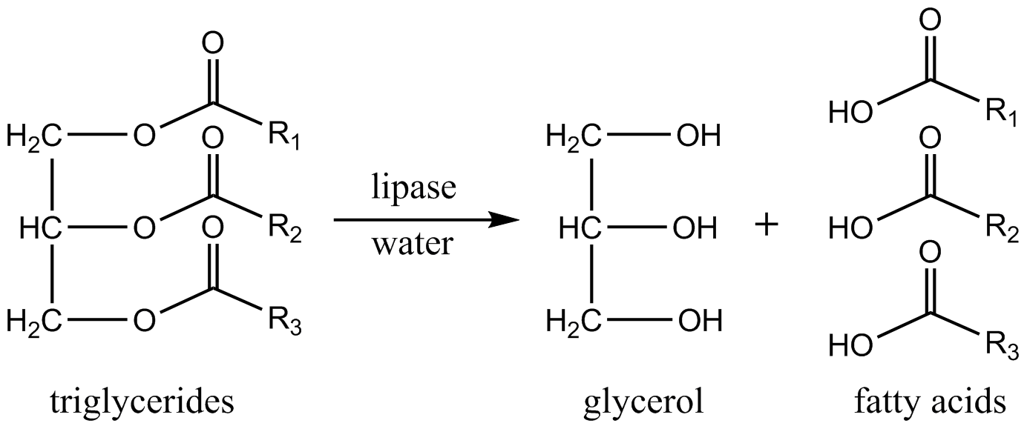
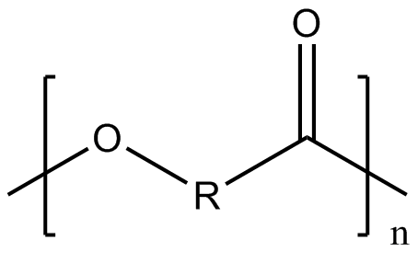
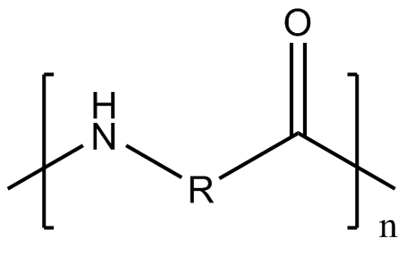
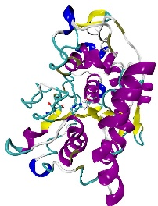
Enzymatic polymerization
The metabolic role of lipase is the hydrolysis of triglycerides
Lipases can be used for enantioselective hydrolysis of ester but also for the reverse reaction (esters or amides formation)
Lipase enzyme is used as a catalysts for polymerization reactions with high regio, enantio and chemoselectivity under mild reaction conditions
Candida Antarica Lipase B (CAL-B) immobilized on polyacrilic resin (Novozyme 435) is a useful catalyst
polyester
polyamide
CALB
Poly-acrylate resin

Slide 3
Enzymatic polymerization
Ring-opening polymerization of β-Lactam catalyzed by CAL-B¹
Maximum degree of polymerization (DP) = 18 monomeric units
Average DP = 8 monomeric units
A optimization of the process is still necessary for an industrial use
Understanding the polymerization reaction and the rate determining step seem important
¹ K. Loos et al. Macromol Rapid. Commun. 2008, 29, 794-797

Slide 4
Target goal
A theoretical mechanism was already proposed by G. Fels et al.¹
This study model the polymerization process until the formation of the dimer
The associate energetic profile was not proposed
It do not explain the rate-determining step of the polymerization reaction
Simulation of the whole polymerization process seems to be important to clarify the CALB catalyzed polymerization mechanism
Starting from the mechanism proposed by G. Fels, we suggest to simulate the CALB catalyzed polymerization process by using the hybrid MC/MD reaction method²
¹G. Felds et al. ACS Catal. 2011, 1, 323-336
²M. Nagaoka et al. Chem. Phys. Letters 2013, 583, 80-86

Slide 5
Target goal
To drive the polymerization reaction with the hybrid MC/MD method, we need to compute the energetic profile of the polymerization reaction
For this, QM and QM/MM calculation are performed
The starting point of each reaction step proposed by G. Fels et al. were taken from molecular dynamic simulation snapshots
The reactive site (QM) was extracted and the reaction path was computed for this small system
The QM structure will be used for the QM/MM calculation
The dynamic simulation were performed under the experimental conditions
The QM calculations were computed in DFT with the B3LYP/6-31G(d) parameter in the vacuum

Slide 6
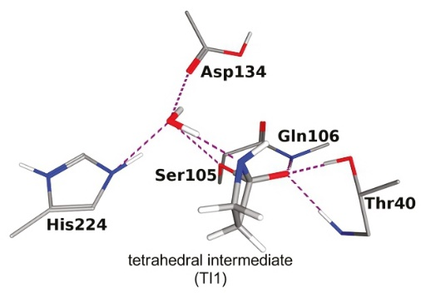
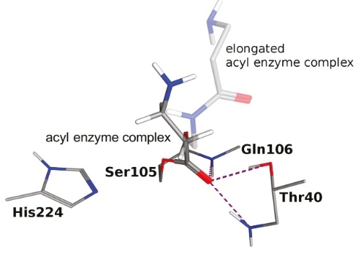
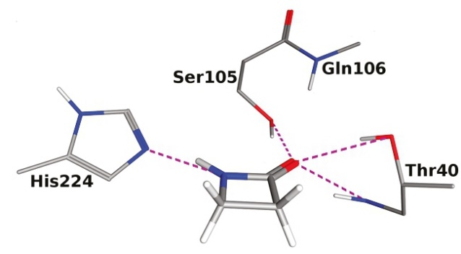
Reaction 1: formation of the acyl complex
Formation of the acyl enzyme complex with a β-lactam molecule
reaction 1
free enzyme
acyl enzyme complex
G. Fels et al. ACS Catal. 2011, 1, 323-336

Slide 7
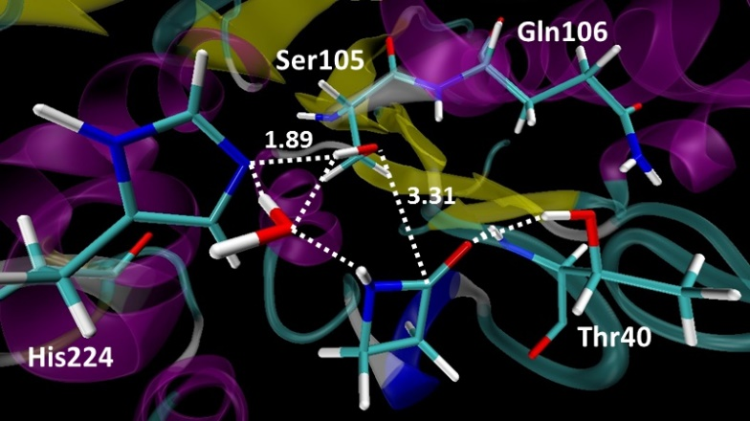
Reaction 1: formation of the acyl complex
Starting point (MD):
Two possible paths:
With water assistance (Path 1)
Without water assistance (Path 2)

Slide 8
Reaction 1: formation of the acyl complex
With water assistance (Path 1)
oxyanion
hole

Slide 9
Reaction 1: formation of the acyl complex
Without water assistance (Path 2)
With water assistance (Path 1)

Slide 10
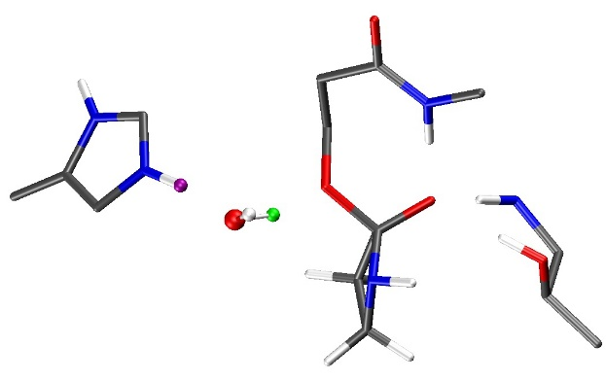
Reaction 1: formation of the acyl complex
The energy barriers are high and the intermediate state are not stabilized compare with the transition state
 | Relative Free Energy (kcal.mol⁻¹) in vacuum
State | With water assistance (Path 1) | Without water assistance (Path 2)
(1) Free enzyme | 0.00 | 0.00
(2) TS1 | 38.35 | 44.00
(3) TI1_1 | 38.09 | 43.52
(4) TI1_2 | 28.34
(5) TS2 | 27.62
(6) Acyl enzyme complex | -12.77
Ser105
+
-
His224
Thr40
tetrahedral intermediate

Slide 11
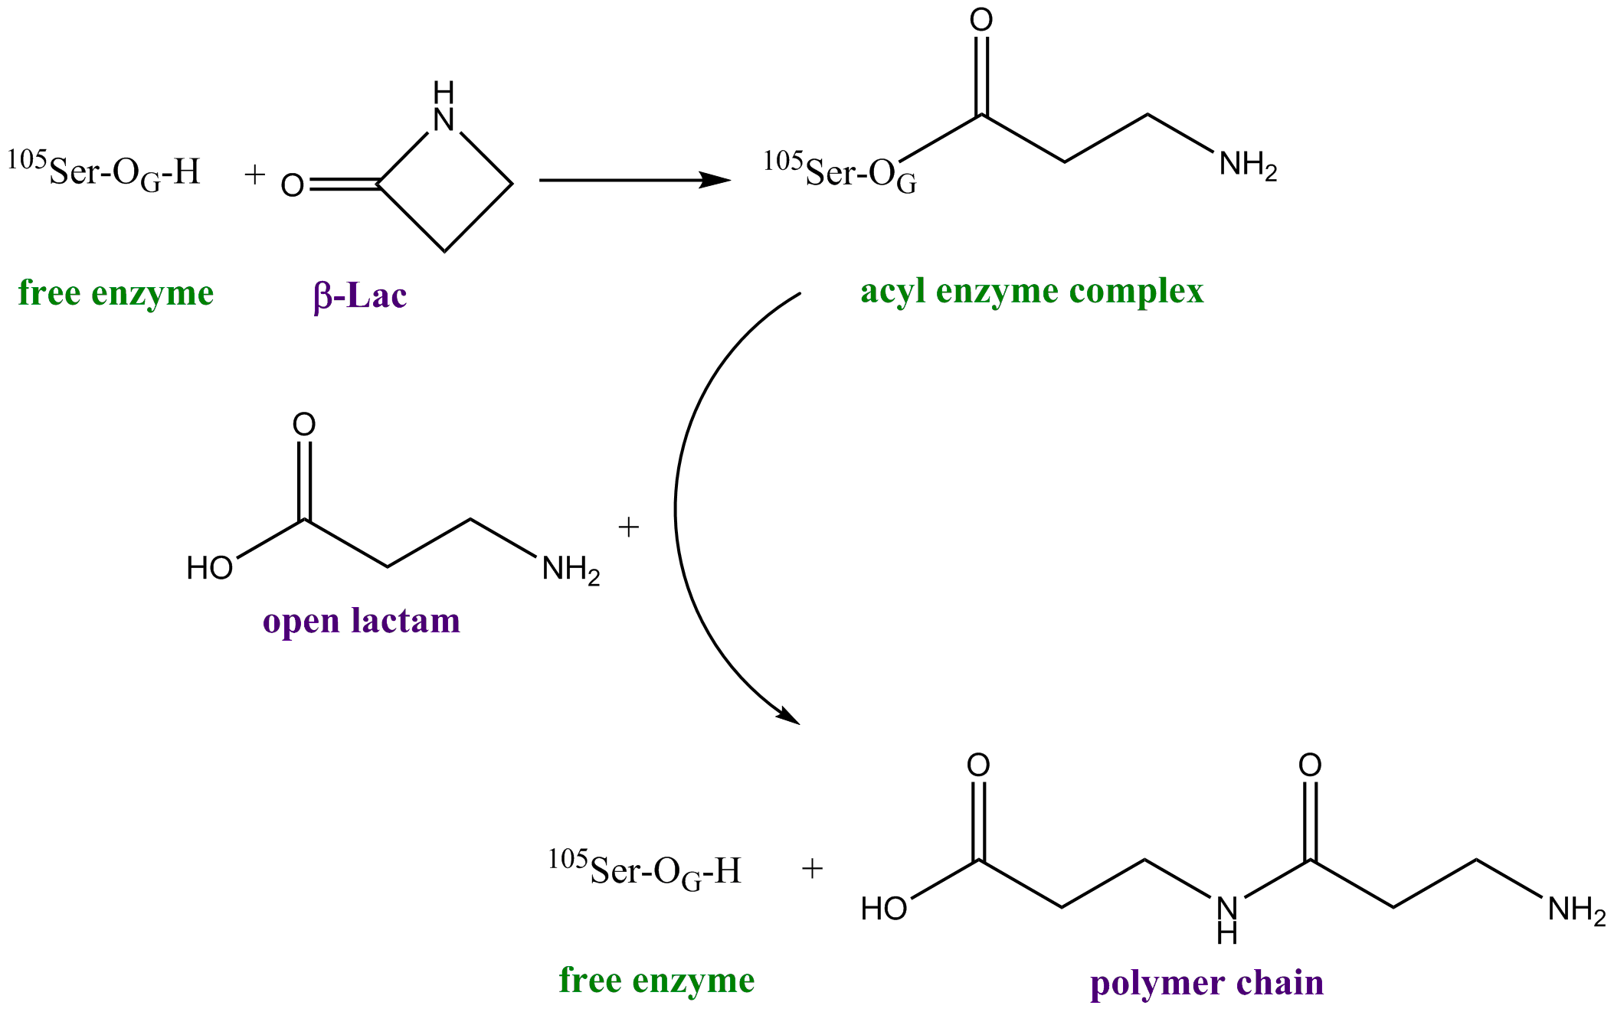
Reaction 2: in situ β-lactam hydrolysis
Elongation of the polymer chain

Slide 12
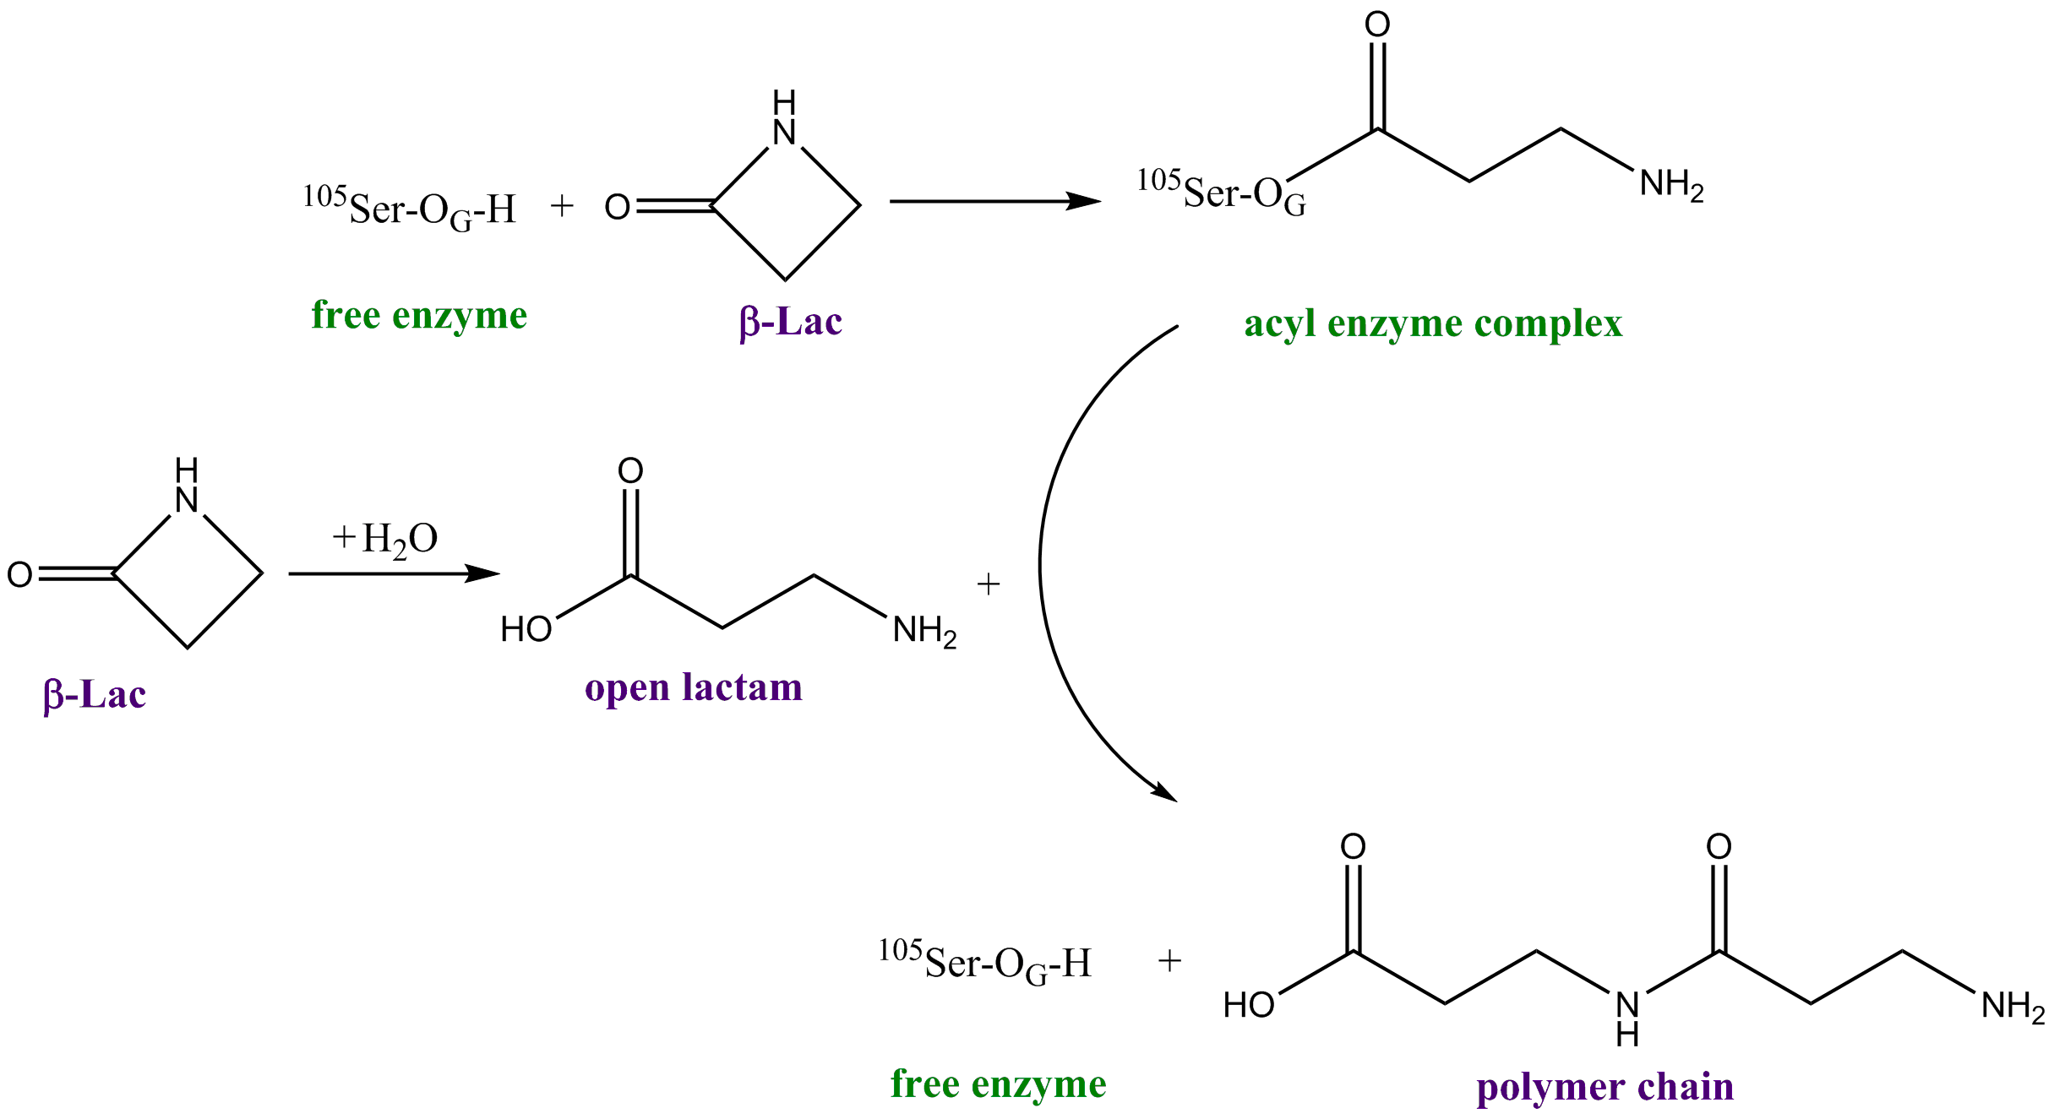
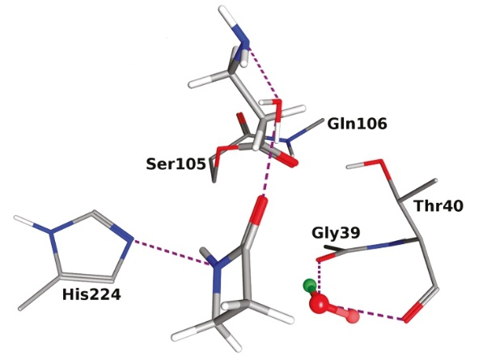
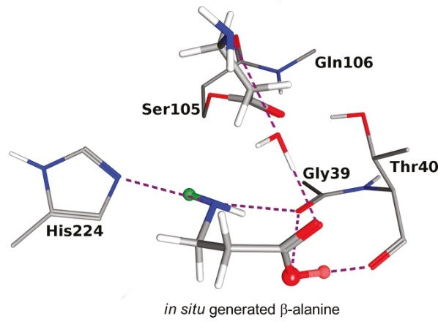
Reaction 2: in situ β-lactam hydrolysis
In situ β-lactam hydrolysis
Active site
reaction 2
G. Fels et al. ACS Catal. 2011, 1, 323-336

Slide 13
Reaction 2: in situ β-lactam hydrolysis
Starting point (MD):
State | Relative Free Energy (kcal.mol⁻¹) in vacuum
(1) β-lactam | 0.00
(2) TS | 33.61
(3) in situ open lactam | -7.77

Slide 14
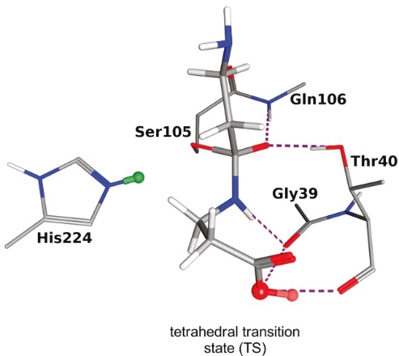
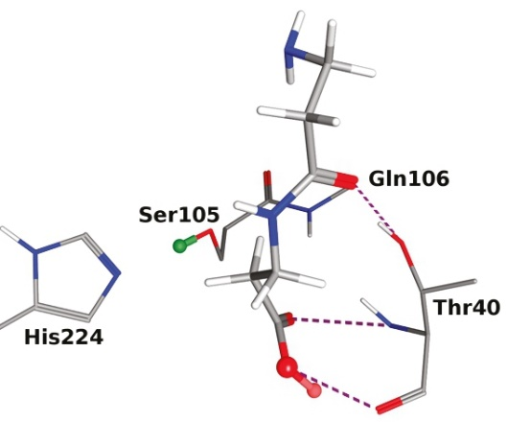
Reaction 3: elongation of the polymer chain
Elongation of the polymer chain
Active site
reaction 3
G. Fels et al. ACS Catal. 2011, 1, 323-336

Slide 15
Reaction 3: elongation of the polymer chain
Direct hydrogen transfer from the open lactam to the serine Ser105
State | Relative Free Energy (kcal.mol⁻¹) in vacuum
(1) Acyl enzyme complex | 0.00
(2) TS | 29.96
(3) Free enzyme + polymer | -2.51

Slide 16
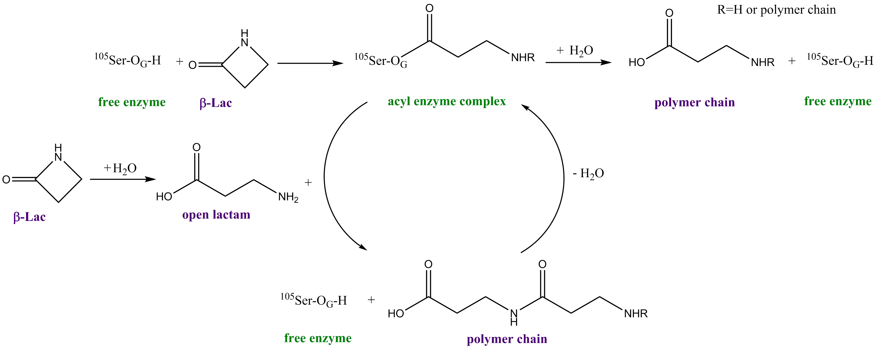
Reaction 4: hydrolysis of the polymer chain
Formation of the acyl enzyme complex with the polymer chain/hydrolysis of the polymer chain
reaction 4
Active site
reaction 4

Slide 17
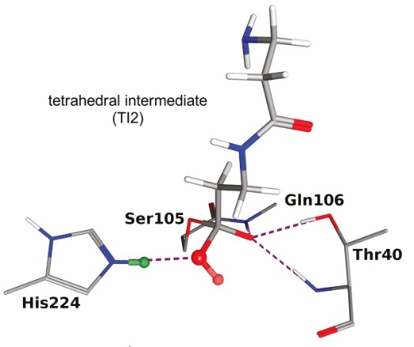
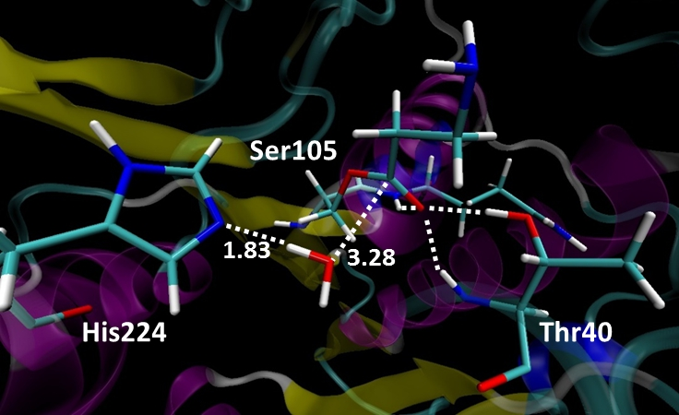
Reaction 4: hydrolysis of the polymer chain
Starting point (MD):
HOH
G. Fels et al. ACS Catal. 2011, 1, 323-336
Release of the polymer chain

Slide 18
Reaction 4: hydrolysis of the polymer chain
oxyanion
hole

Slide 19
Reaction 4: hydrolysis of the polymer chain
The hydrolysis seems to be more preferable in the vacuum that the formation of the acyl complex
25.25
33.30
State | Relative Free Energy (kcal.mol⁻¹) in vacuum
(1) acyl enzyme complex | 0.00
(2) TS1 | 25.25
(3) TI2_1 | 26.59
(4) TI2_2 | 21.40
(5) TS2 | 22.85
(6) free enzyme | -10.45

Slide 20
Conclusion
The formation of the acyl enzyme complex seems to be a rate determining step
The hydrolysis of the acyl complex shows the lowest energetic barrier
These results will be used as a starting point for the QM/MM calculation and may change by considering the whole protein:
Stabilized the intermediate state
Decrease the activation energy
38.35
25.25
Active site
29.96
33.61
33.30

Slide 21
Thank you for your attention

