Slide 1
Mechanistic study of Propylene Polymerization Catalyzed by Kaminsky Complex
Sandhya. K. S
28/7/14

Slide 2
Outline
Introduction to polymerization
Polymerization reaction of propylene using Kaminsky catalyst.
Results and discussion
Future work
Summary

Slide 3
Introduction to polymerization reaction
What is polymer
What is monomer
Various type of polymer preparation
Radical chain growth polymerization
Anionic chain growth polymerization
Cationic chain growth polymerization
Organometallic polymerization
Ziegler-Natta catalysts
Kaminsky catalysts
Isotactic
Syndiotactic
Atactic
R= alkyl or any group

Slide 4
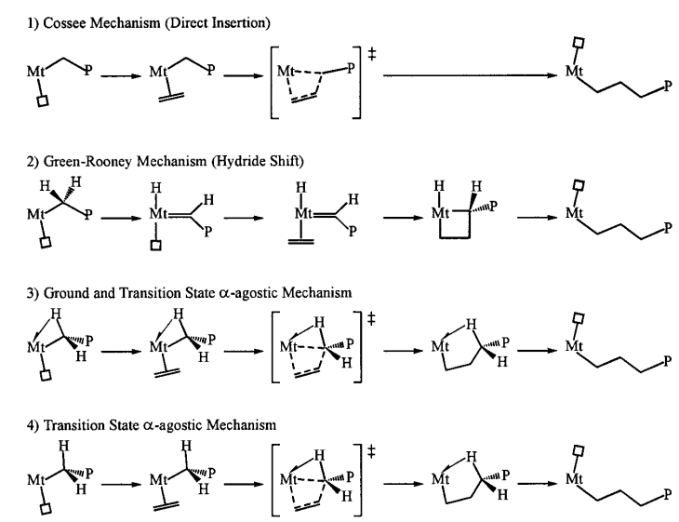
Four mechanistic proposal
Four plaussible mechanism of polymerization
Chemical Reviews, 2000, 100, 1260

Slide 5
Present work of polymerization reaction of propylene by Kaminsky catalyst
First step

Slide 6
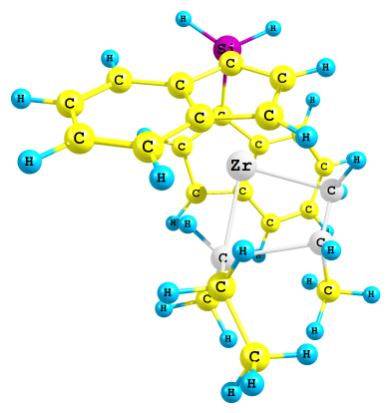
Benchmark studies for the first insertion of propylene
Complexation energy/
binding energy (kcal/mol)
Activation barrier
23.51
24.69
14.43
22.78
20.82
14.42
23.96
21.00
ΔE(B3LYP-3D) = 10.56 kcal/mol
Δ E(B3LYP-2D) = 10.29 kcal/mol
Δ E(B3LYP) = 11.23 kcal/mol
Δ E(M06L) = 10.55 kcal/mol
Δ E(M06) = 8.46 kcal/mol
Δ E(TPSSTPSS) =6.91 kcal/mol
Δ E(wB97XD) = 9.85 kcal/mol
Δ E(M052X) =8.90 kcal/mol
Basis set for Zr LanL2DZ, all other atoms 6-31++G(d,p)
Notes:
Lose Alamose National laboratory 2 double zeta

Slide 7
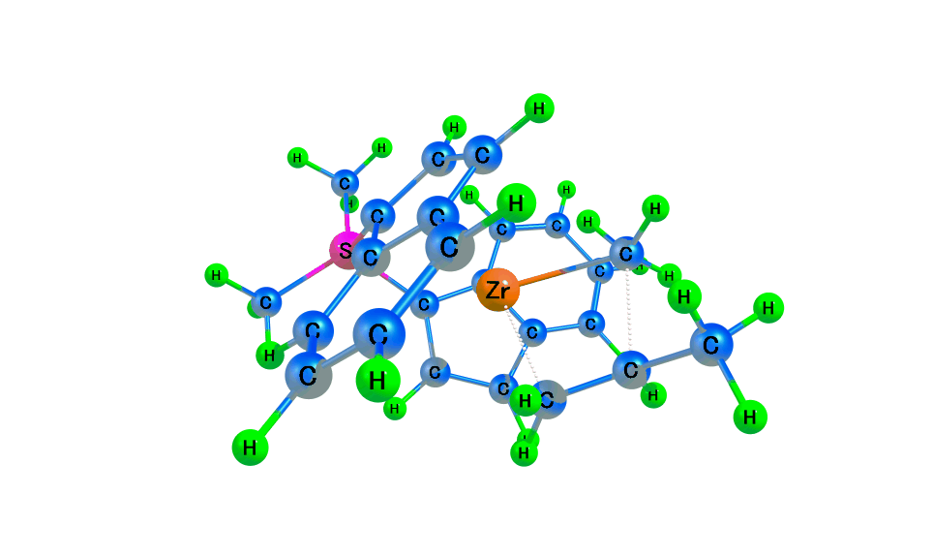
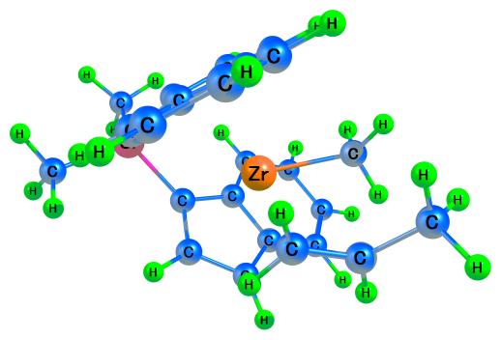
Real models
A type attack
TS
ΔE = 8.38 kcal/mol

Slide 8
Schematic representation of overall mechanism

Slide 9
First insertion Reaction
P1A
P1C
P1B
P1D

Slide 10
Energy profile for the first propylene insertion reaction
TS1
B3LYP-3D
TS1
TS1

Slide 11
Second Insertion Reaction → Two possibilities
P2AA
P2BA
P2AC
P2BC
P2AB
P2BB
P2AD
P2BD

Slide 12
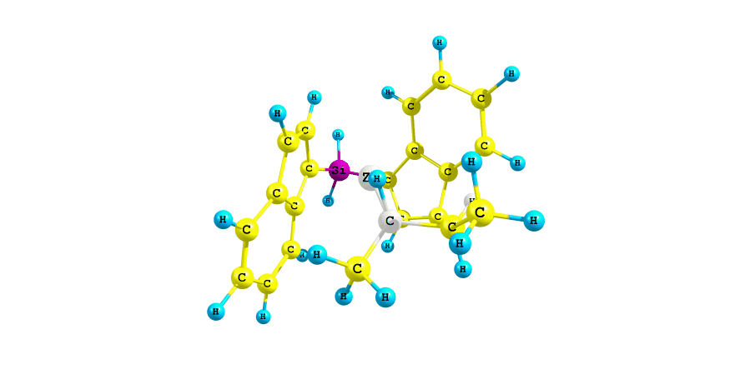
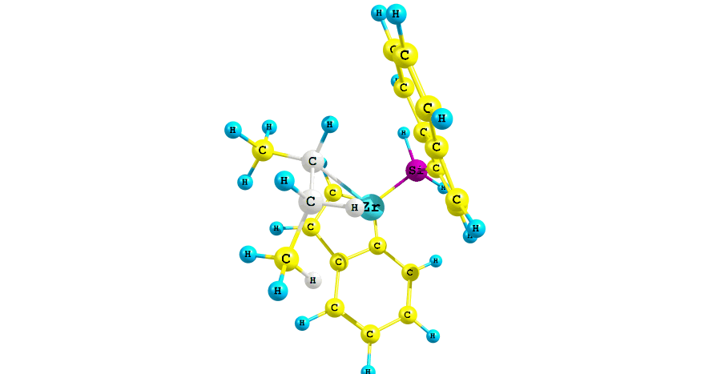
Different possibilities for the agostic interaction

Slide 13
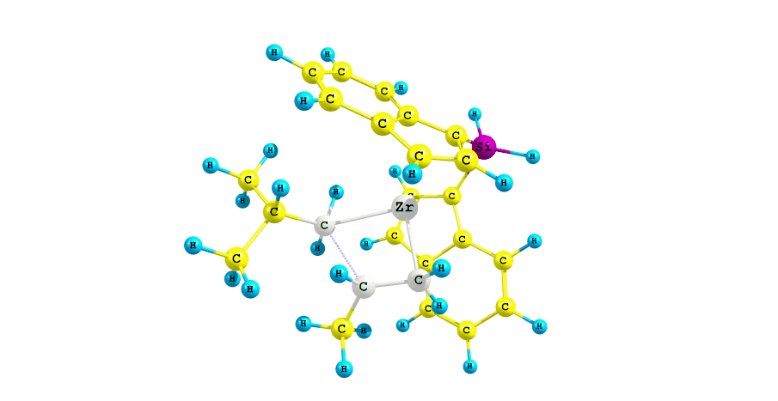
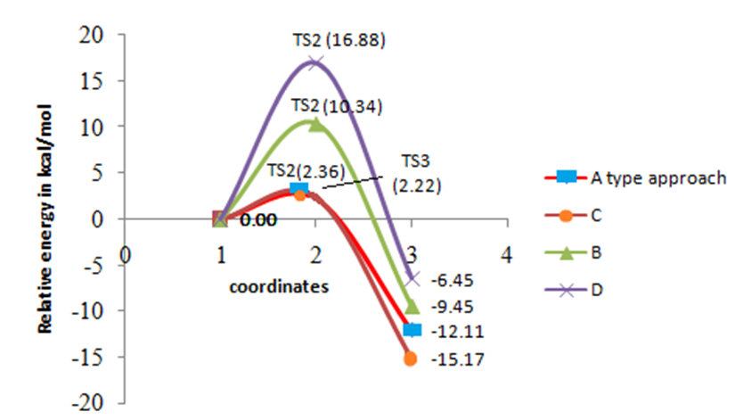
Energy profile for the second propylene insertion reaction from P1A products

Slide 14
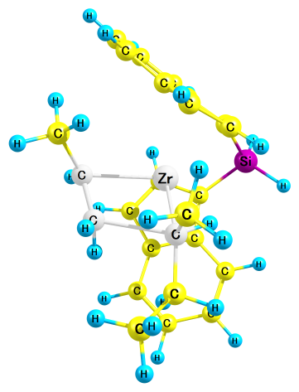
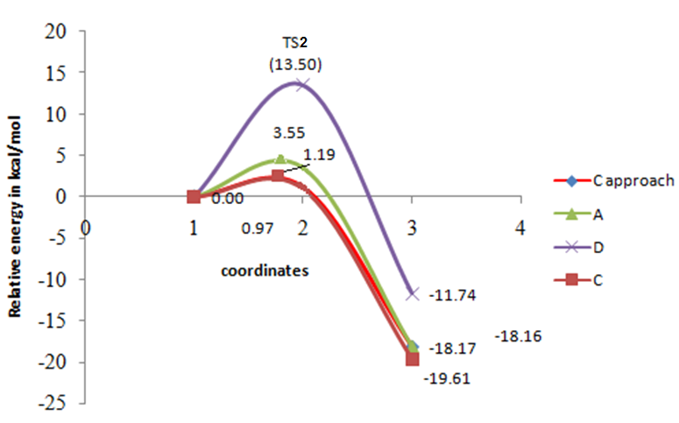
Energy profile for the second propylene insertion reaction from P1B products

Slide 15
Overall energy profile starting from A/C attack of propylene
Isotactic polymerization
(A approach)
Syndiotactic polymerization
(C approach)

Slide 16
Overall energy profile starting from A/C attack of propylene
Atactic polymerization
(D approach)
Atactic polymerization
(B approach)
∆E=16.4
∆E=10.3

Slide 17
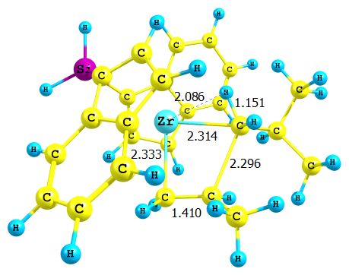
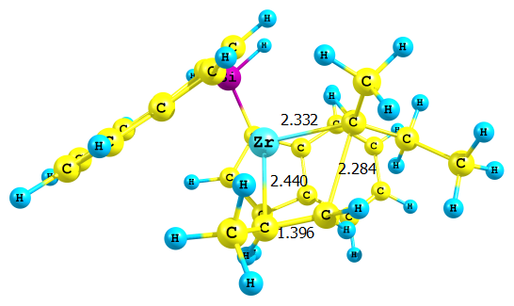
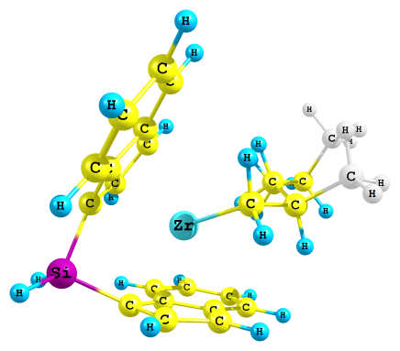
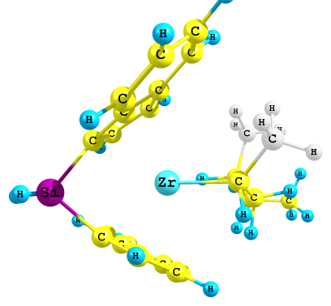
Optimized transition state of second insertion (Isotactic)
OPTIMIZED PRODUCT AFTER
SECOND INSERTION

Slide 18
Overall energy profile starting from B/D attack of propylene
Isotactic polymerization
(D approach)
Syndiotactic polymerization
(B approach)
∆E=17.73kcal/ml
∆E=13.49kcal/ml

Slide 19
Overall energy profile starting from B/D attack of propylene
Atactic polymerization ( A and B approach)

Slide 20
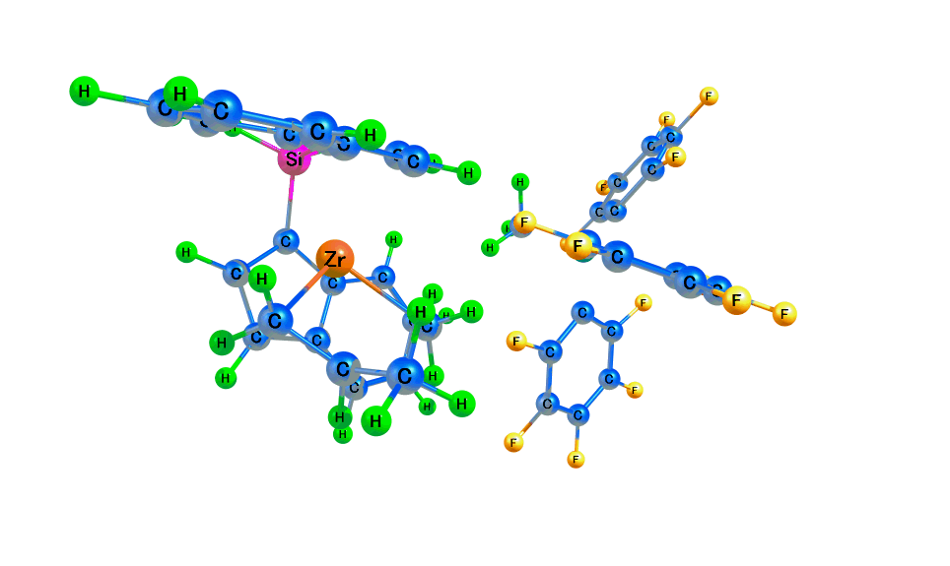
Present work
Counter anion effect
B(C₆F₅)₃CH₃⁻
Work plan for the next four month
MC/MD simulation to study the polymerization reaction
for the whole process.

Slide 21
Summary
Propylene polymerization using Kaminsky catalyst has been studied by M06/6-31++ G(d,p).
Different orientation of propylene considered at first insertion as well as second insertion.
In the first insertion, two different products of pairs are formed.
In the second insertion starting from the A/C products, A type approach of propylene results in the isotactic products while the C approach leads to the syndiotactic products.
In the second insertion from B/D products, D style approach of propylene leads to isotactic polymer whereas B style approach gives syndiotactic polymer.
Remaining products are atactic polymers.
The process are extended in the presence of counter anions, B(C₆F₅)₃CH₃⁻.
For the large polymer can be studied with help of molecular dynamics in order to study the whole process.

Slide 22
Thank you

