Slide 1
FY2016 1st CREST WS
Apr. 22nd, 2016
Conformations of poly(β-alanine)₈ under the interaction with Candida antarctica lipase B (CALB)
Ikuo KURISAKI

Slide 2
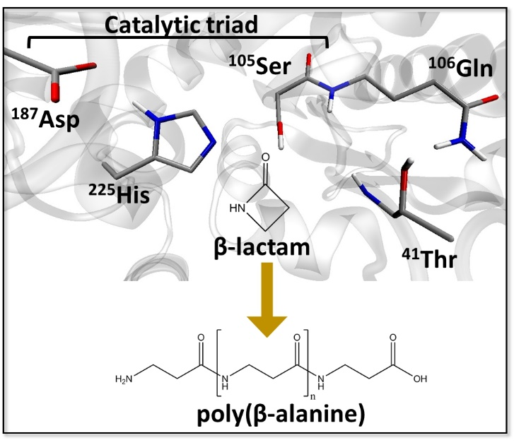
Research background
Enzyme catalyzed polymerization reaction has drawn attention in the field of green chemistry
Candida Antarica Lipase B (CALB) has long been studied in this purpose
This enzyme catalyzes polymerization of β-lactam to generate poly(β-alanine), nylon-3
However, this reaction system has rooms to be improved because the product do not satisfy industrial quality, as for the length and yield
From FY2015 4th CREST WS
The illustration is gifted from Dr. Barberot.

Slide 3
Problem setting
Polymer length must influence polymer elongation reaction. We first examined conformation of the polymer.
CALB
water
Ser¹⁰⁵-OH
Ser¹⁰⁵-O
Poly(β-alanine)
β-lactam
Poly(β-alanine)₈
Cα
N
O
ACE
NME
From FY2015 4th CREST WS
with modification
H
Cβ
8
O

Slide 4
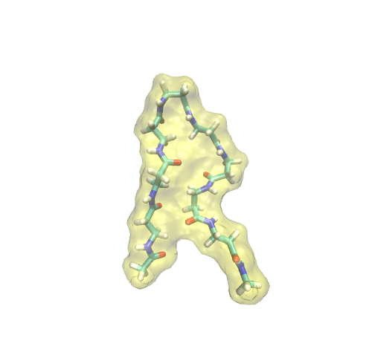
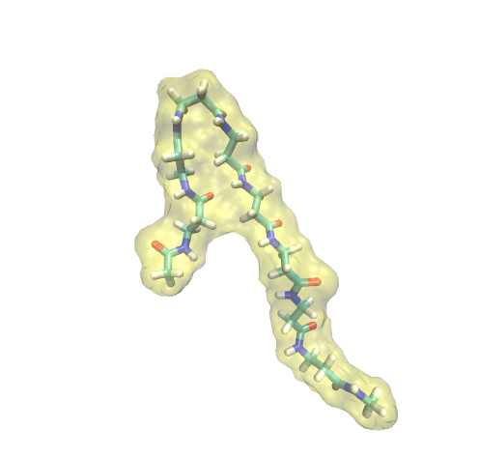
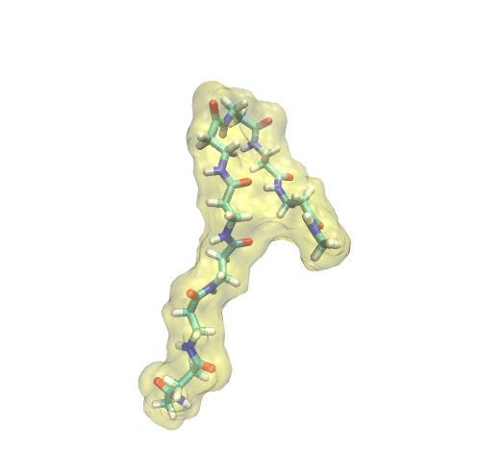
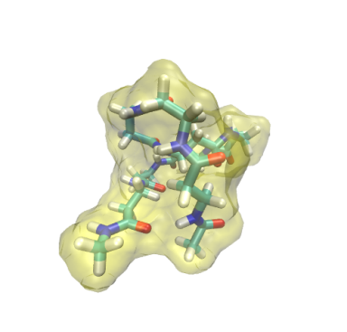
Representative conformations derived from REMD with explicit water @ 300K
extended
hairpin
turn@βAla3
turn@βAla6
globule
Averaged # of HB: 0.07
(total 45,000 conf.)
➔ Supported by the earlier experimental study¹
From FY2015 6th CREST WS
[1] J. D. Glickson and J. Applequist. J.A.C.S., 1971, 93, 3276-3286

Slide 5
Summary for representative conformations
Major conformation!!
conformation | frequency [%]
extended | 86.9
hairpin | 6.2
turn@βAla3 | 4.3
turn@βAla6 | 2.5
globule | 0.1
Extended conformation occupies > 80% of the conformation ensemble.
This results can be reasonable, physico-chemically, because the polymer can be energetically stabilized forming hydrogen bonds with polarized solvent molecules.
From FY2015 6th CREST WS

Slide 6
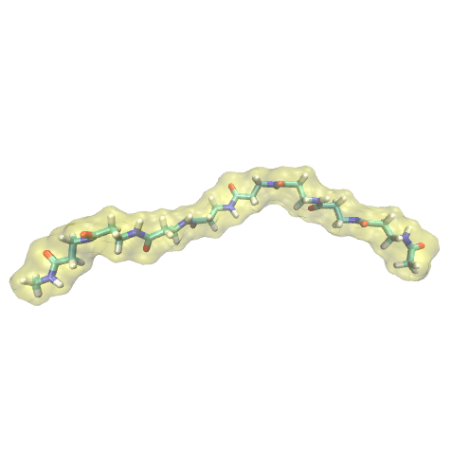
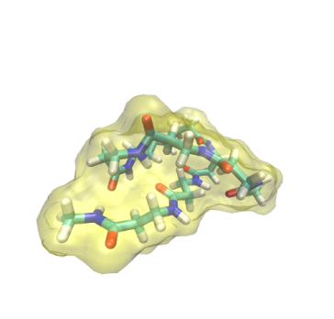
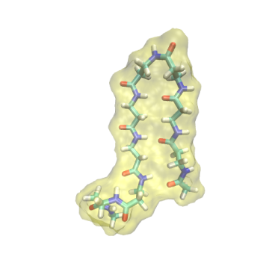
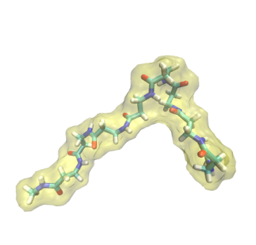
REMD simulation of βAla₈ in toluene @ 374 K
partially
extended
full
extended
globule
hairpin
In contrast to REMD with water solvent, the folded conformations mainly appear.
In non-polarized solvent, a polymer mainly assumes folded conformation with intramolecular hydrogen bonds, so that our results seems to be reasonable.
From FY2015 8th CREST WS

Slide 7
Suggestion on polymerization reaction
Assuming extended conformation is energetically preferable in CALB active site
However, as shown in our REMD simulation, the polymer should assume non-extended conformation in toluene solvent
Once the polymer moves to solvent, it forms non-extended conformation and rarely comes back to the active site
Anchoring polymer to the entrance of the active site could improve the average length of polymer generated by CABL.

Slide 8
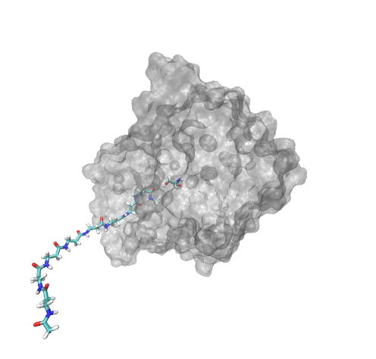
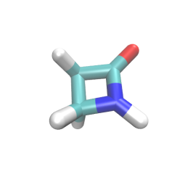
Molecular Dynamics Simulation of CALB-poly(β-alanine)₈ complex
Poly(β-alanine)₈
Initial atomic coordinates of the complex
Cα
N
O
ACE
NME
Ser105
H
Cβ
8
O
β-lactam
Three β-alanine residues are found in the active site.
MD simulation setup
Force Field: Amber99SB, TIP3P, JC ions for TIP3P, GAFF
Solvent: Toluene
Ensemble: NPT (1 bar; 363 K)
Simulation length: 50 ns
Total number of simulations: 5
poly(β-alanine)₈

Slide 9
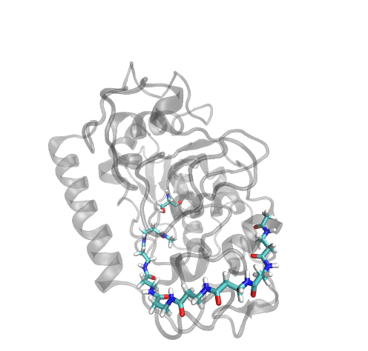
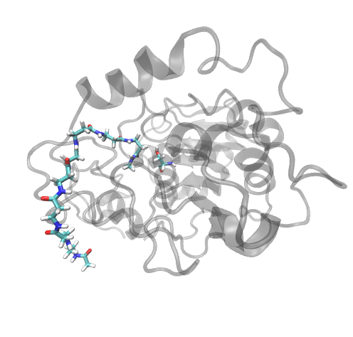
Poly(β-alanine)₈ interacts with CALB on the surface
Ser105
Ser105
➔ These interactions could anchor the polymer on the surface, thus preventing it from releasing to the solvent

Slide 10
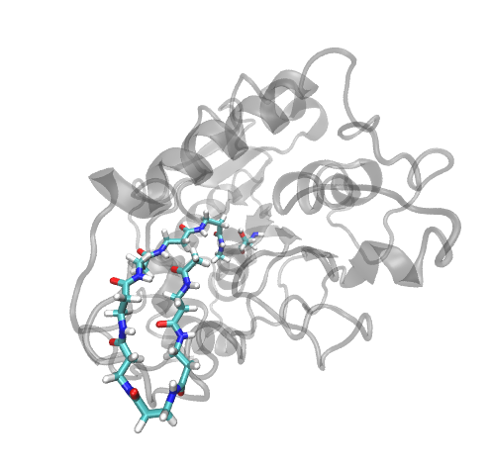
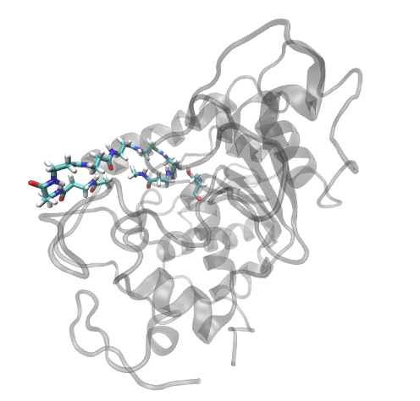
Poly(β-alanine)₈ assumes hairpin conformation, where the active site is occupied by the polymer
Ser105
Ser105
➔ It prevents β-lactam from accessing the active site

Slide 11
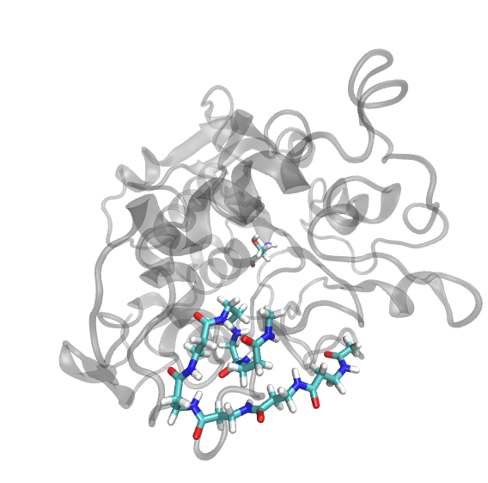
Poly(β-alanine)₈ assumes hairpin conformation and interacts with CALB surface
Ser105
➔ It prevents β-lactam from accessing the active site

Slide 12
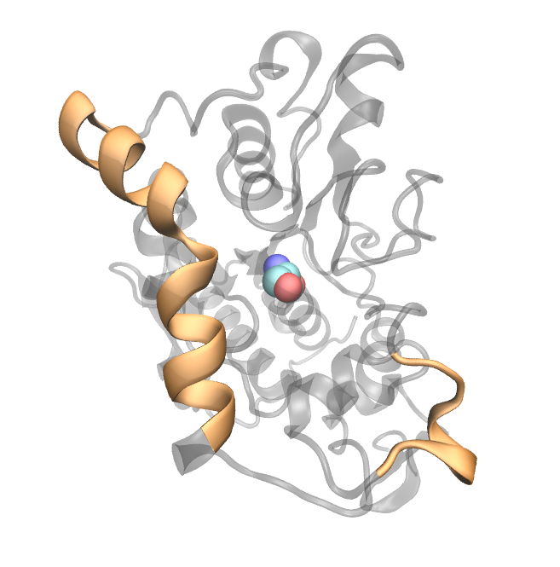
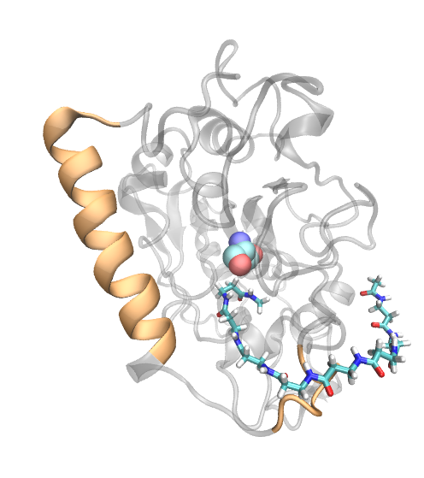
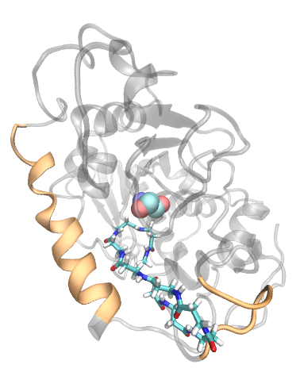
α5 helix interacts with poly(β-alanine)
α5 helix: ¹⁴²GPLDALA¹⁴⁸
α10 helix
The polymer is unfolded and occupies the active site
Ser105
The polymer interacts with CALB’s surface
α5 helix
(Original PDB structure)
α5 helix is unfolded: this could be due to the relatively higher temperature (90 ˚C).
Poly(β-alanine) in the middle and right panels mainly make contact with Pro143 and Leu147, respectively.

Slide 13
Suggestion on improvement of polymerization reaction performance (1)
Only 3 β-alanine residues can stay inside the active site
The polymer is not packed in the active site, which would allows β-lactam to access Ser105.
Meanwhile, the polymer should be anchored on the surface of CALB, or it would be released.
It could thus be assumed that modification of CALB surface affects the reaction through stabilization of the polymer
Ser105
Analyze interaction between CALB and the polymer, and introduce points mutation to promote stability of the complex

Slide 14
Suggestion on improvement of polymerization reaction performance (2)
Poly(β-alanine)₈ assumes folded conformations and sometime leaves from the active site
Folding should prevent β-lactam access to the active site and also polymerization reaction itself.
If such folding could be blocked, it would promote β-lactam access and CALB-polymer interaction, enhancing the reaction, accordingly
Ser105

Slide 15
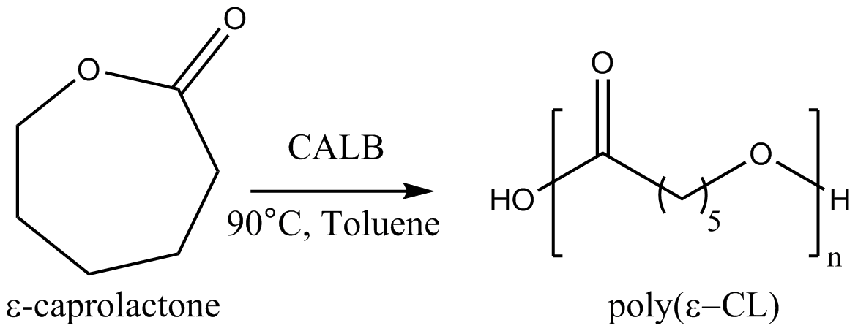
Suggestion on improvement of polymerization reaction performance (2)
There are –CO and -NH groups in this polymer. It can form intra-molecular interaction and folded conformation.
Maximum degree of polymerization(DP_{max}) = 18
Average DP = 8
There is no -NH group in this polymer so that it would not form intra-molecular interaction thus assuming partially or fully extended conformation frequently.
Maximum degree of polymerization(DP_{max}) = 78
Average DP = 29
Find a compound which breaks β-peptide structure, and confirm that it is irrelevant to polymerization reaction
K. Loos et al. Biomacromolecules 2014 15, 234-241

Slide 16
Effect of polymer length on β-lactam access to the active site
‘Three β-alanine residues are found in the active site.’
Ser105
In active site
In bulk solvent
> 3 ligand
1 ligand
poly(β-alanine)₈
activation energy
The activation barrier of β-lactam access might not change after trimer or quadramer is generated.
no ligand
Reaction coordinate
*Schematic image for the dependence of activation barrier for β-lactam access on polymer length

Slide 17
Thank you for your attention

Slide 18
Supporting Information
ACE and NME denote acetyl and N-methyl amide groups, respectively.
H
N
O
H₃C
H₃C

