Slide 1
Improvement of the hybrid MC/MD algorithm to study the mechanism of CAL-B catalyzed ring-opening polymerization of β-lactam
Chantal Barberot, Ikuo Kurisaki, Yuichi Suzuki, Masataka Nagaoka
Nagaoka Laboratory, Graduate School of Information Science, Nagoya University

Slide 2
Synthesis of poly(β-alanine) catalyzed by CAL-B
The lipase catalyzed ring-opening polymerization of β-lactam reaction gives short polymer^{[1]}
Reaction yield = 73%
Maximum degree of polymerization (DP) = 18 monomeric units
Average DP = 8 monomeric units
In order to apply this strategy for an industrial use, it seems important to optimize the reaction conditions or improve the enzymatic function of the CAL-B itself.
To understand the obtaining of short polymer, hybrid MC/MD simulations^{[2]} is performed.
[1] K. Loos et al. Macromol Rapid. Commun. 2008, 29, 794-797.
[2] Nagaoka, M.; Suzuki, Y.; Okamoto, T.; Takenaka, N. Chem. Phys. Lett. 2013, 583, 80–86.

Slide 3
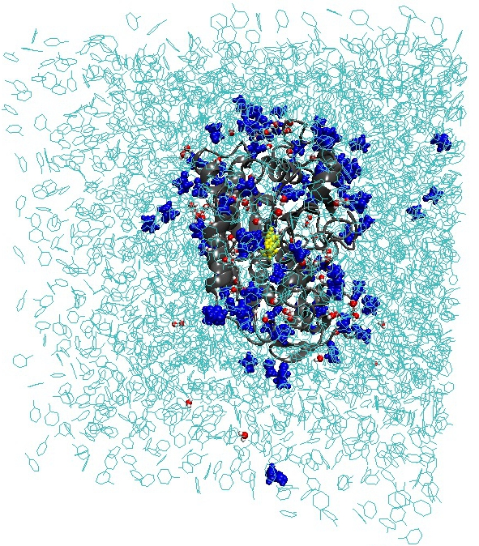
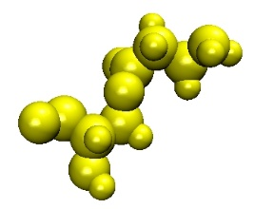
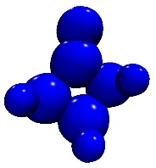
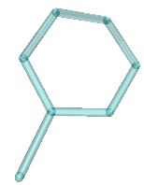
Computational details
The acylated CAL-B is solvated in a toluene box.
92 water molecules are added to the system corresponding to an enzyme water content of 1 % (w/w).
The β-lactam concentration corresponds to the experimental one (0.285 mol.L⁻¹), 92 β-lactam molecules.
Periodic boundaries conditions are applied.
SHAKE method is used to constrain bond involving hydrogen atoms.
To equilibrate the system, a series of MD are performed at 363K and 1 atm.
First, 2000 MC/MD cycles are performed
The NVT-MD (363K) simulation time in one MC/MD cycle is set to 10 ps.
Force field parameters:
Organic molecules: general AMBER force field
Protein: Amber force field ff99SB
Water molecules: TIP3P model
Na⁺: JC ion parameters
82 Å
96 Å
76 Å
Acylated ¹⁰⁵Ser
β-lactam
Water
Toluene

Slide 4
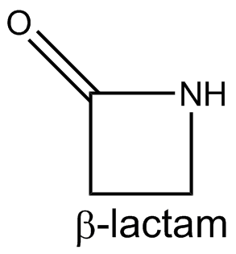
Reaction scheme
19.82
[kcal/mol]
Ligand
binding
5
Activation
Termination
Chain end activation
15.23 [kcal/mol]
1
4
2
33.70 [kcal/mol]
21.71
[kcal/mol]
3
Termination
19.82
[kcal/mol]
2
Elongation

Slide 5
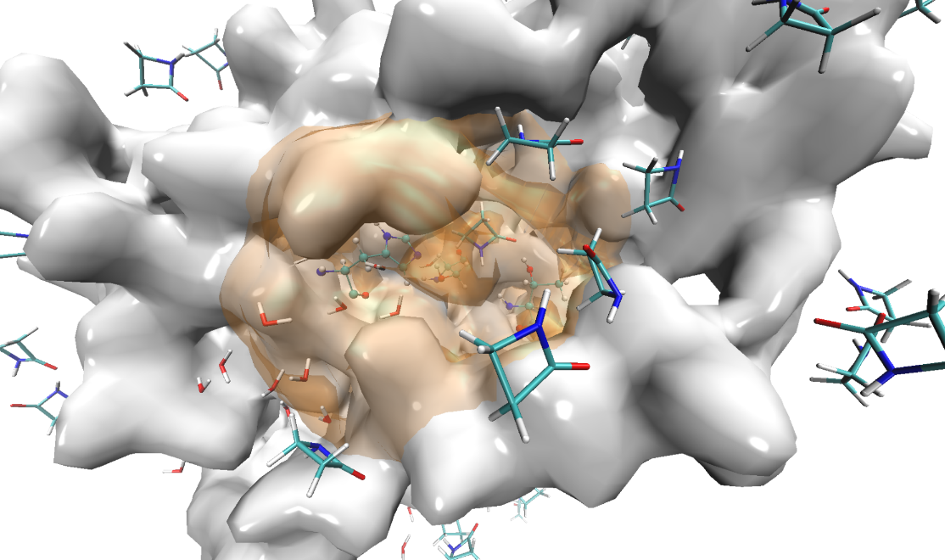
Ligand binding process
The docking process can influence the polymerization results.
A distance criteria will be used (12 Å from the catalytic serine oxygen).
No β–lactam present in the catalytic site?
no
yes
Catalytic serine acylated?
no
Selected
β-lactam
Selection area
β-lactam
yes
Docking reaction weight << chemical reaction weight
Docking reaction weight=0
Ser105
β–lactam is
located < d of the catalytic serine
no
yes
Docking reaction can be selected
Docking reaction can not be selected

Slide 6
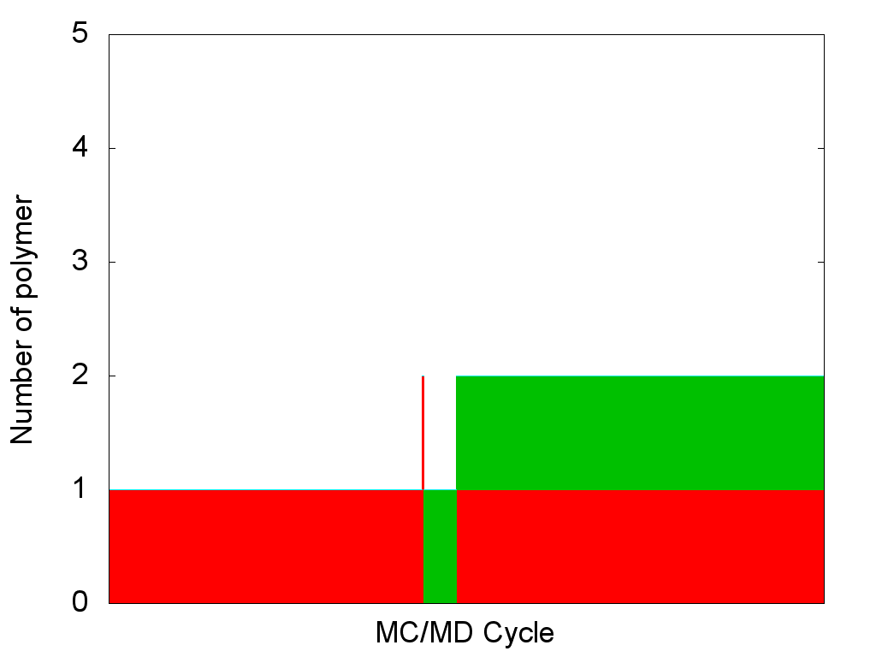
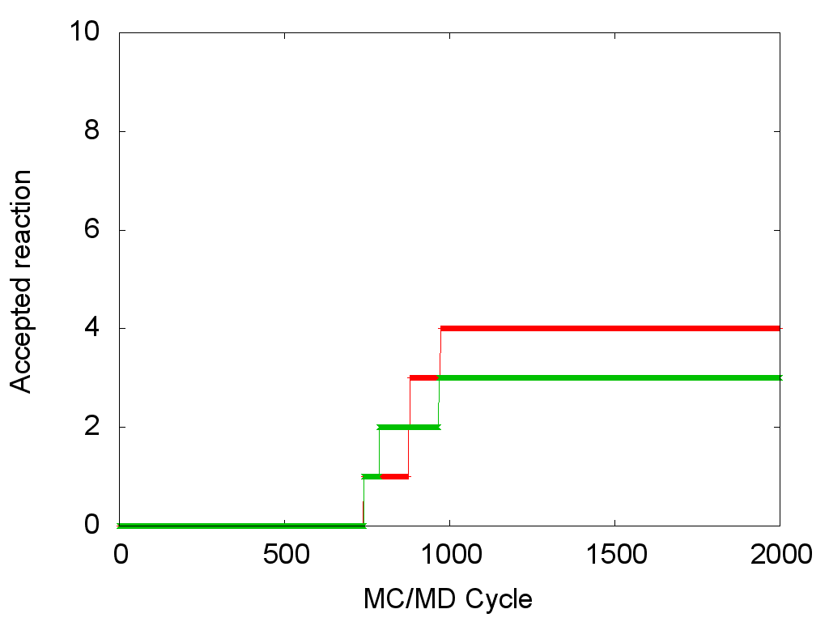
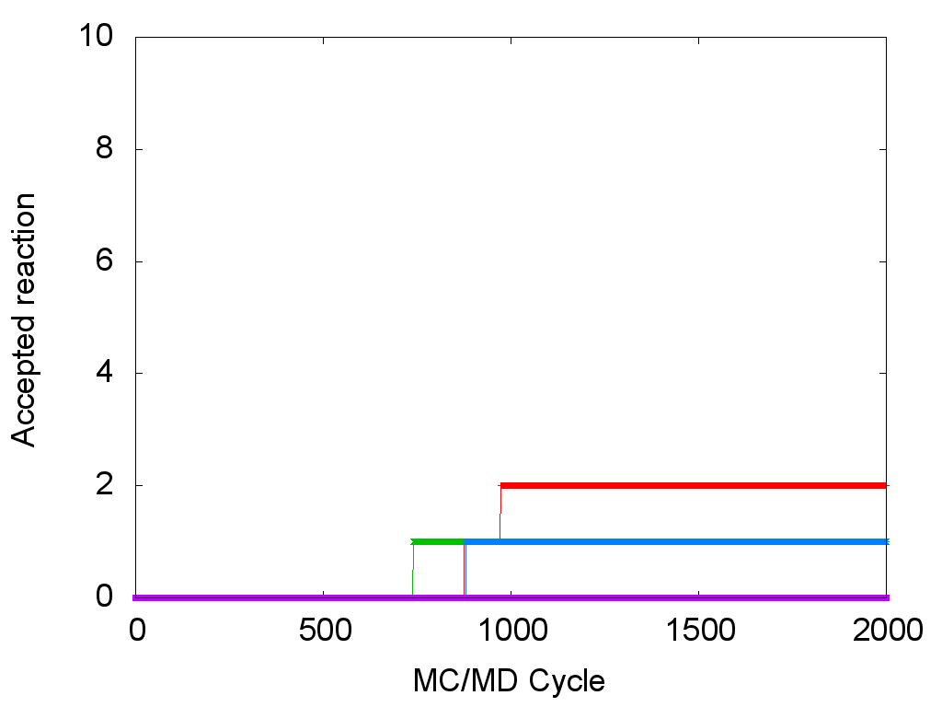
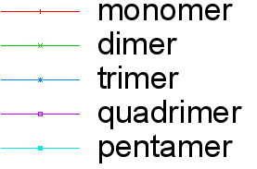
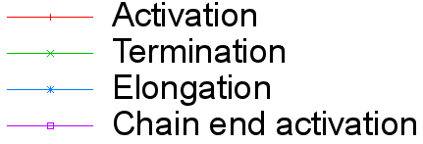
MC/MD simulation results
During 2000 MC/MD cycles, only few chemical reactions occur.
To accelerate the simulation, it is possible to consider the water binding in the reaction scheme.
Acylated Serine
Ligand
binding
5
Activation
Chain end activation
Termination
1
4
2
3
Termination
2
Elongation

Slide 7
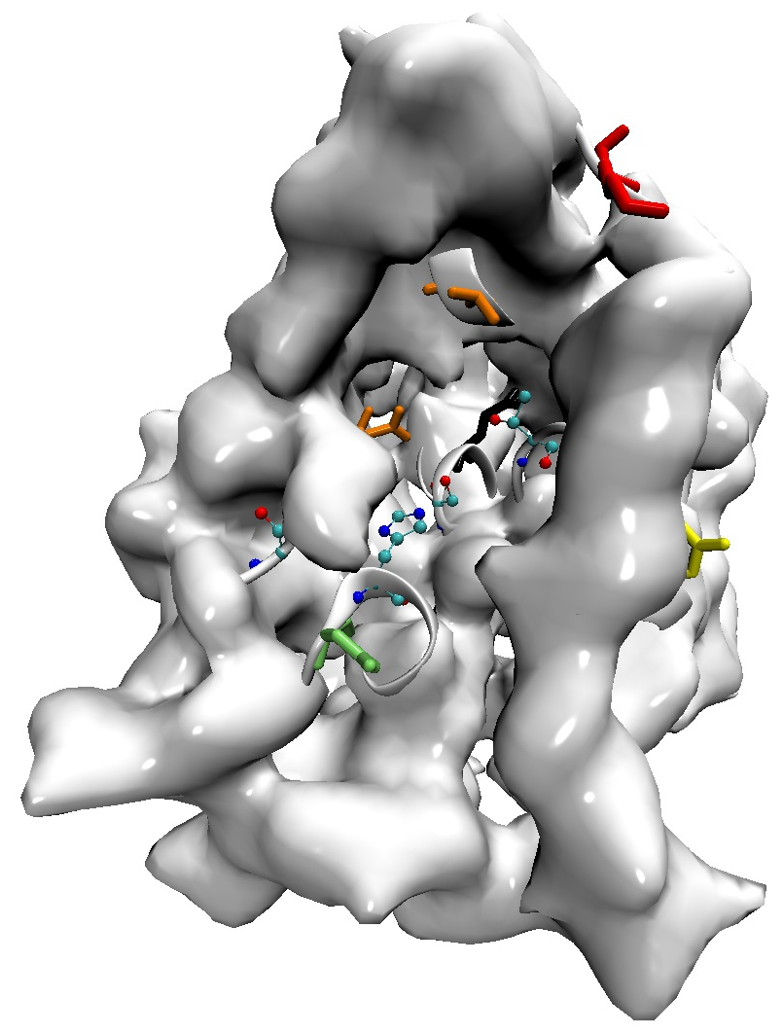
Identifying Water Access Pathways
Four predominant water access pathways were identified^{[4]}:
the primary water channel (PWC).
the secondary water channel (SWC).
Two interfacial water entrances IWE1 and IWE2.
Water molecule can be selected for binding reaction if it located closed to a water pathway entrance.
IWE2
SWC
oxyanion hole
catalytic triad
PWC
Water < 3.0 Å of the contact residue
no
IWE1
yes
Water binding reaction can be selected
Water binding reaction can not be selected
[4] S. P. Benson and J. Pleiss, J. Chem. Theory. Comput. 2014, 10, 5206-5214
Notes:
or in the case of Trp104 of H3 to Ser105.

Slide 8
Reaction scheme with water binding event
If several reactions are selected at the same time, the reaction weights will be considered.
A reaction with a high reaction weight has more probability to be selected than a reaction with a low reaction weight.
19.82
[kcal/mol]
Ligand
binding
5
Activation
Termination
Chain end activation
15.23 [kcal/mol]
1
4
2
33.70 [kcal/mol]
21.71
[kcal/mol]
3
Termination
19.82
[kcal/mol]
2
Elongation
6
Water
binding

Slide 9
Reaction weight
Reaction weights are estimated from the reaction activation energy.
To weight the binding events, we consider the self-diffusion coefficient.
The molecule binding should occur less often than the chemical reactions.
Reaction | Ea (kcal.mol⁻¹) | exp(-Ea/K_{b}T) | Relative reaction probability | Reaction weight
1. Activation | 21.71 | 8.38 ×10⁻¹³ | 1.0 ×10⁻⁴ | 1.0 ×10⁻⁴
2. Termination | 19.82 | 9.43 ×10⁻¹² | 1.0 ×10⁻³ | 1.0 ×10⁻³
3. Elongation | 33.70 | 1.79 ×10⁻¹⁹ | 1.0 ×10⁻¹⁰ | 1.0 ×10⁻¹⁰
4. Chain end activation | 15.23 | 3.37 ×10⁻⁰⁹ | 1.0 | 1.0
Reaction | self-diffusion coefficient (10⁵ cm².s⁻¹)* | Relative reaction probability | Reaction weight
β-lactam binding | 5.27 | 0.39 | 4.0 ×10⁻¹²
Water binding | 13.34 | 1.00 | 1.0 ×10⁻¹¹
*Self-diffusion coefficient computed from 276 molecules in the toluene solvent.

Slide 10
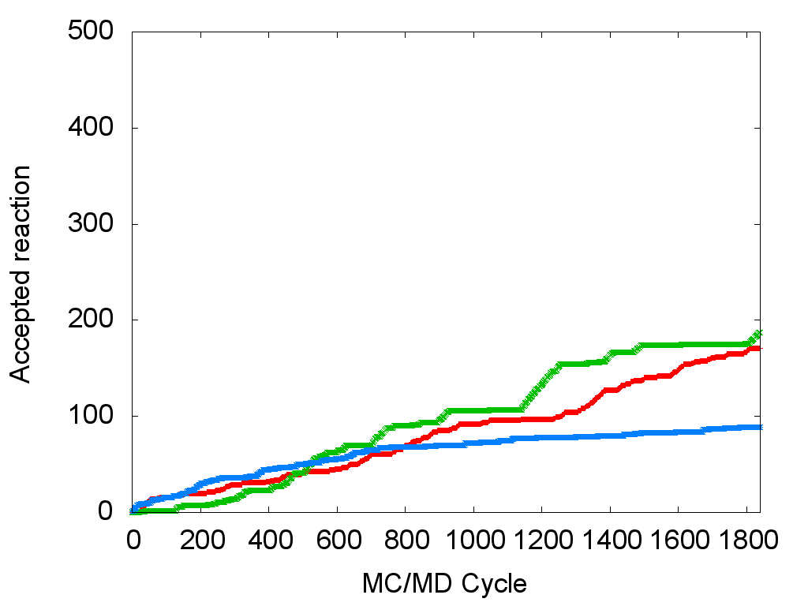
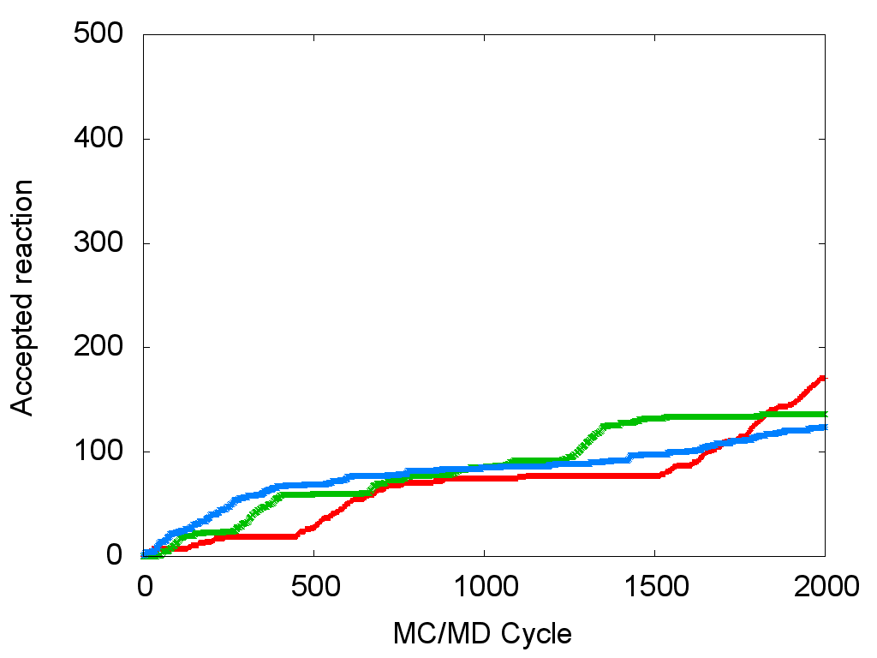
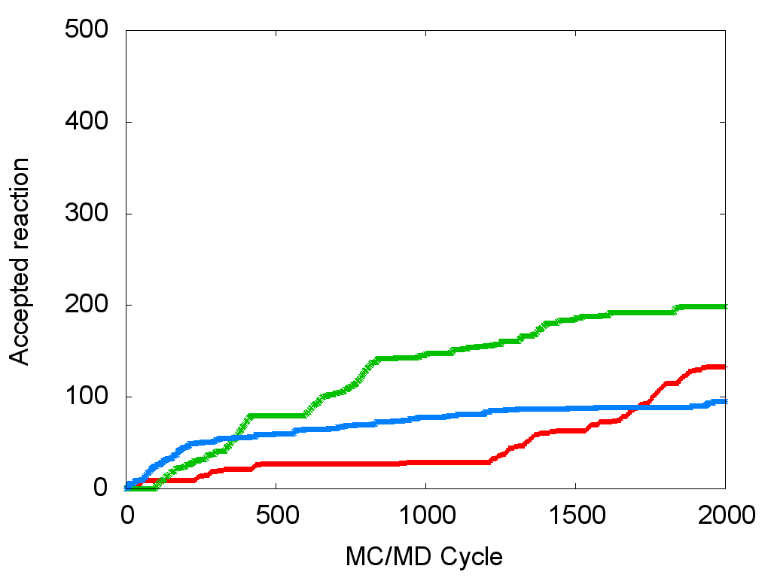
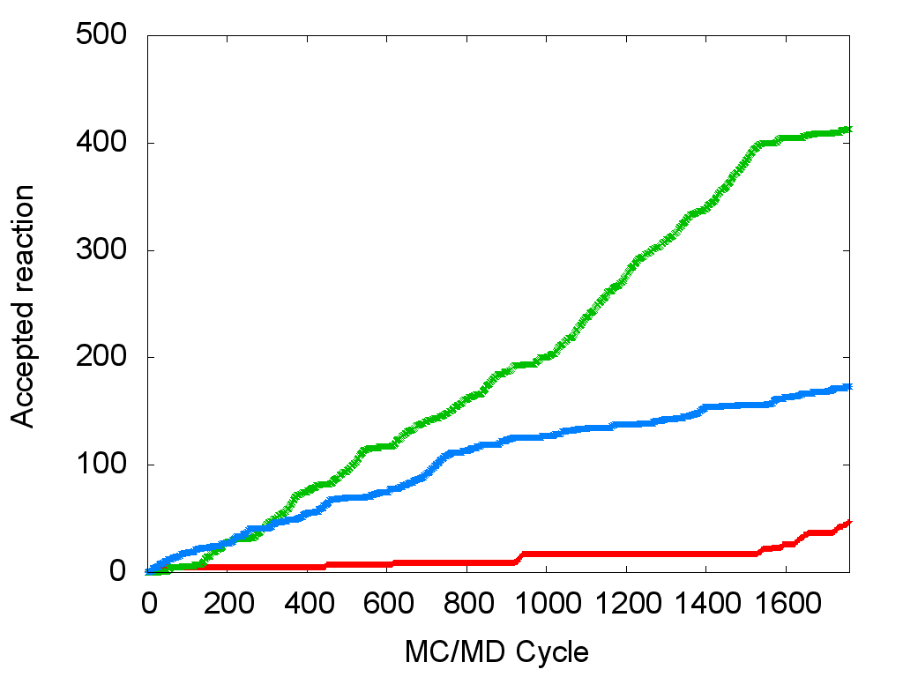
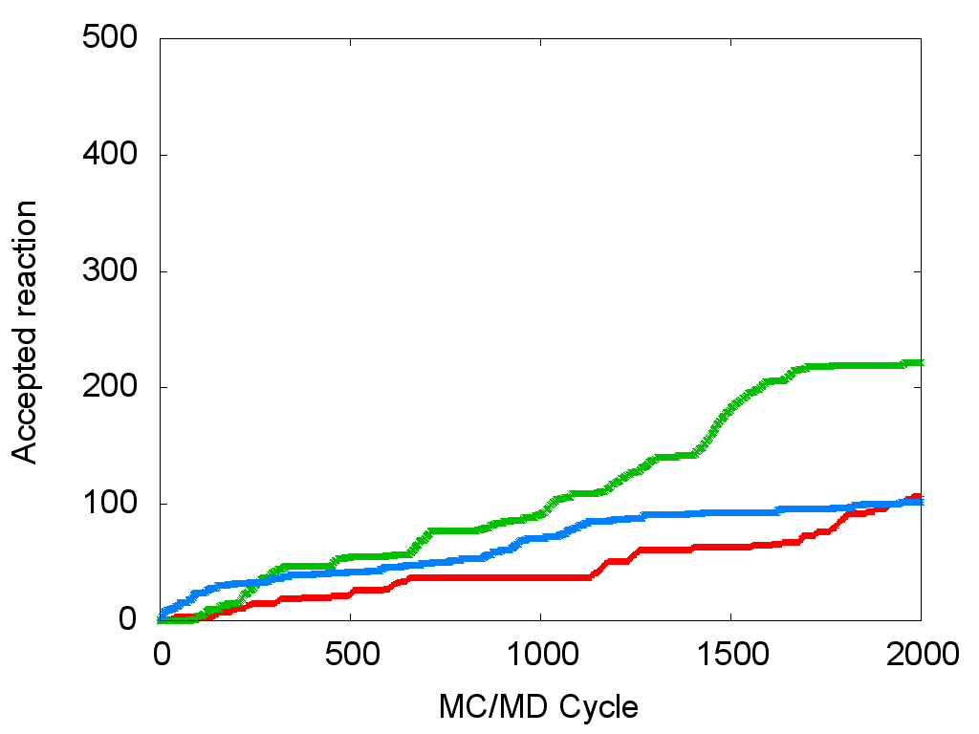
MC/MD simulation results - Accepted Reaction
By adding the water binding, chemical reactions more occur often than without.
Binding event occur more often in comparison to chemical reaction.
1
2
3
4
5

Slide 11
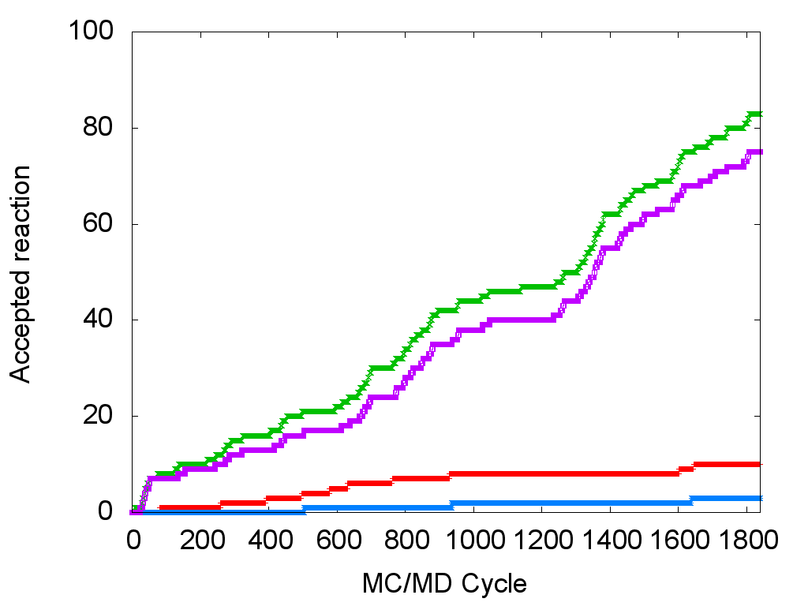
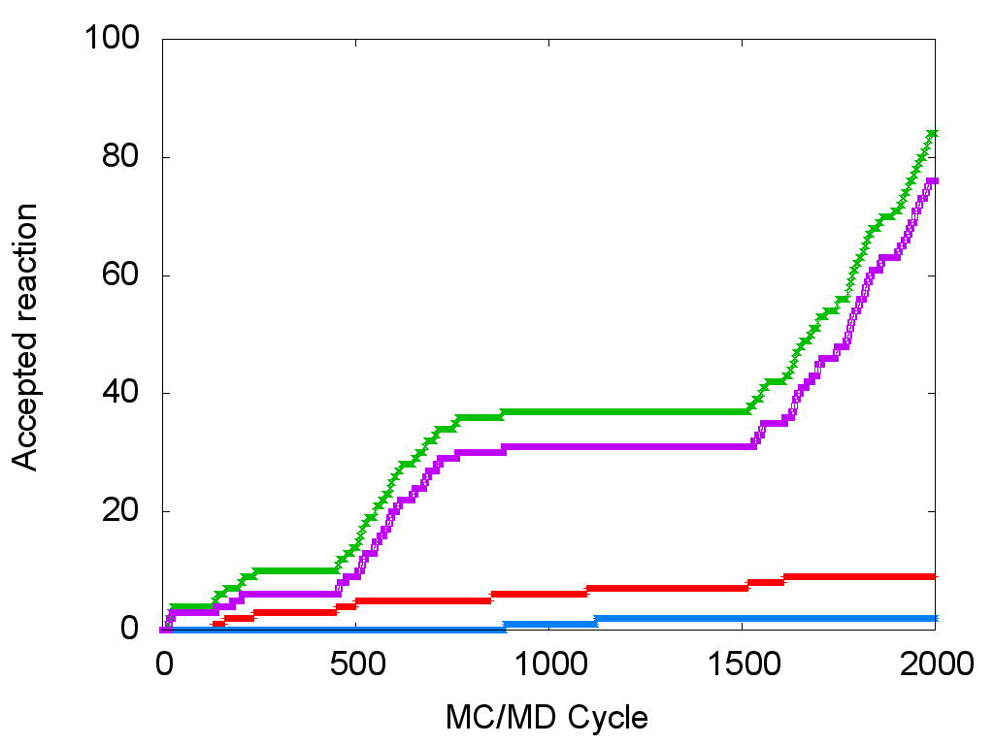
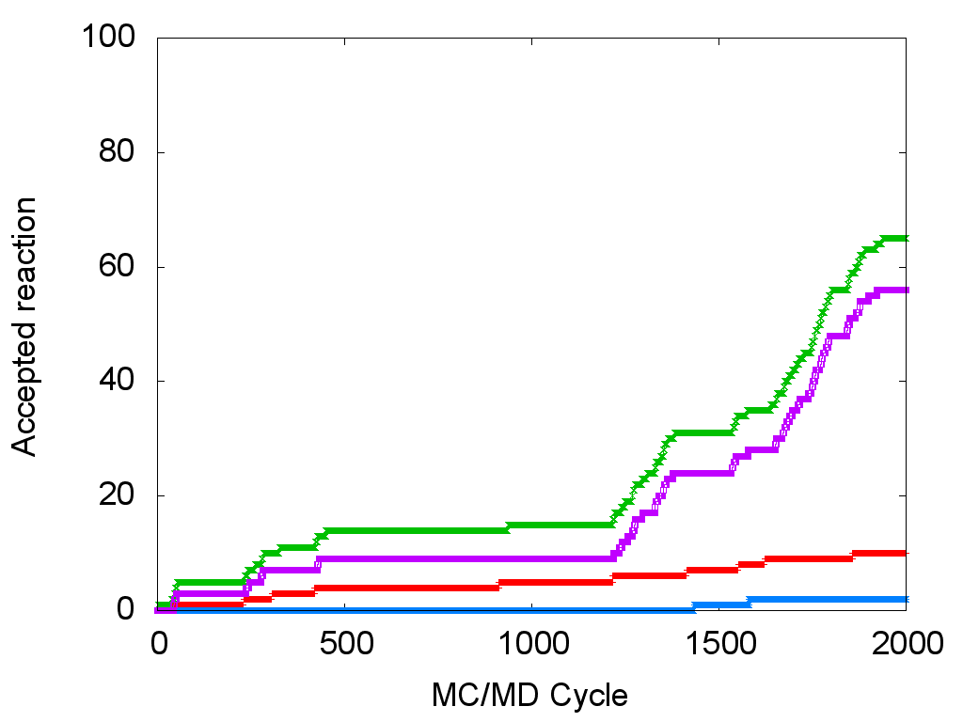
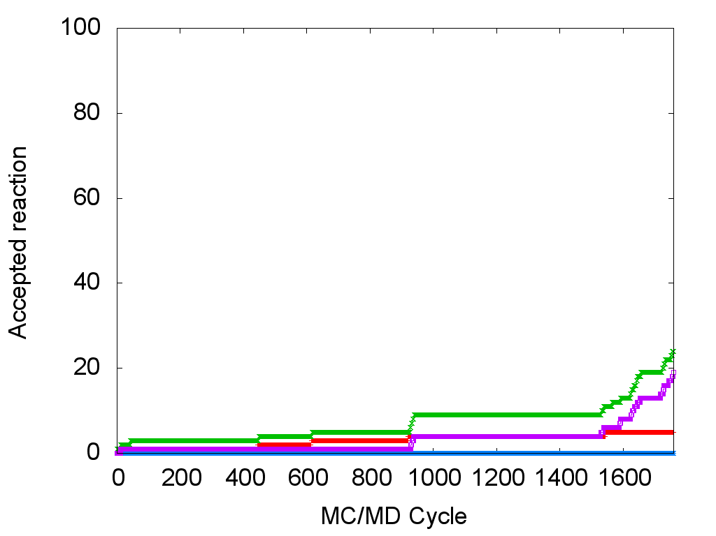
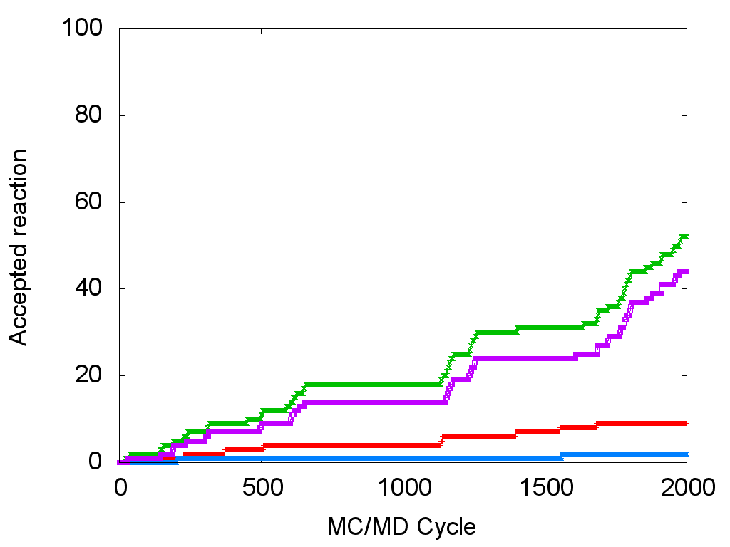
MC/MD simulation results - Nature of the accepted chemical reaction
The termination reaction occurs more often than the other chemical reaction.
1
2
3
Free enzyme
Free enzyme
4
5
Free enzyme

Slide 12
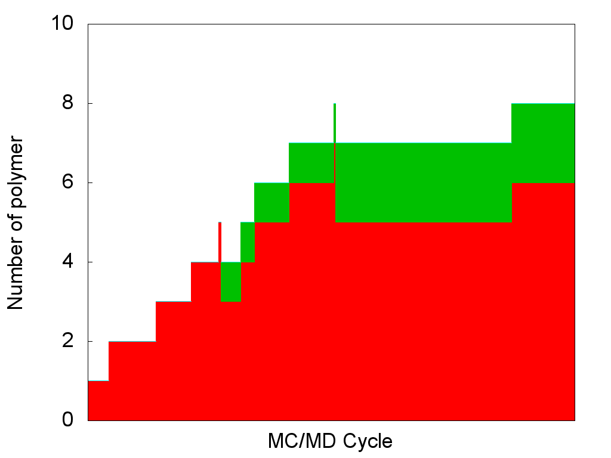
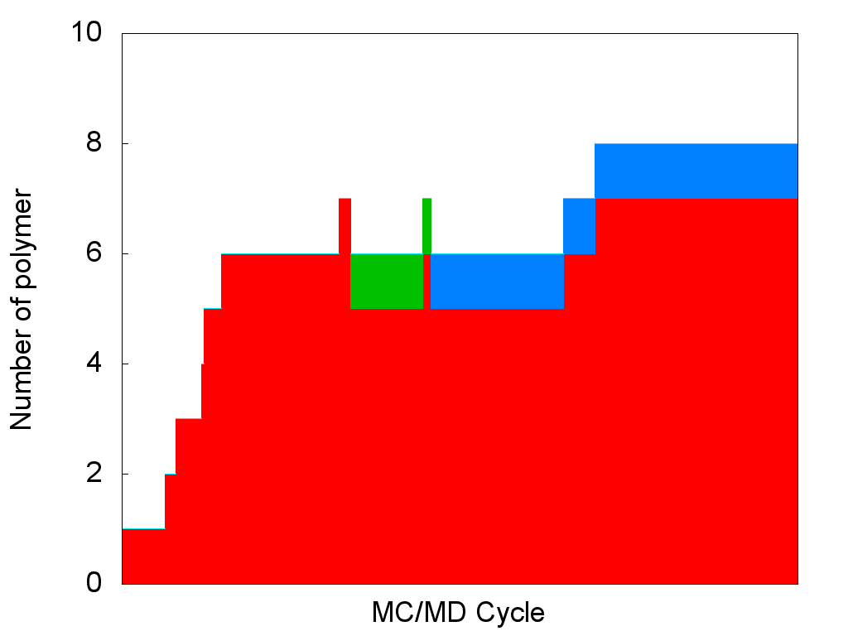
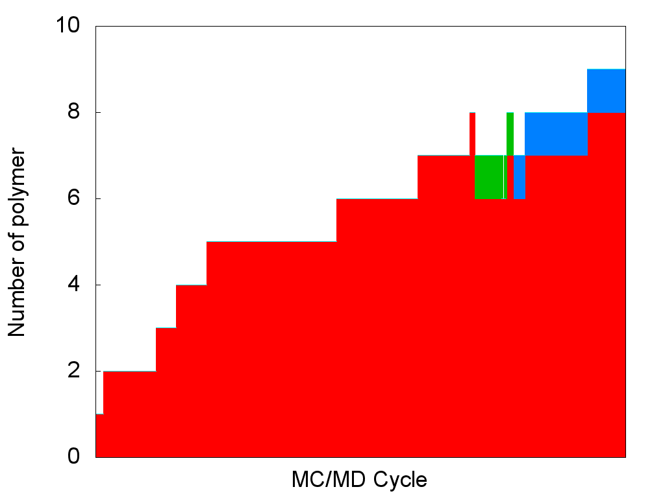
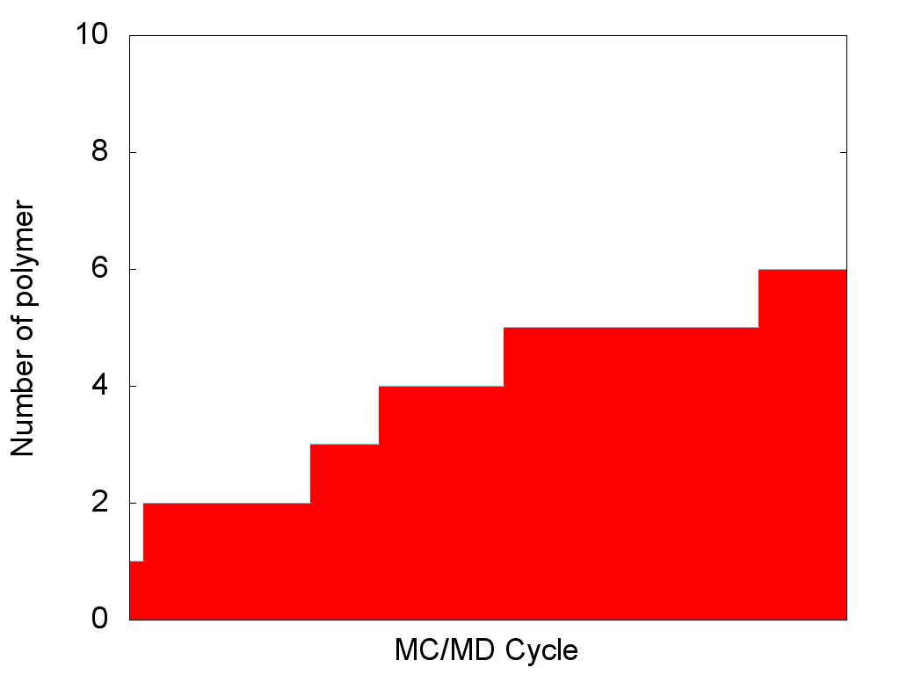
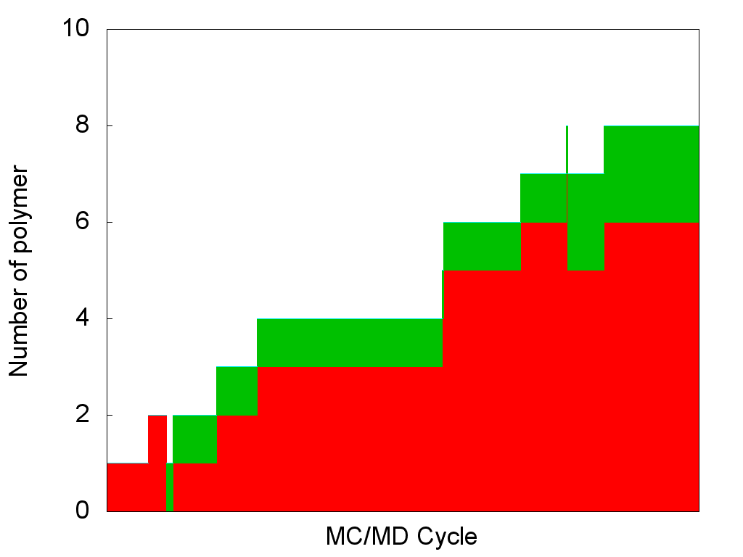
MC/MD simulation results - Number and nature of the polymers obtained
Because the binding events often occur, only short polymer is obtained.
1
2
3
4
5

Slide 13
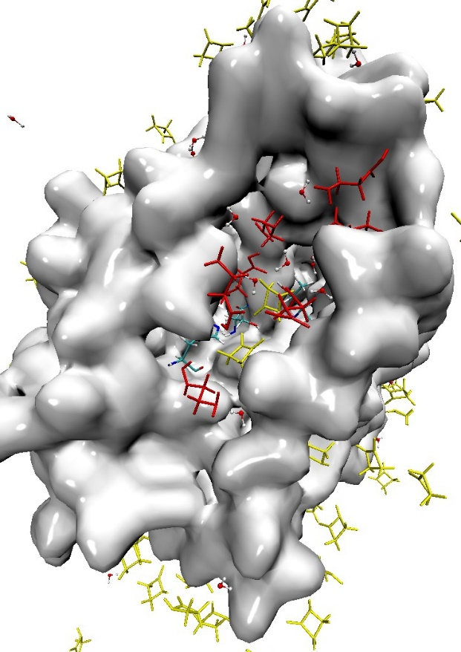
MC/MD simulation results
At the beginning of the simulation, only β–alanine is formed.
β–alanine generated are stored in the active site of CAL-B.
These β–alanine may not be consumed in the elongation reaction.
Cycle 1400
Cycle 1400
3
18Å
catalytic triad
β-lactam
β-alanine

Slide 14
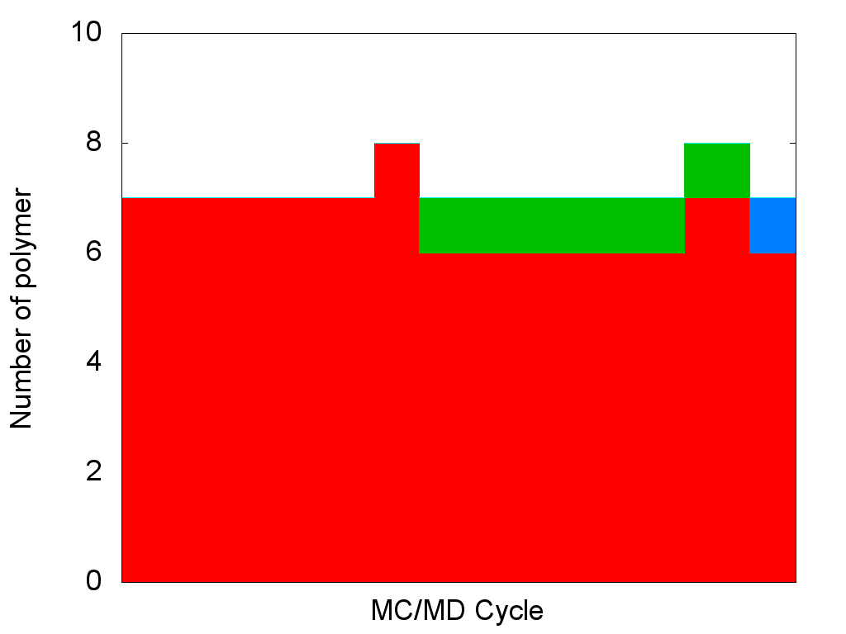
MC/MD simulation results – trimer formation
The previously generated β–alanine molecules are not used in the elongation reaction.
The polymer formation occurs sequentially.
b
d
a
c
e
catalytic site
a
b
c
Ser
Ser
Ser
Ser
e
d
Ser
Ser
Ser
Ser
water

Slide 15
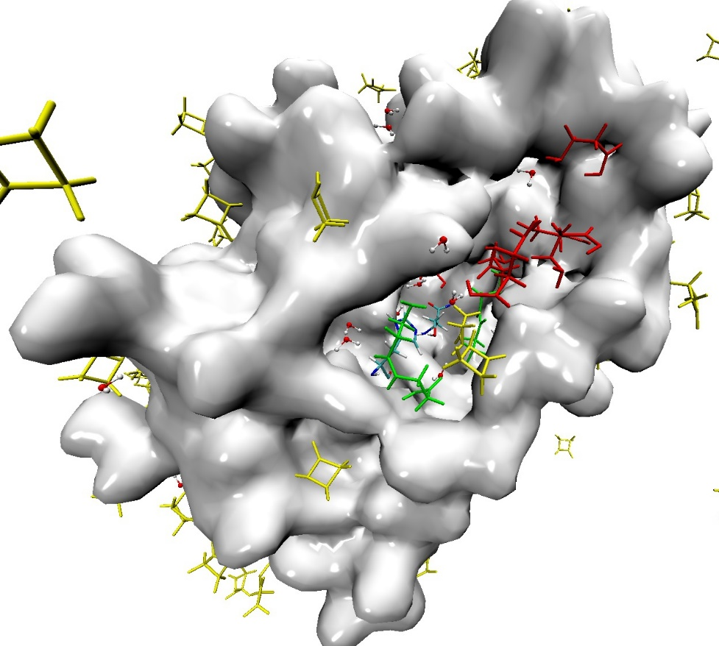
MC/MD simulation results
To consumed the previously generated β-alanine, the diffusion of β-alanine in the active could be considered as a reaction.
It could lead to obtaining longer polymer.
Another alternative is to consider a different water concentration.
5
catalytic triad
β-lactam
β-alanine
dimer
Notes:
15 angstrom

Slide 16
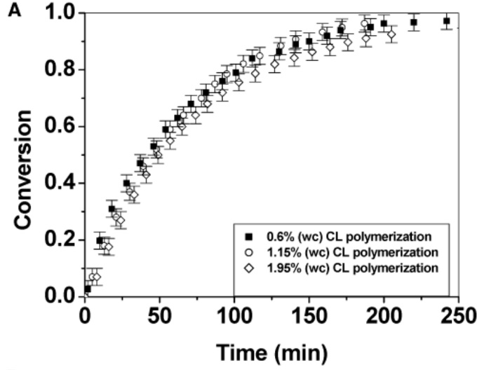
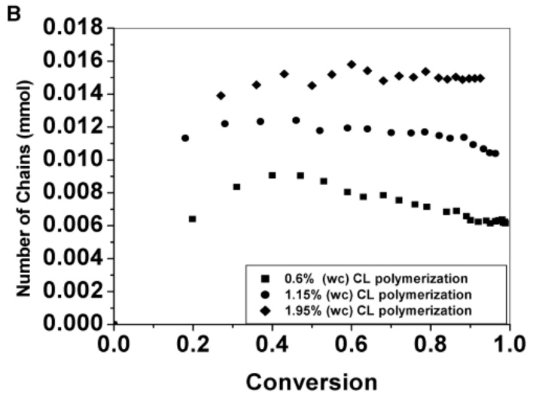
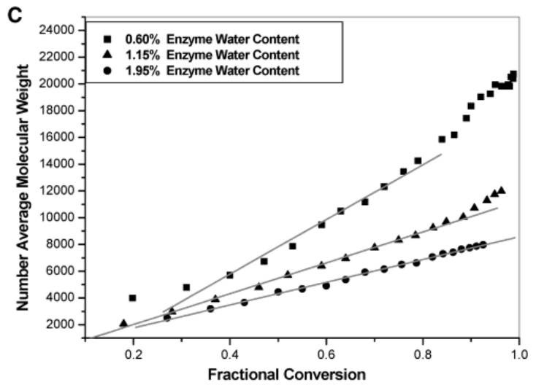
Role of water molecule in the ε-CL polymerization
An increase of water content does not influence the conversion rate.
By decreasing the water content, the number of polymer decrease.
But polymers with longer length are obtained.
By modifying the water concentration, it is possible to increase the polymer length.
[2] Gross, R. et al. Macromolecules 2003, 36 (15), 5530–5536.

Slide 17
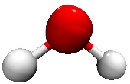
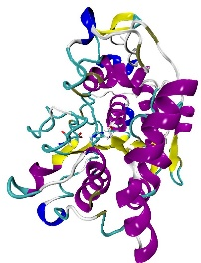
Modification of the system setting
The Novozyme 435 catalyst consists of the CAL-B (20 % of the catalyst weight) immobilized on a resin (80 % of the catalyst weight).
Else in dried experimental condition, water is always present in the catalyst^{[3]}.
The location of the water molecule was not analyzed.
In the current simulation, we will consider a water content of 1% (w/w). We first consider that all the molecules are located on the protein surface.
Another repartition could be considered in the future simulation. We could consider that 20% of water molecule are present on the protein surface while the other are located on the resin.
80%
20%
CAL-B
[3] Gross, R. et al. Macromolecules 2003, 36 (15), 5530–5536.
Poly-acrylate resin

Slide 18
Conclusion
Taking in account the water binding in the reaction scheme allows to accelerate the simulation of the polymerization reaction.
The water binding increase the number of polymer.
In result, shorter polymer is obtained.
Only 2000 MC/MD cycles were performed, this conclusion could change by increasing the number of cycle.
Perspective
To obtain simulation results consistent with the experimental one, two ways could be envisaged:
considering the diffusion of poly(β-alanine) in the protein active site as a reaction.
considering a different water content.

