Slide 1
FY2015 4th CREST WS
Jul. 30th, 2015
Revised Jul. 31st, 2015
Role of Non-site Specific Interaction in Biocatalyzed Reaction: Conformational characterization of poly(β-alanine)
Ikuo KURISAKI

Slide 2
Contents
Revised!!
Research background (P. 3)
Purpose of this study (P. 4)
Problem setting (P. 5-8)
Conformational characterization of poly(β-alanine) (P. 9-21)
Research plan for the next two months (P. 22)
Suggestions at 4nd CREST WS (P. 23-24)

Slide 3
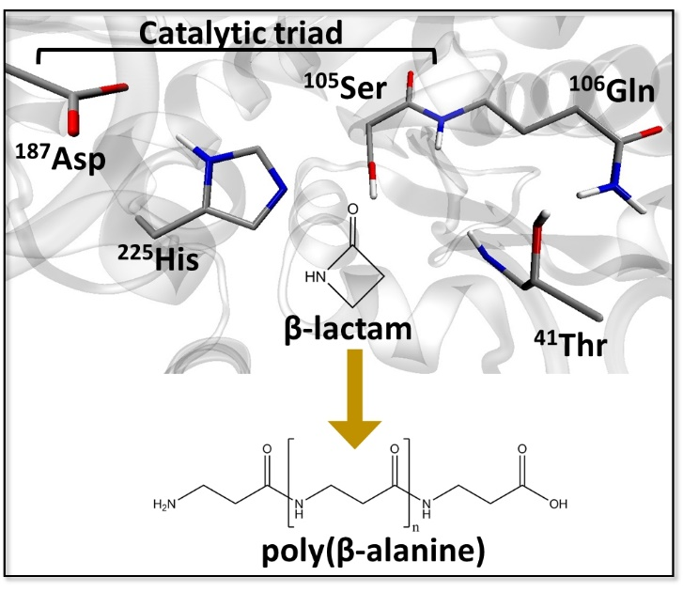
Research background
Enzyme catalyzed polymerization reaction has drawn attention in the field of green chemistry
Candida Antarica Libase B (CALB) has long been studied in this purpose
This enzyme catalyzes polymerization of β-lactam to generate poly(β-alanine), nylon-3
However, this reaction system has rooms to be improved because the product do not satisfy industrial quality, as for the length and yield
The illustration is gifted from Dr. Barberot.

Slide 4
Purpose of this study
A Big Problem
‘How can we synthesize longer polymer with higher yield?’
How to address the problem?
If we can answer the following question, we should have a lead to resolve the problem, ‘what factors do regulate polymer length, and also the yield?’

Slide 5
Problem setting
The factors should be attributed to (1) supply of monomers and (2) progress of elongation reaction.
21.71
[kcal/mol]
19.82
[kcal/mol]
33.70 [kcal/mol]
19.82
[kcal/mol]
15.23 [kcal/mol]
41.56 [kcal/mol]
The illustration is gifted from Dr. Barberot.

Slide 6
Polymer length must influence each of these two factors discussed above.
Revised!!
CALB
water
Ser¹⁰⁵-OH
Ser¹⁰⁵-O
Poly(β-alanine)
β-lactam
We can examine the effect of polymer length on the reaction by analyzing conformation of the polymer.

Slide 7
Suggestions at 2nd CREST WS
Nagaoka-sensei
➔ Is there any poly(β-alanine) structure, e.g., in Cambridge data library? This could be a good reference.
Takayanagi-san
➔ Dihedral angle parameters should be well considered because it haves influence on dynamics of polymer.
➔ Actually, using General Amber Force Field (GAFF) sometimes generates discussion in reviewing process.
➔ Practically, higher energy barrier would retard conformational change.

Slide 8
Are there earlier studies investigating conformations of poly(β-alanine)?
Glickson and Applequist reported that poly(β-alanine) does not form intra-molecular H-bonds in aqueous solution, thus being structurally disordered¹.
Meanwhile, Narita et al. reported that poly(β-alanine) assumes sheet structure in solid state².
Appella et al. reported possibility that β-peptide (but not (poly)β-alanine) forms robust helix in organic solvent³.
Unfortunately, their experimental conditions are different from with those we expected.
[1] J. D. Glickson and J. Applequist. J.A.C.S., 1971, 93, 3276-3286; [2] M. Narita et al. Bull. Chem. Soc. Jpn., 1986, 59, 3553-3557; [3] D. H. Appella et al. J.A.C.S., 1996, 118, 13071-13072.

Slide 9
Conformational characterization of poly(β-alanine)
To my best knowledge, there are no studies reporting conformation of poly(β-alanine) in organic solvent.
We have to examine the relation between polymer length and its conformation by ourselves.
What option can we choose to solve the problem?

Slide 10
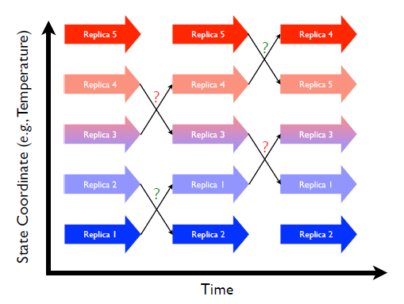
Replica exchange molecular dynamics (REMD) simulation¹
Figure 21. 1.: Replica exchange schematic showing 5 replicas combined in an expanded ensemble. Large arrows represent MD trajectories of sub-ensembles while the smaller arrows represent attempted swaps between replicas in state space. Question marks represent Monte Carlo exchange attempts (green for successful, red for failed)².
[1] A. Mitsutake et al. Biopolymer, 2001, 60, 96-123; [2] Amber 14 manual.

Slide 11
Suggestions at 2nd CREST WS
Nagaoka-sensei
➔ Is there any poly(β-alanine) structure, e.g., in Cambridge data library? This could be a good reference.
Takayanagi-san
➔ Dihedral angle parameters should be well considered because it haves influence on dynamics of polymer.
➔ Actually, using General Amber Force Field (GAFF) sometimes generates discussion in reviewing process.
➔ Practically, higher energy barrier would retard conformational change.

Slide 12
Purpose of REMD simulation
Here we focus on poly(β-alanine) with specific length, namely 8-mer and 18-mer¹.
Purpose:
Confirm whether REMD with GAFF reproduces experimental observations, namely, ‘disordered conformation’ of poly(β-alanine) in aqueous solution²
‘Disorder’ means that a polymer does not form hydrogen bonds (HBs)
[1] L.W. Schwab et al., Macromol. Rapid. Commun. 2008, 29, 794-797; [2] J. D. Glickson and J. Applequist. J.A.C.S., 1971, 93, 3276-3286.

Slide 13
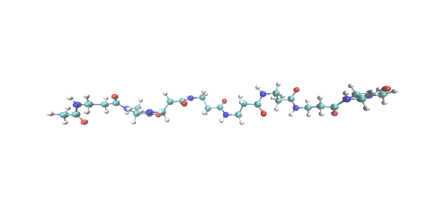
Setup of replica exchange molecular dynamics
8-mer
18-mer
Simulation setting
Heat bath: Langevin thermostat with collision frequency of 1.0 ps⁻¹
Solvent model: generalized Born model developed by A. Onufriev et al.¹ with solvent dielectric constant of 78.5 (simulating aqueous solvent)
Force field: General Amber Force Field (GAFF)²
Time length of independent MD: 100 ps
Number of Exchange: 2000
[1] A. Onufriev et al. Proteins, 2004, 55, 383-394; [2] J. Wang et al. J. Comput. Chem., 2004, 25, 1157-1174.

Slide 14
Setup of replica exchange molecular dynamics for
8-mer
Analyzed!!
240 K
‘The exchange success rate is computed via a Metropolis Monte Carlo move shown in Eq. 21.10 that satisfies detailed balance for swapping temperatures.’ (Amber14 manual)
(21.10)
300 K
363 K
420 K
540 K
600 K
These distributions were computed from 6 independent MD simulations.

Slide 15
Validity of this simulation setup
In the experimental study¹,
[1] Temperature ranges from 40 to 98 ℃, namely 313 to 371 K
[2] Estimated polymer length is ca 370
Although we analyzed conformation ensemble of 8-mer under 300 K, our simulation can be available to discuss consistency between REMD with GAFF and the study.
As for [1], a polymer in aqueous solution, possibly, forms less HBs under relatively high temperature. If we observe fewer HBs at 300 K, the observation would hold to the case under higher temperature.
As for [2], even if polymer length is 370, the HB should be, basically, formed among neighboring residues, so that 8-mer could be a model to examine such local HB formation.
[1] J. D. Glickson and J. Applequist. J.A.C.S., 1971, 93, 3276-3286

Slide 16
Representative conformations of 8-mer@300K
Annotation: extended
Distance: 36.6 Å
# HB: 0
Annotation: bent
Distance: 25.4 Å
# HB: 0
Revised!!
Carbon atom in CH₃^{ACE}
Carbon atom in CH₃^{NME}
Annotation: turn
Distance: 5.1 Å
# HB: 1
Annotation: twist
Distance: 16.8 Å
# HB: 1
Averaged # of HB: 0.06
(total 20,000 conf.)

Slide 17
Distribution of distance between C in CH₃^{ACE} and C in CH₃^{NME} @ 300 K
Revised!!
Carbon atom in CH₃^{ACE}
Carbon atom in CH₃^{NME}
~5%

Slide 18
Distribution of distance between C in CH₃^{ACE} and C in CH₃^{NME} @ 363 K
Revised!!
Shifted to left side
~7%
A polymer might likely assume bent conformation under higher temperature condition

Slide 19
REMD with 8-mer poly(α-alanine) @300K
Annotation: helical
Distance: 14.5 Å
# HB: 4
Revised!!
Annotation: bent
Distance: 22.7 Å
# HB: 0
Annotation: globule
Distance: 12.3 Å
# HB: 3
Annotation: extended
Distance: 29.8 Å
# HB: 0
Averaged # of HB: 1.72
(total 20,000 conf.)
*Notify! Forces are calculated with Amber force field 99SB

Slide 20
Atomic origin of poly(β-alanine) disorder
α-alanine
Revised!!
O
Cα
N
H
H
O
n
H
Cβ
β-alanine
More rotatable?
Cα
N
O
H
H
n
H
Cβ
O

Slide 21
Concluding remarks
According to analyses of REMD-derived conformations, we could expect
Poly(β-alanine) can assume such conformations like ‘turn’ and ‘twist’
However, the population is ca 5%, thus being minor in the conformation ensemble
Extended and bent conformations are major components of the conformational ensemble obtained
Furthermore, intramolecular HB rarely forms
These observations are consistent with experimental one, suggesting the possibility that GAFF can reproduce conformational properties of poly(β-alanine) in aqueous phase.

Slide 22
Research plan for the next 2 months
Extend REMD of 8-mer and confirm the convergence of conformation sampling
Similarly, execute REMD with 18-mer in aqueous solution
➔ We will obtain ensemble view of poly(β-alanine) in aqueous solution, which can be used to evaluate GAFF
Furthermore, execute REMD with both 8- and 18-mer in toluene solvent
➔ We will obtain ensemble view of poly(β-alanine), which can be used to compare poly(β-alanine) in CALB’s active site

Slide 23
Suggested Research plan for the next 2 months
Suggestions at 4nd CREST WS
Revised!!
Nagaoka-sensei
➔ GB simulations should work for the cases of ‘extended’ and ‘bent’ conformations. However, it would not work for the cases of ‘turn’ and ‘twist’. This is due to that cavity formation is ‘discrete’. It is, thus, likely that atoms much strongly interacts if the distance is smaller than sum of the GB radiuses.
This would make the dynamics unstable. It is, therefore, possible that conformation ensemble obtained is different from that derived from REMD with explicit water.

Slide 24
Suggestions at 4nd CREST WS
Revised!!
Takenaka-san
➔ GB does not include entropic effect, explicitly, in other words, microscopic solvation effect, is not taken into account. Peptide changes the conformation under the balancing with microscopic solvation structure, so that this should affect both dynamics and conformation ensemble obtained.
Finally, we had better to examine the effect of GB on conformational sampling. We should find earlier studies that address to compare GB and explicit solvent in the context of REMD. Thus, first, we will check them, and reconsider how to evaluate REMD with GAFF.

Slide 25
Supporting Information

Slide 26
Transition probability for REMD¹
Detailed balance is assumed to obtain equilibrium ensemble
Transition probability is calculated as shown below
[1] Y. Sugita and Y. Okamoto. Chme. Phys. Lett., 1999, 314, 141-151

Slide 27
@240 K
@480 K
@540 K
@600 K

