Slide 1


FY2014 The 1st CREST Workshop
Uppula Purushotham and Norio Takenaka
The Effect of Sodium Ions as an Electrolyte Additive on the Formation of Solid Electrolyte Interphase Film in Lithium-Ion Batteries

Slide 2
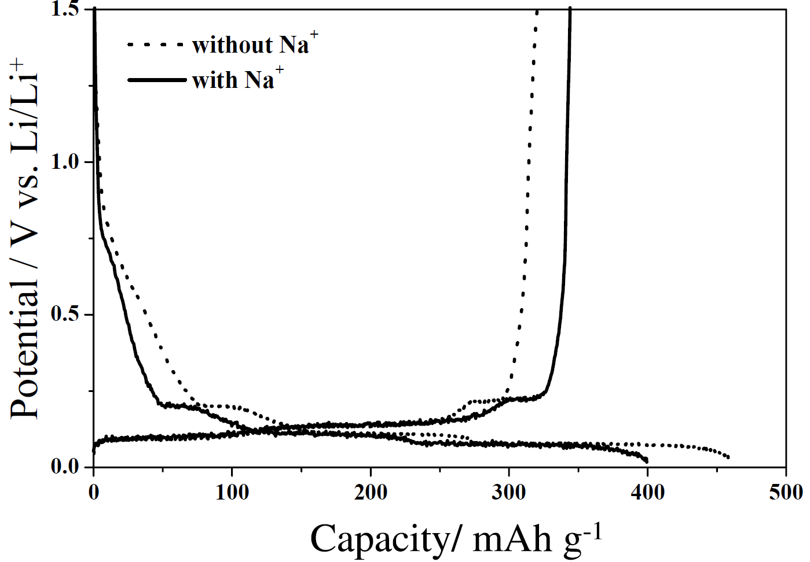
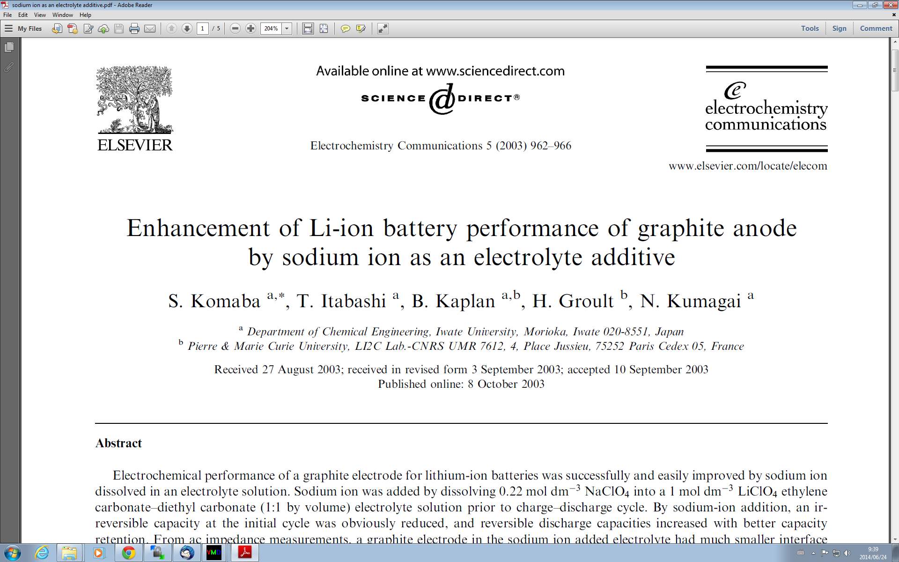
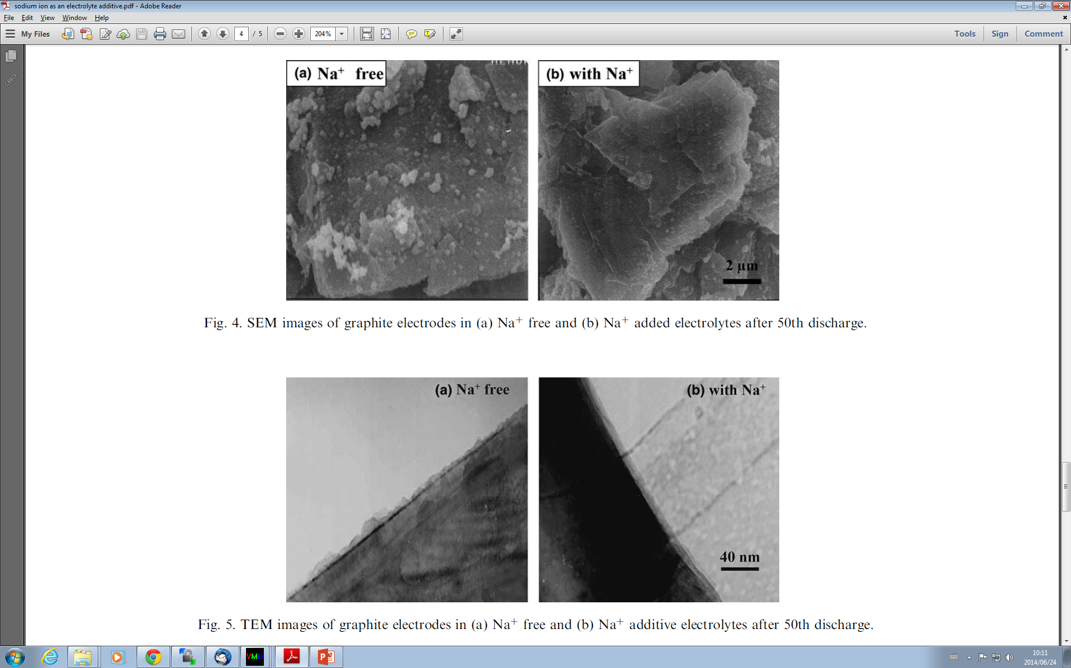
In Na free electrolyte, the graphite shows a reversible capacity of 320 mAh g⁻¹, and an irreversible capacity of 141 mAh g⁻¹. In the Na⁺ added electrolyte, the irreversible capacity is reduced, and a higher reversible capacity of 352 mAh g⁻¹ was observed.
There is no significant difference in the potential variation corresponding to the structures of lithium intercalation–deintercalation into–from graphite in the potential region less than 0.3 V in spite of sodium addition.
Figure 1: Initial charge–discharge curves of natural graphite electrodes without and with Na+ additive (by dissolving 0.22 mol dm⁻³ NaClO4) in 1 mol dm⁻³ LiClO4/EC–DEC (1:1 by volume). Current density: 17 mA g⁻¹.
In SEM images, many white particles in size of sub-µm were deposited and dispersed on the surface of the graphite particle for sodium free system.
The TEM images of Na-free system appeared as rough and disordered deposition also confirmed on the surface. However, the homogeneous and uniform film covers the graphite surface for Na-additive system.
In this study they have concluded that the sodium addition is found to be much effective to enhance a graphite anode performance, that is, not only the suppression of the initial irreversibility but also the better maintenance of discharge capacity.

Slide 3
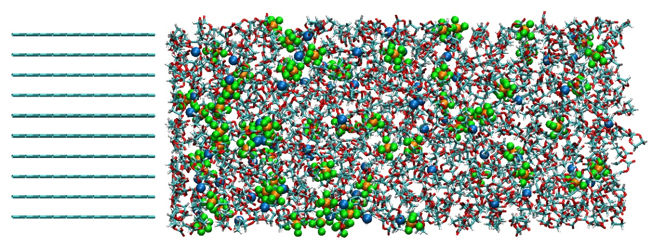
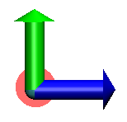
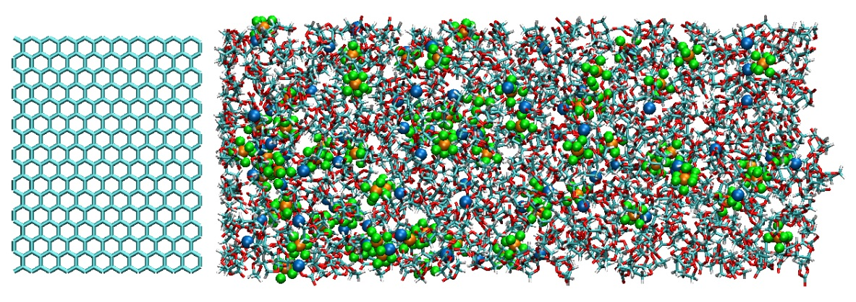
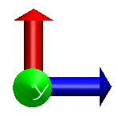
Model Systems
1.1M LiPF₆ PC or EC electrolyte + 0.22M NaPF₆
Temperature ：298K
300.0 Å
PC: 1020
Li⁺: 87
PF₆⁻: 102
Na⁺: 17
37.0 Å
y
z
25.8 Å
EC: 1020
Li⁺: 69
PF₆⁻: 81
Na⁺: 17
34.1 Å
x
z
Z origin
Figure 2: Model systems considered for the hybrid MC/MD simulation.
Notes:
グラファイト間距離は3.7Åであり、この値はLiイオンが完全に詰まった状態(LiC6)の場合の値に対応する。

Slide 4



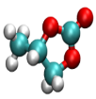
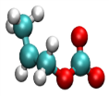
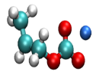
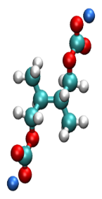





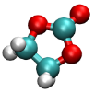

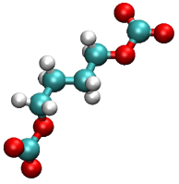



Reaction Schemes and Potential Energies
+ e⁻
+
+ Li⁺/Na⁺
Table 1: The potential energy differences of reaction ΔU_{reac} in gas phase at the B3LYP/6-31+G(d) level of theory
+ e⁻
+ Li⁺/Na⁺
Li/NaCO₃⁻
Li₂/Na₂CO₃
C₃H₆
Reaction type | ΔU_{reac} [kcal/mol]
PC + e⁻ → PC⁻ | -3.8
PC⁻ + Li⁺/Na⁺ → Li/NaPC | -165.1
Li/NaPC + Li/NaPC → Li₂/Na₂DMBDC | -76.0
Li/NaPC → C₃H₆ + Li/NaCO₃⁻ | -44.0
LiCO₃⁻ + Li⁺ → Li₂CO₃ | -180.4
PF₆⁻ → PF₃ + 3F⁻ | 93.6
F⁻ + Li⁺/Na⁺ → Li/NaF | -182.4
PC
PC⁻
Li/NaPC
+ Li/NaPC
+ 2e⁻
+ Li⁺/Na⁺
radical termination
+
3 ×
PF₆⁻
PF₃
Li/NaF
Figure 3: Reaction scheme of PC electrolyte.
(CH₃CHCH₂OCO₂Li/Na)₂, Li₂/Na₂DMBDC
+ e⁻
+
+ Li⁺/Na⁺
+ e⁻
+ Li⁺/Na⁺
Reaction type | ΔU_{reac} kcal/mol]
EC + e⁻ → EC⁻ | -5.2
EC⁻ + Li⁺/Na⁺ → Li/NaEC | -164.6
Li/NaEC + Li/NaEC → Li₂/Na₂BDC | -88.5
Li/NaEC → C₂H₄ + Li/NaCO₃⁻ | -44.2
Li/NaCO₃⁻ + Li⁺/Na⁺ → Li₂ /Na₂CO₃ | -180.4
PF₆⁻ → PF₃ + 3F⁻ | 93.6
F⁻ + Li⁺/Na⁺ → Li/NaF | -182.4
C₂H₄
Li/NaCO₃⁻
Li₂/Na₂CO₃
EC
EC⁻
Li/NaEC
+ Li/NaEC
radical termination
+ 2e⁻
+
3 ×
+ Li⁺/Na⁺
PF₃
F⁻
Li/NaF
(CH₂CH₂OCO₂Li/Na)₂, Li₂ /Na₂BDC
PF₆⁻
Figure 4: Reaction scheme of EC electrolyte.

Slide 5
Methodology
Generalized AMBER force field (GAFF) was used for the electrolyte and reaction products.
For PF₆⁻ force field was obtained by reference to the previous study¹.
The atomic point charges are obtained with the RESP method at the B3LYP/6-31+G(d) level of theory.
SANDER module of AMBER 9 package was used to execute all the atomistic simulations.
The SHAKE method was used to constrain the hydrogen-heavy atom bond distances and the integration time-step was 1 fs.
Temperature was maintained at 298 K.
Then, a production run of the hybrid MC/MD reaction simulation was executed for 2000 MC/MD cycles.
To check the initial structure dependence, the present simulations were performed by using a set of 10 different initial configurations.
When the electrolyte solvents and salts were reduced by adding same number of Na⁺ and Li⁺ cations we have neutralized whole system. These cations are placed randomly in the vacuum region.
To accelerate the ion diffusion, we have executed additional 20 ps MD simulation with a smaller electrostatic interaction (the scaling parameter 0.1).
The whole system was relaxed for 40 ps under normal electrostatic interaction, fixing all the reaction product structures as a whole.
¹J. Phys. Chem. B 2004, 108, 12978−12989

Slide 6
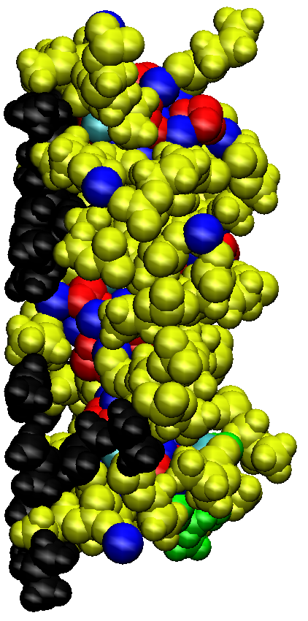
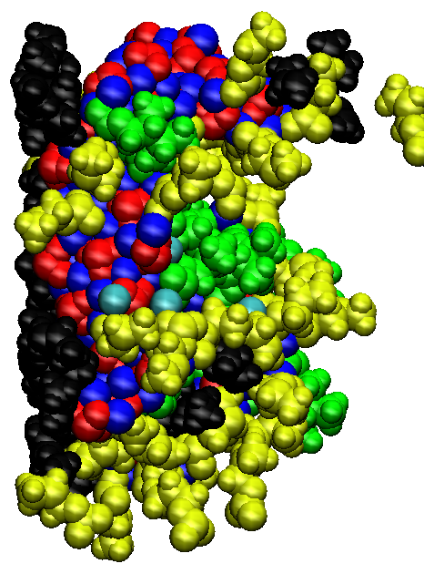
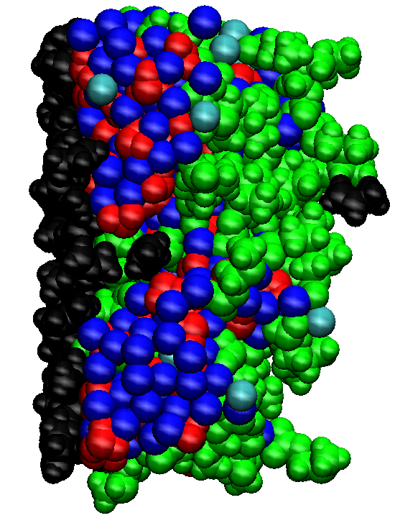
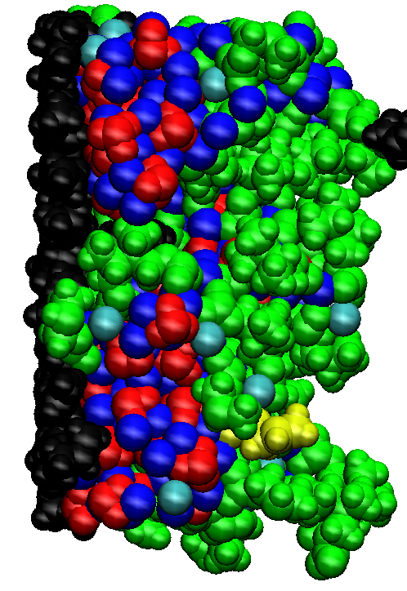
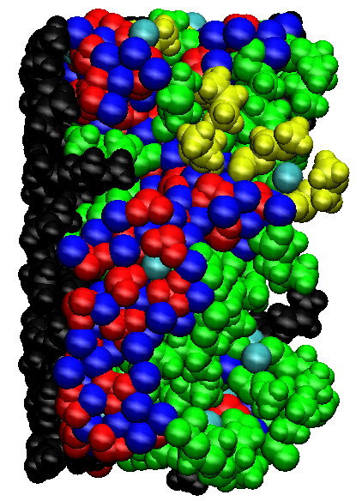
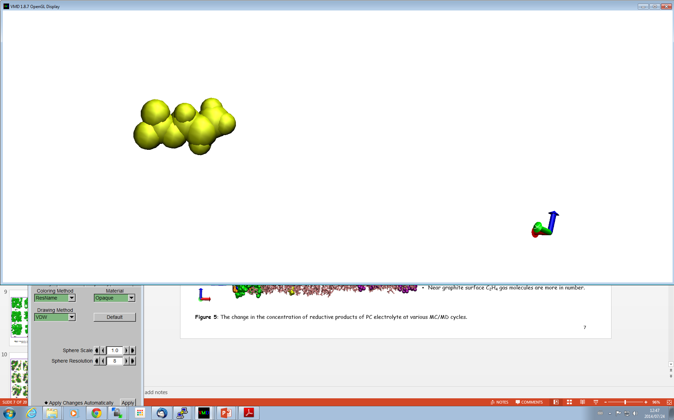
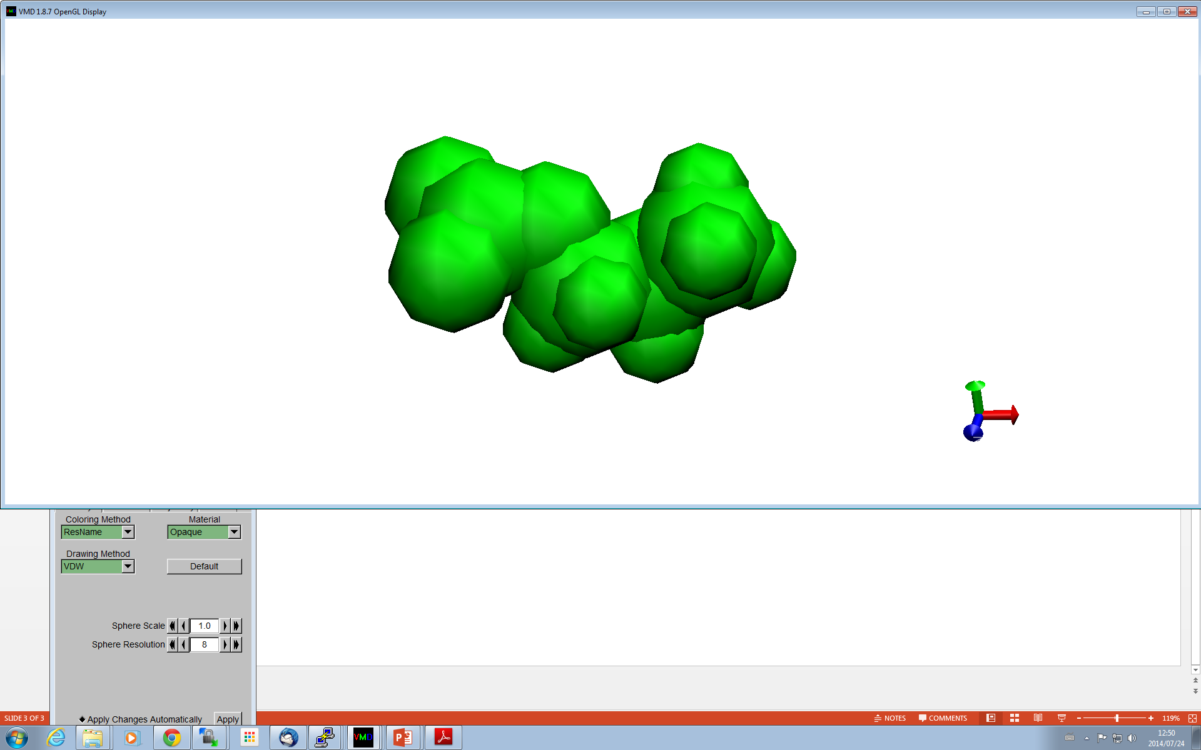
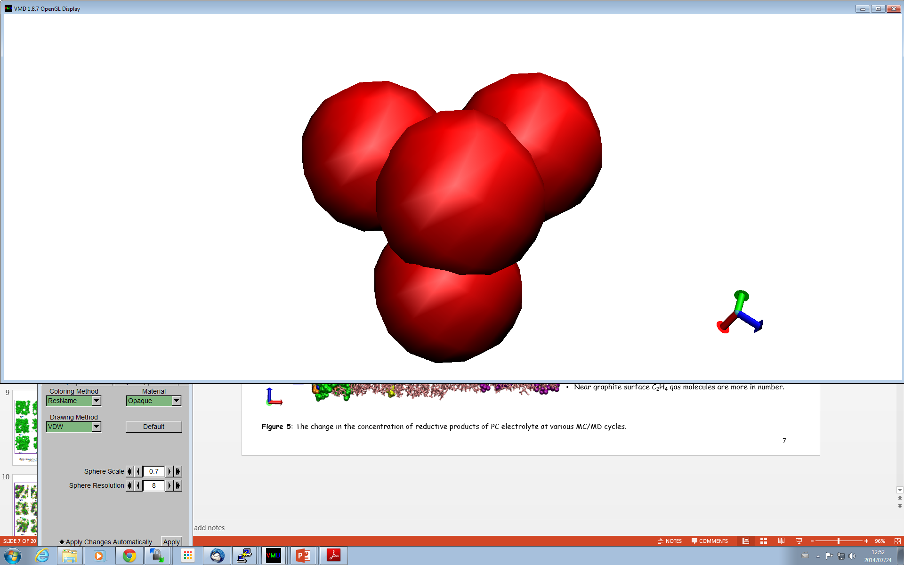
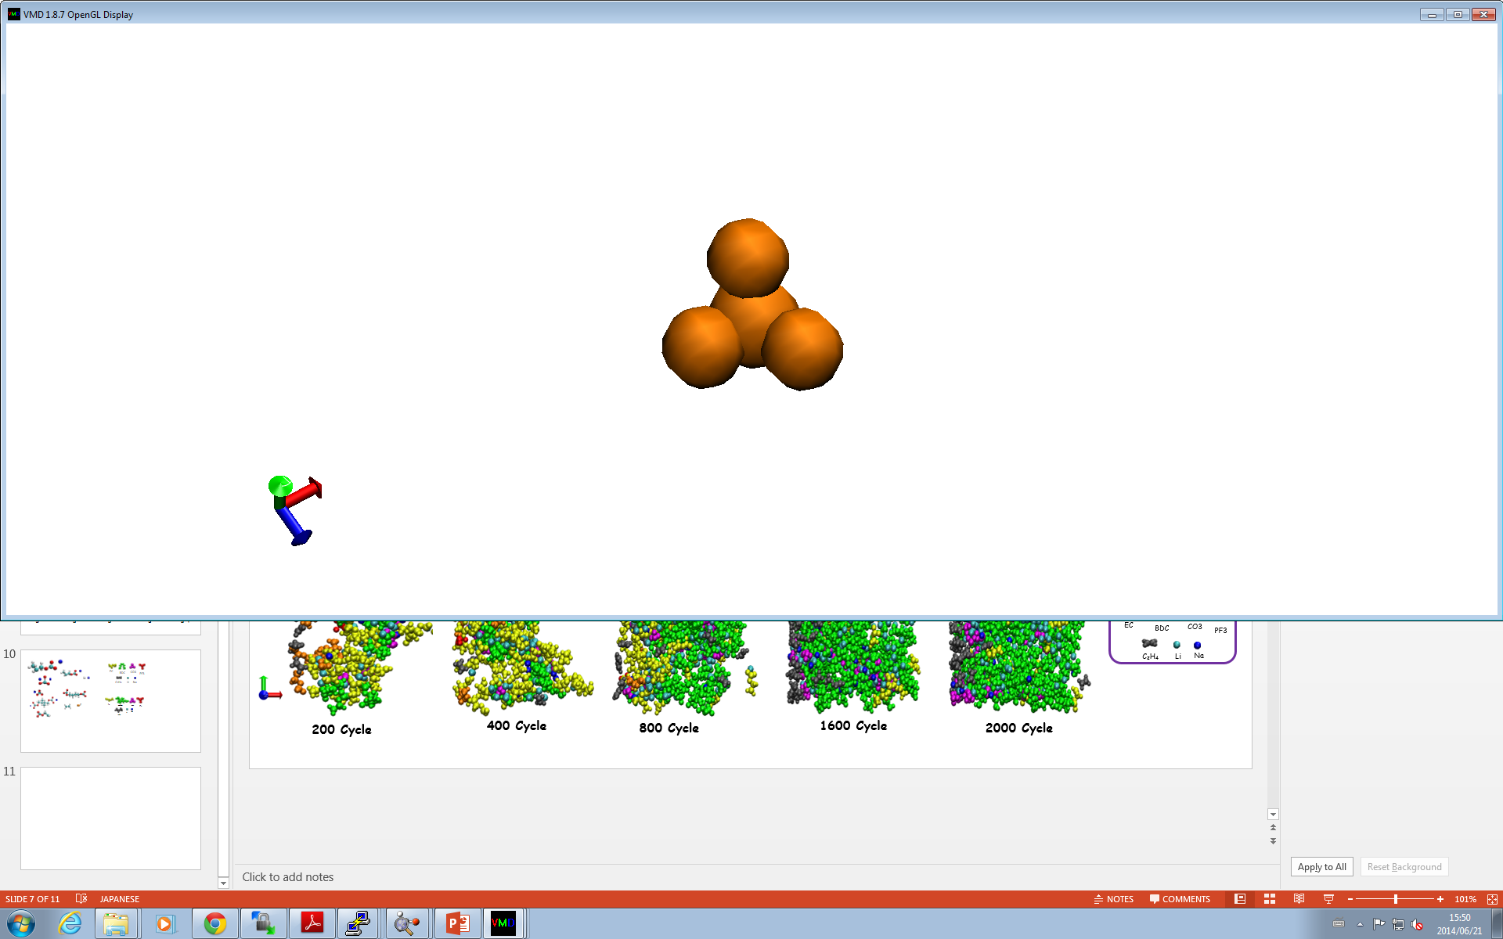
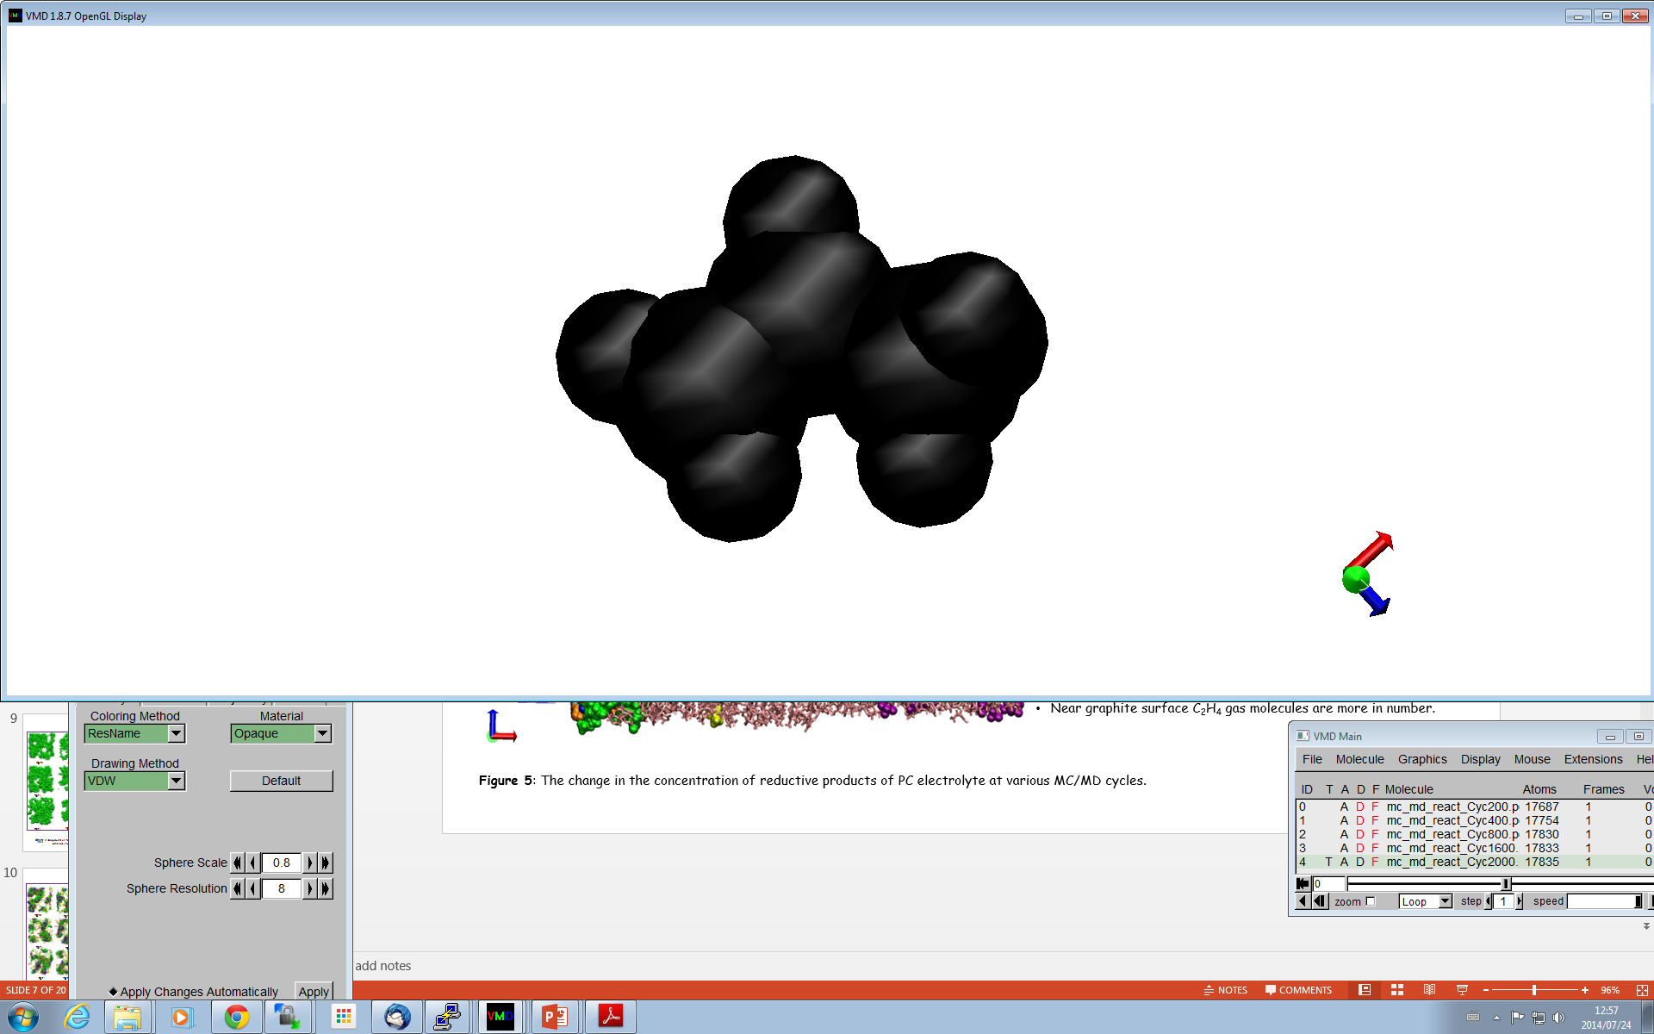
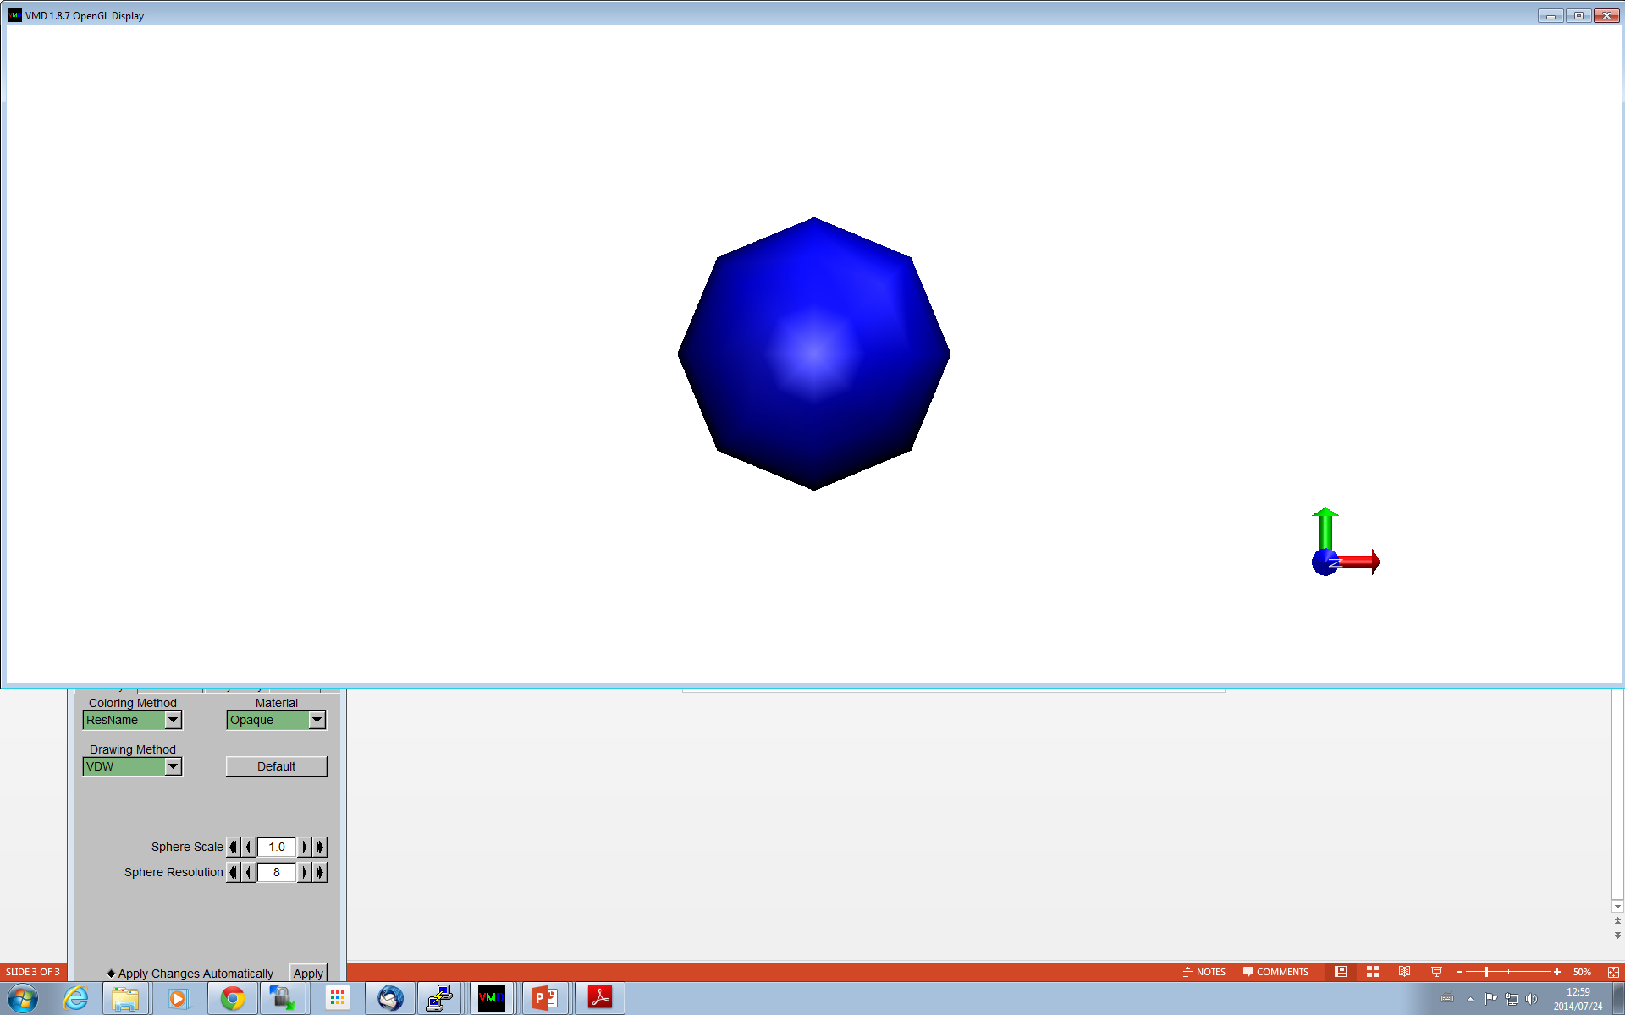
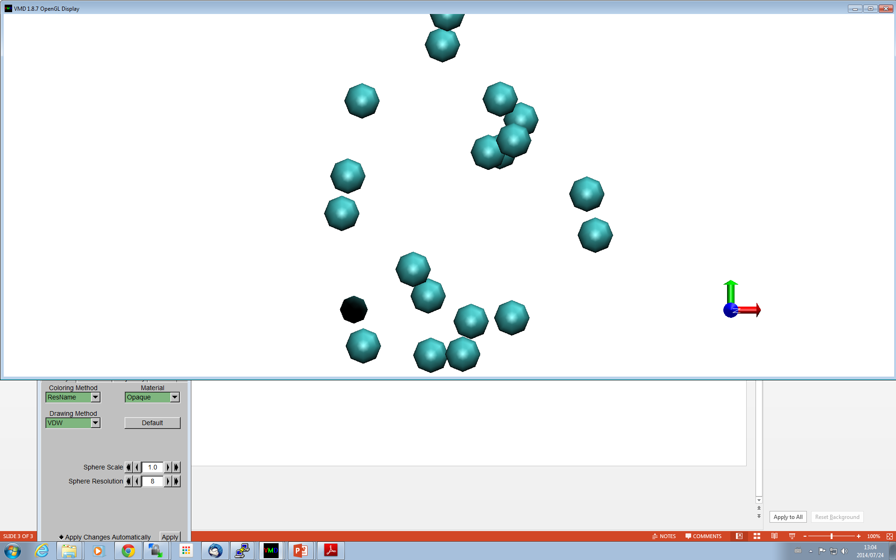
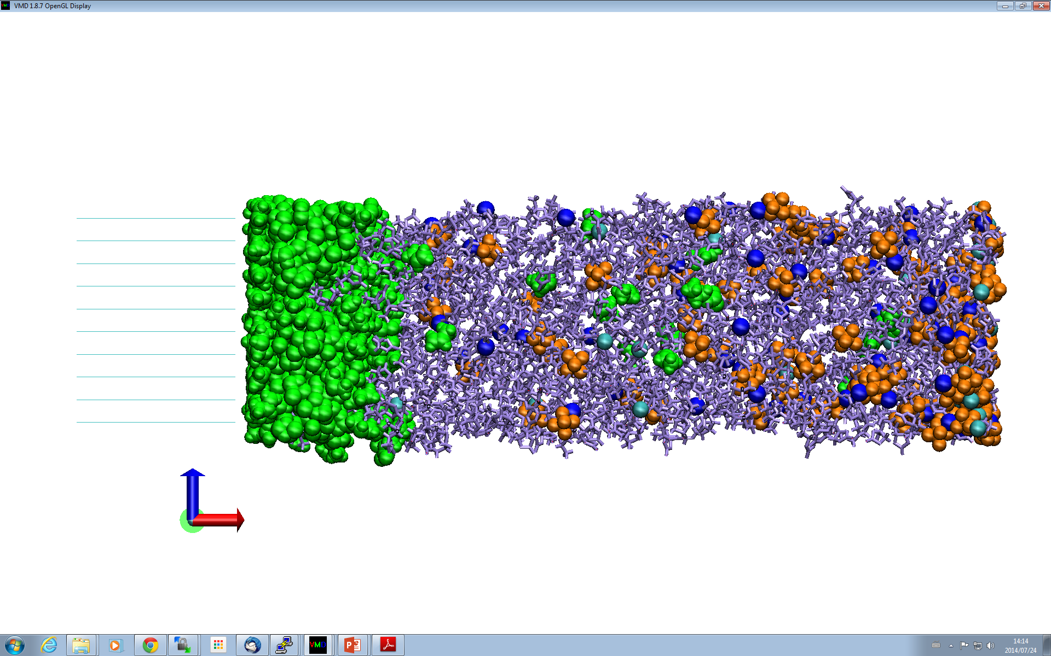
Reductive Products of PC Electrolyte
PC
DMBDC
CO₃
PF₃
C3H₆
Li
Na
200 Cycle
400 Cycle
800 Cycle
1600 Cycle
2000 Cycle
These structures displays how the components of electrolyte solutions developed into the SEI films during the hybrid MC/MD reaction simulations.
Li/NaPC molecules are predominant up to 400 cycles.
After 400 cycles the radical polymerization products Li₂/Na₂DMDBC and Na₂DMBDC and ionic products such as CO₃⁻² are formed the SEI film.
Near graphite surface C₂H₄ gas molecules are more in number.
Figure 3: The change in the concentration of reductive products of PC electrolyte at various MC/MD cycles.

Slide 7
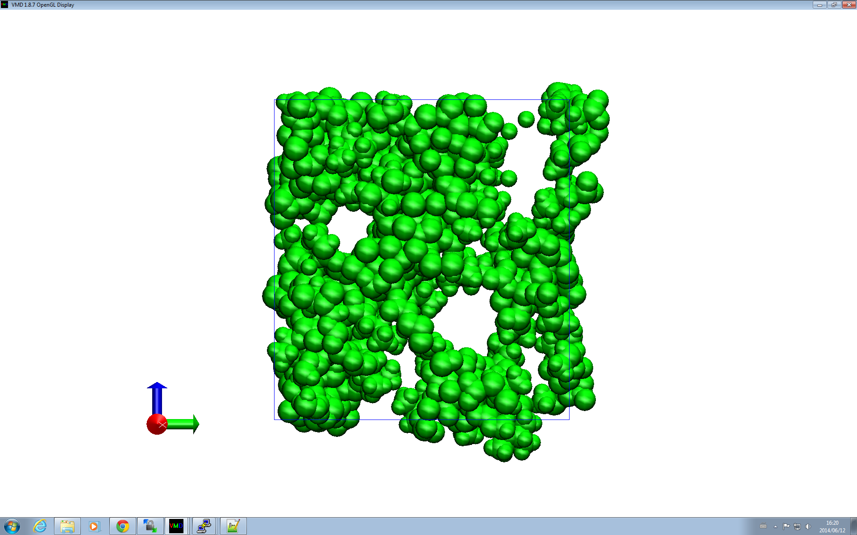
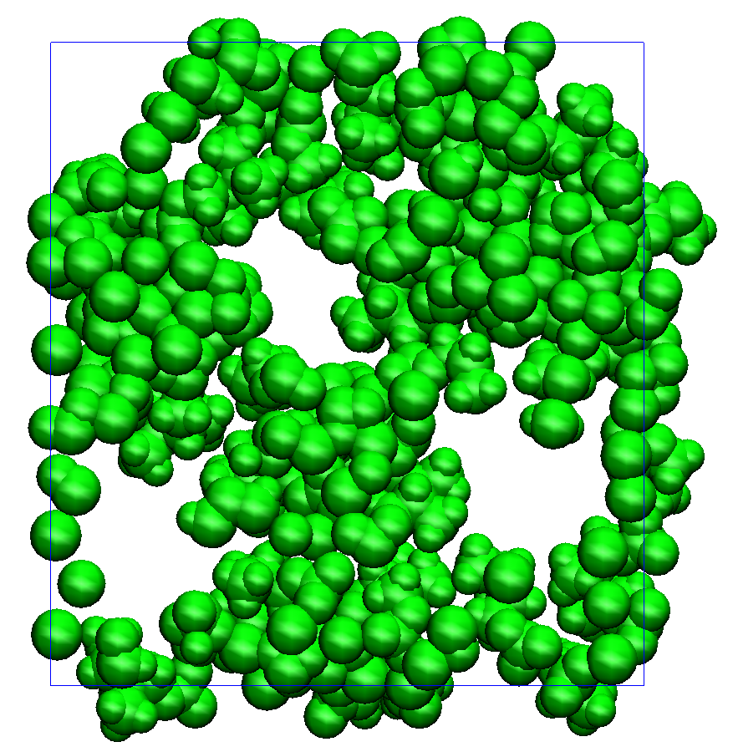
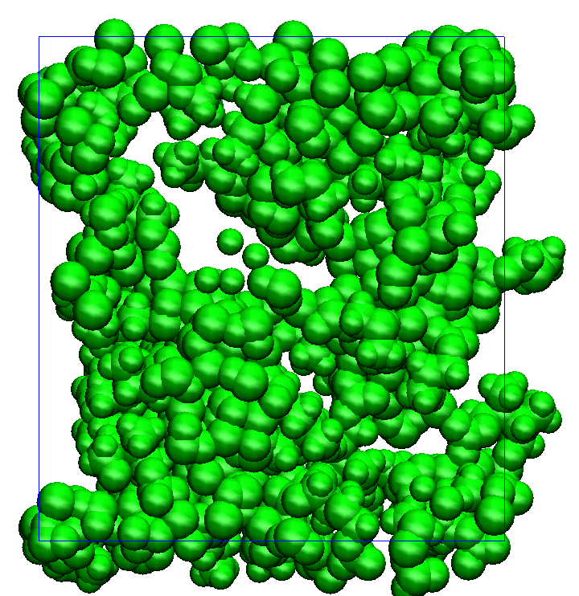
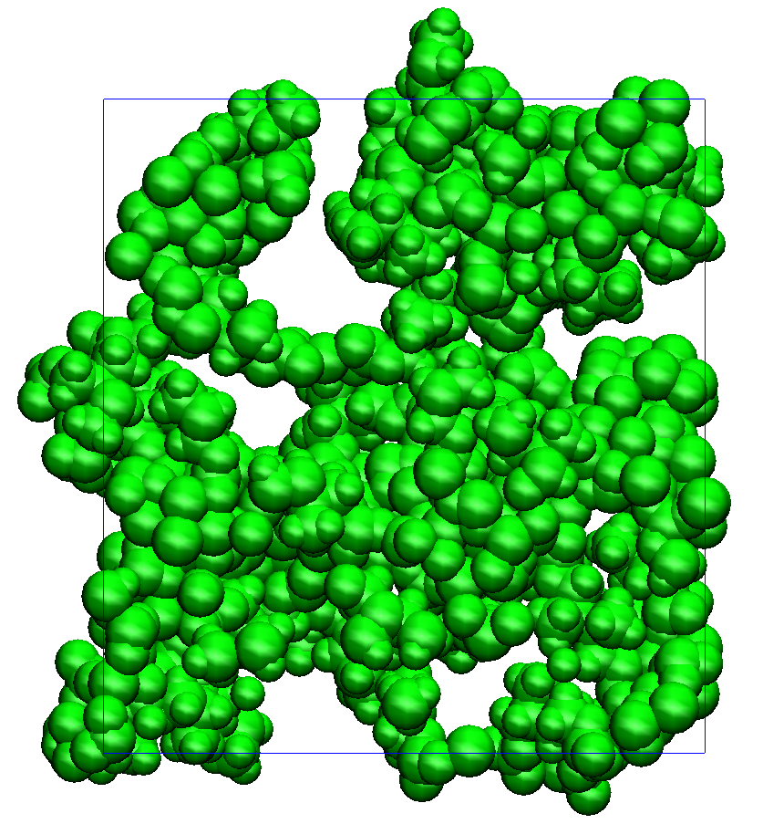
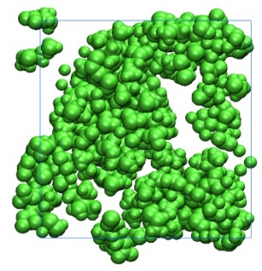
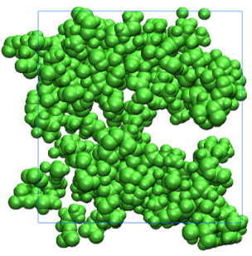
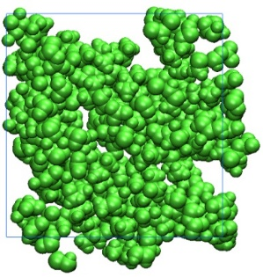
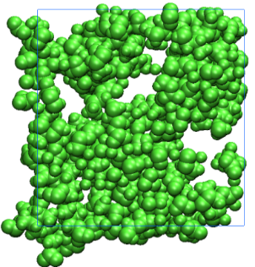
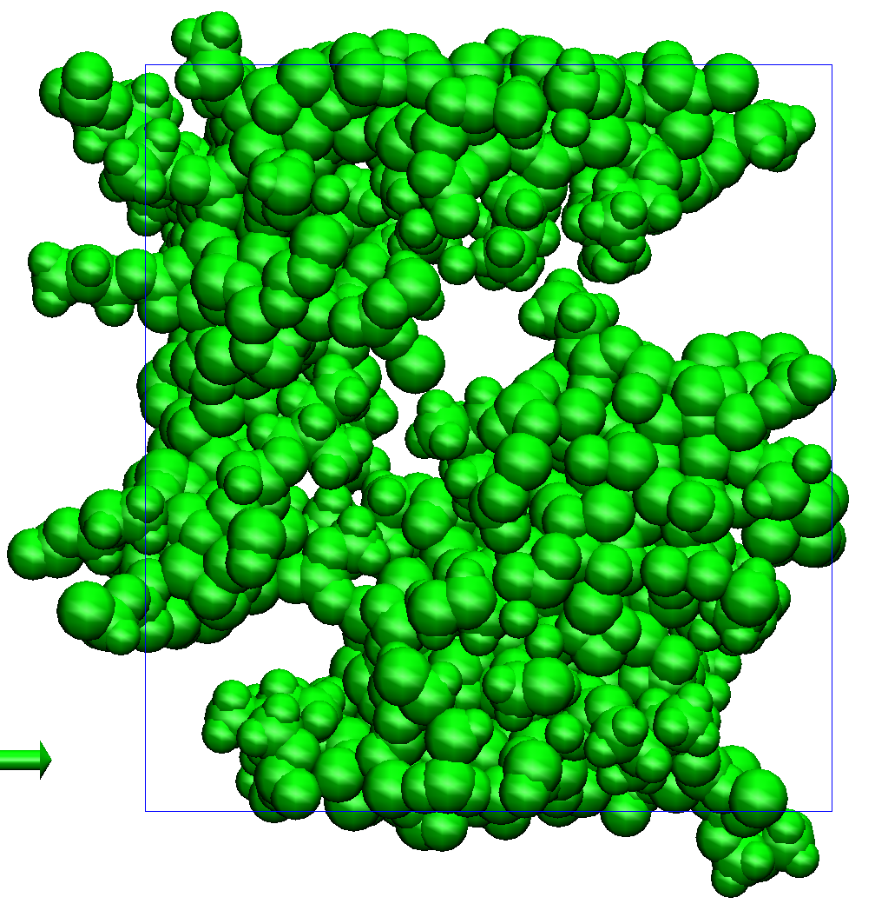
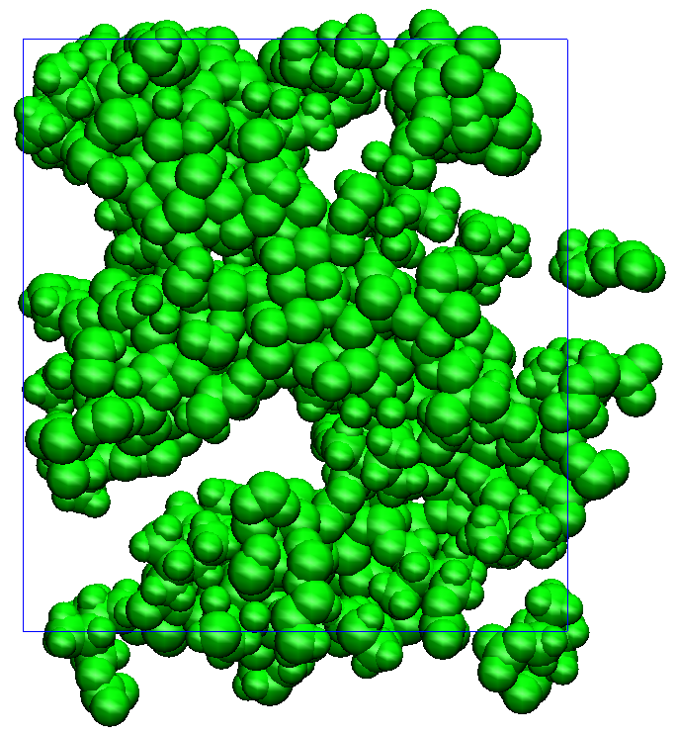
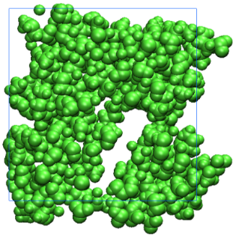
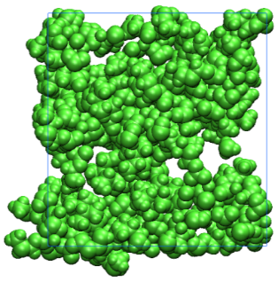
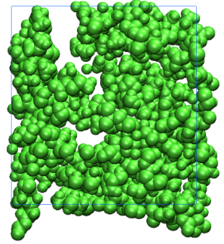
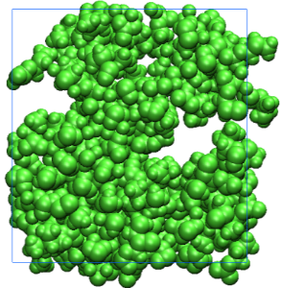
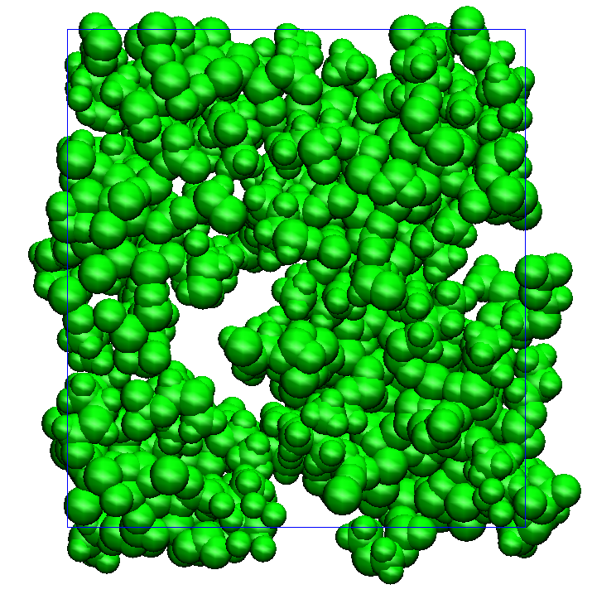
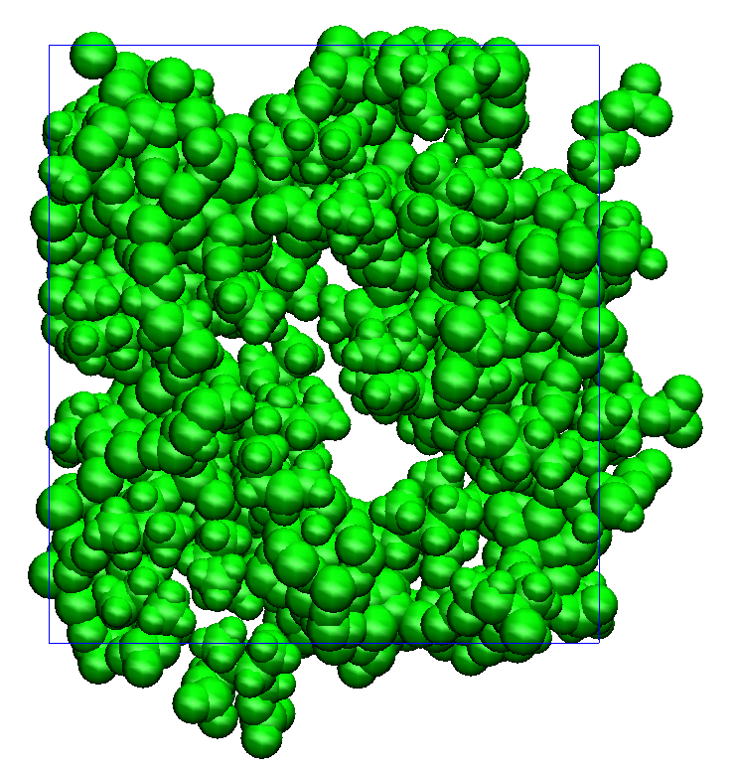
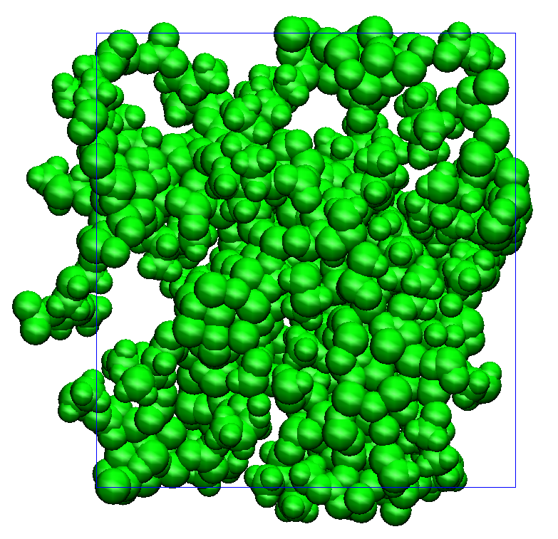
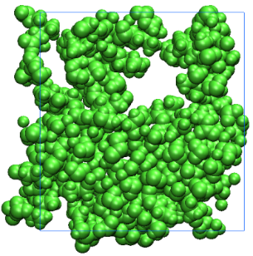
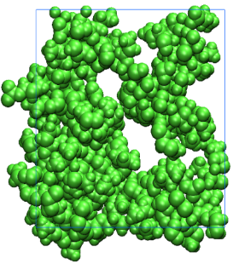
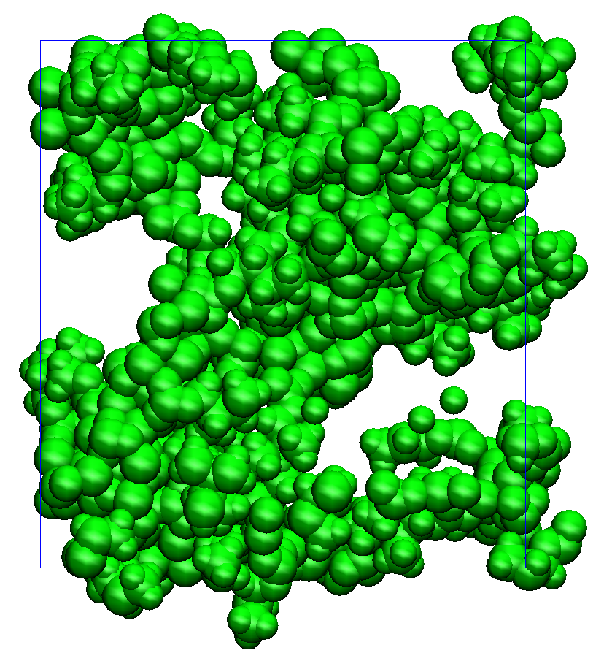
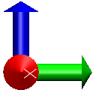
Snapshots of Ten Different Initial Structures
Sample.1
Sample.2
Sample.3
Sample.4
Sample 1
Sample 2
Sample 3
Sample 4
Sample.5
Sample.6
Sample.7
Sample.8
Sample 5
Sample 6
Sample 7
Sample 8
With Na ion
With out Na ion
Sample.9
Sample.10
Sample 9
Sample 10
Figure 4: Snapshots of the front view of the PC-based SEI products visualized in the depth 0 ≤ z ≤ 20 Å of the view from the side of bulk electrolyte. These structures are obtained from ten different initial states. To compare the present results we have mentioned also previous results with out Na ion as a n additive.

Slide 8
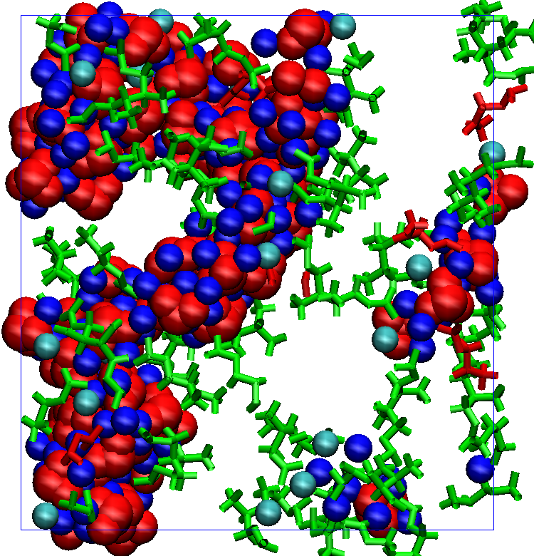
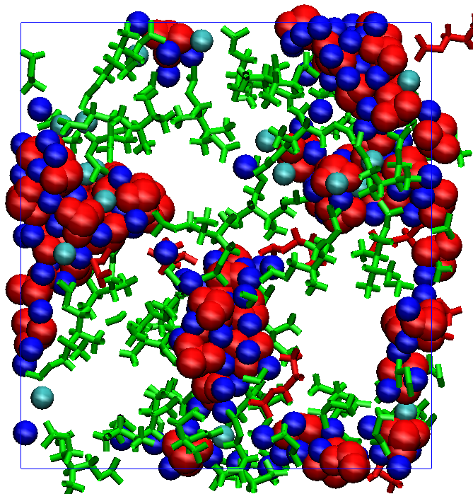
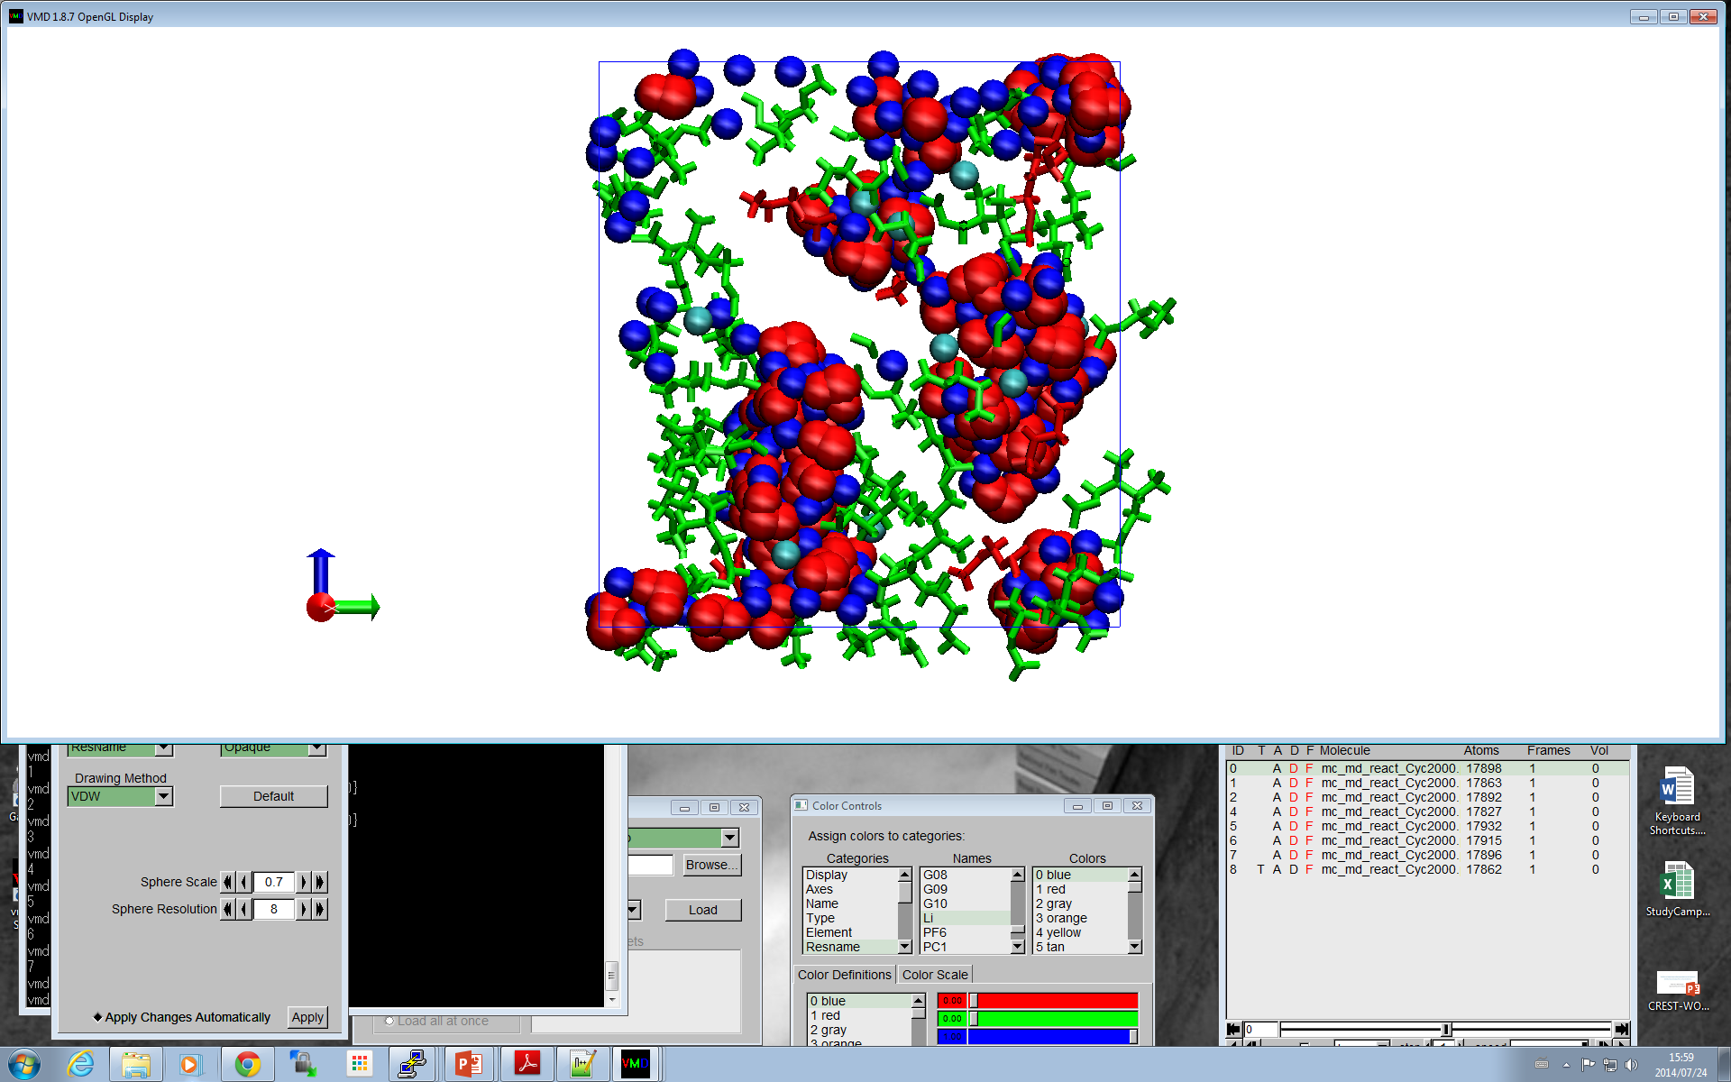

















Snapshots from Ten Different Initial States
Sample 1
Sample.1
Sample.2
Sample.3
Sample.4
Sample 2
Sample 3
Sample 4
Sample 5
Sample.5
Sample.6
Sample.7
Sample.8
Sample 6
Sample 7
Sample 8
With Na ion
With out Na ion
Sample 9
Sample 10
Sample.9
Sample.10
Figure 5: Front view snapshots of the interface structures of the PC-based SEI film visualized in the depth 0 ≤ z ≤ 20 Å of the view from the side of bulk electrolyte. These structures are obtained from 10 different initial states. Inorganic salts (Li₂CO₃, Li, Na) are depicted by the ball model (full vdW radii) (Red: CO₃²⁻, F⁻, Blue: Li⁺ and Cyan: Na⁺), while organic ones (Li/NaPC, Li₂/Na₂DMMBDC) by the stick model (Green: Li/Na DMBDC and red: Li/Na PC). To compare the present results we have also provided previous results with out Na ion as a n additive.

Slide 9



Surface Number Densities
(b)
LiPC
Li₂DMBDC
Li₂CO₃
$ρ_{n}^{s}$ [10⁻³Å⁻²]
LiF
ρ [10⁻³Å⁻²]
ρ [10⁻³Å⁻²]
$ρ_{n}^{s}$ [10⁻³Å⁻²]
C₃H₆
PF₃
PC
MC/MD cycles
MC/MD cycles
Figure 6: Comparison of the change in the surface number densities solvent molecules and reductive products with the MC/MD cycles in case of PC electrolyte with previous results (b).
(b)
LiPC
Li₂DMBDC
Li₂CO₃
LiF
ρ [gcm⁻³]
C₃H₆
${\text{ρ}}_{n}^{s}$[gcm⁻³]
PF₃
Z[Å]
z [Å]
Figure 7: Comparison of time-averaged mass density distribution of the final reductive products incase of PC electrolyte with previous results (b).

Slide 10
Discussion
The formation of SEI film in the PC based electrolyte looks less thicker.
The number of electrolyte molecules near the graphite is very less. However some of PC molecules coming out from the SEI film.
PC electrolyte has larger cavities in its SEI film. These, larger cavities can pass the solvent molecules towards graphite anode surface in the reduction process. It is very important to protect electrolyte solution in the reduction process.
In this study some clusters appear with polar residues, however there are larger cavities appeared in the SEI film formation.
Compare to Na-free SEI film with Na-added SEI film, the effect of Na⁺ ion is not significant.

Slide 11










Reductive Products of EC Electrolyte
200 Cycle
400 Cycle
1600 Cycle
2000 Cycle
800 Cycle
EC
BDC
CO₃
PF₃
C₂H₄
Li
Na
These structures displays how the electrolyte solution components developed into the SEI films during the hybrid MC/MD reaction simulations.
Li/NaEC molecules are predominant in the initial stage.
After 400 cycles polymerization products Li₂BDC, Na₂BDC and ionic products such as CO₃⁻² are predominant.
Near graphite surface C₂H₆ gas molecules are lesser than PC SEI film.
Figure 8: The change in the concentration of reductive products of EC electrolyte at various MC/MD cycles.

Slide 12




















Snapshots of Ten Different Initial States
Sample 1
Sample 2
Sample 3
Sample 4
Sample.1
Sample.2
Sample.3
Sample.4
Sample 5
Sample 6
Sample 7
Sample 8
Sample.5
Sample.6
Sample.7
Sample.8
With Na ion
With out Na ion
Sample 9
Sample 10
Sample.9
Sample.10
Figure 9: Snapshots of the front view of the EC-based SEI products visualized in the depth 0 ≤ z ≤ 20 Å of the view from the side of bulk electrolyte. These structures are obtained from ten different initial states. To compare the present results we have mentioned also previous results with out Na ion as an additive.

Slide 13




















Snapshots of Ten Different Initial States
Sample 1
Sample 2
Sample 3
Sample 4
Sample.1
Sample.2
Sample.3
Sample.4
Sample 5
Sample 6
Sample 7
Sample 8
Sample.5
Sample.6
Sample.7
Sample.8
With Na ion
With out Na ion
Sample 9
Sample 10
Sample.9
Sample.10
Figure 10: Front view snapshots of the interface structures of the PC-based SEI film visualized in the depth 0 ≤ z ≤ 20 Å of the view from the side of bulk electrolyte. These structures are obtained from 10 different initial states. Inorganic salts (Li₂CO₃, Li, Na) are depicted by the ball model (full vdW radii) (Red: CO₃²⁻, F⁻, Blue: Li⁺ and Cyan: Na⁺), while organic ones (Li/NaEC, Li₂/Na₂BDC) by the stick model (Green: Li/Na BDC and red: Li/Na PC). To compare the present results we have also provided previous results with out Na ion as a n additive.

Slide 14



Surface Number and Mass Densities
(b)
LiEC
Li₂BDC
Li₂CO₃
$ρ_{n}^{s}$ [10⁻³Å⁻²]
LiF
ρ [10⁻³Å⁻²]
ρ [10⁻³Å⁻²]
$ρ_{n}^{s}$ [10⁻³Å⁻²]
C₂H₄
PF₃
EC
MC/MD cycles
MC/MD cycles
Figure 11: Comparison of the change in the surface number densities solvent molecules and reductive products with the MC/MD cycles in case of EC electrolyte with previous results (b).
(b)
LiEC
Li₂BDC
Li₂CO₃
LiF
ρ [gcm⁻³]
C₂H₄
${\text{ρ}}_{n}^{s}$[gcm⁻³]
PF₃
Z[Å]
z [Å]
Figure 12: Comparison of time-averaged mass density distribution of the final reductive products incase of EC electrolyte with previous results (b).

Slide 15
Discussion
The formation of SEI film in the EC based electrolyte is denser than PC electrolyte.
The number of electrolyte molecules near the graphite is very less.
At the interface structure the electrolyte molecules are scarce, which is very important for the protection of the electrolyte from the reduction.
It is clear from the above observation that the EC-based SEI film behaves as a protective covering to prevent EC electrolyte from approaching the anode surface.
EC electrolyte has some cavities in its SEI film. Which are smaller in size compare to PC electrolyte SEI film. These cavities are more suitable for Li⁺ ion mobility.
Compare to previous results the effect of Na⁺ appeared very less in the formation of SEI film.
Compare to PC electrolyte, the formation of SEI film is thicker and wider in EC electrolyte .
In next trail of calculations we have increased the concentration of Na⁺ ions from 0.2M to 0.4 M

Slide 16










Reductive Products of EC Electrolyte
300.0 Å
1.1M LiPF₆ PC or EC electrolyte + 0.4M NaPF₆
Temperature ：298K
EC: 1160
Li⁺: 69
PF₆⁻: 95
Na⁺: 28
34.1 Å
x
200 Cycle
400 Cycle
800 Cycle
1600 Cycle
2000 Cycle
z
Z origin
Figure 15: Model systems considered for the hybrid MC/MD simulation.
These structures displays how the electrolyte solution components developed into the SEI films during the hybrid MC/MD reaction simulations.
Li/NaEC molecules are predominant in initial stage.
After 400 cycles polymerization products Li₂/Na₂BDC and ionic products such as CO₃⁻² are predominant.
Near graphite surface C₂H₆ gas molecules are less in number.
Figure 13: The change in the concentration of reductive products of EC electrolyte at various MC/MD cycles.
EC
BDC
CO₃
PF₃
C₂H₄
Li
Na
a)
b)
Figure 16: The front views of the interface structures in the SEI films (a) (visualized in the depth 0 ≤ z ≤ 20 Å of the view from the side of bulk electrolyte). (b) Inorganic salts (Li2CO3, LiF) are depicted by the ball model (full vdW radii) (red, CO₃⁻², F⁻; blue, Li⁺, cyan Na⁺), while organic ones (Li/NaEC, Li₂/Na₂BDC) by the stick model (green).
Figure 14: Snapshot of the EC-based electrolyte SEI film (green, SEI film; blue, Li+; gray, PF3, C2H4, or C3H6; purple, EC or PC; orange, PF6⁻).

Slide 17





Number and Mass Densities
b)
(C)
LiEC
Li₂BDC
Li₂CO₃
LiF
${\text{ρ}}_{n}^{s}$[gcm⁻³]
${\text{ρ}}_{n}^{s}$[gcm⁻³]
ρ [gcm⁻³]
C₂H₄
PF₃
Z[Å]
z [Å]
Z[Å]
Figure 1: Comparison of time-averaged mass density distribution of the final reductive products incase of EC electrolyte with previous results (b). The time-averaged mass density distribution of the Li and Na atoms incase of EC electrolyte (C).
b)
(C)
LiEC
$ρ_{n}^{s}$ [10⁻³Å⁻²]
Li₂BDC
Li₂CO₃
$ρ_{n}^{s}$ [10⁻³Å⁻²]
LiF
ρ [10⁻³Å⁻²]
ρ [10⁻³Å⁻²]
$ρ_{n}^{s}$ [10⁻³Å⁻²]
C₂H₄
PF₃
EC
MC/MD cycles
MC/MD cycles
MC/MD cycles
Figure 17: Comparison of the Change in the surface number densities of solvent molecules and reductive products with the MC/MD cycles in case of EC electrolyte with previous results (b). The change in the concentration of surface number densities of the Li and Na atoms with respect to the MC/MD cycles in case of EC electrolyte (C).

Slide 18
Summary
The formation of SEI film in the EC based electrolyte after increasing the number of Na⁺ ions looks thicker.
The number of electrolyte molecules near the graphite is very less.
At the interface structure the electrolyte molecules are scarce, which is very important for the protection of the electrolyte from the reduction.
EC electrolyte has some cavities in its SEI film. Which are smaller in size compare to PC electrolyte SEI film. These cavities are more suitable for ions mobility.
Compare to previous results the effect of Na⁺ clearly appeared by formation of SEI film in less number of MC/MD cycles.
The mass density of the dimeric molecules are increased compare to previous results.
The mass density of the Na and Li atoms are virtually similar in this study.
Overall compare to non-Na ion SEI film, the Na added SEI film is more thicker and wider.
Compare to PC electrolyte, the formation of SEI film is very thick and wider in EC electrolyte .

Slide 19


