Slide 1
Improving pK_{a} Prediction of Semi-Empirical Quantum Mechanics Constant pH method
Yukichi Kitamura
Notes:
The title of my presentation is “”
Now, I’m developing the constant pH method based on quantum mechanical calculations.
And I’d like to talk some preliminary results.

Slide 2
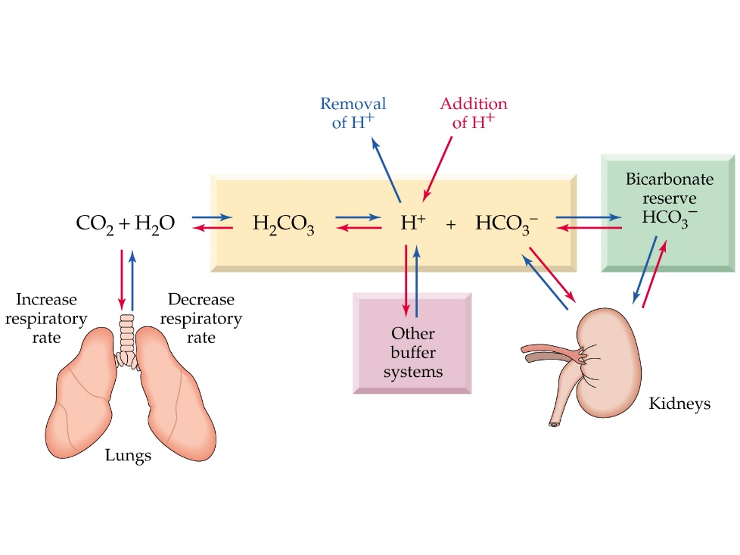
Background: Importance of pH
The pH of water determines the solubility and biological availability of chemical components such as organics (phosphorus, nitrogen, and carbon) and heavy metals (lead, copper, cadmium, etc.).
Exaple-I) Relationships of the bicarbonate buffer system to the lungs and kidneys.
Example-II) Metal toxicity dependent on pH.
*Free ionic form usually works toxic.
MX_{n} → M^{n+} + nX⁻
Base
Acid
[1] lungs and kidneys relation with the bicarbonate buffer system.
http://wps.prenhall.com/wps/media/objects/376/385232/Media-Portfolio/chapter_10/10.html
Notes:
Let’s start to talk about background of my research.
The pH condition is one of environmental variables to control many properties and functions.
As you know, carbon dioxide (CO2) have acid-base equilibrium, which is closely relative to essential function in living body.
In the case of heavy metals, the degree of the solubility determines their toxicity. In general, metals tend to be more toxic at lower pH because they are more soluble.

Slide 3
Previous Computational Approach
For modeling and theoretical computation of pH effects, pH-related processes have been attracting interest.
A Quantum Mechanical Treatment
Direct estimation pK_{a} from thermodynamic cycle for deprotonation reaction in solution
However, it is difficult to include the environmental conditions* from the point of view of computational costs.
Thermodynamic cycle for the pK_{a} calculation using the direct method ^{[2]}.
(e.g., *ionic strength, molecular concentration, presence of other charged molecules, etc.)
[2] F. Barroso daSilva, et al., Biophys. Rev., 9 (2017) 699.
Notes:
Essentially, the proton transfer events between solute and solvent should be treated quantum mechanics. Therefore, …
Moreover, they give us a static property and cannot obtain the dynamical descriptions related to solution pH conditions.

Slide 4
Constant pH (CpH) method
A Classical Mechanical Treatment
To express change in the protonation states, the state transition depending on pH allows within classical force field framework, called constant pH (CpH) method.
Exchange of protonation state and equilibrium
Metropolis Monte Carlo process
Conformation sampling
E_{r}
E_{p}
ΔE_{rp}=E_{p}-E_{r}
Notes:
The other approaches is based on a classical mechanical one.
First, conformational sampling is executed by common simulation method, second, exchange…,
Third, the state transition is accepted or rejected by Metropolis algorism.
This method could better access the protonation-conformation sampling within realistic computational time.

Slide 5
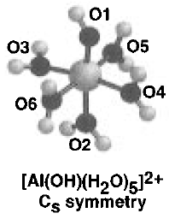
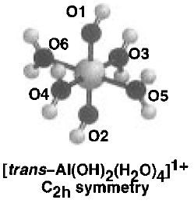
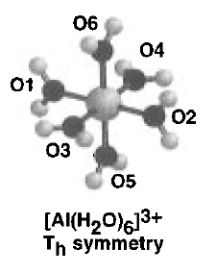
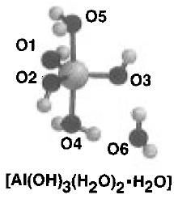
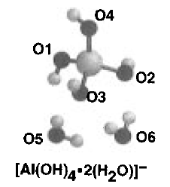
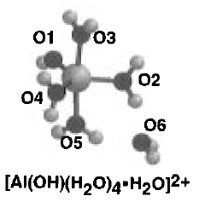
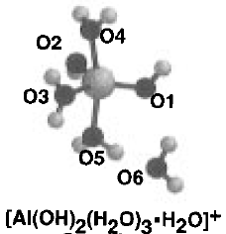
Limitations of MM-based approach
A Classical Mechanical Treatment
However, in some cases, it is difficult to describe the molecular modeling by using common classical force fields such as metal complex systems.
Protonation state and solvation structure changes of aluminum aqua complex system
[3] Ruiz, J. M.; McAdon, M. H.; Garcés, J. M. J. Phys. Chem. B 1997, 101, 1733– 1744
Notes:
Moreover, the inclusion of polarization is limited.
Yoshida-kun have researched this system, and found that semi-empirical Hamiltonian can reproduce their structures qualitatively.
And then he developed the QM-based CpH method and applied to itd pH-dependency.

Slide 6
Contents of Today’s Workshop
In this workshop, I have researched the pK_{a} predictability of semi-empirical QM based CpH method.
I report that:
predicted pK_{a} values of the acetic acid analogues R_{n}-CH_{3-n}-COOH by CpH method with two semi-empirical QM methods (i. e., PM3 and DFTB3 method, implemented in Amber package).
Estimate the energy relationship in model system and discuss the origin of errors.

Slide 7
Theory: Constant pH method
Reshown in previous CREST workshop
Constant pH method consists two parts:
MD: Equilibration and conformation sampling
MC: λ protonation state transition
START
The energy difference for MC trial, depending on pH condition, is constructed from three components.
~20.0 ps
Equilibrium MD
Change the protonation state
Energy Minimization
Searching MD
~20.0 ps
Rejected
Metropolis
Accepted
Figure. Flowchart of CpH method
Update protonation state
Notes:
State transition by MC is intermediately introduced. First term is the instantaneous energy difference before and after transitions.
Second is the free energy difference estimated by adopted QM method.
Third is the free energy term depending on the pH value.

Slide 8
Theory: Calculation of free energy
For free energy estimation, the thermodynamic integration (TI) method was applied.
I modified the original sander module with the simplest implementation for the interpolation.
This is necessary twice QM calculations (λ=0 and 1) per one MD step.
And then linearly combined with energies and forces on all atoms depending on a certain λ value.
Notes:
In previous MM-based CpH method, the ensemble in intermediate states (0<λ<1) is generated by the interpolation of force field parameters (atomic charges, Lennard-Johns and intramolecular ones).
But, the TI calculation employing QM method cannot follow same procedure.

Slide 9
Methods: model system
For the model compound, I adopted the acetic acid, pK_{a} is 4.76.
Before the CpH simulation, the free energy difference between two states ΔG^{QM} was estimated via TI method.
Protonated state
(λ=0, neutral form)
Deprotonated state
(λ=1, negative charged form)
Figure. Acid-based equilibrium of acetic acid

Slide 10
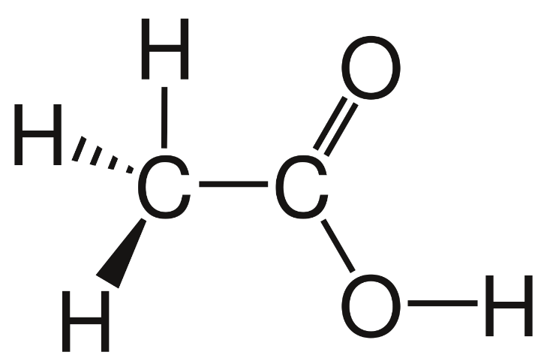
Methods: QM-MM partition (model)
A free proton is treated as a non-interacting dummy particle for the deprotonated state.
No MM
MM
(Dummy H atom)
QM(PM3)
QM(PM3)
Protonated state
(λ=0, q=0 [e])
Deprotonated state (λ=1, q=-1 [e])
Figure. QM-MM partition for acetic acid
Notes:
For λ=0, all atoms are treated as a QM atom.
A free proton generated by deprotonation reaction is not transferred explicitly to simulation box.
And excluded into the QM region.
Solvent is expressed by generalized Born implicit solvation model.

Slide 11
Methods: Calculation of free energy
In addition, I researched the two kinds of acetic acid analogues to R_{n}-CH_{3-n}-COOH computational accuracy.
Fluoro acetic acid is shown smaller pK_{a} values, due to the their strong electron-attracting properties.
F_{n}-CH_{3-n}-COOH
CH₃-CH₂-COOH
Fluoro acetic acid
(R=-F, n=1~3, 2.59~0.3)
Propionic Acid
(R=-CH₃, pK_{a}=4.88)
Figure. Acetic acid analogues
Notes:
On the contrary, pKa of the propionic acid is slightly increased.

Slide 12
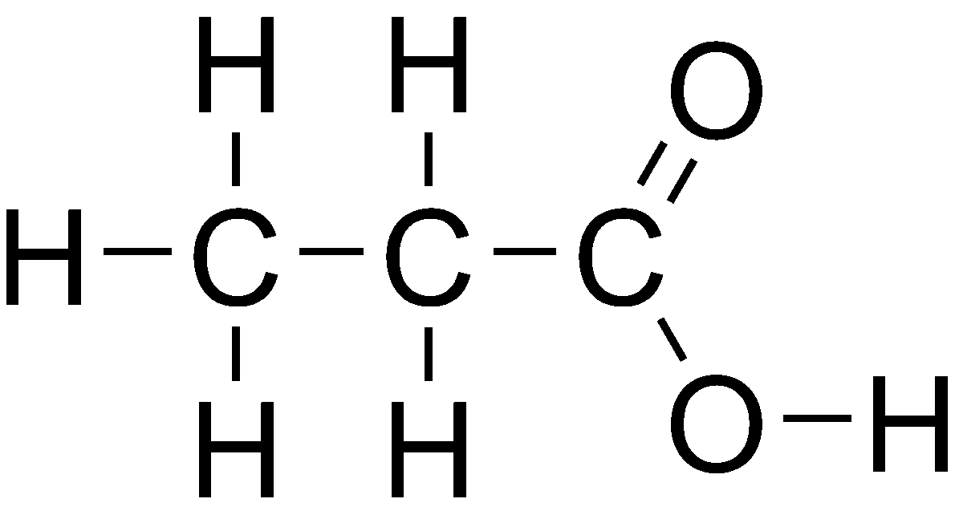
Methods: QM-MM partition
For propionic acid, two distinct QM-MM partition are applied.
The QM-MM boundary is applied the capping Hydrogen atom.
No MM
QM(PM3)
MM
(amber force field)
QM(PM3)
Model-I
(Full QM treatment)
Model-II
(-CH3 group is excluded into MM region)
Figure. QM-MM partition for propionic acid
Notes:
In Model-II, the CH3 group is excluded into MM region.
The QM-MM boundary is applied the capping Hydrogen atom.

Slide 13
pK_{a} shift for fluoro acetic acid
As increasing the number of fluoro-substituents, pKa become smaller.
PM3 Hamiltonian will overestimate the electronegative contribution.
On the other hand, the DFTB3 predictions are seem to be closer to experiments in comparison with PM3.
Table 1. Predicted and Experimental pK_{a} for acetic acid analogue, R_{n}-CH_{3-n}COOH
 |  | Acetic acid | Fluoro-substituted acetic acid pK_{a} (ΔpK_{a})
pK_{a} (shift) |  |  | Mono- | Di- | Tri-
SQMGB-CpH | PM3 | 4.75 | 2.3 (-2.45) | 0.4 (-4.35) | -2.95 (-7.7)
 | DFTB3 | 4.75 | 5.6 (+0.94) | 3.6 (-1.06) | 1.0 (-3.66)
Exp. ^{[1]} |  | 4.76 | 2.59 (-2.17) | 1.34 (-3.42) | 0.3 (-4.46)
[1] Kim S, Thiessen PA, Bolton EE, Chen J, Fu G, Gindulyte A, Han L, He J, He S, Shoemaker BA, Wang J, Yu B, Zhang J, Bryant SH. PubChem Substance and Compound databases. Nucleic Acids Res. 2016 Jan 4; 44(D1):D1202-13. Epub 2015 Sep 22 [PubMed PMID: 5237] doi: 10.1093/nar/gkv951.
Notes:
Predicted and experimental values are summarized in Table 1.
…, which can be explained by substituent effects.
For predicted values, it would seem that pKa of mono-fluoro acetic acid by PM3 (2.3) has the closest value to experimental one.
So, it is considered that …

Slide 14
Thermodynamic cycle
H
H
+F
+H
Model: Acetic acid, pK_{a, model}
-H
-F
F
F
Analogue: Fluoro-substituted acetic acid, pK_{a, analogue}
Figure 1. Thermodynamic cycle in protonation/deprotonation reaction
Notes:
Thermodynamic cycle in protonation/de-protonation reaction is helpful for understanding the pKa shifts from model system. This can be related with the free energy relationship between two systems.

Slide 15
Energy relationship 1/3
In CpH method, the pK_{a}s are predicted as a perturbative shift from that of the model system, based on energetic estimations by force field.
We assume that the pH-dependent deprotonation free energy ΔG_{analogue} for analogue system can be calculated as
Here, ΔΔG^{SQMGB} is de-protonation free energy between model and analogy system, which are estimated by semi-empirical QM method combined with generalized Born (GB) method.
(1)

Slide 16
Energy relationship 2/3
From thermodynamic cycle, this is can related with free energy by hydrogen-fluoro atom exchange reaction between protonation (λ=0) and de-protonation state (λ=1),
and then can derived
(2a)
(2b)
Notes:
The ΔΔG^SQMGB in Eq. (2b) can be contributed as a shift in free energy of the model compound, which is considered the change in the environment of non-bonded interactions of the titratable group when it is transferred from the solvent to the complicated environment.
But, in QM-based CpH method, this contribution include the intramolecular interactions.

Slide 17
Energy relationship 3/3
The potential energy differences in both QM Hamiltonian have negative value and is consistent with experimental trends of pKa shift.
(3)
Table 3. Comparison with potential energy difference ΔΔE_{H↔F} and converted free energy differences ΔΔG^{A-M} between model and analogue
 |  | Acetic acid | Fluoro-substituted acetic acid
ΔΔE_{H↔F} [kcal/mol] (ΔG^{A-M}[kcal/mol]) |  |  | Mono- | Di- | Tri-
SQMGB-CpH | PM3 | 0 (0) | -2.98 (-3.24) | -5.78 (-5.85) | -5.49 (-10.45)
 | DFTB3 | 0 (0) | -0.77 (1.29) | -21.00 (-1.46) | -4.96 (-5.02)
Exp. |  | (0) | -2.98 | -4.69 | -6.12
Notes:
To analyze such contribution, I investigated it by employing the PM3 and DFTB3 method with GB method.
In PM3, the potential energy difference is relatively similar to free energy difference, and pKa shifts by PM3 is mainly contributed from the potential energy differences.

Slide 18
pK_{a} shift for propionic acid
Table 2. Predicted and Experimental pK_{a} for propionic acid analogue, CH₃-CH₂-COOH
 |  | Acetic acid | Propionic acid pK_{a} (ΔpK_{a})
pK_{a} (shift) |  |  | Model-I | Model-II
SQMGB-CpH | PM3 | 4.75 | 4.19 (-0.56) | 5.60 (+0.85)
Exp. ^{[1]} |  | 4.76 | 4.88 (+0.12)
[1] Kim S, Thiessen PA, Bolton EE, Chen J, Fu G, Gindulyte A, Han L, He J, He S, Shoemaker BA, Wang J, Yu B, Zhang J, Bryant SH. PubChem Substance and Compound databases. Nucleic Acids Res. 2016 Jan 4; 44(D1):D1202-13. Epub 2015 Sep 22 [PubMed PMID: 5237] doi: 10.1093/nar/gkv951.
PM3 method cannot be reproduced the experimental values, and the degree of errors seem to be equal.
But, the trend of shift of Model-II is same as one of the experiment.
Notes:
Table summarized results for propionic acid.

Slide 19
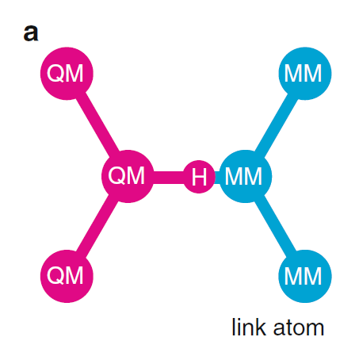
Discussion) Choice of QM-MM boundary
In comparison with two models, the model-II is better for the present system.
In model-II, the QM-MM boundary is defined by cutting C-C single bond, H atom (as link atom) is present only in the QM calculation.
By applying such treatment, the total number of electrons is kept in both system (Model and Analogue).
As a result, it is indicated that the theoretical errors of PM3 Hamiltonian canceled out.

Slide 20
Conclusion
I have researched the pK_{a} predictability of the simple CpH method combined with semi-empirical QM method.
From the results obtained above investigations,
1) Semi-empirical QM methods with GB method were not reproduced the experimental pK_{a} values.
2) The error of PM3 method mainly comes from the potential energetic contribution.
<Next plan>
I investigate the energetic calibration method using high quality QM method.
Notes:
To obtain experimental pKa, this method should be improved.

Slide 21
Thank you for your attention.

Slide 22
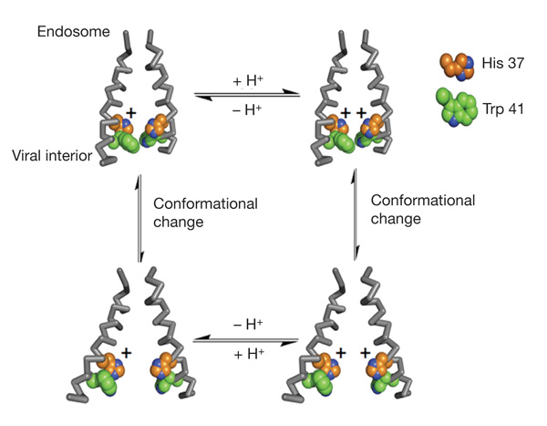
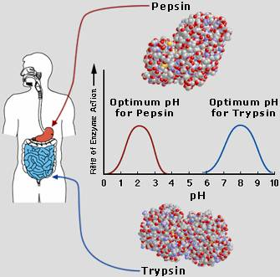
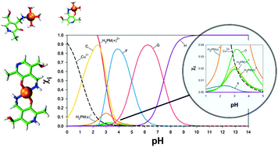
Background: pH dependent phenomena
The protonation equilibria have a strong influence on a variety of chemical reaction processes.
Biology: Ion channel [1], enzyme [2], Protein denature
Chemistry: Catalyst, Metal complex [3], Catalyst
Engineering: Pattern etching, Cleaning, Adsorbent, … etc.
The distribution diagram of pyridoxamine–copper(II) complexes in solution^{[3]}
Ion channel: two helices of the tetramer and one protonation event^{[1]}
Enzyme: the optimum pH for two digestive enzymes in human body^{[2]}
[1] A. L. Stouffer, et al., Nature 451 (2008) 596-599.
[2] Biology10thgrade: https://biology10thgrade.wikispaces.com/Enzymes
[3] R. Casasnovas, et al., Phys. Chem. Chem. Phys. 15 (2013) 16303.
Notes:
As you know, …

Slide 23
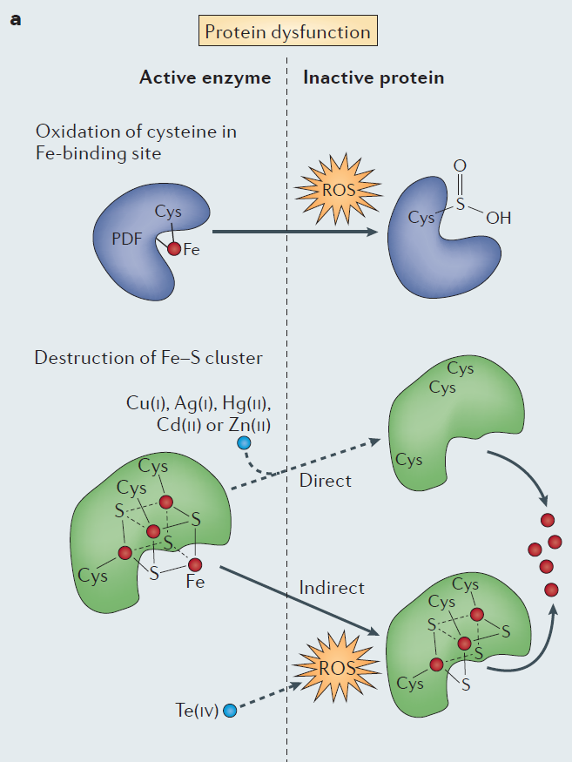
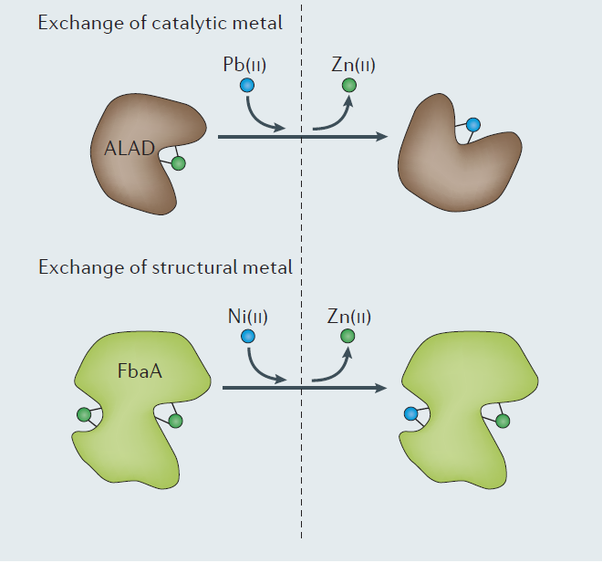
Background: pH dependent phenomena
Example) Metal toxicity
Fig. Mechanics of metal toxicity ^{[2]}
[2] Lemire, J. A., J. J. Harrison, and R. J. Turner. 2013. Antimicrobial activity of metals: mechanisms, molecular targets and applications. Nat Rev Micro. 11:371-384.
Notes:
As you know, …

Slide 24
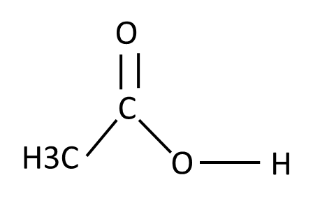
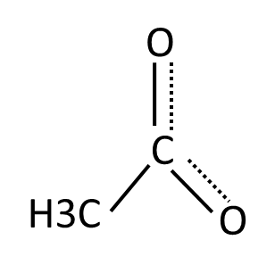
Background: CpH method
A Classical Mechanical Treatment
Energy Diagram via MM force field → Experimental energy compensation
(ΔG^{MM} and ΔG^{pH})
pH<pK_{a}
$$E_{λ_{i−1}}$$
$$−{ΔG}_{λ=0→1}^{MM}$$
$${−ΔG}_{pH}$$
$${ΔE}_{λ_{i−1}→λ_{i}}$$
pH=pK_{a}
$$E_{λ_{i}}$$
$$+{ΔG}_{pH}$$
pH>pK_{a}
⊖
Notes:
The first term is energy difference generated by MD simulation.
Of course, MM-based simulation cannot consider chemical bonding and breaking corresponding to protonation/deprotontation events.
Therefore, the energy difference by MM calculation will not reproduce the correct value.
In CpH method, the free energy compensation is introduced, which is estimated by MM-MD calculation.
And then, pH dependency is included by the third term.

Slide 25
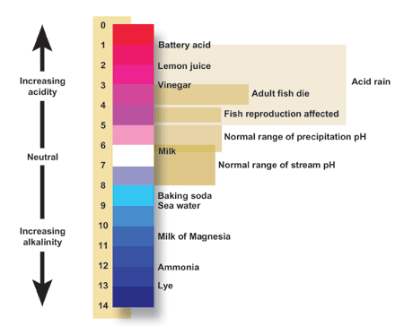
Background: Importance of pH
The pH of water determines the solubility and biological availability of chemical components such as organics (phosphorus, nitrogen, and carbon) and heavy metals (lead, copper, cadmium, etc.).
For example) C
For example) Metal toxicity dependent on pH Metal toxicity dependent on pH.
*Free ionic form usually works toxic.
MX_{n} → M^{n+} + nX⁻
Base
Acid
Definition: pH=−log[H⁺]
For instance, [H⁺] changes from 10⁻² to 10⁻¹⁰ mol/L at the standard conditions of aqueous solution (pH=2-10).
[1] Enviroment Canada; http://www.ec.gc.ca/eau-water/default.asp?lang=En&n=fdf30c16-1.
Notes:
The pH condition is one of environmental variables to control many properties and functions.
As you know, …
In the case of heavy metals, the degree of the solubility determines their toxicity. Metals tend to be more toxic at lower pH because they are more soluble.

