Slide 1
2015/February/10
Tacticity of dimeric and trimeric MMA radicals estimated by DFT calculation
DFT 計算による二量体・三量体 MMA ラジカルの 立体規則性（タクティシティ）解析
Masayoshi Takayanagi
Graduate School of Information Science, Nagoya University

Slide 2
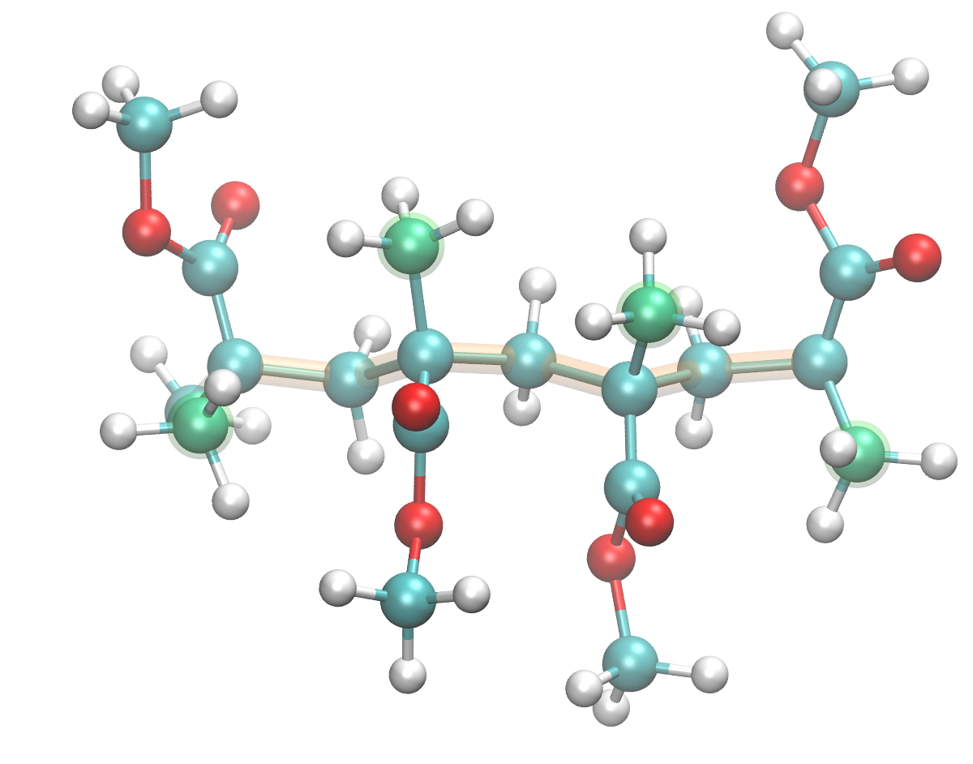
Tacticity of polymethyl methacrylate (PMMA) (known as "acrylic resin" アクリル樹脂)
Tacticity is defined by the extended conformation of the polymer.
Tacticity of diad (by two adjacent groups) racemo (r) CH₃ group on the opposite side meso (m) CH₃ group on the same side
Tacticity of triad (by three adjacent groups) rr, rm, mr, mm
Tacticity of Tetrad (by four adjacent groups) rrr, rrm, rmr, mrr, rmm, mrm, mmr, mmm
Tacticity of Pnetad, Hexad, ...
diad
r
m
r
triad
rm
mr
tetrad
rmr

Slide 3
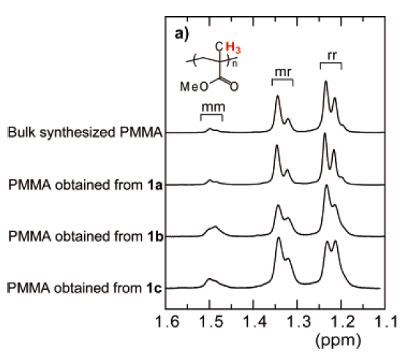
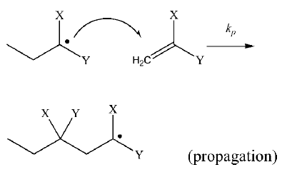
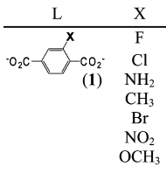
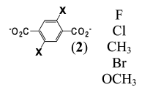
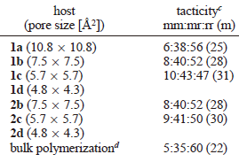
Tacticity of PMMA produced by bulk & inside PCP polymerization
Tacticity of PMMA can be controlled by using PCP channels for radical polymerization.
Tacticity observation by H¹ NMR
1 = Cu, 2 = Zn b c d
Tacticity of product PMMA (meso diad ratio)
In bulk 22% In (1) X=Cl 30%
In 2b 28% In (1) X=NH₂ 27%
In 2c 30% In (1) X=CH₃ 36%
In (2) X=CH₃ 37%
In (2) X=OCH₃ 53%
Macromolecules 2008, 41, 87.
JACS 2010, 132, 4917–4924.

Slide 4
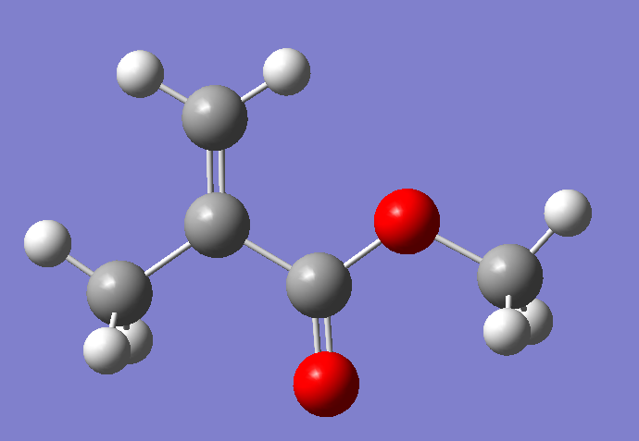
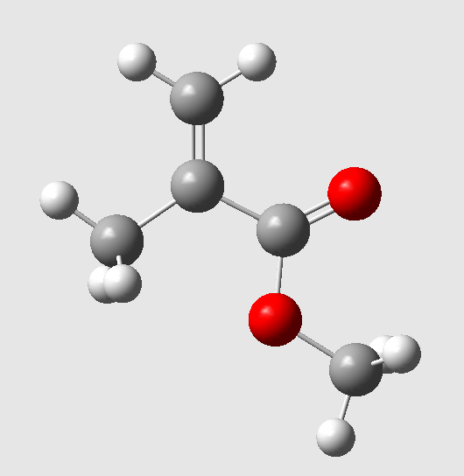
Before MC/MD polymerization simulation, check the GAFF force field quality for tacticity prediction
Methyl methacrylate (MMA) monomers confined in the PCP channels
Energy difference of each conformers are very small.
Check the force field (GAFF) parameters of PMMA.
For this purpose, I first need the most stable conformers of small oligomers. (dimer, trimer, ...)
Most stable
+0.154 kcal/mol

Slide 5
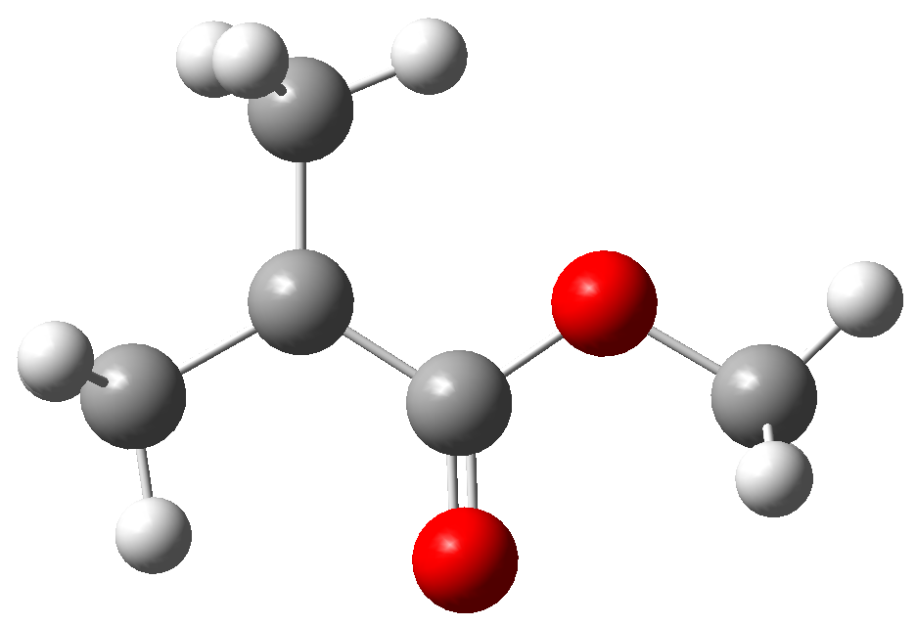
Check the DFT functional and basis sets
Focus on the energy difference with respect to the most stable structure
&
Check the consistency with a reference calculation by
MP2/cc-pvtz
MMA monomer
MMA radical
B3LYP (ROB3LYP) / 6-311G(d,p) is better than 6-31G(d,p)
B3LYP (ROB3LYP) / 6-31G(d,p) is good enough
ROB3LYP is faster than UB3LYP
Single point calculation of the MMA radical (4 CPU parallel)
UB3LYP/6-31G(d,p) 27 sec
ROB3LYP/6-31G(d,p) 22 sec

Slide 6
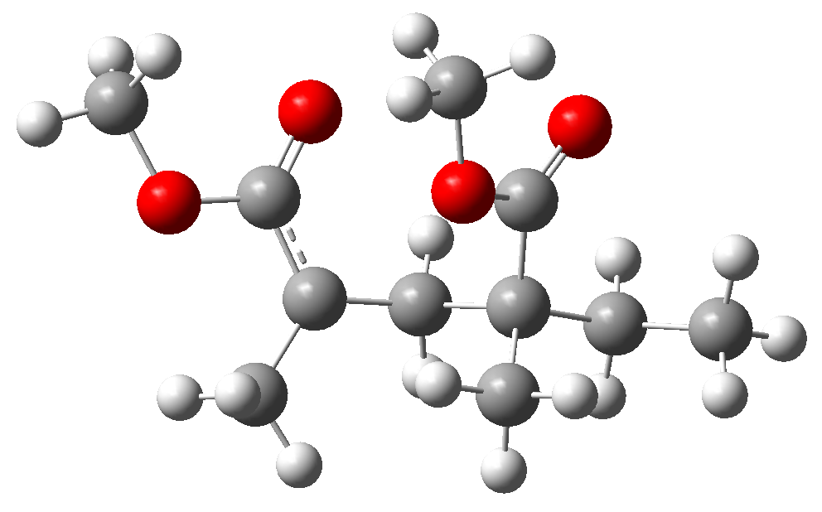
Many conformations even in the dimer radical
mmm residue
(methyl methacrylate middle)
C5
C5
O1
O1
O2
C4
O2
C4
mrd residue
(methyl methacrylate radical)
C2
C3
C2
radical
C3
CT
C1
C1
tmt residue
(terminal methyl)
Angles in this conformation
Rough estimation: each dihedral angle (7 dihedrals) has 2~3 stable angles
conformers

Slide 7
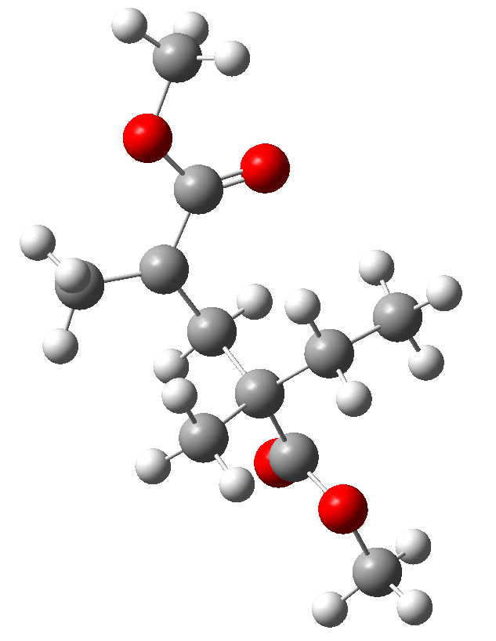
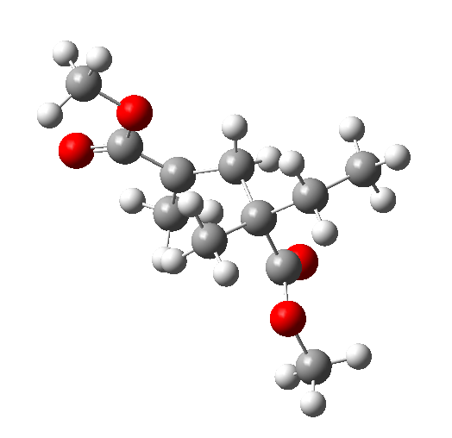
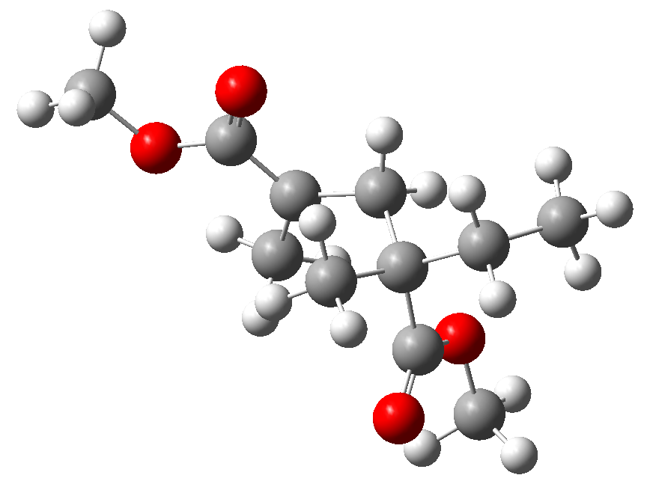
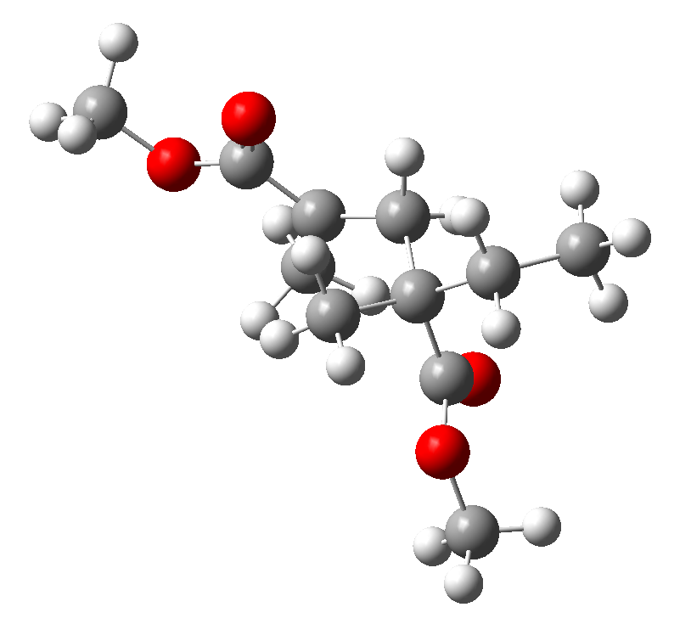
Manual optimization to search the most stable conformation UB3LYP/6-311G(d,p)
racemoOpt5.log
ΔE = +0.51 kcal/mol
+70° rotation & opt
racemoOpt.log ΔE = 0 kcal/mol (as a standard)
180° rotation & opt
180° rotation & opt
racemoOpt4.log ΔE = +0.42 kcal/mol
Most stable?
racemoOpt2.log ΔE = -0.63 kcal/mol
Very difficult to obtain the most stable conformation by manual search → Necessity of automatic search

Slide 8
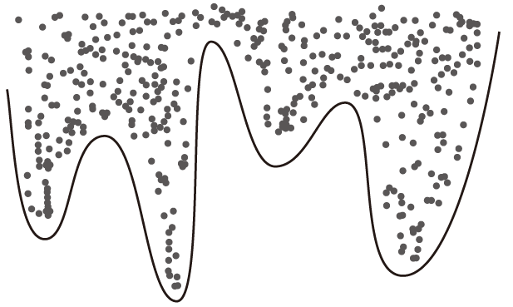
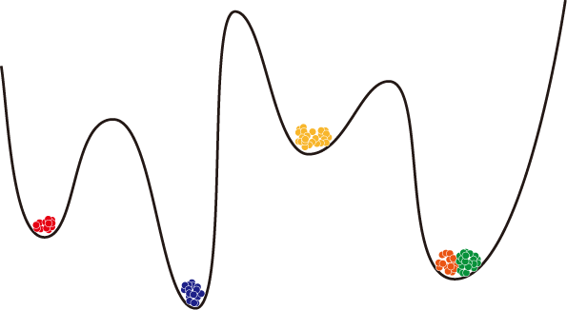
Automatic conformation search by classical MD simulation in vacuum
Prepare MMA dimer radical prmtop file with GAFF force field (with the radical "cr" atom type)
Execute conformation sampling MD (CSMD) simulation of MMA dimer radical in vacuum for 100 ns at high temperature 500 K, reset velocity every 5 ps from a Maxwellian distribution at 500 K ignore dihedral angle & improper terms (set 0 weight) save snapshots every 10 ps, in total 10,000 snapshots
During the CSMD, all the dihedral angles frequently rotate without barrier.
All the 10,000 CSMD snapshots are optimized by MM force field.
Classify the 10,000 optimized snapshots into 500 clusters by clustering with k-means method. More than two clusters often have the same conformation.
Extract a representative structure from each cluster (in total, 500 representative structures).
All 500 representative structures are optimized by DFT calculation (Gaussian09) ROB3LYP/6-31G(d,p) ROB3LYP/6-311G(d,p)
Check the most stable structure & distribution of energy.
mdin for CSMD in AMBER pmemd MD solver, repeat 1000 times
&cntrl
DT = 0.002, NSTLIM = 50000,
NTB = 0, CUT = 99,
NTT = 1, TEMP0 = 500, VRAND=2500, TAUTP=0.5
ntpr = 2500, ntwx = 2500,
nmropt = 1,
&end
&wt
type='TORSION', value1 = 0.0,
&end
&wt
type='IMPROP', value1 = 0.0,
&end
&wt
type='END',
&end
Weight 0 for dihedral (torsion) and improper terms
Cluster ID
1
3
4&5
2
CSMD
MM optimization & clustering

Slide 9
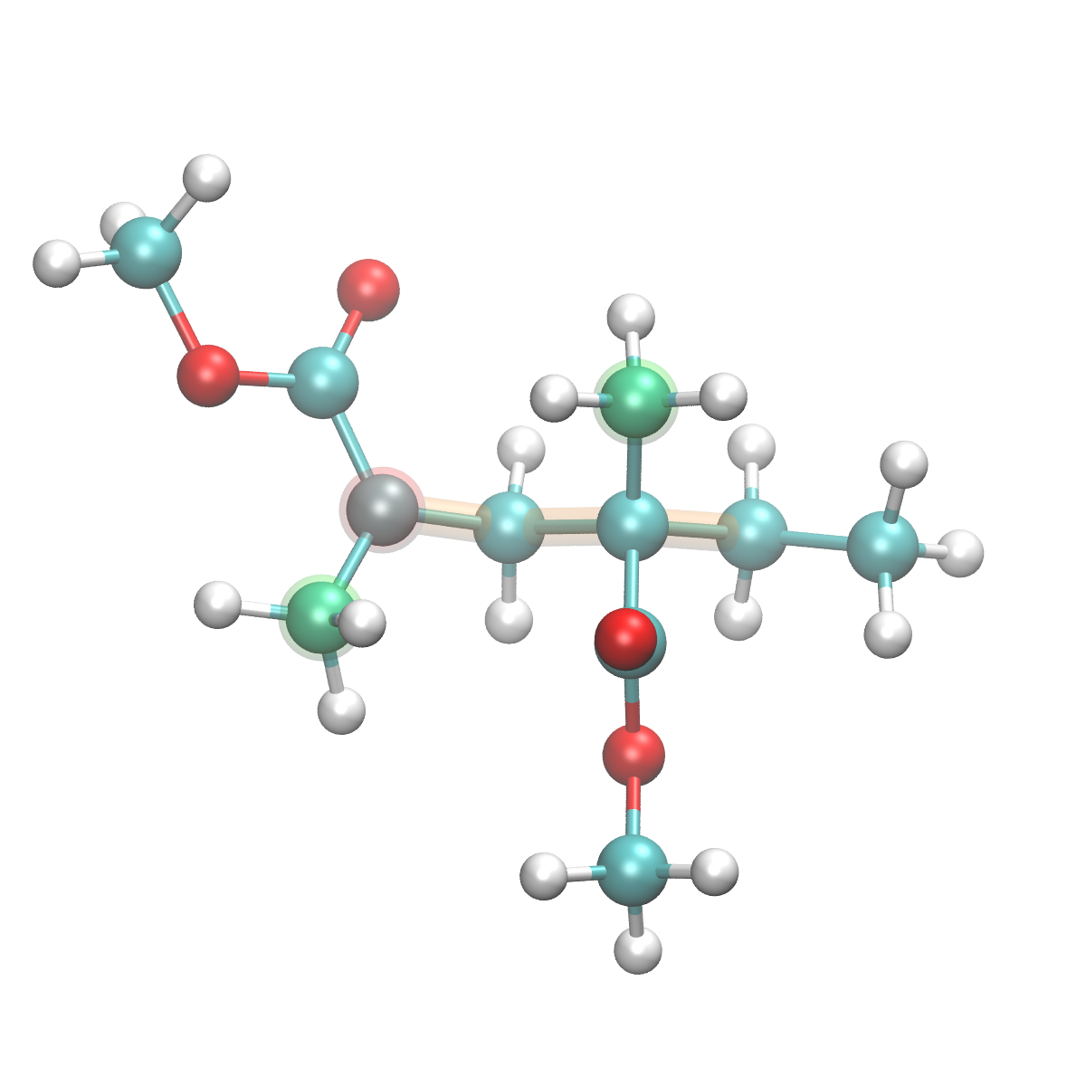
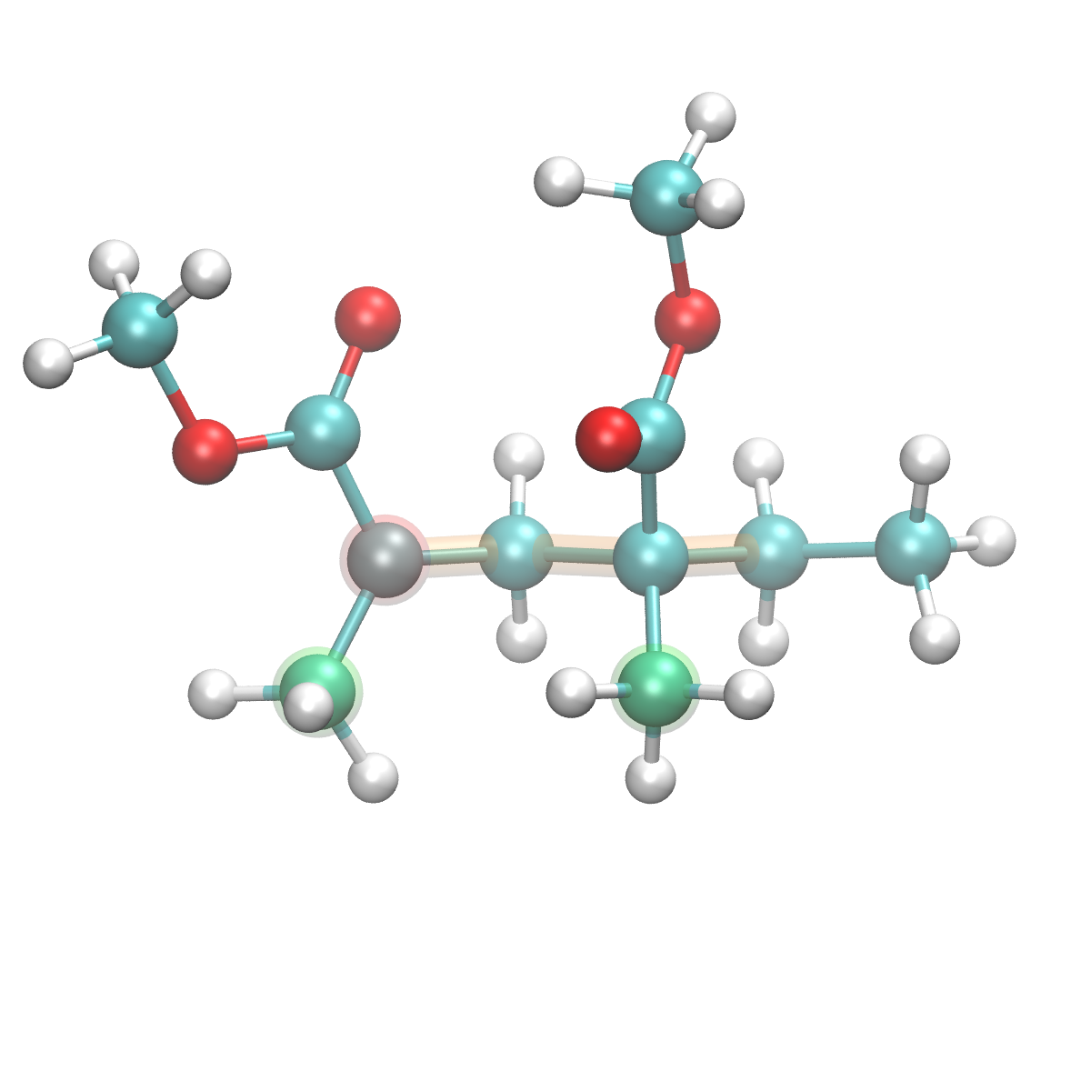
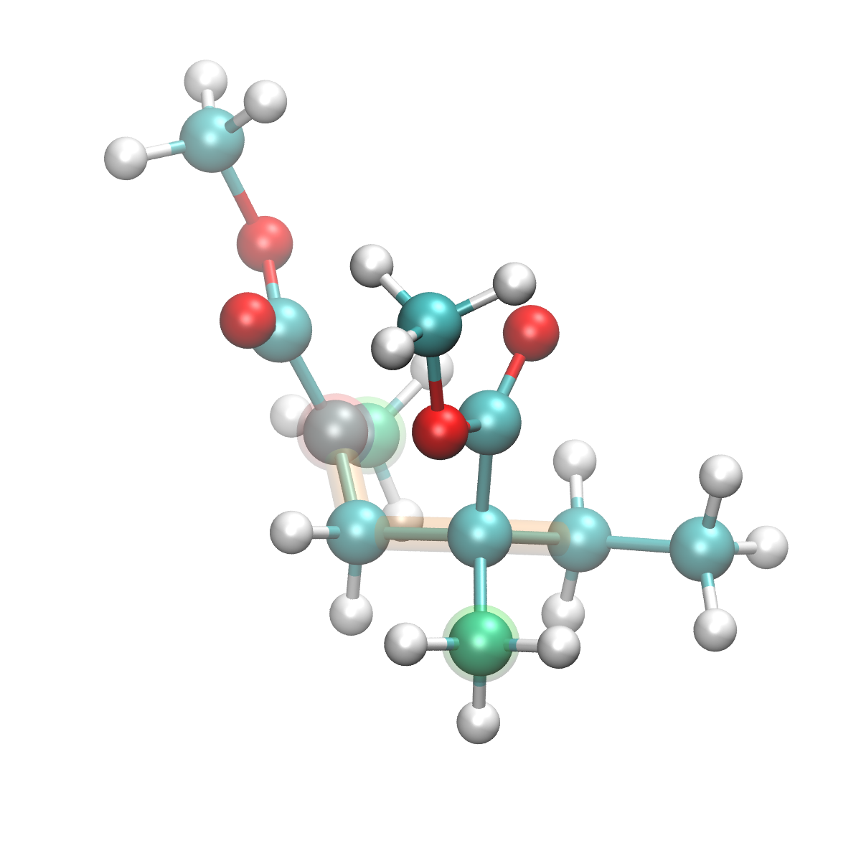
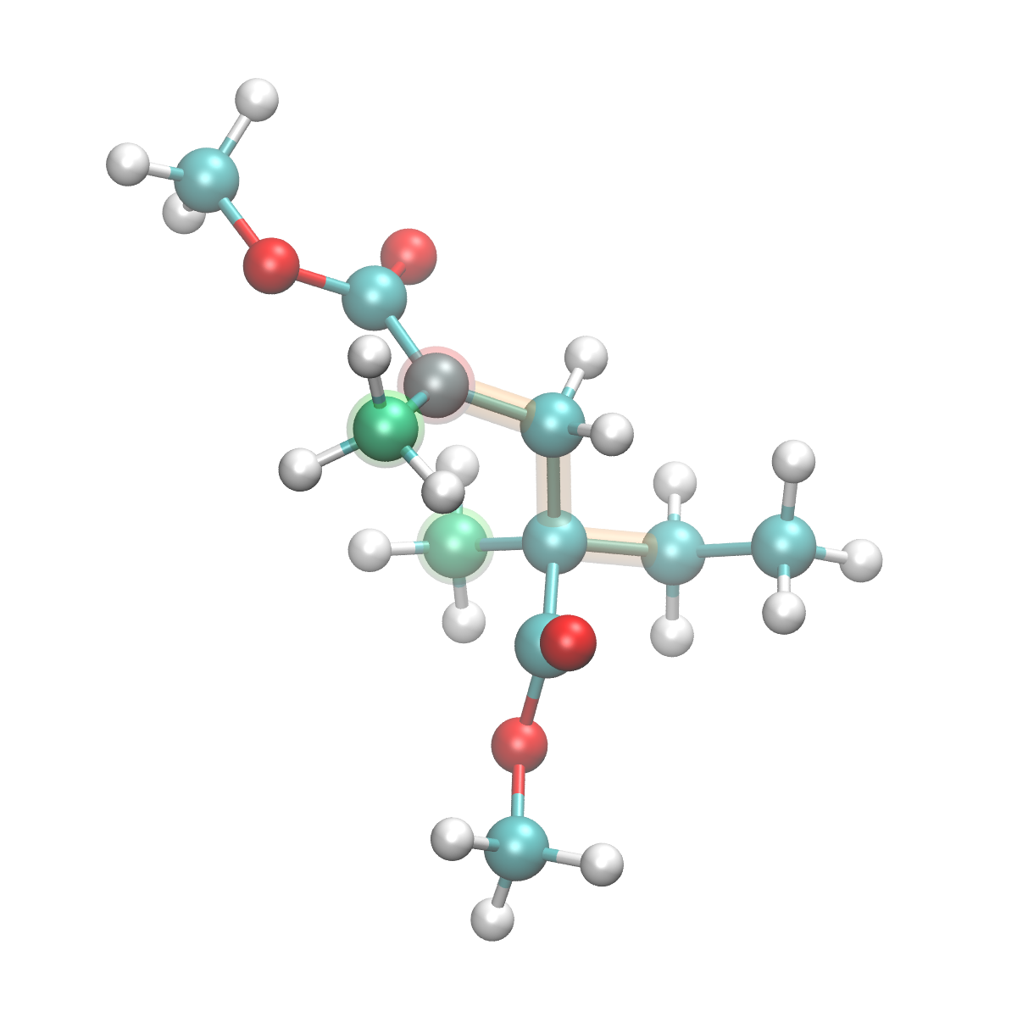
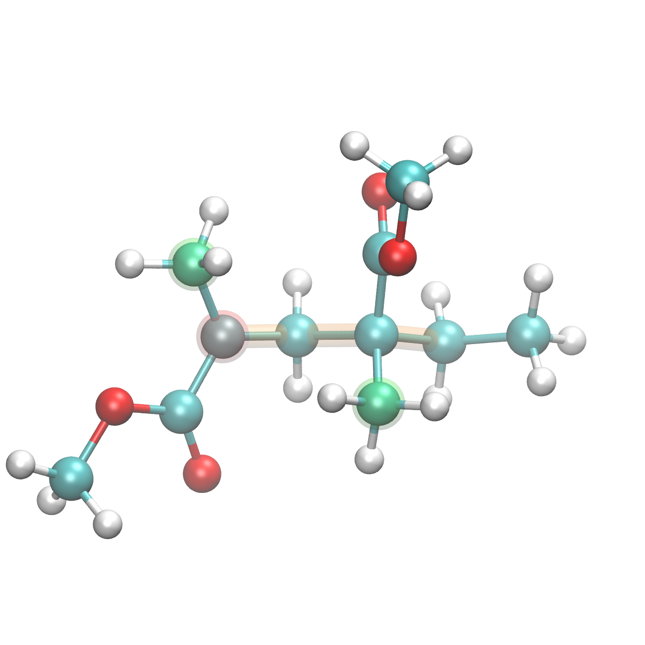
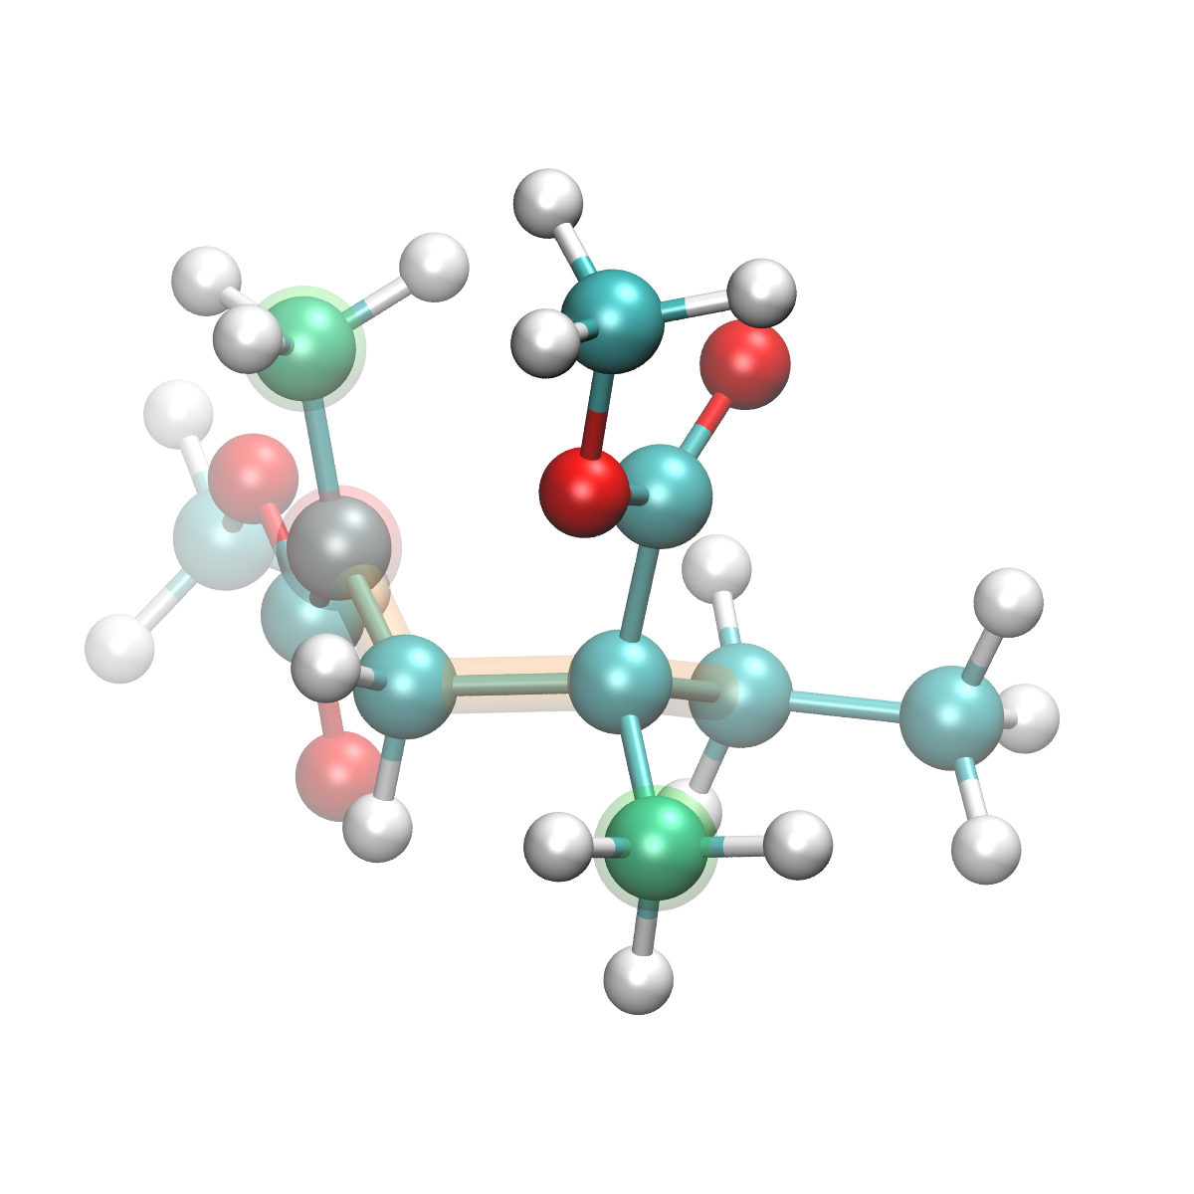
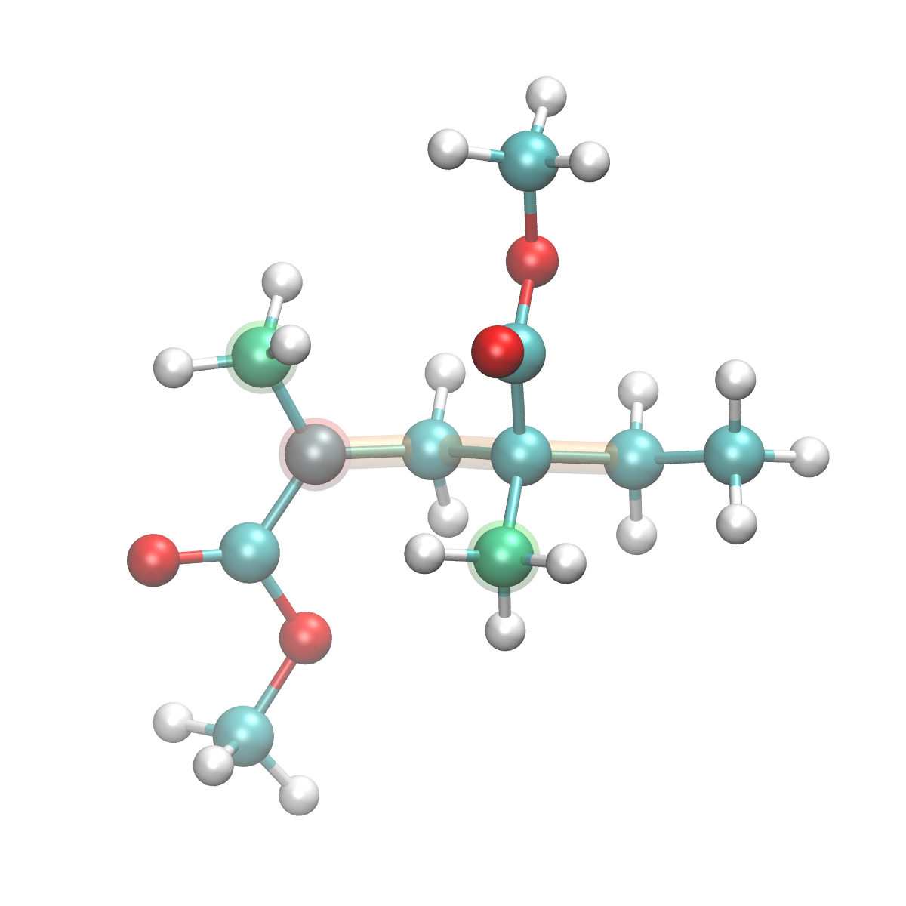
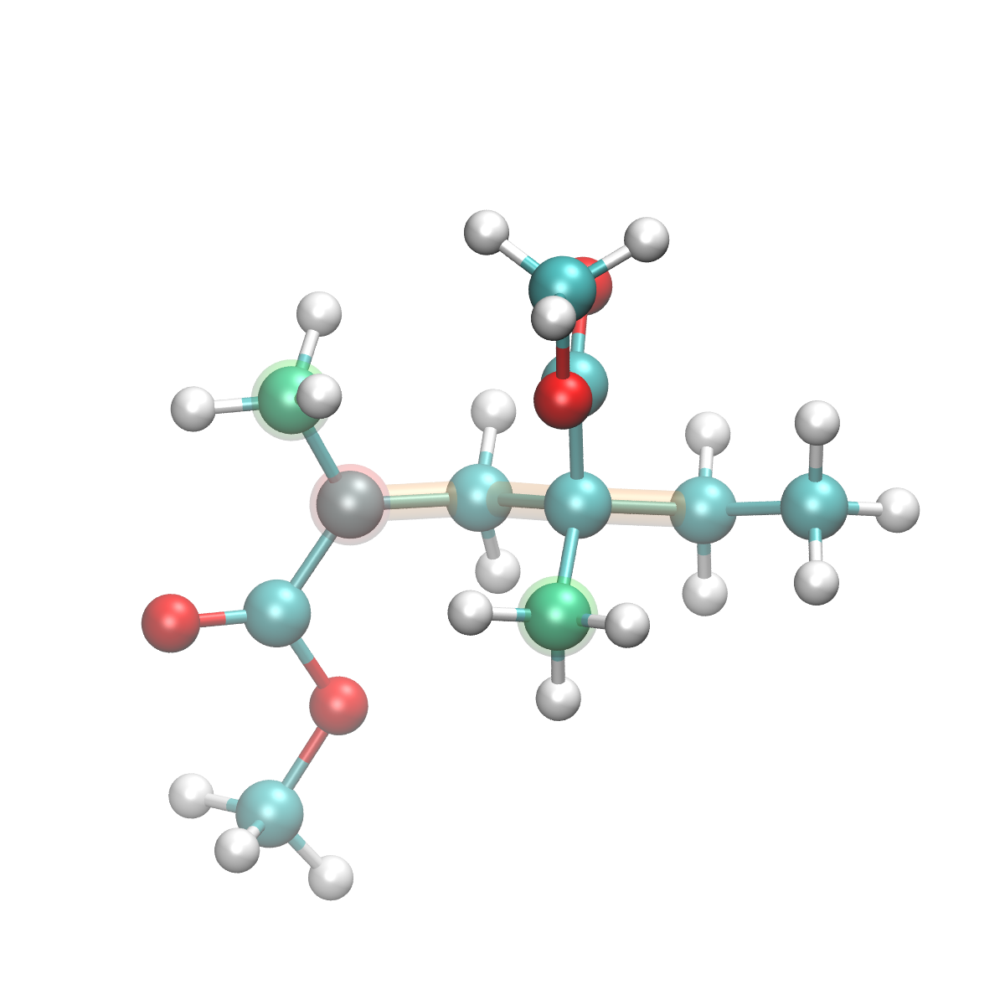
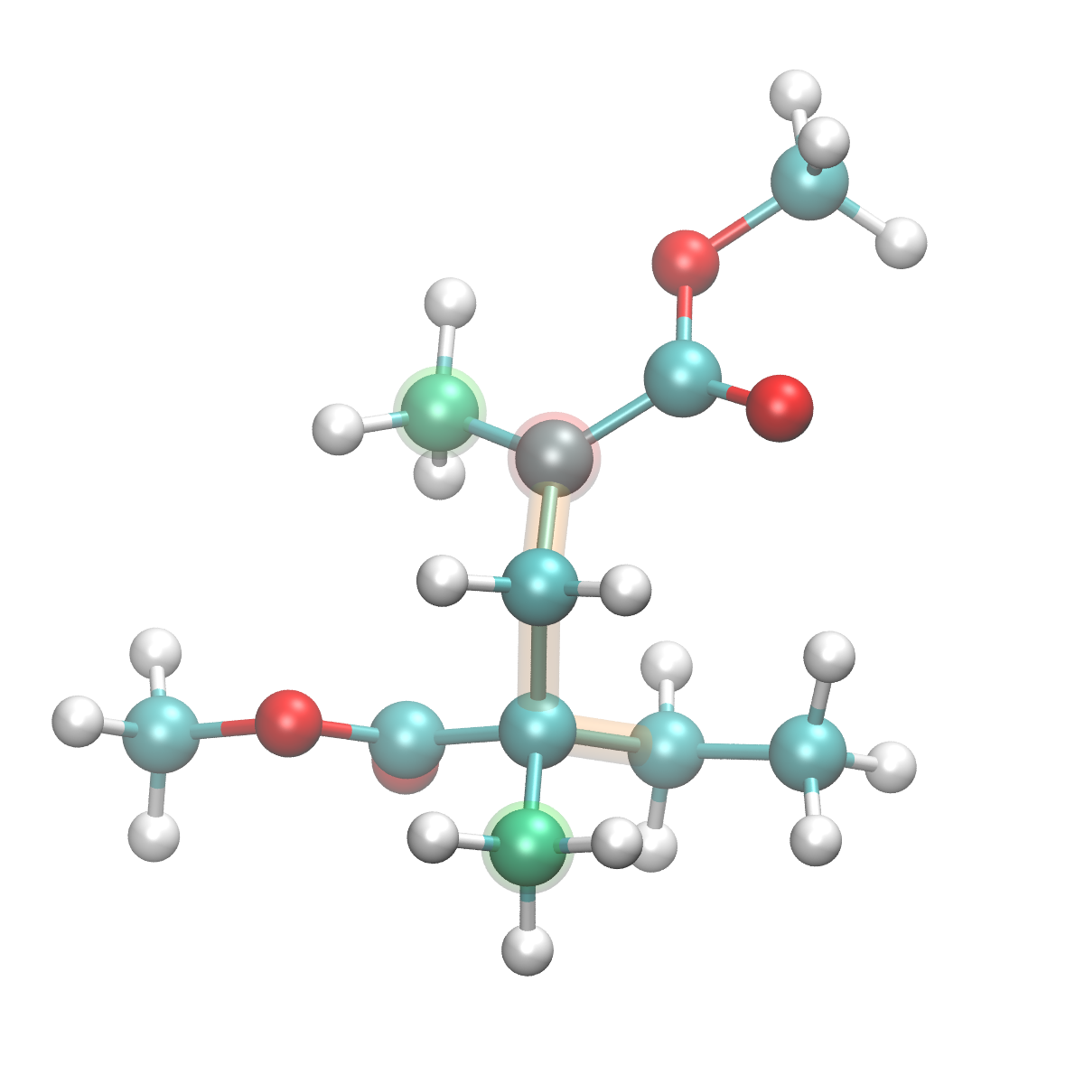
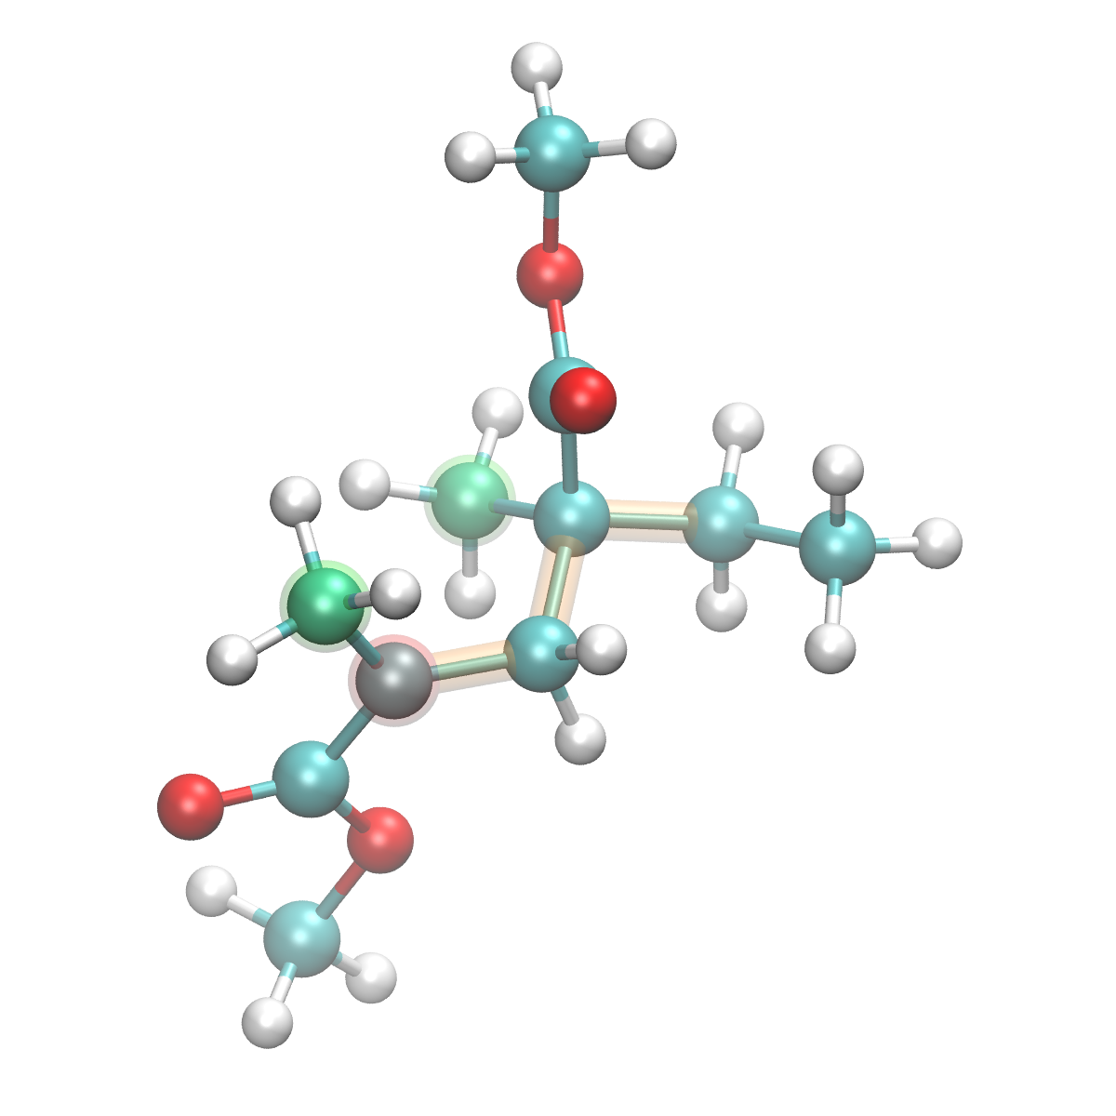
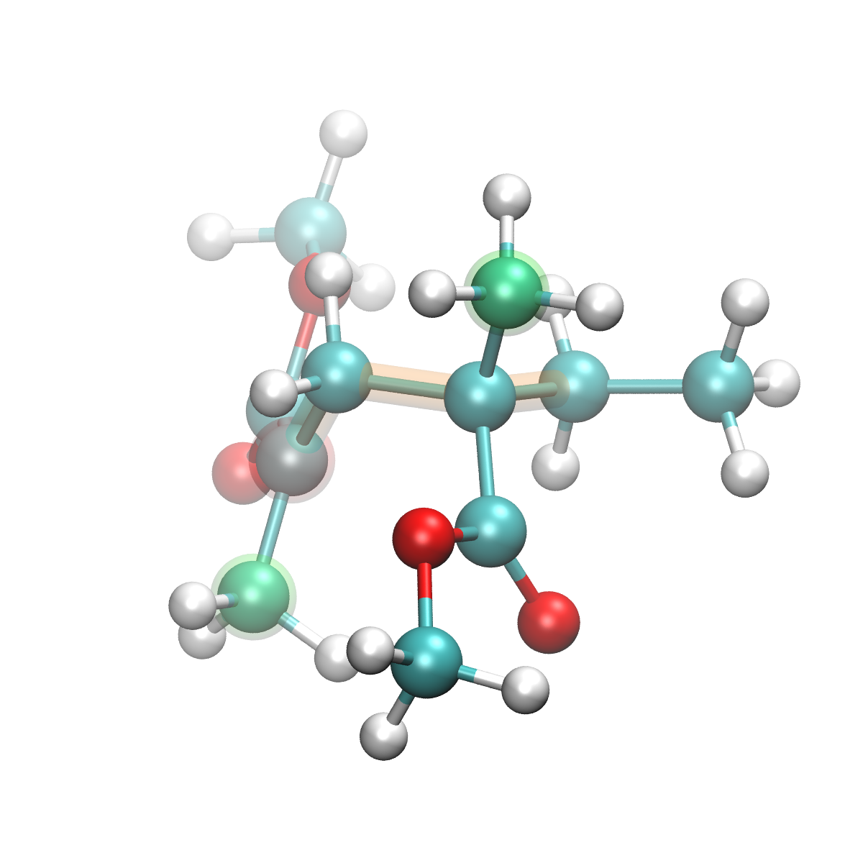
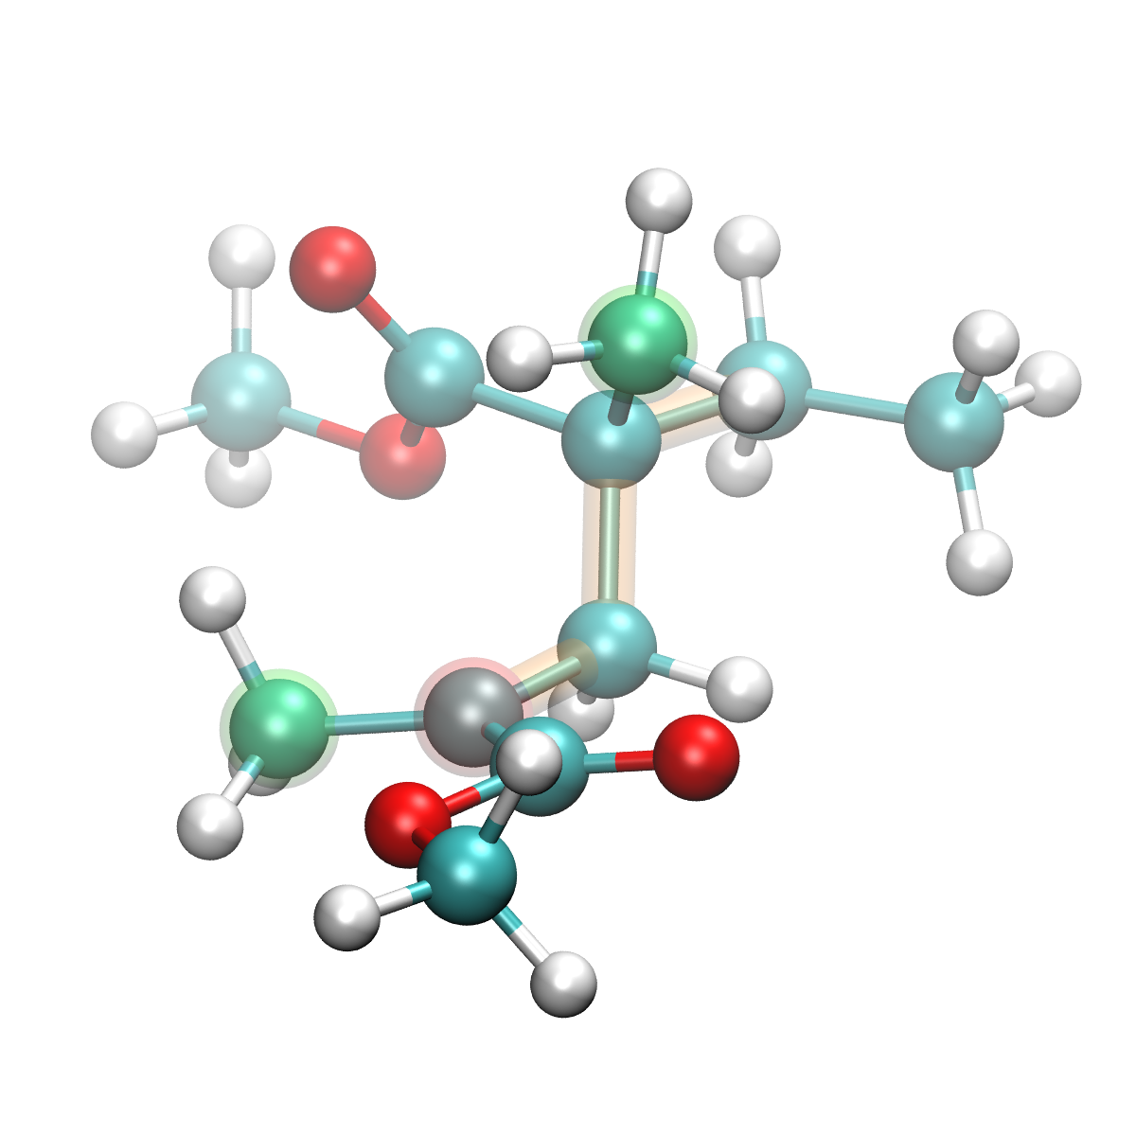
Most stable 12 conformers by ROB3LYP/6-31(d,p)
most stable in page 7
most stable
+0.04 kcal/mol
+0.09 kcal/mol
+0.13 kcal/mol
+0.25 kcal/mol
+0.33 kcal/mol
+0.39 kcal/mol
+0.62 kcal/mol
+0.65 kcal/mol
+0.76 kcal/mol
+0.81 kcal/mol
+0.91 kcal/mol

Slide 10
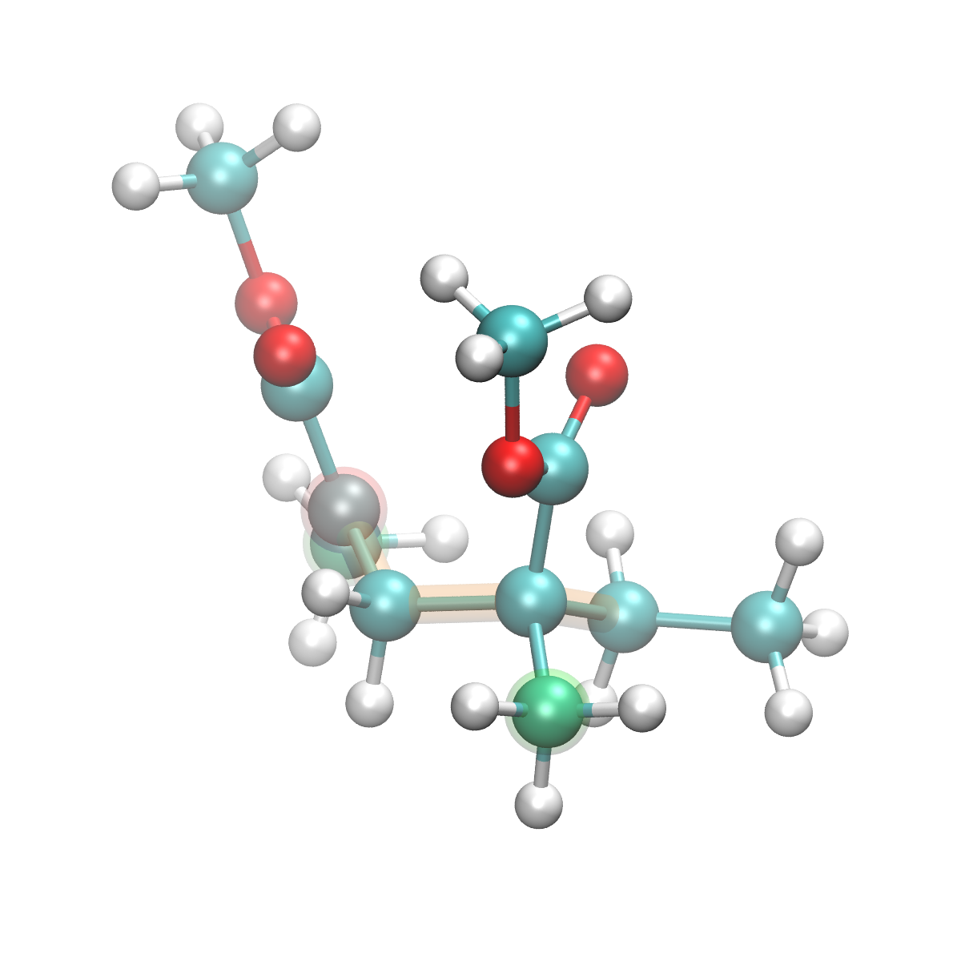
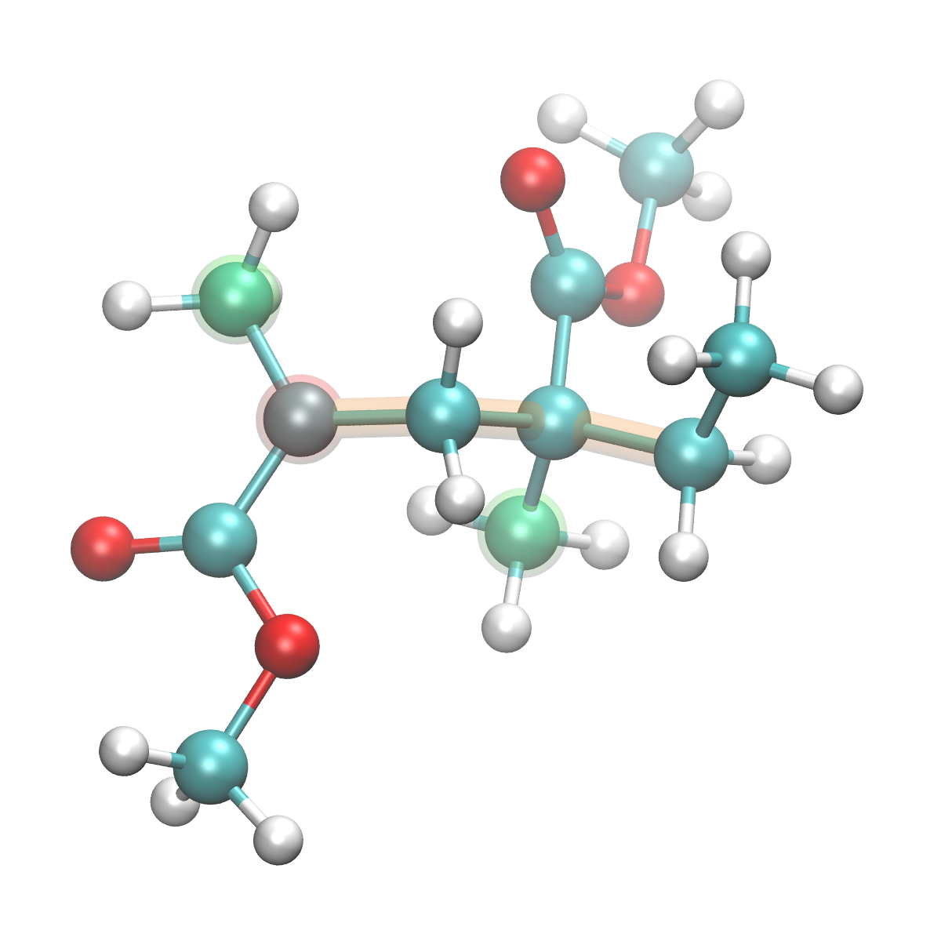
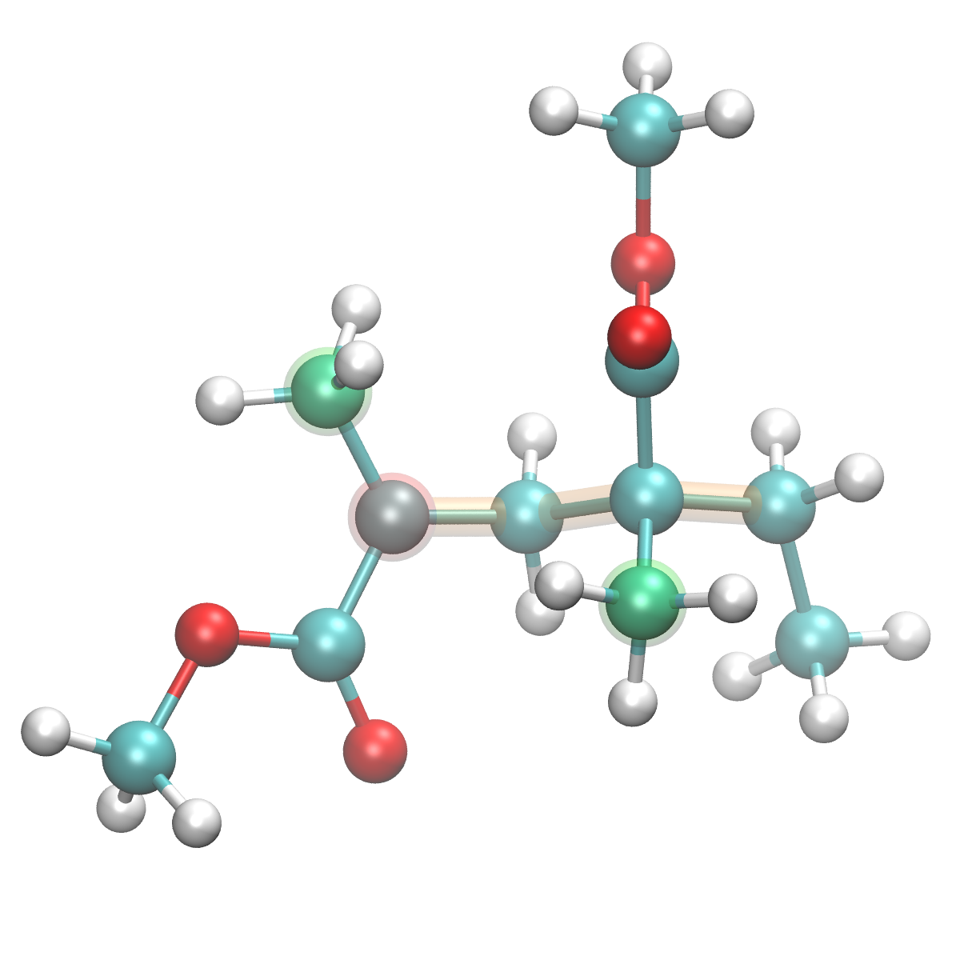
Most stable 12 conformers by ROB3LYP/6-311(d,p)
most stable in page 7
most stable
+0.06 kcal/mol
+0.12 kcal/mol
+0.18 kcal/mol
+0.27 kcal/mol
+0.36 kcal/mol
+0.39 kcal/mol
+0.61 kcal/mol
not in 6-31G(d,p) 12 confomers
not in 6-31G(d,p) 12 confomers
not in 6-31G(d,p) 12 confomers
+0.65 kcal/mol
+0.73 kcal/mol
+0.83 kcal/mol
+0.85 kcal/mol

Slide 11
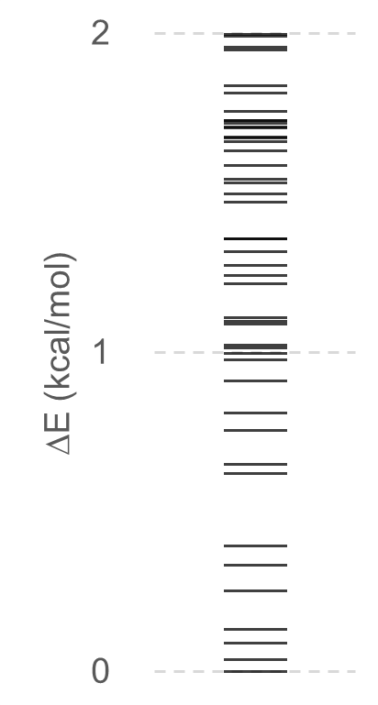
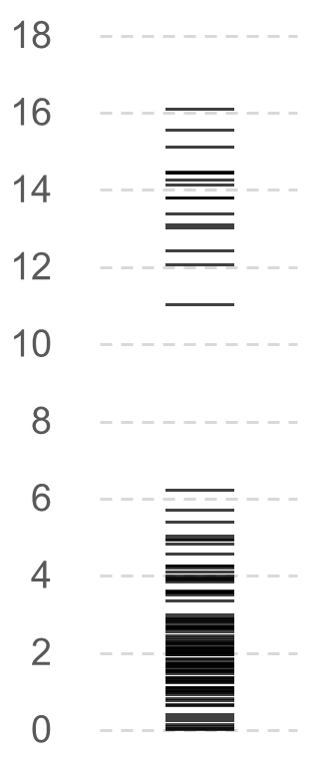
Density of conformers against relative energy in a dimer radical
ROB3LYP/6-31(d,p)
ROB3LYP/6-311(d,p)
in total, 113 confomers
in total, 121 confomers
Relative energies of several conformers differ between 6-31G(d,p) and 6-311G(d,p).
However, most stable conformers (in this case, up to 8) are common with almost the same relative energy.
The 6-31(d,p) is good enough to estimate the most stable conformers and relative energies.

Slide 12
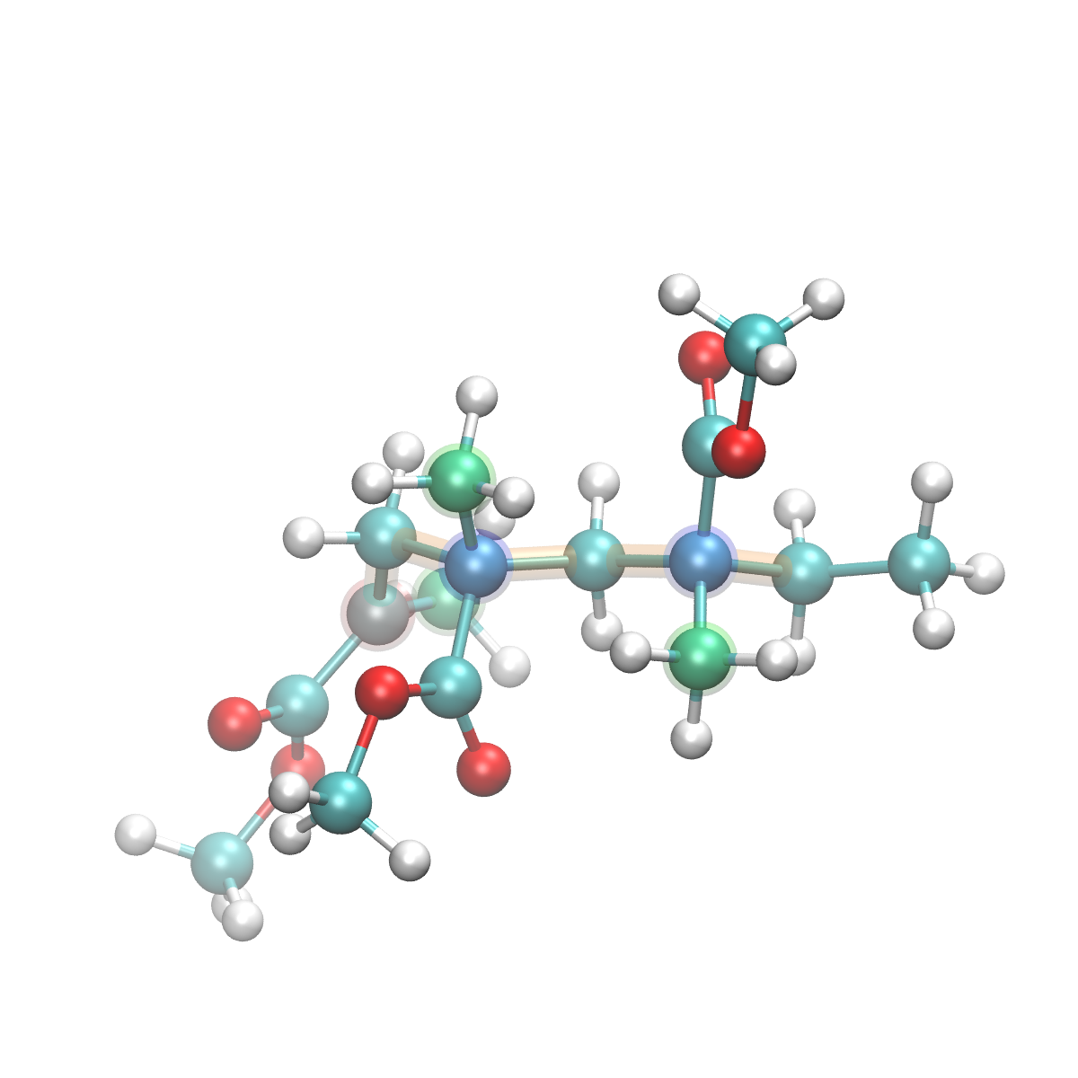
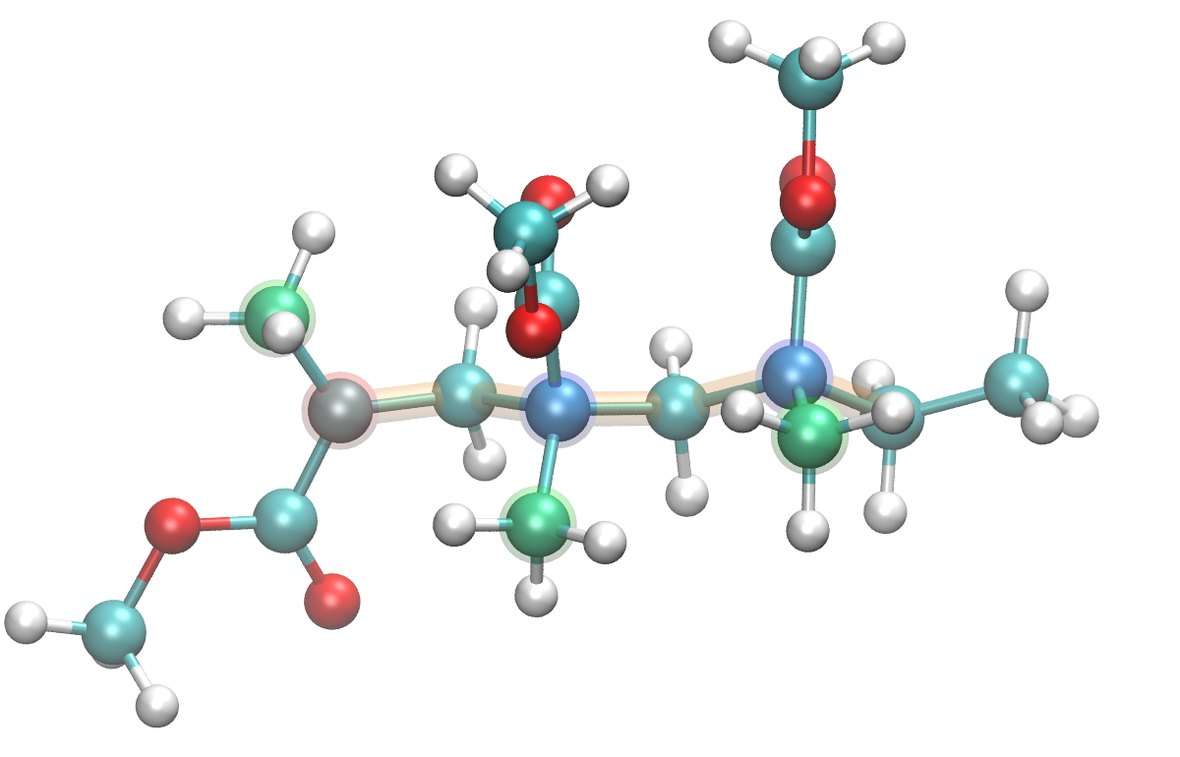
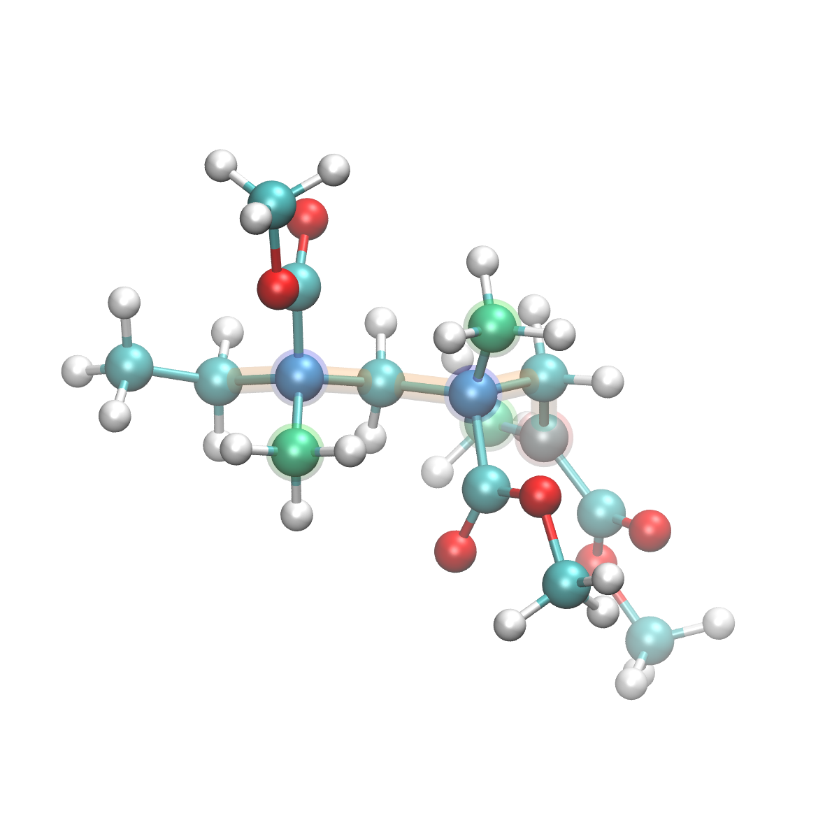
Conformatio Sampling MD (CSMD) for trimer radical
The dimer radical has one chiral carbon and there is a pair of enantiomers. There is no physical quantity (energy) difference between a pair of enantiomers, so I ignored chirality.
The trimer radical has two chiral carbons and there are enantiomers and diastereomers. There are physical quantity (energy) differences between diastereomers, so it is necessary to consider chirality to sample all possible configurations of a trimer radical.
Add chiral inversion process to the CSMD process.
Execute CSMD for 100 ps, and select one chiral carbon by random number and invert CH₃ - COOCH₃ groups by reflection. After reflection, minimize the structure to remove steric collisions created by the inversion.
chiral inversion by reflection
a pair of enantiomers
chiral carbon
Repeat 100 ps CSMD & chiral inversion for 1,000 times, in total 100 ns trajectory with 10,000 snapshots.
Optimize with ROB3LYP/6-31G(d,p) level of DFT calculation.

Slide 13
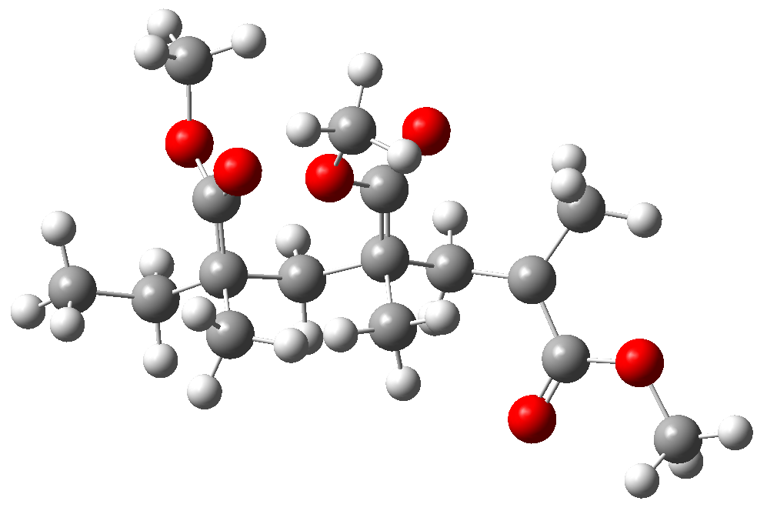
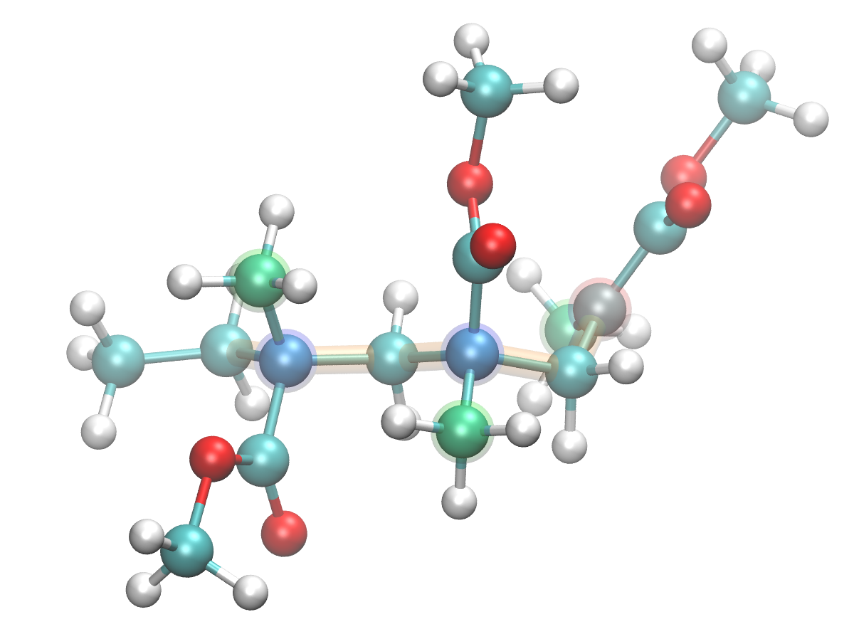
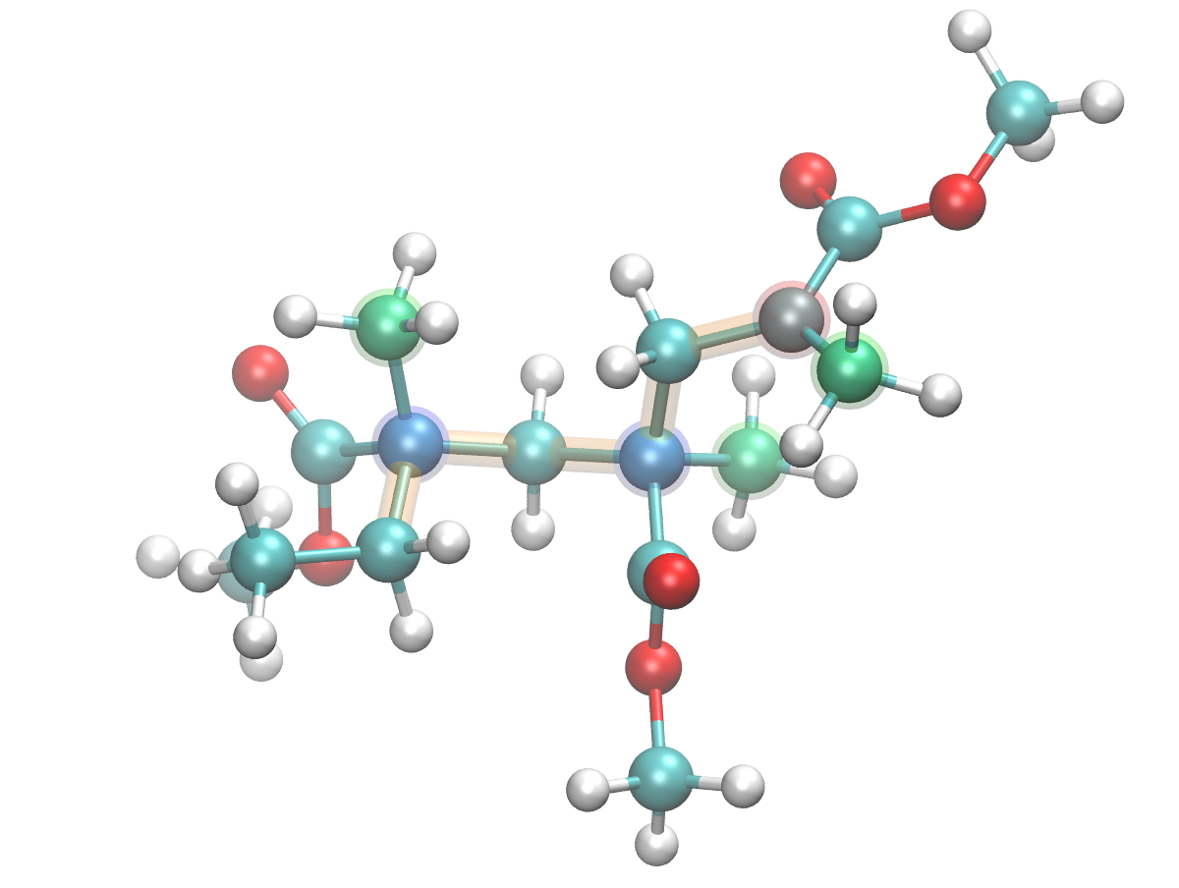
Definition of tacticity & enantiomer elimination
Tacticity of a trimer radical can be defined as D = Dihedral (C₁-C₂-C₂-C₁) - Dihedral (C₃-C₂-C₂-C₃)
-60˚ < D < 60˚ → meso otherwise → racemo
rotate toward extended conformer
C1
C2
C1
C3
C2
C1
C1
C3
C2
C3
C2
C3
C2
C3
C2
C1
C1
C3
Dihedral (C₁-C₂-C₂-C₁) = 93˚ Dihedral (C₃-C₂-C₂-C₃) = -26˚
D = 93 - (-26) = 119˚
racemo
Dihedral (C₁-C₂-C₂-C₁) = -117˚ Dihedral (C₃-C₂-C₂-C₃) = -104˚
D = (-117) - (-104) = -13˚
meso
A pair of enantiomers have the same energy, so I don't focus on the enantiomers.
Enantiomer elimination was realized as follows. when the dihedral angle D_{t} = (C₁-C₂-C₂-C₁) < 0˚, multiply -1 to D.

Slide 14
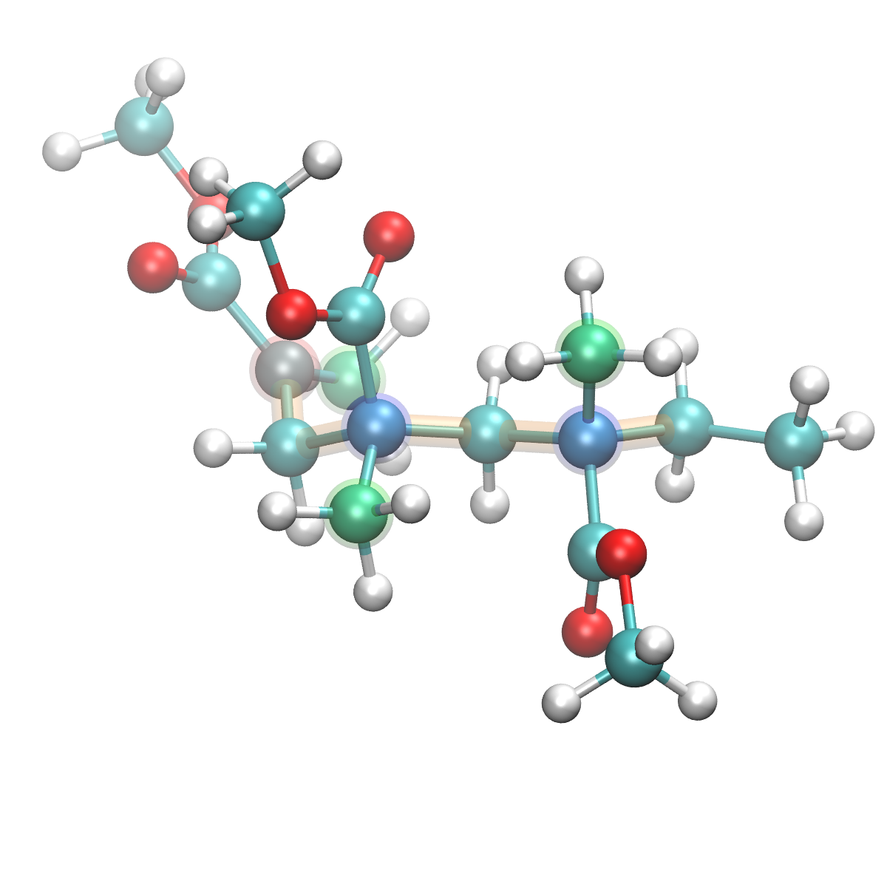
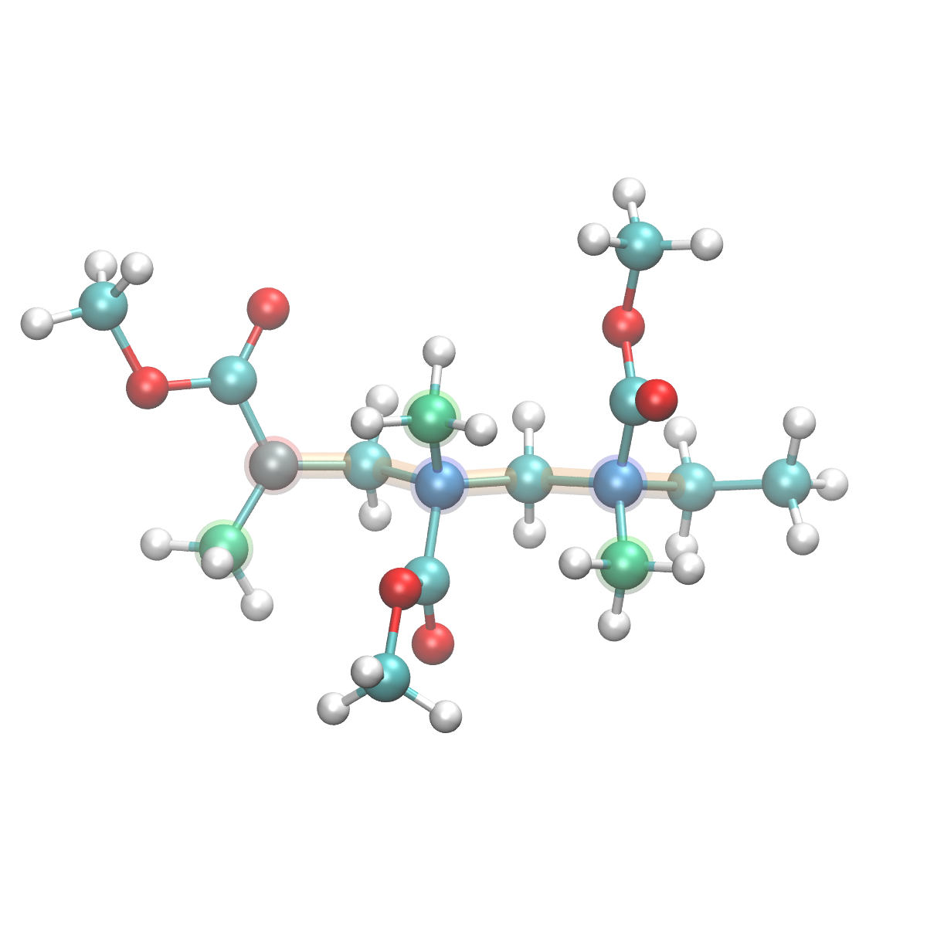
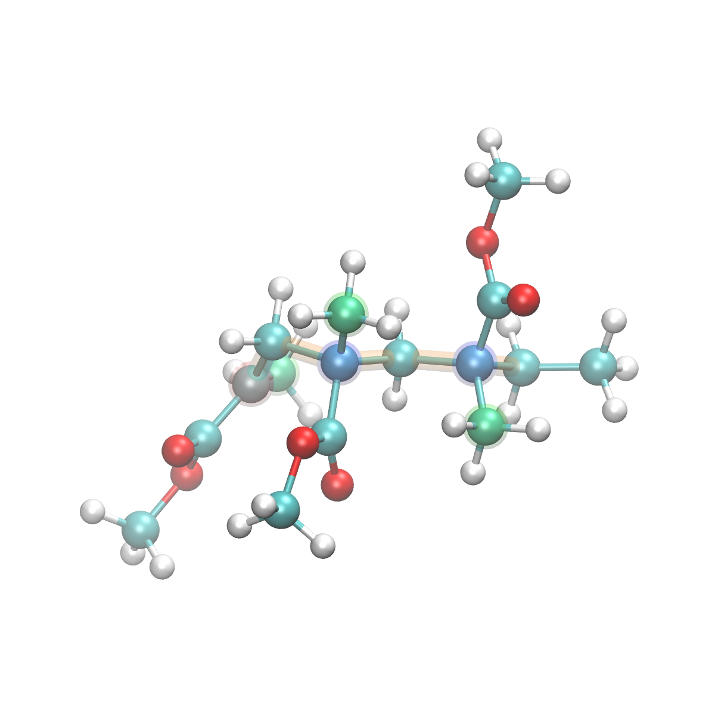
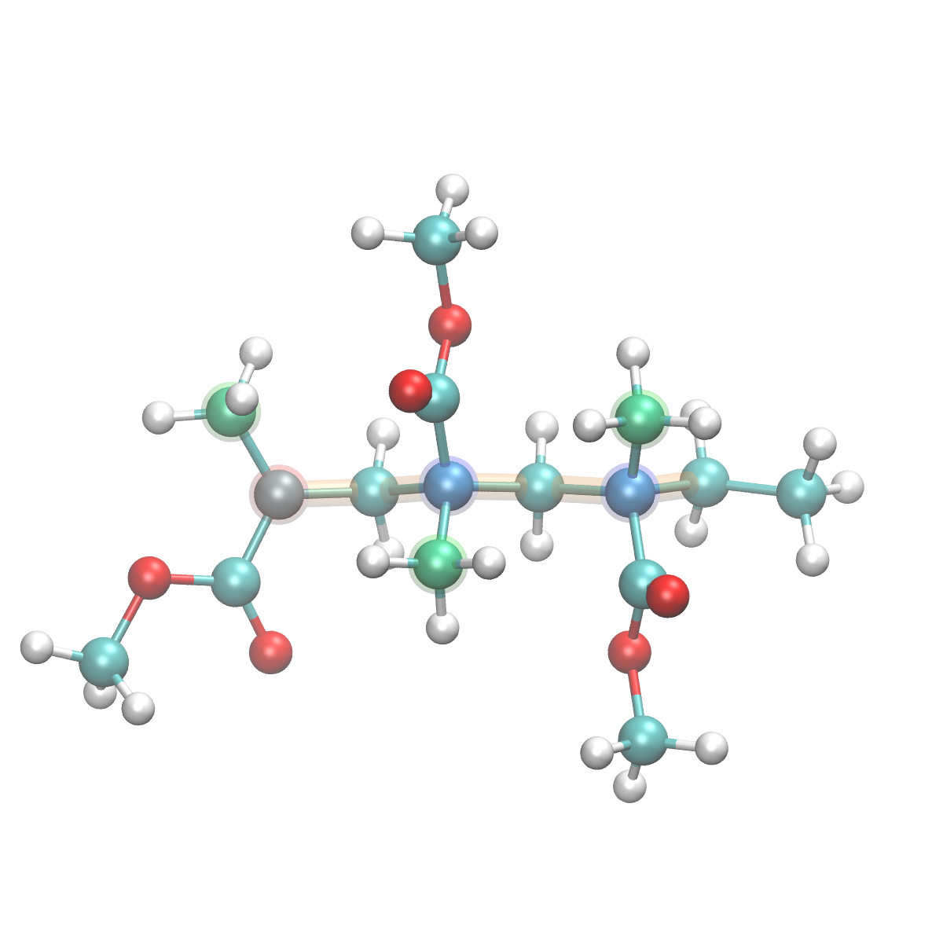
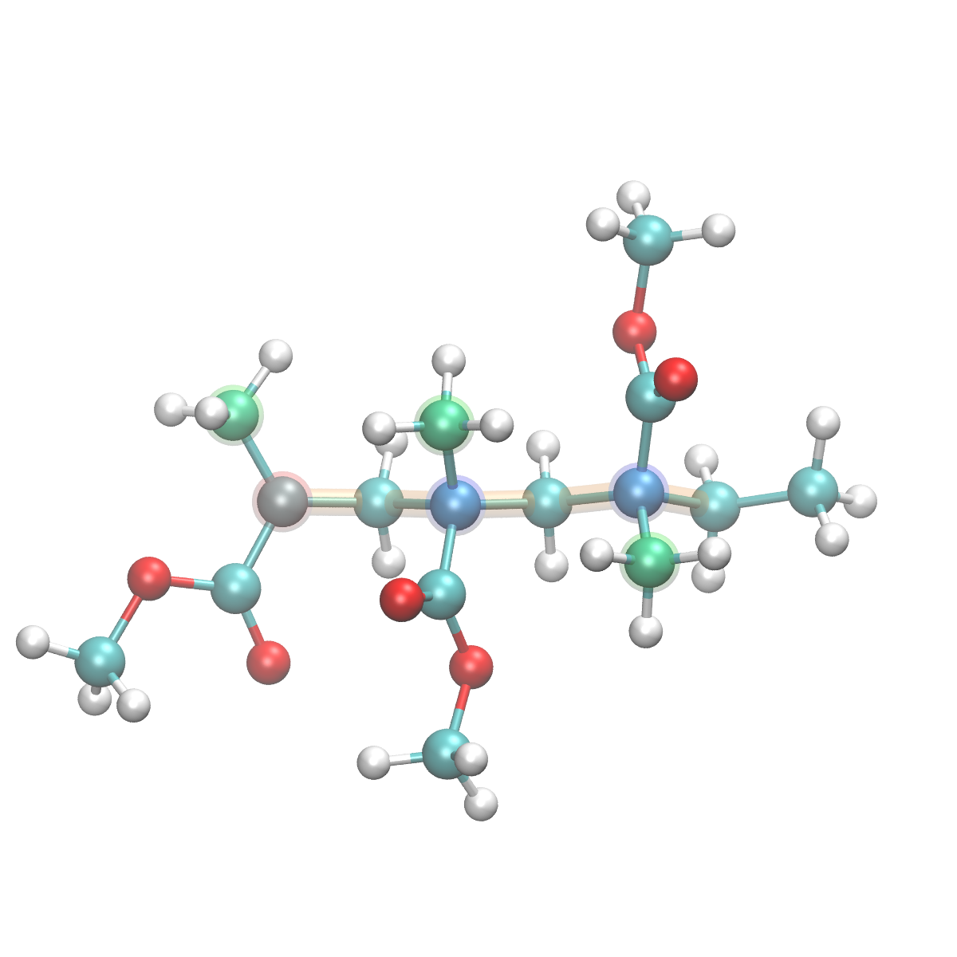
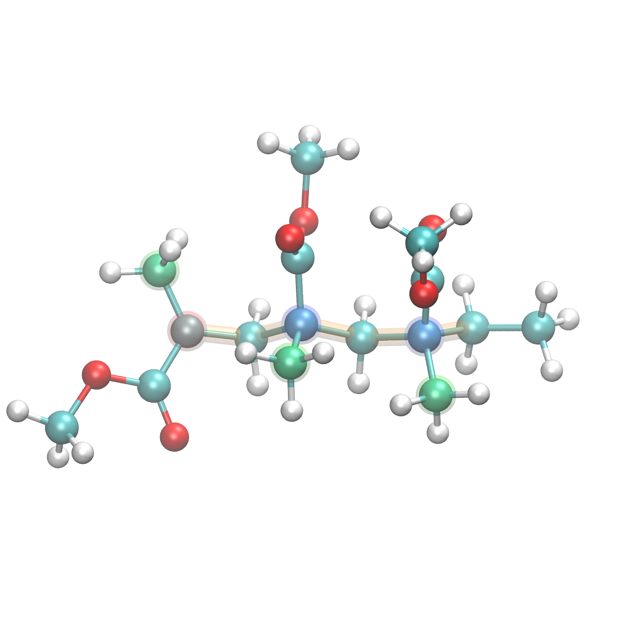
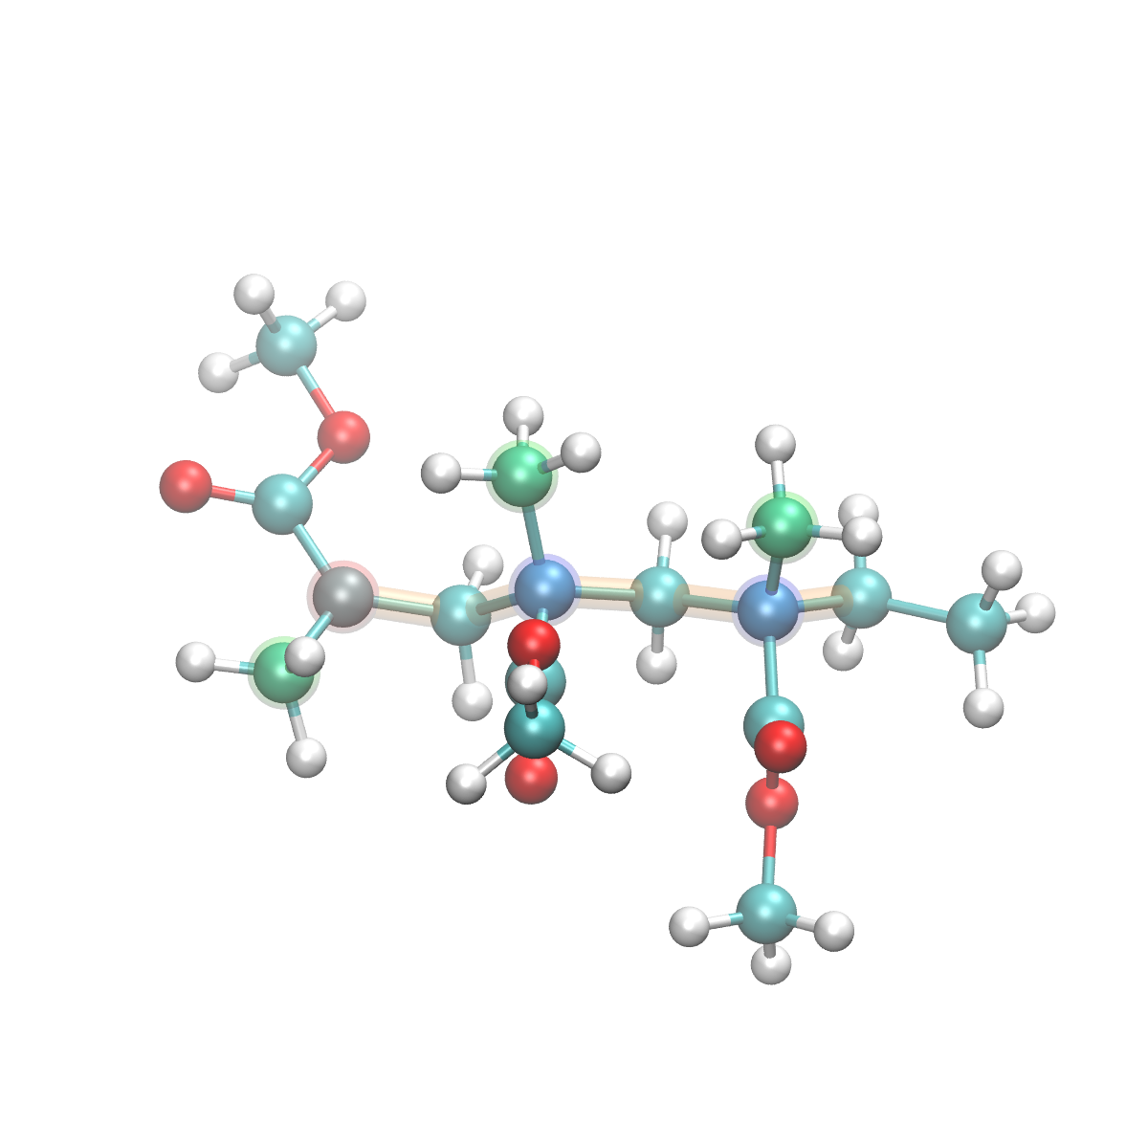
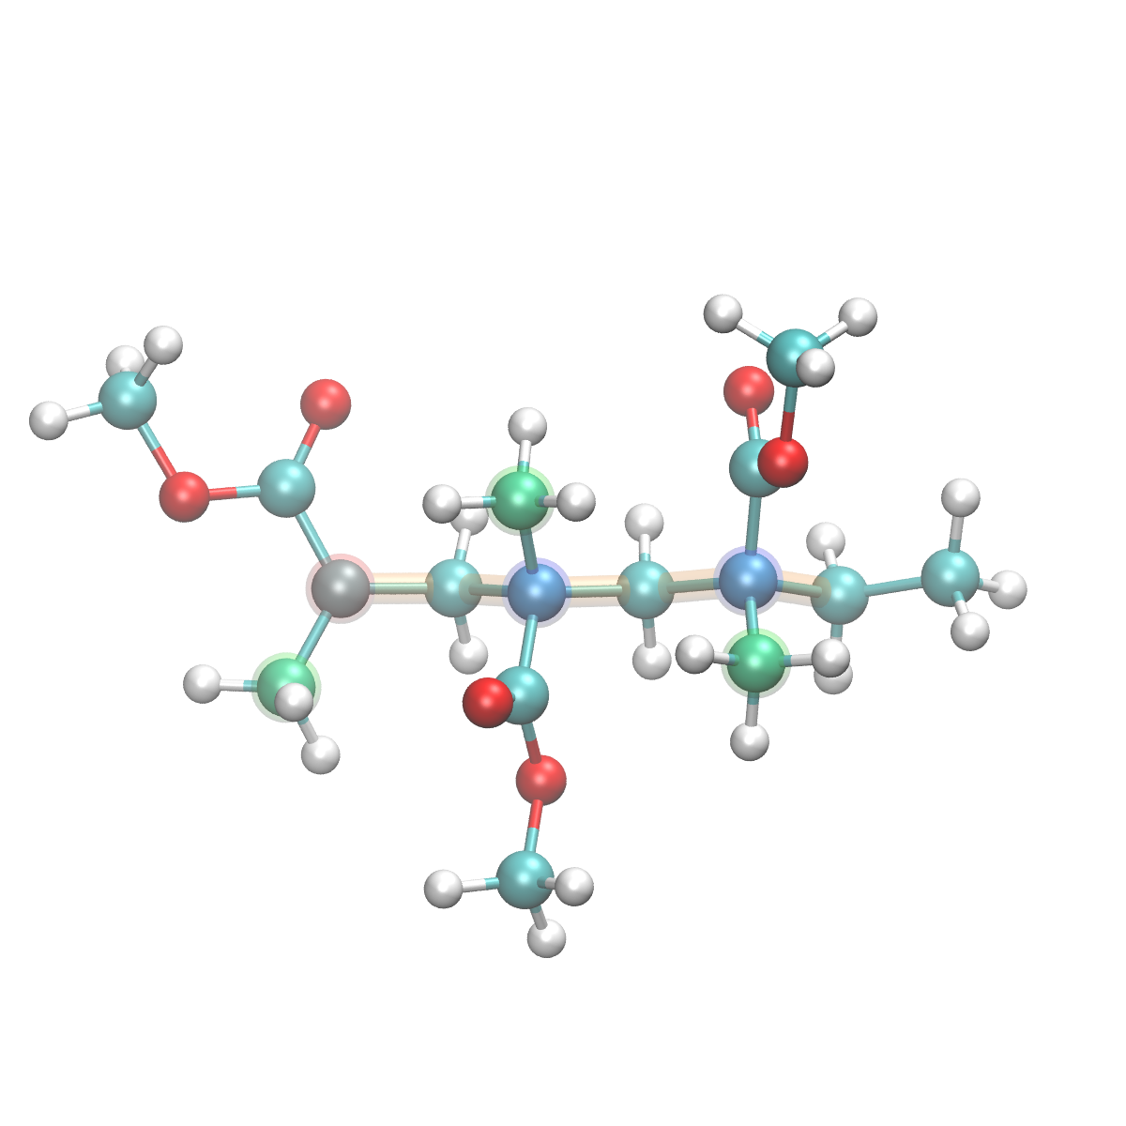
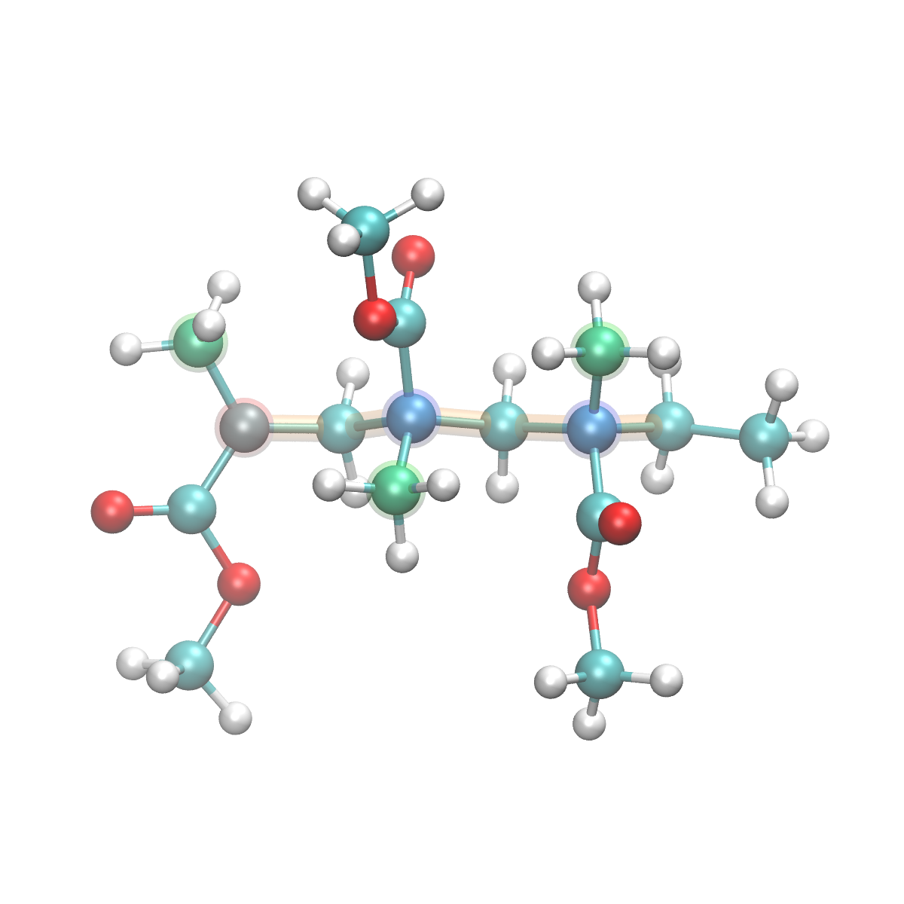
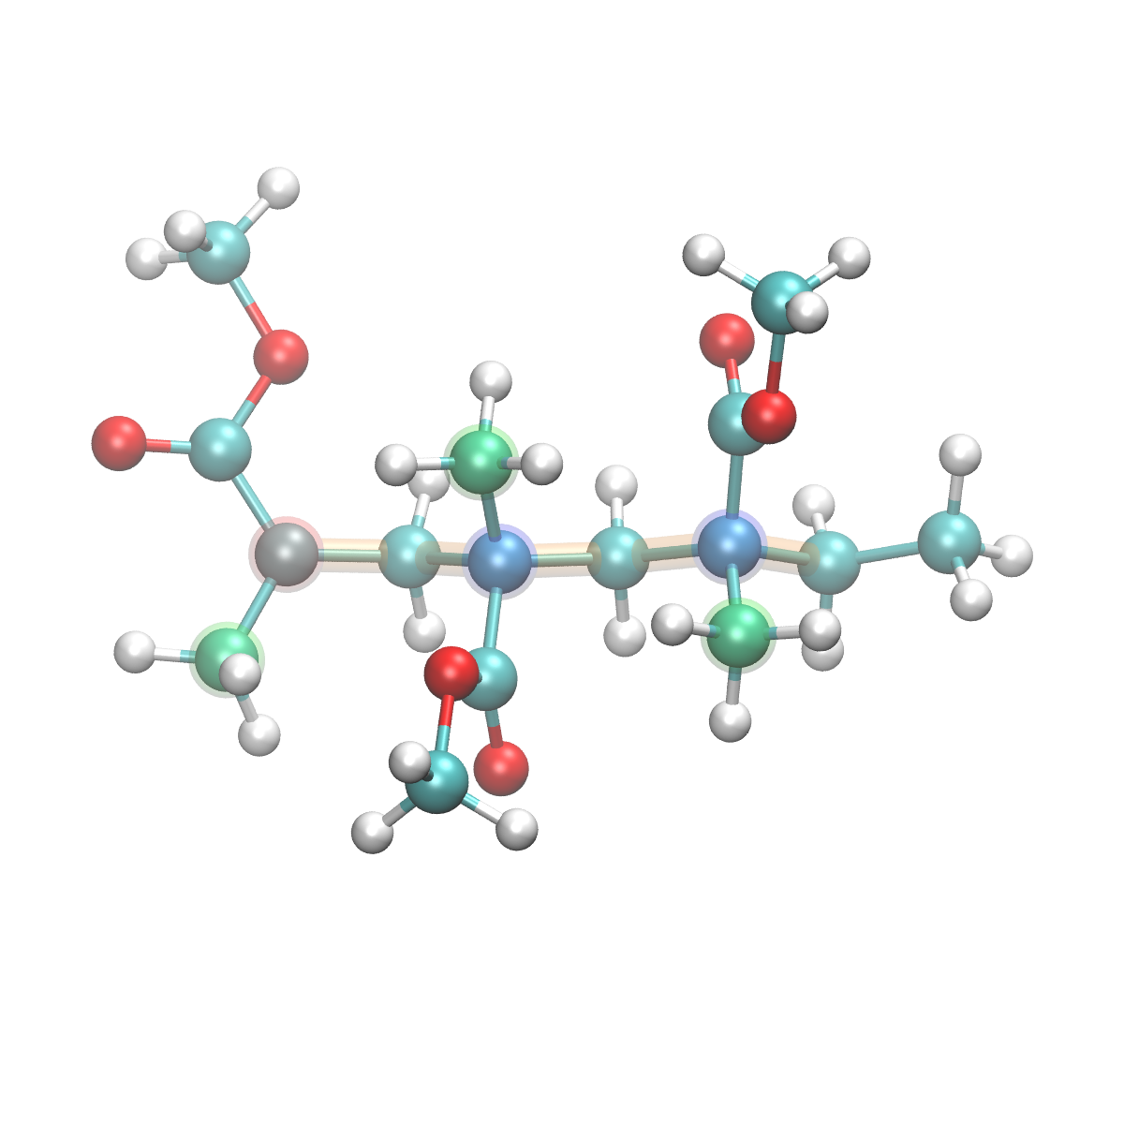
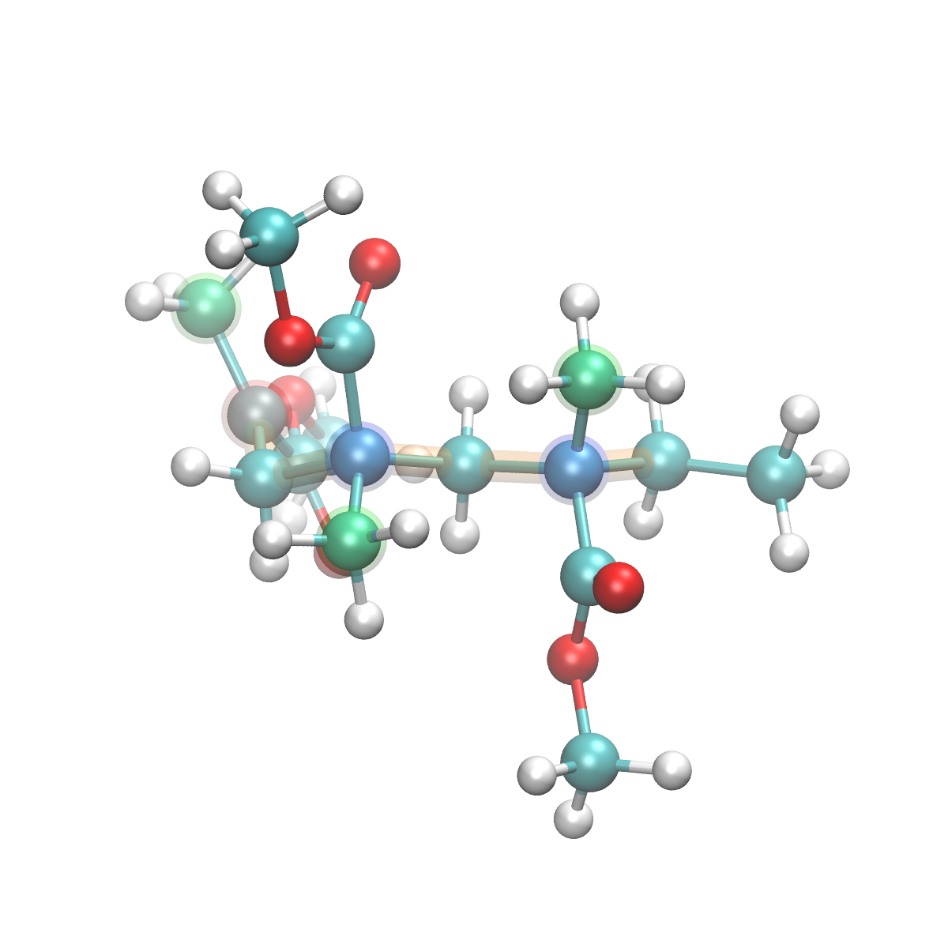
Most stable 12 conformers of a trimer radical
racemo
racemo
racemo
racemo
most stable
+0.13 kcal/mol
+0.17 kcal/mol
+0.41 kcal/mol
racemo
meso
meso
racemo
+0.45 kcal/mol
+0.58 kcal/mol
+0.63 kcal/mol
+0.65 kcal/mol
racemo
racemo
racemo
racemo
+0.68 kcal/mol
+0.74 kcal/mol
+0.75 kcal/mol
+0.80 kcal/mol

Slide 15
Density of conformers against relative energy in a trimer radical
Relative energy (kcal/mol) | Diad | Ratio by Boltzmann factor
0.00 | r | 6.54%
0.13 | r | 5.40%
0.17 | r | 5.09%
0.41 | r | 3.61%
0.45 | r | 3.38%
0.58 | m | 2.79%
0.63 | m | 2.61%
0.65 | r | 2.52%
... | ... | ...
r
m
r
r
m
r
Diad | racemo | meso
No. conformers | 209 | 221
Ratio | 75.5% | 24.5%
bulk polymerization | 78% | 22%
Estimated tacticity ratio well corresponds with experimental bulk polymerization products.

Slide 16
Reason of the very unstable conformers (>15 kcal/mol)
Future work
Execute tetramer (4-mer) and hexamer (6-mer) radical calculations. - Check higher order tacticity - Check the dependency of tacticity on the radical length
Discuss how the PCP channel space enhances the meso tacticity.
Check the quality of GAFF force field to predict conformers with enough accurate energy. If the correspondence is bad, modify the force field parameters.
Most unstable conformer (+17.70 kcal/mol)
By the rotation of the CH₃ at the COOCH₃ group.

