Slide 1
FY2015 2nd CREST Workshop
May 29th, 2015
Role of Non-site Specific Interaction in Biocatalyzed Reaction: A Case Study of Na⁺-activated Serine Protease, Thrombin (1)
Ikuo KURISAKI
Graduate School of Information Science,
Nagoya University

Slide 2
Contents
Introduction of Molecular Recognition
Case Studies of Thrombin
On-going Project
Commitment to CALB polymerization study

Slide 3
Contents
Introduction of Molecular Recognition
Case Studies of Thrombin
On-going Project
Commitment to CALB polymerization study

Slide 4
Molecular recognition is the elementary process of chemical reaction network
+
Association
+
Reaction
Dissociation
Catalyst
Reactant
Product

Slide 5
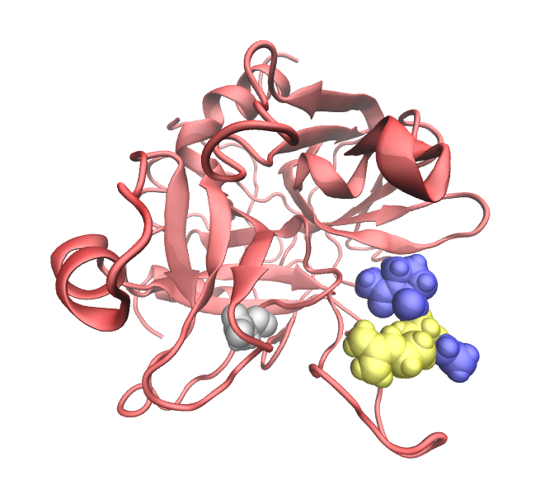
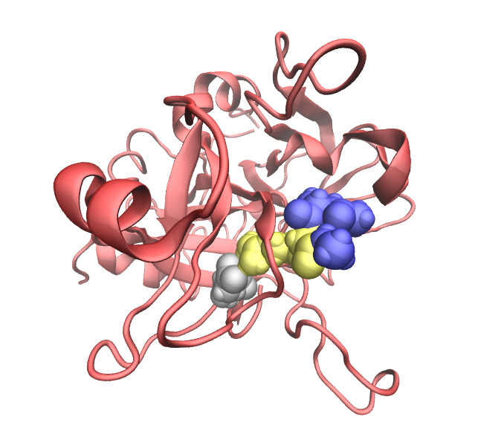
Molecular dynamics simulations could provide atomic insights into intermolecular association
+

Slide 6
Contents
Introduction of Molecular Recognition
Case Studies of Thrombin
On-going Project
Commitment to CALB polymerization study

Slide 7
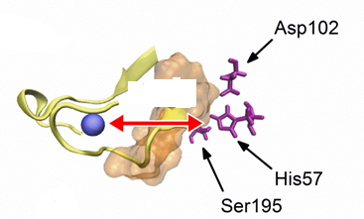
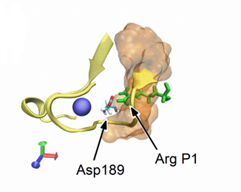
Ⅰ. Introduction
Thrombin is Na⁺-activated enzyme
15 Å
Reaction site
Site-specific interaction with Na⁺ activates thrombin?

Slide 8
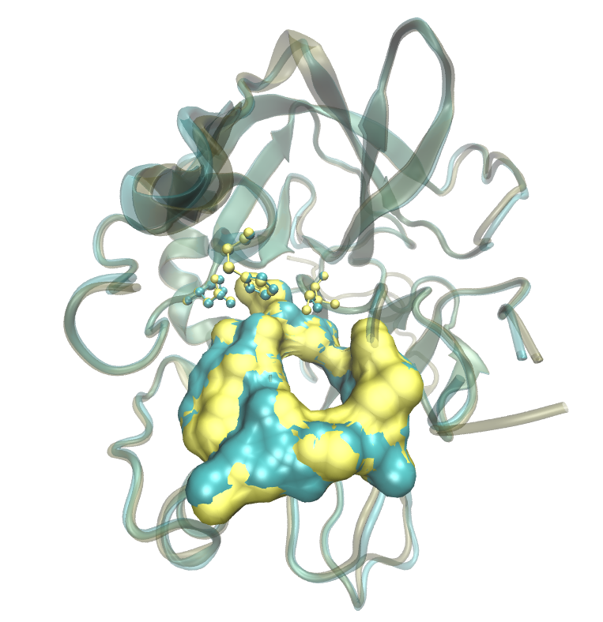
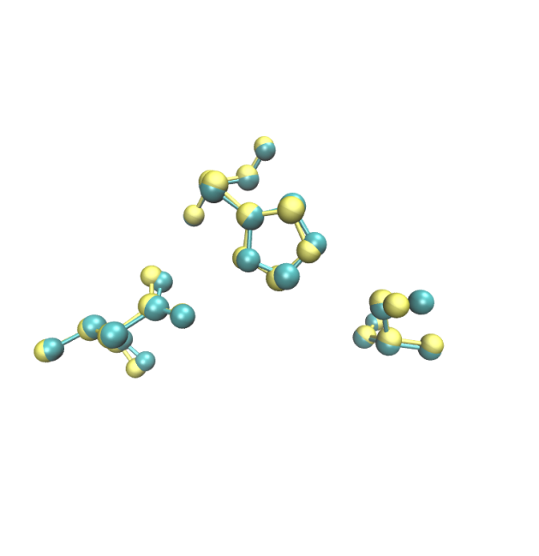
Na⁺-binding does not change active site conformation
Catalytic triad
His57
Ser195
Asp102
His57
S1-pocket
Asp102
Ser195
thrombin-Na⁺
free thrombin
Question:
“Is site-specific interaction sufficient to explain how Na⁺ enhances enzymatic activity of thrombin?”
[Ref. 1] Pineda, J. Biol. Chem. (2004) 279, 31842-31853

Slide 9
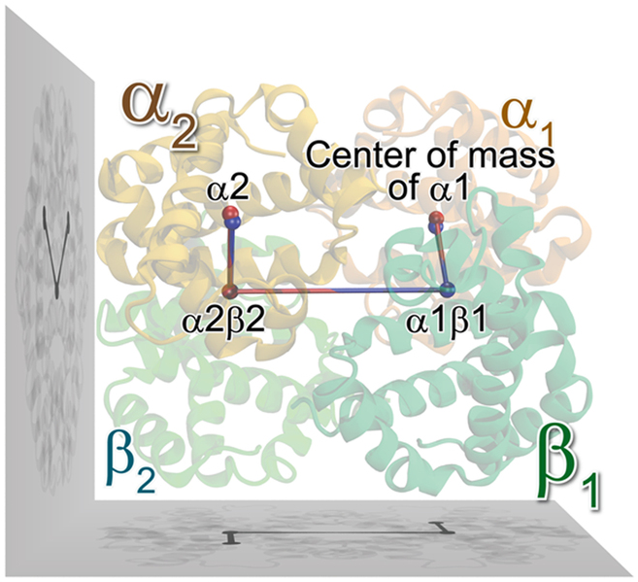
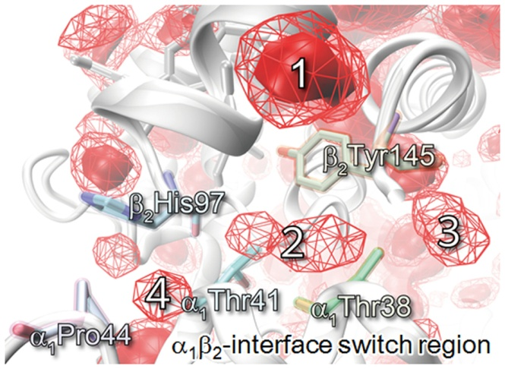
Non-site directed interaction can play a role in functional expression!!
Conformational change of hemoglobin
O₂ distribution around hemoglobin subunit interface
Our conjecture:
“surrounding Na⁺ also contribute to maximization of thrombin’s enzymatic activity.“
[Ref. 2] Takayanagi, IK, Nagaoka, Sci. Rep. (2014) 4, doi: 10.1038/srep04601

Slide 10
Thrombin-substrate association reaction is maximized under the presence of Na⁺
+
+
×2.5
×2.5
①
②
 | Li⁺ | Na⁺ | Cs⁺
k₁* | 38 ± 8 | 103 ± 28 | 37 ± 9
+
Association reaction can be viewed as a two-step reaction:
① Formation of encounter complex ensemble
② Formation of stereospecific complex
[Ref. 3] Wells and Cera., Biochemistry (1992) 31, 11721-11730; [Ref. 4] Suh et al., JACS comm. (2007) 129, 12954-1295

Slide 11
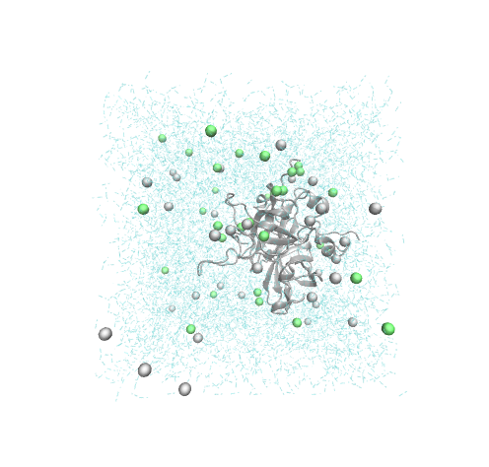
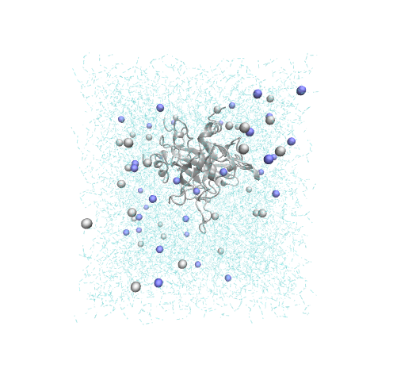
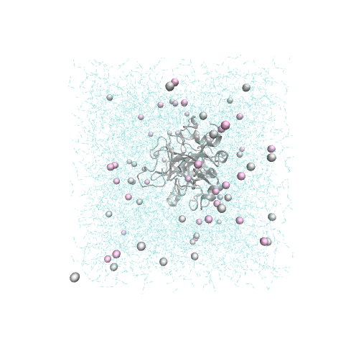
Ⅱ. Methods
MD simulation procedure
Li⁺
Na⁺
Cs⁺
Protein: α-Thrombin (PDBID: 1FPH) Force field: Amber99SB¹, JC ion parameter²
Ions: 33 cation/36 Cl⁻ (140 mM) Water: 11572 SPC/E water model³
Production run: NPT (1 [bar]; 300 [K]; 20 [ns])
…
…
…
NVT
…
…
…
NPT
…
…
…
20 ns
×100 MD simulations
×100 MD simulations
×100 MD simulations
[Ref. 5] Hornak et al., Proteins (2006) 65, 712-725; [Ref. 6] Joung & Cheatham, J. Phys. Chem. B (2008) 112, 9020-9041; [Ref. 7] Jorgensen et al., J. Chem. Phys. (1983) 79, 926-935.

Slide 12
Ⅲ. Results and Discussion
Ⅲ-1. Formation of encounter complex ensemble
+

Slide 13
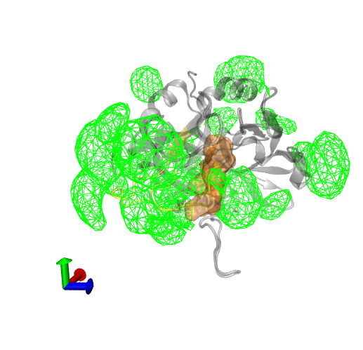
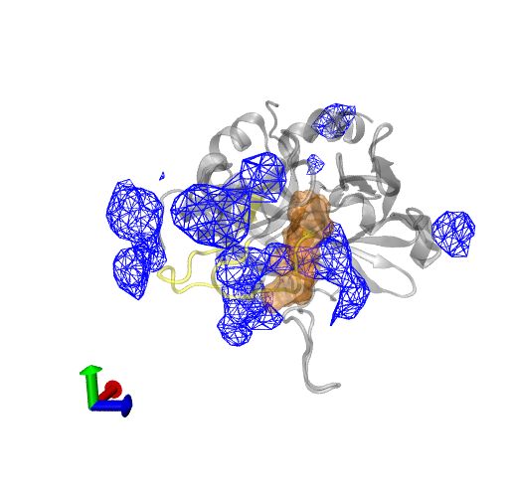
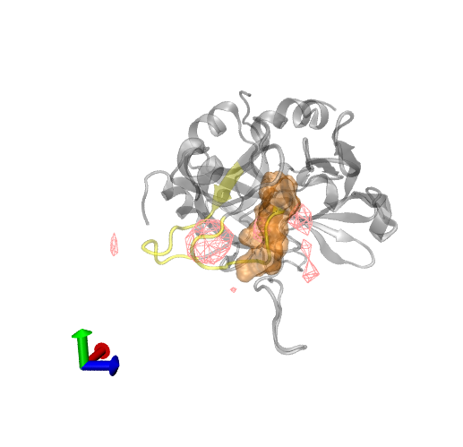
Cation’s distribution around thrombin
Li⁺
S1-pocket
Na⁺
Cs⁺
Small
Large
Cation size
Cs⁺
hydration shell of X [Å] from thrombin surface
Na⁺
Li⁺
cation
X [Å]
Thrombin

Slide 14
Possible disadvantage of Li⁺
+
S1-pocket
+
S1-pocket
+
+
−
+
+
Repulsive interaction should prevent a substrate from forming a encounter complex around the S1-pocket.

Slide 15
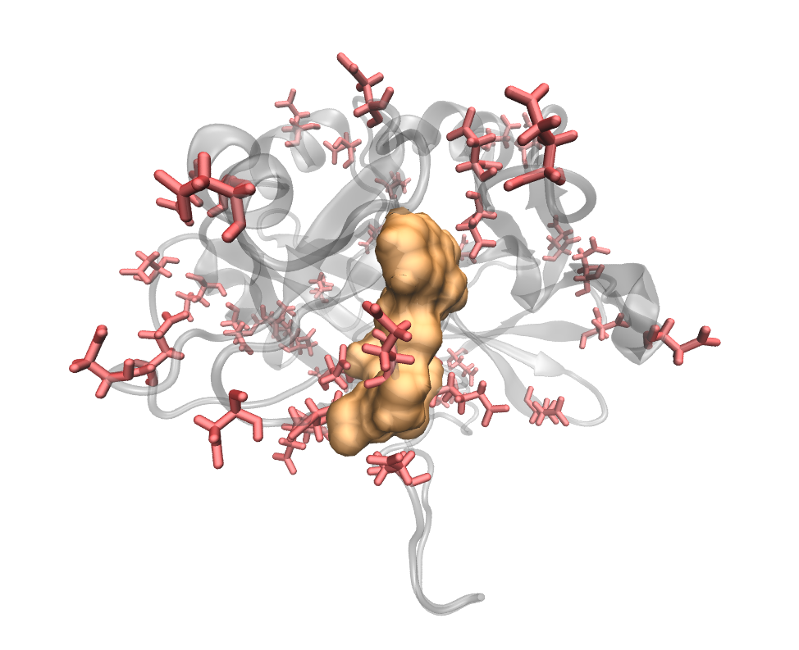
Possible disadvantage of Cs⁺
−
−
S1-pocket
+
+
+
S1-pocket
−
−
−
+
−
+
−
−
−
−
+
+
+
+
*Red indicates negatively charged residues i.e., Glu and Asp.
Negatively charged residues possibly attract Lys or Arg at the P1 site in substrates on thrombin’s surface remote from the S1-pocket, thus increasing repertoire of encounter complex.

Slide 16
Observation Rule 1
The number of “active” encounter complexes would be optimized under the intermediate cation distribution
+
+
+
+
+
+
S1-pocket
+
+
+
+
+
+
+
+
+
+
+
+
+
+
+
repulsive
Non-specific interaction with substrate
attractive

Slide 17
Ⅲ. Results and Discussion
Ⅲ-2. Formation of stereospecific complex
+

Slide 18
The number of cation in the vicinity of the S1-pocket changes
Li⁺
Na⁺
Cs⁺
The number of cations around the S1-pocket
Li⁺: 0.79±0.12; Na⁺: 0.40±0.09; Cs⁺: 0.16±0.05
Cs⁺ would be preferable for substrate access to S1-pocket

Slide 19
Observation Rule 2
Thrombin under the presence of Na⁺ does not necessarily have an advantage over other cations in the formation of the stereospecific complex
Li⁺
Na⁺
Cs⁺

Slide 20
Ⅳ. Concluding Remarks
According to the two observation rules obtained, we propose a conjecture that unbound Na⁺ molecules are involved in maximization of thrombin-substrate association reaction rate constant by optimizing the formation of an encounter complex ensemble.
Li⁺
Na⁺
Cs⁺

Slide 21
Contents
Introduction of Molecular Recognition
Case Studies of Thrombin
On-going Project
Commitment to CALB polymerization study

Slide 22
What kind of encounter complex ensemble forms under specific cation?
+

Slide 23
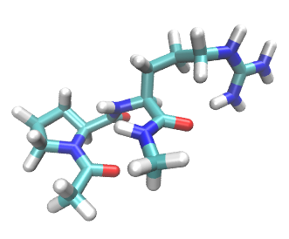
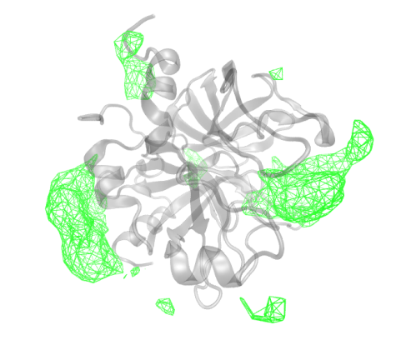
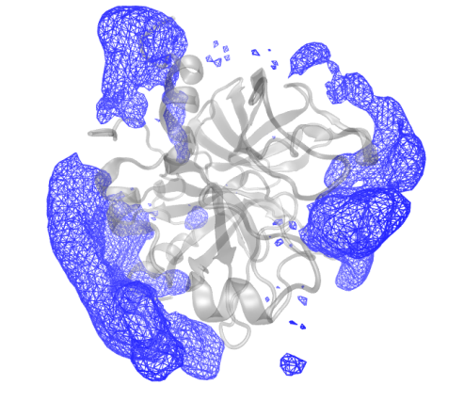
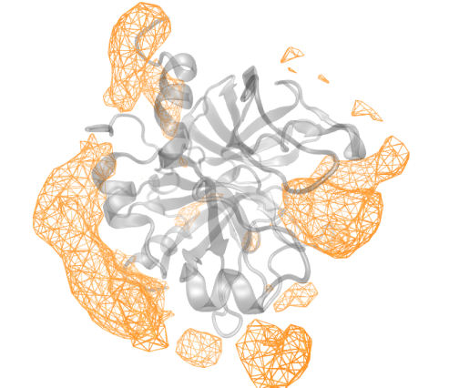
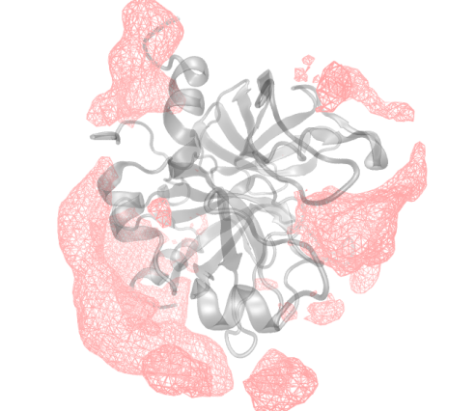
Distribution of ArgP1 around thrombin
NaCl
Model substrate:
Ace-Pro-Arg-Nme
ArgP1
x12
LiCl
NaCl
KCl
CsCl

Slide 24
Contact number, residence time, recursive time of ArgP1 around thrombin
Table 1. Average of number of Arg P1 on thrombin’s surface
Thr-Li⁺ | Thr-Na⁺ | Thr-K⁺ | Thr-Cs⁺
3.30 ± 0.28 | 5.02 ± 0.30 | 5.28 ± 0.32 | 5.68 ± 0.31
Table 2. Average of residential time of Arg P1 on thrombin’s surface [ps]
Thr-Li⁺ | Thr-Na⁺ | Thr-K⁺ | Thr-Cs⁺
138 | 165 | 181 | 181
Table 3. Average of revisiting time of Arg P1 on thrombin’s surface [ps]
Thr-Li⁺ | Thr-Na⁺ | Thr-K⁺ | Thr-Cs⁺
261 | 211 | 223 | 208

Slide 25
Stereospecific complex formation was also observed in the ensemble of MD simulations
+

Slide 26
Thrombin-substrate association was observed by using MD simulations!
+

Slide 27
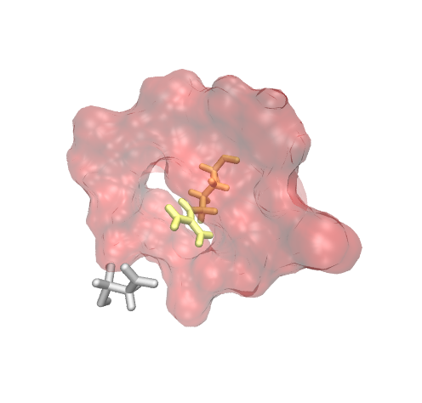
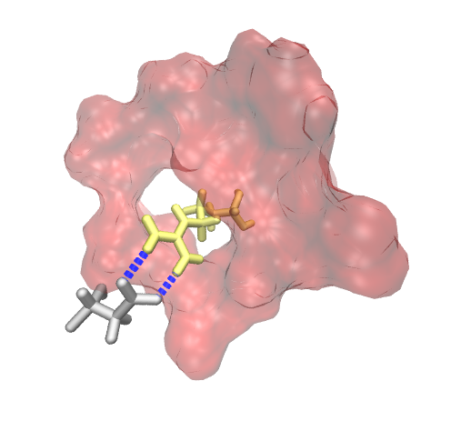
Thrombin-substrate association is two-step reaction
Step-1: ArgP1 of substrate enters the S1-pocket of thrombin.
Step-2: ArgP1 forms hydrogen bonds with Asp189 of thrombin.
In Step-1, ArgP1 of substrate could not interact with Asp189 of thrombin!
ArgP1
Asp189
Step-1
Step-2
Step-1
Step-2

Slide 28
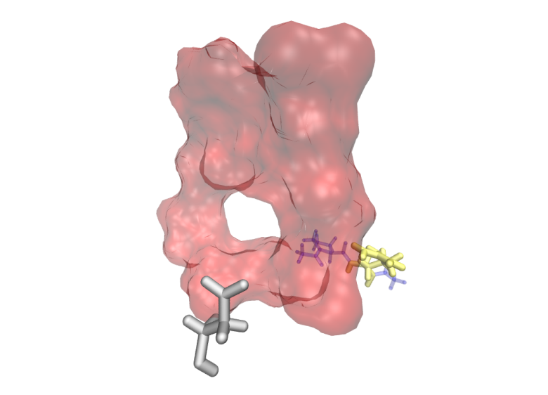
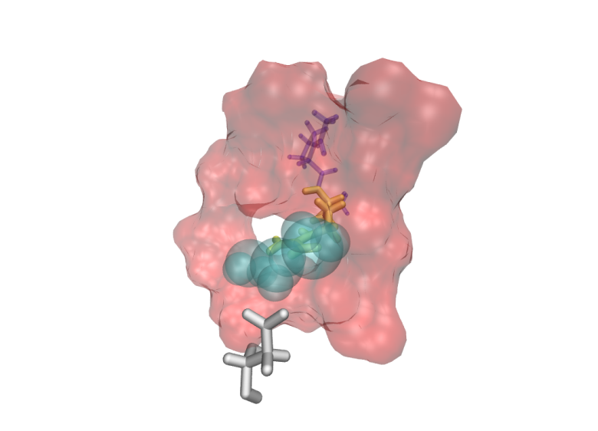
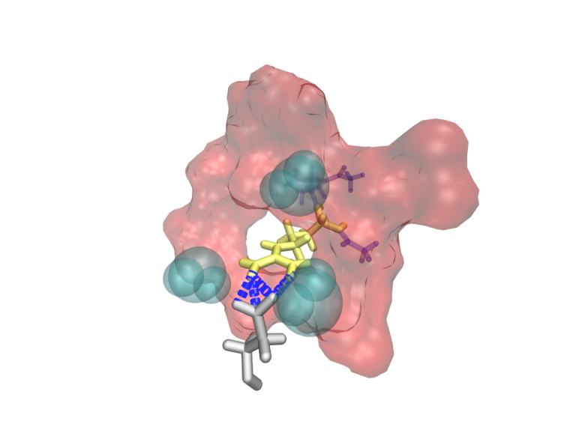
Relocation of water molecules is a “time -consuming” process.
+
Step-1
@25 ns
Step-2
@233 ns
Water
ArgP1
Asp189

Slide 29
Assumed difficulty for MC/MD simulation
Protein-substrate association is “time-consuming”, so that We have to accelerate protein-reactant association using a trick.
Then, we must pay much attention to reproduce natural protein-substrate association.
However, protein-substrate association mechanism is still elusive at the atomic level.
Therefore, we have to clarify what is the natural protein-substrate association to circumvent a risk of anomalous simulations.
*In particular, enzymatic polymerization reaction is one of the most complicated case, because “substrate” is different in each polymerization stage.

Slide 30
Contents
Introduction of Molecular Recognition
Case Studies of Thrombin
On-going Project
Commitment to CALB polymerization study

Slide 31
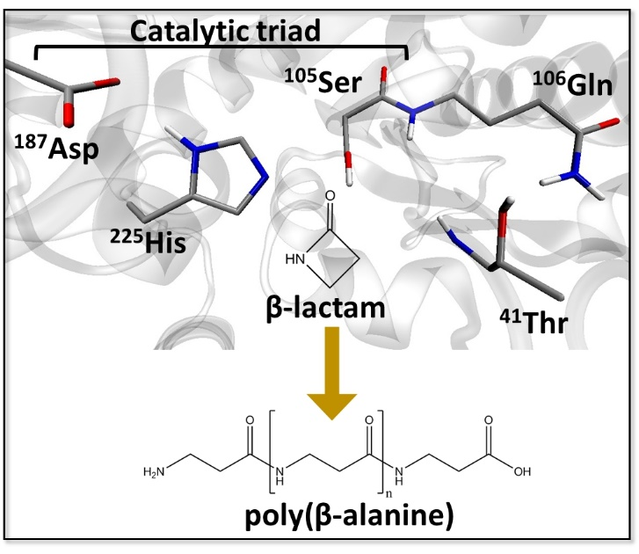
Candida Antartica Lipase B (CALB) synthesizes poly (β-alanine) from β-lactam
The panel is gifted from Dr. Barberot.

Slide 32
How does CALB-β-lactam association change following polymerization?
dimer
formation
trimer
formation
tetramer
formation
Ser¹⁰⁵-O-
Ser¹⁰⁵-O-
Ser¹⁰⁵-O-
A Speculation: Longer polymer would be folded in the active site, thus preventing monomer access, and also water access.

Slide 33
Is there sufficient space in CALB’s active site?
Polymer conformer
Folded
Extended
v.s
Ser¹⁰⁵-O-
Ser¹⁰⁵-O-
Large
Small
Space in the active site
A Speculation: Polymer’s conformer should be influenced by available space in the active site.

Slide 34
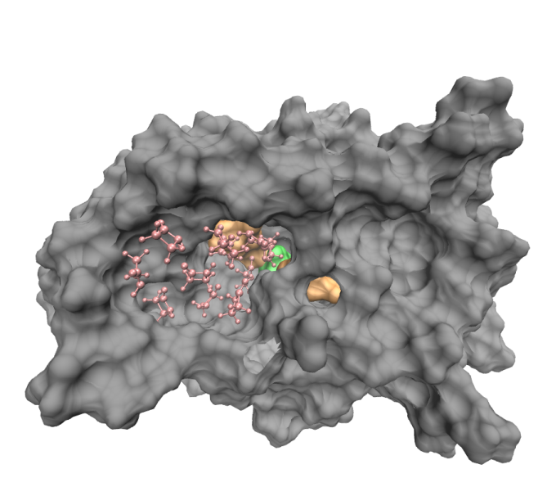
How many β-lactam and/or β-alanine can reside in the active site of CAL-B?
As for β-lactam, 11 molecules occupy the active site. There is sufficient space in the active site, so that it is possible that β-alanine polymer is folded in the site.
Simulation setup
CALB solvated by c.a. 1500 β-lactam molecules
75 ns MD simulation under NPT condition
Pink: β-lactam; green: catalytic serine: orange: oxo-anion hole and catalytic histidine
Question: What conformer does β-alanine polymer assume in the active site? Furthermore, how does it influence following monomer access into the active site?

Slide 35
Research plan for the next 2 months
Purpose
Examine what conformers poly β-alanine takes in CALB active site, assuming that a polymer elongation is just completed
Methods
Prepare CALB structures forming complex with a shorter polymers, i.e., dimer or trimer, and execute MD simulations
Expected results
Both dimer and trimer could be stored stably in the active site, while the later should make more contacts with CALB than the former.

Slide 36
Suggested Research plan for the next 2 months
Takayanagi-san
➔ Dihedral angle parameters should be well considered because it haves influence on dynamics of polymer.
➔ Actually, using GAFF is sometimes accused by reviewer.
➔ Higher energy barrier would retard conformational selection.
Nagaoka-sensei
➔ Is there any poly alanine structure, e.g., in Cambridge data library? This could be a good reference.

Slide 37
Thank you for your attention

