Slide 1
Tue. Oct. 6th
FY2015’s 5th, CREST Workshop
Theoretical Investigation of Ion Transport Pathway in Solid Electrolyte Interphase Film
Norio Takenaka^{1,2}
Graduate School of Information Science, Nagoya University¹,
Elements Strategy Initiative for Catalysts and Batteries (ESICB), Kyoto University²

Slide 2
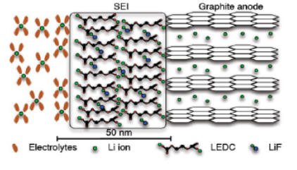
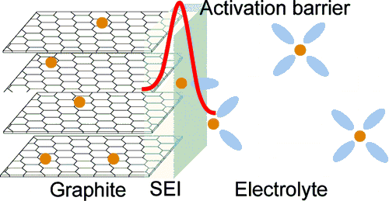
Background
・Li⁺ (or Na⁺) transfer at an anode/electrolyte interface is an essential process of the charge-discharge reaction in LIB (or NIB).
・According to experimental investigations, there are two possibilities of the rate-determining step on this process, i.e., (1) desolvation of Li⁺ (or Na⁺) and (2) Li⁺ (or Na⁺) transfer inside the SEI film.
It is necessary to investigate the ion transfer at the atomistic level.
Fig. Schematic illustrations of an anode/electrolyte interface

Slide 3
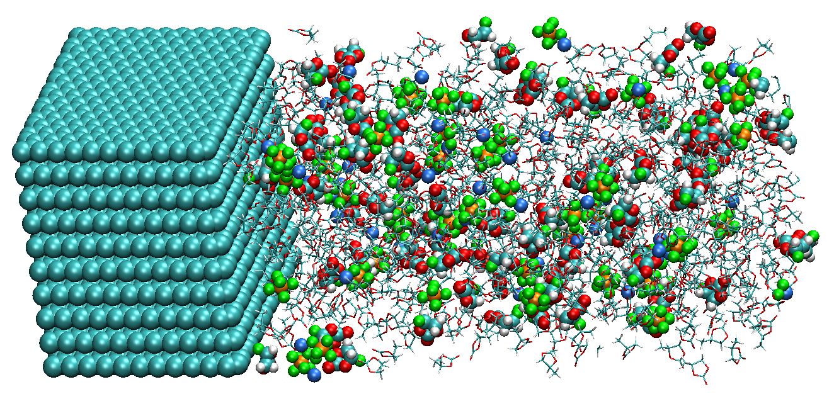
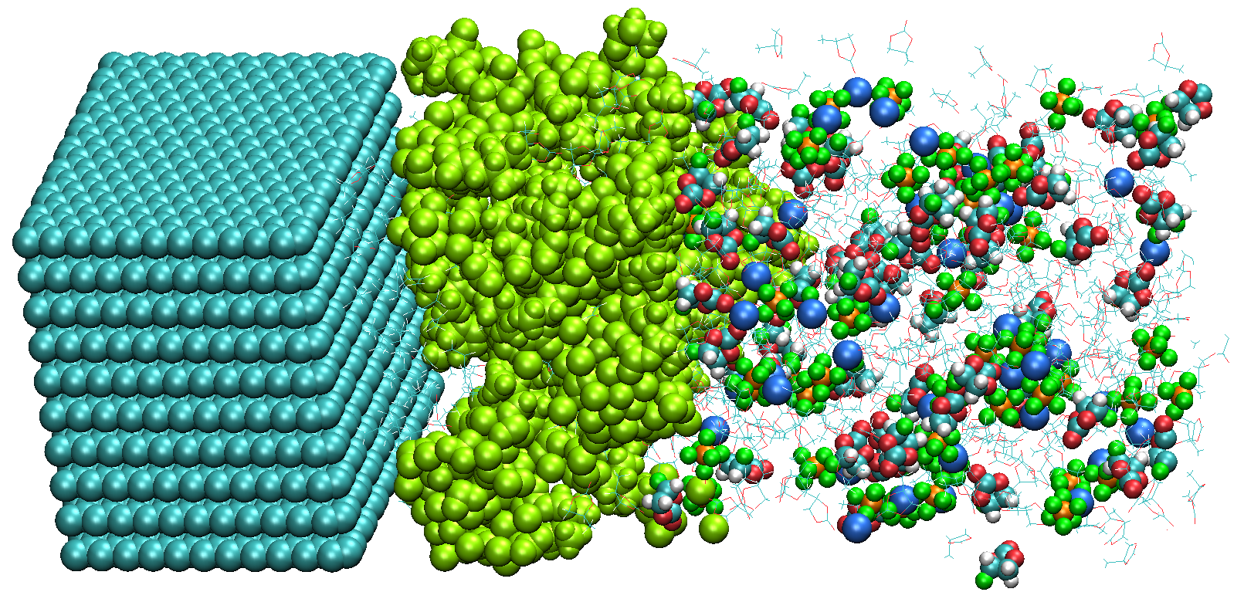
Purpose of Present Research
・Recently, we could obtain the realistic computational models of SEI film using a hybrid MC/MD reaction method [1,2].
[1] NT et al., J. Phys. Chem. C, 118(20), 10874 (2014); [2] NT et al., J. Phys. Chem. C, 119(32), 18046 (2015).
e⁻
SEI
Hybrid MC/MD
reaction simulation
・Using these computational models, the ion transport pathways in the SEI film have been investigated without and with additives (i.e., FEC or DFEC).

Slide 4
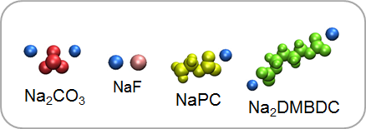
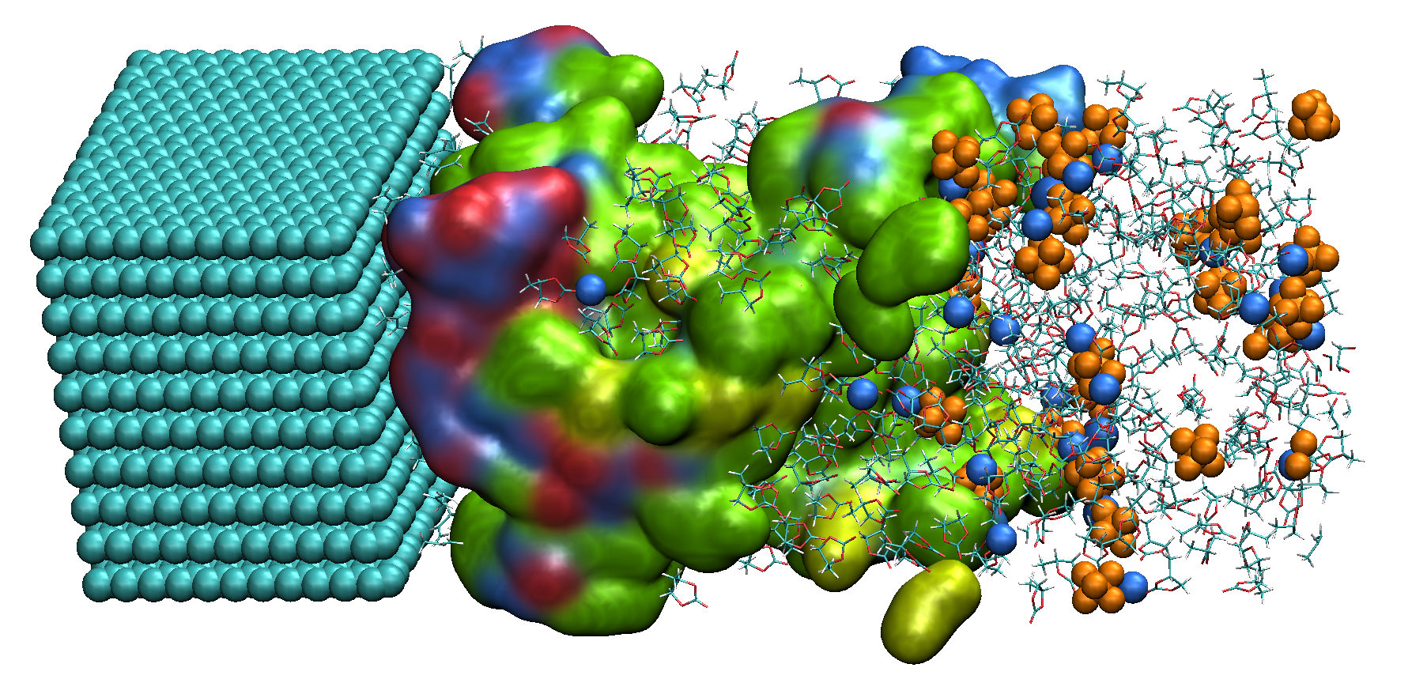

Model System
Species in SEI film
Anode
SEI film
(a) Side View
(SEI film, surface view; Na⁺ and PF₆⁻, van der Waals view; PC and Gas, stick view)
(b) Front view of SEI film from the side of anode
(0 < z < 20 Å)
・ For this purpose, I employed the system including NaPF₆-PC electrolyte solution and SEI film without and with FEC or DFEC additives.

Slide 5
Algorithm to obtain migration pathway of Na⁺
・The migration pathways were investigated by using a following procedure.
(1) First, the total system is divided to discrete grid points (grid size = 0.3 Å).
(2) Next, at each grid point, we obtain a sphere which contacts with the SEI film.
If the radius R is smaller than a van del Waals radii of Na⁺ (1.84 Å), this grid
point becomes the possible cavities for the migration pathway.
(3) Finally, we connect the cavities from the anode surface to the bulk electrolyte
to search for the migration pathways as the connective cavities.
SEI
R
Grid point

Slide 6
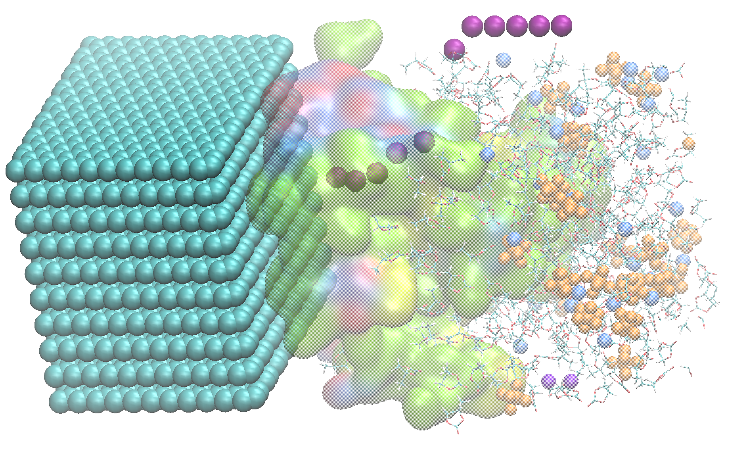
One of obtained migration pathway
Purple: migration pathway
R [Å]
R_{min} = 3.8 Å
(anode)
z [Å]
(bulk electrolyte)
origin of z axis
Fig. Change in the cavity radius
・ This pathway must be reasonable because the minimum radius R_{min} (3.8 Å) on the pathway was larger than a van del Waals radii of Na⁺ (1.84 Å).

Slide 7
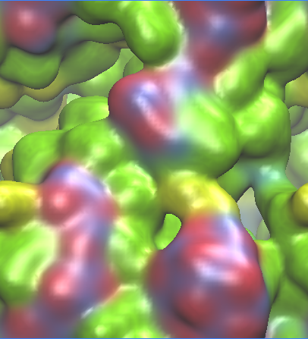
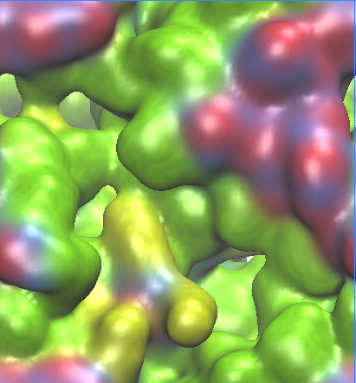
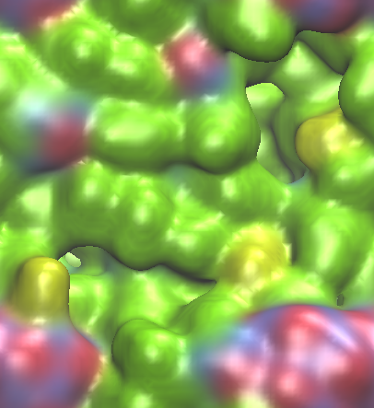
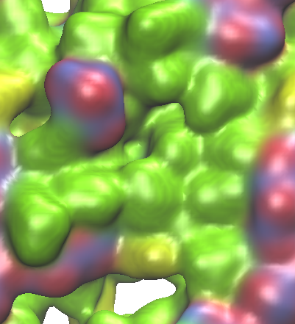
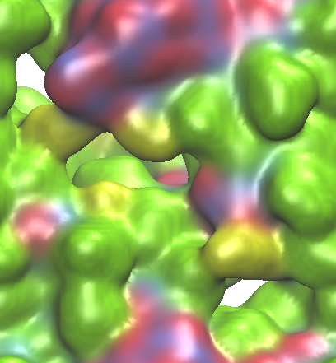
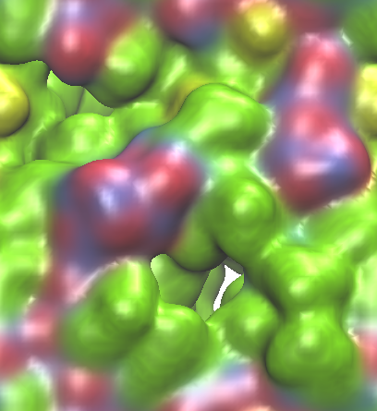
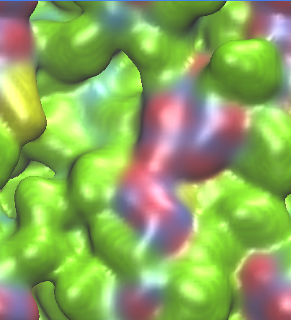
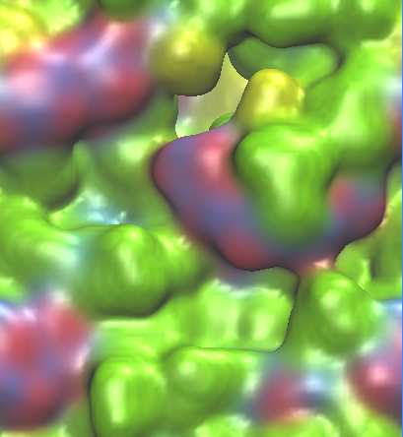
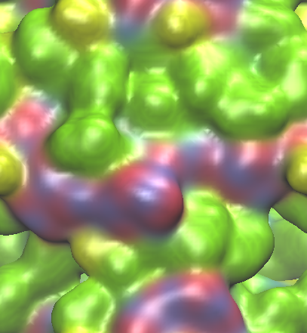
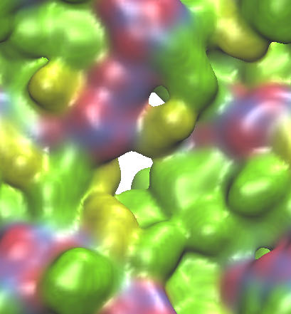
SEI film and migration pathway of Na⁺ (without additive)
10 Å
Front view of SEI film
1 pathway
No pathway
No pathway
1 pathway
1 pathway
No pathway
1 pathway
No pathway
1 pathway
No pathway
Number of pathways：5, Average of minimum radius：2.6 Å
➤ There were some pathways in the SEI film obtained by the hybrid MC/MD reaction method. Actually, such cavities were formed by the organic salts.

Slide 8
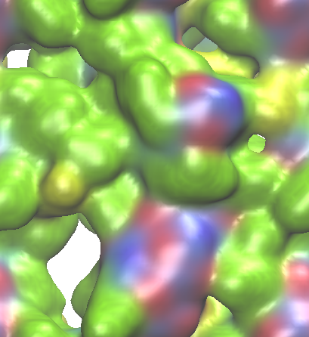
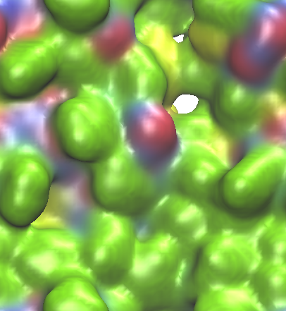
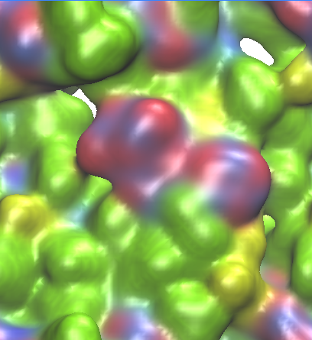
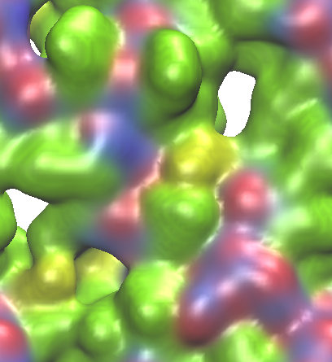
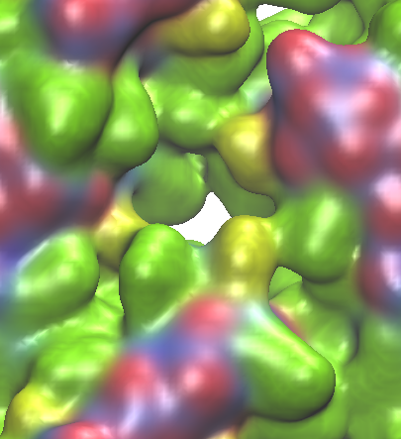
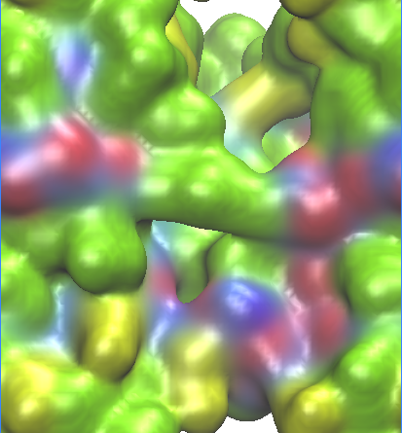
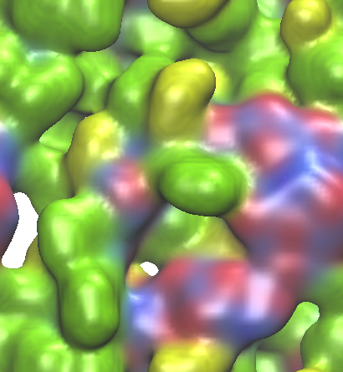
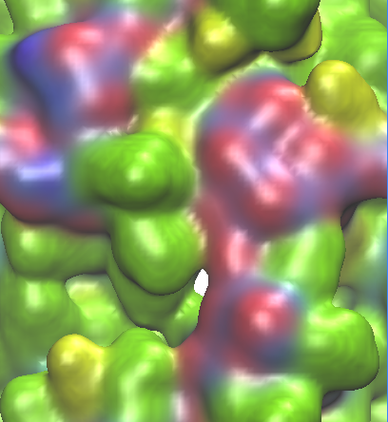
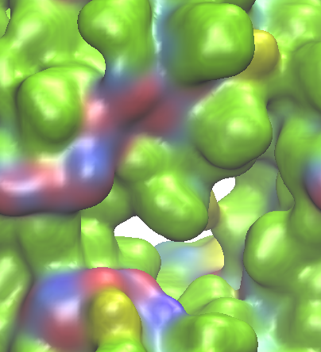
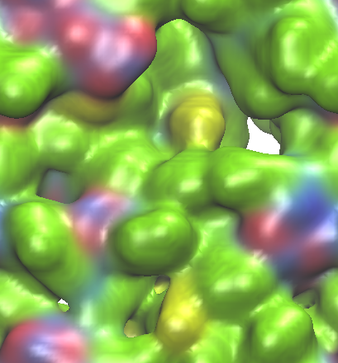
SEI film and migration pathway of Na⁺ (with FEC)
10 Å
Front view of SEI film
2 pathways
1 pathway
1 pathway
1 pathway
1 pathway
1 pathway
1 pathway
1 pathway
No pathway
1 pathway
Number of pathways：10, Average of minimum radius：2.8 Å
➤Since the surface of SEI film became smooth by adding FEC, the number of pathways was found to increase.

Slide 9
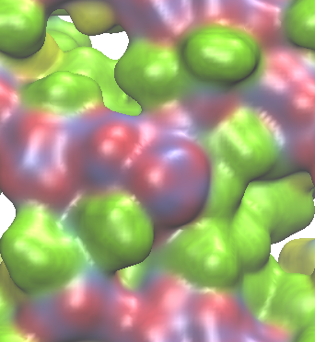
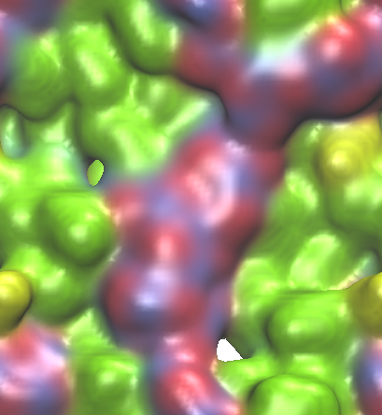
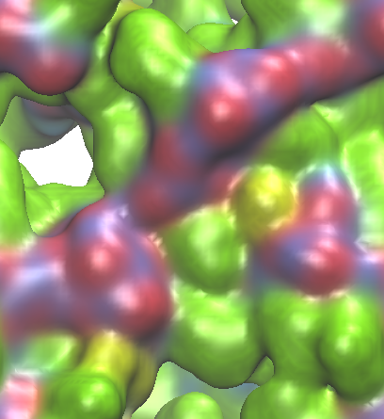
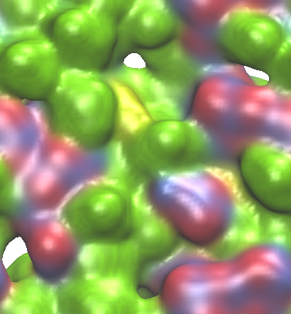
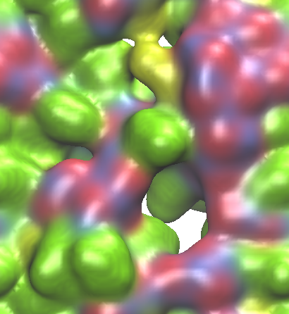
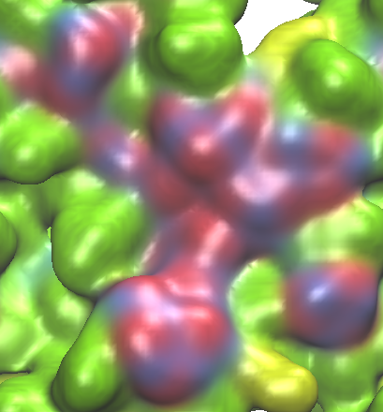
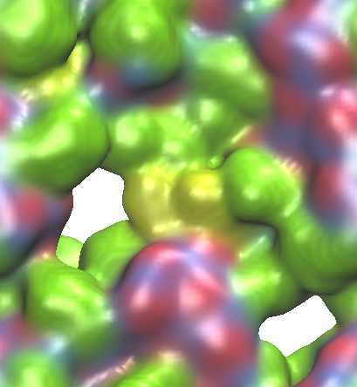
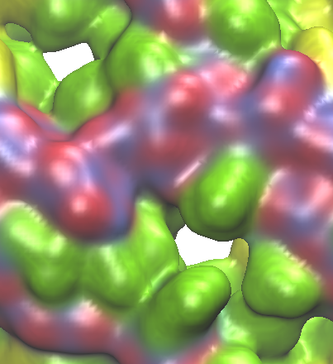
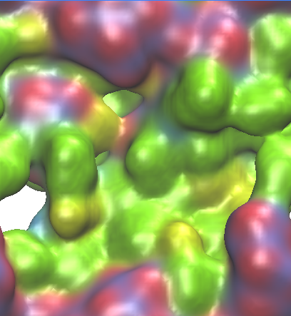
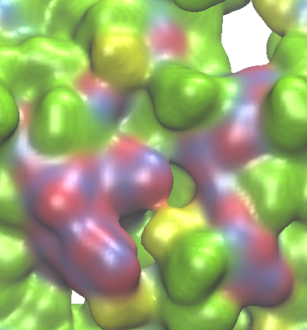
SEI film and migration pathway of Na⁺ (with DFEC)
10 Å
Front view of SEI film
2 pathways
No pathway
2 pathways
1 pathway
1 pathway
1 pathway
2 pathways
1 pathway
2 pathways
2 pathways
Number of pathways：14, Average of minimum radius：3.1 Å
➤Although the number of pathways increased by adding DFEC, the average of minimum radius increased in comparison to that in the FEC-added SEI film.

Slide 10
Solvation number of ion on a migration pathway
Solvation number
R [Å]
(anode)
z [Å]
(anode)
z [Å]
(a) Solvation number
(b) Change in the cavity radius
・The solvation number around the Na⁺ was estimated by executing 1.0 ns MD simulations, fixing only the z coordinate at each positon.
・It was found that the solvation number decreases as the ion moves from the bulk electrolyte to anode surface.

Slide 11
Summary
・In the present study, I have investigated the migration pathways of Na⁺ in the SEI film by using a new algorithm.
・By using the present algorithm, all the possible pathways can be obtained at the lower calculation cost than that of the TMD method.
・As a result, the number of pathways were found to increase by adding the additives into the electrolyte.
・It was found that the solvation number decreases as the ion moves from the bulk electrolyte to anode surface.
・In future, the activation free energy should be estimated on the obtained pathways to compare it with the experimental values.

Slide 12
Thank you for your attention

