Slide 1
Developments of molecular simulation method depending on the environment pH conditions: Hydrogen bond analysis of di-peptide system
Yukichi Kitamura

Slide 2
Background
I have developed the molecular simulation method considering the environment pH conditions (Micro Constant pH MS method).
Conformation sampling
Exchange of protonation state and equilibrium
Monte Carlo process
Our method succeeded in the reproduction of the experimental pH curve with statistical efficiency!
Notes:
The solute molecule is effectively exchanged between its protonation states by applying the Monte Carlo process combined with Gaussian filtering scheme.

Slide 3
Micro Constant pH MS method
The energy difference for MC is constructed from three components.
The contribution of ΔG_{pH} is smaller than first and second components because of the large thermal fluctuations. → Gaussian filtering scheme and correction term.
Notes:
First term is the instantaneous energy difference before and after transitions.
Second is the mean value of energy difference estimated by MM force field.
Third is the free energy term depending on the pH value.
The magnitude of energy fluctuation is forty to fifty kilocalories per mole.
On the other hand, this is 1.4 kilocalorie per 1 pH unit.
This will bring about the inefficiency of MC sampling.
To avoid such problem, we introduced the Gaussian filtering scheme and correction term.

Slide 4
Micro Constant pH MS method
1 MC trial is consisted by 4 steps.
1 MC Trial
MC
1st stage MD
Change state and minimization
2nd stage MD with Gaussian filtering scheme
Gaussian filtering scheme
(1) After the 1st stage MD, the protonate state is randomly exchanged, and execute minimization.
(2) execute the 2nd stage MD with new state and check the energy difference ∆E at every step before MC trial.
(3) if ∆E is sufficiently small, the MD run is stopped and switches to next MC part (Gaussian filtering), .
Notes:
Our method is constructed by MC and MD part.
MD is executed the conformation sampling. On the other hand, MC is employed for protonation transition.
In 1st stage of MD, the conventional MD is executed.

Slide 5
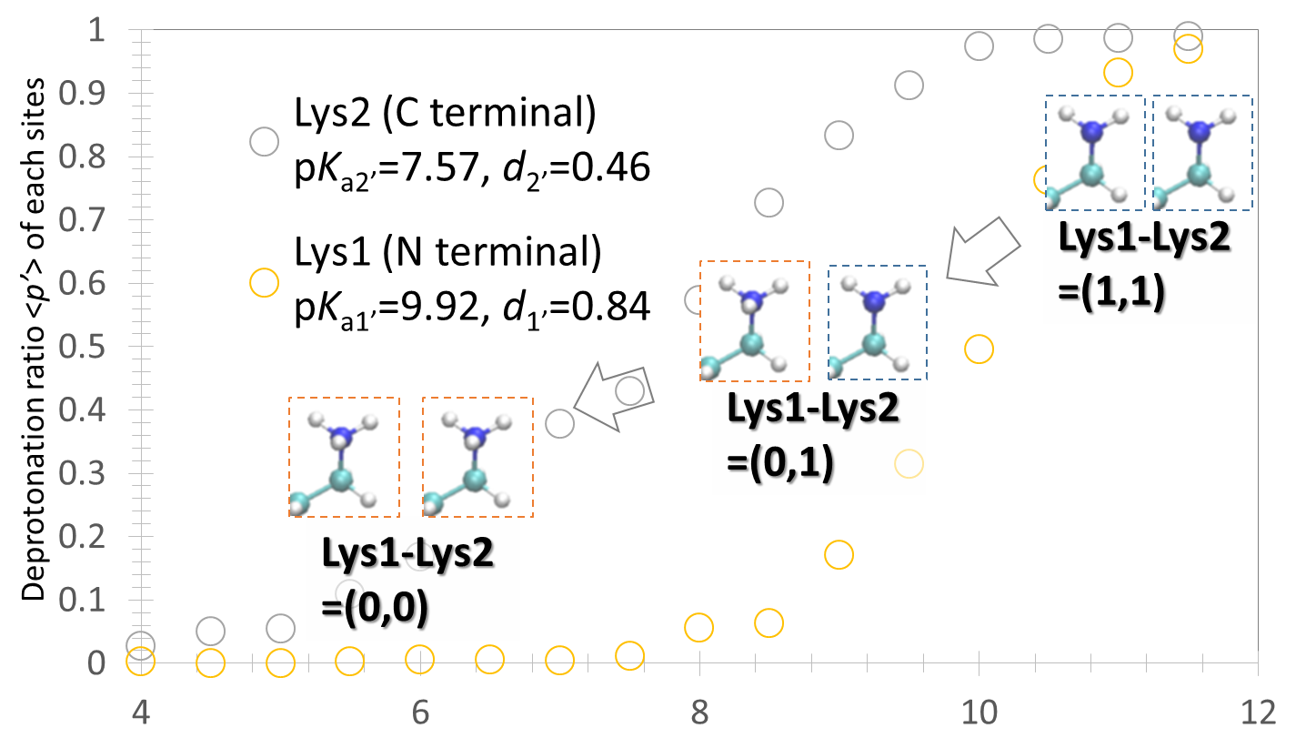
Contents of Today’s Workshop
In the last CREST workshop, I have reported some results of pH curve for lysine dipeptide and discussed the physical origin of local pKa.
The (0,1) and (1,0) have the energy difference of about 4.0 kcal/mol, which is the cause of difference of pKa shifts between two residues.

Slide 6
Contents of Today’s Workshop
In this workshop, I have analyzed the hydrogen bonding network around the solute molecule to obtain the microscopic origin of difference of pK_{a} shifts.

Slide 7
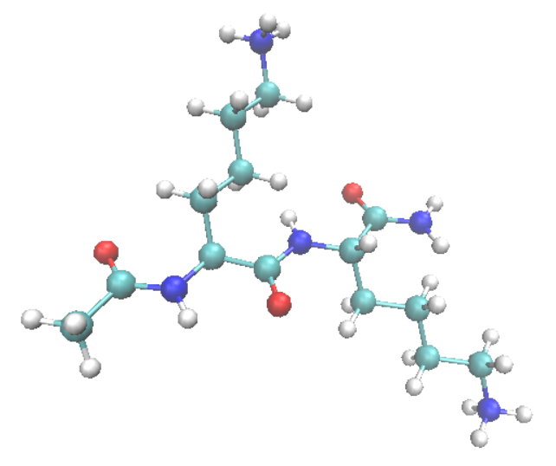
Target system
•Dipeptide system
The two lysine residues are called “Lys1” (located in N terminal side) and “Lys2” (located in N terminal side), respectively.
Stepwise protonation reaction
Lysine dipeptide include the two titration sites and can be modeled by the two stepwise dissociation reaction.
pK_{a1}=5.95、 pK_{a2}=8.66
(J. Makowska, et al., J. Solution. Chem. 41, 1738-1746 (2012))
Lys2
Acetyl-Lys-Lys-amide
(with 2 Cl anion)
Lys1
→
→
Notes:
As a model system, I adopted the tri-peptide including one lysine residue.
This has one protonation site and the pKa value is 10.34.
For neutralization, one counter ion was considered.

Slide 8
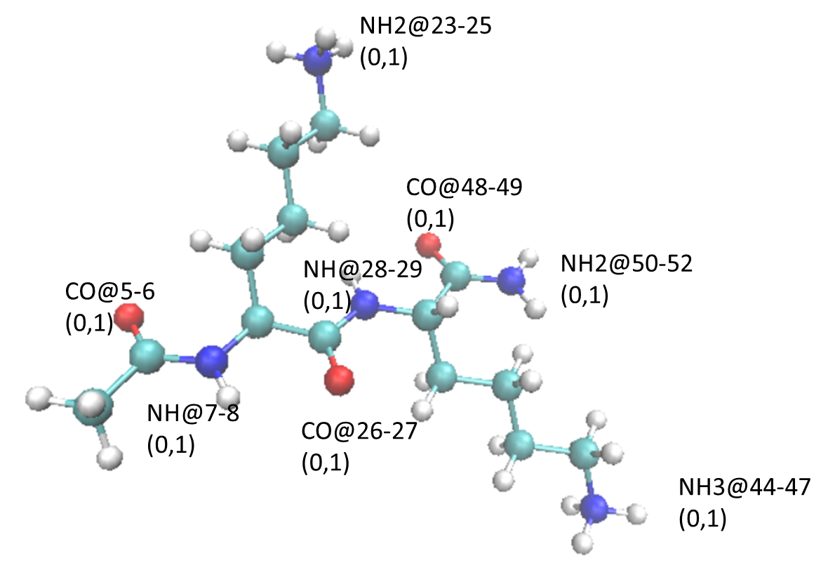
Target system
LynLys (0,1)
LysLyn (1,0)
Notes:
As a model system, I adopted the tri-peptide including one lysine residue.
This has one protonation site and the pKa value is 10.34.
For neutralization, one counter ion was considered.

Slide 9
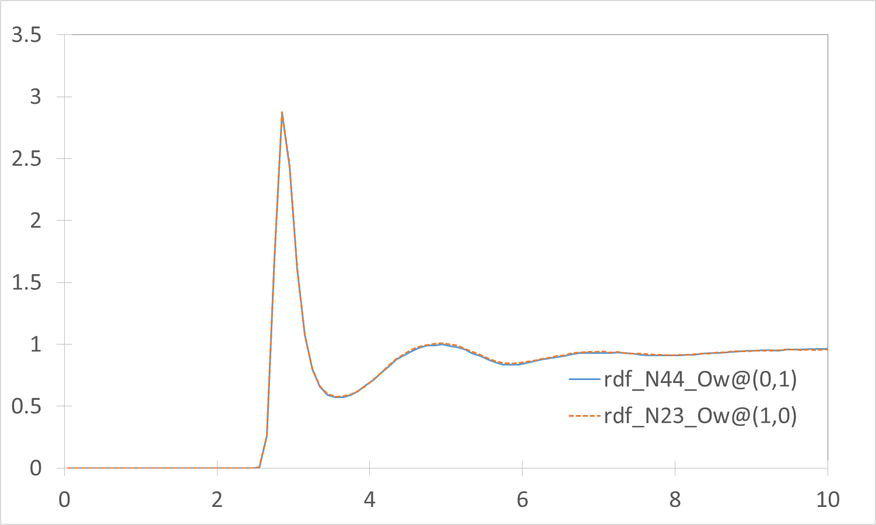
Radial distribution function
Radial distribution function between di-peptide and surrounding water molecules.
Radial distribution function
Distance [Å]
Solvent structure of NH₃ group is equal in two states.
Notes:
By update and update, the correct energy distribution must be obtained.

Slide 10
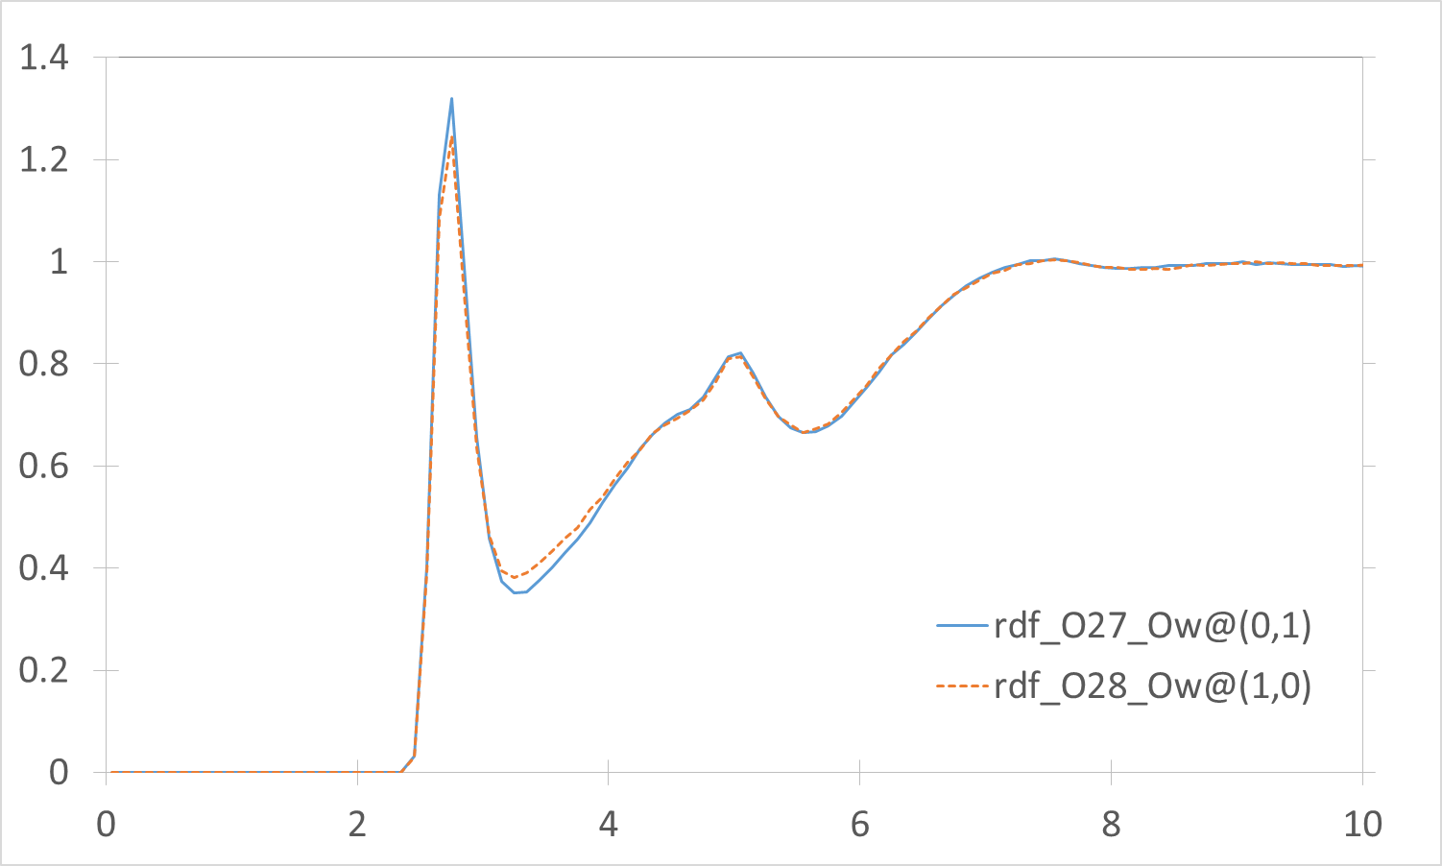
Radial distribution function
Radial distribution function between di-peptide and surrounding water molecules.
Radial distribution function
Distance [Å]
(0,1) state forms a stronger Hydrogen bonding.
Notes:
By update and update, the correct energy distribution must be obtained.

Slide 11
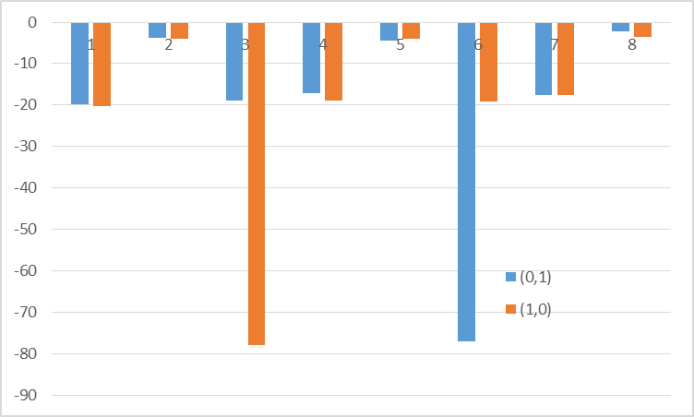
Decomposition of interaction energy
Interaction energies [kcal/mol]
No. block
The largest components corresponds to the NH₃ group.

Slide 12
Deviation into particle
For detailed analysis, I estimated the interaction energies of parts deviated into some small blocks.
3:NH2@23-25
7: CO@48-49
1:CO@5-6
5: NH@28-29
8:NH2@50-52
2:NH@7-8
4:CO@26-27
6: NH3@44-47
The block is assigned the number from 1 to 8.
Notes:
As a model system, I adopted the tri-peptide including one lysine residue.
This has one protonation site and the pKa value is 10.34.
For neutralization, one counter ion was considered.

Slide 13
Decomposition of interaction energy
Note that the components of NH₃ group is rearranged in order the of (0,1).
Interaction energies [kcal/mol]
No. block
CO group, N term and NH3 group of N term has the larger difference between two states.

Slide 14
Origin of difference of pKa shift
The (0,1) state can form stronger H-bonding with waters that (1,0) state.

Slide 15
Decomposition of interaction energy
The large positive interaction energy between CO and NH3 group of N term indicated that two groups enhance the H-bonding with water molecules (which is consist with results of intermolecular interaction).
The stronger H-bonding of (0,1) state is originated the intramolecular interaction with NH₃ group.

Slide 16
Conclusion
I have analyzed the solvation strucuture to obtain the microscopic origin of difference of pK_{a} shifts.
From these results, the difference between two states can be explained by intramolecular interaction with NH₃ group.
As a result, the intermolecular interaction is contributed that (0,1) state become stable.
<Next plan>
I will apply micro constant pH method to the more complex protonation system.
Notes:
The number of MC trial in present simulation is not enough to converge.

Slide 17
Thank you for your attention.

Slide 18
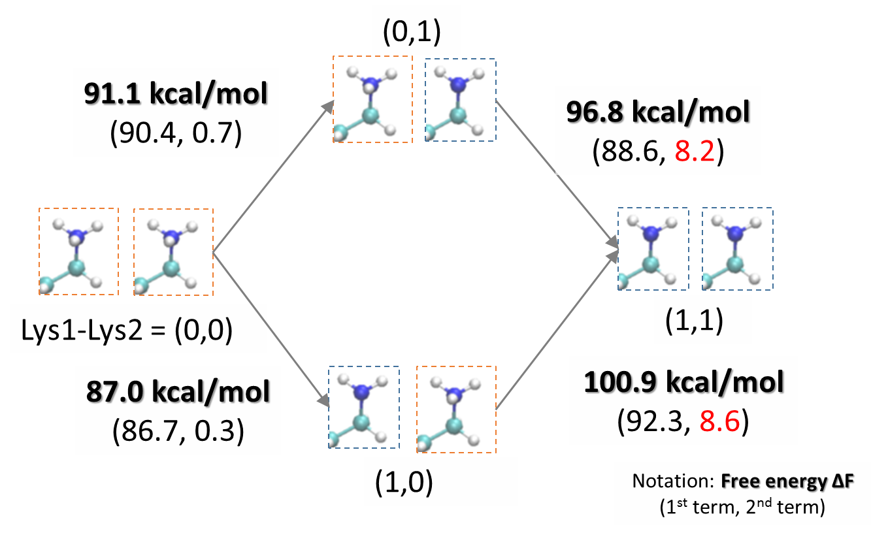
Contents of Today’s Workshop
On the transition from full-protonation state to one-protonation states, the different protonation affinity was originated from the difference of transition energy.

Slide 19
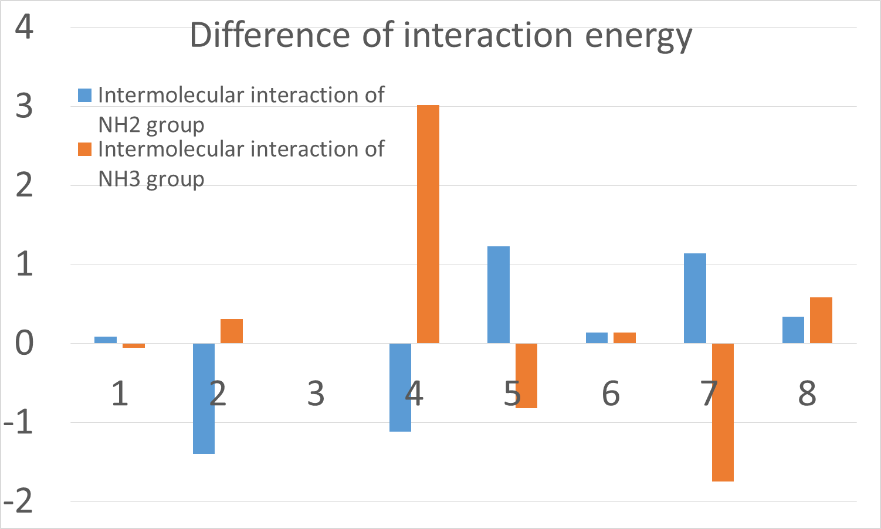
Intramolecular interaction
I also estimated the intramolecular (electrostatic) interactions.
Interaction energies [kcal/mol]
No. block
NH3 group bring about the larger difference.
And (0,1) state became unstable.
Notes:
This is the function to estimate the correction term.
I suspected that the problem in low pH region was caused by the their values of function.
I have revised the function with a wide pH region.

