Slide 1
4th CREST Workshop Uppula Purushotham
Sodium Ions as Electrolyte Additive for Lithium Ion Batteries

Slide 2
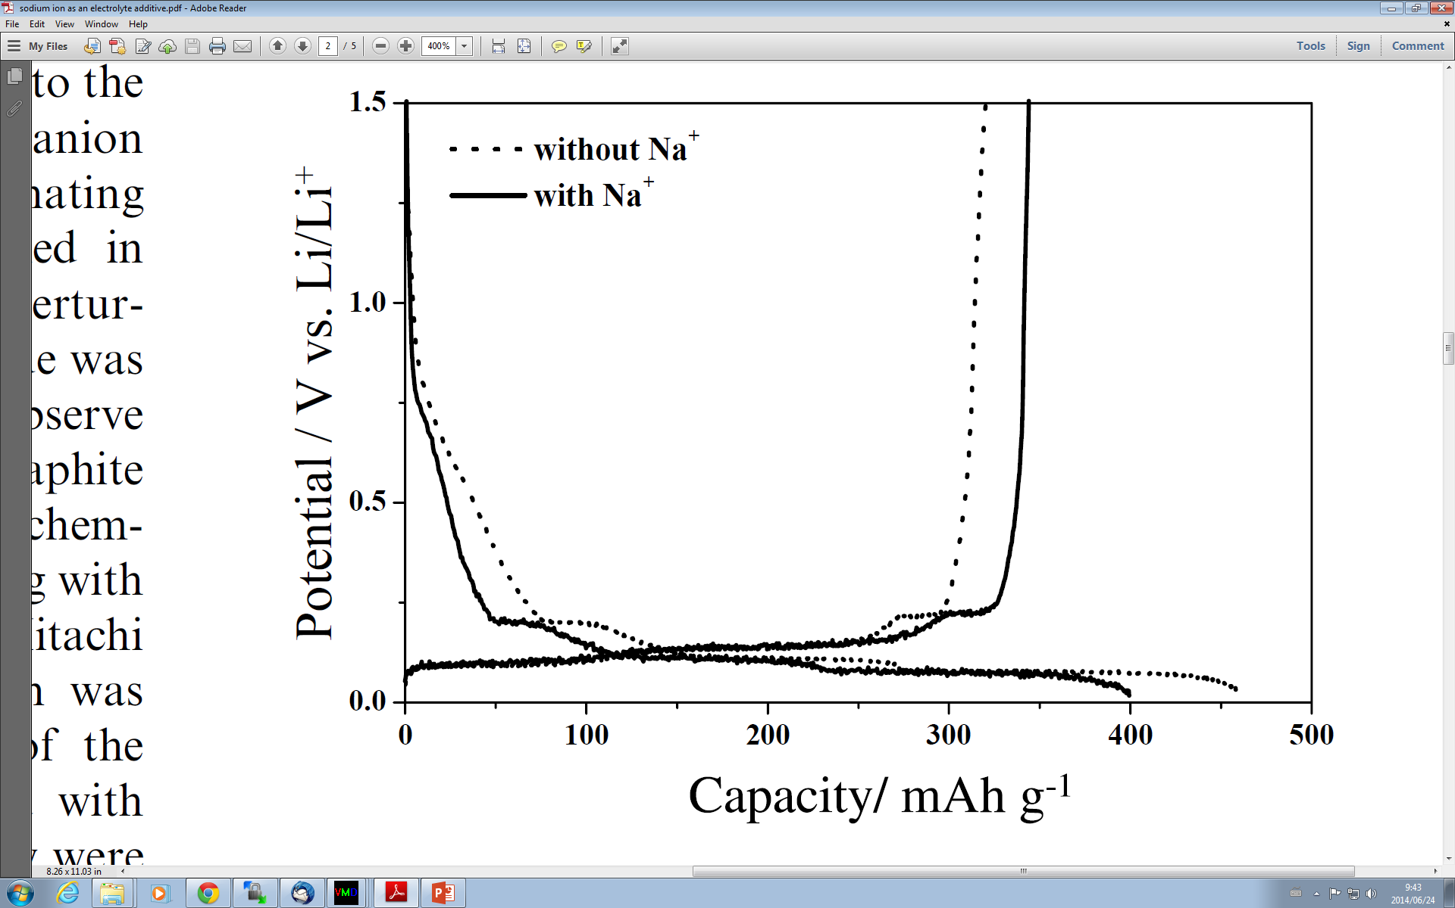
In Na⁺ added electrolyte, the irreversible capacity is reduced, and a higher reversible capacity of 352 mAhg⁻¹ was obtained.
The homogeneous, uniform and smooth SEI layer on the graphite surface was confirmed in Na added system.
Figure : Initial charge-discharge curves of natural graphite electrodes without and with Na⁺ additive (by dissolving 0.22 mol dm⁻³ NaClO4) in 1 mol dm⁻³ LiClO4/EC–DEC (1:1 by volume). Current density: 17 mA g⁻¹.

Slide 3
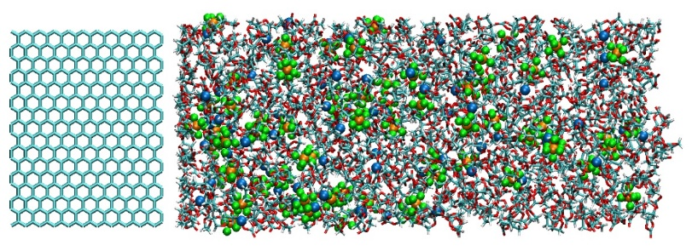
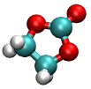
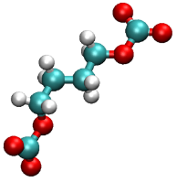
Model Systems and Reaction Scheme
In previous model system the concentration of Na⁺ ions are not resemble with experimental system.
Thus, I have estimated the volume of system by NPT ensemble simulation.
The concentration of 13 Na⁺ ions met the experimental criteria 0.22 mol/dm³.
1.1M LiPF₆ EC electrolyte
300.0 Å
Temperature ：298K
EC: 850
Li⁺: 69
PF₆⁻: 67
34.1 Å
x
+ e⁻
Li⁺/Na⁺
Z origin
+
z
+ e⁻
Li⁺/Na⁺
C₂H₄
Li/NaCO₃⁻
Li₂/Na₂CO₃
1.1M LiPF₆ EC electrolyte + 0.22M NaPF₆
300.0 Å
Temperature ：298K
EC
EC⁻
Li/NaEC
+ Li/NaEC
EC: 850
Li⁺: 69
PF₆⁻: 80
Na⁺: 13
34.1 Å
+ 2e⁻
+ Li⁺/Na⁺
x
+
3 ×
F⁻
Li₂ /Na₂BDC
z
Z origin
PF₆⁻
PF₃
Li/NaF

Slide 4
Reductive Products of EC Electrolyte
Na-free EC electrolyte system
200 Cycle
800 Cycle
1600 Cycle
2000 Cycle
EC
BDC
CO₃⁻²
PF₃
Na-added EC electrolyte system
C₂H₄
Li
Na
200 Cycle
800 Cycle
1600 Cycle
2000 Cycle
In both the systems the SEI film is formed by the combination of electrolyte reductive products after every MC/MD cycle.

Slide 5
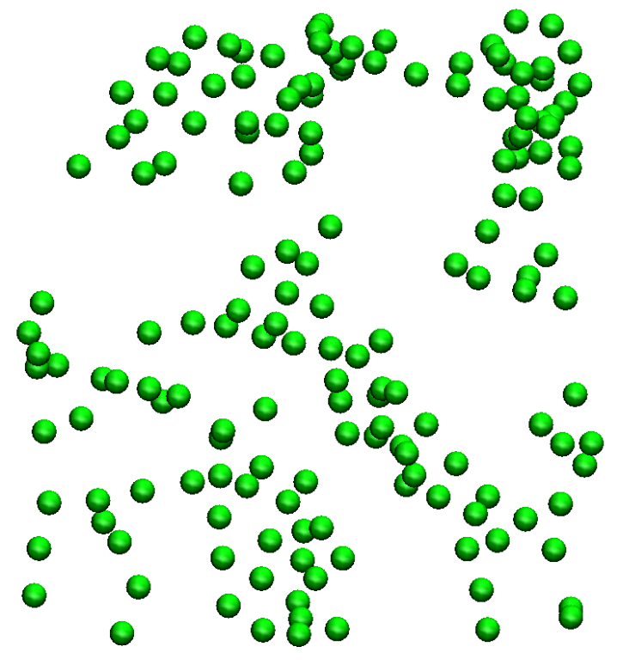
Comparison of Results
Li Na-free
Li Na-added
Na Na-added
Li and Na atoms are distributed homogeneously in the Na-added system, which is responsible for smoother SEI film surface.

Slide 6
Surface Number Density Analysis
Na added system
Na free system
1140
1060
457
483
$ρ_{n}^{s}$ [10⁻³Å⁻²]
$ρ_{n}^{s}$ [10⁻³Å⁻²]
$ρ_{n}^{s}$ [10⁻³Å⁻²]
MC/MD cycles
MC/MD cycles
Figure : Comparison of the Change in the surface number densities of solvent molecules and reductive products with respect to the MC/MD cycles of EC electrolyte with Na added and Na free systems.
The composition ratio of the reaction products became almost unchanged in the final stage, which shows the formation of SEI film.
The number of MC/MD cycles are increased to form SEI film after addition of Na ions.
In Na added system more electrolyte molecules (~26 molecules) are consumed to form SEI film.

Slide 7
Mass Density Analysis
a)
b)
ρ [gcm⁻³]
ρ [gcm⁻³]
Z Å
Z Å
Figure: Comparison of mass density distribution of the final reductive products along Z axis incase of EC electrolyte with Na⁺ ions as additive (a) and with out Na⁺ ions as additive (b).
Thickness of the SEI film has been increased after addition of Na due to the more number of reductive products.

Slide 8
Thickness of SEI Film Based on Li Atom Percentage
EC_20%Na (0Å to 41Å)
EC_NoNa (0Å to 31Å)
In Na added system the thickness of SEI film has been increased by 10Å.
Percentage of Li
Z-axis Å
Figure: Comparison of the SEI film thickness based on percentage of Li along the Z-axis incase of EC electrolyte with Na⁺ ions as additive and EC electrolyte with out Na⁺ ions.

Slide 9
Cavity size
Na free EC electrolyte
Na added EC electrolyte
The ratio of fractional accessible volume in the interface structure of Na added EC-based electrolyte is 0.27
Standard deviation is 0.01
The ratio of fractional accessible volume in the interface structure of Na added EC-based electrolyte is 0.27
Standard deviation is 0.02
In both the systems ratio of fractional accessible volume is similar.

Slide 10
Consumed Number of Electrons to Form SEI Film
The total consumed number of electrons for the formation of SEI film has been estimated by adding electrons in each MC/MD cycle in the present simulations.
More number of electrons are consumed to form SEI film in Na added EC electrolyte than Na free electrolyte.
The present results could not reproduce the experimental observation that the irreversible capacity is decreased by adding Na ions.
324
288
Number of electrons consumed
MC/MD cycles
Figure: Comparison of amount of electrons consumed during the formation of SEI film incase of EC electrolyte with Na⁺ ions as additive and EC electrolyte with out Na⁺ ions.

Slide 11
Various Reductive Products
36
273
30
241
Number of CO₃⁻² Molecules
Number of EC Molecules
10
MC/MD cycles
MC/MD cycles
Figure: Comparison of the number of CO₃⁻² and EC molecules used in SEI film formation of Na added and Na free EC electrolyte systems.
Addition of Na ions increased the consumption of EC molecules (~32) and formation of CO₃⁻² molecules (~4).

Slide 12
Conclusions
Homogeneous distribution of Na and Li atoms are appeared in the Na-added system.
After addition of Na the thickness of SEI film has increased by 10Å.
More number of electrons are consumed to form SEI film in Na added system than Na free system, which could not reproduce the experimental observation that the irreversible capacity is decreased by adding Na ions.
In next plan we would like to improve the simulation results by adding the effect of solvent co-interaction on graphite in the MC/MD simulations.

Slide 13
Background of Present Research
According to the experimental results[1], fluoroethylene carbonate (FEC) is the only an effective additive for Na-ion battery among the FEC, DFEC, VC and ES.
The FEC addition improved the cycle performance by decreasing the irreversible capacity to form the SEI film. In case of DFEC, performance is decreased by lowering reversible capacity.
In the present study we would like to investigate the origin of mechanism to form SEI film in DFEC additive PC electrolyte Na-ion battery.
In this regard we have planned to compare the MC/MD simulation results of FEC and DFEC additive PC electrolyte Na-ion battery.
Figure : Reversible capacity versus cycle number plot of PC electrolyte Na-ion battery.
[1] S. Komaba et al., ACS Appl. Mater. Interfaces, 3, 4165 (2011).

Slide 14
Di-Fluoro Ethylene Carbonate Reaction Route
To perform MC/MD simulation, I have prepared the reaction scheme which consists a list of elementary reactions involved in the formation of SEI film.
The reaction scheme of DFEC has been prepared similar to the FEC reaction scheme[2].
The reaction profile of DFEC also modelled by using DFT methods.
+ e⁻
CO₃
C₂F₂
Na₂CO₃
+ e⁻
DF_A
DF_F
DF_G
+ e⁻
PC3
DF3
DF1
DF2
DF_PC
DF3
DFC2OF
CO2
DF_H
reaction route_1
reaction route_2
DF4
[2] P. B. Balbuena et al. J. Electrochem. Soc. 161, A213 (2014).

Slide 15
Reaction Profile of DFEC
11.080
6.292
14.272
Method: B3LYP/6-31+G(d)
Solvent: Propylene carbonate
25.793
Relative energy in kcal/mol
Gas phase
Solvent phase
Reaction products
Figure: Computed reaction profile for Di-fluoro ethylene carbonate reaction route_1.

Slide 16
Reaction Profile of DFEC
7.212
Method: B3LYP/6-31+G(d)
Solvent: Propylene carbonate
10.648
13.638
1.702
Relative energy in kcal/mol
6.884
4.321
Reaction products
Figure: Computed reaction profile for Di-fluoro ethylene carbonate reaction route_2.

Slide 17
Conclusions and Future Plan
The DFEC reaction route_2 is preferable than reaction route_1, which is also similar in case of FEC.
To prepare the DFEC model system for MC/MD simulations I have to estimate the volume of DFEC molecules.
By using that information I will prepare the model system which resembles with experimental conditions.
Further I will perform the MC/MD simulations on the above system.

Slide 18
THANK YOU

