Slide 1
FY2015 The 9th CREST Workshop 2016, March 18
Reactivity of Monomers with Radical Polymer Produced by Radical Copolymerization in a PCP channel
Masayoshi Takayanagi
Graduate School of Information Science,
Nagoya University

Slide 2
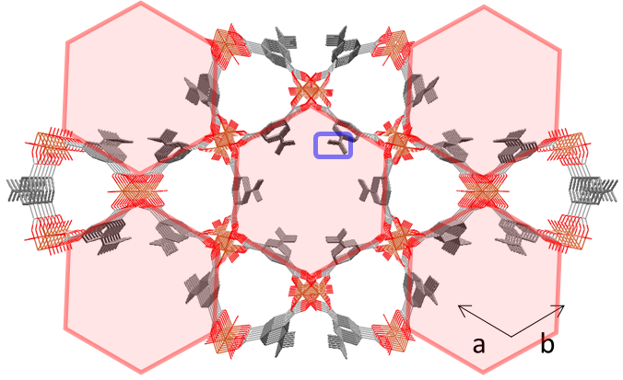
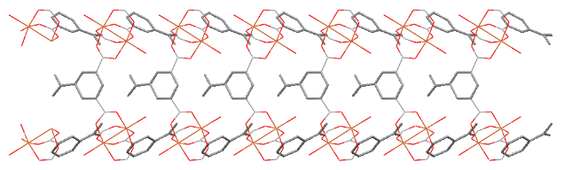
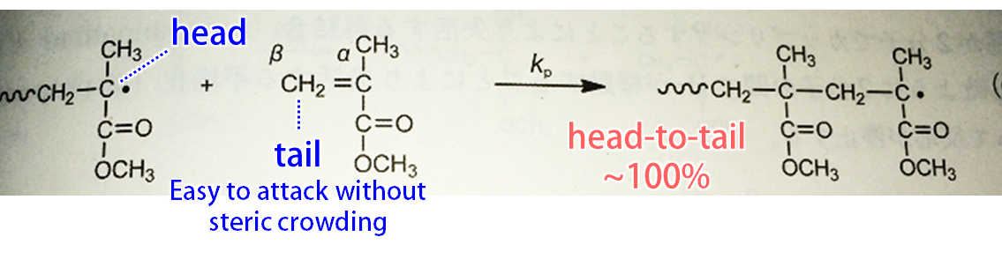
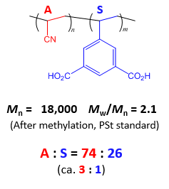
Target system for radical copolymerization
C_{β}
C_{β}
Acrylonitrile (A)
Filled in the hexagonal channel
5-vinylisophthalic acid (S)
Compose wall of the hexagonal channel
Vinyl group exists in the channel
c
Hexagonal channel in PCP framework
+ AIBN
radical copolymerization
of A and S
A
A
A
S
70℃, 48 h
Problem
How is the sequence?
A-A-S? A-A-A-S? A-A-A-A-S?

Slide 3
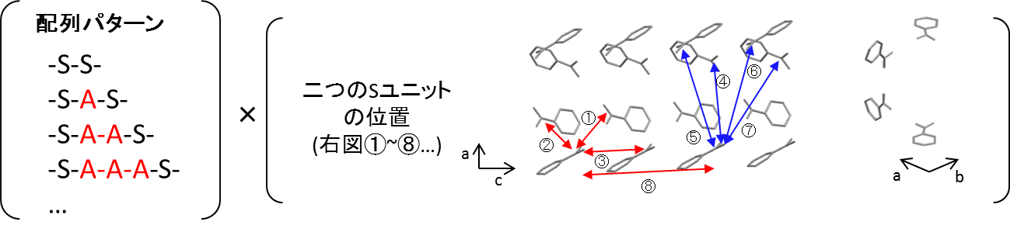
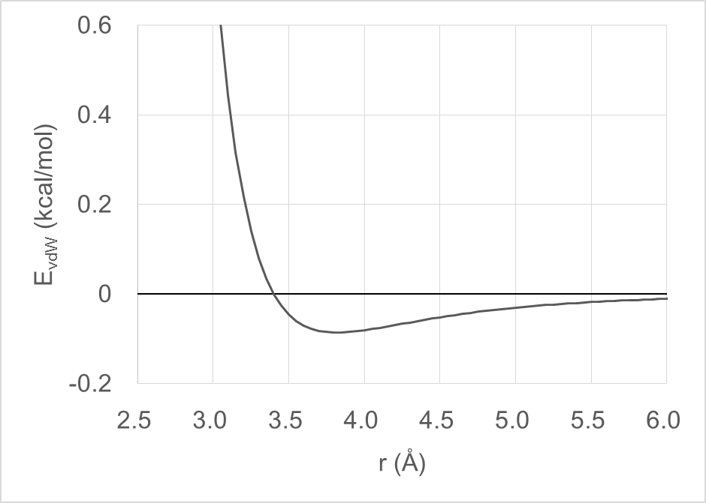
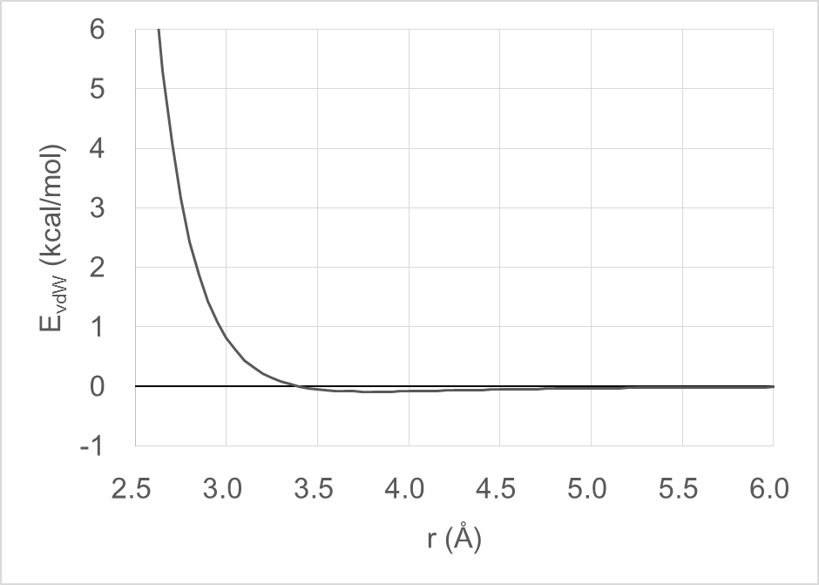
Location between two S for radical elongation
Sequence
Locations between two S
⑩
⑨
⑪
In the previous report: To find the locations of S units to which terminal radical atom can approach, I executed replica exchange MD (REMD) simulations of several radical terminals (SAA･, SAAA･, SAAAA･).
vdW interaction between C･ and C_{β}
r = 3.816 Å
ε = 0.0860 kcal/mol
E_{vdW}(3.2 Å) = 0.217 kcal/mol
E_{vdW}(2.7 Å) = 4.09 kcal/mol

Slide 4
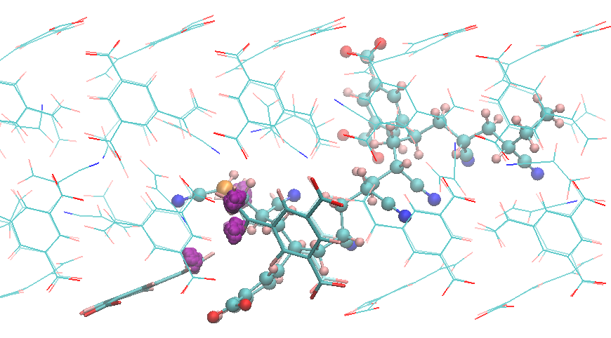
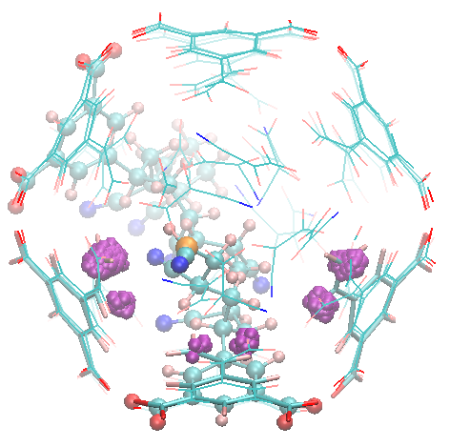
SAA･ terminal case
y
y
②
②
③
x
z
x
z
15 ns REMD trajectory at 343 K, save snapshots every 0.2 ps, 75,000 snapshots
If C･-C_{β}(S) distance is shorter than 3.2 Å, the C_{β}(S) is drawn by purple sphere.
Frequency of approach
② > ③
Shortest C･-C_{β}(S) distance
location ② 2.765 Å
location ③ 3.047 Å
Shortest C･-C_{β}(A) distance 2.874 Å

Slide 5
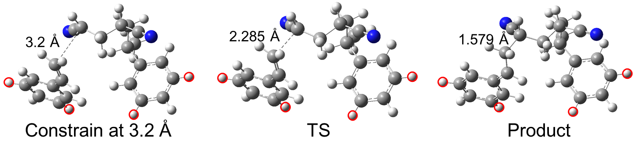
DFT calculation of SAA･+S at location ②
From the shortest C･-C_{β}(S) distance (2.765 Å) snapshot at location ②,
I executed DFT calculations to obtain the reaction barrier.
DFT calculation details and model system preparation
・DFT level at UM06-2X/6-311+G(2df,p)//UB3LYP/6-31G(d) in vacuum
・Extract SAA･ + S
・Substitute COO- groups of S units with H atoms
This substitution resulted in less than 0.3 kcal/mol reaction barrier differences.
・Constrain substituted H and H-bound C atoms at the snapshot structure.
１．Optimize structure with C･-C_{β}(S) constraint at 3.2 Å (reactant)
２．Optimize TS structrure
３．Optimize product structure
Locations of atoms with red circles are constrained during optimizations.
0 kcal/mol
7.2 kcal/mol
-18.5 kcal/mol
Reaction barrier

Slide 6
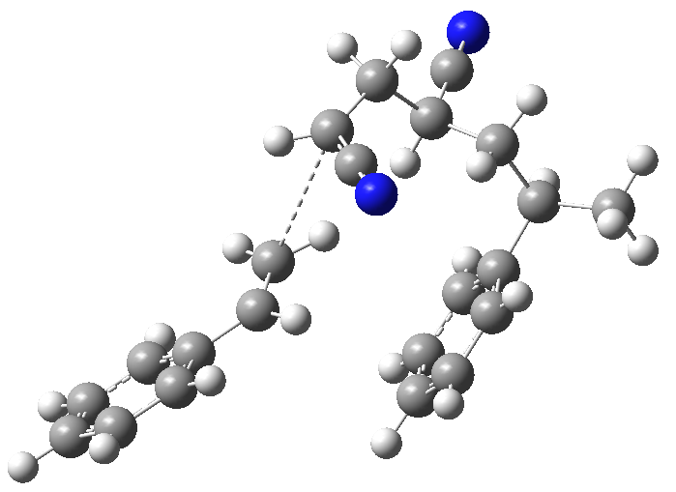
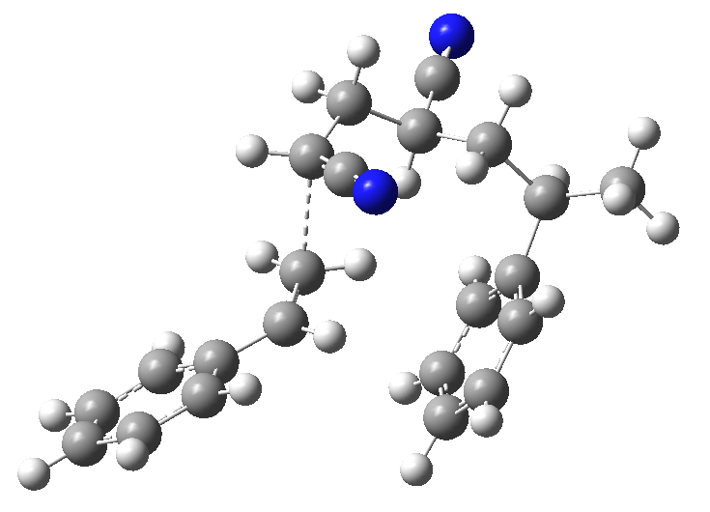
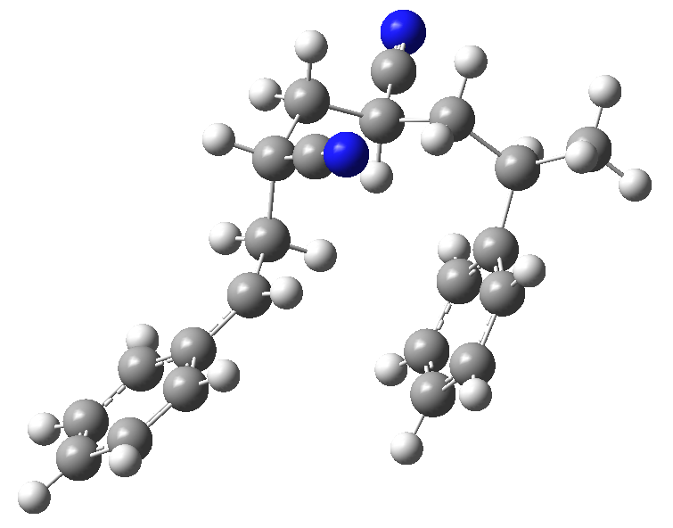
DFT calculation of SAA･+S at location ③
From the shortest C･-C_{β}(S) distance (3.047 Å) snapshot at location ③,
I executed DFT calculations as that in location ②.
3.2 Å
2.313 Å
1.568 Å
Constrain at 3.2 Å
TS
Product
0 kcal/mol
9.9 kcal/mol
-19.4 kcal/mol

Slide 7
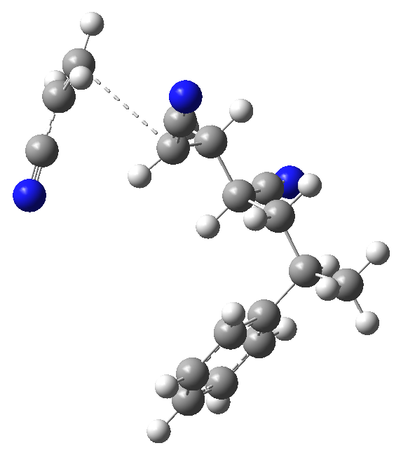
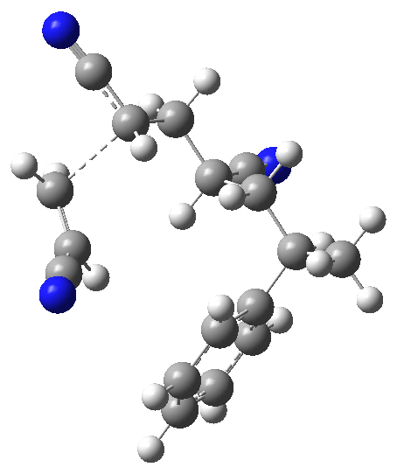
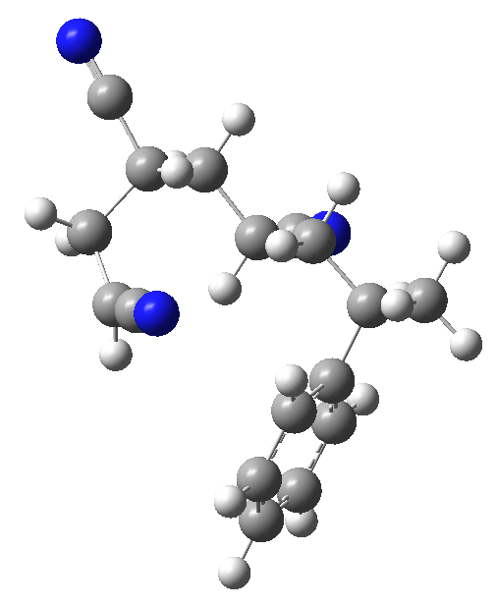
DFT calculation of SAA･+A
From the shortest C･-C_{β}(A) distance (2.874 Å) snapshot,
I executed DFT calculations as that with S.
In this A case, the positional constraint of S is not imposed.
3.2 Å
2.298 Å
1.566 Å
Constrain at 3.2 Å
TS
Product
0 kcal/mol
7.3 kcal/mol
-21.9 kcal/mol

Slide 8
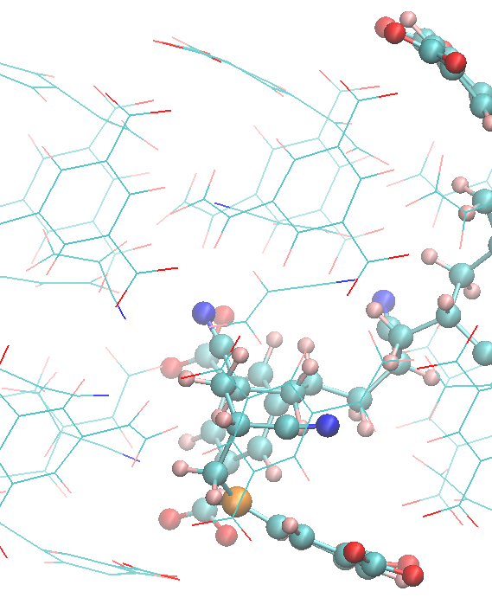
Discussion of reactivity of SAA･
Reaction barriers
SAA･ + S (loc. ②) 7.2 kcal/mol
SAA･ + S (loc. ③) 9.9 kcal/mol
SAA･ + A 7.3 kcal/mol
SAA･ can react with A and S (loc. ②) with
identical energy barrier.
However, the radical atom of SAAS･ produced
by SAA･ + S(loc. ②) cannot approach to
monomer A because the radical atom is
completely covered by SAAS･ chain. (right Fig.)
→ SAAS･ (loc. ②) can be produced but the elongation reaction never proceeds from this. Thus, the reverse reaction SAAS･ to SAA･ + S should occur to elongate the radical chain.
Therefore, most of cases, SAA･ should react with monomer A.
A part of SAA･ can react with S at location ③.
Energy barrier difference 2.6 kcal/mol
exp( (2.6 kcal/mol) / k_{B}T) ~ 2%

Slide 9
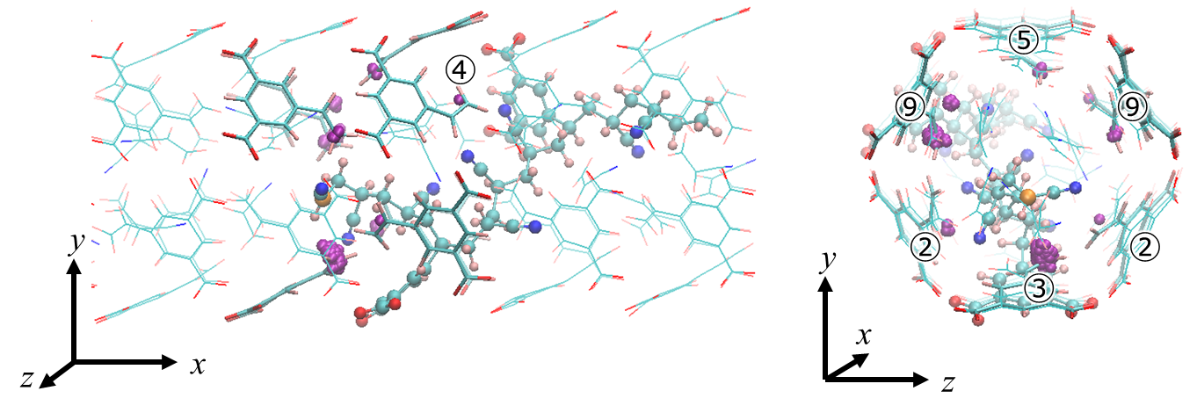
SAAA･ terminal case
⑨
15 ns REMD trajectory at 343 K, save snapshots every 0.2 ps, 75,000 snapshots
If C･-C_{β}(S) distance is shorter than 3.2 Å, the C_{β}(S) is drawn by purple sphere.
Frequency of approach
③＞⑨＞⑤≒②＞④
Shortest C･-C_{β}(S) distance
location ③ 2.812 Å location ② 3.133 Å
location ⑨ 3.008 Å location ④ 3.141 Å
location ⑤ 3.004 Å
Shortest C･-C_{β}(A) distance 2.862 Å

Slide 10
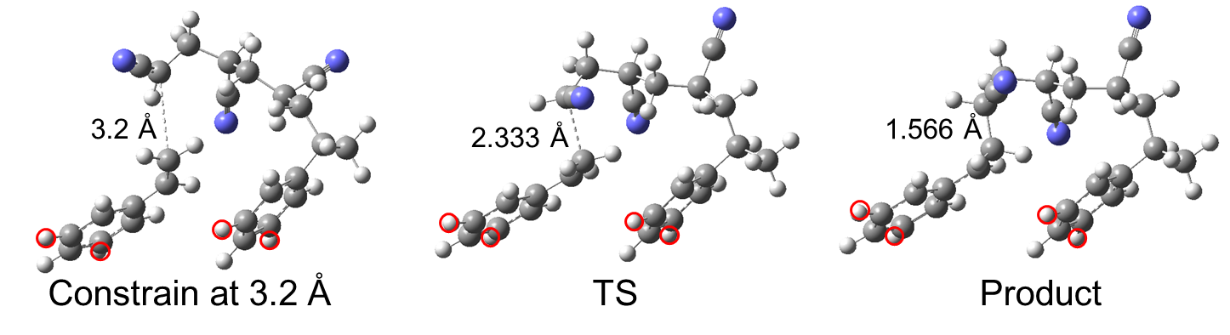
DFT calculation of SAAA･+S at location ③
From the shortest C･-C_{β}(S) distance (2.812 Å) snapshot at location ③,
I executed DFT calculations.
0 kcal/mol
8.7 kcal/mol
-22.0 kcal/mol

Slide 11
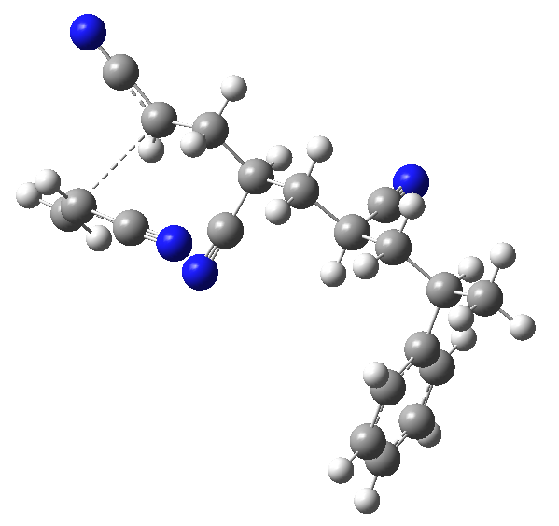
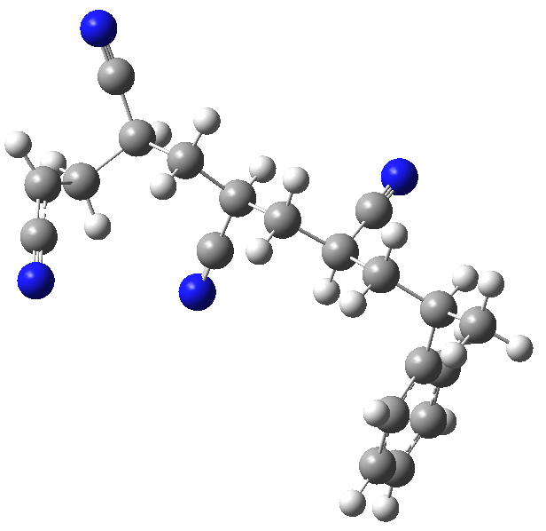
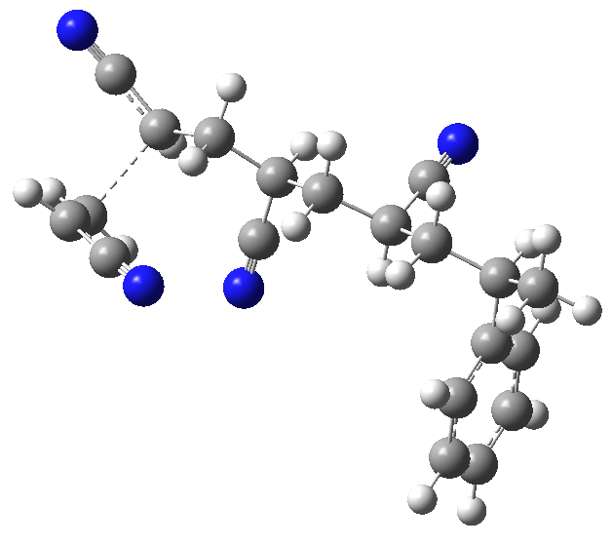
DFT calculation of SAAA･+A
From the shortest C･-C_{β}(A) distance (2.862 Å) snapshot,
I executed DFT calculations.
1.566 Å
3.2 Å
2.270 Å
Constrain at 3.2 Å
TS
Product
0 kcal/mol
9.8 kcal/mol
-26.8 kcal/mol

Slide 12
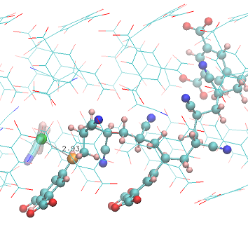
Discussion of reactivity of SAAA･
Reaction barriers
SAAA･ + S (loc. ③) 8.7 kcal/mol
SAAA･ + A 9.8 kcal/mol
SAAA･ can react with A and S (loc. ②) with similar energy barrier.
If the energy difference 1.1 kcal/mol is meaningful (the accuracy of DFT calculations can be as large as 1 kcal/mol order), reactivity with S (loc. ③) is 5-times higher than that with A.
This suggests SAAA･ react with monomer S more than 80%.
→ consistent with experimental ratio A:S = 3:1
SAAAS･ can continue the elongation by its open radical atom.

Slide 13
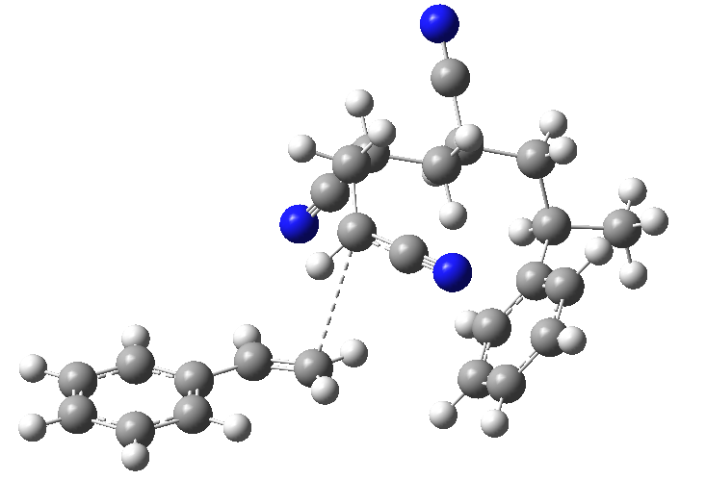
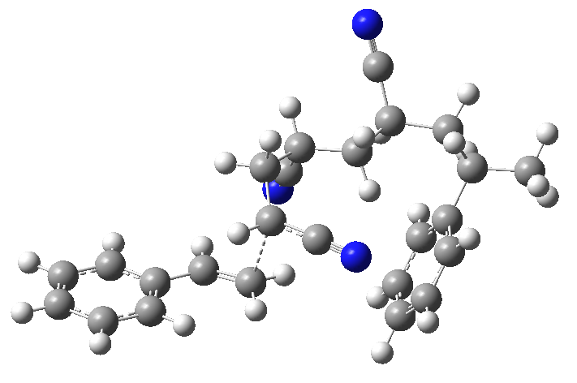
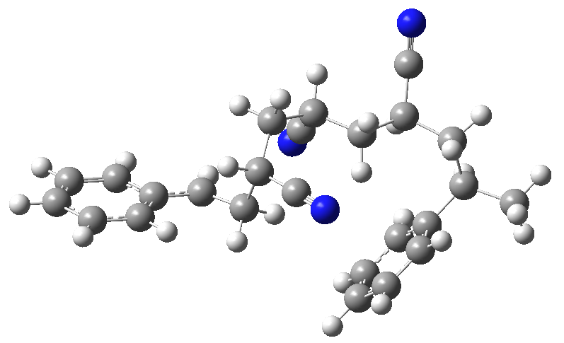
DFT calculation of SAAA･+S without constraint
In bulk copolymerization of A and S, the alternating sequence ASASAS･･･ is reported, meaning that terminal A･ prefers S. To check this preference, I executed the reaction barrier of SAAA･ + S without constraint.
From the shortest C･-C_{β}(S) distance (2.812 Å) snapshot at location ③,
I executed DFT calculations without positional constraint.
1.568 Å
2.339 Å
3.2 Å
Constrain at 3.2 Å
TS
Product
0 kcal/mol
5.3 kcal/mol
-30.3 kcal/mol
The barrier 5.3 kcal/mol with S without positional constraint
(lower than that with A, 9.8 kcal/mol) is consistent.

Slide 14
Summary
Reaction barrier 7.2 kcal/mol
No approach of monomer to the radical atom
SAAS(②)･
Reverse rection to SAA･
Main reaction
route
7.3 kcal/mol
8.7 kcal/mol
SAA･
SAAA･
SAAAS(③)･
ΔE = 2.6 kcal/mol gives 98:2 from exp(-ΔT/k_{B}T)
ΔE = 1.1 kcal/mol gives 80:20 from exp(-ΔT/k_{B}T)
9.9 kcal/mol
9.8 kcal/mol
SAAS(③)･
SAAAA･
Main reaction route suggests the sequence of copolymer SAAASAAASAAA･･･
Consistent with the experimental ratio A:S = 3:1

