Slide 1
Thu. Oct. 23th
The 3rd, CREST Workshop
On Additive Effect of Fluoroethylene Carbonate on Solid Electrolyte Interphase Film Formation in Sodium-Ion Batteries
Norio Takenaka^{1,2}
Graduate School of Information Science, Nagoya University¹,
Elements Strategy Initiative for Catalysts and Batteries (ESICB), Kyoto University²
1

Slide 2

MEXT program
Elements Strategy Initiative for Catalysts and Batteries: Interplay Between Experimental and Theoretical Studies
Primary objective is to develop rare metals-free catalysts and batteries. To accomplish this objective, we reveal the microscopic mechanism in the catalysts and batteries which are complex materials by the interplay between the experimental and theoretical studies.
As one of specific targets,
we develop the rare metals-free secondary battery.
Li-ion battery
Na-ion battery
(Li = rare metal)
(Na = common metal)
2

Slide 3
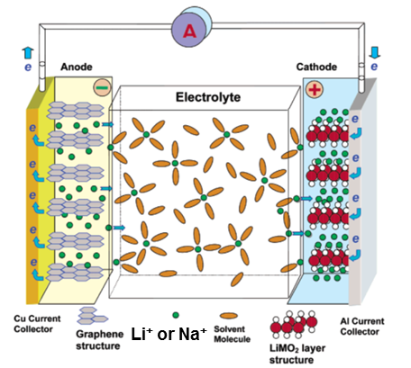
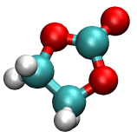
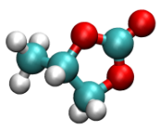
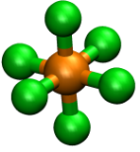

From Li-Ion Battery to Na-Ion Battery
To produce the practical Na-ion battery, the optimized design of materials is required because Na⁺ is larger than Li⁺.
Solvent
Anode
Cathode
Electrolyte
EC
PC
Salt
・・・
Salt
Solvent
Anode material
Graphite →
Hard carbon
Li⁺ → Na⁺
Cathode material
CoO₂ → MnO₂, NiO₂
PF₆⁻

Slide 4
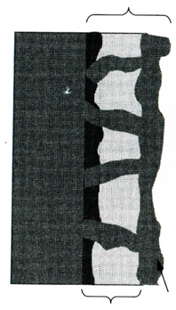
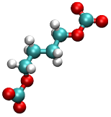


Background of Present Research①
Solid Electrolyte Interphase (SEI) Film
・During the initial charging cycles, the reductive reaction products of the electrolyte form a solid electrolyte interphase (SEI) film on the anode surface.
・The ideal SEI film can protect the electrolyte from the further reduction while maintaining Na⁺ exchange. Therefore, it is closely related to the lifetime of battery.
To improve the SEI film formation, the addition of additive is very important.
SEI Film
Exchange
Na⁺
Reduction of electrolyte
Block
Solvent
Na-ion battery
Inorganic Salts
(e.g. Na₂CO₃)
Organic Salts
(e.g. ROCO₂Na)
S. Komaba et al., Adv. Funct. Mater, 21, 3859 (2011).

Slide 5
Background of Present Research②
Additive effect on the SEI film formation
S. Komaba et al., ACS Appl. Mater. Interfaces, 3, 4165 (2011).
・According to the experiment by Prof. Komaba, fluoroethylene carbonate (FEC) was only an effective additive in the Na-ion battery among the FEC, DFEC, VC and ES that are well-known as the effective additive in the Li-ion battery.
・The FEC addition was found to improve the cycle performance by decreasing the irreversible capacity to form the SEI film.
FEC-added (10 vol%)
FEC-free
Figure. Reversible capacity versus cycle number plots in Na-ion battery

Slide 6
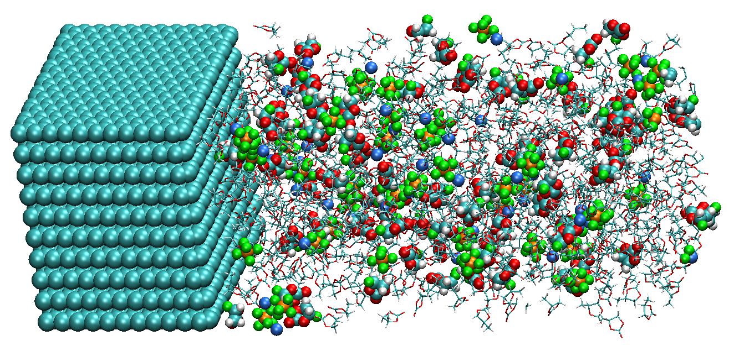
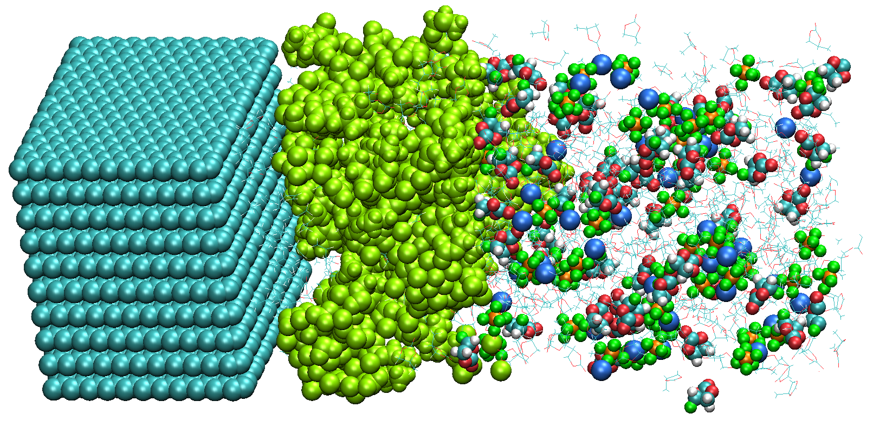
Purpose of Present Research
・In the present study, to investigate the microscopic additive effects on the SEI film formation in the Na-ion cell, we have executed the atomistic reaction simulations via the recently developed hybrid MC/MD reaction method[1,2].
・For this purpose, we have compared the calculation results between with and without FEC additives into the electrolyte.
e⁻
Hybrid MC/MD
reaction simulation
Initial state
Final state
[1] M. Nagaoka, Y. Suzuki, T. Okamoto, NT, Chem. Phys. Lett., 583, 80 (2013).
[2] NT, Y. Suzuki, H. Sakai, M. Nagaoka, J. Phys. Chem. C, 118, 10874 (2014).

Slide 7
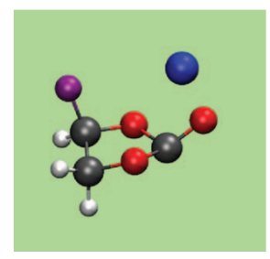
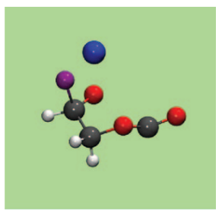
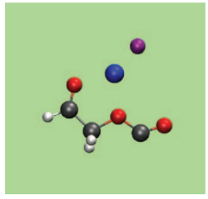
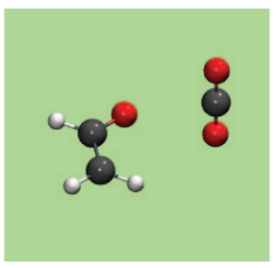
Most Probable Reaction Pathway for FEC Reduction
・ Quantum Chemical Calculation
K. Leung et al., J. Electrochem. Soc., 161(3), A213 (2014).
NaF
C₂H₃O
CO₂
➤The most probable singly reduced products were predicted to be NaF, CO₂ and
C₂H₃O molecules since the free energy of activation was smallest.
・ Experimental F 1s XPS spectra
S. Komaba et al., ACS Appl. Mater. Interfaces, 3, 4165 (2011).
10 vol% FEC addition
2 vol%
0.5 vol%
➤Experimentally, the NaF was evidently
observed as increase in the amount of
added FEC in the Na-ion cell.
Without FEC
Pristine

Slide 8
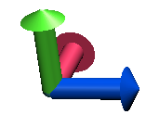
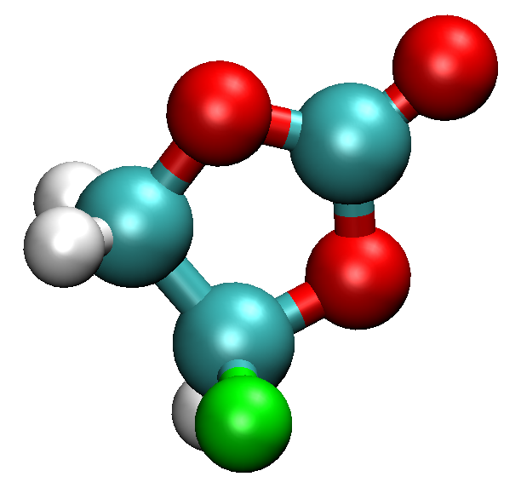
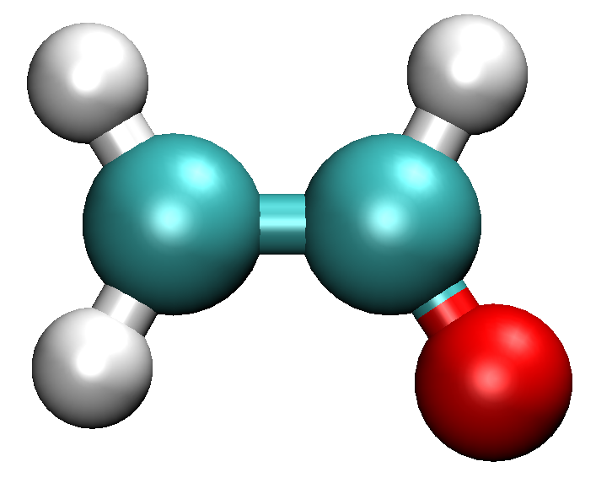

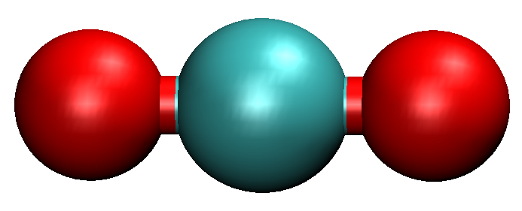



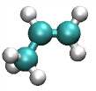


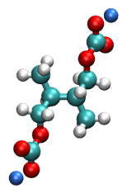
Simulation Model and Reaction Scheme
Carbon anode
NaPF₆ electrolyte with or without FEC
1.1M NaPF₆ PC electrolyte
Negatively Charged
(-2 e)
System I
System II
(without FEC)
(with 10 vol% FEC)
PC: 850
Na⁺: 87
PF₆⁻: 85
PC: 850
Na⁺: 87
PF₆⁻: 85
FEC: 118
x
y
z
+ e⁻, + Na⁺
+
+
FEC
NaF
CO₂
C₂H₃O
+ 2e⁻, + 3Na⁺
+
+
+
PF₆
PF₃
3NaF
+ e⁻, + Na⁺
+ e⁻, + Na⁺
+
Na₂CO₃
C₃H₆
PC
NaPC
+ NaPC
(CH₃CHCH₂OCO₂Na)₂
Na₂DMBDC

Slide 9
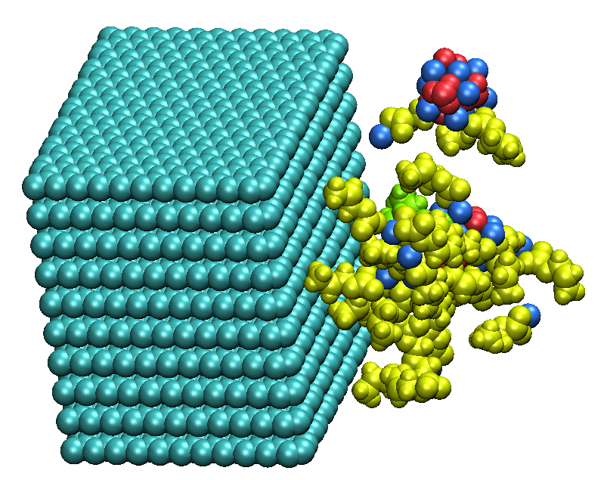
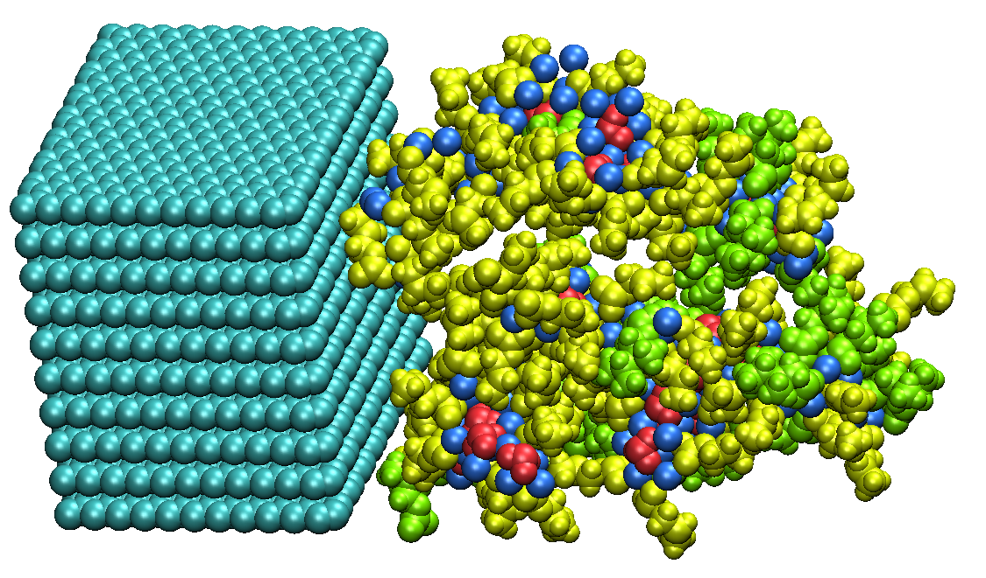
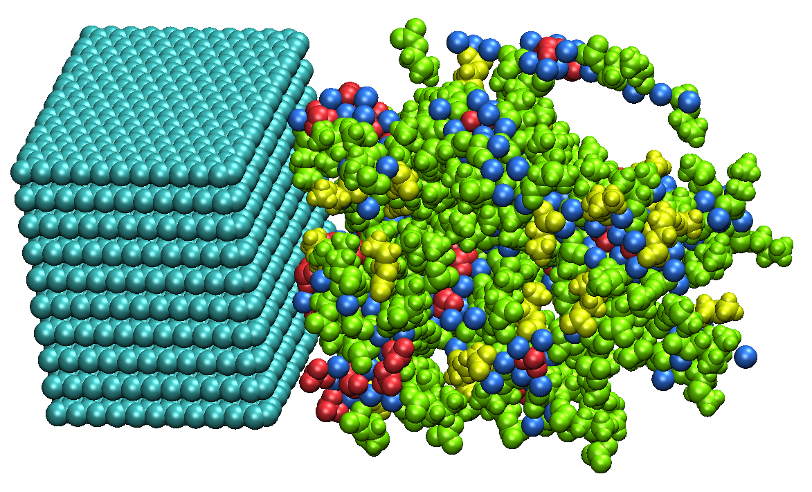


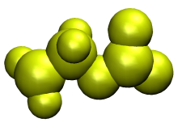
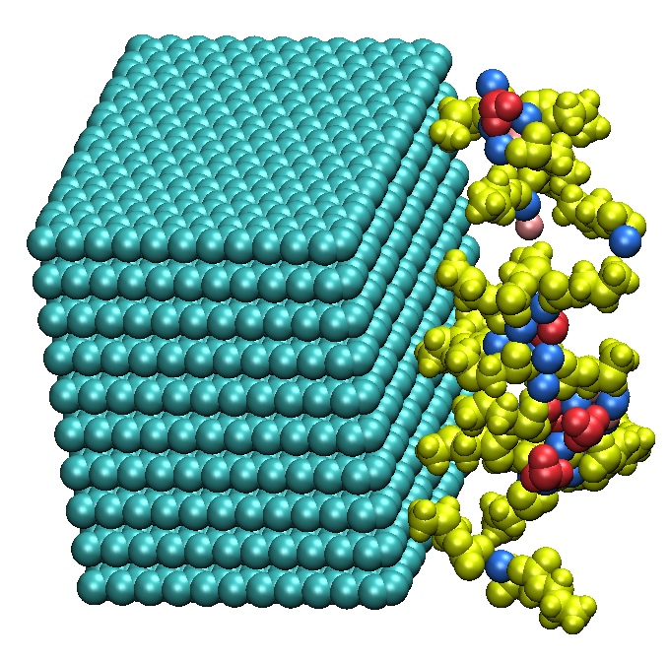
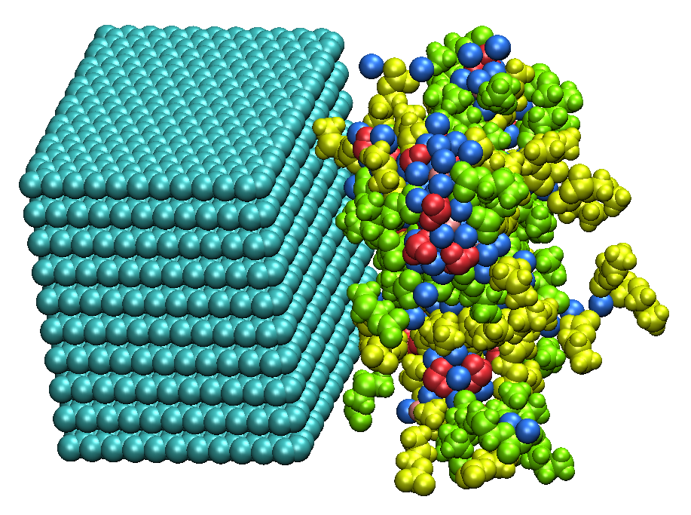
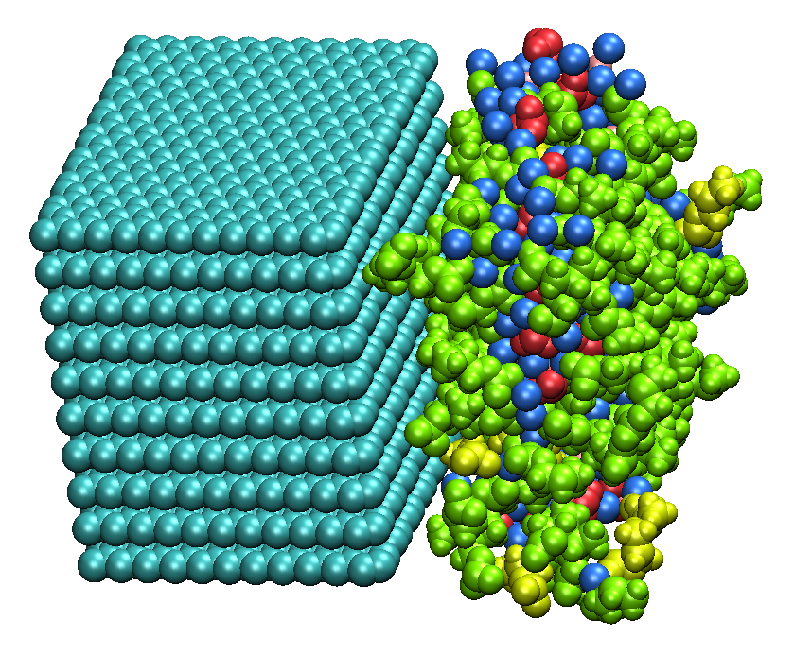
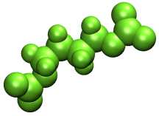
SEI Film Formation Processes
(1) FEC-free electrolyte (System I)
Species
Na₂CO₃
NaF
(a) 100 cycle
(b) 500 cycle
(c) 1500 cycle
(2) FEC-added electrolyte (System II)
NaPC
Na₂DMBDC
(a) 100 cycle
(b) 500 cycle
(c) 1500 cycle
➤In both systems, the SEI film is formed by aggregating the reaction products of
electrolyte via the hybrid MC/MD reaction simulations.

Slide 10

Change in Number Densities of Reaction Products
(They are obtained by different 10 initial configurations.)
NaPC
NaPC
PC
Na₂DMBDC
Na₂DMBDC
FEC
[10⁻²Å⁻²]
[10⁻²Å⁻²]
[10⁻²Å⁻²]
Na₂CO₃
[10⁻²Å⁻²]
Na₂CO₃
NaF
NaF
PC
MC/MD cycles
MC/MD cycles
(a) Without FEC (System I)
(b) With FEC (System II)
・ The composition ratio of the molecular mixture of the reaction products became
almost unchanged in the final stage of the formation processes.
・ By adding FECs, the production of NaF complexes drastically increased.

Slide 11
Consumed Amount of Electrons to Form SEI Film
By counting the added electrons in each MC/MD cycle through the present simulations, we estimated the integrated values per unit area of carbon anode.
Without FEC
Total consumed electron
number to form SEI film
With FEC
(1) without FEC (System I)
0.23 [e Å⁻²]
(2) With FEC (System II)
0.20 [e Å⁻²]
Consumed amount of electrons [eÅ⁻²]
Down
14 %!!
MC/MD cycles
➤The present simulations could reproduce the experimental observations
that the irreversible capacity decrease by adding FECs.

Slide 12
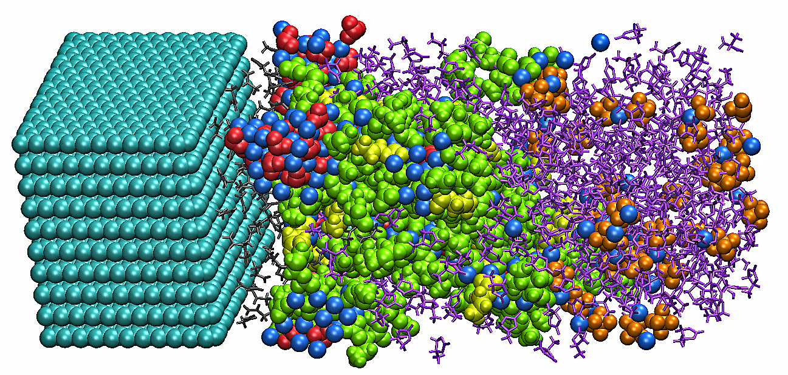

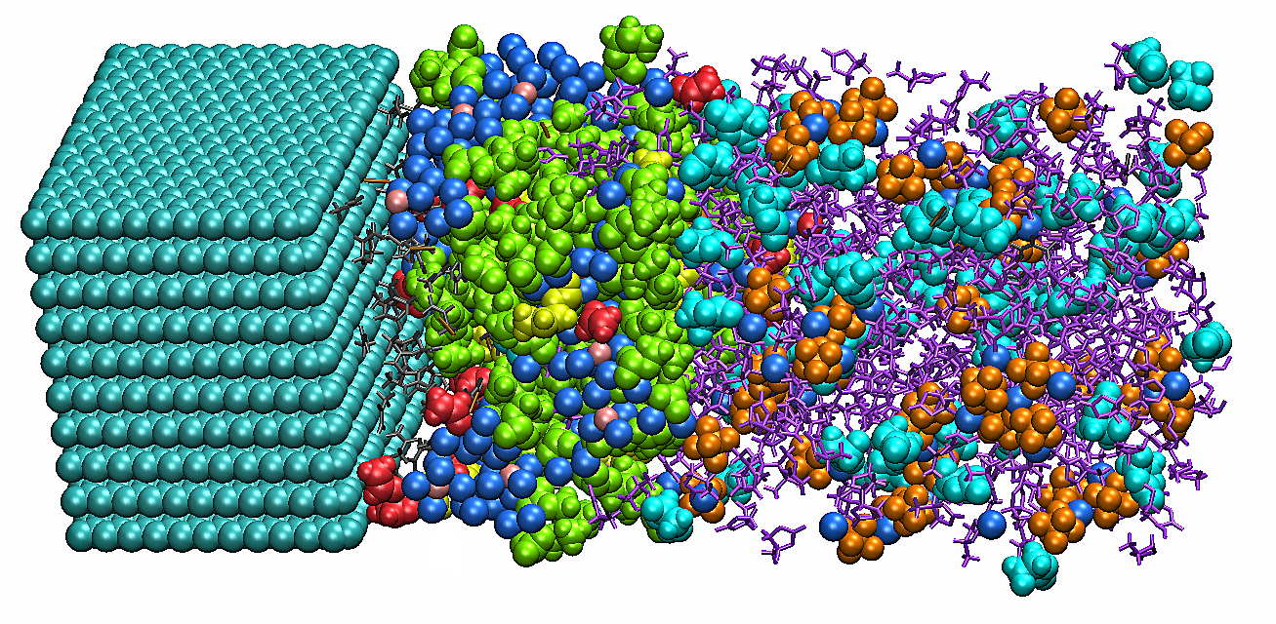
Atomistic Structures of SEI Film and Electrolyte
Purple: PC, Light blue: FEC, Gray: Gas, Blue: Na⁺, Orange: PF₆⁻
Species in SEI film
Na₂CO₃
NaF
10 Å
(a) Without FEC (System I)
NaPC
Na₂DMBDC
10 Å
(b) With FEC (System II)

Slide 13

Mass Density Distributions of SEI film and Electrolyte
(They are obtained by different 10 initial configurations.)
SEI film
SEI film
Gas molecule
Gas molecule
Electrolyte solvent
Electrolyte solvent
[gcm⁻³]
[gcm⁻³]
z [Å]
z [Å]
(a) Without FEC (System I)
(b) With FEC (System II)
➤These figures clearly indicate that these SEI films can serve solvent molecules
by preventing them from approaching the anode surface.

Slide 14
Mass Density Distributions of SEI film and Electrolyte
57 Å
39 Å
[gcm⁻³]
[gcm⁻³]
z [Å]
z [Å]
(a) Without FEC (System I)
(b) With FEC (System II)
➤By adding FECs, the SEI film thick was found to be reduced by 32 %, meaning
that the SEI film can be efficiently formed by enhancing the aggregation.

Slide 15
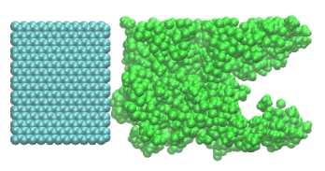
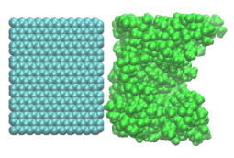
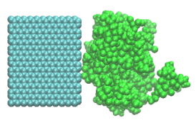
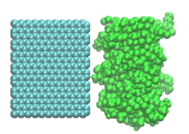
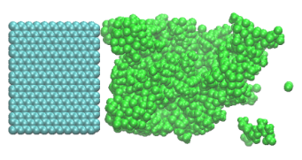
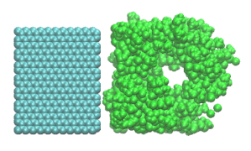
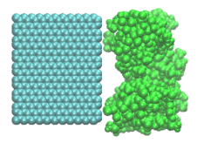
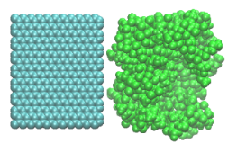
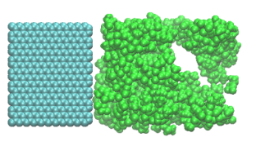
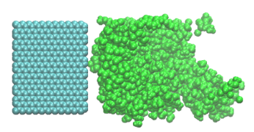
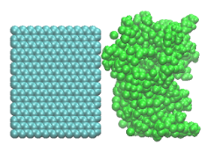


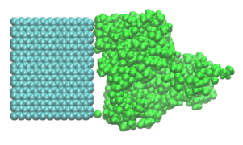
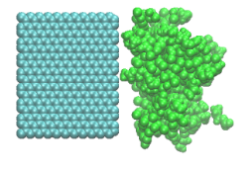
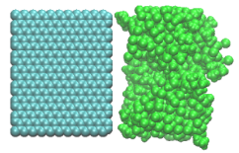
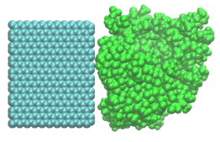
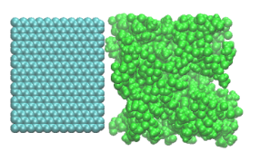
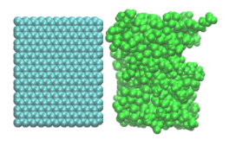
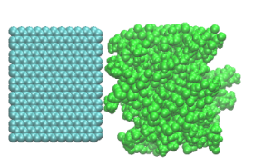
Smoothness of SEI Films – without and with FECs –
VS.
(a) Without FEC (System I)
(b) With FEC (System II)
➤In the FEC-added electrolyte, the surface structure of SEI film in contact with
the electrolyte became smooth by suppressing its undesirable growing.

Slide 16
Additional Hybrid MC/MD Reaction Simulation
To clarify the effect of FEC reduction reactions on the SEI film formation, we have executed additional hybrid MC/MD reaction simulations which artificially restrict only the chemical reactions of FECs in the FEC-added electrolyte.
・ Same Simulation Model
・ Different Reaction Scheme
FEC
FEC-added electrolyte
(System II)
PC: 850
Na⁺: 87
PF₆⁻: 85
FEC: 118

Slide 17
Change in Number Densities and Consumed Electrons
Total electron number: 0.18 [e Å⁻²]
NaPC
PC
Na₂DMBDC
FEC
[10⁻²Å⁻²]
Na₂CO₃
[10⁻²Å⁻²]
NaF
constant
Consumed amount of electrons [eÅ⁻²]
MC/MD cycles
MC/MD cycles
・ By limiting the reduction reactions of FECs, the production of NaF complexes
was found to be drastically reduced.
・ The total consumed number of electrons per unit area of carbon anode was
obtained to be 0.18 [e Å⁻²], which is smaller than that without FECs (0.23).

Slide 18
Mass Density Distributions of Reaction Products in SEI Film
(They are obtained by different 10 initial configurations.)
57 Å
39 Å
43 Å
(System I)
(System II)
(Additional simulation)
➤The FEC addition should enhance forming the compact SEI film without the
presence of NaF complexes generated from FECs.
➤This means that the intact FECs strongly contribute the SEI film formation
on the anode surface.

Slide 19
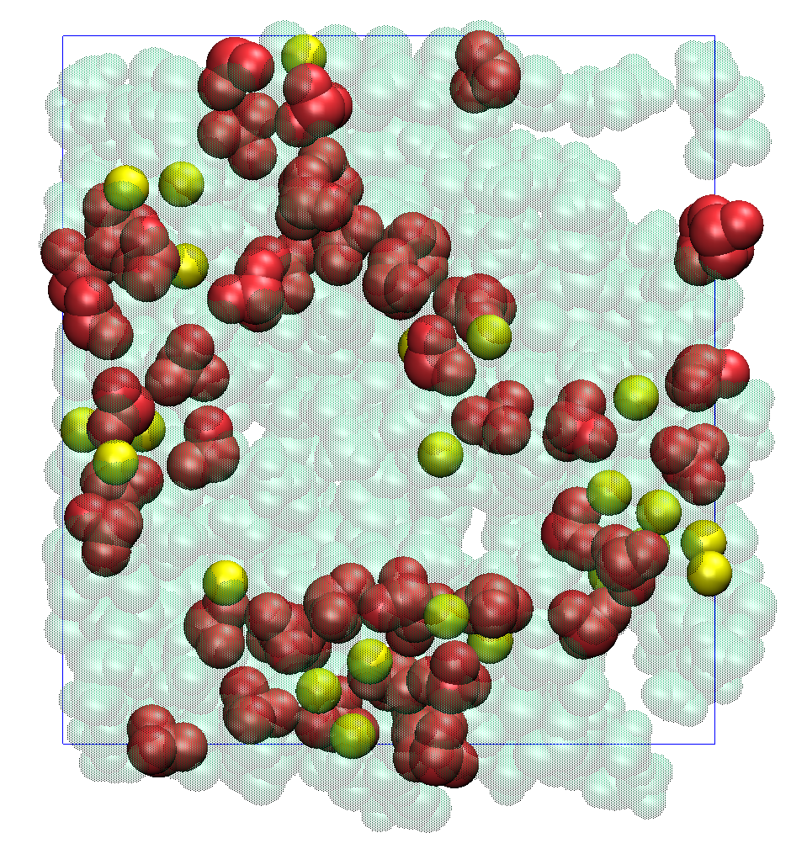
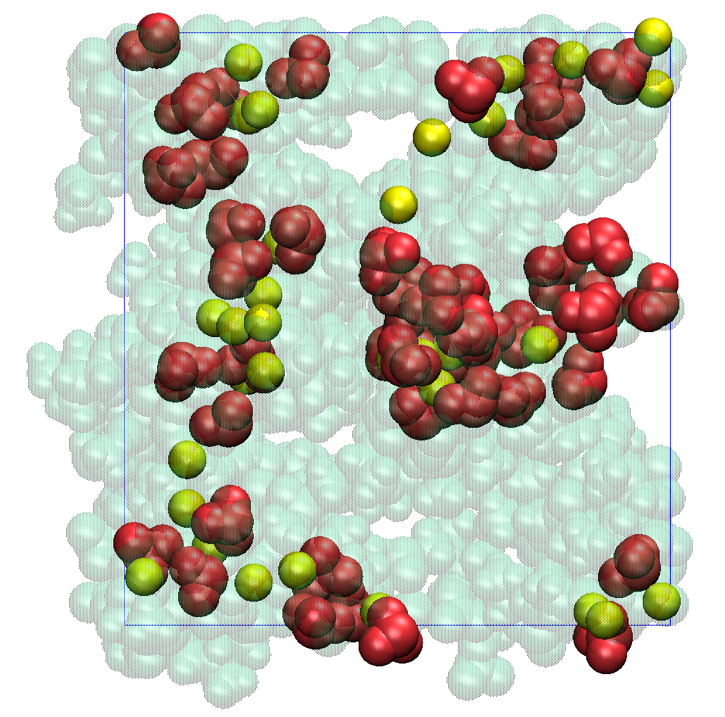
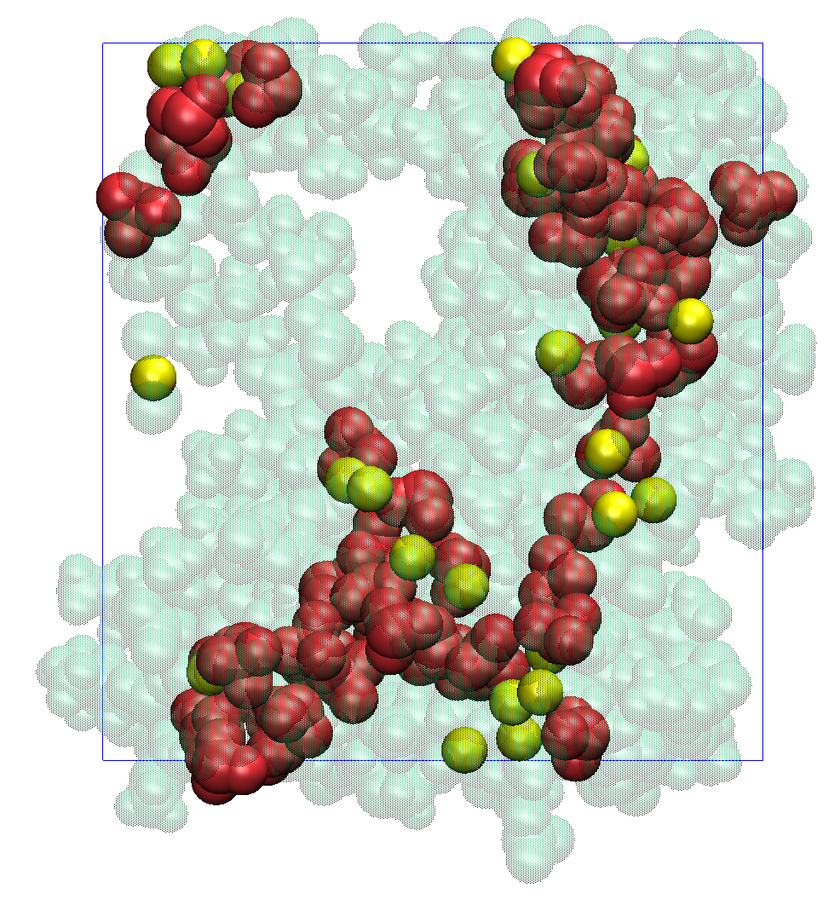
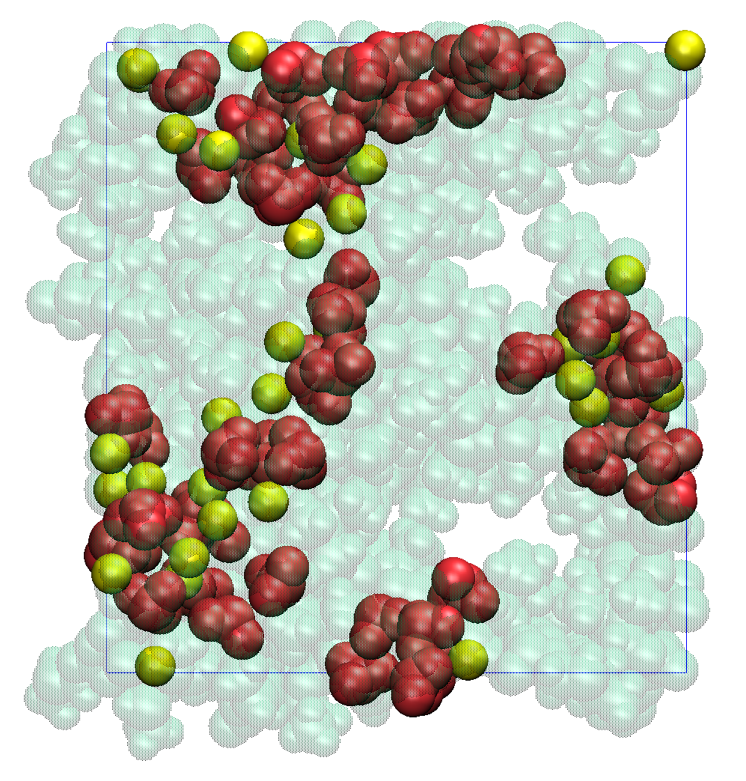






Molecular Configurations of NaF in the SEI Film
Front Views
Green: SEI film, Yellow: F⁻, Red CO₃²⁻
➤Most of NaF complexes (Yellow) came into the formation of inorganic
clusters by coordinating with the Na₂CO₃ complexes (Red) in the SEI film.
➤The generated NaF should not contribute the enhancement in the SEI film
formation although such cluster size should increase by adding FECs.

Slide 20


Intact FECs enhance the aggregation.
System II
Bridge between reaction products
FEC
FEC
Na₂DMBDC
Na⁺
NaPC
Strong electronegativity
Figure. Typical snapshot of film formation process (500 MC/MD cycle)
➤The intact FECs before reductive reaction should enhance the aggregation of
reaction products during the overall processes of SEI film formation owing to
the strong electronegativity of their fluorine atoms.

Slide 21
Summary
・In the present study, we have investigated the microscopic FEC additive effect on the SEI film formation in the Na-ion battery with the hybrid MC/MD reaction method.
・The present simulations could reproduce the experimental observations that the irreversible capacity decreases by adding FEC.
・By adding FECs, the SEI film thick was found to be reduced by suppressing its undesirable growing. This means that the SEI film can be effectively formed so as to decrease the irreversible capacity.
・Through the additional simulations which restrict only the FEC reduction, we concluded that the intact FECs strongly contribute to the SEI film formation owing to the strong electronegativity of their fluorine atoms.

