Slide 1
Tue. Feb. 10th
The 4th, CREST Workshop
Implementation of Fast Constant Potential Method for Hybrid MC/MD Reaction Simulation
Norio Takenaka^{1,2}
Graduate School of Information Science, Nagoya University¹,
Elements Strategy Initiative for Catalysts and Batteries (ESICB), Kyoto University²
Notes:
In my presentation, I explain the detail of fast-version constant potential method, and show the trial calculation to check the present implementation into AMBER program.

Slide 2
Previous Constant Potential Method
In the previous constant potential method, the charges on the electrode are obtained by minimizing the following potential energy under the objective electric potential difference between anode and cathode ΔV (= V⁺－V⁻).
Cathode
Anode
electrolyte
,
Set electric potential
[1] S. K. Reed, O. J. Lanning, P. A. Madden, J. Chem. Phys., 126, 084704 (2007).
However, the calculation cost of previous constant potential method was very expensive for applying to the hybrid MC/MD reaction simulations because it requires the SCF procedure to calculate the electrode charges.
Notes:
In the previous Crest workshop, I introduced the traditional constant potential method. The constant potential method is introduced to apply classical mechanically the electric potential difference to the system. In this method, the atomic charges on the electrode are obtained by minimizing the following potential energy U_e_tot under the objective electric potential difference ΔV. In this figure, the left electrode is cathode, and the right one is anode. This method is of course useful theoretical treatment, but its calculation cost was very expensive for applying to the hybrid MC/MD reaction simulations. Because it requires the SCF procedure as shown in the previous CREST workshop.

Slide 3
Fast Constant Potential Method
Considering the electrochemical cell composed of two parallel electrodes and electrolyte, the induced charges on the electrodes are theoretically obtained without SCF procedure.
Distance: D
Cathode
Anode
electrolyte
q_{LE}
q_{RE}
z axis considering non-periodic
A: surface area of electrode
ΔV: electric potential difference between anode and cathode
(EW3DC method)
[2] M. K. Petersen, R. Kumar, H. S. White, G. A. Voth, J. Phys. Chem. C, 116, 4903 (2012).
The present calculation cost is similar to that of the standard MD simulation.
Notes:
So, I employed the new theoretical treatment to apply the electric potential. This method is recently developed by Voth group in USA, and the calculation cost is similar to that of the standard MD simulation. In the method, we assume the simple electrochemical cell composed of two parallel electrodes and electrolyte. In this case, the induced charges on the electrode are theoretically obtained without SCF procedure like this. In these equations, Q0 is introduced based on the classical electromagnetics. And, the Q_LE is the electrode charges on the cathode, and Q_RE is those on the anode. And, to consider the non-periodic direction along z axis, I used the EW3DC method I explained in the previous CREST workshop.

Slide 4
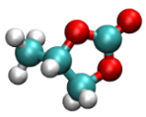

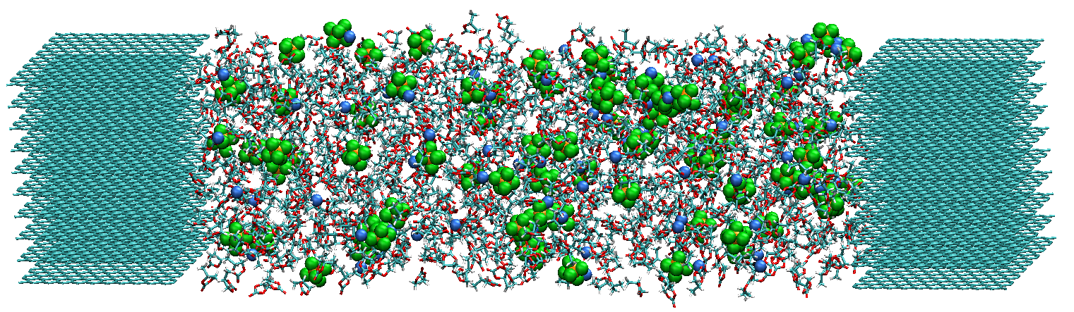

Test System (Graphite Electrode/PC-based Electrolyte)
PC: 850
Li⁺: 85
PF₆⁻: 85
Temperature: 450 K
PC
Li⁺
PF₆⁻
Cathode
128.2 Å
Anode
x
y
z
Graphite
Graphite
1.1 M LiPF₆ PC-based electrolyte
In the present simulations, the electrolyte was first equilibrated at 0 [V]. Then, by applying the electric voltage (4 [V]), the temporal change in the electrode charges were observed with the constant potential method.
Notes:
In this slide, I show the test system to check the implementation of the present method into AMBER program. This system includes the two parallel graphite electrodes and 1.1 molar PC-based electrolyte. And, to accelerate the ion diffusion, I employed higher temperature. In the present simulations, the electrolyte was first equilibrated at 0 V. And, by applying 4 V as the electric voltage, I investigated the temporal change in the electrode charges by using the present method.

Slide 5
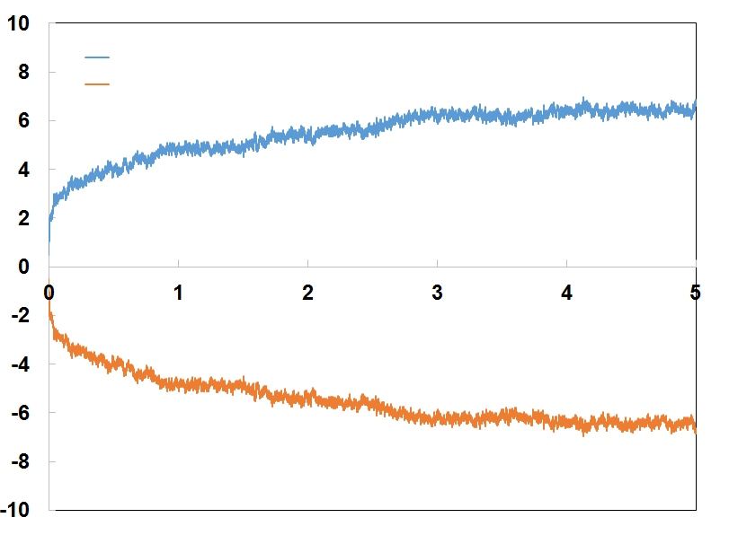
Temporal Change of Electrode Charges
cathode
anode
cathode
Charge [e]
anode
Time [ns]
In the first stage (t < ~100 ps), the charges drastically change because the orientation of solvent molecules should change quickly.
On the other hand, in the latter stage, the charge curves become loose due to the small ion diffusion.
Notes:
This figure shows the temporal change of electrode charges on the cathode and anode, respectively. As you can see, their absolute values increased depending on the increase in the MD step. In the first stage, the charges drastically change because the orientation of solvent PC molecules quickly changes near the graphite. In the latter stage, the charge curves become loose like this. By applying the voltage, the anion move to the cathode, while the cation move to the anode. But, such ion diffusion is very slow. So, the charge curves become loose in the latter stage.

Slide 6
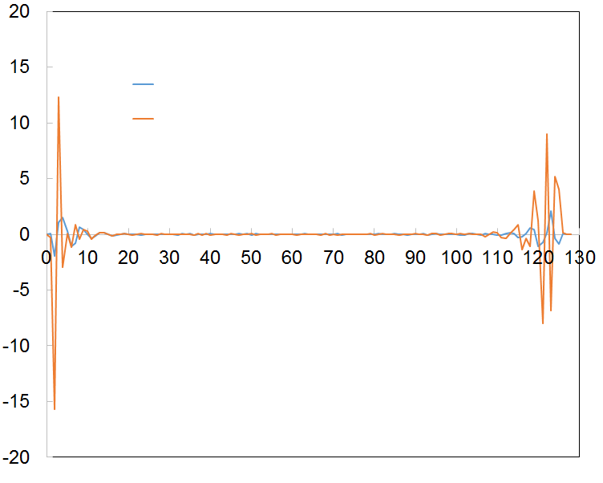
Charge Distribution on Z Axis
To estimate the electric potential difference, the charge distribution ρ(z) is calculated along z axis (z = 0 shows the cathode surface) by using 10 ns MD sampling under the constant voltage (0 or 4 V).
0 V
4 V
ρ(z) [e]
z [Å]
Notes:
To estimate the electric potential difference, I first calculated the charge distribution ρ(z) along z axis by using 10 ns MD sampling under the constant voltage. In this figure, z = 0 shows the cathode surface. As you can see, at the 4 V, the first peak became negative near the cathode surface. Please show the orange curve. On the other hand, near the anode surface, the first peak became positive. And, in the bulk region, the charges became zero.

Slide 7
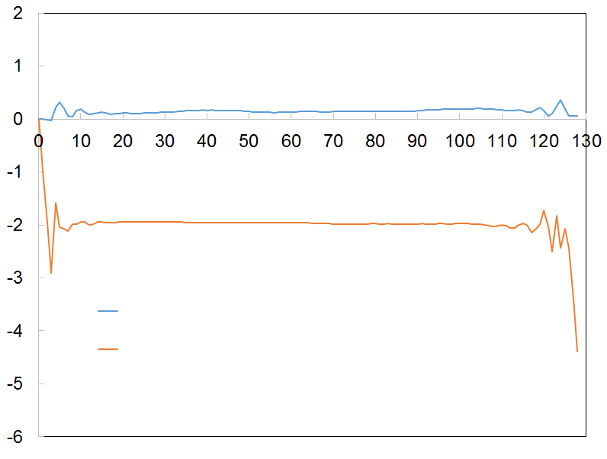
Electric Potential Change
Electric potential [V]
Poisson’s equation:
0 V
4 V
z [Å]
The calculated electric potential differences became set values (0 or 4 V).
The electric potential was constant in the bulk region, meaning that the electric field contributes only the molecules near the electrode.
Notes:
Next, I show the electric potential change along z axis. By integrating this poisson’s equation using ρ(z), I estimated these electric potential changes. Here, Ρ(z) is calculated in the previous slid like this. As you can see, the calculated electric potential difference became about 0 or 4 V, respectively. So, the present implementation could be successful. And, the electric potential was constant in the bulk region. This means the electric filed contributes only the molecules near the electrode.

Slide 8
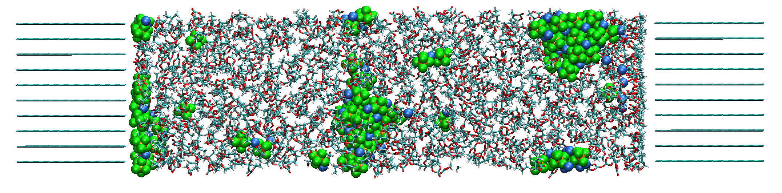
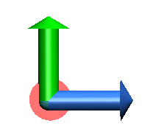
One of Problem in the Present Simulation
y
z
By executing the long-term MD simulation (t > 10 ns), the Li⁺ and PF₆⁻ aggregated, and they formed the large cluster.
Therefore, the present force filed should be modified so as to suppress such aggregation during the MD simulations.
One of the method is to reproduce correctly the experimental diffusion constant by changing the Lennard-Jones parameters.
Notes:
Finally, I show the problem in the present simulation. This slide is not shown in the handout. In the previous slides, I first mixed cations and anions by using the smaller electrostatic interactions, and then executed the 10 ns MD simulations to estimate the charge distribution and electric potential. But, when I executed the long-term MD simulations which is larger than 10 ns, the Li+ and PF6- anions aggregated, and they formed the large cluster like this. So, I think the present force field should be modified so as to suppress such aggregation during the MD simulations. To avoid this problem, one of the method is to reproduce correctly the experimental diffusion constant by changing the Lennard-Jones parameters. This is because the ions’s diffusion constant is closely related to these aggregation. By using the present parameters, the diffusion constant became smaller than the experimental values by one order of magnitude. To improve the diffusion constant, I consider the repulsive interactions between cations and anions are essentially important. So, I will increase the minimum position of Lennard-Jones functions.

Slide 9
Conclusion and Future Work
To apply the hybrid MC/MD reaction simulations, the fast constant potential method was implemented into AMBER program.
The present calculation cost was similar to the standard MD simulations because the charges are easily obtained by using the theoretical equations.
By using the present constant potential method, the electric potential differences became the set values.
However, to execute the long-term MD simulations, the Li⁺ and PF₆⁻ aggregated due to their inaccurate Lennard-Jones parameters.
I will optimize the Lennard-Jones parameters so as to suppress such aggregation, and execute the hybrid MC/MD reaction simulations by using the present constant potential method.

Slide 10
Thank you for your attention

