Slide 1
Thu. Dec. 3rd
The 4th, CREST Workshop
Implementation of Constant Potential Method into AMBER
Norio Takenaka^{1,2}
Graduate School of Information Science, Nagoya University¹,
Elements Strategy Initiative for Catalysts and Batteries (ESICB), Kyoto University²

Slide 2
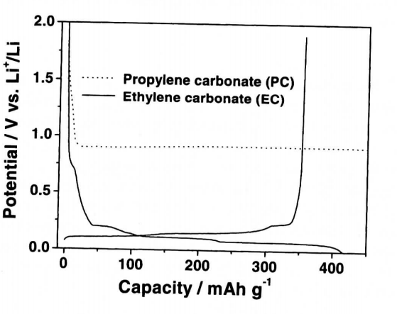
Background of Present Research
To pursue the advancement of SEI film formation simulation, I will combine the constant (electric) potential method with the hybrid MC/MD reaction method.
・ According to experimental researchers, the SEI film can be mainly formed in the plateau region on the charge curve, where the electric potential is constant.
・ To reproduce correctly the SEI film formation, the hybrid MC/MD simulations should be executed at the appropriate electric potential (e.g., ~ 0.2 V vs. Li+/Li in this figure).
Figure. Charge-discharge curve in LIB

Slide 3
Constant (Electric) Potential Method①
The constant (electric) potential method can execute the classical MD simulation under the constant electric potential between the anode and cathode [1].
The electric potential on each charge q_{j} (or atom j) V_{j}, is theoretically obtained as the derivation of Coulomb potential of the system by its charge.
In the method, the charges on the electrode are obtained by minimizing the following potential energy under the objective electric potential difference between anode and cathode ΔV (= V⁺－V⁻).
Anode
Cathode
Arbitrary atomic charge
electrolyte
,
Set electric potential
[1] S. K. Reed, O. J. Lanning, P. A. Madden, J. Chem. Phys., 126, 084704 (2007).

Slide 4
Constant (Electric) Potential Method②
To minimize the potential energy , the atomic charges on the electrode are optimized so that the derivation becomes 0 through the SCF procedure like the geometry optimization with the quantum chemical calculation.
If
,
In the standard classical MD simulation, the Coulomb potential is described by the Ewald summation method to include the long-range electrostatic interactions.
V_{c}: volume of the system
α: Ewald coefficient
m: Reciprocal space vector
r: Real space vector
Direct sum
Reciprocal sum
Self energy
Then, the electric potential V_{i} on the arbitrary atomic charge i is

Slide 5
Appropriate Ewald Method for Two-dimensional System
・ In the two-dimensional system such as the electrode surface, the conventional
three-dimensional Ewald (EW3D) method cannot be used.
・ The traditional two-dimensional Ewald (EW2D) method is reasonable, but the
calculation cost is very expensive. Therefore, a widely used approach is the
conventional EW3D method in a simulation box with large empty space that is
sufficient to avoid the artificial interactions between the periodic images.
However, it is known the calculation accuracy of this treatment is not favorable.
・ Under the circumstances, the EW3DC method have been developed [2], and it
can reproduce the identical numerical results as the EW2D method.
Typical example:
MD simulation box
Empty (or vacuum) region
Non-periodic direction
Non-periodic direction
[2] A. Bródka, A. Grzybowski, J. Chem. Phys., 117, 8208 (2002).

Slide 6
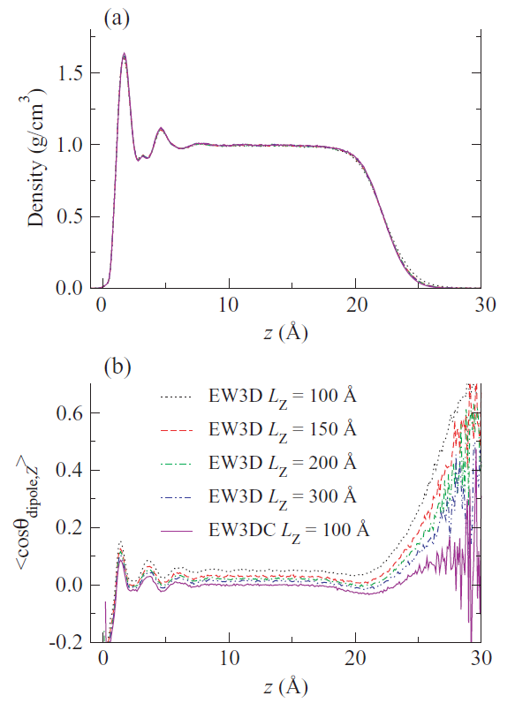
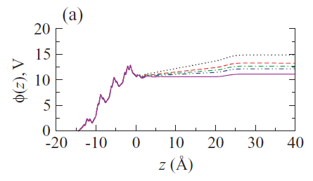
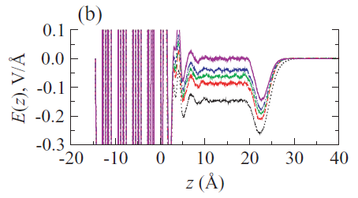
Modified Three-dimensional Ewald Method
In the EW3DC method, the correction term is added to the EW3D method.
MD simulation box
Empty (or vacuum) region
V_{c}: volume of the system
z: real space coordinate along the non-periodic direction
z axis considering non-periodic
One example: Quartz/water interface system [3]
[3] I. Yeh, A. Wallqvist, J. Chem. Phys., 134, 055109 (2011).
Mass density
Empty region
Electrostatic potential
Electric field
The EW3DC method can improve the electrostatic potential and electric field
in the two-dimensional system.
Orientation of water molecules

Slide 7
Implementation into AMBER Code
Program main
multisander
Program architecture of AMBER
Existing subroutine
MD main
sander
Modified subroutine
Main routine for constant potential method
Integrator
runmd
Optimization of charges on the electrode through the SCF with the conjugate gradient routine
Forces
force
Direct sum
Reciprocal sum
Self energy
Ewald
ewald_force
Direct sum
get_nb_energy
Reciprocal sum
Recip_reg
Self energy
self
① Calculation of electric potential (= )
② Correction by the EW3DC method

Slide 8
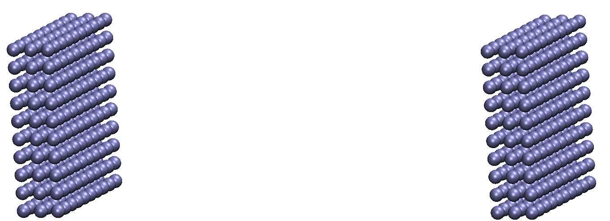
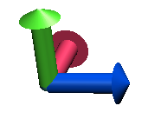
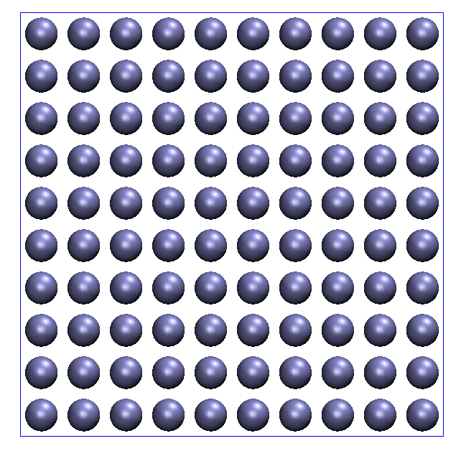
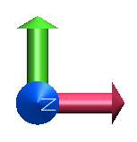
Test System① (Two Electrodes Arranged as Parallel Plates)
(a) Side view
Number of atoms per 1 plate: 100
Distance of closest approach: 100 Å
Anode
V⁻ = -2 [V]
Cathode
V⁺ = 2 [V]
x
y
Non-periodic direction
z
3 layers
3 layers
39.0 Å
(b) Front view
Empty volume:
~ 39.0 × 39.0 × 900 [Å³]
3.9 Å
39.0 Å
y
x
(111) planes in fcc of Pt crystal

Slide 9
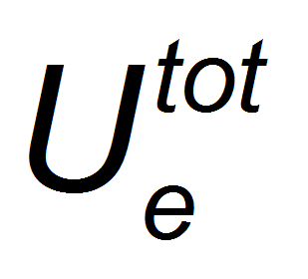
Convergence of Energy and Charges in Test System①
Anode
Cathode
0.333 [e]
Potential energy [kcal/mol]
Summation of electrode charge [e]
-0.333 [e]
Optimization cycle
Optimization cycle
(a) Potential energy
(b) Electrode charge
The convergence of potential energy and electrode charges are very good.

Slide 10
Comparison between Calculation and Theoretical Values
If the system consists of an ideal, infinite, parallel plate capacitor, we can obtain the induced charges from classical electrostatics.
The total induced charges are .
Surface area: A
In the present system (on page 8),
Distance: d
Anode
Cathode
V⁻
V⁺
Voltage potential difference: ΔV
(= V⁺－V⁻)
The present calculation values (±0.333 [e]) were very good agreement with the theoretical one.
Figure. Schematic illustration
Additionally, the electrode charges on each layer are ±0.268 [e] (first), ±0.068 [e] (second), ±0.002 [e] (third), meaning that the induced charges are mainly contributed by the nearest-neighbor surfaces (~80 %).

Slide 11
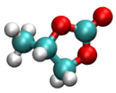

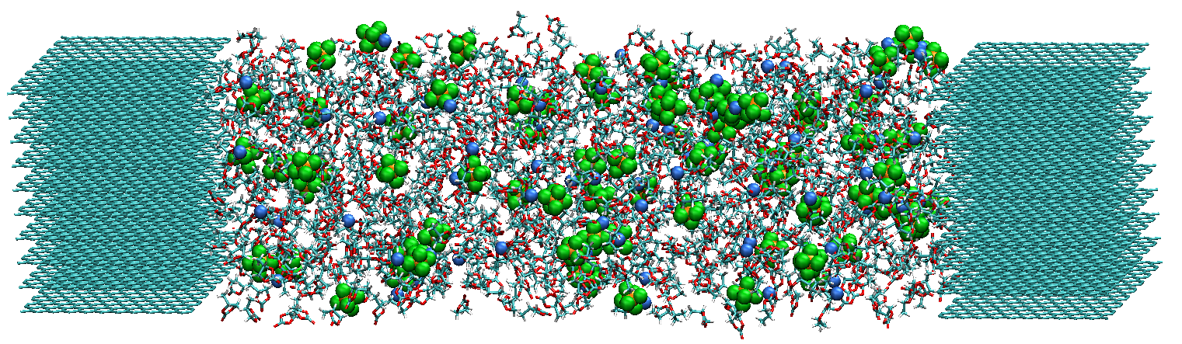
Test System② (Graphite Electrode/PC-based Electrolyte)
PC: 850
Li⁺: 85
PF₆⁻: 85
PC
Li⁺
PF₆⁻
Anode
Cathode
V⁻ = -2 [V]
114.2 Å
V⁺ = 2 [V]
x
y
z
Graphite
Graphite
1.1 M LiPF₆ PC-based electrolyte
In the present simulations, the electrolyte was first equilibrated at 0 [V]. Then, by applying the electric voltage (4 [V]), the temporal change in the electrode charges were observed with the constant potential method.

Slide 12
Convergence of Energy and Charges in Test System②
By using the initial structure obtained via the equilibration at 0 [V], the electrode charges were optimized so that the electric potential difference becomes 4 [V].
Anode
Cathode
0.282 [e]
Potential energy [kcal/mol]
Summation of electrode charge [e]
-0.282 [e]
Optimization cycle
Optimization cycle
(a) Potential energy
(b) Electrode charge
In the electrolyte, the potential energy and electrode charges converged.

Slide 13
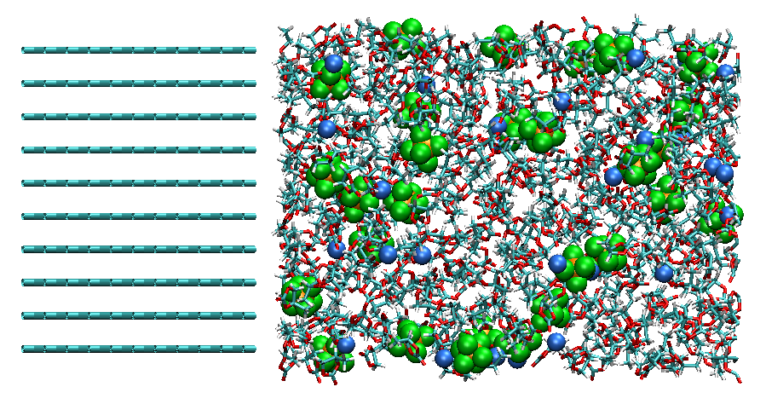
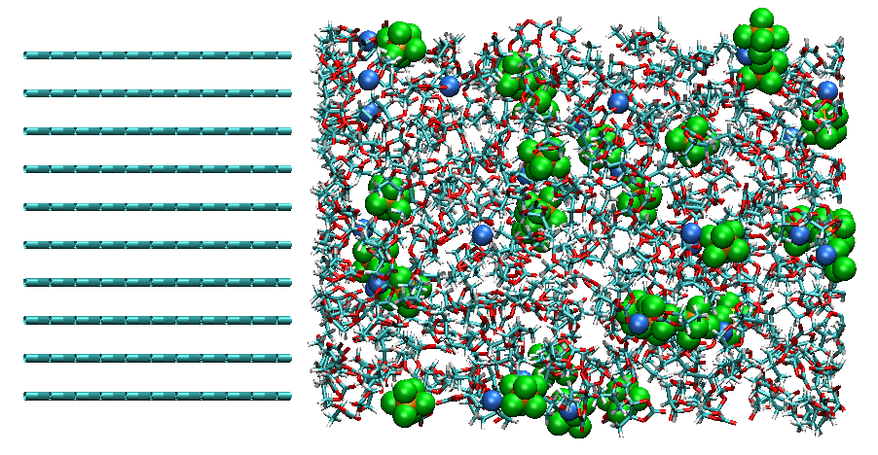
Temporal Change in Electrode Charges and Electrolyte Structures
Anode
Cathode
Summation of electrode charge [e]
(a) Initial structure (t = 0 [ps])
Time [ps]
(b) Final structure (t = 50 [ps])
(1) Temporal change of electrode charges
(2) Electrolyte structure near the anode
The induced electrode charges and electrolyte structures were obtained self-consistently with the increase in the MD time steps.

Slide 14
Number Density Distribution Depending on Voltage①
Gray: PC, Orange: PF₆⁻, Blue: Li⁺
PC
PF₆⁻
Li⁺
anode
cathode
anode
cathode
Number density
Number density
z [Å]
z [Å]
(a) 0 [V]
(b) 4 [V]
The electric double layer was found to be clearly formed in response to the voltage as a result from the charge separation of Li⁺ and PF₆⁻ in the electrolyte.

Slide 15
Number Density Distribution Depending on Voltage②
positive
negative
Orange: -CH₃, Blue: -CO₃
anode
cathode
anode
cathode
Number density
Number density
z [Å]
z [Å]
(a) 0 [V]
(b) 4 [V]
The positive –CH₃ residues were found to turn to the anode surface, which is negatively charged.

Slide 16
Conclusion and Future Work
To improve the SEI film formation simulation, the constant potential method was implemented into the AMBER code. At the same time, the EW3DC method was introduced for the two-dimensional system.
By using the method, the calculated electrode charges were found to be very good agreement with the theoretical one.
In the electrode-electrolyte system, the electrode charges were obtained in response to the voltage, providing the electric double layers.
However, since the present program was unstable depending on the selection of initial charges (data not shown), it should be modified.
Nevertheless, the calculation cost of constant potential method was still expensive for the hybrid MC/MD reaction simulations due to the SCF procedure. Therefore, I will examine the alternative method without SCF [4].
[4] M. K. Petersen, R. Kumar, H. S. White, G. A. Voth, J. Phys. Chem. C, 116, 4903 (2012).

Slide 17
Thank you for your attention

Slide 18
One example: Quartz/water interface system [3]
[3] I. Yeh, A. Wallqvist, J. Chem. Phys., 134, 055109 (2011).
Electrostatic potential
Mass density
Electric field
Orientation of water molecules

Slide 19
Fast Constant Potential Method
Considering the electrochemical cell composed of two parallel electrodes and electrolyte, the induced charges on the electrodes are obtained as follows.
Distance: D
Cathode
Anode
Arbitrary atomic
charge
electrolyte
q_{LE}
q_{RE}
z axis considering non-periodic
A: surface area of electrode
ΔV: electric potential difference between anode and cathode
[4] M. K. Petersen, R. Kumar, H. S. White, G. A. Voth, J. Phys. Chem. C, 116, 4903 (2012).

