Slide 1
Developments of molecular simulation method depending on the environment pH conditions: A review of previous studies
Yukichi Kitamura
Notes:
Now, I’m developing the molecular dynamics methods depending on the environment pH conditions. This is the first time that I will speak to all CREST members about that. So, I would like to provide an overview of the current states of the previous studies.

Slide 2
Contents
Introduction
Theory
Basic idea of constant pH method
Constant pH method
Discrete titration models
Continuous protonation models
Comparison of two methods
Future Perspective and Directions
Notes:
They are today's contents.

Slide 3
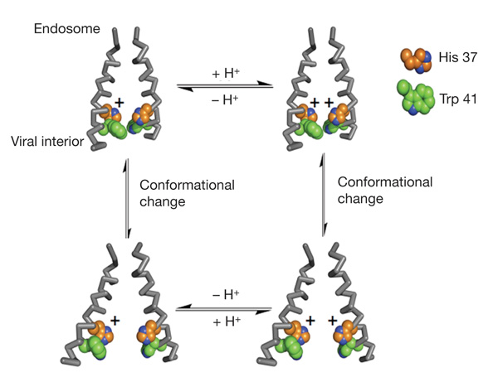
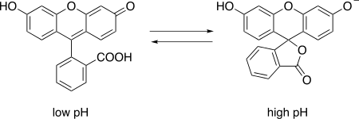
Introduction: pH-dependent behaviors
An environmental pH has a great effect on the function of many molecules.
Fluorescein (It is widely used as a pH-dependent Fluorescent tracer)
pH-activated proton channel (from influenza A virus)
[*] A. L. Stouffer, et al., Nature 451 (2008) 596-599.
Notes:
An environmental pH has a great effect on the function of many molecules. Here is two examples: pH-dependent fluorescent tracer and pH-activated proton channel. The behaviors of such molecules can be understood by their functions depending on the dynamics of proton binding.

Slide 4
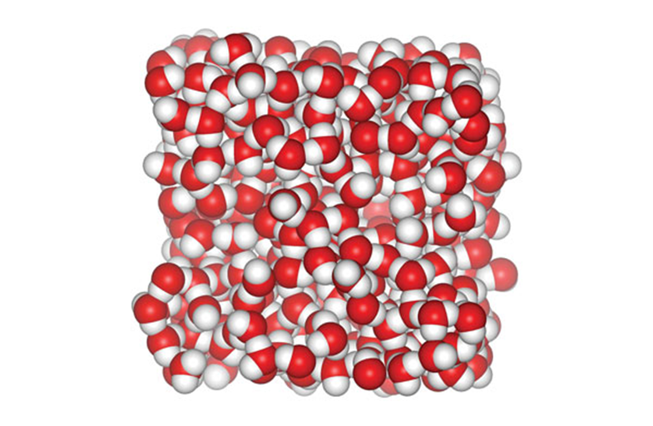
Introduction: Technical Difficulties
Great technical difficulties stand in the way of its success ...
The concentration of hydronium ions (H₃O⁺) is very low (10⁻¹⁴ - 10⁻¹ [mol/L]) and cannot directly treat in a typical simulation box.
+
H₃O⁺
At typical pH condition, a simulation box includes 30,000 water molecules per H₃O⁺.
Notes:
It is generally difficult to treat the protonation events by using common theoretical methods.

Slide 5
Introduction: Basic strategy
Constant pH method is one of simulation method that allow protonation/deprotonation events depending on environment pH conditions.
In constant pH methods, a hydronium ion is not explicitly taken account in simulation.
Instead, the solution pH is introduced to the molecular simulation as an thermodynamic variable “λ” (which has 0 to 1), like temperature and pressure.
Notes:
To treat the pH-dependent behaviors of biomolecules, the constant-pH method have been proposed.
Constant pH method is one of simulation method that allow protonation / deprotonation events depending on environment pH conditions.
In these methods, a hydronium ion isa not explicitly taken account in simulation.
Instead, the solution pH is introduced t the molecular simulation as an thermodyanamic variable, like temperature and pressure.

Slide 6
Introduction: Basic strategy
The constant pH approach is categorized by
1) how to treat λ value (or develop the λ value)
− Discrete titration models
or
− Continuous protonation models
2) how to estimate the energies of protonation events.
− explicit solvation models
or
− implicit solvation models
Notes:
The constant pH approach is categorized by 1) how to treat λ value and 2) how to estimate the energies of protonation events.

Slide 7
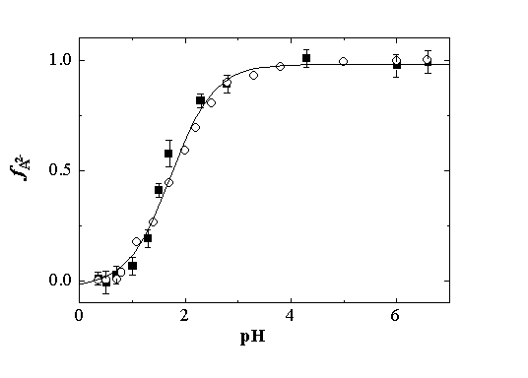
Theory: Basic idea of constant pH
The basic strategy of the constant pH method was developed based on the changes in the populations of the (pH-dependent) protonation as a function of solution pH condition.
Deprotonation
pH
This is also called the titration curve.
Notes:
The basic strategy of the constant pH method was developed based on the changes in the populations of the protonation as a function of solution pH condition.

Slide 8
Theory: Basic idea
When solution pH is pK_{A} value of solute molecule, the populations of the protonated and deprotonated forms are equal.
Deprotonation
pK_{A}
pH
Notes:
When solution pH is pKa value of solute molecule, the populations of the protonated and deprotonated forms are equal.

Slide 9
Theory: Basic idea of constant pH
→ The population of deprotonated state is increased according to an increase in solution pH value.
Deprotonation
pK_{A}
pH
The titration curve can fit to the expected Henderson-Hasselbalch equation.
Notes:
The population of deprotonated state is increased according to an increase in solution pH value.
The titration curve can fit to the expected Henderson-Hasselbalch equation.

Slide 10
Theory: Basic idea of constant pH
The titration curve can be re-expressed by a change in the relative free energy difference between two states.
By changing titration parameter λ based on free energy term ∆G^{pH} (which depends on solute pH), it can be achieved to sample the pH-dependent ensemble of solute molecules.
Notes:
The titration curve can be re-expressed by a change in the relative free energy difference between two states.
By changing titration parameter λ based on free energy term, it can be achieved to sample the pH-dependent ensemble of solute molecules.

Slide 11
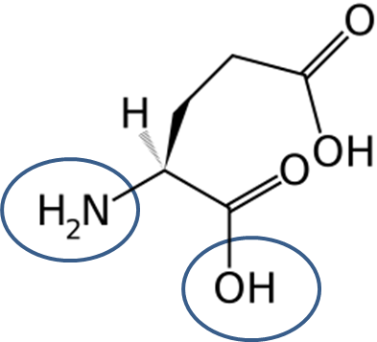
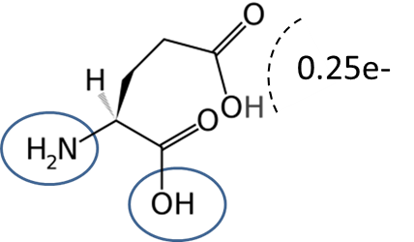
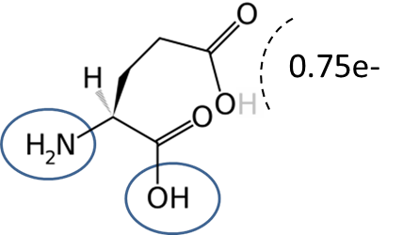
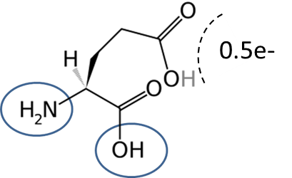
Theory: Constant pH method
The transition between titration states is expressed by the changes of coupling parameter λ.
Discrete models
(the titration states are switched between two states)
e-
Protonated state (λ=0)
Deprotonated state (λ=1)
Continuous models
(λ is changed continuously via intermediated states)
Intermediated state (λ=0.25)
Intermediated state (λ=0.75)
Intermediated state (λ=0.5)
Notes:
The transition between titration states is expressed by the changes of coupling parameter λ.
In discrete models, the titration states are switched between two states.
On the other hand, in continuous models, λ is changed continuously via many intermediated states.

Slide 12
Theory: Discrete titration models
In discrete models, the MD and MC parts are reciprocally executed and the transition events are accepted (or rejected) according to the transition probability under the Metropolis scheme.
It is necessary to estimate the free energy difference at every MC trial, so the continuum models are usually employed.
MC Cycle
MD
MC
Notes:
In discrete models, the MD and MC parts are reciprocally executed and the transition events are accepted (or rejected) according to the transition probability under the Metropolis scheme.
It is necessary to estimate the free energy difference at every MC trial, so the continuum models are usually employed.

Slide 13
Theory: Continuous models
Continuous constant pH MD utilizes an extended Hamiltonian to propagate spatial (real) and titration (virtual) coordinates, which introduces the forces on ‘λ-particles‘ (titration coordinates) as a fictional degree of freedom to the real particle system.
By temporally developing according to the extended Hamiltonian, it can be achieved to sample the pH-dependent ensemble of solute molecules.
Notes:
Continuous constant pH MD utilizes an extended Hamiltonian to propagate spatial and titration coordinates, which introduces the forces on “λ-particles” as a fictional degree of freedom to the real particle system.
By temporally developing according to the extended Hamiltonian, it can be achieved to sample the pH-dependent ensemble of solute molecules.

Slide 14
Theory: Comparison of two models
Method | Advantage | Disadvantage
Discrete model | ◦ Easy coding ◦ Low calculation cost (which is not depended on the number of titratable sites) ◦ can sample a physical-meaningful state only. | ◦ Estimation of free energy at every trial ◦ It is difficult to include the explicit solvation effects
Continuous model | ◦ without calculating the free energy at every step ◦ can include the explicit solvation effects | ◦ Difficult coding ◦ High calculation cost (2^{N}, N is the number of titration sites) ◦ Sampling of unphysical state
Either of two methods (both discrete and continuous models) have some disadvantages.
Notes:
This is table which I was summarized the advantage and disadvantage of two methods.
The discrete model is easy coding with low calculation cost.
And it can sample a physical-meaningful state only.
But, it is difficult to include the explicit solvation effects, because it is necessary to estimate the free energy at every MC trial.
On the other hand, the continuous model can include the explicit solvation effects without calculating the free energy. However, the coding is difficult and calculation cost is high.
Either of two methods have the disadvantages.

Slide 15
Future Perspective and Directions
Solution pH is an important variable in condensed systems, like other environment conditions.
To address this issue, the constant-pH approaches have been proposed and shown good performance on several applications.
In most previous studies, the researchers have focused on reproduction of pK_{A} value and the conformation changes of protein depended on the solution pH.
However, most of reaction system controlled by pH condition have not been performed by using the molecular simulation method.

Slide 16
Future Perspective and Directions
Biomolecule
Reproduction of pKa value
Conformation changes
Small reactant compounds
Acid catalytic reaction
Spectra, self-organization, etc.
Constant pH
methods
<Unexplored field>
Notes:
I think it is one of the interesting challenge to simulate multi-site systems coupled with other reaction events to understand the pH-dependent phenomena.
It can be realized by combination of hybrid MC/MD and constant pH methods.

Slide 17
Thank you attention.

