Slide 1
2014/July/28
Collaboration with
“Hyper-nano-space” CREST
and its Molecular Technological Basis
超空間CRESTと分子技術CRESTの協働
Masayoshi Takayanagi
Graduate School of Information Science,
Nagoya University

Slide 2


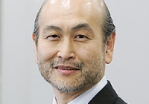
Hyper-nano-space CREST （超空間CREST）
CREST: Creation of Innovative Functional Materials with Advanced Properties by Hyper-nano-space Design
超空間制御に基づく高度な特性を有する革新的機能素材等の創製
Research Supervisor
Tohru Setoyama
(Executive Officer Fellow,
Mitsubishi Chemical Corporation)
Creation of Functional Polymer Materials
in Tailor-Made Nanospaces
テーラーメイドナノ空間設計による高機能高分子材料の創製
Research Director
Takashi Uemura
(Associate Professor,
Kyoto University)
Collaborator
M. Nagaoka
M. Takayanagi
Other three groups

Slide 3
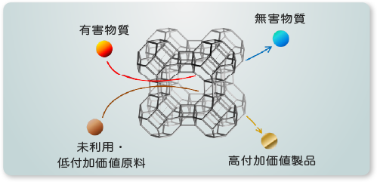
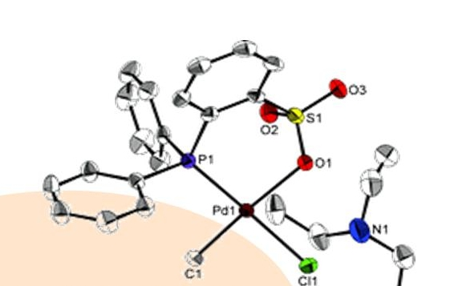
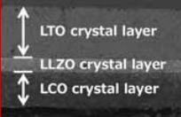
Hyper-nano-space CREST （超空間CREST）
Strategic Objective
Creation of new functional materials by means of technology for controlling spaces and gaps in advanced materials in order to realize selective material storage, transport, chemical separation, and conversion, etc.
Other groups: application oriented projects
Zeolite membrane for
separation & catalyst
Matsukata group,
Waseda Univ.
Catalyst development
for polar polypropylene
Nozaki group,
Univ. of Tokyo
All-solid-state
lithium ion battery
Teshima group,
Shinshu Univ.

Slide 4
Hyper-nano-space CREST （超空間CREST）
To improve Japanese industrial competitiveness,
we have to create high-quality products which is not easily copied by other countries.
To this end, it is necessary to understand fundamental science under the technology.
During the 5.5 years project, I expect you to climb the “commercialization mountain” to the halfway point.
Research Supervisor
Tohru Setoyama
Commercialization
In contrast to the three groups for application, we expect Uemura group to promote fundamental science.
Handover to the following projects
CREST
Ideas, seeds

Slide 5
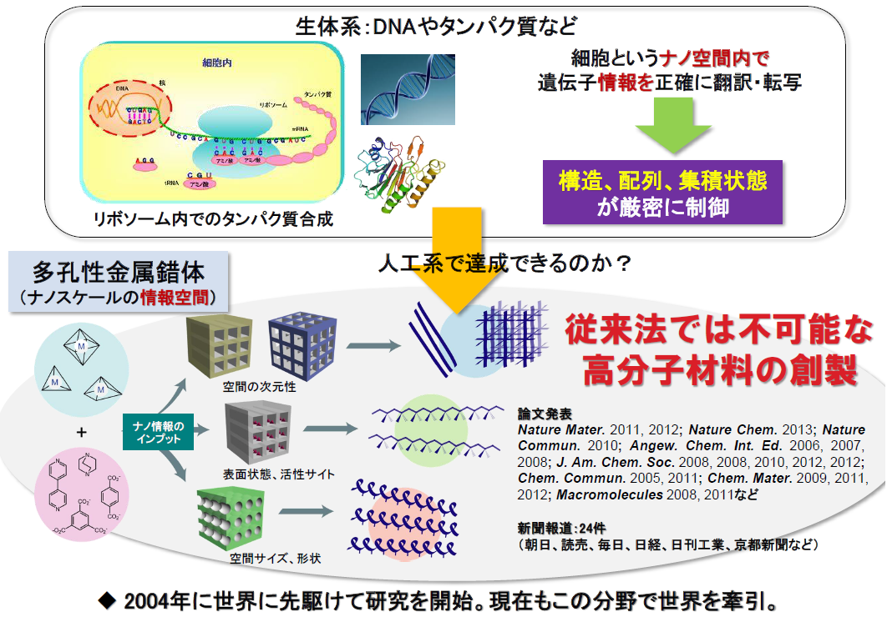
Target of Uemura group
Living cells control reactions very precisely (e.g. DNA/protein synthesis)
By utilizing artificial nano-size spaces in PCPs (MOFs),
create brand-new functional polymers.

Slide 6
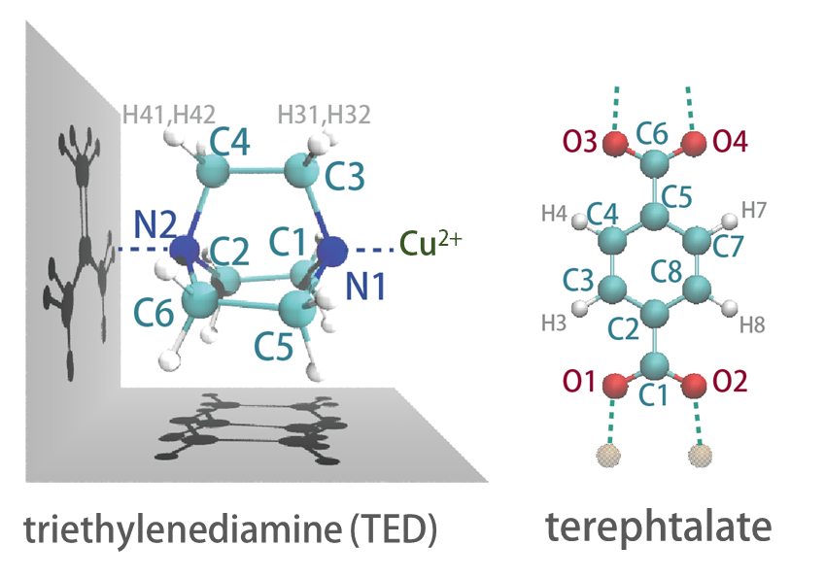
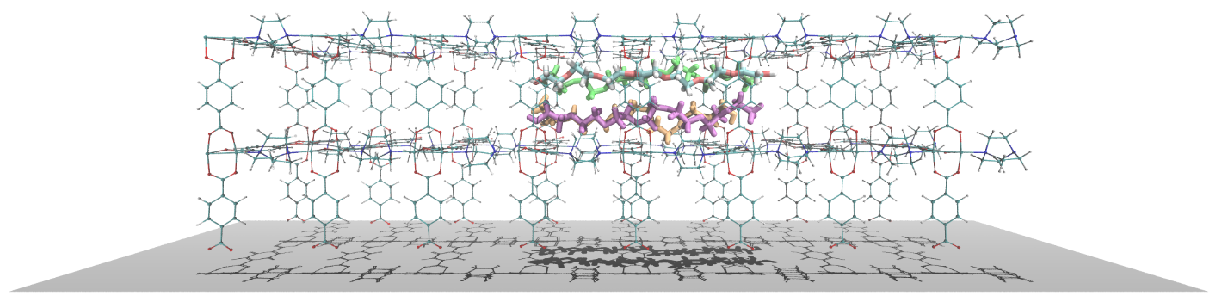
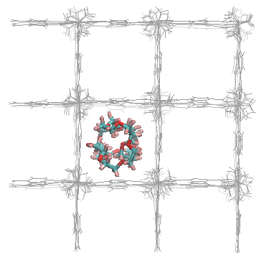
Porous Coordination Polymer (PCP) or Metal Organic Framework (MOF)
+
Cu²⁺
Zn²⁺
…
Organic ligands
Metal ions
Absorb guest molecules inside pores
→
Porous Coordination Polymer (PCP)
/ Metal Organic Framework (MOF)

Slide 7
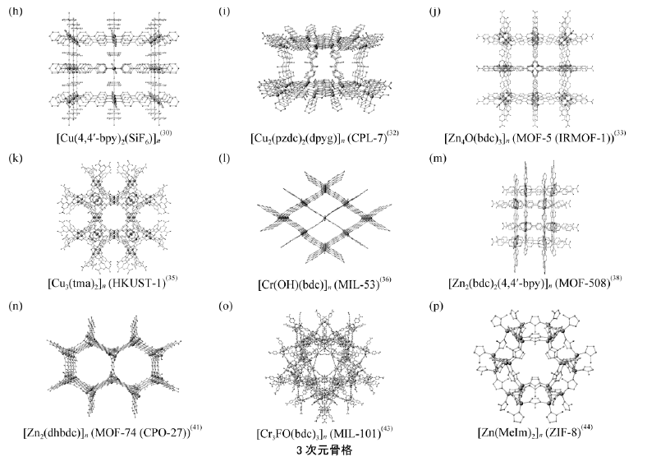
Porous Coordination Polymer (PCP) or Metal Organic Framework (MOF)
Wide variety of framework structures of PCPs
Large surface area of pores
→ efficient absorption of guest molecules, e.g. promising for H₂ storage

Slide 8
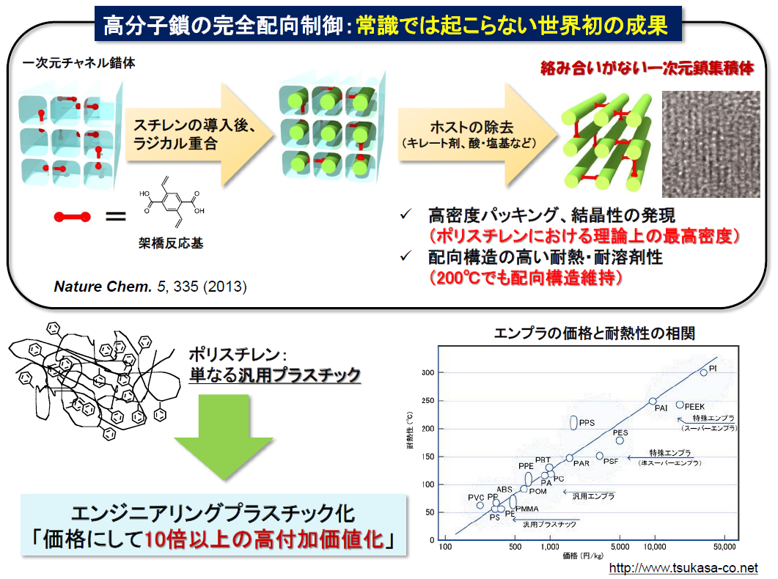
Polymerization in PCP pores
Control polymer conformations inside PCPs.
& Use PCP pores for polymerizations.
Insert monomers &
radical polymerization
Remove PCP by
chelate, acid, or base
High heat resistance polymer
heatproof
temperature
Create high-value plastic
price

Slide 9
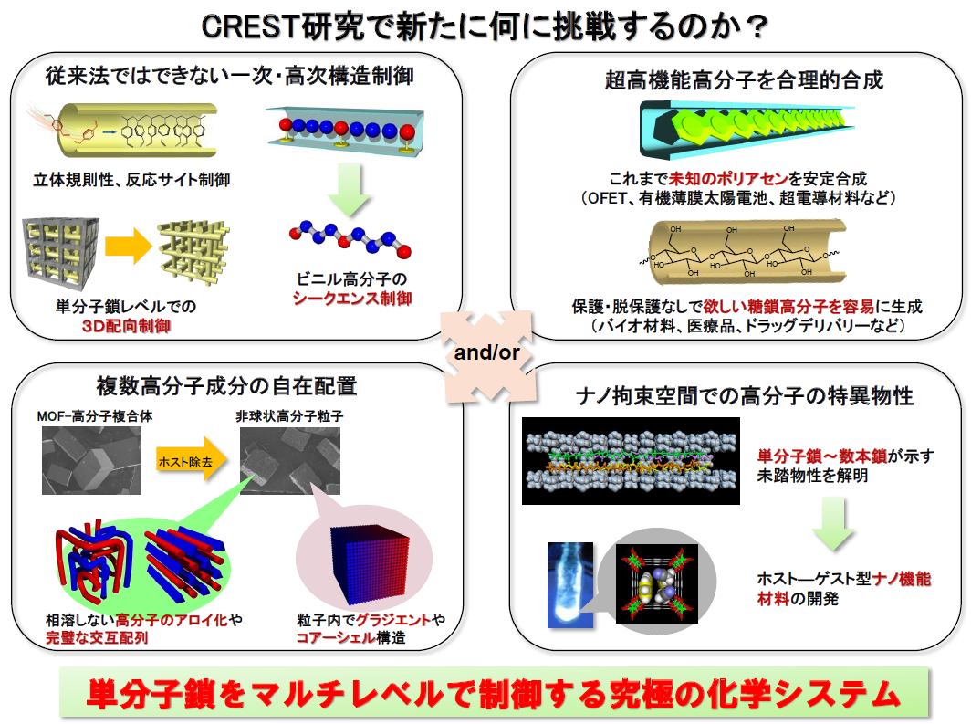
Target of Uemura group
Nagaoka group:
Computational analysis

Slide 10
Research goal of Nagaoka group
It is difficult to experimentally investigate behaviors of guest molecules inside PCP pores.
By using molecular simulation technique, we investigate various behaviors of guest molecules such as structures of each molecule, accumulated structure of multiple molecules, and diffusion.
Polymerization processes inside PCP pores are simulated by the hybrid MC/MD method to obtain information on the effects of PCP nanopores for the polymerization reactions.
→ Propose promising organic ligands of PCP for the polymerization.
Collaboration with the “Molecular Technology” CREST with MC/MD method

Slide 11
Previous computational studies on PCPs in Nagaoka group with Uemura group
長岡グループが過去に行った
多孔性金属錯体の理論研究

Slide 12
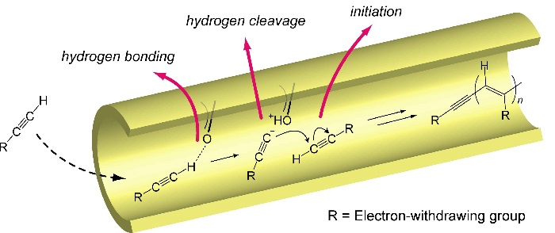
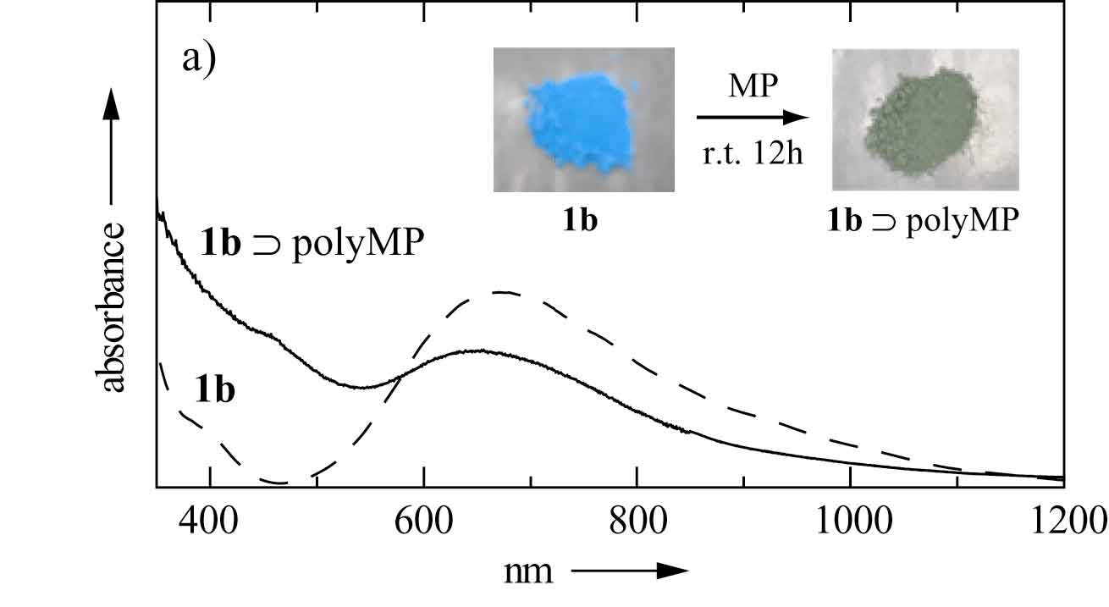
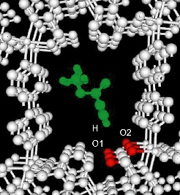
Analysis of guest molecules in PCP pores
All-atom models
（QM or MM）
Molecular simulation
(MD or MC)
Experimental studies
* Angew. Chem. Int. Ed. 2006, 45, 4112
All-atom model building to explain experimental results.
Analysis of structures of guest molecules by MD simulations.
Analysis of thermodynamic properties (e.g. average adsorption energy, average number of adsorbed molecules) by grand canonical MC (GCMC) simulations.
PCP structures are fixed
(since general forcefields is not applicable for PCP structures)
Notes:
１．X線結晶構造解析では決まらないような、ディスオーダーのあるMOFの構造最適化
２．ナノ空間に導入したモノマーの配向構造を計算し、生成してきた高分子の構造と比較することで、どのように重合反応が起こっているかを調べる。反応の動的過程を計算で可視化することができれば、より面白い研究になる。
３．上記の二つの過程を行うことで、計算科学の方から、このようなMOFを作れば、反応場として有用だということを示すこと。
現在の研究では、色々な配位子を場当たり的に合成して、たまたまうまく行けば良いというスタンスなので、計算して合理的にMOFを設計し、それを使って高度な重合制御ができれば非常に有用。

Slide 13
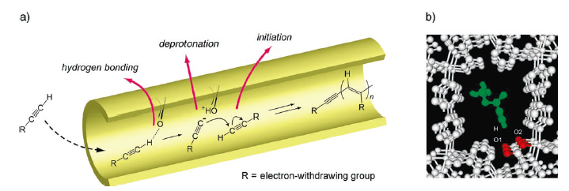
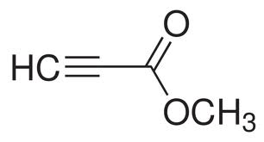
1: Adsorption structure of guest molecules
methyl propiolate
プロピオール酸メチル
By using the UFF general forcefield, optimize the adsorbed guest molecule structure in the PCP [Cu₂(pzdc)₂(pyrazine)]_{n} (CPL-1).
-C≡CH group of the guest molecule are hydrogen bonded to the exposed oxygen atoms of PCP pore surface.
This adsorbed structure can explain the polymerization mechanism predicted by the experimental observations.
Uemura, T.; Kitaura, R.; Ohta, Y.; Nagaoka, M.; Kitagawa, S. Angew. Chem. Int. Ed. Engl. 2006, 45, 4112–4116.

Slide 14
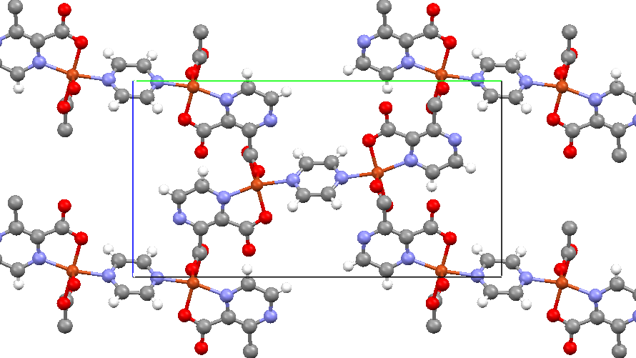
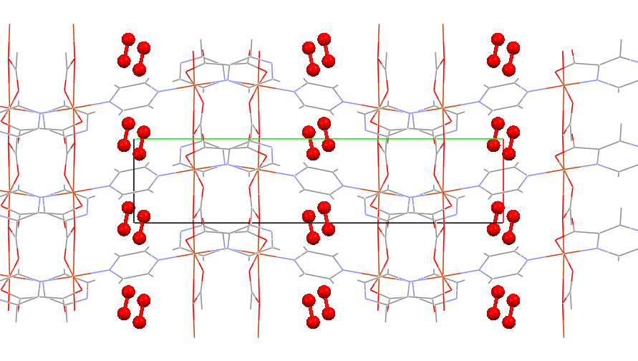
2: O₂ adsorption on CPL-1 (CpPy)
[Cu₂(pzdc)₂(pyz)]_{n} （CPL-1） or CpPy ("Cu₂(pzdc)₂"を"Cp", "pyz"を"Py"と表記)
(pzdc: pyrazine-2,3-dicarboxylate, pyz:pyrazine)
Py
Cp
CpPy crystal (from a –axis view)
CpPy·2O₂ crystal (from c –axis view)
CpPy·nO₂ (0 ≤ n ≤ 2)
In the O₂ saturated condition, two O₂ molecules align parallel to each other and indicates the properties similar to solid oxygen.
By the intermolecular interactions between the guest O₂ and host PCP pore surface, the O₂ dimer structure is stable up to 110 K.
(the melting temperature of solid O₂ is 54.3 K )
Nagaoka, M.; Ohta, Y.; Hitomi, H. Coord. Chem. Rev. 2007, 251, 2522–2536.

Slide 15
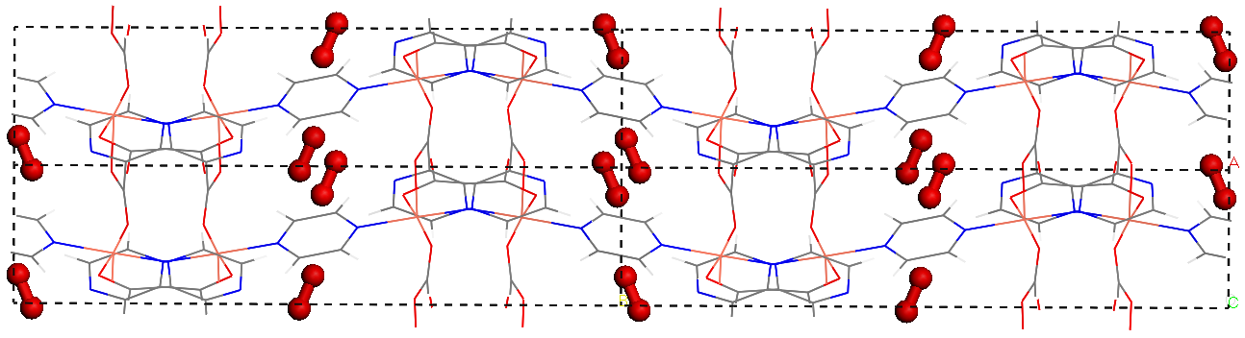
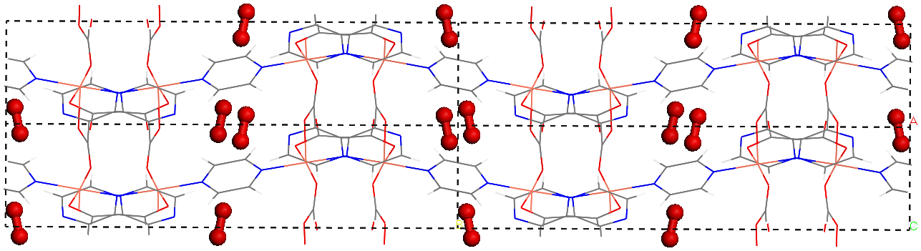
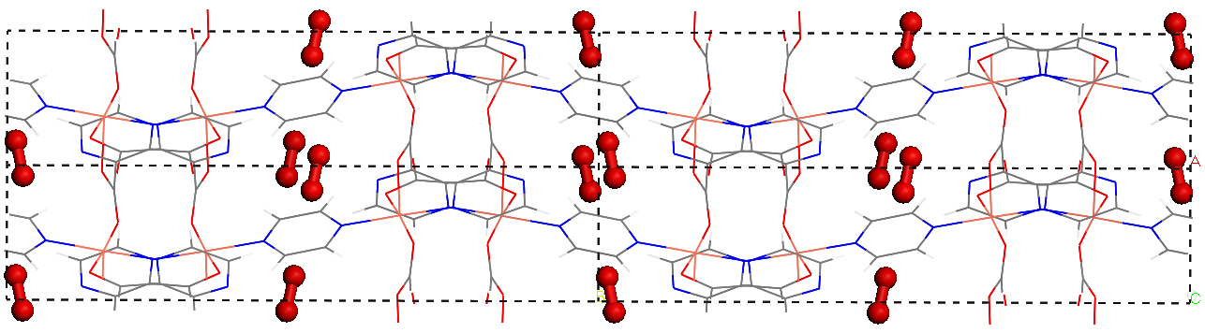
Structure optimization by three point O₂ model
Table. Inclination angles of O₂ against three
lattice axes of CpPy framework
Forcefield parameter fit to consider quadrupole-quadrupole interaction of O₂
↓
Experimental O₂ structures can be obtained
V_{LJ}
V_{LJ}+V_{EQQ}
XRPD
a-axis
24.61
11.82
11.56
b-axis
67.19
78.36
78.48
c-axis
87.71
94.76
97.71
Two point model (no charge on O₂)
（V_{LJ}）
Three point model（V_{LJ}+V_{EQQ}）
Three point model of O₂
to include quadrupole interactions
X-ray crystal structure
(80 kPa/O₂ gas, 90 K)

Slide 16
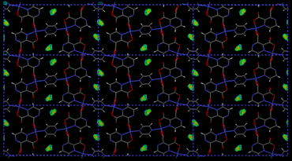
Average num. of O₂ by GCMC simulation
Grand canonical MC (GCMC) analysis
The thermodynamic average <A> of an observable A can be obtained by
Configurations of O₂ molecules are probabilistically updated in the Metropolis algorithm. (update by O₂ creation, deletion, translation, rotation)
Calculation conditions
Three point model of O₂
O2 partial pressure 80 kPa
(as in experimental condition)
CpPy framework structure is fixed at
two structures
Empty CpPy: crystal structure without O₂
Apo CpPy: crystal structure with O₂
8 million Monte Carlo steps
（Z: distribution function）
O₂ density (green color)
by GCMC simulation

Slide 17
Analysis of temperature dependency
Average number of absorbed O₂ <N> (blue) and average adsorption energy <E> (red) in the temperature from 70 to 200 K at the two CpPy structures.
Connect two curves (Empty-CpPy at high temp. and Apo-CpPy at low temp.
Empty-CpPy structure
Apo-CpPy structure
<N>
Drastic O₂ adsorption around 115 K was reproduced.
(Experimentally, adsorption occurs at 130 K)
<E>

Slide 18
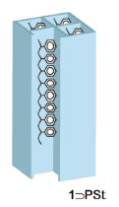
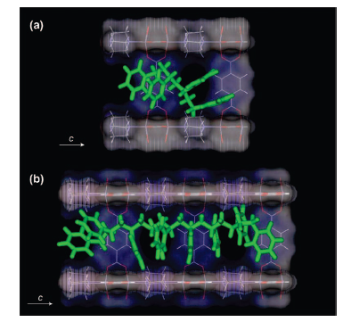
3: Polystyrene conformation in JAST-1 pore
Conformation of polystyrene (PSt) in the JAST-1 ([Zn₂(bdc)₂ted]_{n}) pore was analyzed by MD simulation.
For short PSt chain (n=4), side chains of the terminal styrene (benzene ring) stacks with the JAST-1 pore wall and the backbone is bent.
For long PSt chain (n=9), stacking of the terminals occurs as in the short chain. However, the backbone forms linear structure.
Uemura, T.; Horike, S.; Kitagawa, K.; Mizuno, M.; Endo, K.; Bracco, S.; Comotti, A.; Sozzani, P.; Nagaoka, M.; Kitagawa, S. J. Am. Chem. Soc. 2008, 130, 6781–6788.

Slide 19
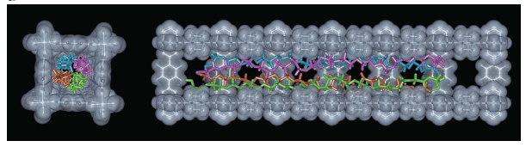
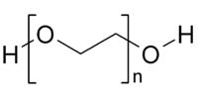
4: Thermal transition of PEGs in JAST-1 pores
Polyethylene glycol（PEG）
Prediction of the linear tetramer structure of polyethylene glycol (PEG) in the JAST-1 pores by MD simulation.
Details are explained later.
Uemura, T.; Yanai, N.; Watanabe, S.; Tanaka, H.; Numaguchi, R.; Miyahara, M. T.; Ohta, Y.; Nagaoka, M.; Kitagawa, S. Nat. Commun. 2010, 1, 83.

Slide 20
Current study
Anisotropic behavior of guest molecules in PCP (JAST-1) pores

Slide 21
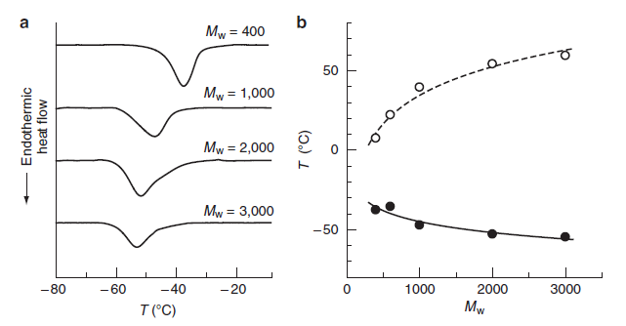
Unique thermal transition of PEG in JAST-1
In PCP pores, thermal transition temp. is lower in longer PEG
In bulk PEG, thermal transition temp. is higher in longer PEG
Free liquid-like PEG at high temperature
Thermal transition
Thermal transition temp.
Inverse relation
Solid-like state at low temperature
Linear PEG structure?
Molecular weight
Uemura et al. Nat. Commun. 2010
What is the reason of the unique thermal transition temperature dependency ?
First, analyze the liquid-like PEG structure at high temperature.

Slide 22
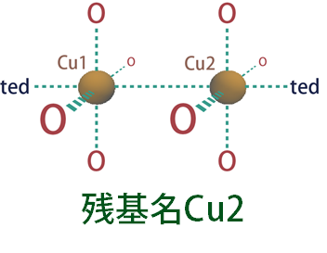
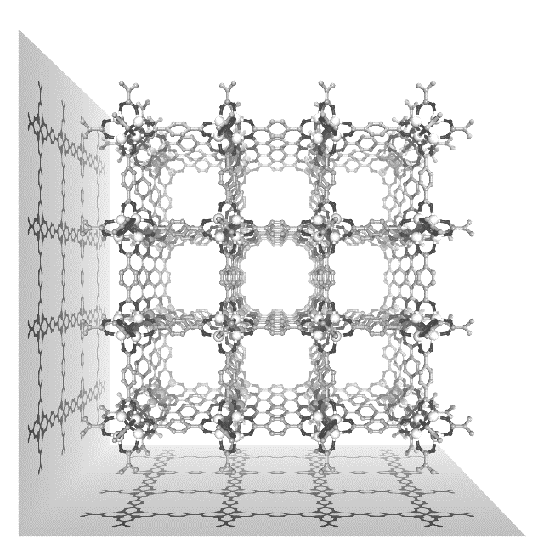
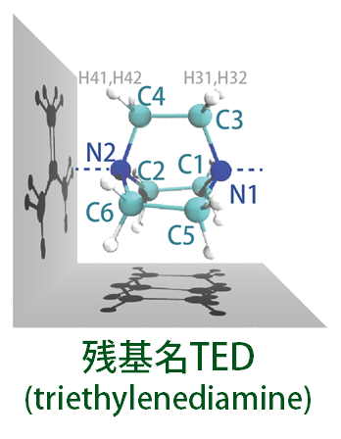
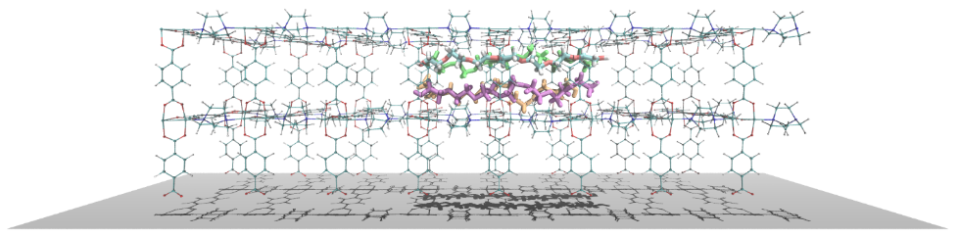
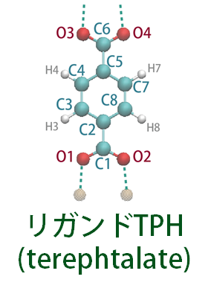
MD model of JAST-1
Zn ion
Organic ligands
JAST-1 PCP
Flexible forcefield reported in
J. Am. Chem. Soc. 134, 4207 (2012).

Slide 23
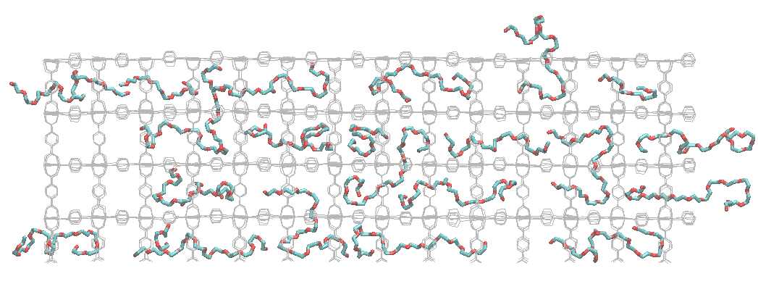
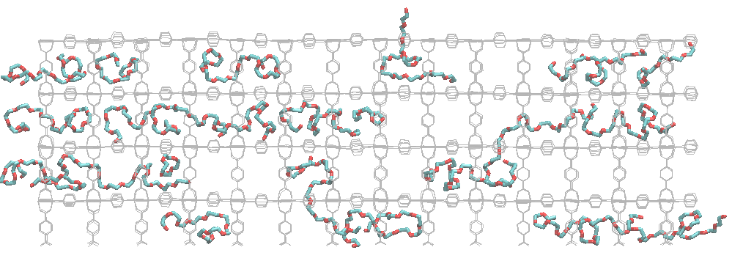
Preliminary results
PEG molecules with molecular weight 634.7 (n=14) was put in the JAST-1 pores.
Execute extremely high temperature MD at 1500 K for 100 ns to prepare random PEG distribution with fixing PCP structure
Execute MD simulation
at 550 K for 100 ns
with flexible PCP
Execute MD simulation
at 300 K for 200 ns
with flexible PCP
At 550 K, each PEG structure is extended
with scattered distribution.
At 300 K, each PEG structure is bent
with localized distribution.

Slide 24
Future work
Simulate polymerization reaction in PCP pores by hybrid MD/MD method
Collaboration with molecular technology CREST

Slide 25
PEG structure below thermal transition temperature
Free liquid-like PEG at high temperature
It was predicted that four linear PEG align in the JAST-1 pore below the transition temperature (about 240 K).
However, there is no direct evidence for this aligned structure.
To analyze the structural and alignment behavior of PEGs at the low temperature, usual MD simulation is not appropriate since PEGs are immobile in such low temperature.
Thus, I will use MC/MD procedure with the combination of local structural arrangement by MD and large structural changes by MC treatment.
Thermal transition
Solid-like state at low temperature
Linear PEG structure?
Uemura et al. Nat. Commun. 2010

Slide 26
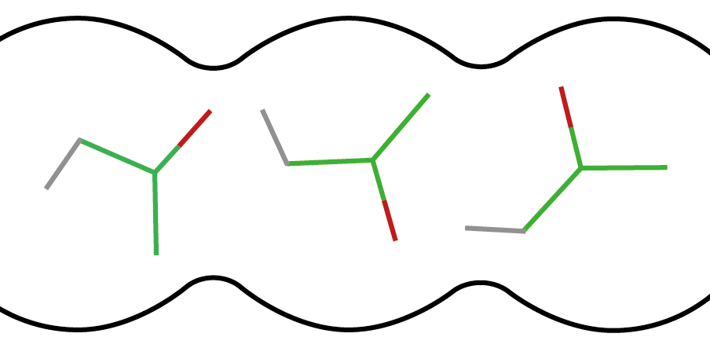
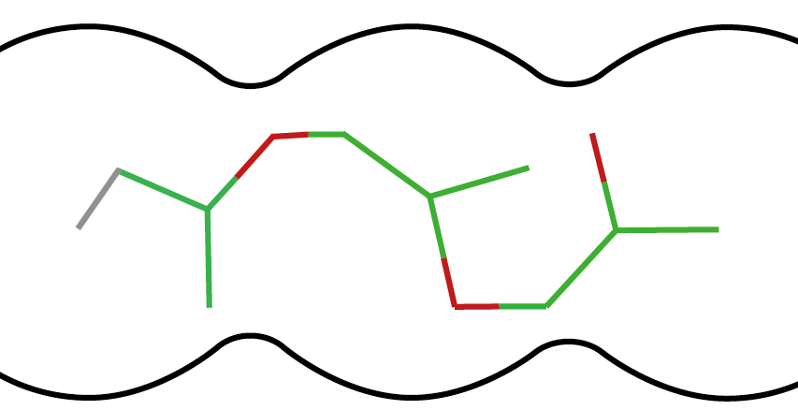
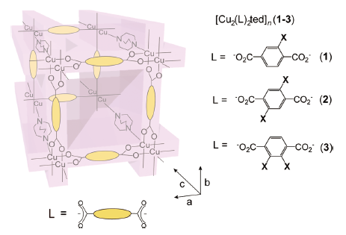
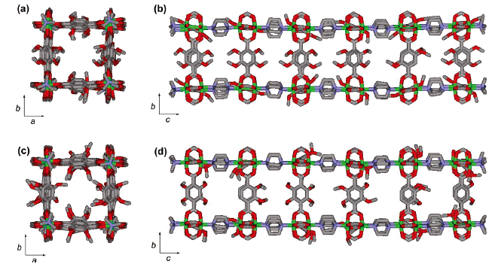
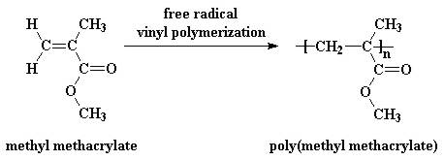
Simulate polymerization reactions in PCP pores
By the hybrid MC/MD method, simulate the polymerization reactions in PCP pores
Uemura et al., J. Am. Chem. Soc. 132, 4917–4924 (2010).
Analyze the polymer properties
(e.g. tacticity)
Compare product polymers using different PCPs with several organic ligands.

