Slide 1
FY2015 The 5th CREST Workshop 2015, October 6
Trial Copolymerization Simulation in a
PCP Channel
Masayoshi Takayanagi
Graduate School of Information Science,
Nagoya University

Slide 2
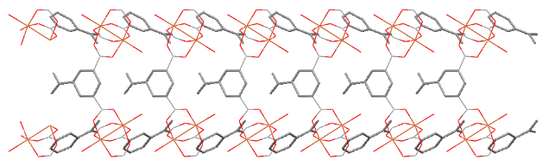
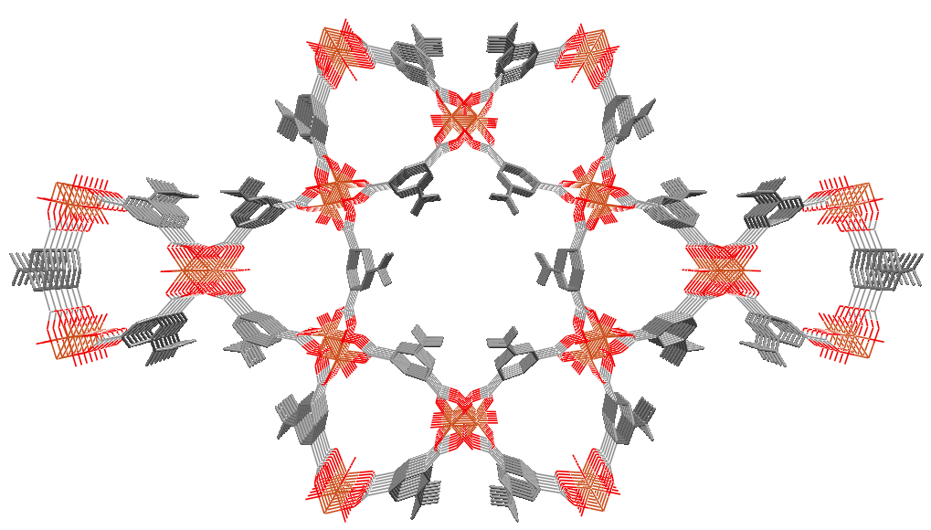
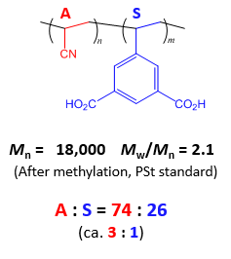
Target system for radical copolymerization
c
5-vinylisophthalic acid (S)
Compose wall of the hexagonal channel
Vinyl group exists in the channel
a
b
Acrylonitrile (A)
Filled in the hexagonal channel
Hexagonal channel in PCP framework
+ AIBN
radical copolymerization
of A and S
A
A
A
S
70℃, 48 h
Problem
How is the sequence?
A-A-S? A-A-A-S? A-A-A-A-S?

Slide 3
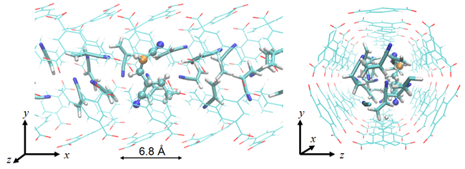
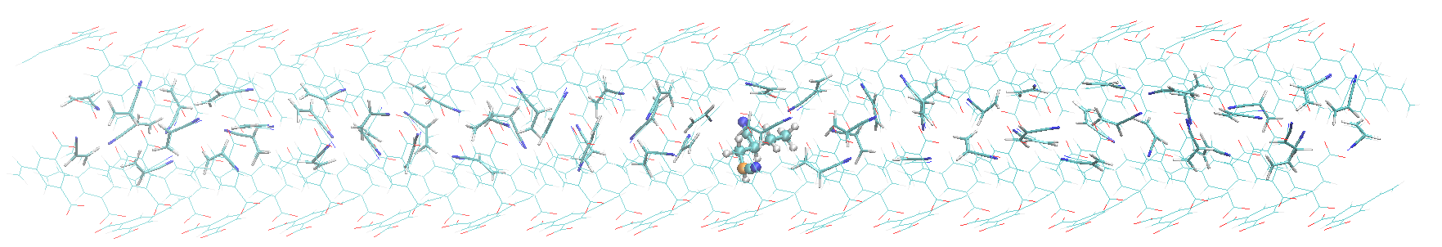
Simulation model
5-vinylisophthalic acid (S)
Thin lines: S monomers (channel surface) Thick lines: A monomers Ball & Stick model: CH₃-A-A^{rad}
Whole model
15 unit cells
Periodically connected in the x-axis
I modeled only the hexagonal channel with GAFF force field
COO⁻ groups of S are fixed at the locations of the crystal
In real PCP, the COO⁻ groups are bound to Cu paddle wheel units
4.34 A monomers per unit cell are allocated in the channel
4.34 was determined by experimental density
A model radical molecule CH₃-A-A^{rad} is prepared

Slide 4
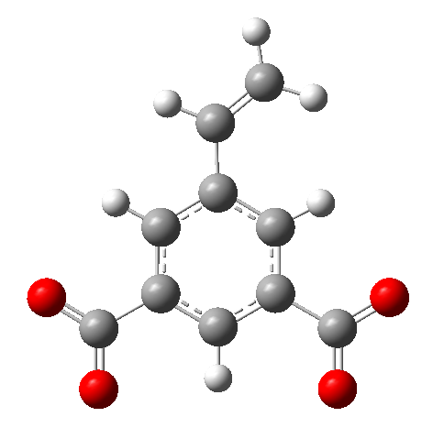
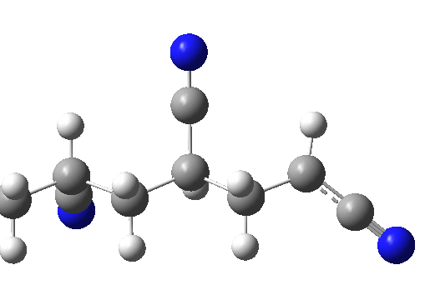
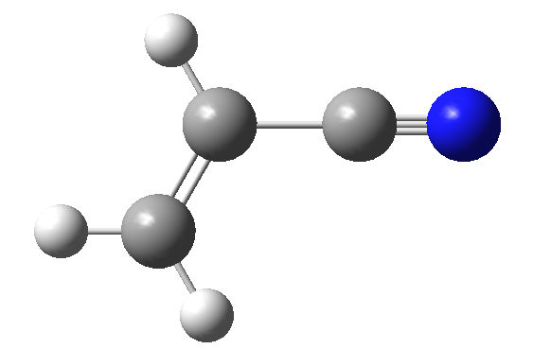
Assumed reaction mechanism
When the radical atom approaches to the β-carbon of monomer,
the radical elongation reaction occurs
The threshold distance for elongation is 3 Å (tentative length)
When the terminal is A, reaction with S is preferred
i.e. if S can approach, always react with S
When the terminal is S, reaction is always with A
At this trial simulation, not Monte Carlo approach
When monomer approaches, reaction always occurs
S
β-carbon
radical
β-carbon
A

Slide 5
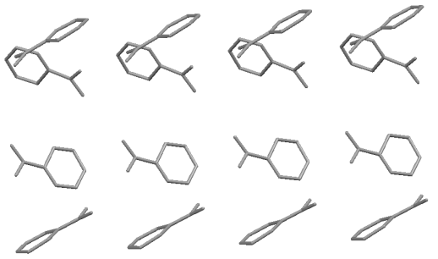
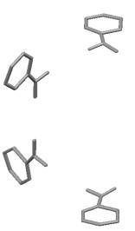
Location between S
Patter of sequence
-S-S-
-S-A-S-
-S-A-A-S-
-S-A-A-A-S-
…
⑥
Location of
two S monomers (①~⑧ in right fig.)
④
×
①
a
②
⑤
c
③
a
b
⑧
Elongation simulation procedure
1. Optimize the MD simulation model.
2. Execute MD simulation at 343 K for 10 ns.
3. When the radical approached to β-carbon (distance < 3 Å)
during the MD trajectory, react with the monomer
A^{rad} prefer S, S^{rad} always react with A
4. If monomer approach did not occur, execute higher
temperature MD (400 K, 500 K, 700K, ...).
5. Create a new bond between radical and vinyl group and go back to 1.

Slide 6
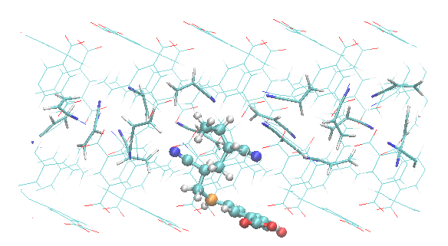
Initial elongation （ CH₃-A-A^{rad} + S → CH₃-A-A-S^{rad} ）
Radical can approach to a vinyl group of S during MD simulation at 343 K
According to the rule (A^{rad} prefer monomer S),
the terminal A^{rad} react with the S
(below fig.) optimized structure of CH₃-A-A-S^{rad} after elongation
Ball & stick: radical polymer
Thin lines: S monomers
Thick lines: A monomers
Orange atom: radical atom in S^{rad}

Slide 7
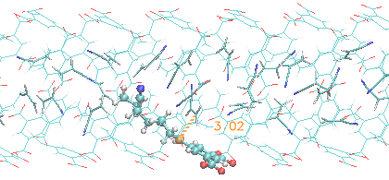
2nd elongation（ CH₃-A-A-S^{rad} + A → CH₃-A-A-S-A^{rad} ）
Execute MD simulation at 343 K 10 ns, no access of monomer
→ CH₃-A-A part of radical polymer inhibits access of A to radical
MD simulations at 400 K and 500 K failed to find A access
At 700 K, after conformational change of the radical polymer, monomer A can approach to the radical
（below right fig.）Structure immediately before elongation
Red circle part inhibits access of A to radical
Need radical polymer conformational change for A access

Slide 8
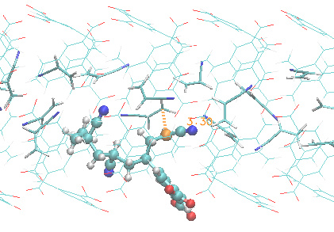
3rd elongation（ CH₃-A-A-S-A^{rad} + A → CH₃-A-A-S-A-A^{rad} ）
Execute MD simulation at 343 K for 10 ns
Monomer A can easily approach to the radical
(below Fig.) Structure immediately before elongation

Slide 9
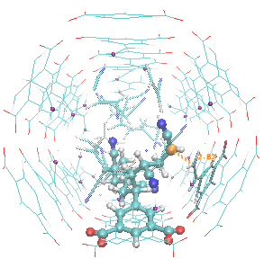
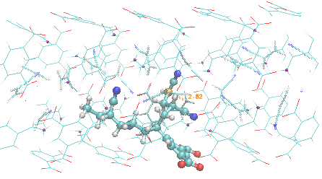
4th elongation（ CH₃-A-A-S-A-A^{rad} + S → CH₃-A-A-S-A-A-S^{rad} ）
Radical can approach to monomer A easily
However, since the radical may find partner S by the conformational change of radical polymer, I executed 500 K MD for 10 ns
The terminal -S-A-A^{rad} could approach to adjacent S (slide 5 location ②)
（below fig.）Structure immediately before elongation
Elongation partner (A or S) depends on the below balance
If the reaction barrier with A is low, react with A
If the conformational change occurs fast, react with S

Slide 10
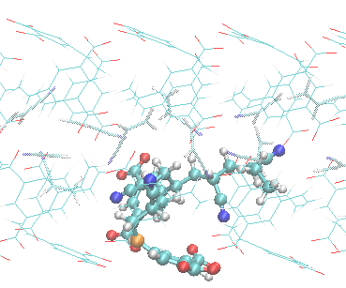
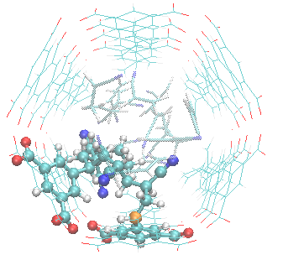
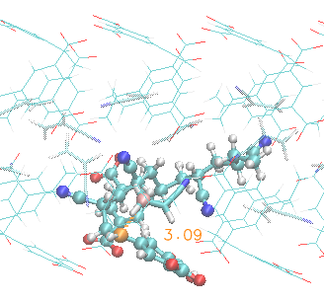
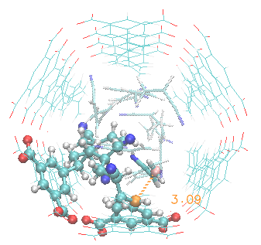
5th elongation （...-S-A-A-S^{rad} + A → ...-S-A-A-S-A^{rad} ）
I executed MD simulations at 343 K to 500 K
Monomer approach of A did not occur
Part of radical polymer inhibits access (right fig.)
I rotated the C^{ben}-C^{rad}-C-C dihedral angle manually and executed MD simulation at 500 K
Monomer A could approach to radical (below fig.)
（below fig.) Structure immediately before elongation

Slide 11
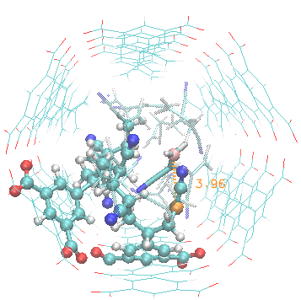
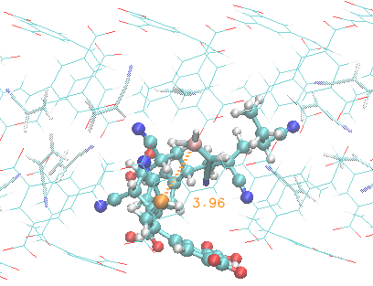
6th elongation（...-S-A-A-S-A^{rad} + A → ...-S-A-A-S-A-A^{rad} ）
Monomer A can easily approach to radical
（below fig.）Structure immediately before elongation

Slide 12
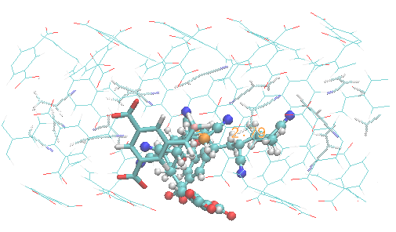
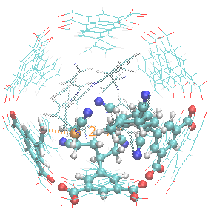
7th elongation （...-S-A-A-S-A-A^{rad} + S → ...-S-A-A-S-A-A-S^{rad} ）
Radical approached to S at (slide 5 location ②) and (slide 5 location ④)
The distance at location ② is shorter so I chose the location ②
（below fig.）Structure immediately before elongation

Slide 13
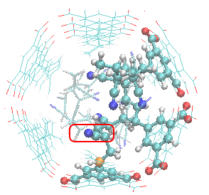
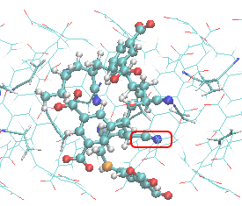
No 8th elongation, since no monomer access to radical
Executed MD simulations at 343 K, 400 K, 500 K, 700 K, 900 K, 1200 K
However, no access of monomer to radical
Side chain of A in the radical polymer (red frame in below fig.)
inhibited monomer access
It is very difficult to realize next elongation from this situation
Possible approach to this situation is to consider the reverse reaction and try different elongation reaction
Elongation at the location ④ can be the different elongation

Slide 14
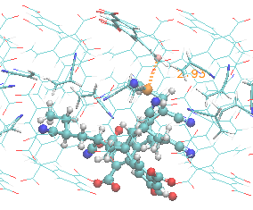
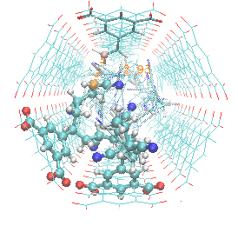
Another 7th elongation（...-S-A-A-S-A-A^{rad} + S → ...-S-A-A-S-A-A-S^{rad} ）
Elongation at location ④
（below fig.）Structure immediately before elongation

Slide 15
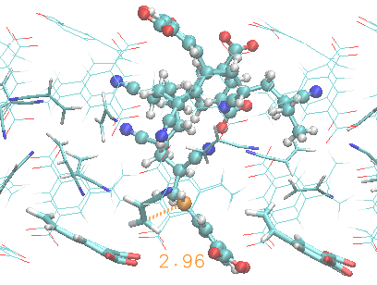
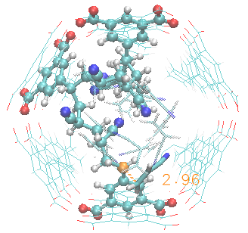
8th elongation （...-S-A-A-S^{rad} + A → ...-S-A-A-S-A^{rad} ）
In this case, monomer A approached to the radical at 500 K
The radical polymer can continue to elongate.
（below fig.）Structure immediately before elongation

Slide 16
Insights obtained from this elongation simulation
For radical polymerization reactions in confined space such as PCP channels, monomer access to the radical atom needs long time to wait for the (relatively) slow conformational change of radical polymer.
This radical confinement is consistent with experimental observation that the concentration of PMMA radical in PCP framework is 0.48-2.6 mmol/kg, which is significantly higher than those in conventional solution polymerization 10⁻⁴–10⁻⁵ mmol/kg. (1)
(1) Uemura, T et al. Macromolecules 2008, 41, 87–94.
Need to sample large conformational space of product polymer at the target temperarture (High temperature MD gives different conformational space)
Replica exchange MD is one of the possible approach
Need correct weight for the A^{rad} to react with A or S
As shown in slide 9, balance of reaction barrier and conformational change of product polymer is important

