Slide 1
2015, April 17
MC/MD implementation with MC step of translation and swap molecules for analyzing binary guest mixture in PCP channels
PCP細孔内における異種ゲスト分子混合状態解析のための 並進・交換MC操作のMC/MD実装
Masayoshi Takayanagi
Graduate School of Information Science, Nagoya University

Slide 2
Usual small molecules Easy to make mixtures similar polarity combination → mixture
Polymers Very difficult to make polymer alloys (mixtures)
Utilize PCP channels for createing polymer alloys Brand-new plastic with very interesting property
1st Polymerization in half of the PCP channels
2nd Polymerization in the rest of the PCP channels
Remove PCP by adding EDTA (Chelating agent)

Slide 3
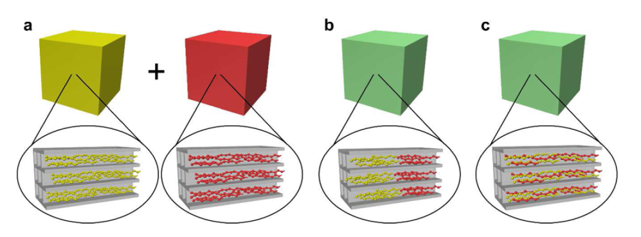
Introduce binary oligomers immucible in bulk, OEG & alkane, into PCP channels
OEG & alkane form domains and interact each other in each PCP crystal
However, atomic insights (i.e. domain size) is unknown
Promising technique to create new PCP with multiple guest oligomers
Yanai, N. et al. Chem. Mater. 2012, 24, 4744–4749.

Slide 4
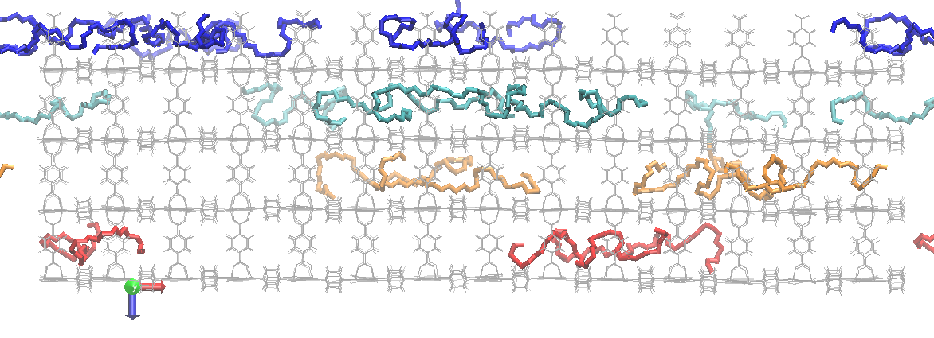
First, I implemented MC step of translation
Test system for MCMD simulation (MC step with guest OEG translation)
20 OEG (oligo(ethylene glycol) ) guest molecules in ZnPCP framework
OEGs are colored by its z-direction coordinate
Initial structure (left) after an MD simulation at 450 K temperature for 100 ns
y
x
z
x
OEG

Slide 5
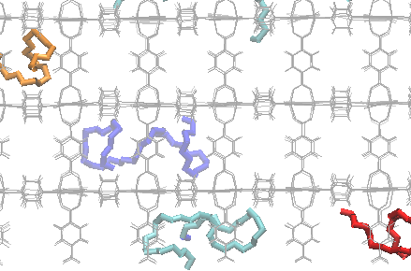
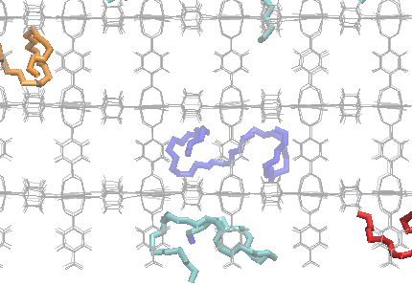
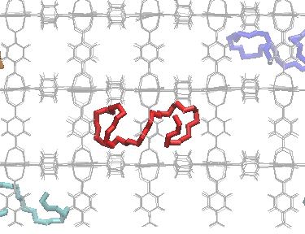
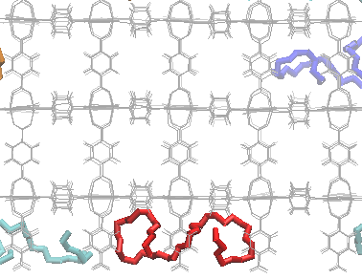
Monte Carlo Step (MCS) to translate guest OEG molecule
Translate + or -9.804 Å in the X direction
y
x
Translation along the PCP channel
Translate + or -10.948 Å in the Y or Z direction
y
x
Translation to the adjacent PCP channel

Slide 6
MCMD simulation procedure
Select one OEG molecule randomly
Select one translation vector randomly from { (+9.804,0,0), (-9.804,0,0), (0,+10.948,0), (0,-10.948,0), (0,0,+10.948), (0,0,-10.948) }
Translate the OEG molecule by the vector
TEMP0 Heat bath temperature
DT Integration time step
NSTEP Number of MD step
TAUTP Time constant for heat bath coupling
VRAND When not 0, reset atomic velocities every VRAND steps at the temperature TEMP0
belly constraint: Fix the atomic positions at the specified (in this case, initial) positions.
Relax only the translated OEG molecule by a constrained MD (TEMP0 = 300 K, DT=0.5 fs, NSTEP=1000, TAUTP=2 fs, VRAND=50 belly constraint except for the translated OEG)
Calculate potential energy before the translation and after the translation & relaxation
Judge the translation by Metropolis algorithm
Monte Carlo step (MCS)
Execute MD simulation for 5 ps at 300 K (TEMP0=300 K, DT=1 fs, NSTEP=5000, TAUTP=500 fs)
Save atomic velocities & use them in the next cycle MD initial velocities
Repeat MCMD cycle

Slide 7
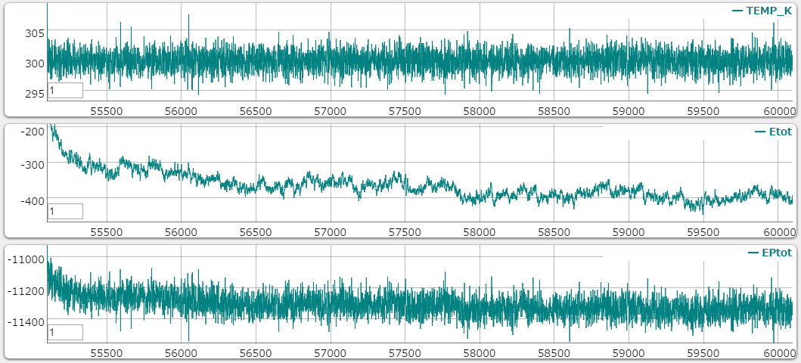
Reference MD at 300 K temperature for 5 ns
MD at 300 K for 5 ns
Each OEG molecule almost keeps its initial location.
Temperature (K)
Total energy (kcal/mol)
Potential energy (kcal/mol)
picoseconds

Slide 8
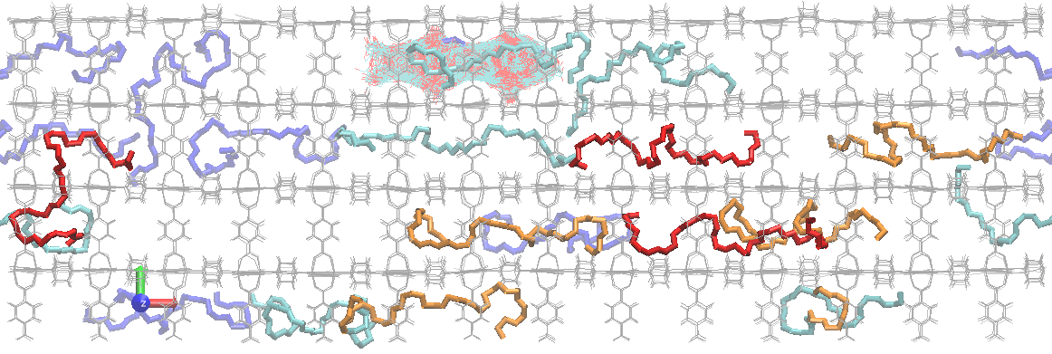
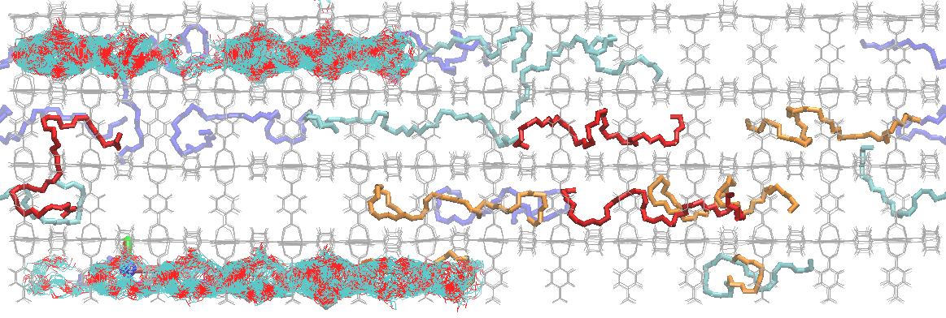
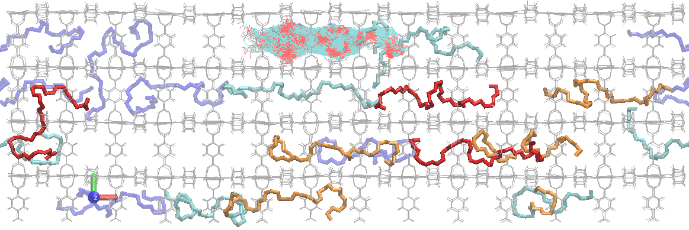
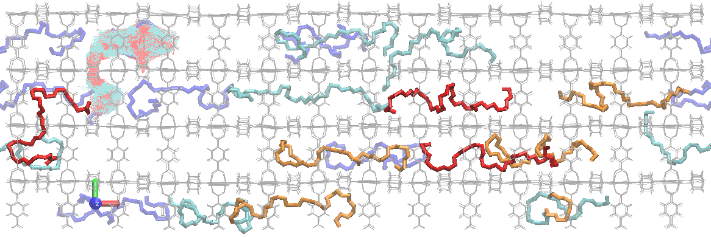
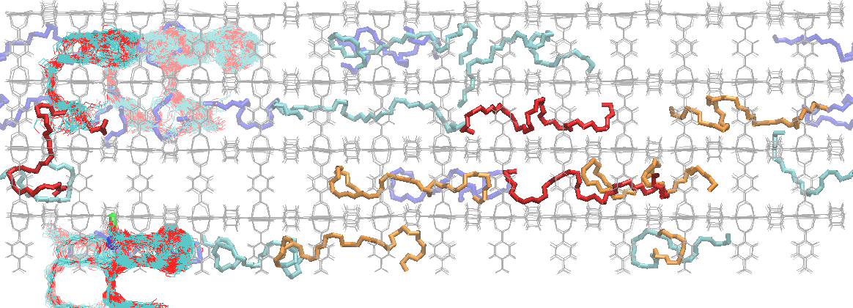
Translation behavior in reference MD (left) and MCMD (right)
OEG 1
OEG 1
OEG 2
OEG 2
OEG 3
OEG 3
OEG 4
OEG 4
Reference MD
Superimposed snapshots at 0-5 ns every 5 ps. No translation occured.
MCMD 1 MCS / 5 ps MD, total 1000 MCS
Superimposed snapshots every MCS. Frequent translation occured.

Slide 9
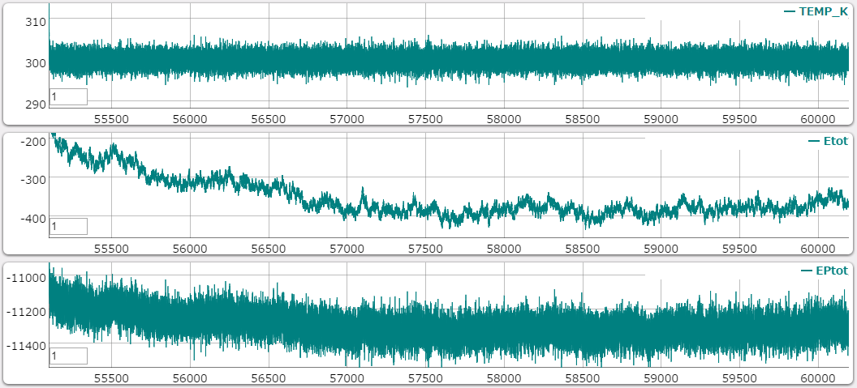
MCMD progress
Initial
After 100 MCS
After 50 MCS
After 1000 MCS
Temperature (K)
Total energy (kcal/mol)
Total & potential energies seem to be very similar to those in reference MD (slide 7)
Potential energy (kcal/mol)

Slide 10
Cycle 961 Ep = -11096.1332 Er = -11111.5104 dE = 15.3772 Odds = 0.0000000000 Reject
Cycle 962 Ep = -11312.0346 Er = -11307.9119 dE = -4.1227 Odds = 1.0000000000 Accept
Cycle 963 Ep = -11315.6136 Er = -11325.7333 dE = 10.1197 Odds = 0.0000000425 Reject
Cycle 964 Ep = 1462.4285 Er = -11351.1029 dE = 12813.5314 Odds = 0.0000000000 Reject
Cycle 965 Ep = -8798.7977 Er = -11240.9243 dE = 2442.1266 Odds = 0.0000000000 Reject
Cycle 966 Ep = -10880.0833 Er = -11375.1385 dE = 495.0552 Odds = 0.0000000000 Reject
Cycle 967 Ep = -11322.8849 Er = -11350.7286 dE = 27.8437 Odds = 0.0000000000 Reject
Cycle 968 Ep = -11307.9950 Er = -11320.4554 dE = 12.4604 Odds = 0.0000000008 Reject
Cycle 969 Ep = -11339.6715 Er = -11346.3208 dE = 6.6493 Odds = 0.0000143252 Reject
Cycle 970 Ep = -11391.4328 Er = -11375.5883 dE = -15.8445 Odds = 1.0000000000 Accept
Cycle 971 Ep = -11242.6517 Er = -11265.9095 dE = 23.2578 Odds = 0.0000000000 Reject
Cycle 972 Ep = -11281.3274 Er = -11285.1101 dE = 3.7827 Odds = 0.0017553680 Reject
Cycle 973 Ep = -11328.2912 Er = -11341.9693 dE = 13.6781 Odds = 0.0000000001 Reject
Cycle 974 Ep = -5434.2867 Er = -11342.9935 dE = 5908.7068 Odds = 0.0000000000 Reject
Cycle 975 Ep = -11267.0039 Er = -11278.7052 dE = 11.7013 Odds = 0.0000000030 Reject
Cycle 976 Ep = -11349.4653 Er = -11335.4864 dE = -13.9789 Odds = 1.0000000000 Accept
Cycle 977 Ep = -11219.2068 Er = -11237.5745 dE = 18.3677 Odds = 0.0000000000 Reject
Cycle 978 Ep = -11230.3786 Er = -11255.1962 dE = 24.8176 Odds = 0.0000000000 Reject
Cycle 979 Ep = -11187.3033 Er = -11193.3746 dE = 6.0713 Odds = 0.0000377713 Reject
Cycle 980 Ep = -11237.2843 Er = -11256.9728 dE = 19.6885 Odds = 0.0000000000 Reject
Cycle 981 Ep = -11368.6936 Er = -11381.7014 dE = 13.0078 Odds = 0.0000000003 Reject
Cycle 982 Ep = -10806.2654 Er = -11290.0253 dE = 483.7599 Odds = 0.0000000000 Reject
Cycle 983 Ep = -10334.4033 Er = -11341.6607 dE = 1007.2574 Odds = 0.0000000000 Reject
Cycle 984 Ep = -9245.4223 Er = -11287.7031 dE = 2042.2808 Odds = 0.0000000000 Reject
Cycle 985 Ep = -11319.9395 Er = -11326.2282 dE = 6.2887 Odds = 0.0000262295 Reject
Cycle 986 Ep = -11298.7221 Er = -11314.9891 dE = 16.2670 Odds = 0.0000000000 Reject
Cycle 987 Ep = -11283.4058 Er = -11279.2552 dE = -4.1506 Odds = 1.0000000000 Accept
Cycle 988 Ep = -11269.5415 Er = -11280.5940 dE = 11.0525 Odds = 0.0000000089 Reject
Cycle 989 Ep = -11242.5491 Er = -11241.5835 dE = -0.9656 Odds = 1.0000000000 Accept
Cycle 990 Ep = -11243.1283 Er = -11255.9110 dE = 12.7827 Odds = 0.0000000005 Reject
Cycle 991 Ep = -11285.8650 Er = -11298.8219 dE = 12.9569 Odds = 0.0000000004 Reject
Cycle 992 Ep = -11257.9527 Er = -11266.0032 dE = 8.0505 Odds = 0.0000013657 Reject
Cycle 993 Ep = -11235.8249 Er = -11239.3626 dE = 3.5377 Odds = 0.0026475639 Reject
Cycle 994 Ep = -11337.9988 Er = -11335.5777 dE = -2.4211 Odds = 1.0000000000 Accept
Cycle 995 Ep = -8849.9022 Er = -11352.0952 dE = 2502.1930 Odds = 0.0000000000 Reject
Cycle 996 Ep = 12976.4709 Er = -11365.5130 dE = 24341.9839 Odds = 0.0000000000 Reject
Cycle 997 Ep = -11206.1105 Er = -11225.8991 dE = 19.7886 Odds = 0.0000000000 Reject
Cycle 998 Ep = -11304.8439 Er = -11300.9981 dE = -3.8458 Odds = 1.0000000000 Accept
Cycle 999 Ep = -11248.8862 Er = -11252.7700 dE = 3.8838 Odds = 0.0014815577 Reject
Cycle 1000 Ep = 319601980.1073 Er = -11367.8964 dE = 319613348.0037 Odds = 0.0000000000 Reject
Metropolis sampling results in the final 40 MCS
Ep: Potential energy of the structure after translation & relaxation
Er: Potential energy before the MCS

Slide 11
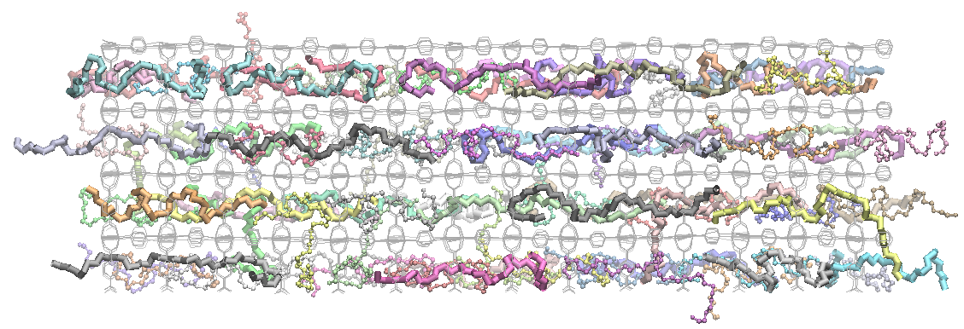
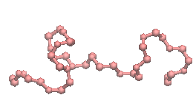
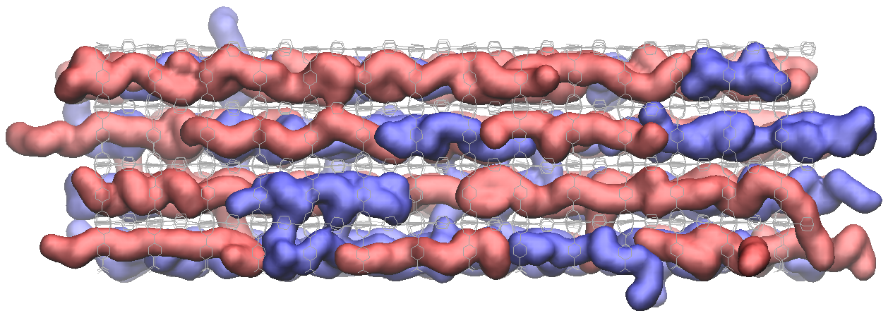
Prepare binary guest oligomer in the PCP system.
Prepare PCP framework with 40 OEG & 40 alkane C₄₃ (C₄₃H₈₈) guests
→ 1500 K MD for 5 ns to randomize guest distribution constrain PCP framework (with vdW interaction factor 0.01 & Coulomb interaction factor 0.0)
→ 700 K MD for 5 ns to randomize guest distribution constrain PCP framework (with vdW interaction factor 0.1 & Coulomb interaction factor 0.5)
→ 550 K or 373 K production MD for 25 ns
OEG
C₄₃
OEG
C₄₃
Initial snapshot of 550 K or 373 K production MD

Slide 12
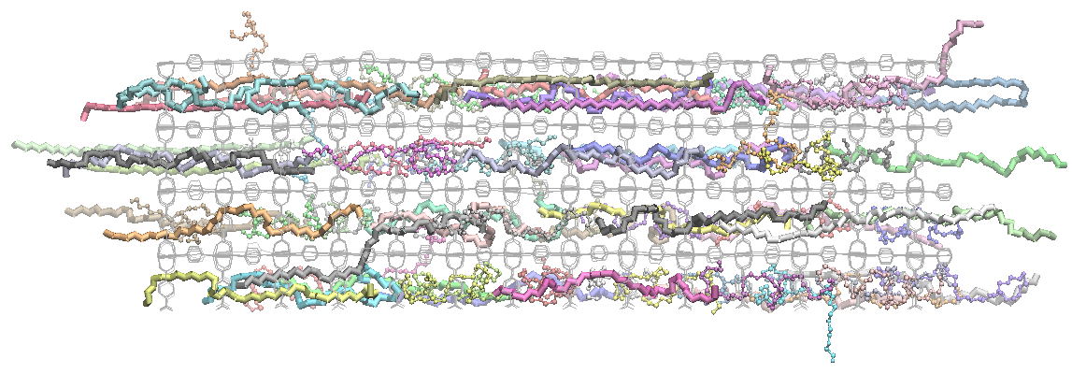
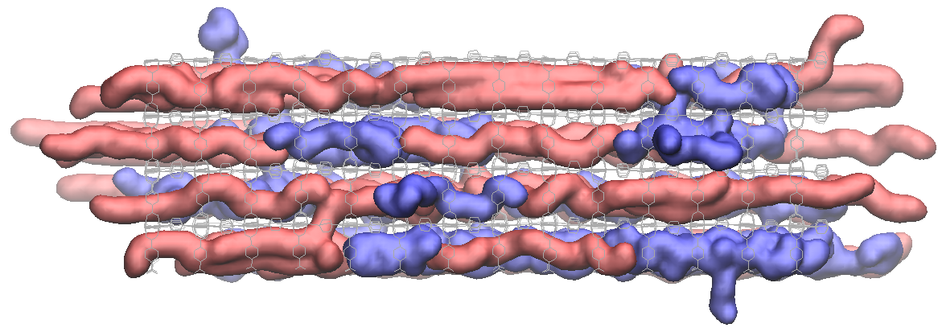
Total energy in 550 K MD
Total energy in 373 K MD
In both temperature, guest oligomer diffusion is very limited in the 25 ns time scale.
Total energy continue to decrease. → Longer MD is necessary to achieve the equilibrium state.
Structures of OEG and C₄₃ are very different.
Random-coil like OEG
Linearly extended C₄₃
→ Simple swap of two oligomers (e.g. swap the center of mass of two oligomers) is not good.
Final snapshot of 550 K MD
Final snapshot of 373 K MD

Slide 13
Future works
Improve the translation MCS especially, structural relaxation part include not only the translate molecule but also its surroudings
Add swap MCS with considering the different shape of oligomers
Check the equilibrium behavior of the MC/MD trajectory canonical distribution is achieved or not
Add radical elongation reaction MCS
Refactoring (or rebuild) the MCMD program

