Slide 1
Fri. Ja. 6th
FY2015’s 7th, CREST Workshop
Free Energetic Investigation on Sodium Ion Transport in Solid Electrolyte Interphase Film
Norio Takenaka^{1,2}
Graduate School of Information Science, Nagoya University¹,
Elements Strategy Initiative for Catalysts and Batteries (ESICB), Kyoto University²

Slide 2
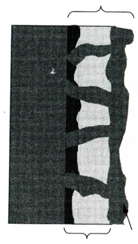
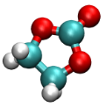
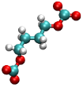


Background of present research
During the initial charging cycles, the reductive reaction products of the electrolyte form a solid electrolyte interphase (SEI) film on the anode surface.
The SEI film can protect the electrolyte from the further reduction while maintaining Na⁺ exchange. Therefore, it is closely related to the lifetime of battery.
SEI Film
Exchange
Na⁺
Reduction of electrolyte
Block
Solvent
Na-ion battery
Inorganic Salts
(e.g. Na₂CO₃)
Organic Salts
(e.g. ROCO₂Na)
S. Komaba et al., Adv. Funct. Mater, 21, 3859 (2011).

Slide 3
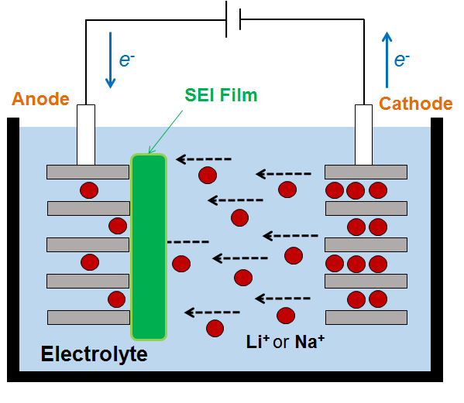
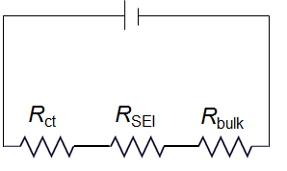
Background of present research
Among several processes of ion and electron transport, the lithium (or sodium) ion transfer at an anode/electrolyte interface is an essential process of the charge-discharge reaction of lithium (or sodium) ion batteries.
Battery resistance is typically the sum of the bulk electrolyte resistance (R_{bulk}), resistance of the SEI (R_{SEI}), and an ion transfer resistance (R_{ct}).
Resistances of ion transfer
R_{ct}: charge transfer resistance from SEI film to anode
R_{SEI}: resistance of ion transfer in SEI film
R_{bulk}: resistance of ion transfer in bulk electrolyte
Schematic illustration

Slide 4
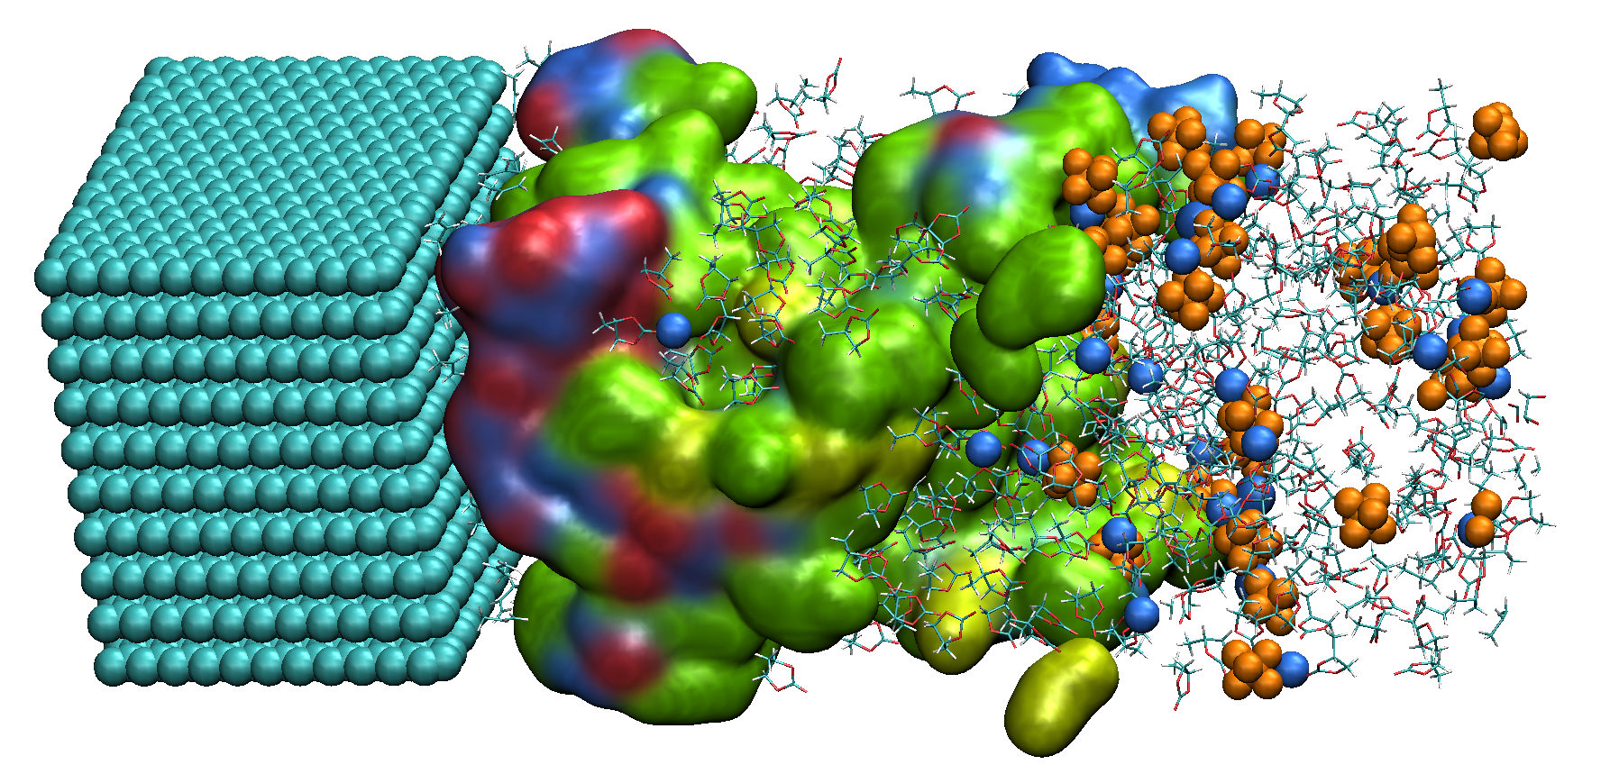
Background of present research
In the present study, the microscopic mechanism of Na⁺ transfer processes inside the SEI film has been investigated.
For this purpose, the free energy changes were calculated along the ion transfer pathway inside the SEI film obtained by the hybrid MC/MD reaction method.
Anode
SEI film
Na⁺ transfer
Schematic illustration

Slide 5
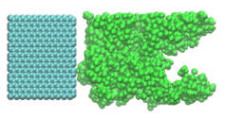
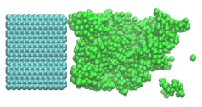
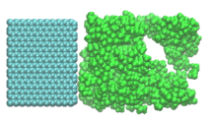
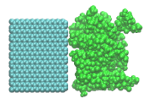
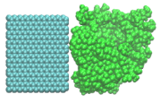
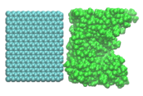
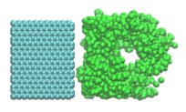
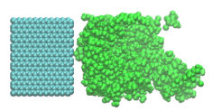
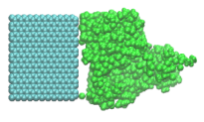
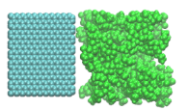

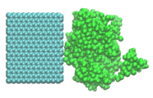
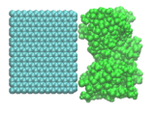
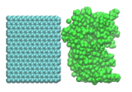
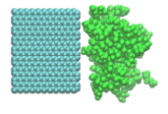
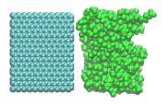
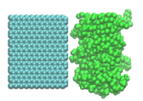
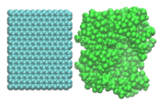
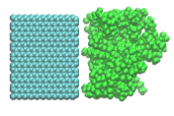
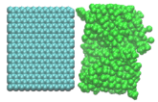
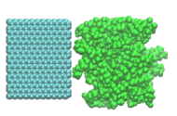
Model systems
In the present study, the calculation models of the SEI film were obtained by the hybrid MC/MD reaction method with 10 different initial configurations.
Anode
SEI film
（Electrolyte：non-display）
1 nm
x
z
(a) Calculation models of SEI film in NaPF₆ PC electrolyte（without additive）
1 nm
x
z
(b) Calculation models of SEI film in NaPF₆ PC electrolyte（with FEC）

Slide 6

Algorithm to obtain migration pathway of Na⁺
・The migration pathways were investigated by using a following procedure.
(1) First, the total system is divided to discrete grid points (grid size = 0.3 Å).
(2) Next, at each grid point, we obtain a sphere which contacts with the SEI film.
If the radius R is smaller than a van del Waals radii of Na⁺ (1.84 Å), this grid
point becomes the possible cavities for the migration pathway.
(3) Finally, we connect the cavities from the anode surface to the bulk electrolyte
to search for the migration pathways as the connective cavities.
SEI
R
Grid point

Slide 7
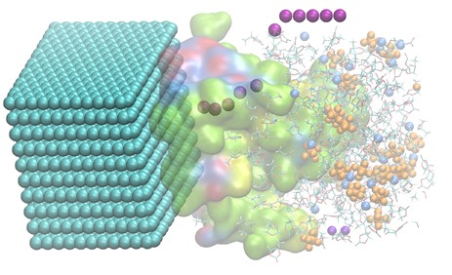
Free energy calculation method
To obtain the free energy profiles along the migration pathways of Na⁺ inside the SEI film, thermodynamic integration (TI) method was employed.
: Average force in z direction of a selected Na⁺ fixed at z = z_{k}
: interval (= 1 Å)
Purple: Pathway of selected Na⁺
Calculation condition
Simulation time: 1 ns (100 ps equilibration)
Temperature: 298 K
Anode surface charge [1]: -2.5 μC/cm²
The selected Na⁺ and SEI film were fixed.
[1] I. A. Hamad, M. A. Novotny, D. O. Wipf, P. A. Rikvold, Phys. Chem. Chem. Phys., 12, 2740 (2010).

Slide 8
Free energy profiles (FEC-free system)
The free energy profiles were analyzed by using two samples.
(Standard errors were estimated with the two-sided 95 % confidence interval.)
Free energy [kcal/mol]
Free energy [kcal/mol]
(Anode)
z [Å]
(Anode)
z [Å]
(a) Without additive (Sample 1)
(b) Without additive (Sample 2)
The free energy increased as the Na⁺ move from bulk electrolyte to anode, showing that the SEI film work as the resistance for the ion transport.
However, the shape of free energy profiles were so different depending on the pathways inside the SEI film.

Slide 9
Free energy profiles (FEC-added system)
The free energy profiles were analyzed by using two samples.
(Standard errors were estimated with the two-sided 95 % confidence interval.)
Free energy [kcal/mol]
Free energy [kcal/mol]
(Anode)
(Anode)
z [Å]
z [Å]
(a) With FEC (Sample 1)
(b) With FEC (Sample 2)
As with the FEC-free system, it is suggested by the free energy change that the migration of Na⁺ proceeds in the multistep process.
The calculated activation barriers were 14 ~ 30 kcal/mol, which are good agreement with the experimental values (12 ~ 24 kcal/mol) in LIB.

Slide 10
Mass density distribution of SEI film components
Total
Total
Inorganic salt
Inorganic salt
Organic salt
Organic salt
Mass density [g/cm³]
Mass density [g/cm³]
z [Å]
z [Å]
(b) Without additive (Sample 1)
(b) Without additive (Sample 2)
Total
Total
Inorganic salt
Inorganic salt
Mass density [g/cm³]
Organic salt
Organic salt
Mass density [g/cm³]
z [Å]
z [Å]
(c) With FEC (Sample 1)
(d) With FEC (Sample 2)
Since the SEI film components were spatially inhomogeneous, the free energy changes became stepwise inside the SEI film.

Slide 11
Contribution of electric field (FEC-free system)
The free energies were divided into the contribution of electric field (i.e., electrostatic interaction between anode and Na⁺) and other one.
Total free energy
Total free energy
Electric field
Electric field
Other
Other
Free energy [kcal/mol]
Free energy [kcal/mol]
z [Å]
z [Å]
(a) Without additive (Sample 1)
(b) Without additive (Sample 2)
It was found that the contribution from the electric field was quite large for the ion transport inside the SEI film.
Therefore, the activation barriers of ion transport is considered to be strongly affected by the strength of the electric field (or voltage).

Slide 12
Conclusion
In the present study, the transport mechanism of Na⁺ inside the SEI film was investigated near the anode surface.
According to the free energetic analyses, it was found that the SEI film acts as the resistance for the ion transport, while the electric filed enhances its migration in the charging process.
At the same time, the calculated activation barriers were good agreement with the experimental values in LIB.
However, to compare directly the calculation results with the experimental ones, more statistical data may be needed.

