Slide 1
Formation of an acyl enzyme complex; first step of CAL-B catalyzed ring-opening polymerization of β-lactam
Chantal Barberot, Yuichi Suzuki, Ikuo Kurisaki, Masataka Nagaoka
Nagaoka Laboratory, Graduate School of Information Science, Nagoya University

Slide 2
Polyamides
Polyamides are one of the most used polymers, found in several applications in industry, e.g., plastics, fibers.
Among polyamides, nylon 3 is composed of a β-alanine monomeric unit and is widely used in industry .e.g.;
the manufacturing of nano-composites¹
cosmetic²
water purification³
Nylon 6, 6
Nylon 6 or PA6
monomer unit
Nylon 3, poly(β-alanine)
¹Itagaki, T.; Komori, Y.; Sugahara, Y.; Kuroda, K. J. Mater. Chem. 2001, 11, 3291–3295.
²Grollier, J. F.; Fourcadier, C.; Courtois, M. Detergent and foaming cosmetic composition delaying the regreasing of hair. US4851154, 1989.
³Huang, S. Y.; Fisher, M. M. Water purification employing poly(beta-alanine). US4247432, 1981.

Slide 3
Poly(β-alanine) synthesis
There are several ways to synthesize poly(β-alanine)
Anionic polymerization of acrylamide in the presence of a strong base⁴.
Polymerization through group (IV) of metal alkoxides⁵.
Polycondensation of β–alanine in ionic liquid⁶.
-> lead to branched polymer
⁴Breslow, D. S.; Hulse, G. E.; Matlack, A. S. J. Am. Chem. Soc. 1957, 79, 3760–3763.
⁵Steunenberg, P.; Könst, P. M.; Scott, E. L.; Franssen, M. C. R.; Zuilhof, H.; Sanders, J. P. M. Eur. Polym. J. 2013, 49, 1773–1781.
⁶Zhang, S.; Dias Goncalves, L.; Lefebvre, H.; Tessier, M.; Rousseau, B.; Fradet, A. ACS Macro Lett. 2012, 1, 1079–1082.

Slide 4
Poly(β-alanine) synthesis
There are several ways to synthesize poly(β-alanine)
Anionic polymerization of acrylamide in the presence of a strong base⁴.
Polymerization through group (IV) metal alkoxides ⁵
Polycondensation of β–alanine in ionic liquid⁶.
Synthesic route | Reaction conditions | Yield (%) | $$\overline{DP}$$ | DPmax
1 | t-Butyl-ONa | 65
2 | No catalyzer | 74 | 10 | 24
 | Metal alkoxides = Zr(Ot-Butyl)₄ | 81 | 15 | 53
 | Metal alkoxides = Hf(Ot-Butyl)₄ | 75 | 24 | 58
3 | Ionic liquid = [MMlm]Cl | 83 | 49.5
 | Ionic liquid =[MMlm](MeO)₂PO₂ | 94 | 27.8
MMlm=1,3-dimethylimidazolium chloride
⁴Breslow, D. S.; Hulse, G. E.; Matlack, A. S. J. Am. Chem. Soc. 1957, 79, 3760–3763.
⁵Steunenberg, P.; Könst, P. M.; Scott, E. L.; Franssen, M. C. R.; Zuilhof, H.; Sanders, J. P. M. Eur. Polym. J. 2013, 49, 1773–1781.
⁶Zhang, S.; Dias Goncalves, L.; Lefebvre, H.; Tessier, M.; Rousseau, B.; Fradet, A. ACS Macro Lett. 2012, 1, 1079–1082.

Slide 5
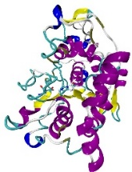
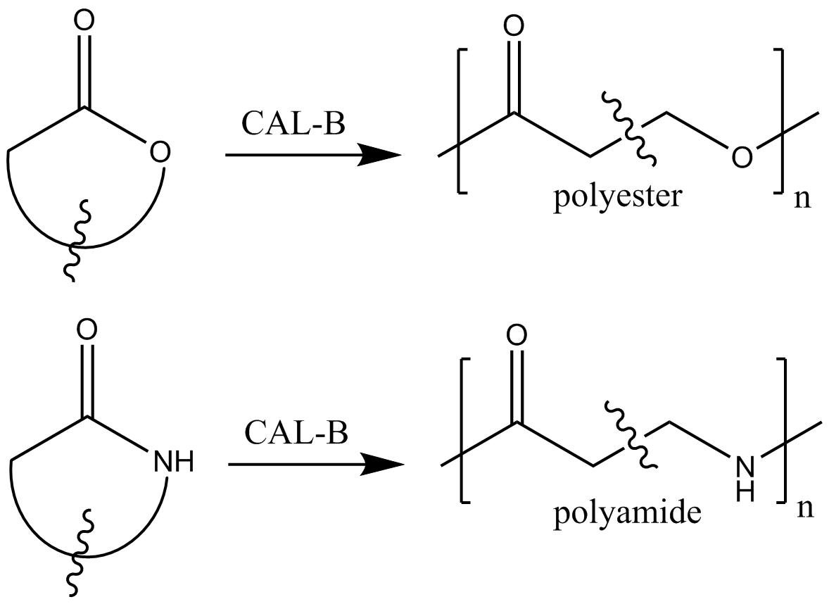
Enzymatic polymerization
During the last 20 years, enzyme-catalyzed reactions have been extensively studied in the field of green chemistry.
Candida Antartica Lipase B (CAL-B) is one of the most commonly used biocatalyst (the polymerization reaction is shown below).
In particular, this biocatalyst was employed for the formation of polyester or polyamide starting from cyclic material, i.e., ring-opening polymerization reaction.
CAL-B
Poly-acrylate resin

Slide 6
Enzymatic polymerization
It is revealed how the CAL-B catalyzes the ring-opening polymerization of β-Lactam and the length of the poly(β-alanine) chain generated⁷.
 | Reaction conditions | Yield (%) |  | DPmax
Entry 1 |  | 65
Entry 2 | No catalyzer | 74 | 10 | 24
 | Metal alkoxides = Zr(Ot-Butyl)₄ | 81 | 15 | 53
 | Metal alkoxides = Hf(Ot-Butyl)₄ | 75 | 24 | 58
Entry 3 | Ionic liquid = [MMlm]Cl | 83 | 49.5
 | Ionic liquid =[MMlm](MeO)₂PO₂ | 94 | 27.8
Entry 4 | CAL-B | 73 | 8 | 18
MMlm=1,3-dimethylimidazolium chloride
⁷K. Loos et al. Macromol Rapid. Commun. 2008, 29, 794-797

Slide 7
Enzymatic polymerization limitation
According to the earlier study, there are two possible explanations for the low reaction rate.
Under dried condition, water molecules are present in the reaction mixture. These water molecules can often hydrolyzed the acyl enzyme complex to release a short polymer chain⁸.
The reduced solubility of the poly(β-lactam) to toluene leads to the aggregation of the CAL-B and the polymer produced, thus forming an insoluble complex⁹.
To verify these two hypotheses, we address to simulate the polymerization reaction by using the hybrid MC/MD reaction method¹⁰. Insights obtained would lead to optimization of the reaction process.
⁸Mei, Y.; Kumar, A.; Gross, R. A. Macromolecules 2002, 35, 5444–5448.
⁹Stavila, E.; Alberda van Ekenstein, G. O. R.; Woortman, A. J. J.; Loos, K. Biomacromolecules 2014, 15, 234–241.
¹⁰M. Nagaoka et al. Chem. Phys. Letters 2013, 583, 80-86.

Slide 8
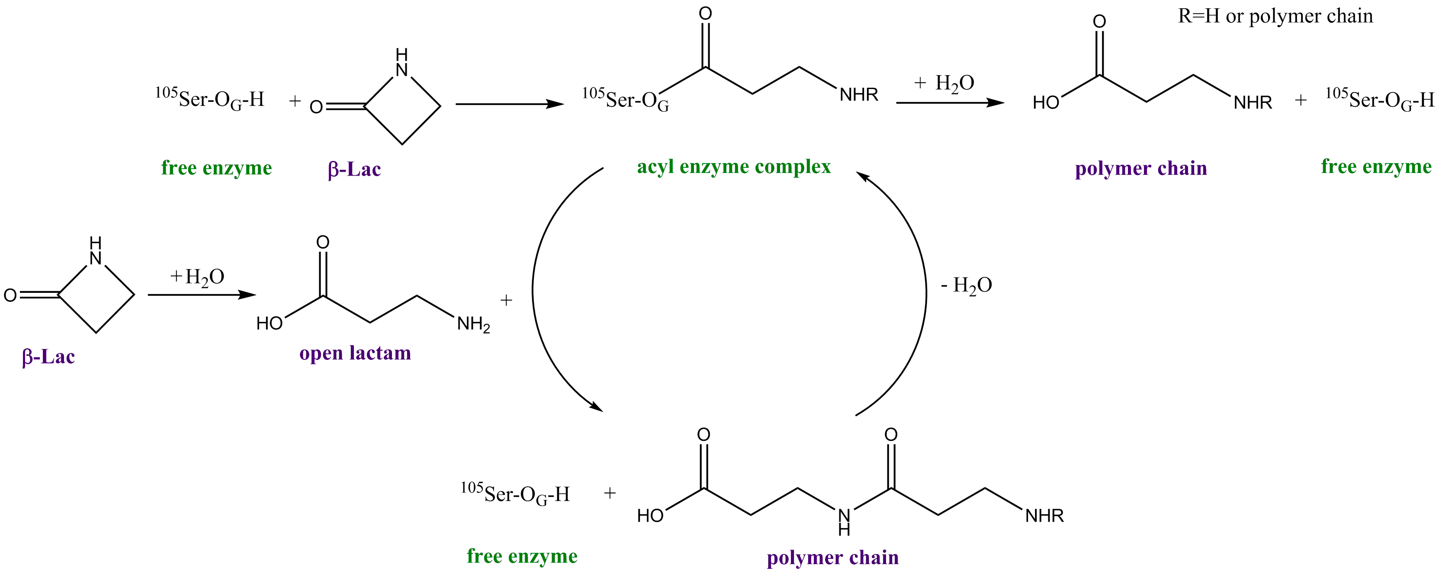
Reaction scheme of the polymerization reaction
Hybrid MC/MD simulations are performed using the following reaction scheme. ¹¹
However, the earlier study did not report activation energies of the reaction.⁵ So, we have to determine them using QM calculations.
Formation of an acyl complex
Release of the polymer chain
Active site
Elongation of the polymer chain
Formation of an acyl complex
In situ β–lactam ring opening
¹¹G. Fels et al. ACS Catal. 2011, 1, 323-336

Slide 9
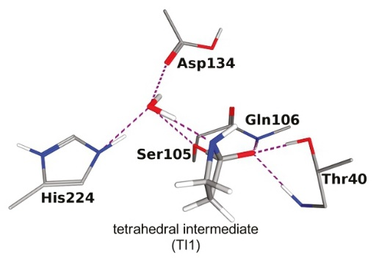
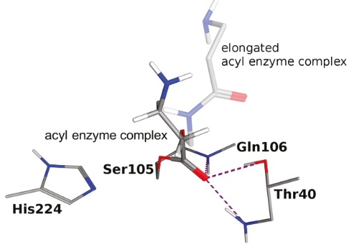
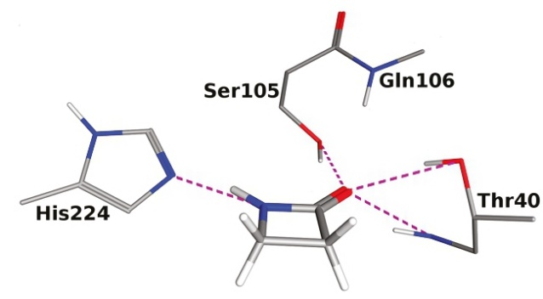
Reproducibility of the results (1)
The formation of the acyl enzyme complex is a two-steps reaction.
free enzyme and β-lactam molecule
tetrahedral intermediate
acyl enzyme complex
 | Relative electronic energy (kcal.mol⁻¹) B3LYP/6-31G(d,p)
 | Gas phase
(1) RC (Free enzyme) | 0.00
(2) TS1 | 26.43
(3) TI | 18.62
(4) TS2 | 26.06
(5) PC (Acyl enzyme complex) | -0.96

Slide 10
Reproducibility of the results (2)
MD
The snapshot structures used show difference in the energetic profile.
•
•
•
•
•
pick-up a snapshot structure and minimized by MM
extract the active site
QM calculation in gas phase
 | Relative electronic energy (kcal.mol⁻¹) B3LYP/6-31G(d,p)
snapshot | 1 | 2 | 3 | 4 | 5
(1) RC (Free enzyme) | 0.00 | 0.00 | 0.00 | 0.00 | 0.00
(2) TS1 | 26.43 | 21.76 | 20.98 | 20.79 | 24.16
(3) TI | 18.62 | 14.33 | 12.21 | 12.52 | 16.98
Relative electronic activation energy:
22.82 ± 2.42 kcal.mol⁻¹

Slide 11
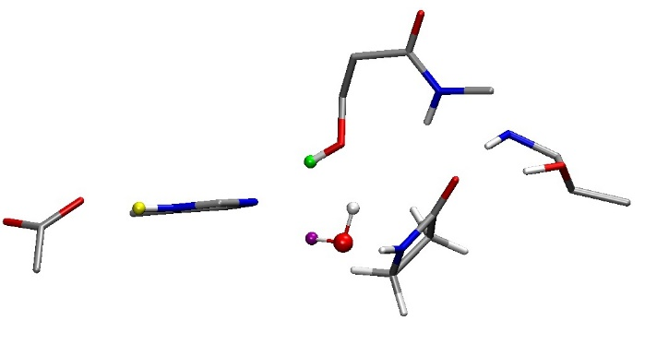
Reproducibility of the results (3)
The activation energy shows dependency on the distance between the lactam carbonyl and the serine residue.
snapshot | Electronic activation energy (kcal.mol⁻¹) B3LYP/6-31G(d,p)
1 | 26.43
2 | 21.76
3 | 20.98
4 | 20.79
5 | 24.16
 | Distance lactam carbonyl – Oxyanion hole (Å)
snapshot | O(Lac) – NH (¹⁰⁶Gln) | O(Lac) – NH (⁴⁰Thr) | O(Lac) – OH (⁴⁰Thr)
1 | 2.41 | 1.96 | 1.94
2 | 2.50 | 1.98 | 1.94
3 | 2.47 | 1.92 | 1.95
4 | 2.13 | 1.99 | 1.91
5 | 3.47 | 1.89 | 1.93
 | Distance (Å)
snapshot | CO(Lac) – NH (¹⁰⁵Ser) | N(²²⁴His) – HO (¹⁰⁵Ser) | NH(²²⁴His) – O(¹⁸⁸Asp)
1 | 3.69 | 1.86 | 1.58
2 | 3.44 | 1.70 | 1.47
3 | 3.61 | 1.86 | 1.56
4 | 3.06 | 1.63 | 1.50
5 | 3.78 | 1.62 | 1.08
¹⁰⁵Ser
¹⁰⁶Gln
⁴⁰Thr
²²⁴His
Wat
Oxyanion hole
¹⁸⁷Asp
β-lac

Slide 12
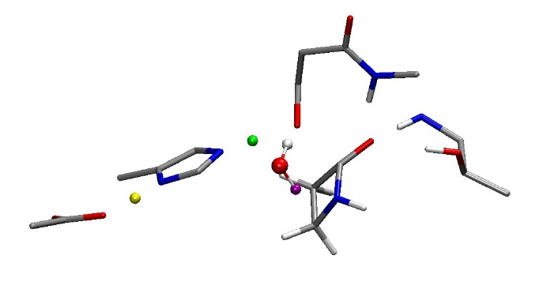
Reproducibility of the results (4)
It is possible to say that the structures of the transition state are similar among these five simulations.
 | Distance lactam carbonyl – Oxyanion hole (Å)
snapshot | O(Lac) – NH (¹⁰⁶Gln) | O(Lac) – NH (⁴⁰Thr) | O(Lac) – OH (⁴⁰Thr)
1 | 1.97 | 1.96 | 1.82
2 | 2.23 | 1.92 | 1.83
3 | 1.96 | 1.95 | 1.79
4 | 1.94 | 1.95 | 1.81
5 | 2.07 | 1.95 | 1.88
¹⁰⁵Ser
¹⁰⁶Gln
²²⁴His
⁴⁰Thr
Wat
¹⁸⁷Asp
β-lac
Oxyanion hole
 | Distance (Å)
snapshot | C(Lac) – NH (¹⁰⁵Ser) | O (¹⁰⁵Ser) – H (¹⁰⁵Ser) | N(²²⁴His) – H (¹⁰⁵Ser) | N(²²⁴His) – H(²²⁴His) | H(²²⁴His) – O(¹⁸⁸Asp)
1 | 2.05 | 1.54 | 1.08 | 1.50 | 1.07
2 | 1.97 | 1.57 | 1.07 | 1.57 | 1.05
3 | 2.08 | 1.55 | 1.08 | 1.53 | 1.06
4 | 2.04 | 1.58 | 1.07 | 1.48 | 1.07
5 | 2.06 | 1.63 | 1.07 | 1.58 | 1.04

Slide 13
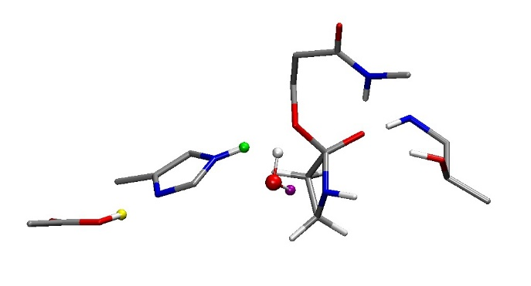
Reproducibility of the results (5)
Also, the structures of tetrahedral intermediate are similar among the five simulations.
The structure of the reactant is possibly attributed to difference in energy value.
 | Distance lactam carbonyl – Oxyanion hole (Å)
snapshot | O(Lac) – NH (¹⁰⁶Gln) | O(Lac) – NH (⁴⁰Thr) | O(Lac) – OH (⁴⁰Thr)
1 | 1.72 | 1.85 | 1.74
2 | 1.75 | 1.86 | 1.74
3 | 1.75 | 1.83 | 1.70
4 | 1.74 | 1.84 | 1.73
5 | 1.73 | 1.86 | 1.75
¹⁰⁶Gln
¹⁰⁵Ser
²²⁴His
⁴⁰Thr
Wat
Oxyanion hole
¹⁸⁷Asp
β-lac
 | Distance (Å)
snapshot | O (Wat) – HN(Lac) | O (¹⁰⁵Ser) – HN(²²⁴His) | N(²²⁴His) – HO(¹⁸⁸Asp)
1 | 1.89 | 1.79 | 1.55
2 | 1.90 | 1.77 | 1.57
3 | 1.96 | 1.89 | 1.58
4 | 1.86 | 1.86 | 1.56
5 | 1.84 | 1.83 | 1.60
 | Distance (Å)
snapshot | C(Lac)-O(Lac) | C(Lac)-N(Lac)
1 | 1.32 | 1.50
2 | 1.32 | 1.51
3 | 1.32 | 1.51
4 | 1.32 | 1.50
5 | 1.32 | 1.52

Slide 14
Formation of an acyl enzyme: energetic profile
The formation of the acyl enzyme complex is a two-steps reaction.
free enzyme and β-lactam molecule
tetrahedral intermediate
acyl enzyme complex
 | Relative electronic energy (kcal.mol⁻¹) B3LYP/6-31G(d,p)
 | Gas phase | PCM (ε=4)* | Protein Field (AG-IF) *
(1) RC (Free enzyme) | 0.00 | 0.00 | 0.00
(2) TS1 | 26.43 | 25.14 | 15.00
(3) TI | 18.62 | 18.63 | 9.84
(4) TS2 | 26.06 | 26.98 | 25.76
(5) PC (Acyl enzyme complex) | -0.96 | -3.58 | 17.48
* Each structure is optimized in gas phase using the B3LYP/6-31G(d,p) in gas phase

Slide 15
Strategy to optimize a transition state
Generally, it is difficult to energetically optimize a transition state using standard QM/MM methods.
To circumvent the difficulty, micro-iterative procedure is often employed^{12,13}.
This procedure consists of a cycle of QM and MM optimizations.
Minimization the MM part by keeping the QM part frozen.
Minimization the QM part by keeping the MM part frozen.
Continue step (1) and (2) until convergence
MM part
Minimization of QM part
Minimization of MM part
QM part
¹²Vreven, T.; Frisch, M. J.; Kudin, K. N.; Schlegel, H. B.; Morokuma, K. Mol Phys 2006, 104, 701–714.
¹³Zhang, Y.; Liu, H.; Yang, W. J. Chem. Phys. 2000, 112, 3483–3492.

Slide 16
Strategy to optimize a transition state
Only a small part of the system (core), which is associated with the reaction, is treated by QM calculation. The rest of the degrees of freedom (environment) is frozen in the transition state optimization¹⁴.
The environment is minimized using MM calculation (e.g., conjugate gradient method) keeping the core frozen. AG-IF interface is employed.
Transition state structure is searched using Rational Function Optimization, where only the atoms in the core are allowed to move using Gaussian09. This process is carried out until the default G09 convergence criteriaª.
If it is not converged, returns to point 1.
MM part
Core zone
TS search in core
Minimization of Environment
QM part
ªMaximum gradient less than 0.00045 a.u., rms gradient less than 0.00030 a. u., maximum displacement less than 0.0018 a.u., rmsd displacement less than 0.0012 a.u..
¹⁴Prat-Resina, X.; González-Lafont, À.; Lluch, J. M. J. Mol. Struct. THEOCHEM 2003, 632, 297–307.

Slide 17
Definition of the core zone
During the QM calculations, the atoms involved in the imaginary frequency will be considered in the core zone.
TS1
TS2
core zone

Slide 18
Results (1)
We can observe that the product and the tetrahedral intermediate shows further stabilization by the interaction with protein environment.
 | Relative electronic energy (kcal.mol⁻¹) B3LYP/6-31G(d, p)
 | Gas phase | Protein Field (AG-IF)
 |  | Protein Field (AG-IF) (Single point calculation) | After a complete optimization of the 10 Å around the QM part
(1) RC (Free enzyme) | 0.00 | 0.00 | 0.00
(2) TS1 | 27.81 | 15.00 | *
(3) TI | 18.64 | 9.84 | 0.40
(4) TS2 | 26.49 | 25.76 | *
(5) PC (Acyl enzyme complex) | -2.58 | 17.48 | -10.60
*not converged

Slide 19
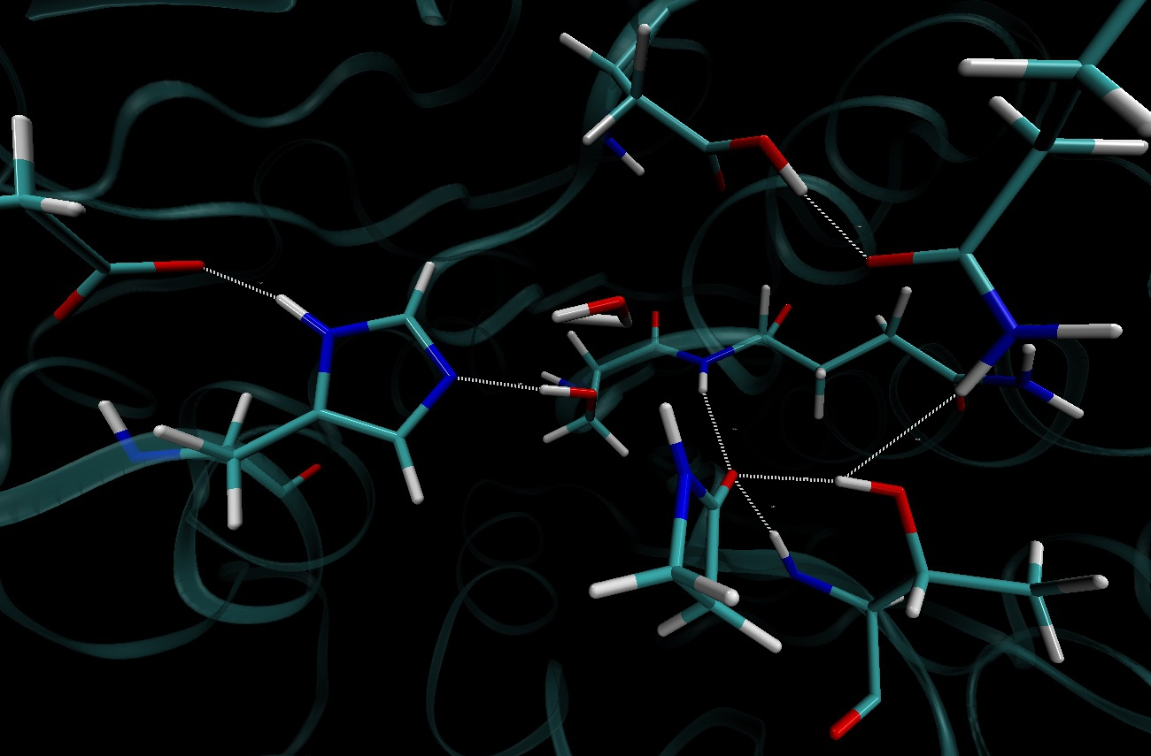
Results (2)
Reactant structure:
¹³⁴Asp
¹⁸⁷Asp
1.71 (1.58)
¹⁵⁸Gln
¹⁰⁶Gln
1.81 (1.86)
2.34 (2.41)
¹⁰⁵Ser
1.85 (1.94)
²²⁴His
1.91 (1.97)
⁴⁰Thr
β-lac
CO(β-lac)-O(¹⁰⁵Ser): 3.23 (3.69)
The distances are reported in Å. The QM/MM optimization results are reported first. In parenthesis, the QM optimization results are reported.

Slide 20
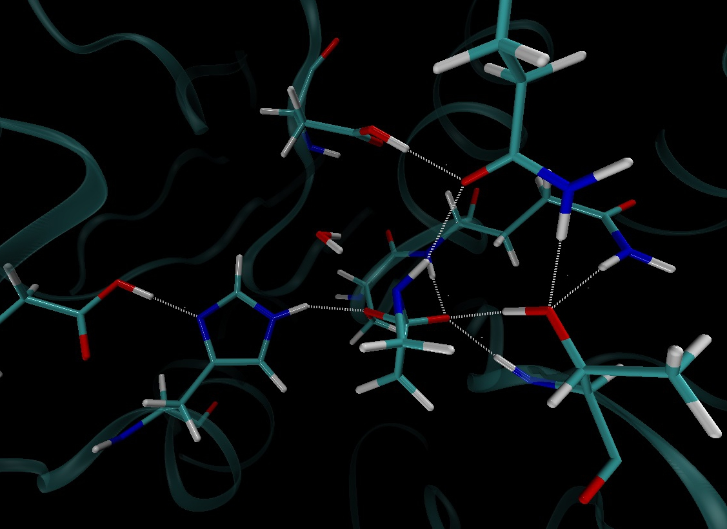
Results (3)
Tetrahedral intermediate structure:
¹³⁴Asp
¹⁵⁸Gln
 | Relative electronic energy B3LYP/6-31G(d, p)
(1) RC | 0.00 kcal.mol⁻
(3) TI | 0.40 kcal.mol⁻
(5) PC | -10.60 kcal.mol⁻
¹⁰⁵Ser
¹⁰⁶Gln
¹⁸⁷Asp
1.63 (1.55)
1.75 (1.72)
1.90 (1.79)
1.76 (1.74)
1.76 (1.85)
²²⁴His
β-lac
⁴⁰Thr
The distances are reported in Å.

Slide 21
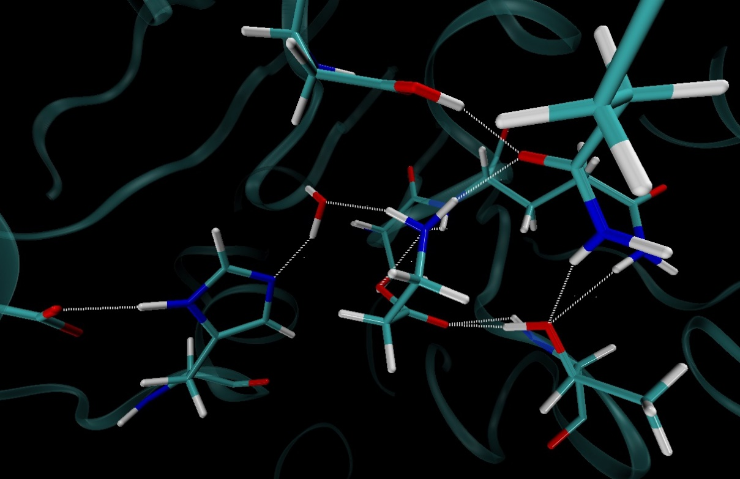
Results (4)
Product structure:
¹³⁴Asp
¹⁵⁸Gln
¹⁰⁵Ser
1.81 (2.13)
 | Relative electronic energy B3LYP/6-31G(d, p)
(1) RC | 0.00 kcal.mol⁻
(3) TI | 0.40 kcal.mol⁻
(5) PC | -10.60 kcal.mol⁻
1.80 (1.82)
¹⁰⁶Gln
¹⁸⁷Asp
1.62 (1.60)
2.26 (2.17)
β-lac
1.85 (1.95)
²²⁴His
⁴⁰Thr
The distances are reported in Å.

Slide 22
Conclusion
The energetic profile of the reaction is similar among the five simulations.
The structural difference is mainly attributed to the reactant.
The transition states are similar among the five simulations.
The tetrahedral intermediate states are similar among the five simulations.
When the protein structure is taken into account, the tetrahedral intermediate and the product structures are energetically stabilized. This might be due to the interactions with the protein environment.
After we complete this QM/MM simulations, We will perform similar simulations for the other steps of CAL-B catalyzed ring-opening polymerization of the β–lactam.
Perspectives

Slide 23
Thank you for your attention

