Slide 1
FY2016 3rd CREST WS
Jun. 29, 2016
Analyzing trajectories of MC/MD simulations for CALB polymerization reaction
Ikuo KURISAKI

Slide 2
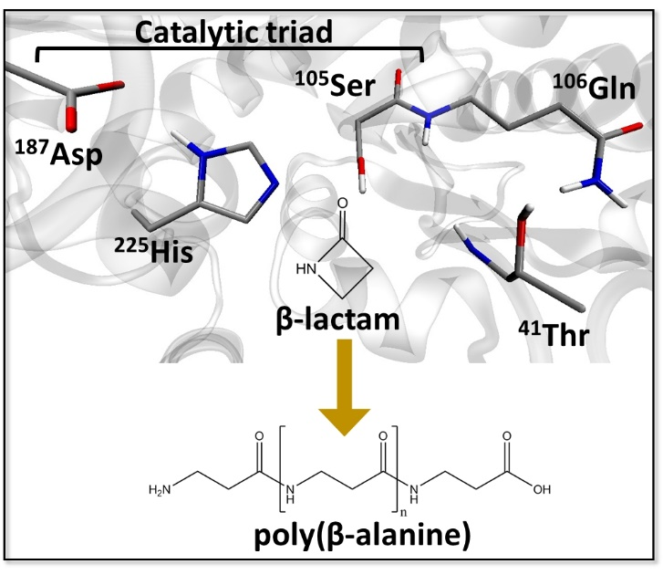
Research background
Enzyme catalyzed polymerization reaction has drawn attention in the field of green chemistry
Candida Antarica Lipase B (CALB) has long been studied in this purpose
This enzyme catalyzes polymerization of β-lactam to generate poly(β-alanine), nylon-3
However, this reaction system has rooms to be improved because the product do not satisfy industrial quality, as for the length and yield
From FY2015 4th CREST WS
The illustration is gifted from Dr. Barberot.

Slide 3
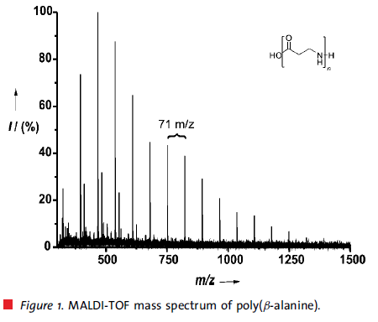
Research background
Degree of polymerization (DP) is insufficient for industrial usage
6-mer
CALB catalyzed poly(β-alanine) synthesis:
Average DP: 8 mer; Maximum DP: 18 mer
Conventional methods:
Average DP: 24 mer; Maximum DP: 58 mer
➔ Polymer generated by using CALB is still shorter by three times.
Toward the industrial usage of CALB
Optimizing reaction condition
Redesigning CALB as biocatalyst
are indispensable.
Insights into the reaction mechanism would provide strategies to address the problems.
8-mer (average)
18-mer (maximum)
Ref. Schwab L. et al., Macromol. Rapid Commun., 2008, 29, 794-797:

Slide 4
Problem setting
Polymer length must influence polymer elongation reaction. We first examined conformation of the polymer.
CALB
water
Ser¹⁰⁵-OH
Ser¹⁰⁵-O
Poly(β-alanine)
β-lactam
Poly(β-alanine)₈
From FY2015 4th CREST WS
with modification
Cα
N
O
ACE
NME
H
Cβ
8
O

Slide 5
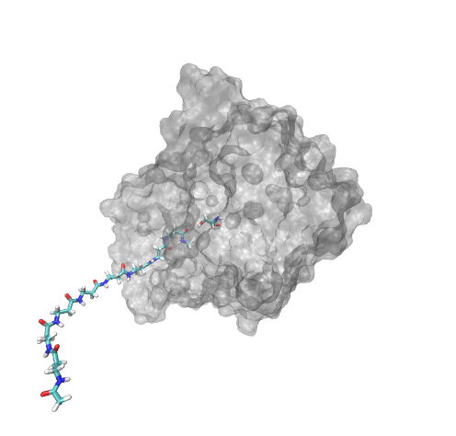
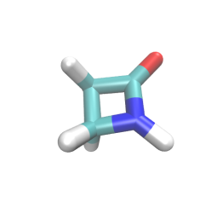
Molecular Dynamics Simulation of CALB-poly(β-alanine)₈ complex
Poly(β-alanine)₈
Initial atomic coordinates of the complex
Cα
N
O
ACE
NME
Ser105
H
Cβ
8
O
β-lactam
Average DP length
Three β-alanine residues are found in the active site.
MD simulation setup
Force Field: Amber99SB, TIP3P, JC ions for TIP3P, GAFF
Solvent: Toluene
Ensemble: NPT (1 bar; 363 K)
Simulation length: 50 ns
Total number of simulations: 5
poly(β-alanine)₈
From FY2016 1st CREST WS
with modification

Slide 6
Set poly(β-alanine)₈ manually
CALB
Poly(β-alanine)₈
Ser¹⁰⁵-OH
Pulling to the active site pocket
Ser¹⁰⁵-OH
Relaxing under thermal fluctuation
Ser¹⁰⁵-OH

Slide 7
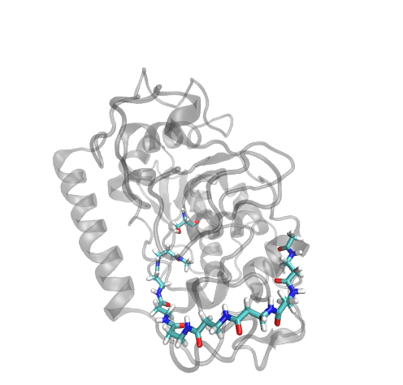
Suggestion on effect of polymer on the following elongation process (1)
Ser105
Only 3 β-alanine residues can stay inside the active site
The polymer is not packed in the active site, which would allow β-lactam to access Ser105.
Meanwhile, the polymer would be interact with the surface of CALB, or it might be released.
From FY2016 1st CREST WS
with modification

Slide 8
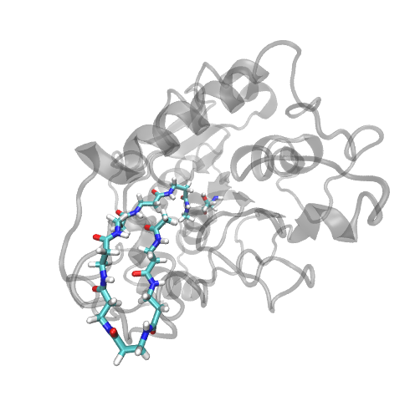
Suggestion on effect of polymer on the following elongation process (2)
Poly(β-alanine)₈ assumes folded conformations and sometime leaves from the active site
Folding should prevent β-lactam access to the active site and also polymerization reaction itself.
If such folding could be blocked, it would promote β-lactam access and CALB-polymer interaction, enhancing the reaction, accordingly
Ser105
From FY2016 1st CREST WS
with modification

Slide 9
Reply to the problem setting
Polymer elongation itself would not completely prevent β-lactam and a water molecule access to the active site.
Instead, assuming folded conformation would prevent β-lactam and a water molecule from entering the active site.
Question
The above insights are provided from conventional MD simulation, where polymer elongation process is not treated explicitly.
For example, is it possible that β-lactam enters the active site after polymer is generated?
To answer the question, we analyze MD/MD trajectories.

Slide 10
Today’s Contents
Analyze MC/MD trajectories
The trajectory with hexamer formation
The other 6 trajectories

Slide 11
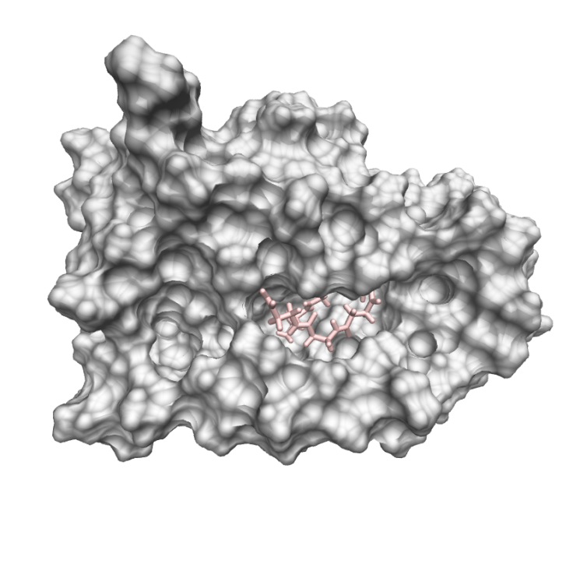
Where is the hexamer found?
Ser105 behind the surface
1652th cycle
N-terminal
Snapshot structure at the 1652th cycle
The N-terminal of the hexamer is found near the catalytic Ser105.
The hexamer is packed in the active site pocket.

Slide 12
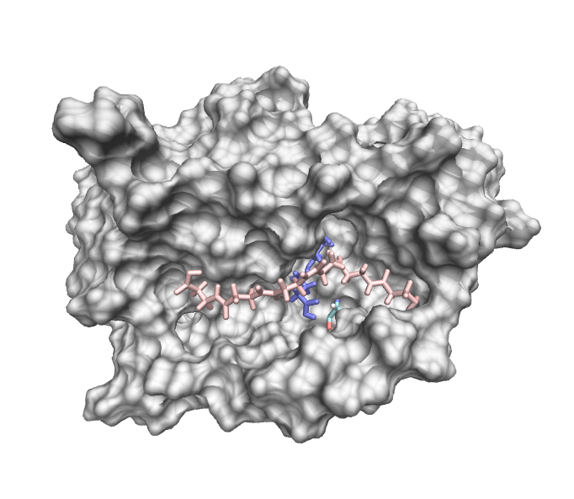
Would the hexamer continue to elongate?
Ser105 behind the surface
15 Å
2916th cycle
N-terminal
Snapshot structure at the last cycle
The N-terminal of the hexamer is distant by 15 Å from Ser105. It suggests that the polymer would not elongate if the N-terminal does not come back to the vicinity of Ser105.
Two monomers, colored in blue, are found around Ser105.

Slide 13
Why does polymer elongation stop and result in short polymer generation in MC/MD simulation?
N-terminal of polymer leaves from the active site pocket
As a polymer is extended, it could interact with interface of CALB on multiple sites.
That would make the N-terminal away from the active site pocket.

Slide 14
The snapshot structure provides the following observations:
Even after hexamer formation, β-lactam can still enter the active site, then being converted into β-alanine.
(In other words, polymer elongation does not necessarily block β-lactam to enter the active site, which is predicted from the previous MD simulations.)
Hexamer is attached to the active site pocket, not the outside.
(This is new observation from MC/MD simulations. 3 or more β-alanine residues can stay in the active site pocket.)
We give further discussion for the second point. The point is how hexamer stays in the active site pocket.

Slide 15
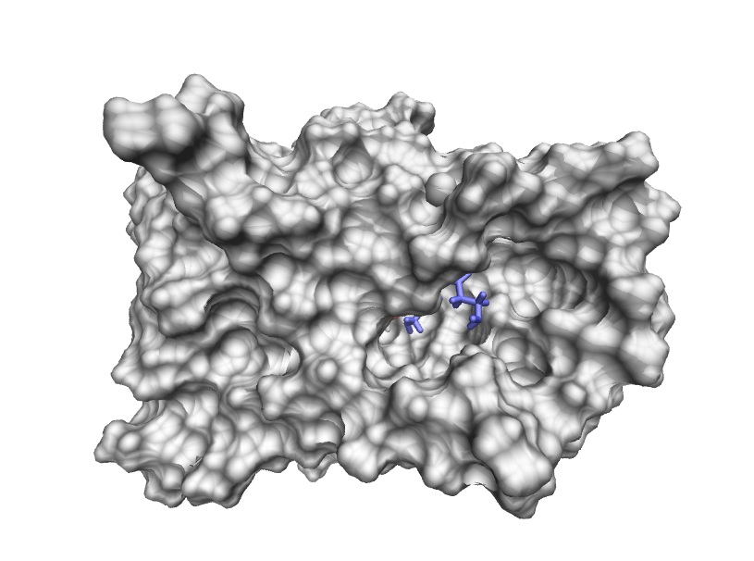
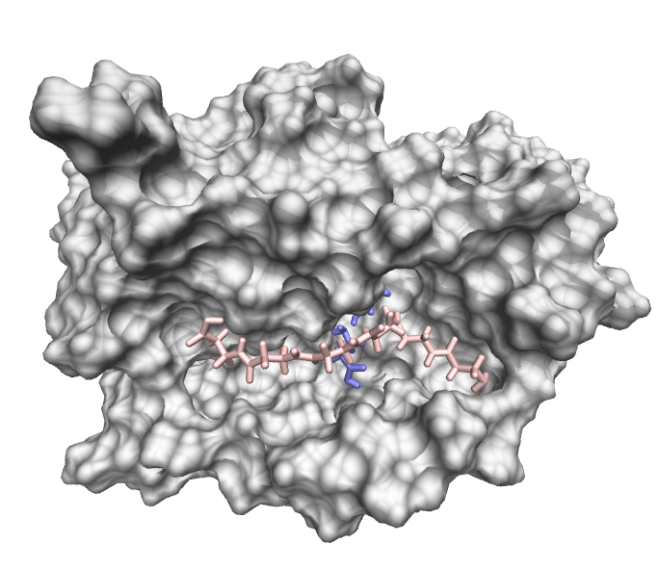
Active site pocket is connected with the others through polymer elongation
The left and right pockets are connected. A part of the polymer is located at the left pocket
The left and right pockets are separated by this part
Snapshot structure at the initial cycle
Snapshot structure at the last cycle
The hexamer lies on the pockets

Slide 16
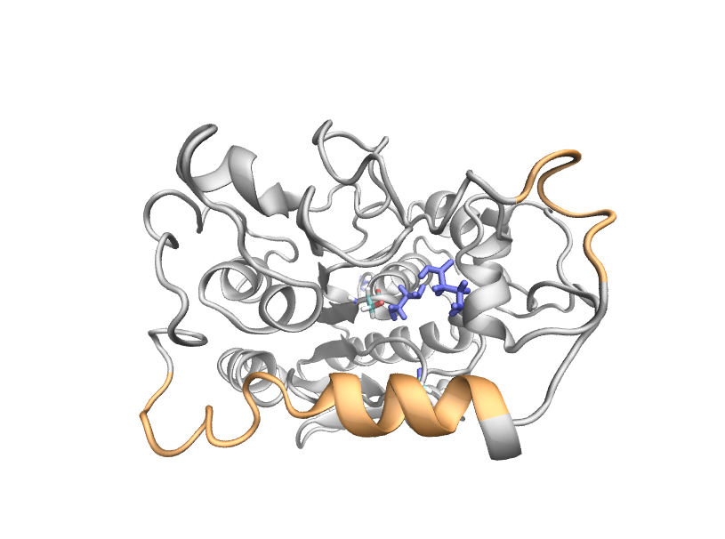
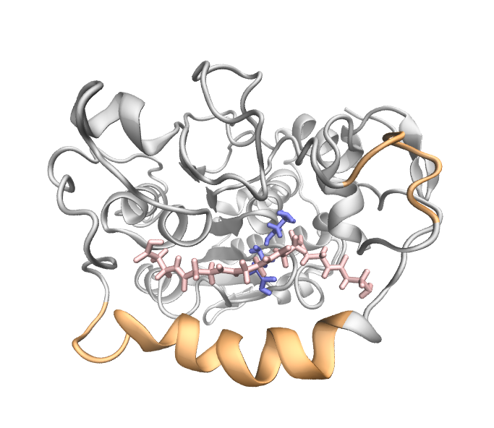
The a10 helix shifts downward through polymer elongation
an alternative helix
α5 helix
α10 helix
Snapshot structure at the initial cycle
Snapshot structure at the last cycle

Slide 17
Is this deformation advantageous in polymer elongation or not?
If we obtain an alternative hexamer formation trajectory, we could answer the question

Slide 18
Results of the six MC/MD simulations
annotation | the number of MC/MD cycle | polymer length (the number)
Traj-A | 2986 | 1-mer (2), 5-mer (1)
Traj-B | 4000 | 1-mer (1), 2-mer (1), 3-mer (2)
Traj-C | 3367 | 1-mer (3), 3-mer (1)
Traj-D | 8000 | 1-mer (2), 2-mer (1)
Traj-E | 4293 | 1-mer (3)
Traj-F | 2244 | 1-mer (2)
Hexamer did not appear so far. Pentarmer is the longest among the 6 MC/MD trajectories.

Slide 19
2425th cycle
Longer simulations does not necessarily result in longer polymer.
(Traj-D and traj-E are extended by 8000 and 4293 cycles, but they did not show even trimer formation.)

Slide 20
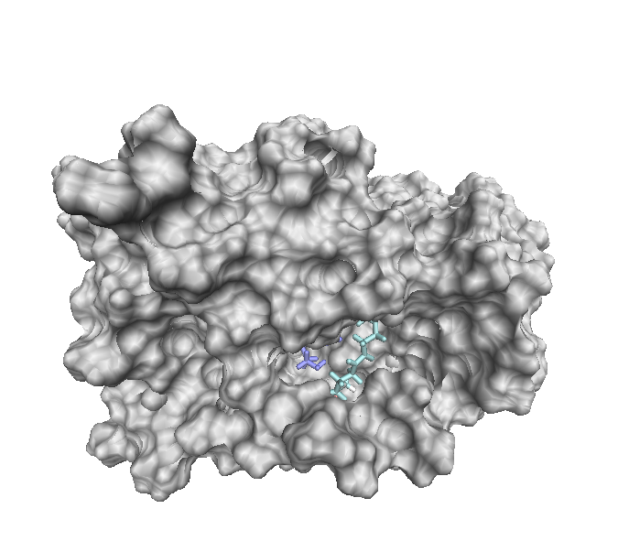
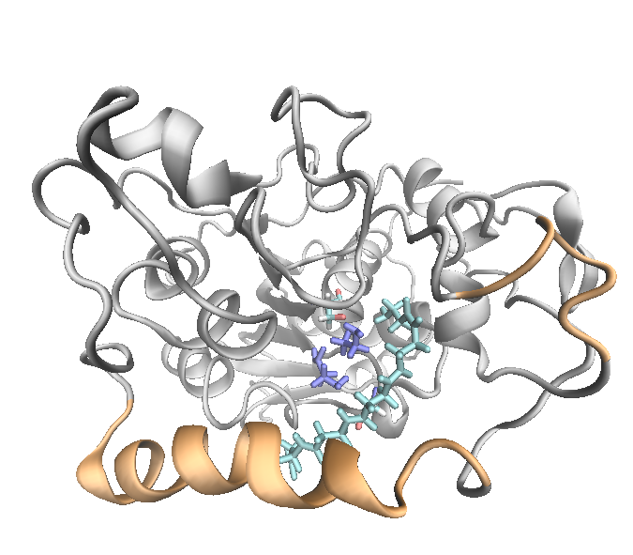
The a10 helix shifts downward through polymer elongation, but pentamer does not lie between pocket.
Snapshot structures at the last cycle: surface (left) and cartoon (right)

Slide 21
Is it possible that polymer elongation still continue?
Possibly, because the N-terminal is close to Ser105 by ca 4 Å.
It is worth extending the trajectory.
Ser105 behind the surface
Polymer elongation would stop similarly to the case of hexamer.
4 Å
N-terminal

Slide 22
How about Traj-B, where two trimers are generated?
annotation | the number of MC/MD cycle | polymer length (the number)
Traj-A | 2986 | 1-mer (2), 5-mer (1)
Traj-B | 4000 | 1-mer (1), 2-mer (1), 3-mer (2)
Traj-C | 3367 | 1-mer (3), 3-mer (1)
Traj-D | 8000 | 1-mer (2), 2-mer (1)
Traj-E | 4293 | 1-mer (3)
Traj-F | 2244 | 1-mer (2)
The number of β-alanine residue is similar to the case of pentamer. Is the active site pocket deformed similarly?

Slide 23
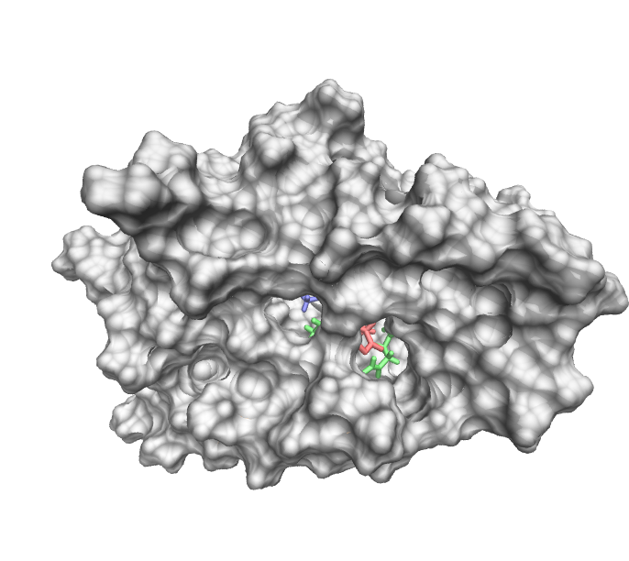
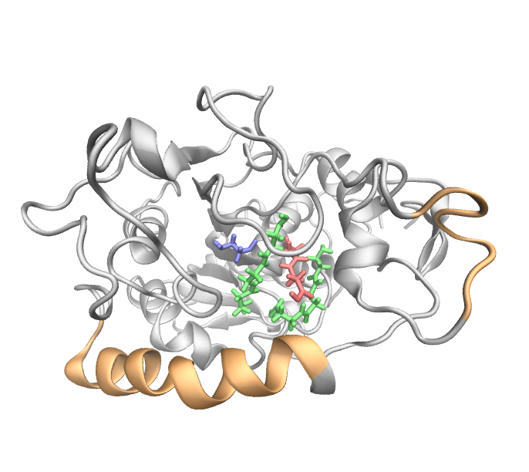
The α10 helix covers the active site pocket
Snapshot structures at the last cycle
Polymers (3-mer x 2; 2-mer x 1; 1-mer x 1) are packed inside the active site pocket.
The N-terminals of these trimer are distant from Ser105, so that elongation reaction would not occur.

Slide 24
We observed the three MC/MD trajectories focusing on shape of the active site pocket.
The active site pocket can be deformed through polymer elongation process.
However, it remains elusive how such deformation affect polymer elongation: we need further investigation with additional trajectories.

Slide 25
The next 2 months
Extend the pentamer trajectory and examine whether the polymer elongation occurs
With no regard to hexamer formation, the simulation would provide observation for how polymer elongation is stopped.
Continue to analyze these MC/MD trajectories focusing on reactions chosen during simulations
This might provide alternative insights into shorter polymer generation.
Try to get insights into the role of α10 helix for polymer elongation
Although this is optional, it is expected that we find a strategy to improve short polymer generation by modifying the active site pocket

Slide 26
Thank you for your attention

Slide 27
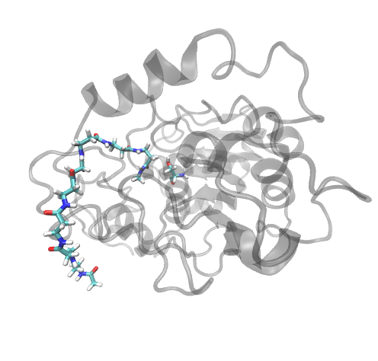
Poly(β-alanine)₈ interacts with CALB on the surface
Ser105
Ser105
➔ These interactions could anchor the polymer on the surface, thus preventing it from releasing to the solvent
From FY2016 1st CREST WS
with modification

Slide 28
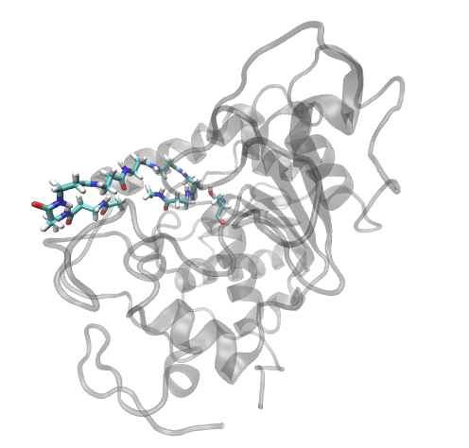
Poly(β-alanine)₈ assumes hairpin conformation, where the active site is occupied by the polymer
Ser105
Ser105
➔ It prevents β-lactam from accessing the active site
From FY2016 1st CREST WS
with modification

Slide 29
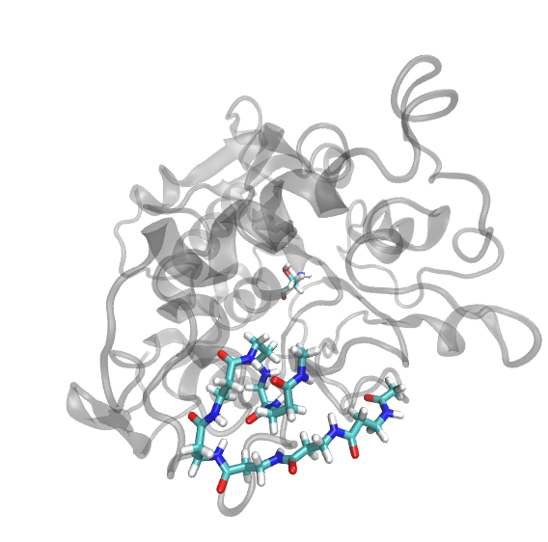
Poly(β-alanine)₈ assumes hairpin conformation and interacts with CALB surface
Ser105
➔ It prevents β-lactam from accessing the active site
From FY2016 1st CREST WS
with modification

Slide 30
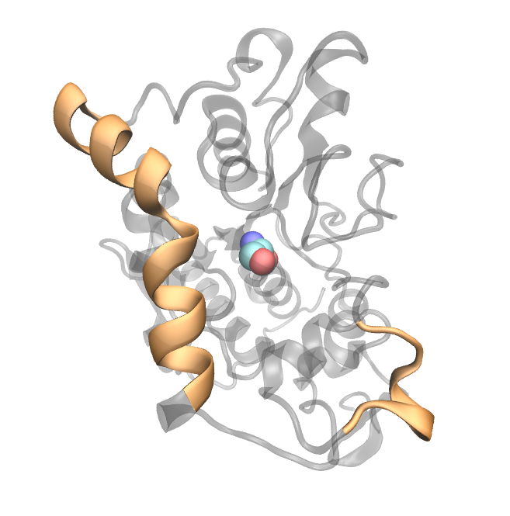
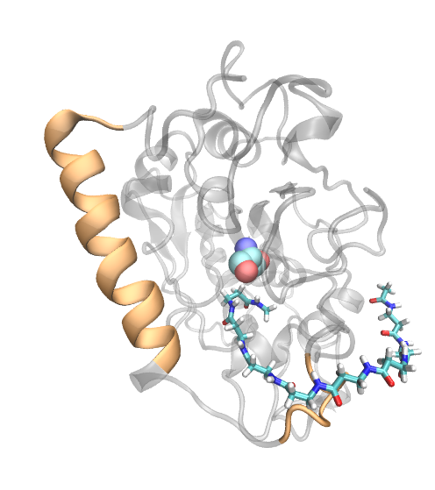
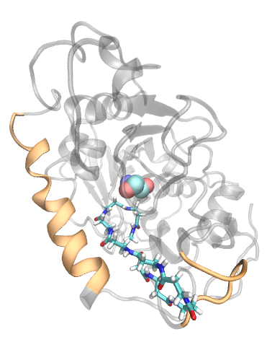
α5 helix interacts with poly(β-alanine)
From FY2016 1st CREST WS
with modification
α5 helix: ¹⁴²GPLDALA¹⁴⁸
α10 helix
The polymer is unfolded and occupies the active site
Ser105
The polymer interacts with CALB’s surface
α5 helix
(Original PDB structure)
α5 helix is unfolded: this could be due to the relatively higher temperature (90 ˚C).
Poly(β-alanine) in the middle and right panels mainly make contact with Pro143 and Leu147, respectively.

Slide 31
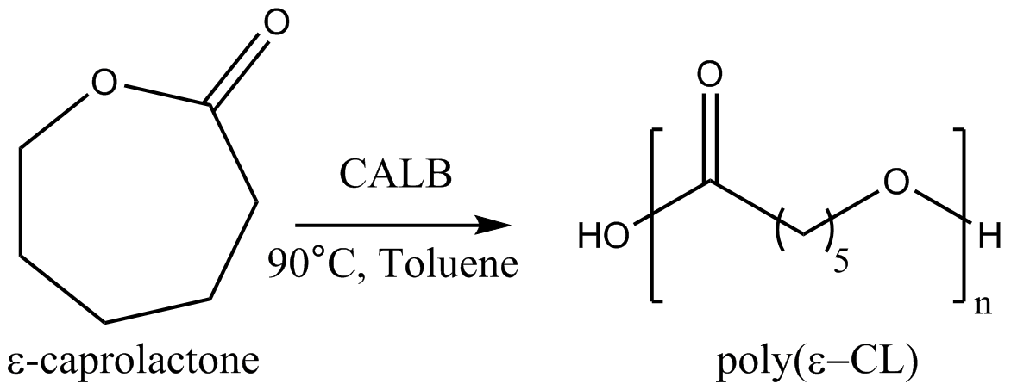
Suggestion on improvement of polymerization reaction performance (2)
There are –CO and -NH groups in this polymer. It can form intra-molecular interaction and folded conformation.
Maximum degree of polymerization(DP_{max}) = 18
Average DP = 8
There is no -NH group in this polymer so that it would not form intra-molecular interaction thus assuming partially or fully extended conformation frequently.
Maximum degree of polymerization(DP_{max}) = 78
Average DP = 29
Find a compound which breaks β-peptide structure, and confirm that it is irrelevant to polymerization reaction
K. Loos et al. Biomacromolecules 2014 15, 234-241

Slide 32
Sys-7
最終構造
ヘキサマーの位置・反応できそうか？

Slide 33
Sys-6
最終構造
ダイマー・トライマーの位置

Slide 34
Sys-5
最終構造
トライマーの位置

Slide 35
Sys-3
最終構造
ダイマーの位置
解析スクリプトにエラーがありそう。
Dimerは x1 monomer x2

Slide 36
Sys-2
最終構造
モノマーの位置

Slide 37
Sys-4
最終構造
モノマーの位置

Slide 38
How can we generate longer polymer?

