Slide 1
Trial MC/MD simulation on Zirconocene and New Proposal of Catalytic shuttling for Block polymers
Sandhya
10/2/2015

Slide 2
Outline of the presentation
DFT study on cis approach of propylene with respect to [CH₃B(C₆F₅)₃]⁻ on
ansa-zirconocene complex.
Mechanism of ansa-Hf complex for the first insertion using different approach
propylene.
Trial MC/MD simulation of ansa-zirconocene propylene Complex.
Proposal of new reaction scheme for the preparation of olefin block polymers.
Future plan for the next month.

Slide 3
cis approach of propylene with respect to [CH₃B(C₆F₅)₃]⁻ (CA)
Energy [kcal/mol] | A | C
Activation barrier | 10.55 | 10.04
Method used M06/6-31G(d,p) , LanL2DZ for Zr
We could not figure out TS of cis B and D approach
of propylene with respect to CA.
Activation barrier is thrice than trans insertion of propylene C approach to the complex in the presence of CA.
Activation barrier is twice than trans insertion of propylene A approach to the complex in the presence of CA.
This clearly confirms that these two approach are not favorable for the propylene insertion.
Hence system prefers for the trans approaches of A and C propylene to the complexes.

Slide 4
First insertion of ansa-hafnium complexes
Four isomers of ansa-hafnium complexes
Activation barrier for the first insertion reaction mechanism of Hf complexes
Energy [kcal/mol] | A | C | B | D
Activation barrier(Hf) | 7.94 | 7.91 | 13.11 | 19.12
Method used M06/6-31++G(d,p) , LanL2DZ for Zr
Activation barrier(Zr) | 8.46 | 8.36 | 13.16 | 18.59
Comparing the previously studied Zr ansa complexes show that activation barrier is slightly decreased,
However it dose not change much from the Zr complexes.

Slide 5
Computational details for test hybrid MC/MD simulation
One catalyst, one propylene,184 pentane solvent and Cl⁻
MK ESP charges are calculated at M06/6-31++G(d,p)
Force fields parameters such bond constants, angles and torsional angle were calculated from the M06/6-31++G(d,p)
General amber force field, amber force field and universal force fields.
Periodic boundary conditions are applied
NPT-MD for 10ps (300K and 1atm) for equilibration.
NVT-MD for 50ps before MC/MD simulation.
NVT-MD (300K) simulation time in one MC/MD cycle is 10ps.

Slide 6
Trial Hybrid MC/MD simulations
Time consuming for
Preparation of prepin files for MD or MC/MD simulations.
Manual insertion of charges on the complex systems
-> Fortran program.
B + A
C + A + D
IN
IN1
MC/MD
IN2
PRP
PRA
Ansa zirconozene propylene complex
Product
Formation of first insertion of propylene after first cycle.
Validity of parameters again supports the well working of the dynamic simulation.
Confirming the applicability of force filed parameters from DFT calculations for the hybrid MC/MD simulation.

Slide 7
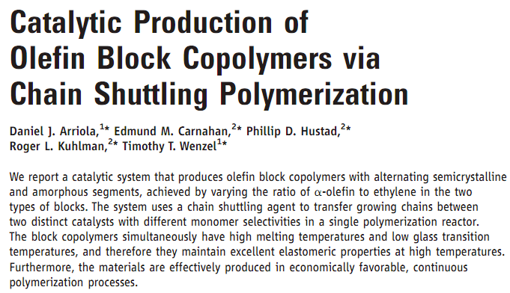

Slide 8
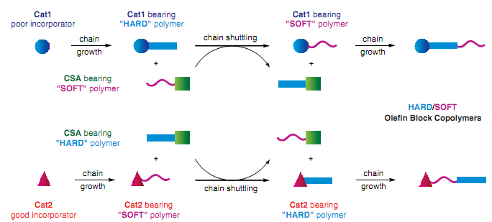

Slide 9
Catalysts for block polymerization
Cat 1
Cat 2
CSA
Monomers
and
1-octene
ethylene

Slide 10
Reactive catalysts formation

Slide 11
Transmetallation - I of two catalysts
Propagation steps of two catalysts
A
B
Propagation affords catalysts bearing two different polymers in a same pot.
Transmetallation leads to the formation of four different reactive
species from two different reactants i.e. A, B, C and D
C
D

Slide 12
Transmetallation - II of two catalysts
Transmetallation reaction of catalyst and CSA plays a pivotal role for the exchange of polymers between two catalyst
Propagation steps after transmetallation II
Propagation yields to olefin block polymers
in a single pot.

Slide 13
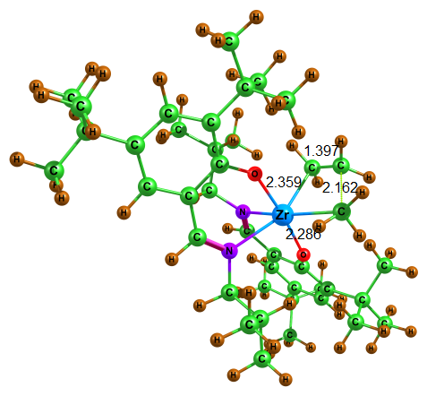
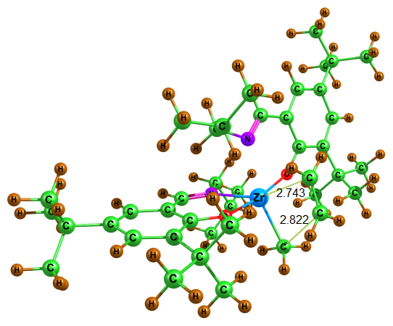
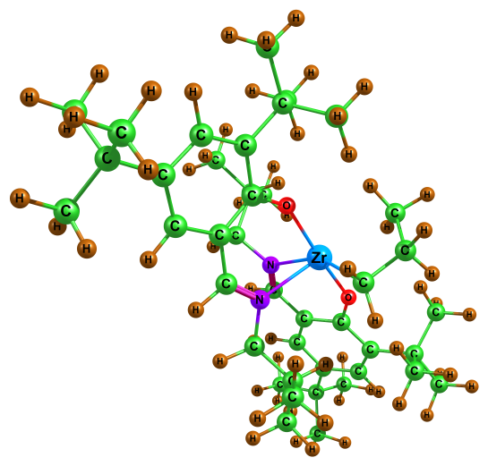
First insertion for the Cat1 with ethylene : Preliminary study
Method : LANL2DZ for metal
6-31G(d) for other atoms
Activation barrier for the first insertion of ethylene
= 4.96 kcal/mol
TS1
Ca1Reactant
Ca1Product

Slide 14
Future plan- For the next month
Main: Completion of a manuscript regarding the force field development and MD simulation on the ansa-zirconocene propylene Complexes.
MC/MD simulations on the reference catalyst with many propylene and solvents.
Continue the new project.
Preliminary would be optimizations of propagation steps using M06 method.

Slide 15
Thank you

