Slide 1
MD Simulation on [(CH₃)₂Si(Ind)₂ZrMe(C₃H₆)]⁺[CH₃B(C₆F₅)₃]⁻using improved force field parameters
K. S. Sandhya
30/06/2015

Slide 2
Outline of the presentation
Project 1
Preparation of ion pair complex for MD simulation
MD simulation of [(CH₃)₂Si(Ind)₂ZrMe(C₃H₆)] [CH₃B(C₆F₅)₃] with improved parameters
Analysis on the approach of [CH₃B(C₆F₅)₃] during the MD simulation
Analysis on the metastable structure
Trial MC/MD simulations
Project -2
Reaction mechanism with in situ generated new Hf catalyst
Comparison of energy profile with Cat3 catalyst
Conclusions
Future plan

Slide 3
Transferability of force filed parameters from A to other systems
A general approach
Parameters are transferred to
all conformers with counteranion
Parameters for [CH₃B(C₆F₅)₃ has been
taken from recent paper.
Analyze the approach of counteranion with respect to propylene.
It can influence the reaction pathway by altering the activation barrier and
preference of primary insertion than secondary insertion.

Slide 4
Creation of model for [(CH₃)₂Si(Ind)₂ZrMe(C₃H₆)] [CH₃B(C₆F₅)₃](reference complex)
IND
PH1
ME
PH2
ZR
PRP
B
PH3
MEB
Model : η5 Cp ring and one Zr
PN
Computational details
One catalyst, one [CH₃B(C₆F₅)₃], one propylene and 647 pentane solvent
Periodic boundary conditions are applied
NPT-MD for 20ps (300K and 1atm) for equilibration
NVT-MD (300K) for molecular dynamics (50ps) simulation
Method M06 DFT method for optimization
Basis set for Zr –ECP with LanL2DZ, all other atoms - 6-31++G(d,p)
MK method having same level was applied to calculate ESP charge for the complexes from the optimized geometry

Slide 5
MM refinement of dihedral rotation with DFT relaxed optimized scan
c4
zr
c9
c9-c2-zr-c4
c2
-φ
c4
zr
c9
- φ anticlockwise
Blue DFT relaxed scan
Gray MM optimized scan with
Force field parameters from DFT
Orange MM optimized scan with
modified force field parameters
Better agreement of MM optimization after
fitting empirical force filed parameters with DFT optimized
relaxed scan on dihedral rotation.
The improved parameters will be used in the MD simulations and MCMD calculations

Slide 6
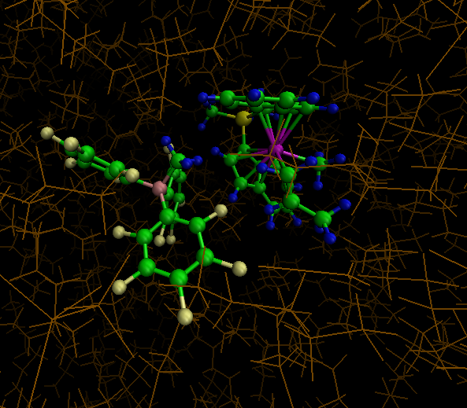
MD simulation of [(CH₃)₂Si(Ind)₂ZrMe(C₃H₆)] [CH₃B(C₆F₅)₃]
At 300 K
At 273 K
c4
zr
c9
c9-c2-zr-c4
c2
φ
CA of CH3 C…Zr of catalyst
Average distance 5.2 Å
At 343 K
5.2 Å
Snap shoot structure at 10ps

Slide 7
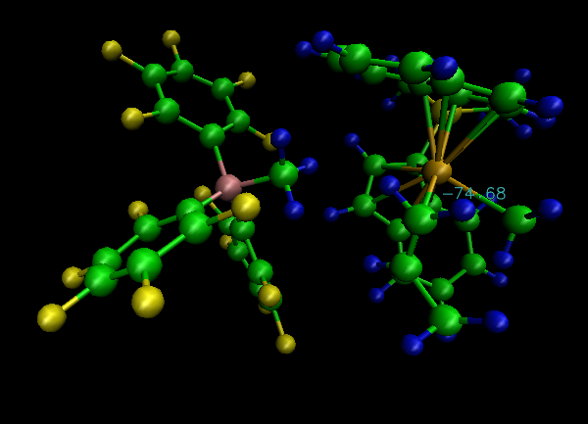
MD simulation of [(CH₃)₂Si(Ind)₂ZrMe(C₃H₆)] [CH₃B(C₆F₅)₃] for long time
At 343 K
The average dihedral
rotation is 78 degree.
5.5 Å
cb
zr
The distance between cation and anion is analyzed
by noting the distance between CH3 carbon of borate
And Zr of catalyst.
c2
c4
c4
c9
The average distance is 5.5 Å
Snap shoot at 3ns

Slide 8
Trial MC/MD simulation on [SiH₂(Ind)₂ZrCH₃]⁺[CH₃B(C₆F₅)₃]⁻
Periodic boundary conditions are applied.
NPT-MD for 10ps (300K and 1atm) for equilibration.
NVT-MD for 50ps before MC/MD simulation. Then NVT-MD (300K) simulation time in one MC/MD cycle is 10 ps.
PEN
Trial 1
MC/MD
With reference catalyst
+ 184 pentane
This test calculation shows that well working of MCMD method
PEN
Trial 2
NVT-MD (300K) simulation time in one MC/MD cycle is 1ns. Total 10 cycles
MC/MD
+ 1687 pentane
+ 186 Propylene
No reaction
Initial catalyst
The strong electrostatic interaction between catalyst and borate did not allow the propylene to accommodate in the vacant
shell of Zr catalyst for the insertion step.
Hence, dissociation of CA should be anticipated prior to insertion.

Slide 9
Third Trial MC/MD simulation on [Si(CH₃)₂(Ind)₂ZrCH₃]⁺[CH₃B(C₆F₅)₃]⁻
Dissociation of borate with respect to catalyst is conducted prior to insertion.
Trial 3
PEN
NVT-MD (300K) simulation time in one
MC/MD cycle is 1ns. Total 1000 cycles
+ 1687 pentane
+ 186 Propylene
MC/MD
No reaction
Even after dissociation of CA, propylene is not in the close contact (reaction criteria) for the insertion reaction.
Hence, real condition is required. The exact ratio of the reaction is calculated.
1 (Catalyst) : 2049 (MAO) : 94146 ( Toluene) : 145674904 (Propylene)
In the next trial will be 1 : 1 : 46 : 14226
Toluene : Propylene ratio can be 5 : 1422
Displacement of CA with propylene is necessary for the insertion.

Slide 10
Project -2
Catalyst for the chain shuttling reaction
Transmetallation - I of two catalysts
cat1
cat2
Possible mechanistic step
Propagation steps of two catalysts
A
B
C
D
Propagation affords catalysts bearing two different polymers in a same pot.
Transmetallation leads to the formation of four different reactive
species from two different reactants i.e. A, B, C and D

Slide 11
Propagation steps of Hf catalyst- Two cases
Pathway I
Pathway II

Slide 12
Real activate catalyst is cat4?
Cat3
cat4
The insertion of octene in cat4 is really required ????

Slide 13
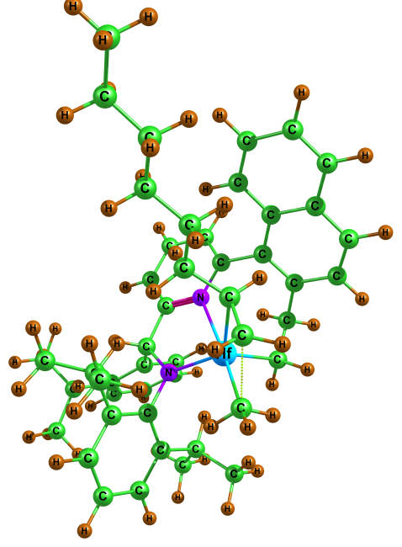
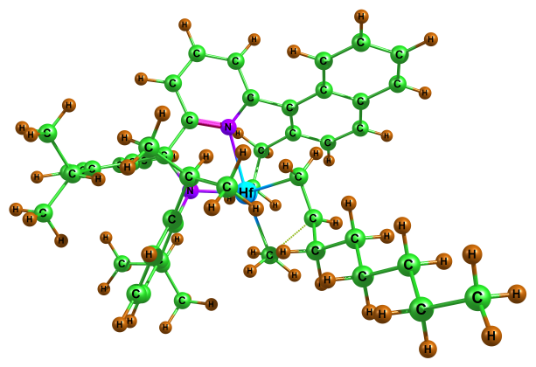
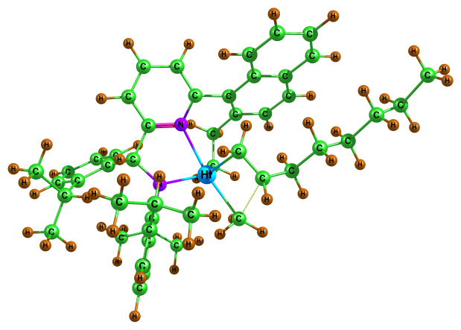
Reaction energy profile for the insertion step from cat4
Cat3 + ethylene + octene
R1b + octene
Cat4
TS in D path
TS in A path
TS in C path
TS in B path ???

Slide 14
Conclusions
The improved parameters give more reliable results based on refinement of MM relaxed optimization which fits reasonably good with DFT scan of dihedral rotation.
Approach of CA changes with respect to conformers and this can be one of the important factors for predominating primary insertion reaction than secondary insertion.
[(CH₃)₂Si(Ind)₂ZrMe(C₃H₆)] [CH₃B(C₆F₅)₃] shows a metastable form of propylene conformer at 273K, 300K and 343 K.
The metastable structure existence clearly indicate that the metastable conformer of propylene is highly favorable for insertion reaction.
Future plan
Probability distribution function and radial distribution functions will be calculated for reference and all conformers.
With the improved parameters, I will conduct further trial MCMD simulations for displacement reaction.
Finding the missing reaction energy profile for the transmetallation reactions- CSP 2

Slide 15
Thank you………

