Slide 1
Molecular Dynamic Simulation on the Ansa-Zirconocene Propylene Complexes and the Product after First Insertion of Propylene
K. S. Sandhya and N. Koga
Dec. 3, 2014

Slide 2
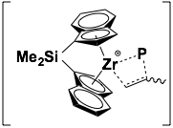
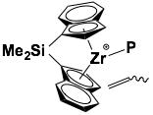
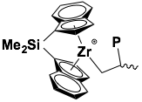
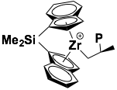
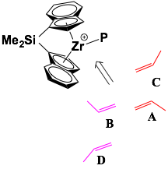
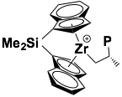
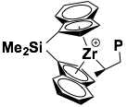
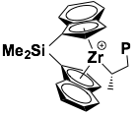
Insertion of propylene into Zr-P(polymer end) bond
primary
insertion
If one of them repeatedly occurs, the isotactic polymer is obtained.
secondary
insertion
isotactic

Slide 3
Contents
Force field for reactants and product.
Models in MD simulation for ansa-zirconocene complexes
ESP atomic charges using CHELPG and MK schemes for reactants and product.
Failure of CHELPG charges for product.
MD simulation of propylene complexes and product.
Rotation of propylene
MD simulation of insertion product (isobutyl complex)
Future plan
Summary

Slide 4
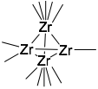
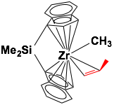
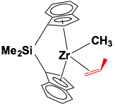
Different models of ansa-zirconocene complex
Three different models are created for MD simulation studies.
1st model
2nd model
3rd model
0.001Å
η5 Cp ring and four Zr/4 centers
η5 Cp ring and one Zr
η1 Cp ring and one Zr
A small tetrahedron of four Zr/4 centers to include 1,3-repulsive interaction (Brintzinger et al. J. Mol. Struct., 485-486, 409 1999)
η¹ model with one Zr is neglected due to the lack of various parameters for indenyl ligands and hence shown distorted structures during the simulations.
The results obtained with this model was presented in the last workshop.

Slide 5
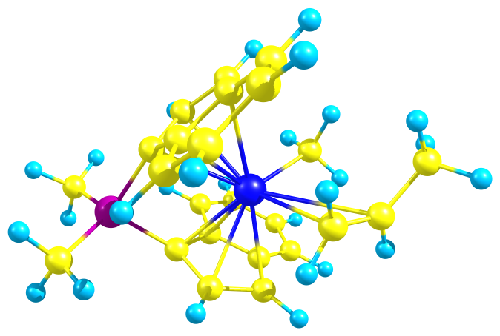
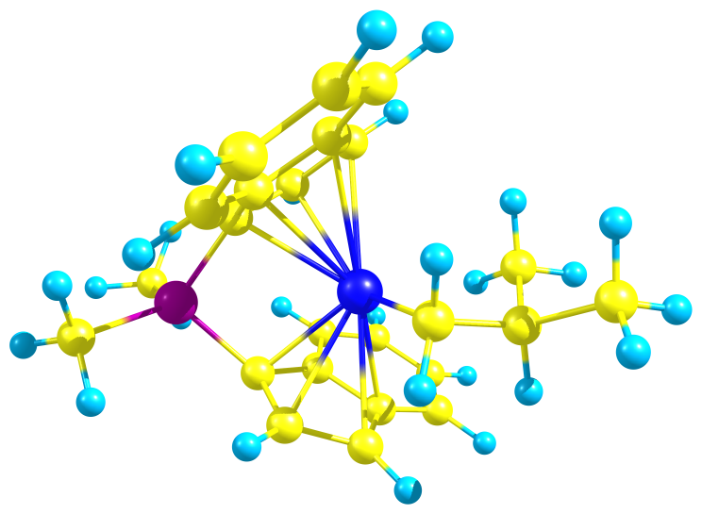
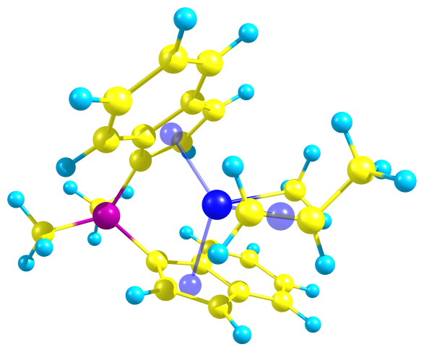
Atom types used for the A complex and product for different models
2nd model
3rd model
propylene complex
product
ha
ha
ca
ca
hc
ca
du
C4
C3
hb
C3
C3
c2
c9
C2
C3
du1
hd
ha
C5
C5
du
ha
Description :
ca: aromatic carbon
c5: cyclopentadienyl carbon
c2,c9: unsaturated sp2 carbon in propylene
ha: hydrogen in unsaturated as well as aromatic carbon.
hb and hd: hydrogens bonded with unsaturated carbon c2
du: dummy atoms at centroids of Cp rings
du1: dummy atom at centroid of propylene C=C bond
Atom types are different for reactants and product.
For the third model, two dummy atoms are inserted into the centroids of the Cp ligands and one dummy atom is inserted to the center of the double bond of propylene.

Slide 6
Force field parameters for reactants and product
Force field parameters for reactants and product created (DFT calculations)
Bond | K1 | Distance [Å]
zr-c2 | 204(200) | 2.58 (2.60)^{d}
zr-c9 | 258 | 3.011
c9-ha | 396 | 1.094
c2-hb(c2-hc) | 396(340) | 1.091(1.090)^{d,b}
c2-hd | 399 | 1.093
c9-c2 | 590 | 1.324
c9-c3 | 314 | 1.481
zr-cp | 219 | 2.430
c4-ha | 367 | 1.099
zr-c4 | 150 | 2.242
Angle | K2 | Angle [º]
si-c5-zr | 7.50 | 98.85
zr-c2-hb | 1.28 | 103.10
zr-c2-hd | 2.09 | 86.42
zr-c9-ha | 3.96 | 95.58
zr-c2-c9 | 4.18 | 94.29
zr-c9-c2 | 0.03 | 59.07
zr-c9-c3 | 2.09 | 117.7
Dihedral angle | Multi-plicity | K3 | γ [º] | Perio-dicity, n
c4-zr-c2-c9 | 1 | 4.5 | 16.23 | 1
c4-zr-c9-c3 | 1 | 1.8 | 47.44 | 1
hc-c4-zr-c2 | 1 | 0 | 0 | 2
hc-c4-zr-c9 | 1 | 0 | 0 | 2
hc-c4-zr-c5 | 1 | 0 | 0 | 2
hc-c2-c3-c3^{b} | 9 | 1.4 | 0 | 3
c2-c3-c3-hc^{b} | 9 | 1.4 | 0 | 3
^{d} Values in parenthesis values are
for product.
Parameters taken from literature
Bond | K1 | Distance [Å]
c3-hc | 345ª | 1.09ª
c4-hc | 340^{b} | 1.09^{b}
zr-c5 | 137^{b} | 2.38^{b}
zr-c4 | 200^{b} | 2.26^{b}
si-c5 | 506^{b} | 1.90^{b}
zr-zr | 500^{b} | 0.001^{b}
Angle | K2 | Angle [º]
c5-zr-c2 | 40^{b} | 105.0^{b}
hc-c4-hc | 35^{b} | 109.5^{b}
si-c3-hc | 35ª | 109.5ª
c3-si-c3 | 40ª | 109.5ª
zr-c4-hc | 150^{b} | 109.5^{b}
si-c5-c5 | 40ª | 126.0ª
c5-c3-c3 | 70^{b} | 109.5^{b}
c5-si-c5 | 70ª | 109.5ª
c3-si-c5 | 22ª | 109.5ª
Atom type | van der Waals depth,ε [kcal/mol] | van der Waals radius, [Å]
zr | 1.000^{b} | 0.000^{b}
si | 1.908^{b} | 0.086^{b}
c4 | 1.910^{b} | 0.130^{b}
Other parameters are also taken from
a. Bosnich et. al., J. Am. Chem. Soc., 1995, 117, 1352-1368
b. Brintzinger et.al., J. Mol. Struc., 1999, 485-486, 409-419, Organometallics, 2000, 19, 3597 3604

Slide 7
Structural comparison between DFT optimized geometry and MD minimized geometry (A complex)
Structural Parameters of A | DFT | MD (NPA charges) | MD (CHELPG charges) | MD (MK charges)
zr-c2 | 2.58 | 2.64 | 2.61 | 2.58
zr-c9 | 3.01 | 3.03 | 3.01 | 3.02
zr-c4 | 2.24 | 2.35 | 2.29 | 2.25
zr-cp | 2.43 | 2.41 | 2.43 | 2.40
zr-c2-hb | 104 | 104 | 104 | 102
zr-c2-hb | 85 | 73 | 80 | 74
zr-c9-ha | 95 | 125 | 95 | 93
zr-c9-c3 | 119 | 89 | 120 | 120
c4-zr-c2-c9 | –20 | –20 | –19 | –20
Atom type | Atomic charges
 | NPA | CHELPG | MK
zr | 0.937 | 1.237 | 0.6264
c4 | –0.456 | -1.123 | -0.598
c2 | -0.226 | -0.584 | -0.3847
c9 | 0.75 | -0.025 | 0.2248
si | 0.666 | 1.850 | 0.9372
MD minimized geometry obtained using CHELPG and MK atomic charges are more similar to DFT structure.

Slide 8
Computational details
One catalyst, one propylene and 270 pentane solvent
GAFF and ESP charges are used
Basis set for Zr LanL2DZ and for all other atoms 6-31++G(d,p)
CHELPG and MK methods were applied to calculate ESP charges for the complexes of the optimized geometries of reactants and product. However, MK method gave the more proper charges (next slide) and hence further calculations are proceeded with MK charges.
Periodic boundary conditions are applied
NPT-MD for 20ps (300K and 1atm) for relaxation
NVT-MD (300K) simulation time in one MD cycle was 1ps

Slide 9
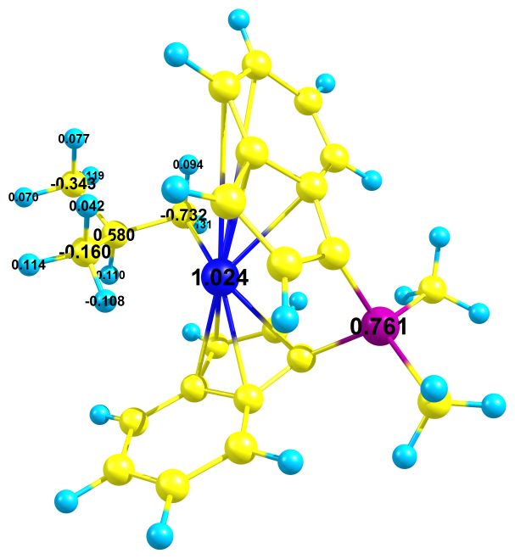
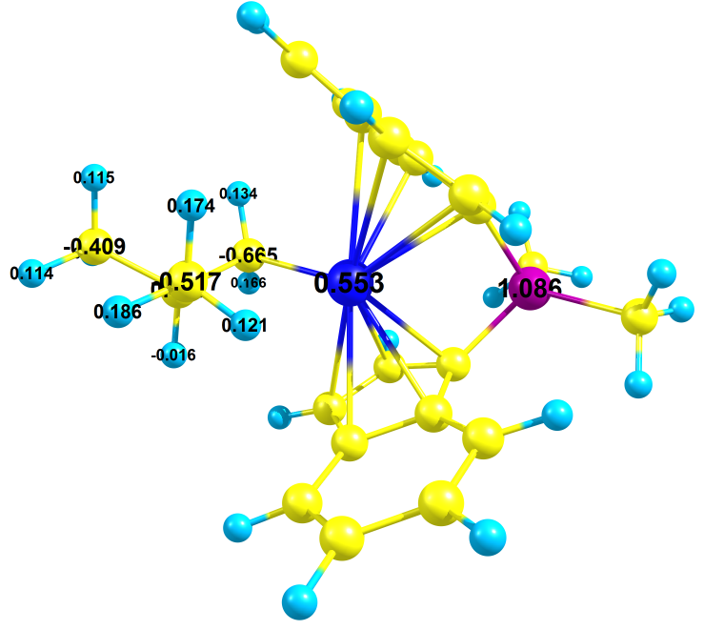
MD simulation for the isobutyl ansa-zirconocene complex (the product of the first insertion of propylene to type A complex )
Using CHELPG charges the systems are destroyed during MD simulation regardless of the presence or the absence of counter anion, Cl⁻. The same problem was encountered in the initial complex without propylene.
The main reason for this is that the highly positively charged Zr contacts with highly negatively charged chlorine.
In the absence of counter anion, the negative charge on the hydride (-0.108) of CH₃ in the propylene will contact with Zr and destroy the system.
CHELPG charges
M06/ 6-31++G(d,p)
MK charges
M06/ 6-31++G(d,p)
+0.553
on Zr
Negative charge
–0.108
Positive charge
+0.121
+1.024
on Zr

Slide 10
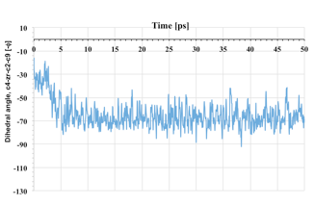
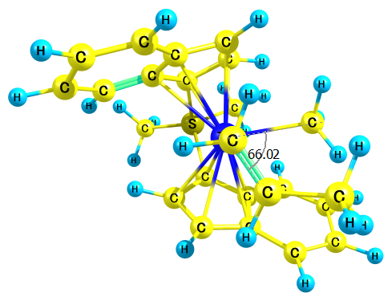
MD simulation for the propylene ansa-zirconocene complex (A complex)
η5 model with one Zr atom
MK charges
c4
ϕ
c9-c2-zr-c4
c9
c2
Dihedral angle
–66.02
At 20ps
This figure clearly shows the presence of stable structure where the averaged dihedral angle is –67˚ different from DFT structure.

Slide 11
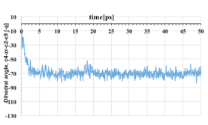
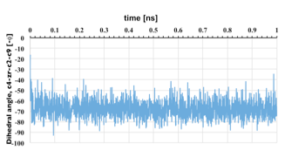
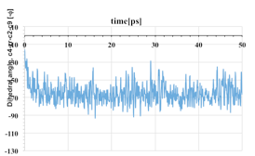
MD simulation for propylene ansa-zirconocene complex (A complex): Longer time and various temperatures
100 K
MK charges
400 K
At 100 K as well as at 400 K the meta stable structure was observed.

Slide 12
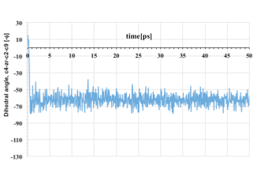
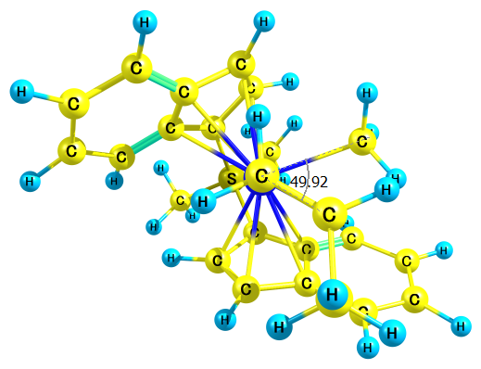
MD simulation for the propylene ansa-zirconocene complex (C complex)
c9-c2-zr-c4
c4
MK charges
ϕ
c9
c2
–49.92
Dihedral angle
At 20ps
This shows the presence of metastable structures.
The average dihedral angle is –62˚.
This orientation of the propylene ligand is similar to that in A complex.

Slide 13
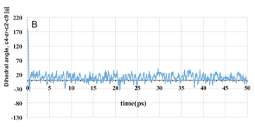
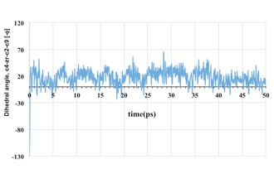
MD simulation for the propylene ansa-zirconocene complex (B and D complexes)
MK charges
B
A
Averaged dihedral angle is 10˚.
D
C
B complex changed to A complex
D complex changed to C complex
B and D are not stable and may not under go further reaction for first insertion.
Averaged dihedral angle is 17˚.

Slide 14
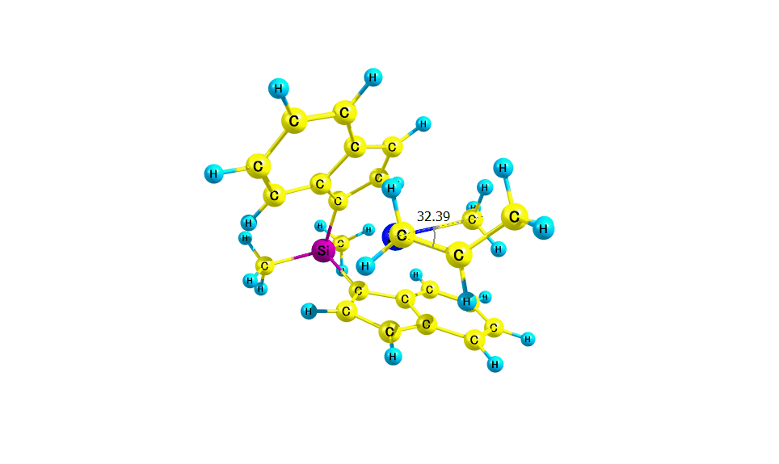
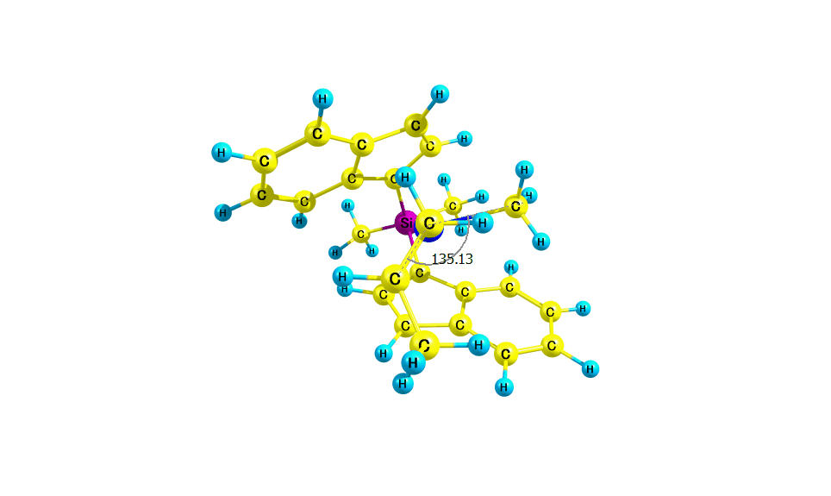
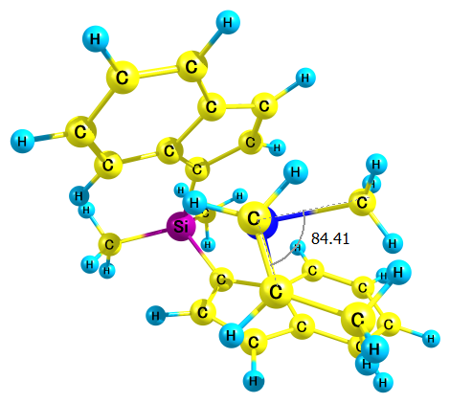
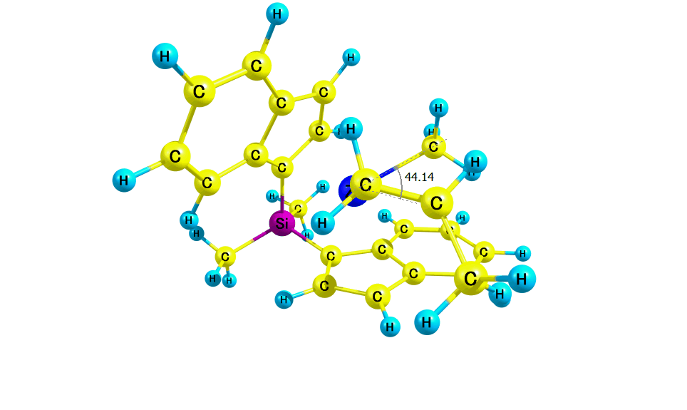
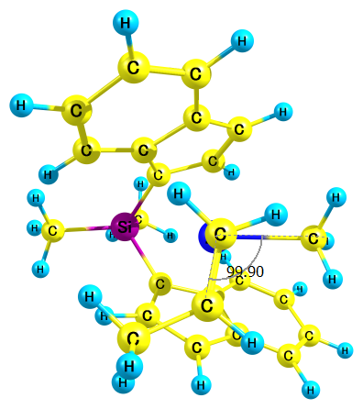
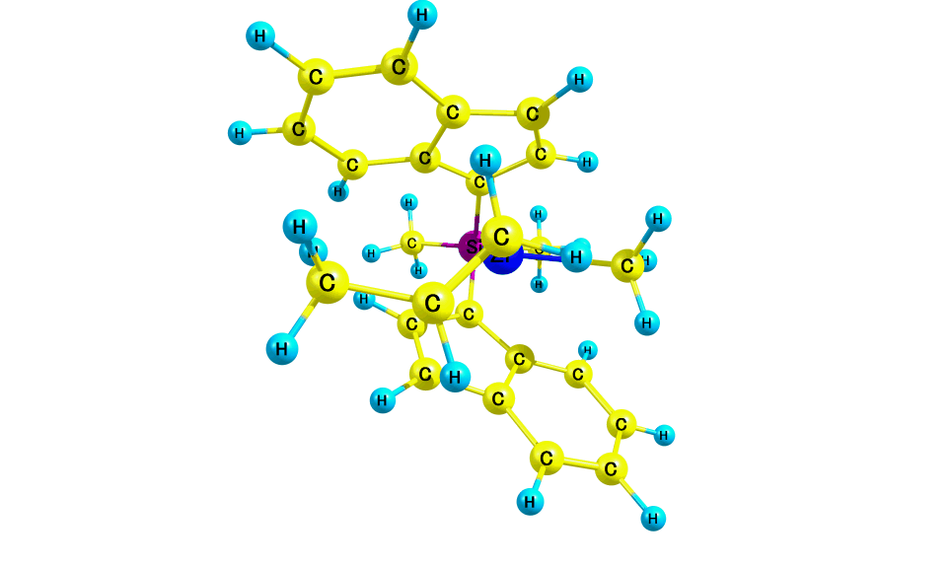
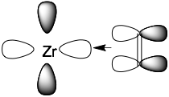
DFT studies on rotation of propylene
0.00 kcal/mol
A
0.83
TS1
–0.27
metastable
2.35
TS2
0.59
B
0.00 kcal/mol
C
2.43
TS1
0.13
metastable
2.35
TS2
0.41
D
In Zr^{IV} (d0) alkene complex, electron donation is responsible for the alkene coordination, whereas there is no back-donation which would prohibit the rotation.
donation
back-donation

Slide 15
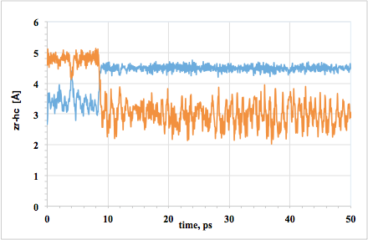
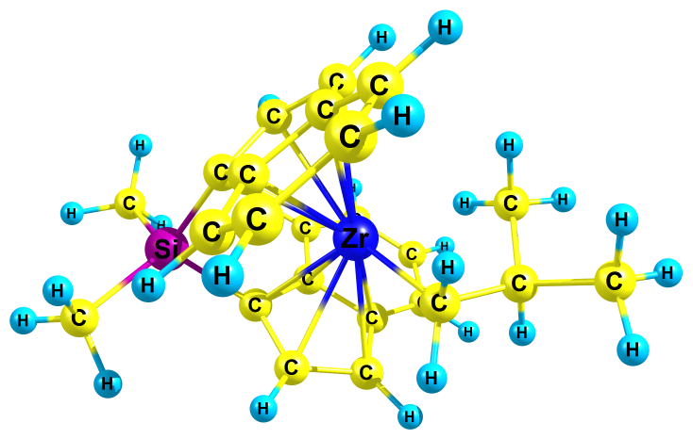
MD simulation for the isobutyl ansa-zirconocene complex (the product of the first insertion of propylene to type A complex )
With the MK method, the atomic charge on Zr (0.55) is smaller than that by other methods (appr. 0.9 and 1.02) and the systems were not destroyed.
zr-hc1
zr-hc2
hc1
hc2
η5 Cp ring and one Zr
This MD graph clearly indicates that the c_{α}c_{β} bond of isobutyl rotating along its axis
A close interaction of H with metal is observed. The average distance is 2.75 Å.
(In DFT, this value is 2.27 Å)

Slide 16
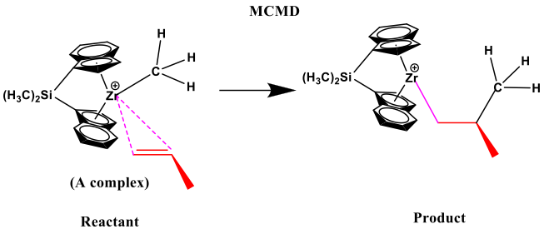
Summary
Three models ((1)η⁵ and four Zr (2) η⁵ and one Zr (3) η¹ model with one Zr ) were used for the MD simulation.
When CHELPG charges for the product as well as reactant complex without propylene were used, the systems were destroyed by counter anion (Cl⁻).
Therefore, MK charges were used in MD simulation for all systems and will be used in future work, since the systems are not destroyed by Cl⁻ ion in MD simulation with MK charges.
Future plan
Trial and error method for the suitable models for MCMD simulation
MCMD for the propylene insertion reaction.

