Slide 1
FY2016 9th CREST WS
Feb. 7, 2017
Toward Improving Enzymatic Polymerization Reaction Simulation:
Discussion on Molecular Origin of the Short Polymer Problem

Slide 2
Today’s contents
Background of this research
Insights into CALB inside Novozyme435
Discussion on the molecular origin of short polymer problem
Roadmap toward improvement of the simulation

Slide 3
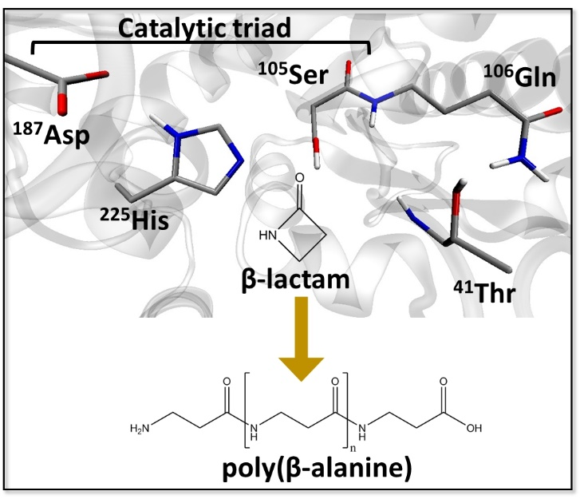
Research background
Enzyme catalyzed polymerization reaction has drawn attention in the field of green chemistry.
Candida Antarica Lipase B (CALB) has long been studied in this purpose.
This enzyme catalyzes polymerization of β-lactam to generate poly(β-alanine), nylon-3.
However, this reaction system has rooms to be improved because the product do not satisfy industrial quality, as for the length and yield.
The illustration is gifted from Dr. Barberot.

Slide 4
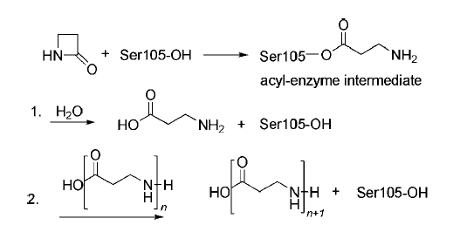
When N or C-terminal of poly (β-alanine) approaches Oγ of Ser105 in acyl-enzyme intermediate, the polymer elongation reaction occurs
(A) CALB forms acyl-enzyme intermediate via β-lactam ring opening reaction.
(B) β-alanine is generated from hydrolysis reaction of the acyl-enzyme intermediate.
(C) Poly (β-alanine) is elongated via reaction between polymer and acyl-enzyme complex.
Scheme 2. The proposed pathway of the ring-opening polymerization. The acyl-enzyme intermediate is formed and attacked. (1) By water to release β-alanine. (2) By a growing oligomer (n.1, 2, . . .) to yield the poly(β-alanine).
dimer formation
trimer formation
(A)➔(B)➔(A)➔(C)➔(A)➔(C)➔…
Ref. Schwab L. et al., Macromol. Rapid Commun., 2008, 29, 794-797:

Slide 5
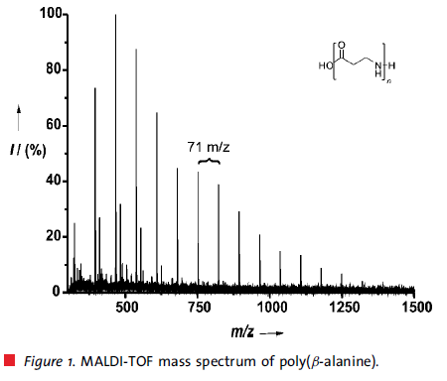
Issue we are addressing
Degree of polymerization (DP) is insufficient for industrial usage
With conventional methods:
Average DP: 24 mer; Maximum DP: 58 mer
With CALB catalyzed poly(β-alanine) synthesis:
Average DP: 8 mer; Maximum DP: 18 mer
➔ Polymer generated by using CALB is still shorter by three times.
Toward the industrial usage of CALB, ‘optimizing reaction condition’ and/or ‘redesigning CALB as biocatalyst’ are indispensable.
Insights into the reaction mechanism would provide strategies to address the problems.
6-mer
8-mer (average)
18-mer (maximum)
Ref. Schwab L. et al., Macromol. Rapid Commun., 2008, 29, 794-797:

Slide 6
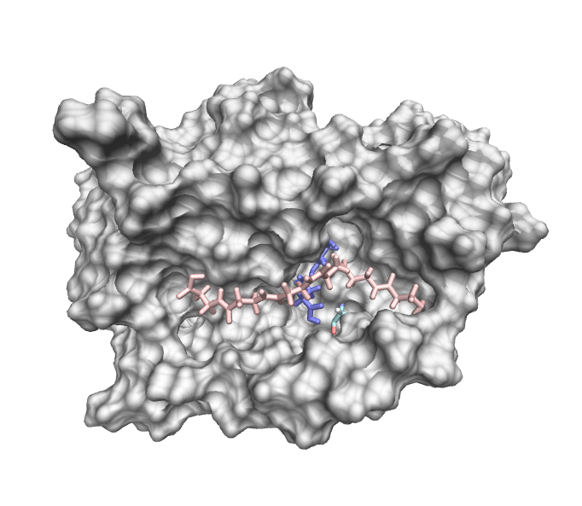
Achievements and problems we’re facing
Using MC/MD simulation, hexamer is generated so far. However, polymer extension does not continue anymore.
Ser105 behind the surface
15 Å
2916th cycle
N-terminal
Snapshot structure at the last cycle

Slide 7
Problem is the N-terminal is away from Serine 105
Ser105 behind the surface
Polymer elongation would not continue in this simulation.
This should be due to that the N-terminal of the hexamer is distant by 15 Å from Ser105.
15 Å
N-terminal
Is there an alternative strategy to promote polymer reorientation?

Slide 8
Strategies to solve the issue
Accelerate molecular dynamics with…
biased potential
faster MD engines (pmemd, pmemd.cuda)
Consider reaction field properly
Referred in 7th CREST-WS
We have employed isolated CALB for simulations. However, CALBs are immobilized in acrylic resin in experimental condition.
What is different between isolated and absorbed CALB?

Slide 9
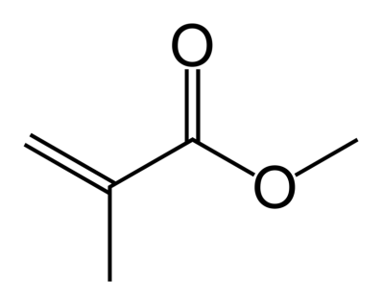
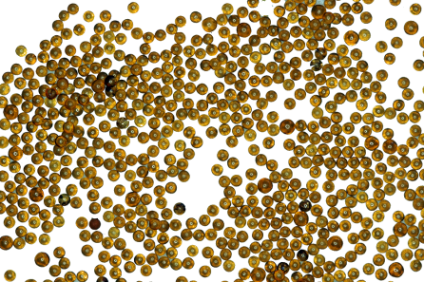
In Novozyme435, CALBs are absorbed in multiporous acrylic resin
Novozyme435 (N435) is commercially available heterogeneous biocatalysts consisting of CALB and acrylic resin (=樹脂).
The resin is made from methyl methacrylate (MMA) polymer, and has pores to absorb CALB (see left panel for MMA).
N435 is a kind of polymer beads, which has many pores and absorb CALB inside.
[1] http://www.lenntech.com/products/Lanxess-Lewatit-Resins/Lewatit-VP-OC-1600/Lewatit-VP-OC-1600/index.html

Slide 10
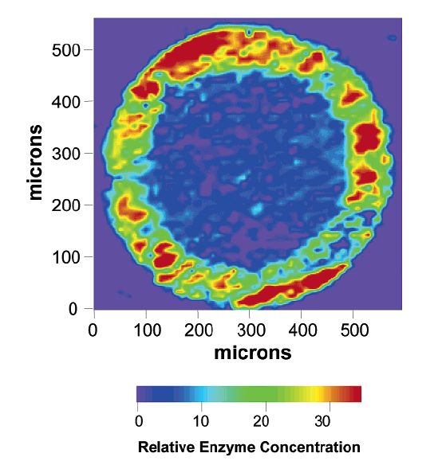
CALB is localized in an external shell of N435
Mei et al. reported structural observations of N435 with synchrotron infrared microspectroscopy
Inhomogenious distribution would be due to insufficient concentration of CALB: greater amount of CALB results that CALBs are distributed homogeneously.
CALB is localized in an external shell of the N435 beads with a thickness of 80-100 mm.
This could be high affinity between CALB and resin.
Secondary structure of CALB is sustained by absorption on a resin.
Ref. Mei Y. et al., Biomacromolelules 2003, 4, 70-74

Slide 11
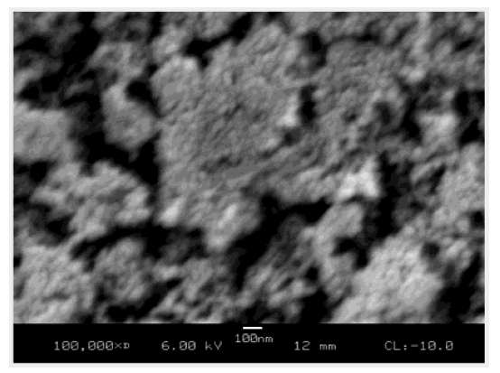
Multiple CALBs would be found in a pore?
“SEM showed that the average pore size in Novozyme435 beads is about 100 nm, more than 10 times larger than the size of the CALB molecule…”
100 ns
*”SEM” is scanning electron microscope (=走査型電顕).
**A pore is outlined by yellow.
Figure. SEM image of the center section of Novozyme435 beads
Ref. Mei Y. et al., Biomacromolelules 2003, 4, 70-74

Slide 12
Why does N435 generate 8 mer in average, and 18 mer in maximum?
Conjecture
Polymer elongation is carried out with multiple CALBs in a pore of N435 (see the right panel).
The following process could be assumed:
An oligomer is released from CALB in a pore.
It accesses to alternative CALB in the same pore.
Elongation reaction continues.
: CALB
100 ns
*This illustration is made from Figure 3 in Mei’s study.
**A pore is outlined by yellow.
Ref. Mei Y. et al., Biomacromolelules 2003, 4, 70-74

Slide 13
This conjecture can be tested by simulating polymerization with a system containing 2 or more CALBs
For example, setting two CALBs face-to-face would support oligomer re-binding.
CALB
Active site
Polymer

Slide 14
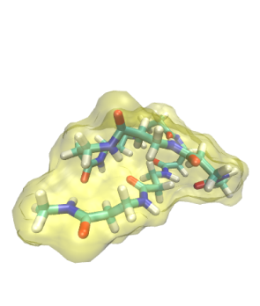
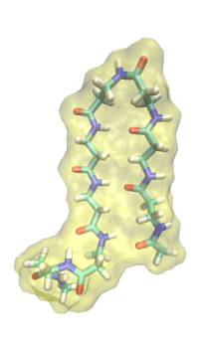
Hydrophobicity of β-alanine leads to short polymer problem?
It is still unclear why 18 mer is the maximum in CALB-catalyzed poly(β-alanine) synthesis. What does lead to the limitation?
globule
hairpin
8-mer forms intramolecular interaction in toluene solvent. This would prevent it from accessing to the active site of CALB.
Elongation of polymer might interfere with binding to CALB.

Slide 15
Blocking intramolecular interaction might promote further polymer elongation
For example, setting two CALBs face-to-face would unfold oligomer with CALB-oligomer intermolecular interaction formation.
CALB
Polymer
Active site

Slide 16
Toward improving enzymatic polymerization reaction simulation
The first subject is to reproduce 8 mer by addressing the following issues.
Remembering structural characteristics of N435, prepare simulation systems
➔This would require a brief modification in ligand binding scheme.
Accelerate molecular dynamics with…
biased potential
faster MD engines (pmemd, pmemd.cuda)
➔As for the second option, we have to prepare alternative script to edit PDB file.

Slide 17
Thank you for your attention

Slide 18
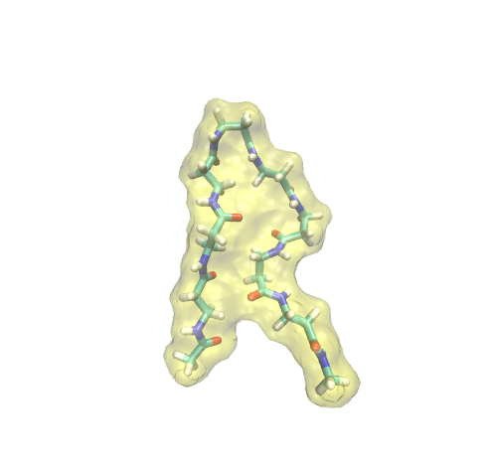
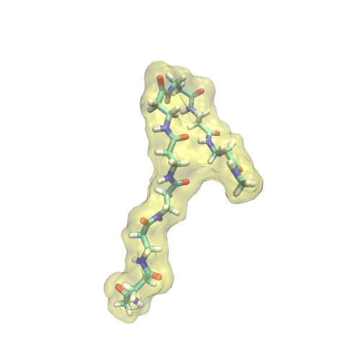
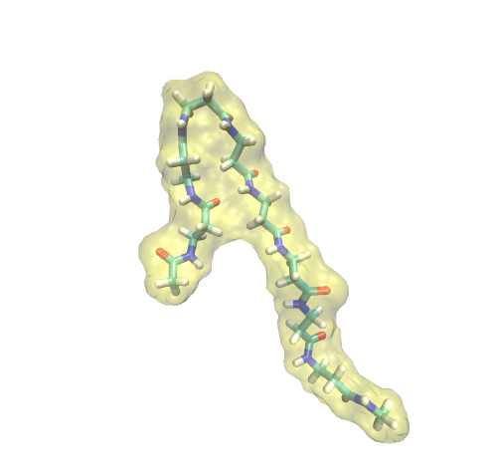
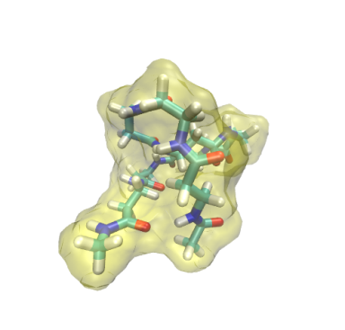
Summary for representative conformations
Such structural flexibility could be mainly attributed to rotation of Cα-Cβ (see the panel below).
hairpin
turn@βAla3
turn@βAla6
globule
extended
β-alanine
Cα
N
O
H
H
H
n
Cβ
O

Slide 19
一方、Novozym-435で18量体までは伸長が進む理由はなんだろうか？
MC/MD反応法シミュレーションで得られたポリマーは、最長で6量体であった
実験によれば平均ポリマー長は8量体である
CALBが樹脂内に固持されることで、不均一に空間分布することに答えがあるのかもしれない
CALBのサイズが空孔の10分の1程度であることを鑑みると、１つの空孔内に複数個CALBが吸着していることもあり得るのではないだろうか？
あるCALBの下で伸長したポリマーが、別のCALBに受け渡されてそこで更に伸長するのではないだろうか？
ポリマーの伸長は、N末端とC末端の両方から起こる。ポリマーの両端がそれぞれCALBと相互作用することで、空孔内部からの溶出を抑えることができるのではないだろうか？
CALB間でのポリマーの受け渡しが起こるようにCALBを配置すれば、MC/MD反応法シミュレーションでより長いポリマーの生成を観察することができるのではないだろうか？
樹脂内部の空孔
例えば、CALBが二量体を形成するような配置する
CALB

Slide 20
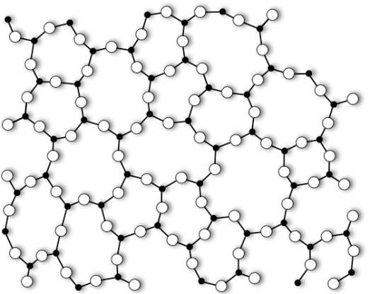
Multiple CALBs would be found in a pore
Schematic illustration of multiporous resin section
resin
: CALB
: MMA
[1] Mei Y. et al., Biomacromolelules 2003, 4, 70-74;

