Slide 1
CREST Workshop Uppula Purushotham
Graphene Electrode Dependency on the Reduction Mechanism of Propylene Carbonate in Sodium-ion Batteries: A Density
Functional Theory Study

Slide 2
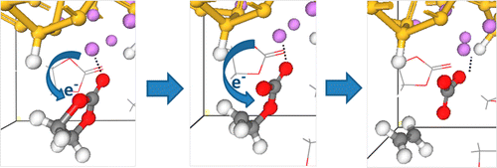
Background of Present Research
Fig. Reduction Mechanisms of Ethylene Carbonate on Si Anodes of Lithium-Ion Batteries
Recent theoretical studies revealed that electrolyte decomposition is strongly depend on the electrolyte-electrode interactions in presence of the electrode. [1-2]
Thus, to investigate the microscopic mechanism of the SEI film formation, it is essential and inevitable to consider explicitly the electrolyte-electrode interactions.
In the present study we have consider the graphene electrode effect on the reductive decomposition of propylene carbonate (PC).
In addition, effect of solvation on the PC decomposition has been addressed by using sophisticated computational methods.
1. Ma, Y.; Balbuena, P. B. J. Electrochem. Soc. 2014, 161, E3097.
2. Martinez de la Hoz, J. M.; Leung, K.; and Balbuena, P. B. ACS Appl. Mater. Interfaces, 2013, 5, 13457.

Slide 3
Computational Details
Table: Total Energy (TE) in hatrees and Inter Layer Spacing (ILS in Å) of the 3X3 graphene dimer model system at various level of theories with 6-31G(d) basis set.
C₈₄H₃₆ Point Group: C_{2h}
Method | ILS
B3LYP-D3 | 3.308
B3LYP | 3.712
M06-2X | 3.245
HF | 3.957
3.308
Fig. Optimized geometry of graphene dimer at B3LYP-D3/6-31G(d) level of theory.
Experimental Inter Layer Spacing ̴ 3.353 (±0.04) Å¹
B3LYP-D3/6-31G(d) method provides reasonable Inter Layer Spacing than other methods.
All geometry optimizations and frequency analysis in this study was carried using above method.
Adsorption energy defined by following equation
Adsorption energies of graphene PC-Na⁺ complex (E₁), PC-Na⁺ complex (E₂) and graphene Na⁺ complex (E₃).
Energy of graphene PC-Na⁺ complex
Energy of graphene
Energy of PC-Na⁺ complex
Energy of PC
Energy of graphene Na⁺ complex
Energy of Na
¹Y. Baskin et al., Phys. Rev. 1955, 100, 544.

Slide 4
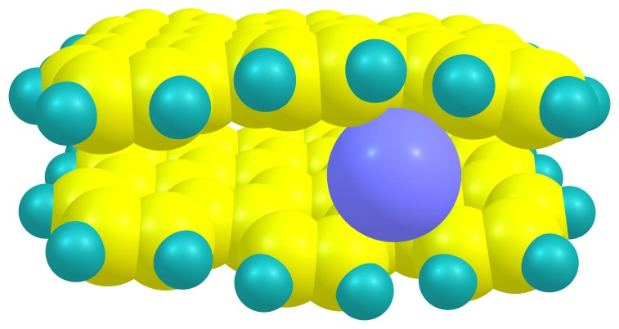
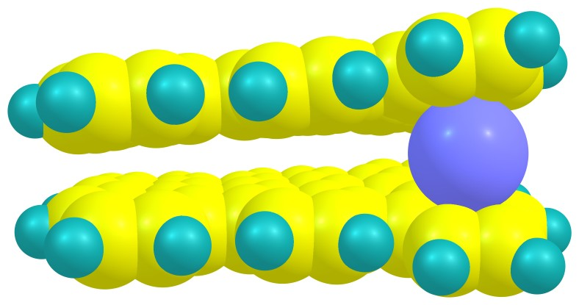
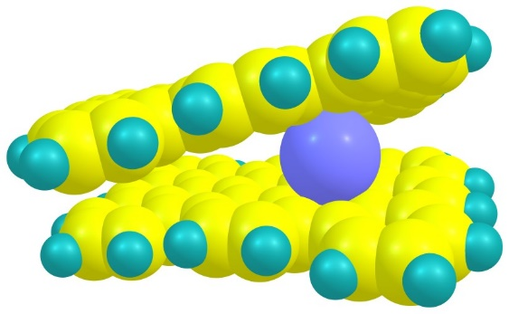
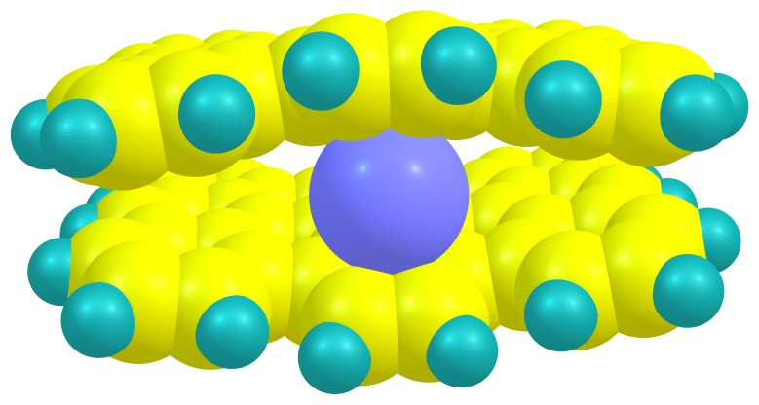
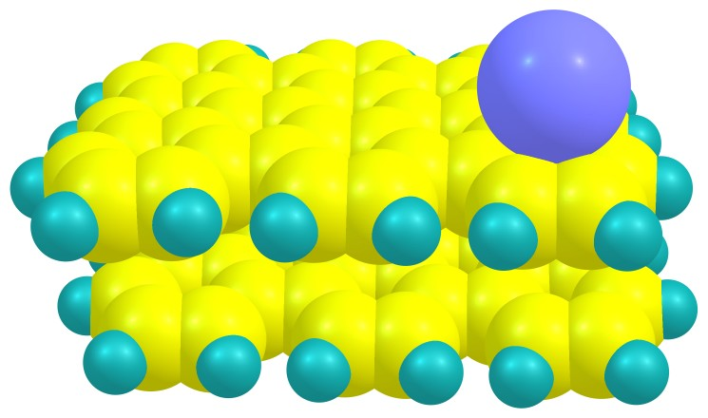
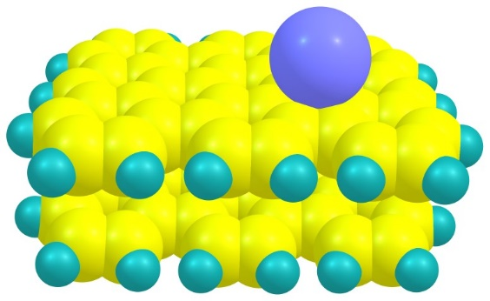
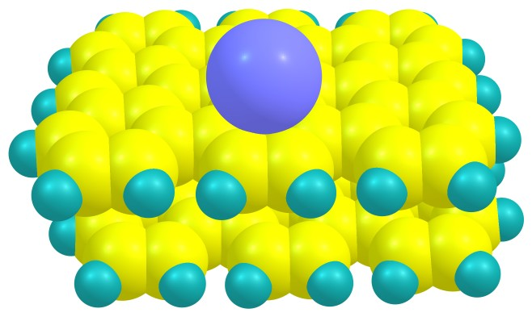
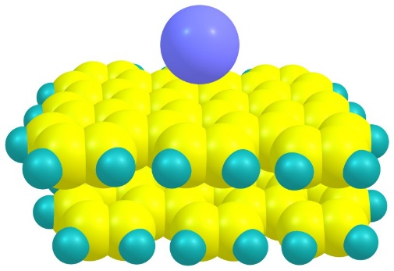
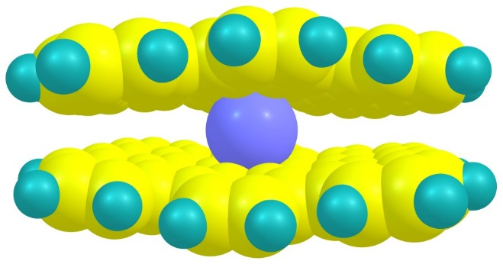
Possible Na Adsorption Sites on Graphene
G-Na1 (-57.443)
G-Na2 (-56.315)
G-Na3 (-53.805)
G-Na4 (-58.640)
G-Na5 (-48.052)
G-Na6 (-48.422)
G-Na7 (-47.461)
G-Na8 (-42.783)
G-Na9 (-47.604)
Fig. Optimized geometries of possible Na⁺ adsorption sites on the graphene and their adsorption energies (E₃ in kcal/mol) in parenthesis at B3LYP-D3/6-31G(d) level of theory.

Slide 5
Most Stable PC Complex
A sequential search of possible PC adsorption sites (10 different initial conformers) on the graphene surface imparted GPC-Na-2 as the most stable conformer with stronger adsorption.
Table: Adsorption energy (E₁ in kcal/mol) for possible PC adsorption sites on graphene at B3LYP-D3/6-31G(d) level of theory.
2.231
3.374
Structure | E₁
GPC-Na-1 | -47.513
GPC-Na-2 | -48.614
GPC-Na-3 | -47.951
GPC-Na-4 | -46.180
GPC-Na-5 | -46.808
GPC-Na-6 | -33.063
GPC-Na-7 | -33.369
GPC-Na-8 | -33.404
GPC-Na-9 | -34.494
GPC-Na-10 | -33.919
Fig. Optimised structure of GPC-Na-2 complex
In GPC-Na-2 complex, PC moved to between two graphene layers with strong interaction of Na and carbonyl oxygen with 2.231 Å distance and PC also moved closer to graphene surface than other conformers.
In the above complex, the C=O bond stretches slightly by ∼0.018 Å, while the C₂-O₃ and C₂-O₁ bonds shrinks by ~0.020 Å compared to the PC in gas phase.
The calculated adsorption energy (E₁), -48.614 kcal/mol, is greater than that of non-adsorbed Na⁺-PC (E₂ = -43.706 kcal/mol). Thereby, the graphene surface favors a strong binding of Na⁺-PC .

Slide 6
Optimized Geometries of PC After One and Two Electron Reduction
3.264
2.231
3.374
2.274
3.113
2.324
3.234
GPC-Na⁺(ΔΕ=0.00)
GPC-Na (ΔΕ=-100.602)
GPC-Na⁻ (ΔΕ=-41.759 )
Fig. Optimized geometries of GPC-Na⁺ complex, one electron reduction complex (GPC-Na) and two electron reduction complex (GPC-Na⁻ ) along with their reaction energies(ΔΕ) in kcal/mol.
The electron transfer step is highly exothermic, with ΔΕ =−100.602 kcal/mol. It also lower than in the non-adsorbed Na⁺-PC complex (ΔΕ = −91.371 kcal/mol).
This suggests that one electron transfer on the graphene surface may be more thermodynamically favorable. However, the strong adsorption energy and negative reaction energy shows that two electron reduction may also possible.
After one and two electron transfer, majority of the negative charge (~90%) located on the graphene surface. This reveals that graphene is able to buffer the sharp charge change on PC and Na⁺. This effect stabilizes the complex and brings about lower reaction energy.

Slide 7
The Possible Bond Cleavages in the PC
6
After one electron reduction : C₂-O₃, C₂-O₁, C₄-O₃ and C₅-O₁
After two electron reduction : C₅-O₁/C₄-O₃ together
After one electron reduction C₄-O₃ and C₅-O₁ bond cleavage products and C₅-O₁/C₄-O₃ bonds cleavage product after two electron reduction has been investigated. However, the C₂-O₃ and C₂-O₁ bond cleavage products were not found.
2
1
3
5
4
7
2.274
3.193
PC molecule with possible bond cleavages
3.264
2.274
3.113
C₄-O₃ and C₅-O₁ bond cleavages have reaction energy 17.714 kcal/mol and 19.139 kcal/mol respectively.
Based on the previous studies of PC reductive decompositions we have considered the C₄-O₃ bond cleavage for further calculations.
After the bond cleavage, more charge on the complex is shifted from graphene to PC molecule.
C₅-O₁ bond
GPC-Na-1 (ΔΕ= 17.714)
C₄-O₃ bond
2.228
3.384
GPC-Na
Fig. One electron reduction products and their reaction energies in kcal/mol.
G-PC-Na-2 (ΔΕ= 19.139)

Slide 8
One Electron Reduction Products
3.264
2.188
3.255
2.274
3.113
2.228
3.384
C₄-O₃ bond
GPC-Na (RE= 0.00 kcal/mol)
GPC-Na-TS1 (RE = 22.740 kcal/mol)
GPC-Na-IN1 (RE = 13.211 kcal/mol)
Fig. Calculated intermediate (GPC-Na-IN1) and transition state (GPC-Na-TS1) of PC C₄-O₃ bond cleavage after one electron reduction on the graphene surface and their relative free energies (RE) at B3LYP-D3/6-31G(d) level of theory.
The C₄-O₃ bond cleavage proceeds with activation free energy barrier of 22.740 kcal/mol through GPC-Na-TS1 transition state.
In comparison to activation free energy barrier of PC-Na⁺ complex (10.283 kcal/mol), the presence of electrode (graphene) increase the activation barrier by factor of two in GPC-Na complex.
Addition of electron increased the charge density on the graphene and some of this charge injected from graphene to PC in the TS. However the charge on graphene is more (-0.52) than PC (-0.30).
These results reveals that the unequal charge distribution between graphene and PC molecules increase the activation barrier in the GPC-Na complex.

Slide 9
Two Electron Reduction Products
1.837
2.203
2.324
2.174
3.103
3.767
2.216
3.175
3.234
C₅-O₁/C₄-O₃
GPC-Na-2e⁻ (RE = 0.000 kcal/mol)
GPC-Na-TS-2e (RE = 32.033 kcal/mol)
GPC-Na-IN-2e (RE = 11.247 kcal/mol)
Fig. Calculated intermediate (GPC-Na-IN-2e) and transition state (GPC-Na-TS-2e) of PC C₅-O₁/C₄-O₃ bond cleavage after two electron reduction on the graphene surface and their relative free energies (RE) at B3LYP-D3/6-31G(d) level of theory.
Activation free energy barrier 32.033 kcal/mol
The lower reaction energy and activation energy reveals that C₅-O₁/C₄-O₃ bonds cleavage is possible in two electro reduction products.
In the transition state the charge is more on PC (-1.21) in comparison to graphene (-0.58). This higher energy on the PC may facilitates the decomposition of PC after two electron reduction.
Along with C₄-O₃ bonds cleavage in one electron reduction decomposition, C₅-O₁/C₄-O₃ bonds cleavage can also be possible in the two electron reduction of PC decomposition.

Slide 10
Effect of Solvation
2.233
2.234
2.240
2.233
3.298
2.241
3.302
2.234
3.435
GPC-Na-PC2-1 (E₁ = -42.513)
GPC-Na-PC2-2 (E₁ = -41.860)
GPC-Na-PC2-3 (E₁ = -42.169 )
The systematic search of PC solvated conformers impart GPC-Na-PC2-1 as most stable structure with strong adsorption.
The adsorption energy, -42.513 kcal/mol, is lower than that of mono PC adsorbed GPC-Na-PC complex (-48.614 kcal/mol). Thereby, the addition of PC solvent weakens the adsorption.
In this complex, the charge is shifted from graphene to PC molecules compare to GPC-Na-PC complex, may be this facilitates the dissociation of PC.
In most stable conformer PC molecules are relatively closer to the graphene than other conformers.
2.300
2.443
GPC-Na-PC2-4 (E_{ads} = -43.860)
GPC-Na-PC2-5 (E_{ads} = -35.731)
Fig. Optimised structure of GPC-Na-(PC)2 complexes at B3LYP-D3/6-31G(d) level of theory and their adsorption energy (E₁) in kcal/mol

Slide 11
One Electron Reduction Products
2.260
2.260
2.257
2.425
2.203
2.243
C₄-O₃ bond
GPC-Na-PC2 (RE = 0.000 kcal/mol)
GPC-Na-PC2-TS (RE = 21.407 kcal/mol)
GPC-Na-PC2-IN (RE = 8.948 kcal/mol)
Fig. Calculated intermediate (GPC-Na-PC2-IN) and transition state (GPC-Na-PC2-TS) of PC C₄-O₃ bond cleavage after one electron reduction on the graphene surface along with their relative free energies (RΕ) at B3LYP-D3/6-31G(d) level of theory.
Activation free energy: 21.407 kcal/mol
The solvation slightly, decreased the activation free energy barrier in comparison to the barrier of non-solvated GPC-Na-PC decomposition.
Addition of electron increased charge density on the graphene. In comparison to non-solvated complex (GPC-Na) after solvation charge on the PC was increased from 0.06 to 0.12. In solvated TS charges on the graphene and Na⁺ were decreased (~0.05) and the charge on the graphene and PC were virtually equal.
The equivalent charge distribution on the graphene and PC molecules in the solvated complex may facilitates the faster decomposition of the PC decomposition.

Slide 12
Two Electron Transfer Products
2.302
2.293
2.870
2.302
2.295
2.348
C₅-O₁/C₄-O₃ bonds
GPC-Na-PC2-2e (RE = 0.000)
GPC-Na-PC2-TS-2e (RE = 28.801)
GPC-Na-PC2-IN-2e (RE = 2.974)
Fig. Calculated intermediate (GPC-Na-PC2-IN-2e) and transition state (GPC-Na-PC2-TS-2e) of PC C₅-O₁/C₄-O₃ bond cleavage after two electron reduction on the graphene surface and their relative free energies (RE in kcal/mol) at B3LYP-D3/6-31G(d) level of theory.
Activation free energy: 28.801 kcal/mol
The solvation decreased the activation barrier by 3.232 kcal/mol in comparison to non-solvated GPC-Na-PC decomposition barrier.
Addition of electron increased charge density on the graphene. In comparison to non-solvated complex (GPC-Na-2e) after solvation charge on the PC was increased from -1.61 to -1.55. In solvated TS charges on the graphene was decreased (~0.06) and the charge on the PC is more than graphene.
The uneven charge distribution on the graphene and PC molecules in the TS of two electron reduction may responsible for the higher activation barrier than one electron reduction (12.459 kcal/mol).

Slide 13
Conclusions
In the present study we investigate the graphene electrode and solvation effect on the reductive decomposition of propylene carbonate.
B3LYP-D3/6-31+G(d) method provides reasonable Inter Layer Spacing for graphene dimer in comparison to experimental results than various other methods.
The graphene surface favors a strong binding of Na⁺-PC complex than that of non-adsorbed Na⁺-PC complex.
The one electron reduction is favorable than two electron reduction. However, along with C₄-O₃ bond cleavage in one electron reduction decomposition, C₅-O₁/C₄-O₃ bonds cleavage can also be possible in the two electron reduction of PC decomposition due to the reasonable activation energy.
The solvation slightly decreased the activation barrier of PC decomposition in comparison to non-solvated GPC-Na-PC complex. The equivalent charge distribution on the graphene and PC molecules in the solvated complex may facilitates the faster decomposition of the PC decomposition.
The uneven charge distribution on the graphene and PC molecules in the TS of two electron reduction may responsible for the higher activation barrier (28.801 kcal/mol) than one electron reduction (21.407 kcal/mol).

