Slide 1
CREST Workshop Uppula Purushotham
Graphene Electrode Dependency on the Reduction Mechanism of Propylene Carbonate in Sodium-ion Batteries: A Density
Functional Theory Study

Slide 2
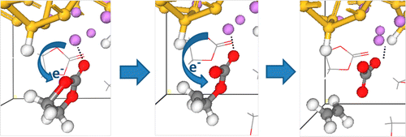
Background of Present Research
Fig. Reduction Mechanisms of Ethylene Carbonate on Si Anodes of Lithium-Ion Batteries
Recent theoretical studies revealed that electrolyte decomposition is strongly depend on the electrolyte-electrode interactions in presence of the electrode [1-2].
In a study, the one and two-electron transfer processes of EC and FEC on the Li⁺ adsorbed Si cluster revealed that the two-electron transfer process is more favorable for FEC reductive decomposition on the Si anode. [1]
Thus, to investigate the microscopic mechanism of the SEI film formation, it is essential and inevitable to consider explicitly the electrolyte-electrode interactions.
In the present study we investigate the graphene electrode effect on the reductive decomposition of propylene carbonate.
1. Ma, Y.; Balbuena, P. B. J. Electrochem. Soc. 2014, 161, E3097.
2. Martinez de la Hoz, J. M.; Leung, K.; and Balbuena, P. B. ACS Appl. Mater. Interfaces, 2013, 5, 13457.

Slide 3
Selection of Suitable Method
Table: Total Energy (TE) in hatrees and Inter Layer Spacing (ILS in Å) of the 3X3 graphene dimer model system at various level of theories with 6-31G(d) basis set.
Method | ILS
B3LYP-D3 | 3.308
B3LYP | 3.712
M06-2X | 3.245
HF | 3.957
Experimental Inter Layer Spacing
̴ 3.353 (±0.04) Å¹
Theoretical prediction ̴ 3.4 Å²
B3LYP-D3 method provides reasonable Inter Layer Spacing and stable structure than other methods.
3.308
C₈₄H₃₆ Point Group: C_{2h}
Optimized geometry of graphene dimer at B3LYP-D3/6-31G(d) level of theory
¹Y. Baskin et al., Phys. Rev. 1955, 100, 544.
² Cao et al., Nano Lett. 2012, 12, 3783.

Slide 4
Computational Details
All geometry optimizations and frequency analysis in this study was carried out with B3LYP-D3/6-31+G(d) level of theory.
All the calculations were carried out with using Gaussian 09.
Adsorption energy defined by following equation
= Adsorption energy
Total energy of the optimized substrate-adsorbate structures
Energy of the substrate in free state
Energy of adsorbates in free state

Slide 5
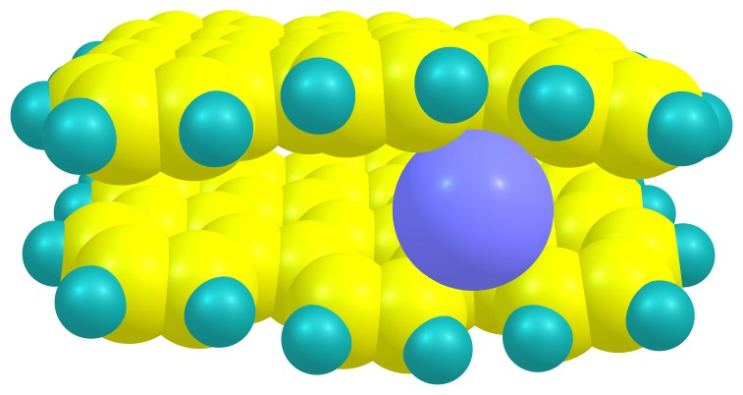
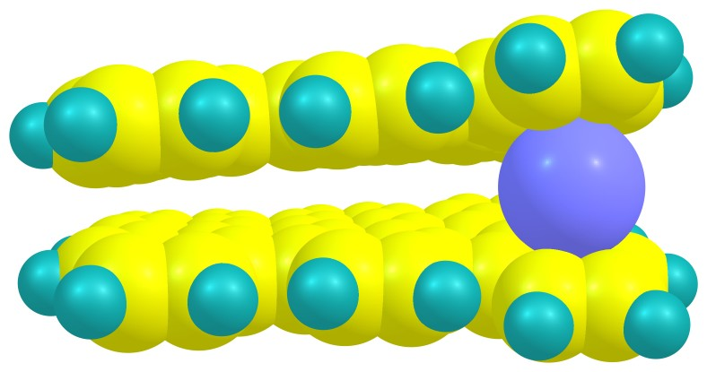
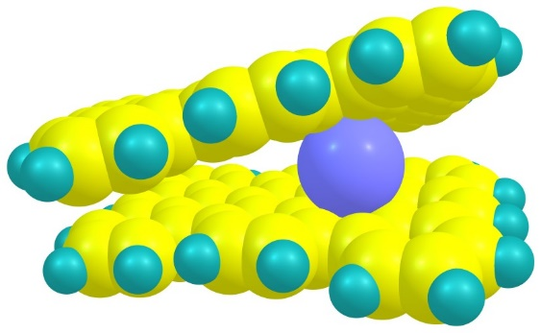
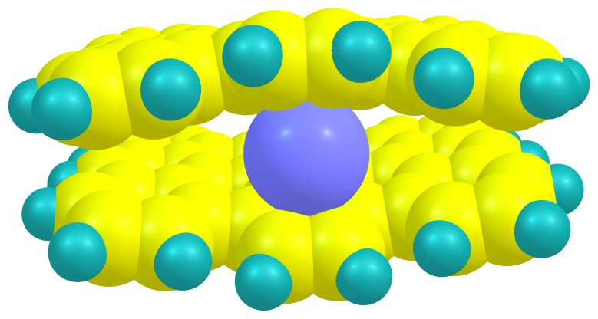
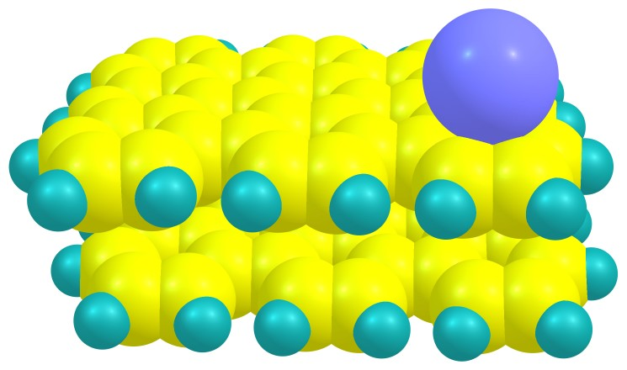
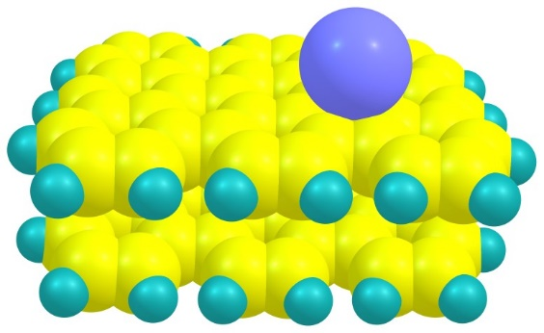
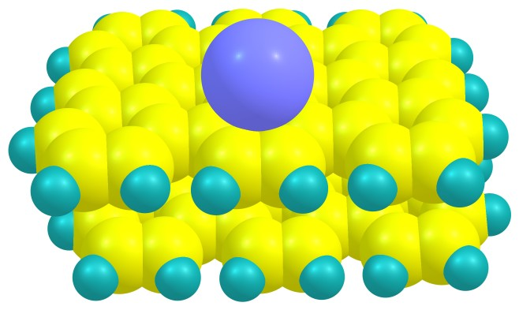
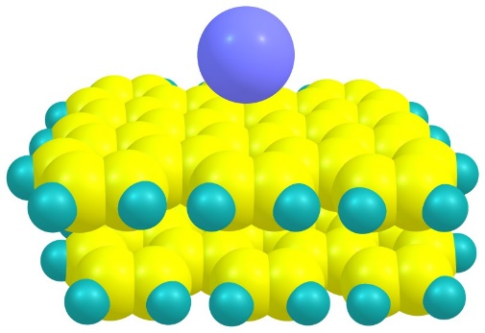
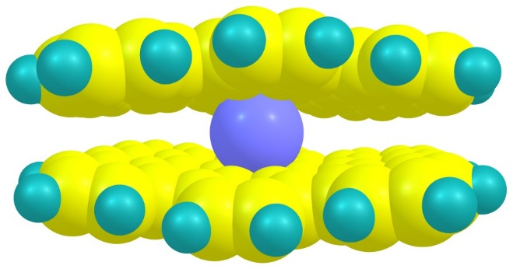
Possible Na Adsorption Sites on Graphene
G-Na1 (-57.443)
G-Na2 (-56.315)
G-Na3 (-53.805)
G-Na4 (-58.640)
G-Na5 (-48.052)
G-Na6 (-48.422)
G-Na7 (-47.461)
G-Na8 (-42.783)
G-Na9 (-47.604)
Fig. Optimized geometries of possible Na adsorption sites on the graphene and their adsorption energies (E_{ads} in kcal/mol) in parenthesis at B3LYP-D3/6-31G(d) level of theory.

Slide 6
PC Adsorption Sites on Graphene Surface
G-PC-Na-1
G-PC-Na-2
G-PC-Na-3
G-PC-Na-4
G-PC-Na-5
G-PC-Na-6
G-PC-Na-7
G-PC-Na-8
G-PC-Na-9
G-PC-Na-10
Fig. Optimized geometries of possible G-PC-Na⁺ complex on graphene surface

Slide 7
Most Stable PC Complex
Table: Adsorption energy (E_{ads} in kcal/mol) for possible PC adsorption sites on Graphene at B3LYP-D3/6-31G(d) level of theory.
2.231
3.374
Structure | E_{ads}
GPC-Na-1 | -47.513
GPC-Na-2 | -48.614
GPC-Na-3 | -47.951
GPC-Na-4 | -46.180
GPC-Na-5 | -46.808
GPC-Na-6 | -33.063
GPC-Na-7 | -33.369
GPC-Na-8 | -33.404
GPC-Na-9 | -34.494
GPC-Na-10 | -33.919
Fig. Optimised structure of G-PC-Na-2 complex

Slide 8
Optimized Geometries of PC After One and Two Electron Reduction
3.264
2.231
3.374
2.274
3.113
2.324
3.234
G-PC-Na⁺ (E_{ads} = -48.614 kcal/mol)
G-PC-Na (E_{ads} = -55.378 kcal/mol)
G-PC-Na⁻ (E_{ads} = -104.150 kcal/mol)
Fig. Optimized geometries of G-PC-Na⁺ complex, one electron reduction complex (G-PC-Na) and two electron reduction complex (G-PC-Na⁻ )
Reaction energies (ΔΕ)
G-PC-Na⁺ → G-PC-Na : -100.602 kcal/mol
G-PC-Na⁺ → G-PC-Na⁻ : -41.759 kcal/mol
The one electron reduction is favorable than two electron reduction. However negative reaction energy shows that it can also possible.

Slide 9
The Possible Bond Cleavages in the PC
After one electron reduction : C₂-O₃, C₂-O₁, C₄-O₃ and C₅-O₁
After two electron reduction : C₅-O₁/C₄-O₃ together
After one electron reduction C₄-O₃ and C₅-O₁ bond cleavage products and C₅-O₁/C₄-O₃ bonds cleavage product after two electron reduction has been investigated. However, the C₂-O₃ and C₂-O₁ bond cleavage products are not found.
6
2
1
3
5
4
7
2.274
3.193
PC molecule with possible bond cleavages
3.264
2.274
3.113
C₅-O₁ bond
G-PC-Na-1 (E_{ads} = -30.021 kcal/mol )
C₄-O₃ bond cleavage is favorable with lower reaction energy (-17.714 kcal/mol than C₅-O₁ bond cleavage (19.139 kcal/mol). The positive reaction energy shows that this bond cleavage is not thermodynamically favorable.
C₄-O₃ bond
2.228
3.384
G-PC-Na (E_{ads} = -55.378 kcal/mol)
Fig. One electron reduction products
G-PC-Na-2 (E_{ads} = -28.672 kcal/mol)

Slide 10
Propylene Carbonate Reaction Scheme and Energy Profile
Activation barrier energy for the cleavage of C₄-O₃ bond through G-PC-TS3 is 28.413 kcal/mol.
G-PC-IN5 complex is more stable than other intermediates.
The present reaction profile is also similar to PC-Na⁺ complex profile with out graphene, however, the activation energy is significantly increases in the present study.
It reveals that graphene surface showed significant effect on the decomposition of PC molecules.
G-PC-IN1
G-PC-TS3
G-PC-TS6
G-PC-IN7
Relative energy (ΔΕ in kcal/mol)
28.413
G-PC-IN2
G-PC-IN5
G-PC-IN8
Figure: Potential energy (ΔΕ in kcal/mol) profile for the reductive decomposition process of Na⁺- PC on the graphene surface.

Slide 11
Optimized Geometries and Adsorption Energy
3.264
2.231
3.374
2.274
3.113
2.188
3.255
G-PC-IN1 (E_{ads} = -48.614)
G-PC-IN2 (E_{ads} = -55.378)
G-PC-TS3 (E_{ads} = -43.661)
2.274
3.193
After one electron reduction G-PC-IN2 adsorbed more strongly than other molecules. However, after dissociation of C₄-O₃ bond, weak adsorption appeared in the G-PC-IN4.
This reveals that PC electrolyte molecules show strong interaction with graphite surface than dissociative molecules after one electron reduction with high adsorption energy and short C-O distance.
G-PC-IN4 (E_{ads} = -28.672)
Fig. Optimized geometries with representative bond lengths and adsorption energies (E_{ads} in kcal/mol) in parenthesis.

Slide 12
Optimized Geometries and Adsorption Energy
1.900
3.285
3.262
2.226
2.264
3.246
2.202
G-PC-IN5 (E_{ads} = -89.501)
G-PC-TS6 (E_{ads} = -49.776)
G-PC-IN7 (E_{ads} = -66.784)
2.208
3.174
3.693
After 2 electron reduction G-PC-IN5 showed strong adsorption than other complexes.
The propene molecule moved away from the graphene surface in final product thus, it showed very low adsorption energy.
Overall, G-PC-IN5 showed strong interaction with graphene surface, which is also more stable complex with lower energy on the potential energy barrier.
Two electron reduced complexes are more strongly adsorbed on the graphene surface in comparison to one electron reduction complexes.
G-PC-IN8 (E_{ads} = -35.209)

Slide 13
Two Electron Reduction Products
2.203
2.324
2.174
3.234
3.103
3.767
C₅-O₁/C₄-O₃ bonds
G-PC-Na⁻ (E_{ads} = -104.150 kcal/mol)
G-PC-Na-3 (E_{ads} = -50.085 kcal/mol)
2.319
3.199
Activation barrier energy 34.978 kcal/mol
Reaction energy
-15.534 kcal/mol
G-PC-Na⁻ TS-(E_{ads} = -71.267 kcal/mol)
The lower reaction energy and activation energy reveals that C₅-O₁/C₄-O₃ bonds cleavage is possible in two electro reduction products.
Along with C₄-O₃ bonds cleavage in one electron reduction decomposition, C₅-O₁/C₄-O₃ bonds cleavage can be possible in the two electro reduction of PC decomposition.

Slide 14
Conclusions
In the present study we investigate the graphene electrode effect on the reductive decomposition of propylene carbonate.
B3LYP-D3/6-31+G(d) method provides reasonable Inter Layer Spacing for graphene dimer than various other methods.
The conformer with Na⁺ ion captured between two graphene layers is more reasonable than other conformers.
The one electron reduction is favorable than two electron reduction. However negative reaction energy shows that both the reductions are possible.
In one electron reduction C₄-O₃ bond cleavage is favorable with lower reaction energy (-17.714 kcal/mol than C₅-O₁ bond cleavage (19.139 kcal/mol).
The lower reaction energy and activation energy reveals that C₅-O₁/C₄-O₃ bonds cleavage is possible in two electro reduction products.
Along with C₄-O₃ bonds cleavage in one electron reduction decomposition, C₅-O₁/C₄-O₃ bonds cleavage also possible in two electro reduction of PC decomposition.

