Slide 1
Developments of molecular simulation method depending on the environment pH conditions: Proposal of micro constant pH-MS method
Yukichi Kitamura
Notes:
Now, I’m developing the molecular simulation (MS) methods depending on the external pH conditions.
In the 4th CREST workshop, I have introduced the theoretical background of continuous titration based constant pH method.
And then, I talked about how to implement it into amber package and have also discussed their computational disadvantages.
So, I have developing the new method based on the discrete transition model, we call it micro constant pH-MS method.
In today's workshop, I would like to talk about the basic concept of micro constant pH-MS method and its computational performance for model system.

Slide 2
Contents of Today’s Workshop
Now, I’m developing the molecular simulation (MS) methods depending on the external pH conditions.
In the 6th CREST workshop, I have introduced the theoretical background of continuous constant pH method.
And then, I talked about how to implement it into amber package and have also discussed their computational disadvantages.
So, I have developing the new method based on the discrete transition model, we call it micro constant pH MS method.
In this workshop, I would like to talk about the basic concept of micro constant pH MS method and its computational performance for model system.
Notes:
Now, I’m developing the molecular simulation (MS) methods depending on the external pH conditions.
In the 6th CREST workshop, I have introduced the theoretical background of continuous constant pH method.
And then, I talked about how to implement it into amber package and have also discussed their computational disadvantages.
So, I have developing the new method based on the discrete transition model, we call it micro constant pH-MS method.
In this workshop, I would like to talk about the basic concept of micro constant pH-MS method and its computational performance for model system.

Slide 3
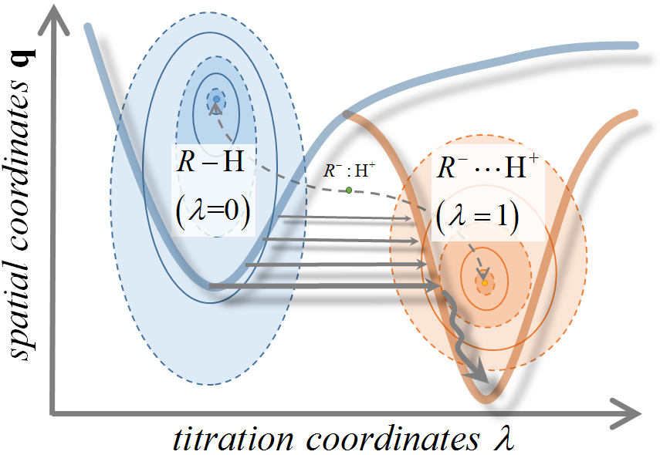
Micro Constant pH MS method 1/3
Conventional Molecular Simulation Method
(by temporary developing spatial coordinates and atomic velocities)
↓
Constant pH method enables the sampling coupled with two coordinates!
Constant pH Molecular Dynamics
(the titration states are switched between two states)
Notes:
<First, I will talk about the basis concept of micro constant pH MS method.>
The molecular simulation (MS) method can generate a representative sampling of a system at a finite temperature.
A configuration generated by the classical method is limited to only ensemble in a certain situation that any chemical reaction does not occur.
In constant pH method, the titration coordinate λ is introduced into whole system Hamiltonian to express the transition events between titration states.
We can treat the pH-dependent ensemble of the solute molecules while using a conventional molecular force field based approach.

Slide 4
Micro Constant pH MS method 1/3
The molecular simulation (MS) method can generate a representative sampling of a system at a finite temperature.
A configuration generated by the classical method is limited to only ensemble in a certain situation that any chemical reaction does not occur.
In constant pH method, the titration coordinate λ is introduced into whole system Hamiltonian to express the transition events between titration states.
We can obtain the pH-dependent ensemble of the solute molecules while using a conventional molecular force field based approach.
Notes:
<First, I will talk about the basis concept of micro constant pH MS method.>
The molecular simulation (MS) method can generate a representative sampling of a system at a finite temperature.
A configuration generated by the classical method is limited to only ensemble in a certain situation that any chemical reaction does not occur.
In constant pH method, the titration coordinate λ is introduced into whole system Hamiltonian to express the transition events between titration states.
We can treat the pH-dependent ensemble of the solute molecules while using a conventional molecular force field based approach.

Slide 5
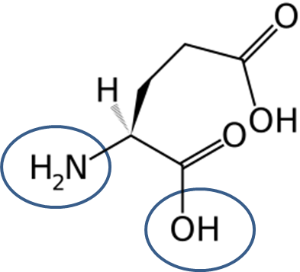
Micro Constant pH MS method 2/3
To avoid the disadvantage of continuous models, I adopted the discrete model.
Discrete models
(the titration states are switched between two states only)
e-
Protonated state (λ=0)
Deprotonated state (λ=1)
<Advantages of discrete model>
1) Discrete model enables to generate the physical meaningful configuration only.
↔ Continuous model is unavoidably to visit the unphysical states (δ< λ <1-δ, with δ≈0.1).
2) Computational effort is linear increase.
↔ High cost, 2^{N} (If there are N titration sites)
Notes:
To avoid the disadvantage of continuous models, I adopted the discrete model (in micro constant pH MS method).
In discrete models, the titration states are switched between two states only.
There are some advantages of discrete model.
1) Discrete model enables to generate the physical meaningful configuration only.
↔ Continuous model is unavoidably to visit the unphysical states (δ< λ <1-δ, with δ≈0.1).
2) Computational effort is linear increase.
↔ On the other hand, the computational cost is very high, 2N (If there are N titration sites).

Slide 6
Micro Constant pH MS method 2/3
The MD and MC parts are reciprocally executed and the transition events are accepted (or rejected) according to the transition probability under the Metropolis scheme.
It is necessary to estimate the free energy difference at every MC trial, therefore the continuum models are usually employed.
1 MC Trial
MD
MC
Notes:
In discrete models, the MD and MC parts are reciprocally executed and the transition events are accepted (or rejected) according to the transition probability under the Metropolis scheme.
It is necessary to estimate the free energy difference at every MC trial, therefore the continuum models are usually employed.

Slide 7
Micro Constant pH MS method 3/3
There is a serious problem on the combination of explicit solvent model and discrete transition model.
With explicit solvent model, a sudden change of titration site results in a large energy penalty, which leads to an improper MC trial.
To avoid such large energy fluctuations, we introduced the Gaussian filtering scheme and the correction term.
State transition
λ=0 → λ=1
Energy [kcal/mol]
<λ=0>
<λ=1>
Total MD Step [ps]
Notes:
There is a serious problem on the combination of explicit solvent model and discrete transition model.

Slide 8
Gaussian filtering scheme 1/3
1 MC trial is consisted by 4 steps.
1 MC Trial
MC
Sampling run
Change state and minimization
Product run with Gaussian filtering scheme
Gaussian filtering scheme
(1) After sampling MD (Sampling run), the protonate state is randomly exchanged, and execute minimization.
(2) execute MD run (product run) with new state and check the total energy at every step before MC trial.
(3) if ∆E is sufficiently small, the MD run is stopped and switches to next MC part (Gaussian filtering), .

Slide 9
Gaussian filtering scheme 2/3
trial2
trial1
trial3
＜λ=0＞
＜λ=1＞
Selected energy zone
Figure. schematic image of pre-selection procedure by Gaussian filtering scheme.
Notes:
This is schematic image of pre-selection procedure by Gaussian filtering scheme.

Slide 10
Gaussian filtering scheme 3/3
The energy difference between reaction (E₀, sampling run) and product (E₁’, product run) is employed in MC procedure.
The Gaussian filtering works to select the instantaneous configuration having sufficiently small energy difference.
By such pre-selection step in product run, the MC acceptance ratio will be efficiently increased.

Slide 11
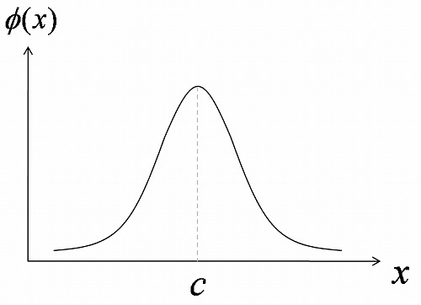
Numerical Results: Gaussian filtering scheme
To check the numerical performance, I executed the MC simulation with the ideal function.
Model system
The energy is generated by the random numbers according with normal distribution.
Simulation setting
Mean value for reaction: -10⁵ [kcal/mol]
Mean value for product: -1.01 ∗10⁵ [kcal/mol]
Variance of both system: 50 [kcal/mol]
Variance for Gaussian filter: 1k_{B}T [kcal/mol]
Total 1000 MC trial
μ=-10⁵ [kcal/mol]
μ=-1.01∗10⁵ [kcal/mol]
σ²=50 [kcal/mol]
Notes:
To check the numerical performance, I executed the MC simulation with the ideal function.
They are the simulation setting.

Slide 12
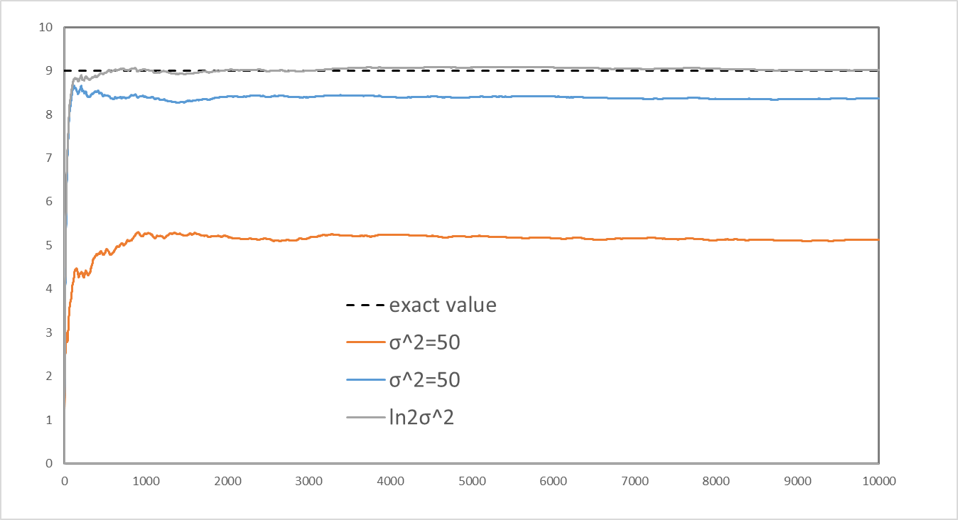
Numerical Results: Gaussian filtering scheme
Averaged deprotonation ratio
Without Gaussian Filter
With Gaussian Filter (σ²=k_{B}T)
With Gaussian Filter (σ²=k_{B}T) + correction term (C=0.693k_{B}T)
Total MC trial
Figure. Change in the averaged deprotonated ratio as a function of sampling MD step
Without the Gaussian filter, the average ratio of deprotonated compound was 0.5 and the exact value (≈0.9) could not be reproduced.
Notes:
This is also showed the change in the averaged deprotonated ration as a function of sampling MD step.

Slide 13
Numerical Results: Gaussian filtering scheme
Averaged deprotonation ratio
Without Gaussian Filter
With Gaussian Filter (σ²=k_{B}T)
With Gaussian Filter (σ²=k_{B}T) + correction term (C=0.693k_{B}T)
Total MC trial
Figure. Change in the averaged deprotonated ratio as a function of sampling MD step
By applying the Gaussian filter, the estimated value neared the exact one, but could not be reproduced completely.

Slide 14
Numerical Results: Gaussian filtering scheme
Averaged deprotonation ratio
Without Gaussian Filter
With Gaussian Filter (σ²=k_{B}T)
With Gaussian Filter (σ²=k_{B}T) + correction term (C=0.693k_{B}T)
Total MC trial
Figure. Change in the averaged deprotonated ratio as a function of sampling MD step
By combination with the Gaussian filter and correction term, we could reproduce the exact value.

Slide 15
Addition of Correction term 1/3
By added the Gaussian filtering scheme, a bad effect by energy fluctuation see to avoid.
However, the two values did not match completely.
This is because of the artificial procedure of Gaussian filtering scheme, which is determined the variance in Gaussian filter.
To correct such numerical errors, the correction term is added into the energy difference by using MC procedure.

Slide 16
Addition of Correction term 2/3
The correction term corresponds to the numerical error by the variance in Gaussian filter.
In final state, the transition probability distribution satisfies
The exact value <λ>_{final} of titration state is estimated by free energy difference between two states.

Slide 17
Addition of Correction term 2/3
On the other hand, in the MC procedure with Gaussian filtering scheme, the transition probability P is given by
And, the average titration state of model system can estimated by

Slide 18
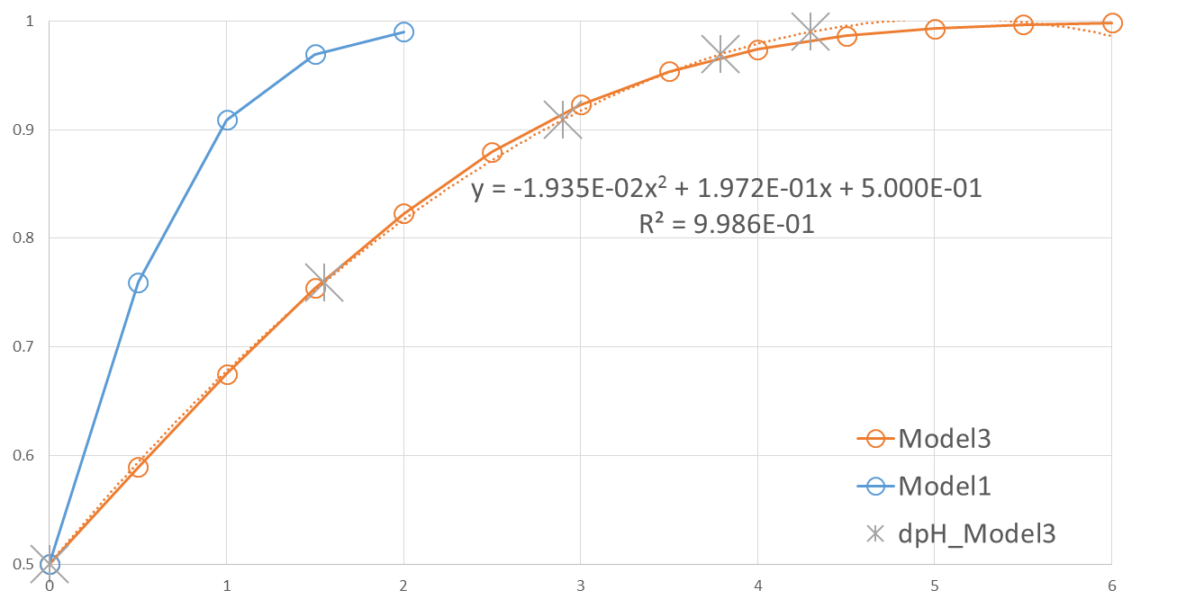
Addition of Correction term 3/3
ΔpH_{error}
Averaged state, <λ>
Model with Gaussian filter(σ²=10k_{B}T)
ΔpH_{exact}
ΔpH_{model}
Exact value
ΔpH
Figure. Change in the averaged deprotonated ratio as a function of ΔpH
The correction term corresponds to the energy difference between exact and estimated value, and obtained by conversion from ΔpH_{error} to the energy contribution.

Slide 19
Flowchart of micro constant pH MS method
START
PMEMD for Product system
Loop start
Main loop
Select Res
Calculate energies and forces
PMEMD for Reaction system
Update the velocities
If ∆E is sufficiently small, the MD run will be stopped and switches to next MC part.
Update the positions
Minimization
W<ε[0,1]
Gaussian Filter
No
Metropolis
Yes
End loop
End loop
Figure. Flowchart of micro constant pH MS method
END
Notes:
First, execute the reaction run with initial state.
After reaction run, randomly exchange of the transition state and energy minimization.
And then, execute the production run with new state.
In the production run, the MD will be stopped and switches to next MC part, if dE is sufficiently small.

Slide 20
Numerical Results: Gaussian filtering scheme
Model system
Simulation setting
Sampling NPT-MD run: 5 ps per each cycle
(Total 5.0 ns, 1000 MC trial)
5 CpH-MD simulations
(at pH values of pKa-1.0, -0.5, 0, +0.5, +1.0)
e-
Protonated state (λ=0)
Deprotonated state (λ=1)
※ The C- and N-terminal are kept neutral
Notes:
To check the numerical performance, I executed the simulation.
As a model system, I adopted the 10 glutamic acid in aqueous solution.
They are the simulation setting.

Slide 21
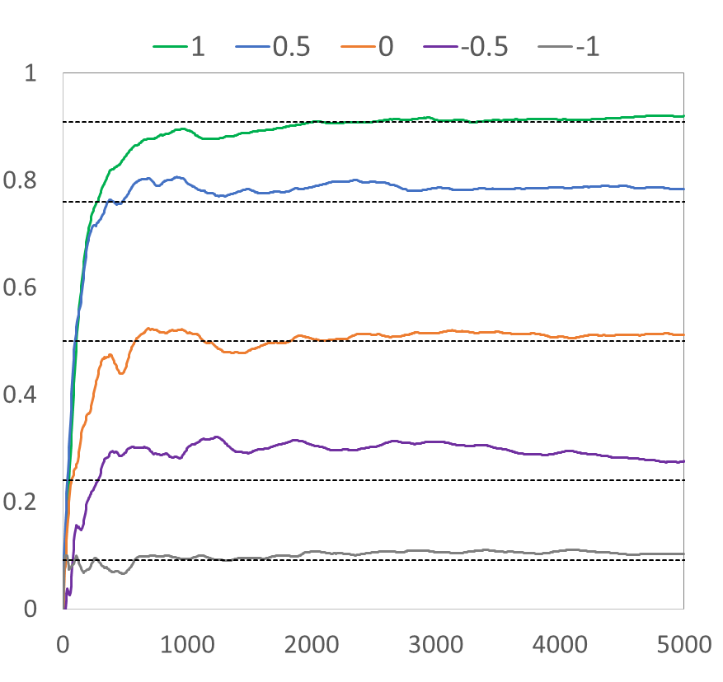
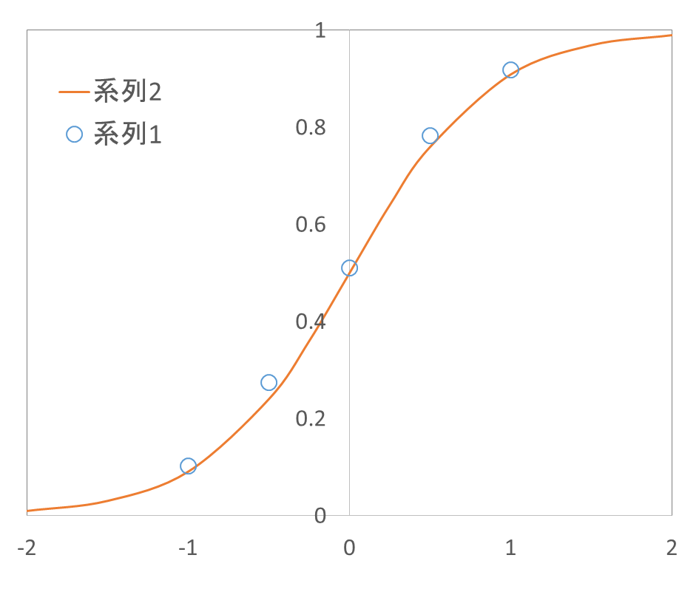
Numerical Results: Gaussian filtering scheme
Theoretical curve
Predicted value
Averaged deprotonation ratio
Averaged deprotonation ratio
Total sampling MD step [ps]
pH - pK_{a}
Our developed method could succeed in reproduction of experimental pH!

Slide 22
Conclusion
I have proposed the micro constant pH MS method.
Advantages of the micro constant pH MS method
Easy coding and low calculation effort
sample a physical-meaningful state only.
employ the explicit solvent model
Numerical result is shown that the micro constant pH MS method is a general framework to simulate the effect of pH in a wide range of molecular systems and materials.

Slide 23
Thank you for your attention.

Slide 24
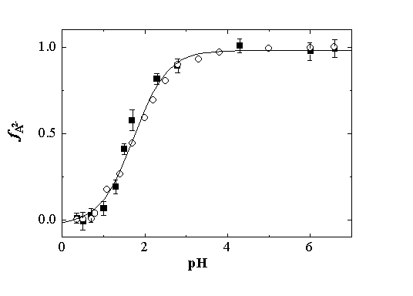
Theory: Basic idea of constant pH
→ The population of deprotonated state is increased according to an increase in solution pH value.
Deprotonation
pK_{A}
pH
The titration curve can fit to the expected Henderson-Hasselbalch equation.
Notes:
The population of deprotonated state is increased according to an increase in solution pH value.
The titration curve can fit to the expected Henderson-Hasselbalch equation.

Slide 25
Theory: Basic idea of constant pH
The titration curve can be re-expressed by a change in the relative free energy difference between two states.
By changing titration parameter λ based on free energy term ∆G^{pH} (which depends on solute pH), it can be achieved to sample the pH-dependent ensemble of solute molecules.
Notes:
The titration curve can be re-expressed by a change in the relative free energy difference between two states.
By changing titration parameter λ based on free energy term, it can be achieved to sample the pH-dependent ensemble of solute molecules.

Slide 26
Theory: Discrete titration models
In discrete models, the MD and MC parts are reciprocally executed and the transition events are accepted (or rejected) according to the transition probability under the Metropolis scheme.
It is necessary to estimate the free energy difference at every MC trial, so the continuum models are usually employed.
MC Cycle
MD
MC
Notes:
In discrete models, the MD and MC parts are reciprocally executed and the transition events are accepted (or rejected) according to the transition probability under the Metropolis scheme.
It is necessary to estimate the free energy difference at every MC trial, so the continuum models are usually employed.

Slide 27
Theory: Continuous models
Continuous constant pH MD utilizes an extended Hamiltonian to propagate spatial (real) and titration (virtual) coordinates, which introduces the forces on ‘λ-particles‘ (titration coordinates) as a fictional degree of freedom to the real particle system.
By temporally developing according to the extended Hamiltonian, it can be achieved to sample the pH-dependent ensemble of solute molecules.
Notes:
Continuous constant pH MD utilizes an extended Hamiltonian to propagate spatial and titration coordinates, which introduces the forces on “λ-particles” as a fictional degree of freedom to the real particle system.
By temporally developing according to the extended Hamiltonian, it can be achieved to sample the pH-dependent ensemble of solute molecules.

