Slide 1
Developments of molecular simulation method depending on the environment pH conditions: Implementation of continuous method and its problem
Yukichi Kitamura
Notes:
Now, I’m developing the molecular dynamics methods depending on the environment pH conditions.
In the 2nd CREST workshop, I have introduced the basic concept of constant pH method and talked about motivation of future works.
I have implemented the continuous MD method into amber package before.
So, in today's workshop, I would like to talk about its computational performance.

Slide 2
Theory: Constant pH MD method 1/3
Conventional Molecular Dynamics
(by temporary developing spatial coordinates and atomic velocities)
Constant pH Molecular Dynamics
(the titration states are switched between two states)
Notes:
The MD methods solve Newton’s equation of motion for atoms on an energy surface.
MD requires a set of initial coordinates and velocities, and an interaction potential.
And time-dependent properties can be obtained by temporary developing spatial coordinates and atomic velocities.
Constant pH method is one of simulation method that allow protonation/ deprotonation events depending on environment pH conditions.
In constant pH MD method, the coupling parameter λ is introduced into whole system Hamiltonian to express the transition between titration states.
The kinetic energy estimated by velocities of λ is added.
And the potential function is depended on the λ value.

Slide 3
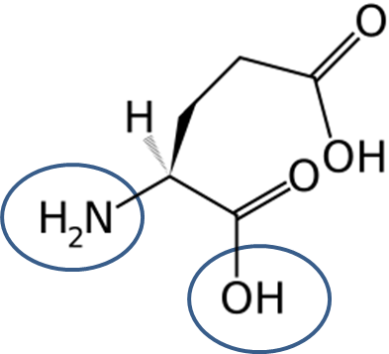
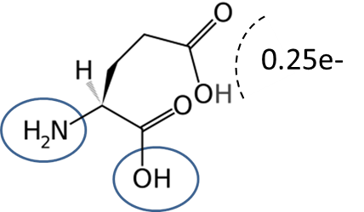
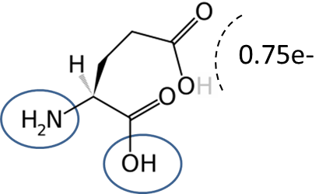
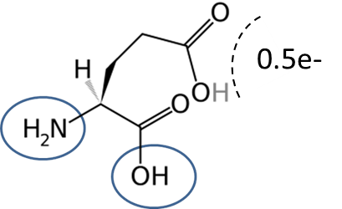
Theory: Constant pH MD method 2/3
The transition between titration states is expressed by the changes of coupling parameter λ.
Discrete models
(the titration states are switched between two states)
e-
Protonated state (λ=0)
Deprotonated state (λ=1)
Continuous models
(λ is changed continuously via intermediated states)
Intermediated state (λ=0.25)
Intermediated state (λ=0.75)
Intermediated state (λ=0.5)
Notes:
The constant pH methods are classified into two categories; discrete and continuous models.
Constant pH MD method is one of continuous models and we have implemented this method.
The transition between titration states is expressed by the changes of coupling parameter λ.
I continuous models, λ is changed continuously via many intermediated states.

Slide 4
Theory: Constant pH MD method 3/3
Continuous constant pH MD utilizes an extended Hamiltonian to propagate spatial (real) and titration (virtual) coordinates, which introduces the forces on ‘λ-particles‘ (titration coordinates) as a fictional degree of freedom to the real particle system.
By temporally developing according to the extended Hamiltonian, it can be achieved to sample the pH-dependent ensemble of solute molecules.
Notes:
Continuous constant pH MD utilizes an extended Hamiltonian to propagate spatial and titration coordinates, which introduces the forces on “λ-particles” as a fictional degree of freedom to the real particle system.
By temporally developing according to the extended Hamiltonian, it can be achieved to sample the pH-dependent ensemble of solute molecules.

Slide 5
Implementation 1/5: Extended Hamiltonian
Whole extended Hamiltonian of continuous constant pH MD method
→ real system
→ λ particle system
Notes:
This is also showed the detailed extended Hamiltonian.
The first and second terms correspond to kinetic energy and potential energy of real system.
U_int term means the potential energy coupled with real and titration coordinates.
On the other hand, the fourth and fifth terms correspond to kinetic energy and potential energy for titration coordinates.
Moreover, U* is constructed from three terms.
These were introduced to sample the titration coordinates effectively.
Details of these term are explained later.

Slide 6
Implementation 2/5: Electrostatic interaction
<Single titration site>
Electrostatic interactions can be described as the electric force between two charged objects, falling off gradually with distance (1/r) between them.
Therefore, electrostatic interactions are estimated by changing the charge value in proportion to λ value.
Notes:
First, I show the potential function for single titration site system.
Electrostatic interactions can be described as the electric force between two charged objects, falling off gradually with distance (1/r) between them.
Therefore, electrostatic interactions are estimated by changing the charge value in proportion to λ value.

Slide 7
Implementation 3/5: vdW interaction
<Single titration site>
vdW interactions can be described as the Lennard-Jones potential function (which is given by an R⁻⁶ and R⁻¹² term).
To estimate the vdW interaction, it is necessary to calculate the new vdW parameters between two states at every step.
Notes:
vdW interactions can be described as the Lennard-Jones potential function (which is given by an R-6 and R-12 term).
To estimate the vdW interaction, it is necessary to calculate the new vdW parameters between two states at every step.

Slide 8
Implementation 4/5: intramolecular term
<Single titration site>
In addition, it is also necessary to estimate the intramolecular terms.
Notes:
In addition, it is also necessary to estimate the intramolecular terms.

Slide 9
Implementation 5/5
Cph_flag==0
MD main:
sander()
Read file: mdread.f
and rdparm.f,…, etc
Csh program:
Make .top file
Forces:
force()
Call
sander()
Cph_flag==1
Integrator:
runmd()
Update parameters:
q’=(1-λ)q⁰+λq¹
A_{cn}(:)=0, B_{cn}(:)=0
Update parameters:
q’=0
Main loop
ew_force()
ew_force()
Update the velocities
Calculate intramolecular interactions with Force Field λ=0: bond(), angle(), ephi(),…, etc
Call
sander()
Cph_flag==2
Update the positions
Calculate intramolecular interactions with Force Field λ=1: bond(), angle(), ephi(),…, etc
Output
Notes:
This is schematic flow diagram.
To provide a general implement for Constant pH MD method, I have modified to call external sander subroutine in force subroutine.
The energy and gradient can obtained the external file.
Cph_flag=1: Calculation the vdW interactions
Cph_flag=2: Calculation the intramolecular interactions

Slide 10
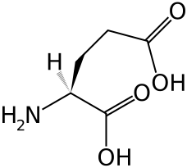
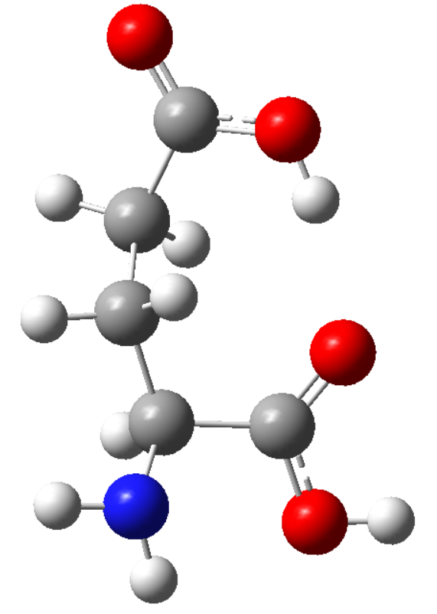
Test system 1/2
Solute: 1 glutamic acid molecule
H18 is titratable atom
Solvent: SPC-water model
O15
H18
Modification prepin file at two states
Neutral state (λ=0)
※ C/N terminal is kept neutral.
Ionized state (λ=1)
Modified the force field and charge of O15 and H18 atom
Here, atom name of H18 (DH) is dummy hydrogen atom.

Slide 11
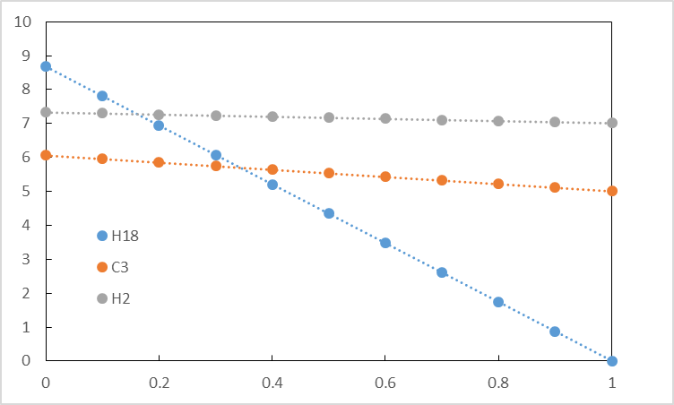
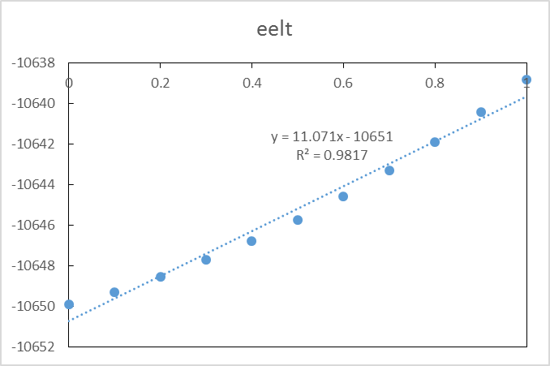
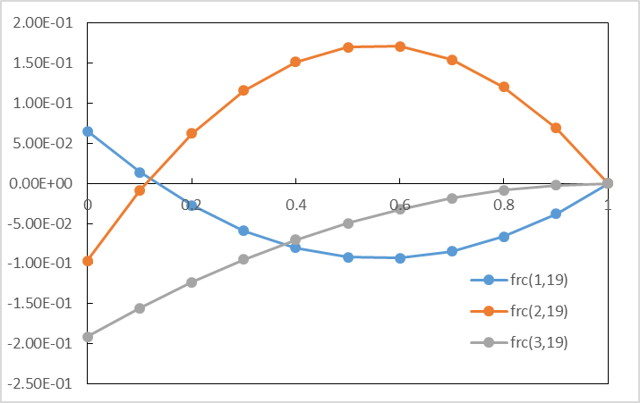
Test system 2/2
e-
q_{i}
Protonated state (λ=0)
Deprotonated state (λ=1)
※ C/N terminal is kept neutral.
λ
Electrostaic energy
gradient
Notes:
The right panel shows the changes in atomic charge as a function of titration value λ.
The bottom-left panels are the changes in electrostatic energy and gradient as a function of titration value λ.
The energy and forces can be represented as quadratic function of the λ value.

Slide 12
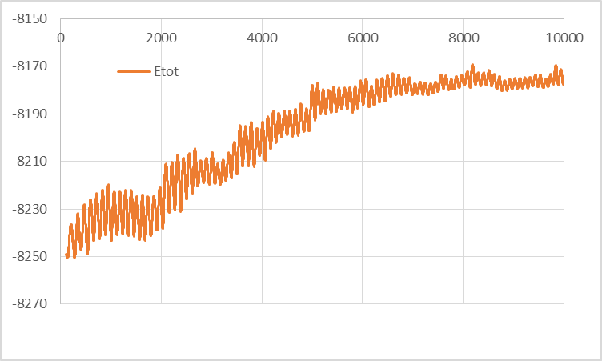
NVE-MD test 1/2
For first test calculation, I executed MD simulation with NVE condition and confirmed the conservation of energy during the simulation.
Total energy [kcal/mol]
This behavior is originated from algorithm of Constant pH-MD method.
Notes:
As a result, it was found that the total energy is not conserved.
I checked the program bag and researched the previous paper.
As a result, I concluded such behavior is originated from algorithm of CpH-MD method.

Slide 13
NVE-MD test 2/2 – Non-conservativeness
In CpH-MD method, it is necessary to estimate the free energy curve before execution of sampling run, which drives continuous changes of λ.
Because this value is free energy difference obtained by ensemble average (which is mean value), CpH-MD cannot be conserved the total energy of system (the extended Hamiltonian is not quantity of preservation.)

Slide 14
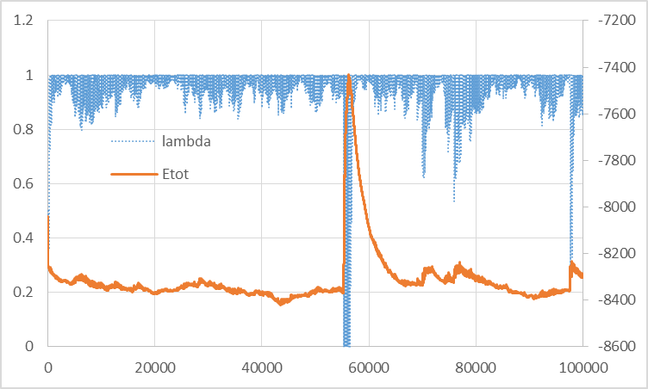
NVT-MD test 1/2
Artificial temperature rising
λ [-]
Total energy [kcal/mol]
Time [fs]
Example of the continuous CpH MD method with NVT condition.
Notes:
Next, I showed the example of the continuous CpH MD method with NVT condition with weak coupling thermostat.
Horizontal axis is MD time, left-vertical axis corresponds to the titration coordinates and right-vertical axis corresponds to the total energy of system.
As you can see, the NVT simulation shows unstable behaviors due to the artificial temperature rises induced by large fluctuation of λ value.

Slide 15
NVT-MD test 2/2 – Effect of mass
For test calculation, I changed the condition and investigated the behavior of the simulation.
A small (virtual) mass can achieve the high transition frequency between meaningful value (λ = 0 and λ = 1). However, this is introduced the artificial temperature rises.
On the other hand, a heavy mass can avoid the increases of total energy, but decreases the transition event.
Notes:
As a result, it was found that the mass of titration λ particle is efficiently parameter to control the simulation.
Thus, it is necessary to set the proper mass value of λ particle.

Slide 16
N-site system
<N-th titration site – intermolecular contribution>
Notes:
Finally,
These are intermolecular contribution for N-th titration site system.

Slide 17
N-site system
<N-th titration site – intramolecular contribution>
Notes:
And they are intramolecular ones.

Slide 18
Problems in the implementation
[Intermolecular term]
To consider the all possible protonation states of the system, the computational effort formally scales exponentially (2^{N}) with the number of titration sites in the system (N).
This is because the titration coordinates are coupled with other sites.
[Intramolecular term]
Intramolecular term can be estimated by mixed the two values at λ=0 and 1.
(which is not coupled with other titration sites)
Notes:
2^N=N-th power of 2

Slide 19
Conclusion
The continuous constant pH MD method has some disadvantages
Under NVE condition, the total energy does not conserved.
Under NVT condition, the unstable simulation due to the artificial temperature rises induced by large fluctuation of λ value.
High calculation cost 2^{N}, N is the number of titration sites
→ These results are shown that continuous method is not suitable to combine with hybrid MC/MD reaction method.
Notes:
These results are shown that continuous method is not suitable to combine with hybrid MC/MD reaction method.
Especially, the 3rd one is problematic to combine with hybrid MC/MD reaction method.

Slide 20
Thank you for your attention.

Slide 21
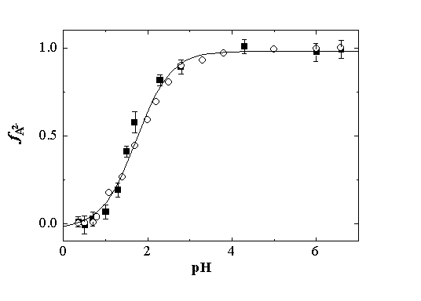
Theory: Basic idea of constant pH
→ The population of deprotonated state is increased according to an increase in solution pH value.
Deprotonation
pK_{A}
pH
The titration curve can fit to the expected Henderson-Hasselbalch equation.
Notes:
The population of deprotonated state is increased according to an increase in solution pH value.
The titration curve can fit to the expected Henderson-Hasselbalch equation.

Slide 22
Theory: Basic idea of constant pH
The titration curve can be re-expressed by a change in the relative free energy difference between two states.
By changing titration parameter λ based on free energy term ∆G^{pH} (which depends on solute pH), it can be achieved to sample the pH-dependent ensemble of solute molecules.
Notes:
The titration curve can be re-expressed by a change in the relative free energy difference between two states.
By changing titration parameter λ based on free energy term, it can be achieved to sample the pH-dependent ensemble of solute molecules.

Slide 23
Theory: Discrete titration models
In discrete models, the MD and MC parts are reciprocally executed and the transition events are accepted (or rejected) according to the transition probability under the Metropolis scheme.
It is necessary to estimate the free energy difference at every MC trial, so the continuum models are usually employed.
MC Cycle
MD
MC
Notes:
In discrete models, the MD and MC parts are reciprocally executed and the transition events are accepted (or rejected) according to the transition probability under the Metropolis scheme.
It is necessary to estimate the free energy difference at every MC trial, so the continuum models are usually employed.

Slide 24
Theory: Continuous models
Continuous constant pH MD utilizes an extended Hamiltonian to propagate spatial (real) and titration (virtual) coordinates, which introduces the forces on ‘λ-particles‘ (titration coordinates) as a fictional degree of freedom to the real particle system.
By temporally developing according to the extended Hamiltonian, it can be achieved to sample the pH-dependent ensemble of solute molecules.
Notes:
Continuous constant pH MD utilizes an extended Hamiltonian to propagate spatial and titration coordinates, which introduces the forces on “λ-particles” as a fictional degree of freedom to the real particle system.
By temporally developing according to the extended Hamiltonian, it can be achieved to sample the pH-dependent ensemble of solute molecules.

