Slide 1

The 4th CREST-WS
Probing the Most Stable Isomer of Zirconium Bis(phenoxy-imine) Cation: A Computational Investigation
Soumen Saha, Masayoshi Takayanagi, Kentaro Matsumoto, Sandhya Karakkadparambil Sankaran, Yuichi Tanaka, Nobuaki Koga, and Masataka Nagaoka1
Nagaoka Laboratory, Graduate School of Informatics, Nagoya University,
Chikusa-ku, Nagoya 464-8601, Japan
16/II/2018
J.Phys. Chem A, 2018, Accepted (DOI: 10.1021/acs.jpca.7b10999)

Slide 2
INTRODUCTION
The apprehended knowledge of geometrical features for the catalysts at the molecular level is the most vital to refine the catalytic activity, and hence, provides the innovative design for the next generation of catalysts.
Among the developments of catalyst, the most influential breakthroughs were the discoveries of metal-phenoxy-imine (or FI: Fenokishi-Imin Haiishi) catalysts.^{1,2}
The bulky substituents in the ortho position with respect to phenoxy-oxygen (i.e., R), and on imine-nitrogen (i.e., R₂) of Zr based FI-catalyst can accomplish an extraordinary high ethylene polymerization activity.²
Phenoxy-imine
X = halides, alkoxides, amides, alkyls, etc.
Zr-FI Catalyst
1. Chem. Rev. 2011, 111, 2363-2449.
2. Acc. Chem. Res. 2009, 42, 1532-1544.
Notes:
Over the past few decades chemists have industrialized several efficient polymerization reactions for converting monomers into the polymers with a broad range of diverse properties. These developments have been mainly attributed to understanding the various catalysts at a molecular level.

Slide 3
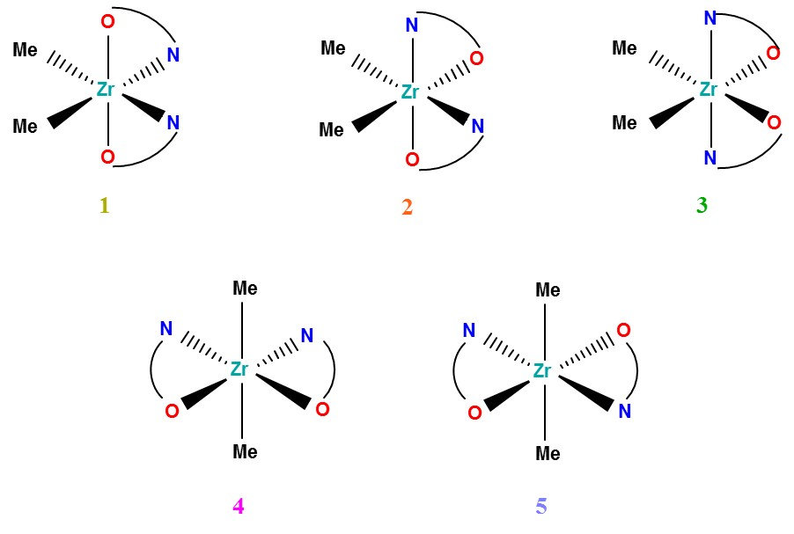
INTRODUCTION
The neutral form of the Zr based FI-catalyst can exhibit at least five different isomers, viz, cis-N/trans-O/cis-X, cis-N/cis-O/cis-X, trans-N/cis-O/cis-X, cis-N/cis-O/trans-X, and trans-N/trans-O/trans-X.¹
Neutral Zr-catalyst
cis-N/trans-O/cis-X
cis-N/cis-O/cis-X
trans-N/cis-O/cis-X
Most often Zr-FI-catalysts are exhibited in the form of 1 isomer,¹ whereas, when sterically demanding group is attached to R₂, 3 isomer appears as the most stable isomer.²
Even more, Zr-catalysts can also be present as a mixture of 1, and 2 isomers in the solution.³
cis-N/cis-O/trans-X
trans-N/trans-O/trans-X
Figure: Schematic representation of five different isomers of the considered neutral Zr-catalyst, where X = Me.
1. Chem. Rev. 2011, 111, 2363-2449.
2. J. Am. Chem. Soc. 2001, 123, 6847-6856.
3. Macromolecules 2003, 36, 523-525.
Notes:
On the other hand, the FI-catalyst has characteristically flexible nature of non-symmetric ligands, and, as a consequence, the neutral form of the Zr based FI-catalyst can exhibit at least five different isomers, viz, cis-N/trans-O/cis-X, cis-N/cis-O/cis-X, trans-N/cis-O/cis-X, cis-N/cis-O/trans-X, and trans-N/trans-O/trans-X (X = halides, alkoxides, amides, alkyls, etc.), based on the orientation of the phenoxy-imine (for instance see Figure 1, where X = Me).^{3,7}
Depending upon the ligand environment, among these five different isomers of the neutral FI-catalyst, at least more than one isomers are nearly equivalent in energy, and as a consequence, those isomers are often in an equilibrium in solution. Since the neutral FI-catalysts displayed a wide range of isomers, it is difficult to identify the most preferred isomer among them. In addition, the active species in the polymerization reaction of FI-catalyst is the cationic form rather than the neutral one.
In addition, the active species in the polymerization reaction of FI-catalyst is the cationic form rather than the neutral one.³

Slide 4
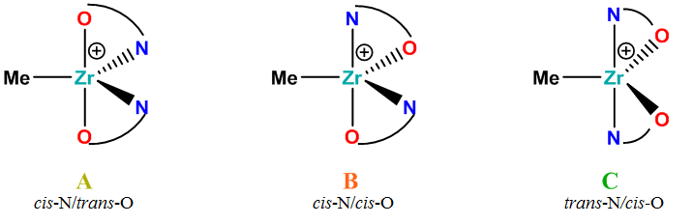
INTRODUCTION
The active species in the polymerization reaction of FI-catalyst is the cationic form rather than the neutral one.¹
Zr-cation
Figure : Schematic representation of three different isomers of Zr-cation.²
The presence of flexible ligands in Zr FI-catalysts makes the computational analysis more difficult.
Note that the existence of more than one isomers can exhibit the multimodal polymerization behavior, and thus, multimodal molecular weight distributions can be observed for the obtained polymers, as proposed by Tohi et al in their experimental study on bis(phenoxy-imine)zirconium complex.³
1. Chem. Rev. 2011, 111, 2363-2449.
2. Macromol. Chem. Phys. 2004, 205, 1179-1186.
3. Macromolecules 2003, 36, 523-525.
Notes:
In addition, the active species in the polymerization reaction of FI-catalyst is the cationic form (Scheme 1 (b)) rather than the neutral one.³ The cationic form also can exhibit three different isomers, viz, cis-N/trans-O, cis-N/cis-O, and trans-N/cis-O depending on the orientation of O and N atoms of phenoxy-imine ligands.
Accordingly, the presence of flexible ligands in Zr FI-catalysts makes the computational analysis more difficult.
In order to model these cations efficiently, one needs to consider various different conformations of each isomer, since a particular isomer can have the different orientation of the side groups in both O atom side as well as N atom side apart from the orientation of O and N atoms.
Note that the existence of more than one isomers can exhibit the multimodal polymerization behavior, and thus, multimodal molecular weight distributions can be observed for the obtained polymers, as proposed by Tohi et al in their experimental study on bis(phenoxy-imine)zirconium complex.¹⁰

Slide 5
INTRODUCTION
One of the most successful Zr-based FI catalysts, which has led to conjoining the soft polymer with hard polymer to form the block copolymer bearing blocks of both hard and soft polymers,¹ is the cation (i).
R = R₁= t-Bu, R₂ = i-Bu, and X = Me
Neutral Zr-catalyst (I)
Zr-cation (i)
In this presentation, we have made an attempt to investigate the qualitative trends for the stability of different isomers of this specific Zr-catalyst (I), particularly, with the emphasizing on the Zr-cation (i).
The energetics of different isomers of the catalyst were aimed to compare and understand the factors of coexistence of multiple isomers.
1. Science 2006, 312, 714-719.
Notes:
One of the most successful Zr-based FI catalysts, which has led to conjoining the soft polymer with hard polymer to form the block copolymer bearing blocks of both hard and soft polymers,¹² is the cation (i) as shown in Scheme 1(b). This special catalyst consists of non-symmetric phenoxy-imine chelating ligands, in which iso-butyl (R₂ = i-Bu) group is attached to N atoms along with tert-butyl (t-Bu) groups in ortho- and para-positions (i.e., R = R₁ = t-Bu) to the phenolic oxygens and X = Me.
Since all the influential factors cannot be appropriately considered in the computational studies due to the convolution rising from the flexibility of the ligand’s architecture, there have been no computational studies executed so far for this special catalyst. The experimental observation of this FI-cation is also scarce.
In the present article, we have made an attempt to investigate the qualitative trends for the stability of different isomers of this specific Zr-catalyst (I), particularly, with the emphasizing on the Zr-cation (i). The energetics of different isomers of the catalyst were aimed to compare and understand the factors of coexistence of multiple isomers.

Slide 6
COMPUTATIONAL METHODOLOGY
In order to search the preferable conformations for three different isomers (i.e., A, B, and C) of the cationic forms (i) we have performed the following steps:
First we have optimized the geometries at QM level by preparing the arbitrary input geometry for the cationic isomer A, B, and C.
To obtain QM potential energy curves, scan calculations for different bonds and angles were performed in the cases of each cationic isomer A, B, and C.
Subsequently, we have prepared tentative force field parameters by using the QM scan calculations as reference.
The 40 ns MD simulations in vacuum have been performed and saving snapshots every 2 ps (in total 20000 snapshots were generated) and then we have sampled out 40 structures.
The obtained 40 conformations for each isomer were further optimized using QM procedure.
Repetitions of these steps were performed to sample another 40 conformations for each isomer of the cationic form (i).
Therefore, altogether 80 different structures for each of the three cationic isomers have been generated using MD simulations and successively, optimization of these structures by QM procedure has been made to obtain the most preferable conformation for each isomer.
Notes:
The presence of flexible side groups (i.e., R, R₁, and R₂-groups) in the phenoxy-imine ligands makes the analysis more challenging in order to determine the most preferable isomers.
Therefore, probably, a strategy to solve this problem is that one may attempt to generate a limited number of structures for a particular isomer, in which orientations of the side chains are different, and then compare the energy values among them as obtained from quantum mechanical (QM) calculation. For the efficient and exhaustive modeling of different isomeric complexes, particularly, for the cationic isomers of (i), we have generated altogether 80 different structures for each of the three cationic isomers using molecular dynamics (MD) simulations and subsequently QM optimization of these structures has been performed in order to obtain the most preferable conformation for each isomeric form.
Here, we expect that MD simulations can selectively sample low-energy conformations by using appropriate force field parameters, which can reproduce the relative energy differences among many conformers.
However, for the metal-organic systems with the Zr center, there is no such appropriate force field parameters available. Therefore, we have developed the force field based on the AMBER force field (GAFF¹³: version 1.4 in AMBER 12¹⁴) parameters. The bonded interaction (i.e., bond, angle, and dihedral angle) parameters have been generated by fitting the QM results. The van der Waals (vdW) radius for Zr is considered as 1.75 Å,¹⁵ and those for other atoms are retrieved from GAFF. The atomic charges have been assigned by QM calculations with the Mertz−Singh−Kollman¹⁶ method. In order to search the preferable conformations for three different isomers (i.e., A, B, and C) of the cationic forms (i) we have performed the following steps: first we have optimized the geometries at QM level (choice of method and basis set for QM calculations is described in the subsequent paragraph) by preparing the arbitrary input geometry for the cationic isomer A, B, and C. To obtain QM potential energy curves, scan calculations for different bonds and angles were performed in the cases of each cationic isomers A, B, and C. Subsequently, we have prepared tentative force field parameters by using the QM scan calculations as reference. The 40 ns MD simulations of the cationic form in vacuum have been performed and saving snapshots every 2 ps (in total 20000 snapshots were generated). Then, K-means clustering with the number of clusters 40 was applied to obtain 40 representative structures. The obtained 40 conformations for each isomer were further optimized using QM procedure. Repetitions of these steps were performed to sample another 40 conformations for each isomer of the cationic form (i) (for more details of each step see Supporting Information). Therefore, altogether 80 different structures for each of the three cationic isomers have been generated using MD simulations and successively, optimization of these structures by QM procedure has been made to obtain the most preferable conformation for each isomer. After searching the preferable conformations of the cationic form (i), we have conducted QM optimizations for the neutral form (I) by adding a Me group to the Zr-atom each in the most preferable conformations of the cationic form (i).

Slide 7
COMPUTATIONAL METHODOLOGY
All the QM calculations have been performed using density functional theory (DFT) with M06¹⁸ functional.
For Zr atom double-ζ basis set (LANL2DZ + f) has been used, whereas for all other atoms 6-31G** basis set is used (i.e., B1 basis set).
For the considered cases, the geometries have also been optimized using M06 method with a basis set of higher quality, B2 (i.e., def2-TZVPP).
The choice of the basis sets has been made based on our laboratory’s previous investigation.¹
The selection of the method (i.e., M06) is directed by the computational investigations on seven different DFT functionals, viz., B3LYP, B3LYP-D3, M05-2X, M06, M06L, M06-2X, and TPSSh, in combination with both B1 and B2 basis sets for three different isomers of Zr-cation (i). The performance of these functionals has been compared with that of MP2 level of theory.
1. Bull. Chem. Soc. Jpn. 2016, 89, 1093-1105.
Notes:
the performance of M06 is in good agreement with that of high level MP2 method at a very decent computational cost.
All the QM calculations have been performed with Gaussian 09¹⁷ suite of program using density functional theory (DFT) with M06¹⁸ functional. For Zr atom double-ζ basis set (LANL2DZ) including f polarization function with the effective core potential (ECP) has been used, whereas for all other atoms 6-31G** basis set is used (i.e., B1 basis set). Subsequently, the frequency calculations are also performed for the most stable structures of neutral (I) and cationic (i) forms of catalyst. For the considered cases, the geometries have also been optimized using M06 method with a basis set of higher quality, B2 (i.e., def2-TZVPP¹⁹), and frequency calculations at M06/B2 level of theory has been conducted.
The choice of the basis sets has been made based on our laboratory’s previous investigations.²⁰ The selection of the method (i.e., M06) is directed by the computational investigations (optimizations as well as frequency calculations) on seven different DFT functionals, viz., B3LYP, B3LYP-D3, M05-2X, M06, M06L, M06-2X, and TPSSh, in combination with both B1 and B2 basis sets (see Table 1 as well as Table S1 in Supporting Information) for three different isomers of Zr-cation (i). The performance of these functionals has been compared with that of MP2 level of theory. For instance, Table 1 clearly indicates that the performance of M06 is in good agreement with that of high level MP2 method at a very decent computational cost. In the case of transition state (TS) calculations, first geometry optimization has been done at M06/B1 level and then the geometry was re-optimized at M06/B2 level of theory. The vibrational mode associated with the observed imaginary frequency is almost same at both the levels of theory. Implicit solvent effect is incorporated by SMD²¹ method using heptane as the solvent. The single point calculations at M06/B2 level of theory on the optimized geometries (as obtained at the same level of theory) were conducted for investigating the solvent effect. The mixed alkyl solvents are generally used for the polymerization reaction¹² and, therefore, we have decided to use heptane as a solvent in our study. The gas phase zero-point energy correction (ZPE) and thermal correction to Gibbs free energy (G_{correction}) values are used to calculate the zero-point corrected energy (E*) and the free energy (G*) in the solvent. In order to understand the origin of the stability for cationic isomers, the electron densities ($ρ$) and Laplacian of the electron density ($∇^{2}ρ$) at the bond critical points (BCPs) were mapped using the AIMALL program.²² Atoms-in-molecules (AIM) calculations can explain the formation of various non-covalent interactions (for example, hydrogen bond,²³⁻²⁸ cation-π interactions^{29,30} etc.) between the atoms.³¹⁻³³ The necessary wave function files (i.e., .wfx) for AIM analysis were created from the calculations of equilibrium geometries as obtained at the M06/B1 level of theory.

Slide 8
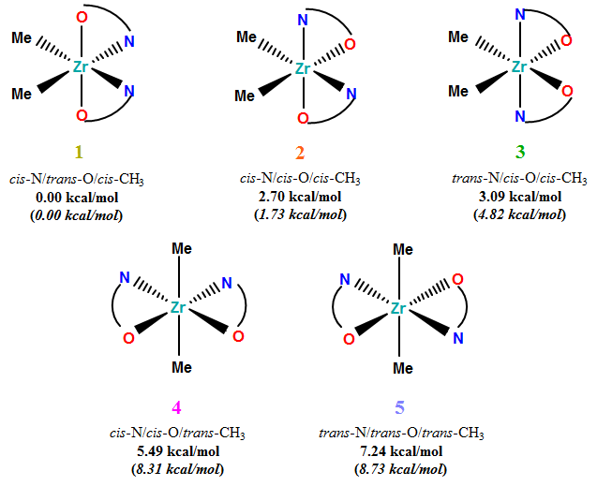
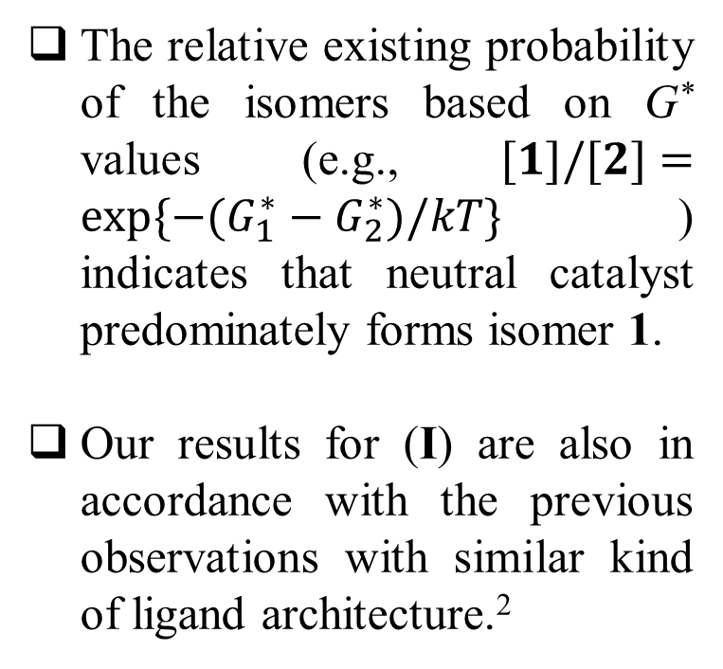
RESULTS AND DISCUSSION
Energetics and Geometrical Features of Neutral Zr-Catalyst (I)
The relative existing probability of the isomers based on G* values (e.g., $[1]/[2]=exp\{−(G_{1}^{∗}−G_{2}^{∗})/kT\}$) indicates that neutral catalyst predominately forms isomer 1.
Our results for (I) are also in accordance with the previous observations with similar kind of ligand architecture.²
Figure : Five different isomers of I. The relative energy values with respect to 1 are also shown, In parentheses, ∆G* values in the solvent are shown.
1. J. Am. Chem. Soc. 2001, 123, 6847-6856.
2. Chem. Rev. 2011, 111, 2363-2449.
Notes:
To the best of our knowledge, the experimental results are not available for this particular Zr-catalyst (I).
3. RESULTS AND DISCUSSION
3.1. Energetics and Geometrical Features of Neutral Zr-Catalyst (I).
Depending on the ligand coordination mode, the neutral form of zirconium bis(phenoxy-imine) catalyst (I) (Scheme 1 (a)) can exhibit five isomers in an octahedral architecture,⁷ as shown in Figure 1. The five isomers, viz., cis-N/trans-O/cis-Me (1), cis-N/cis-O/cis-Me (2), trans-N/cis-O/cis-Me (3), cis-N/cis-O/trans-Me (4), and trans-N/trans-O/trans-Me (5), for the considered Zr-catalyst (I) were optimized at M06/B1 and M06/B2 levels of theory. Subsequently, the calculations in heptane were performed at M06/B2 level, using the geometries as obtained at the same level of theory. On the basis of these calculations, we have observed that these isomers exhibit a distorted octahedral geometry around the Zr atom (Figure S5 in Supporting Information). Almost identical geometrical features are observed for both the levels of theory (see Table S2) while comparing the results for a particular isomer. Based on the energy values as obtained at M06/B1 and M06/B2 levels, it is observed that isomer 1 is the most preferable among the five isomers (see Table S3 in Supporting Information). The trend of the stability remains the same in the case of solvent calculations. The relative free energy (∆G*) values in gas as well as in heptane with respect to isomer 1 are shown in Figure 1. To the best of our knowledge, the experimental results are not available for this particular Zr-catalyst (I). However, in the experimental as well as in the computational study, it has been observed earlier that the Zr-bis(phenoxy-imine) catalysts (with different substitutions on R, R₁, and R₂ positions from catalyst (I)) mostly form isomer-1-like structure, i.e., cis-N/trans-O/cis-X.^{3,8,9} The preference of this isomer among the five isomers has been attributed to the fact that in those catalysts Zr-O bonds are significantly shorter than Zr-N bonds.³ We have also noted that in our considered Zr-catalyst (I), the Zr-O bonds are substantially shorter than the Zr-N bonds (see Table S2), which may be because Zr-O bonds are covalent in nature whereas Zr-N bonds are dative bonds. Moreover, the relative existing probability of the isomers based on G* values (e.g., $[1]/[2]=exp\{−(G_{1}^{∗}−G_{2}^{∗})/kT\}$) indicates that neutral catalyst predominately forms isomer 1 (see Table S3(c)). Thus, our results for the neutral catalyst (I) are also in accordance with the previous theoretical and experimental observations with similar kind of ligand architecture.³

Slide 9
RESULTS AND DISCUSSION
Energetics and Geometrical Features of Zr-Cation (i)
QM Energy (kcal/mol) w.r.t. A
0.00 | 3.16 | 0.83
M06/B1
0.00 | 1.52 | 0.48
MP2/B1
0.00 | 2.83 | -0.08
M06/B2
0.00 | 2.29 | -0.02
MP2/B2†
Solvent (Heptane)
0.00 | 2.35 | 0.82
A and C are equivalent in energy.
M06/B2†
B1 = 6-31G** (LANL2DZ +f polarization functions: Zr); B2 = Def2-TZVPP; †M06/B2//M06/B1; ‘Red Colour’ is more stable.
Notes:
3.2. Energetics and Geometrical Features of Zr-Cation (i).
An active species for the polymerization reaction is the cationic form (Scheme 1 (b)) of Zr-catalyst (i).³ Generally, the Zr-cation can exhibit three different isomers,¹¹ viz, cis-N/trans-O (A), cis-N/cis-O (B), and trans-N/cis-O (C) as shown in Figure 2 (see also Figure S6 in Supporting Information). For the efficient and exhaustive modeling of the preferable structure, altogether 80 different structures for each of the three cationic isomers A, B, and C have been generated by using MD simulations. Subsequently, QM optimizations for these structures have been performed in order to obtain the most preferable geometry among them for each isomeric form (see ‘Computational Details’ in Supporting Information). Table 2 summarizes the relative energies for the most stable geometry among the generated conformers for each cationic isomer as obtained in gas at different levels of theory as well as in solvent phase (see also Table S1, and S4 in Supporting Information). For a particular basis set, the trend of the relative energies for different cationic isomers is similar between the cases of M06 and MP2 methods. Nevertheless, the trend is not the same while comparing the relative energies obtained with two different basis sets for a specific method. For instance, for B1 basis set, isomer A is energetically more stable than isomers B and C with both the methods, whereas, C is more stable with B2 basis set for M06 and MP2 methods. In solvent phase, the relative energy trend is similar to that at M06/B1 (gas phase) level of theory. The solvent phase calculations at M06/B2 level show that A is energetically more favorable than isomers B and C (Table 2). However, for a particular isomer of cation (i), the observed geometrical features are almost equal in the cases of M06/B1, M06/B2, and MP2/B1 levels of theory (see Table S5 in Supporting Information).

Slide 10
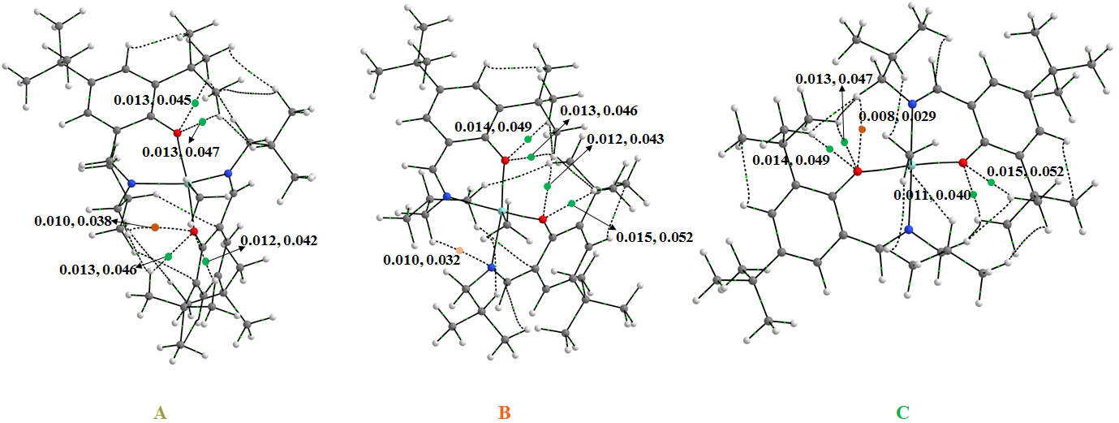
RESULTS AND DISCUSSION
Energetics and Geometrical Features of Zr-Cation (i)
Figure: AIM plot for three different isomers of Zr-cation (i). The electron densities ($ρ$) and Laplacian of the electron density ($∇^{2}ρ$) at the BCPs are also shown.
The AIM analysis indicates the existence of the bond critical points (BCPs) corresponding to five intramolecular hydrogen bonds (H-bonds) in all the three isomers of Zr-cation (i).
The presence of five hydrogen bonds may be the cause of the stability of these three isomers.
Notes:
The AIM analysis indicates the existence of the bond critical points (BCPs) corresponding to five intramolecular hydrogen bonds (H-bonds) in all the three isomers of Zr-cation (i) as shown in Figure 3. For isomer A, the four H-bonds are in between O atom and H atoms of R-group (i.e., t-Bu); and one H-bond is formed between O atom and H atoms of R₂-group (i.e., i-Bu) attached with one of the N atoms (shown by green and orange colored dots, respectively, in Figure 3). For isomer B, the observed four H-bonds are in between O atom and H atoms of R-group (i.e., t-Bu) and one H-bond forms with one of the N atom and H atom of R₂-group (i.e., i-Bu) attached to the other N atom. Similar to isomer A, for isomer C, the four H-bonds are in between O atom and H atoms of R-group (i.e., t-Bu); and one H-bond is formed between O atom and H atom of R₂-group (i.e., i-Bu) attached to one N atom. The presence of five hydrogen bonds may be the cause of the stability of these three isomers. Indeed, the existing probability of isomer B is smaller, whereas that of isomer C is comparable with that of isomer A as observed in Table 2. Since the H-bonds’ strength (based on $ρ$ and $∇^{2}ρ$; see Figure 3) are almost the same for each of the isomers, so it will be difficult to make any conclusion about the stability of the isomers based on AIM results. Therefore, in these circumstances, the important observations are: the existing probability of isomer B is smaller in comparison with the other two isomers (i.e., A and C), and it is impossible to rule out the existence of isomer C in comparison with isomer A. Notably, in the earlier experimental study in collaboration with theory, it has been observed that when R₁= Me and R₂ = C₆H₅, even isomer B can exist as a mixture along with isomer A.¹¹

Slide 11
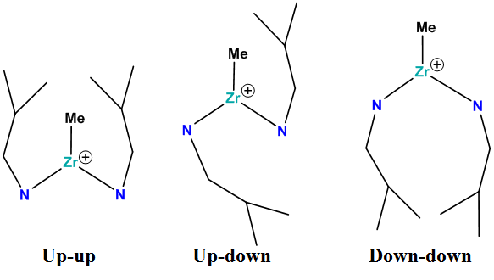
RESULTS AND DISCUSSION
Energetics and Geometrical Features of Zr-Cation (i)
We have observed that the orientations of R₂ (i.e., i-Bu at the N atoms) groups can be different for a particular isomer.
Figure: Schematic representation of three different orientations of R₂ groups for Zr-cation (i).
Isomer A can exist as a mixture in both ‘up-down’ and ‘down-down’ orientations.
Up-down
Down-down
M06/B1
Energy
(kcal/mol)
0.00 | 0.59
B1 = 6-31G** (LANL2DZ +f polarization functions: Zr).
Notes:
We have observed that the orientations of R₂ (i.e., i-Bu at the N atoms) groups can be different for a particular isomer. In general, three different orientations can be possible for two R₂ groups, viz, ‘up-up’, ‘up-down’, and ‘down-down’, as shown in Figure 4. In the case of ‘up-up’ both the R₂ groups are oriented towards Me-group; in ‘down-down’ case both the R₂ groups are in opposite to the Me-group, whereas in ‘up-down’ one R₂ group is oriented towards Me-group and the other one is opposite to the Me-group. Among the different conformations (as generated by M06/B1 optimization after MD simulation, see ‘Computational Details’ in Supporting Information), we have identified the most stable ‘up-up’, ‘up-down’, and ‘down-down’ conformations for each isomer. Indeed, among these three different orientations of R₂ groups for each isomer, one orientation is energetically the most stable and can be considered as the most preferable conformation for a particular isomer. We have witnessed that ‘up-down’ orientation is energetically the most preferred conformation for isomers A and B, whereas ‘up-up’ orientation is the most stable one for isomer C. Notably, isomer A can exist as a mixture in both ‘up-down’ and ‘down-down’ orientations, since the observed G* difference between the most stable ‘up-down’ (i.e., most preferred conformations) and ‘down-down’ structures is only 0.07 kcal/mol (see Table S6(a) in Supporting Information) at M06/B1 level of theory. Another important aspect is that among all the quantum mechanically optimized geometries, we have not found any ‘down-down’ orientation of the R₂ groups for isomer C. This is probably due to the fact that in the ‘down-down’ orientation, because of the steric repulsion between R and R₂ groups, two bulky i-Bu (R₂) groups pull down the N atoms, which in turn makes N-Zr-N angle smaller than O-Zr-O angle. Therefore, the ‘down-down’ structure of isomer C is transforming to the ‘down-down’ structure of isomer A. As a result, we have not observed ‘down-down’ orientation of isomer C while performing QM optimization at M06/B1 level of theory. In order to understand the steric effect between R, and R₂ groups we have performed the restricted geometry optimizations for R = t-Bu or R = Me of the ‘down-down’ orientation at M06/B1 level of theory by restricting the N-Zr-N and O-Zr-O angles to be the same as those in isomer C (i.e. 156.6° and 139.9°, respectively, see Table S5 in Supporting Information). The restricted geometry (when R = t-Bu) indicates that there is an excessive deformation of the six-membered zirconacycle, accompanied by the steric crowding between R and R₂ groups (see Figure S7(a) in Supporting Information), which can be reduced by replacing ‘t-Bu’ group by ‘Me’ groups at R positions (see Figure S7(b)). It is our speculation that because of this steric crowding between R and R₂ groups, isomer C (if exists) is not able to convert into isomer A as these two groups are trying to stay apart from each other. This action clearly counteracts the observance of ‘up-up’ orientation for isomer C during the geometry optimization. It is also evident from previous studies that the presence of the sterically hindered group in R₂ positions favors trans-N/cis-O/cis-X isomer in the case of the neutral catalyst.^{3,8,9} Based on these observations, we have further investigated the effects of the substituent groups for the existence of different isomers, as discussed in the next subsection.

Slide 12
RESULTS AND DISCUSSION
Effect of Stabilization of Isomers
(i)
In order to understand the reason for the existence of isomers B and C, we have computed several different Zr-cations.
We have considered cations (ii) and (iii) to investigate the origin for the existence of isomers B.
(ii)
(iii)
During geometry optimization at M06/B1 level of theory, we have observed only isomers A and B, whereas, isomer C is not found either of these two cases.
Furthermore, the G* difference between these two isomers, A, and B, are only 1.74 and 1.42 kcal/mol for (ii), and (iii), respectively.
It is probable that this kind of ligand architecture has the inherent property to exhibit both the isomers (i.e., A, and B).
B1 = 6-31G** (LANL2DZ +f polarization functions: Zr).
Notes:
3.3. Effect of Stabilization of Isomers.
In order to understand the reason for the existence of isomers B and C, we have computed several different Zr-cations as listed on Tables 3, 4, and 5. For these systems ((iii)-(xvi)), the substitutions on R, R₁, and R₂ groups are mainly different from those in the Zr-cation (i). To keep the same orientation of the R, R₁, and R₂ group, these systems are modified from the structure of the most stable conformation for the corresponding isomer of Zr-cation (i). The geometry optimization and vibrational frequency analysis were done at M06/B1 level of theory (see Figure S8 in Supporting Information).
Although the possibility of existence for isomer B is small in the case of cation (i) (as discussed in subsection 3.2), we have considered cations (ii) and (iii) to investigate the origin for the existence of isomers B (see Table 3). System (ii) is the smallest unit in this ligand architecture, whereas (iii) is the smallest unit for the phenoxy-imine ligand. During geometry optimization at M06/B1 level of theory, we have observed only isomers A and B, whereas, isomer C is not found either of these two cases. Furthermore, the G* difference between these two isomers, A, and B, are only 1.74 and 1.42 kcal/mol for (ii), and (iii), respectively (see Table S7 in Supporting Information). It is a matter of course that in these two cases the presence of aforementioned five H-bonds cannot be formed (see Figure 3), since the H atoms responsible for those H-bonds are not present in (ii) or (iii). Therefore, the presence of H-bonds may not be the only reason for the stability of isomers A and B. It is probable that this kind of ligand architecture has the inherent property to exhibit both the isomers (i.e., A, and B).

Slide 13
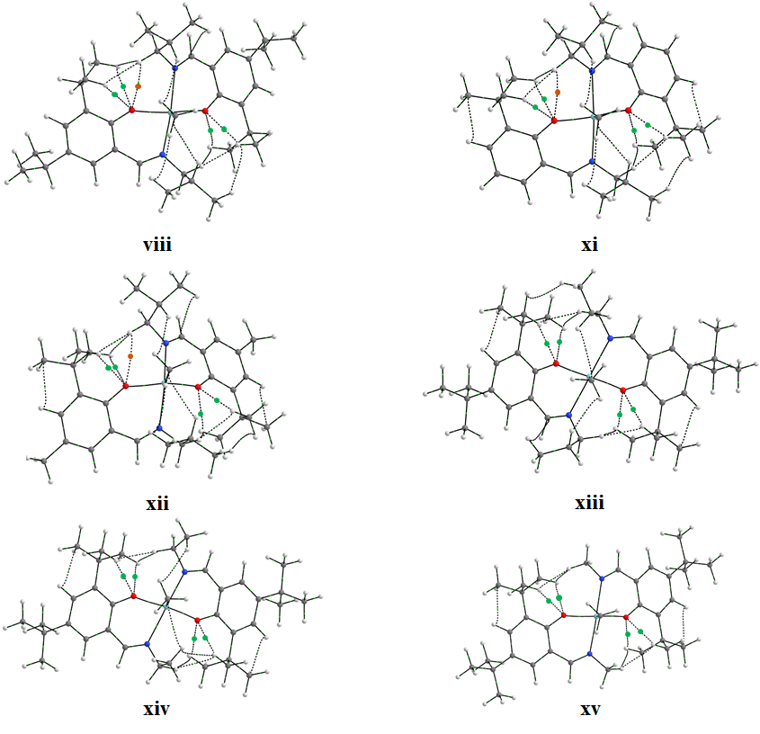
RESULTS AND DISCUSSION
Effect of Stabilization of Isomers
(i)
(iv)
(v)
(vi)
(vii)
(viii)
(ix)
(x)
We have found isomer C only in the case of (viii) along with isomer A. It indicates that a bulky group may be required at R, and R₁ positions, in order to observe isomer C.
From AIM plot of isomer C for (viii), we have observed five H-bonds.
H-bonds could play a role in the stability of isomer C.
Notes:
To explore the origin of the existence of isomer C in the case of cation (i), we have computed only isomers A and C for 13 different cationic systems (see Table 4), starting from (iv) to (xvi). These systems have different substituents at O sides (i.e., at R, and R₁ positions) as well as at N sides (i.e., R₂ positions) from the Zr-cation (i). While changing the substituents at O sides (i.e., at R and R₁ positions) we have kept the substituent at N sides the same as those in cation (i) (i.e., R₂= i-Bu) and, once we have changed the substituents at N sides (i.e., R₂ positions), then R and R₁ are t-Bu group. Apparently, it is delicate to differentiate between isomer A and C for some cations (see Figure S9 in Supporting Information). However, we have designated the structure as isomer A when O-Zr-O angle is larger than N-Zr-N angle, whereas as isomer C when N-Zr-N angle is larger than O-Zr-O angle. Systematic changing at R and R₁ positions from Me group (i.e., (iv)) to Et group (i.e., systems (v), (vi), and (vii)); and furthermore to i-Pr group (in the cases of (viii), (ix), and (x)), we have found isomer C only in the case of (viii) along with isomer A. It indicates that a bulky group may be required at R, and R₁ positions, in order to observe isomer C. More interestingly, cations (ix) and (x) also have the same i-Pr group at R and R₁ positions as (viii) does, but we have not observed isomer C during the QM geometry optimization process. From AIM plot (see Figure 5) of isomer C for (viii), we have observed five H-bonds as we did for cation (i) case (see Figure 3). In the all other cases (i.e., (iv), (v), (vi), (vii), (ix), and (x)), formation of H-bond(s) with O atom and the H atom of R group is not feasible as those H atoms are not present towards the O atom side. Therefore, it is clear that H-bonds could play a role in the stability of isomer C. While keeping R and R₂ groups fixed (i.e., R = t-Bu and R₂ = i-Bu), and varying the substituents at R₁ positions from H to Me group (i.e., cations (xi) and (xii)), we have also noticed the presence of isomer C along with A. The AIM plots of (xi) and (xii)) also indicate the presence of H-bonds between H atoms of t-Bu group, and O atoms (see Figure 5). These observations suggest that the substitutions at R₁ position do not play a role for the existence of isomer C, but a bulky group at R positions is required for the observance of isomer C.
(Table 4: near here)
(Figure 5: near here)

Slide 14
RESULTS AND DISCUSSION
Effect of Stabilization of Isomers
We have also noticed the presence of isomer C along with A.
(xi)
(xii)
The AIM plots of (xi) and (xii)) also indicate the presence of H-bonds between H atoms of t-Bu group, and O atoms.
(xi)
(xii)
These observations suggest that a bulky group at R positions is required for the observance of isomer C.

Slide 15
RESULTS AND DISCUSSION
Effect of Stabilization of Isomers
(i)
(xiii)
(xiv)
(xv)
(xvi)
Except for R₂= H (i.e. (xvi)), we have found isomer C along with isomer A. The presence of a group, such as Me, Et, n-Pr, and i-Bu having a size to some extent, at R₂ positions is necessary in order to exist as isomer C.
The probability of existence of isomer A increases in the order of Me < Et < n-Pr < i-Bu.
But, we have observed isomer A rather than isomer C when R₂ = H.
The steric hindrance might not be only the reason for the relative stability of the isomers.
By changing the R₂ groups one can modulate multimodal to unimodal polymerization behavior of the Zr-FI-catalysts.
Notes:
We have also changed the substitutions at N sides (i.e., at R₂ positions) from n-Pr to Et to Me groups, and finally to H atom by keeping R and R₁ groups to be t-Bu-group (i.e., cations (xiii)-(xvi), see Table 5), and performed QM optimizations in the cases of isomer A and C. Except for R₂= H, we have found isomer C along with isomer A. In the case of R₂=H (xvi) we have observed only isomer A. The AIM plots indicate the presence of four H-bonds in isomer C for cations (xiii), (xiv), and (xv) (see Figure 5). The H-bond between one of the R₂ group in N-side and O atom is not found in these cations. Although this particular H-bond may not be important for the stability of isomer C, the other four H-bonds between O atom and the H atom of R group must be important for the observance of isomer C, and these four may lead to the stability of the structure. Moreover, the presence of a group, such as Me, Et, n-Pr, and i-Bu having a size to some extent, at R₂ positions is necessary in order to exist as isomer C. It is interesting to note that from the energetics (see Table S8 in Supporting Information), we have observed that (xv) (i.e., R₂ = Me) will predominantly exhibit isomer C, and that the probability of existence of isomer A increases in the order of Me < Et < n-Pr < i-Bu, although it was previously^{3,8,9} observed that the presence of the sterically bulky group in R₂ positions favors trans-N/cis-O/cis-X. Moreover, we have observed isomer A rather than isomer C when R₂ groups are replaced by H atoms. It can be said, therefore, that the steric hindrance might not be only the reason for the relative stability of the isomers. However, it is clear that by changing the R₂ groups one can modulate multimodal to unimodal polymerization behavior of the Zr-FI-catalysts.

Slide 16
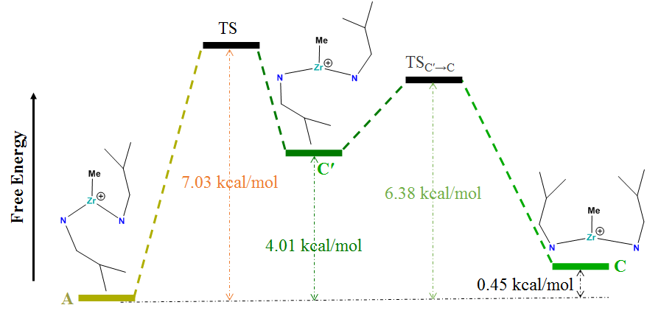
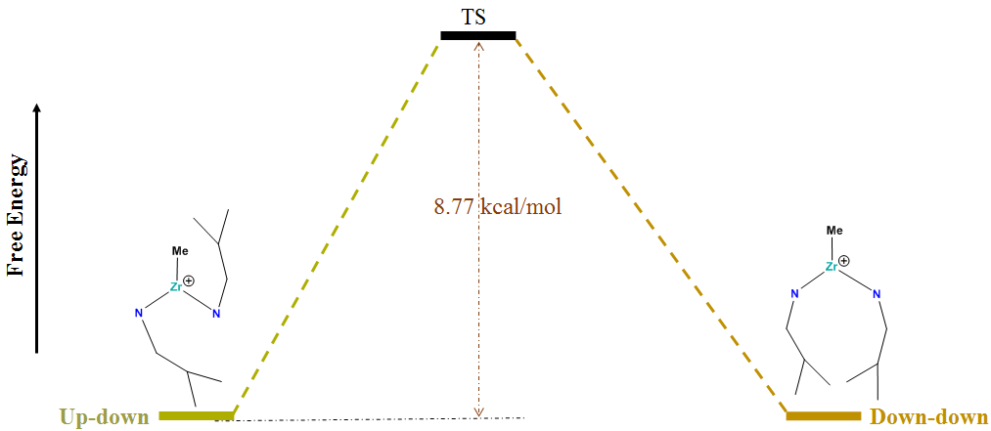
RESULTS AND DISCUSSION
Interconversion between Different Structures of Zr-Cation (i)
The interconversion from A to C may occur via two steps process.
The mutual transition between isomer A and C for cation (i) could be possible.
Isomer A
The isomer A of cation (i) can be present in two different orientations, i.e., ‘up-down’ and ‘down-down’.
M06/Def2-TZVPP
Notes:
3.4 Interconversion between Different Structures of Zr-Cation (i)
We have continued to investigate the possibility of existence of isomer C (‘up-up’) along with isomer A (‘up-down’) for Zr-cation (i), since the observed G* difference between isomer A and C is very small, only 0.45 kcal/mol, in the solvent (i.e., heptane) at M06/B2 level of theory (Table 2). The free energy diagram in the solution for the transition between isomer A and C is shown in Figure 6, as calculated at M06/B2 level of theory (see Table S9, and Figure S10 in Supporting Information). As shown in Figure 6, it is clear that the interconversion from A to C may occur via two steps process, and that the first step is the interconversion from A to C′ followed by that of C′ to C. While the orientation of R₂ (i-Bu) groups is different between C′ and C, the N-Zr-N angle is larger than the O-Zr-O one in C′ as observed in C. Basically, the path from C′ to C is for the conformational change of isomer C. Figure 6 indicates that the mutual transition between isomer A and C for cation (i) could be possible since the activation energy barriers are only 7.03 and 6.38 kcal/mol. Thus, it might be possible to present both the isomers as a mixture in the solution.
(Figure 6: near here)
Further, we have studied the transition between two different orientations, i.e., ‘up-down’ and ‘down-down’, of isomer A by performing the TS calculations (see Figure S11 in Supporting Information), which have been performed at M06/B1 and M06/B2 levels of theory (as discussed in section 2: COMPUTATIONAL METHODOLOGY). The solvent effect is incorporated by single point calculations on those optimized geometries of M06/B2 level of theory (Table S10 in Supporting Information). The free energy diagram (see Figure S12 in Supporting Information) demonstrates that the activation energy barrier is only 8.77 kcal/mol between these two orientations. It is, therefore, plausible that the isomer A of cation (i) can be present in two different orientations, i.e., ‘up-down’ and ‘down-down’, along with isomer C (‘up-up’).

Slide 17
CONCLUSIONS
Isomer 1 (cis-N/trans-O/cis-Me) is the most stable among the five isomers of neutral Zr-catalyst (I).
The existing probability derived from the obtained free energy values suggests that the presence of isomer B is small, whereas that of isomer C is comparable with isomer A.
The presence of bulky group at R₂ positions might be the reason for the existence of isomer C as observed in the case of cation (i).
This particular cation (i) could also display the multimodal behavior, which could lead to the multimodal molecular weight distributions for the obtained polymers.
By changing the substituents at R₂ positions one can modulate multimodal to unimodal polymerization behavior of the Zr-FI-catalysts.
The results presented herein are expected to provide insight into the behaviors of this important FI-catalyst and could become a starting point for exploring the mechanistic pathway of the complicated polymerization reactions.
Notes:
4. CONCLUSIONS
We have computationally investigated the Most Stable Isomer of zirconium bis(phenoxy-imine) catalyst (I). The relative stabilities among these isomers of neutral Zr-catalyst have been assessed quantum mechanically. The results suggest that isomer 1 (cis-N/trans-O/cis-Me) is the most stable among the five isomers, being in accordance with the general theoretical and experimental observations of this kind of phenoxy-imine catalyst.³ However, for the polymerization reaction, the active species is known to be the cationic form of Zr-catalyst rather than the neutral one.³ In general, Zr-cation can exist in three different isomers, viz, cis-N/trans-O (A), cis-N/cis-O (B), and trans-N/cis-O (C). The presence of flexible side groups (i.e., R, R₁, and R₂-groups) in the phenoxy-imine ligands makes the analysis more challenging in order to determine the most stable isomers. For the efficient and systematic modeling of different isomeric complexes, especially, for the cationic (i) isomers, we have generated altogether 80 different structures for each of the three cationic isomers by using MD simulations, and subsequently, QM geometry optimizations of these structures have been performed in order to obtain the most preferable conformation for each isomeric form. Comparing intensively the energetics among the most preferable conformations for the isomeric forms, it leads to a conclusion that isomers A and C are almost equivalent in energy. Moreover, the existing probability derived from the obtained free energy values suggests that the presence of isomer B is small, whereas that of isomer C is comparable with isomer A. The presence of bulky group at R₂ positions might be the reason for the existence of isomer C as observed in the case of cation (i). Even more, isomer A of cation (i) can be present in two different conformations in which the orientation of R₂ groups is altered. By varying the different substituents at R, R₁, and R₂ positions, we have noticed that the presence of H-bonds could be required for the stability of isomer C. Furthermore, the transition state calculations also confirm that the Zr-cation (i) can exist as a mixture of both isomers A and C. In addition, we conjecture that Zr-cation (i) can be present in three different orientations, viz, two conformations of isomer A and one conformation of isomer C. As a consequence, it can be said that during the experimental investigation, this particular cation could also display the multimodal behavior, which could lead to the multimodal molecular weight distributions for the obtained polymers. However, by changing the substituents at R₂ positions one can modulate multimodal to unimodal polymerization behavior of the Zr-FI-catalysts. The results presented herein are expected to provide insight into the behaviors of this important FI-catalyst and could become a starting point for exploring the mechanistic pathway of the complicated polymerization reactions while using ‘Red Moon’ method^{34,35}, i.e., a hybrid MC/MD method.

Slide 18
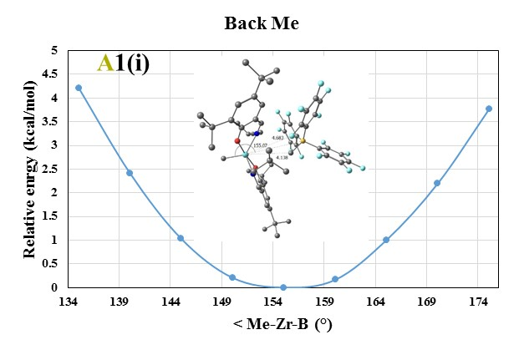
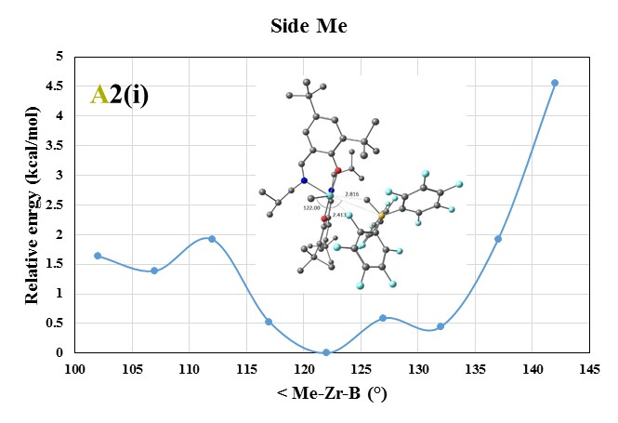
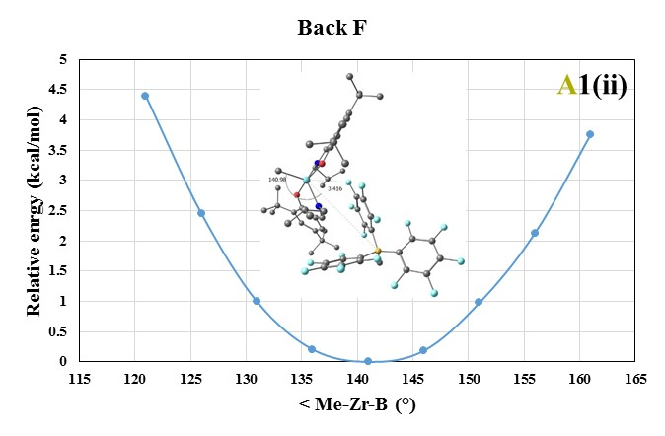
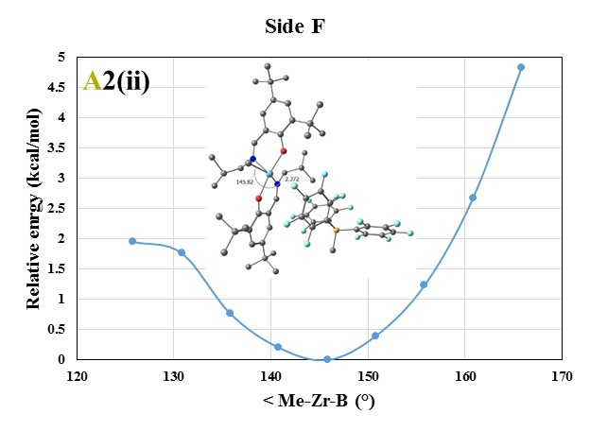
Current Progress
Counter Anion : [H₃C-B(C₆F₅)₃]⁻
Zr-Cation with Counter Anion (QM)
In order to MD calculations for ion-pair with ‘Cation A’ and ‘Borate Anion’, we need to impose some constraints on the angle Me-Zr-B for the back and side structures.
The constraint angle for the back and side structures was obtained from the various QM optimized structures of the ion-pair.
The force constants for each constraint can be 5 kcal/(mol rad*rad) as we have observed from the QM scan for < Me-Zr-B calculations.
Similarly, we have performed for isomer C.
Finally, we have found the most stable conformations among the 80 different conformers for both the isomers.

Slide 19
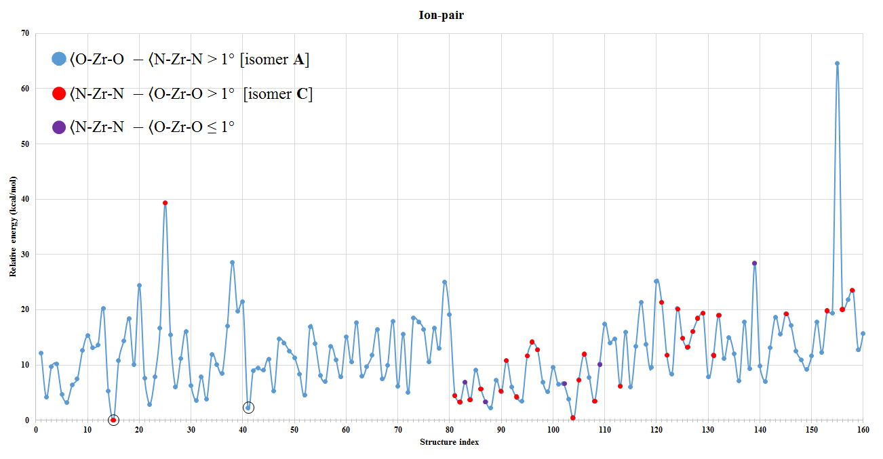
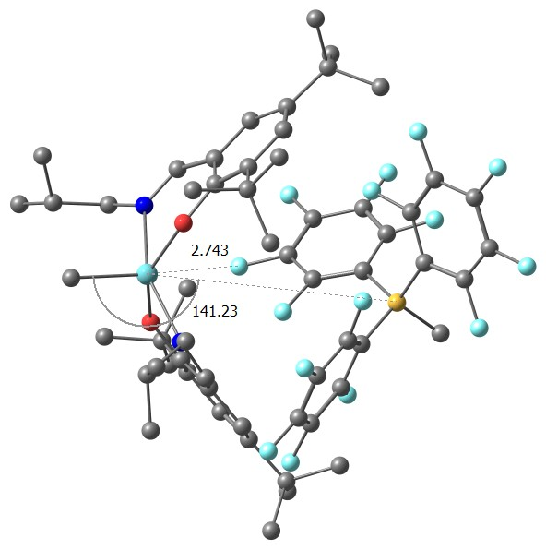
Current Progress
Ion-pair
Zr-Cation A
Zr-Cation C
The energy difference between ion-pair C and A is only 2.25 kcal/mol.

Slide 20
Current Progress
Ion-pair
18
24
42
A
27
25
24
C
04
06
*No. of structures present

Slide 21
Current Progress
Monomer and Zr-FI Cation
The 40 ns MD calculations were performed and obtained 40 clusters for cation A and ethene (monomer); as well as cation C and ethene. The obtained 40 configurations for each cationic isomer were further optimized using QM procedure.
The most stable structure is based on Zr cation A, which is 7.33 kcal/mol more stable than the Zr cation C structure
Performing the calculation between monomer (ethene) and ion-pair.

Slide 22
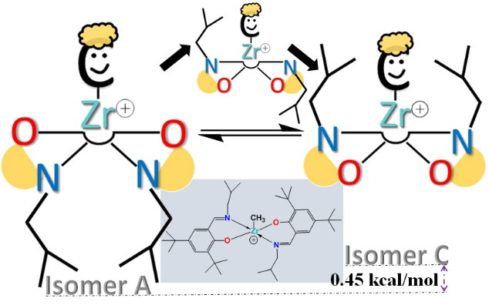
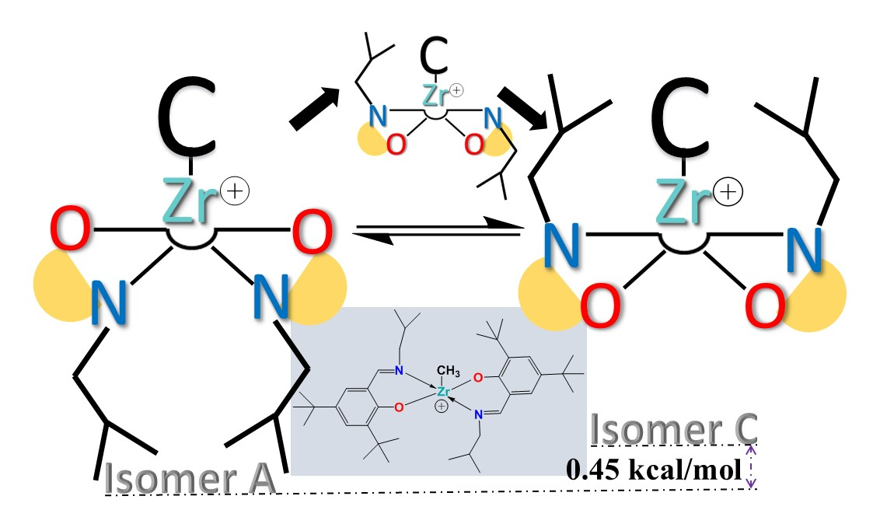
Thank You

Slide 23
(xiii)
(xiv)
(xv)

Slide 24

Chain Shuttling Polymerization (CSP)^{[1]}
Zr-FI Catalyst
Hard: Semicrystalline or high glass transition temperature
Soft: Amorphous and low glass transition temperature
Hard: Semicrystalline or high glass transition temperature
R¹= tBu
No mechanistic information on the complicated CSP process
Cat 1
Cat 2
[1] D. J. Arriola, E. M. Carnahan, P. D. Hustad, R. L. Kuhlman, T. T. Wenzel Science 2006, 312, 714.
Notes:
This Zr-catalyst is one of the Post-Metallocene catalyst. Because of the presence of phenoxy-imine (Fenokishi-Imin Haiishi) group in ligand it is called FI catalyst.
This Zr-FI is one of the catalyst used in Chain Shuttling Polymerization reaction.
Normally, cation 1 will from Hard polymer whereas cation 2 forms soft polymer. But using Chain shuttling agent one can shuttle the polymers and finally one may obatain Block Copolymers.
However, mechanistic information on this complicated CSP process is unknown till now. So one of the aim is explore this mechanistic pathway.

Slide 25
Zr-FI Catalyst: Neutral
O
N
N
Me
N
Me
O
Me
O
Zr
Zr
Zr
Me
N
Me
N
Me
O
O
O
N
1
2
3
Zr-FI Catalyst
0.00 kcal/
mol
3.95 kcal/
mol
5.04 kcal/
mol
(0.0 kJ/
mol
)
(16.5 kJ/
mol
)
(21.1 kJ/
mol
)
Figure 1: Relative energies of Zr-FI Catalyst: based on isomeric structure 1.
Me
Me
N
N
N
O
Zr
Zr
O
O
O
N
Me
Me
4
5
7.33 kcal/
mol
7.91 kcal/
mol
M06/B1
(30.7 kJ/
mol
)
(33.1 kJ/
mol
)
The QM optimization of the structure has been done at M06 level of theory followed by frequency calculation.
The effective core potential (ECP) and LANL2DZ with added f polarization functions are used for Zr. All other atoms use 6-31G** basis set => B1
[2]
[2] S. Matsui et al. J. Am. Chem. Soc. 2001, 123, 6847.
Notes:
A neutral FI catalyst is an octahedral complex. It can form five different isomers.
When we have performed the QM optimization of different isomers of ‘Neutral’ Zr-FI catalyst, we have observed that isomer A is energetically more stable among the five isomers (Figure 1). Similar observation have also been noticed in earlier (JACS, 2001) with different ligand environment (Figure 2).

Slide 26
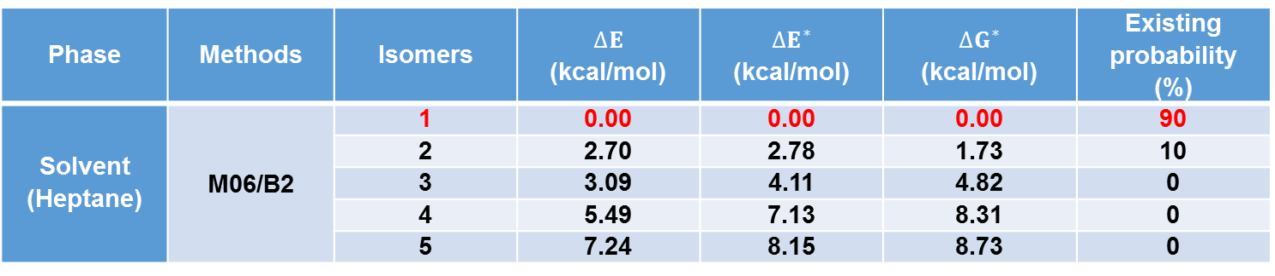
Zr-FI Catalyst: Neutral
Table: The relative energy values of five different isomers of Zr-catalyst (I) in terms of electronic energy (∆E), zero-point corrected energy (∆E*), and free energy (∆G*) as obtained at M06/B2 levels of theory in solvent phase calculations.
Phase | Methods | Isomers | $$∆E$$ (kcal/mol) | $$∆E^{∗}$$ (kcal/mol) | $$∆G^{∗}$$ (kcal/mol) | Existing probability (%)
Solvent (Heptane) | M06/B2 | 1 | 0.00 | 0.00 | 0.00 | 90
 |  | 2 | 2.70 | 2.78 | 1.73 | 10
 |  | 3 | 3.09 | 4.11 | 4.82 | 0
 |  | 4 | 5.49 | 7.13 | 8.31 | 0
 |  | 5 | 7.24 | 8.15 | 8.73 | 0
B2 = Def2-TZVPP; ‘Red Colour’ is more stable.

Slide 27
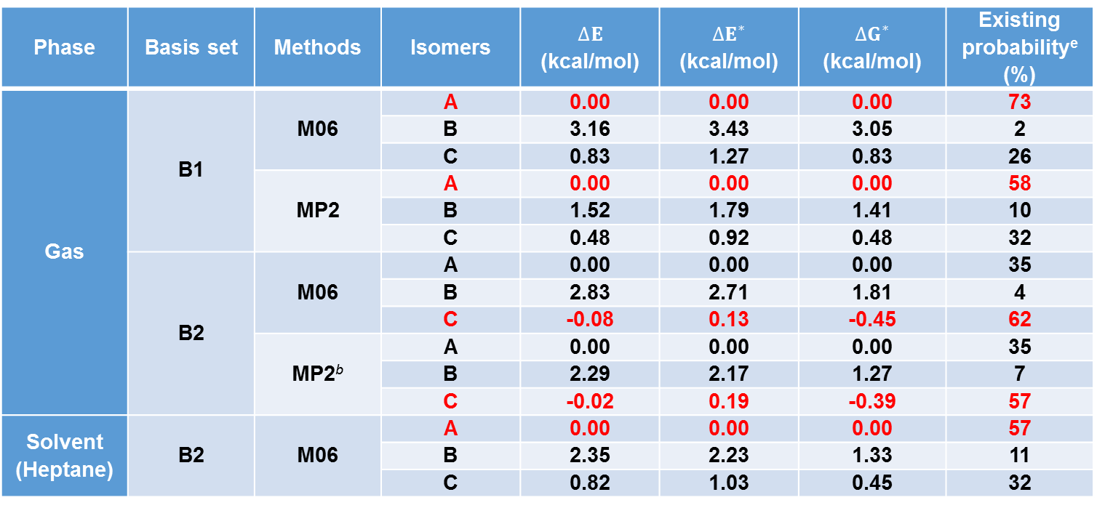
Zr-FI Catalyst: Cation
Table: The relative energy valuesª of three different isomers of Zr-cation (i) in terms of electronic energy (∆E), zero-point corrected energy (∆E*), and free energy (∆G*) as obtained at different levels of theory in gas, and solvent phase calculations.
Phase | Basis set | Methods | Isomers | $$∆E$$ (kcal/mol) | $$∆E^{∗}$$ (kcal/mol) | $$∆G^{∗}$$ (kcal/mol) | Existing probability^{e} (%)
Gas | B1 | M06 | A | 0.00 | 0.00 | 0.00 | 73
 |  |  | B | 3.16 | 3.43 | 3.05 | 2
 |  |  | C | 0.83 | 1.27 | 0.83 | 26
 |  | MP2 | A | 0.00 | 0.00 | 0.00 | 58
 |  |  | B | 1.52 | 1.79 | 1.41 | 10
 |  |  | C | 0.48 | 0.92 | 0.48 | 32
 | B2 | M06 | A | 0.00 | 0.00 | 0.00 | 35
 |  |  | B | 2.83 | 2.71 | 1.81 | 4
 |  |  | C | -0.08 | 0.13 | -0.45 | 62
 |  | MP2^{b} | A | 0.00 | 0.00 | 0.00 | 35
 |  |  | B | 2.29 | 2.17 | 1.27 | 7
 |  |  | C | -0.02 | 0.19 | -0.39 | 57
Solvent (Heptane) | B2 | M06 | A | 0.00 | 0.00 | 0.00 | 57
 |  |  | B | 2.35 | 2.23 | 1.33 | 11
 |  |  | C | 0.82 | 1.03 | 0.45 | 32
ªThe energy values are relative to A; ^{b}MP2/B2//MP2/B1.
B1 = 6-31G** (LANL2DZ +f polarization functions: Zr); B2 = Def2-TZVPP; †Single point calculation at B1; ‘Red Colour’ is more stable.

Slide 28
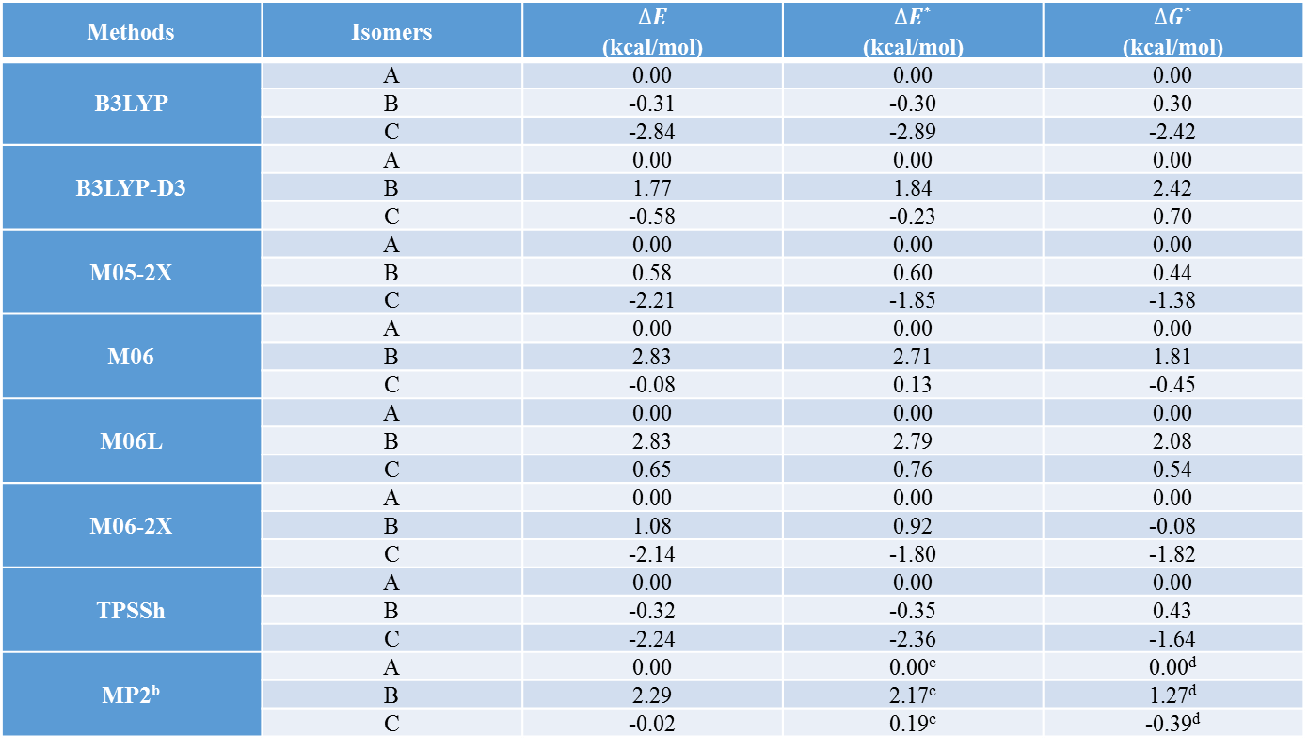
Zr-FI Catalyst: Cation
Table 1: The relative energy valuesª of three different isomers of Zr-cation (i) in terms of electronic energy (∆E), zero-point corrected energy (∆E*), and free energy (∆G*) as obtained at different levels of theory with B2 basis set.
Methods | Isomers | $$∆E$$ (kcal/mol) | $$∆E^{∗}$$ (kcal/mol) | $$∆G^{∗}$$ (kcal/mol)
B3LYP | A | 0.00 | 0.00 | 0.00
 | B | -0.31 | -0.30 | 0.30
 | C | -2.84 | -2.89 | -2.42
B3LYP-D3 | A | 0.00 | 0.00 | 0.00
 | B | 1.77 | 1.84 | 2.42
 | C | -0.58 | -0.23 | 0.70
M05-2X | A | 0.00 | 0.00 | 0.00
 | B | 0.58 | 0.60 | 0.44
 | C | -2.21 | -1.85 | -1.38
M06 | A | 0.00 | 0.00 | 0.00
 | B | 2.83 | 2.71 | 1.81
 | C | -0.08 | 0.13 | -0.45
M06L | A | 0.00 | 0.00 | 0.00
 | B | 2.83 | 2.79 | 2.08
 | C | 0.65 | 0.76 | 0.54
M06-2X | A | 0.00 | 0.00 | 0.00
 | B | 1.08 | 0.92 | -0.08
 | C | -2.14 | -1.80 | -1.82
TPSSh | A | 0.00 | 0.00 | 0.00
 | B | -0.32 | -0.35 | 0.43
 | C | -2.24 | -2.36 | -1.64
MP2^{b} | A | 0.00 | 0.00^{c} | 0.00^{d}
 | B | 2.29 | 2.17^{c} | 1.27^{d}
 | C | -0.02 | 0.19^{c} | -0.39^{d}
ªThe energy values are relative to A ; ^{b}MP2/B2//MP2/B1; ^{c}Zero-point energy correction taken from M06/B2 level
^{d}Free energy correction taken from M06/B2 level
B2 = Def2-TZVPP.

Slide 29
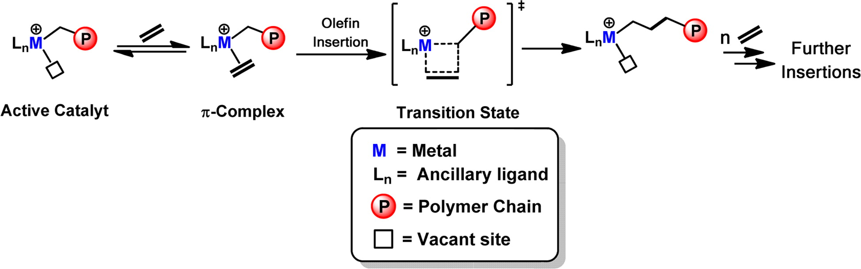
Olefin Polymerization Reaction^{[1]}
②
Active Catalyst
①
③
① coordination of the monomer (olefin) to the catalyst
② insertion of the olefin into the metal–alkyl bond
③ repetition of step ②
[1] A. Motta, I. L. Fragalà, T. J. Marks J. Chem. Theory Comput. 2013, 9, 3491.
Notes:
For past several decades, the α-olefin polymerization reaction has attracted the attention of researchers from scientific and industrial points of view. Scheme of the catalyzed α-olefin polymerization reaction is like this. First, an active metal catalyst and a monomer olefin make π-complex. Second, the insertion of the olefin into the metal–alkyl bond occurs. When the olefin coordination and insertion are repeated, the chain becomes much longer and thus forms polymer.

Slide 30
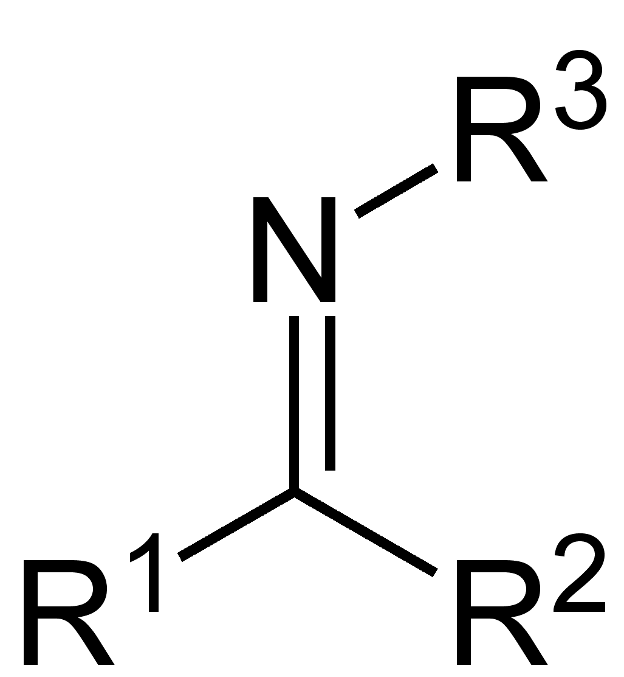
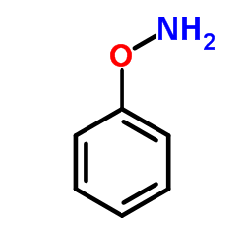
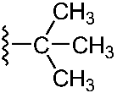
FI Catalyst^{[1]} : Cation 1
A neutral FI (Fenokishi-Imin Haiishi) catalyst is an octahedral complex bearing two bidentate phenoxy-imine ligands (L′; FI ligand) and two X ligands (Scheme 1^{[1]}).
Imine
Phenoxy
Phenoxy-imine
R¹= tBu =
Cat 1 :FI Cat
[1] Acc. Chem. Res. 2009, 42, 1532.

