Slide 1
Mechanisms of Shuttling Polyolefins: A DFT Study
Dr. Sandhya
15/1/2016

Slide 2
Outline
Aim of the study
General background of the chain shuttling polymerization of dual catalyst with monomers
Scheme of reaction mechanism
Reaction mechanism of propagation step and chain exchange (transmetallation)
Conclusion

Slide 3
Aim of the study
Understand the reaction mechanism of chain shuttling polymerization catalyzed by organometallic catalysts using DFT method
Background of polyolefin (PO) catalysts for chain shuttling polymerization
Produce hard polymers
Produce soft polymers
cat1
cat2
DFT using Chain Shuttling Polymerization (CSP)
Two metal catalysts for polyethylene and copolymer
Chain shuttling agent (CSA), ZnEt₂ to swap hard and soft polymer chains
No mechanistic information on the complicated CSP process

Slide 4
Possible mechanistic step
Transmetallation - I of two catalysts
Propagation steps of two catalysts
A
B
C
D
Propagation affords catalysts bearing two different polymers in a same pot.
Transmetallation leads to the formation of four different reactive
species from two different reactants i.e. A, B, C and D

Slide 5
Continuation-> Possible mechanistic step
Transmetallation - II of two catalysts
Transmetallation reaction of catalyst and CSA plays a pivotal role for the exchange of polymers between two catalyst
Propagation steps after transmetallation II
Propagation yields to olefin block polymers
in a single pot.

Slide 6
Propagation step for ethylene and Zr catalyst
6.61

Slide 7
Possible mechanistic step
Insertion steps of Hf catalyst- Two cases

Slide 8
Stereochemistry of first insertion between
Hf and sp3 carbon- Case 1
Method : M06/6-31G(d)and LanL2DZ
Cat3
Δ E = 20.77 k cal/mol
Δ E = 18.84 kcal/mol
Δ E = 17.06 k cal/mol
Δ E = 19.4 k cal/mol
Δ E = 24.0 kcal/mol

Slide 9
Stereochemistry of first insertion between
Hf and sp2 carbon- Case 2
Δ E = 3.49 kcal/mol
Δ E = 3.38 kcal/mol
Δ E = -1.54 kcal/mol
Δ E = 2.82 kcal/mol
Δ E =4.85 kcal/mol

Slide 10
Propagation steps of Hf catalyst- Two cases
Pathway I
Cat3
Pathway II
Cat4

Slide 11
Real activate catalyst is cat4?
Cat3
cat4
The insertion of octene in cat4 is really required ????

Slide 12
Reaction energy profile for the insertion step from cat4
Cat3 + ethylene + octene
R1b + octene
Cat4 + octene

Slide 13
Transmetallation Reaction process for Zr catalyst
REA
PD1
PD1
PD2

Slide 14
Solvent corrected Free energy profile for transmetallation reaction on Zr catalyst and CSA

Slide 15
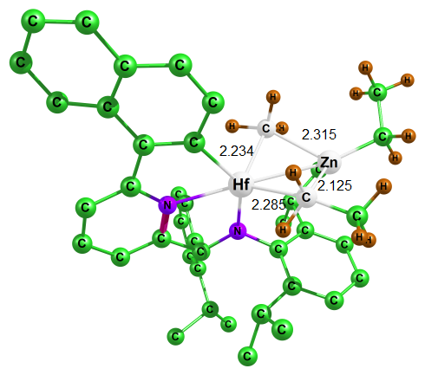
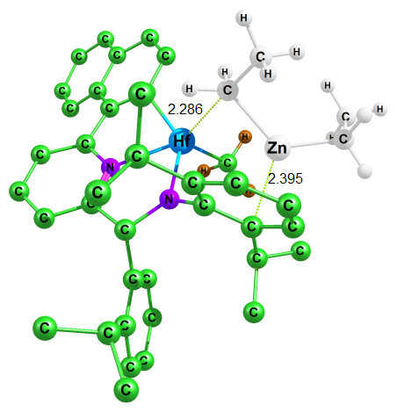
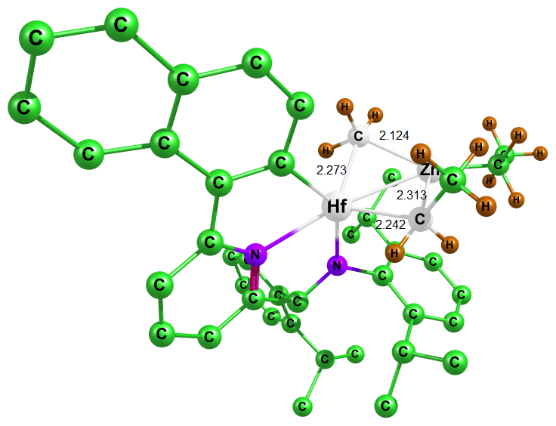
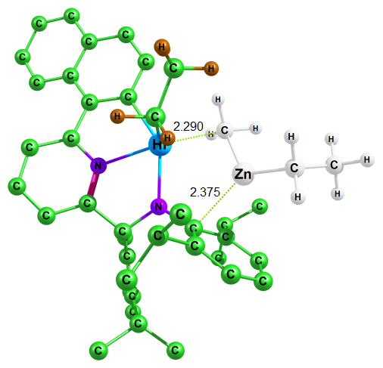
Transmetallation reaction on Hf catalyst and CSA
Step 1
TM1Hf
RTM1
RTM2a
TM2aHf
RTM2a
PTM2a
Cyclic intermediate formed with the
assistance of phenylic group of N arm
and breaking of cyclic intermediate
require assistance of phenylic group of N arm

Slide 16
Relative energy profile for the transmetallation of Hf complex with CSA

Slide 17
Conclusions
In the chain shuttling reaction mechanism, we have proposed all possibilities for the propagations of catalysts as well as the selectivity of monomers using DFT method.
We observed that in situ formed Hf complex can also catalyze the propagation process.
The four-membered ring intermediates between catalyst and ZnEt₂ via transmetallation process shows the ΔG of 16 kcal/mol for Zr complex and 2 kcal/mol for Hf complex. We believe that our work could understand the possibilities of reaction mechanism in depth insight.

Slide 18
Thank you………

