Slide 1
FY2015 The 7th CREST Workshop 2016, January 15
Efficient Sampling of Radical Polymer Conformations in a PCP Channel by Replica Exchange MD
Masayoshi Takayanagi
Graduate School of Information Science,
Nagoya University

Slide 2
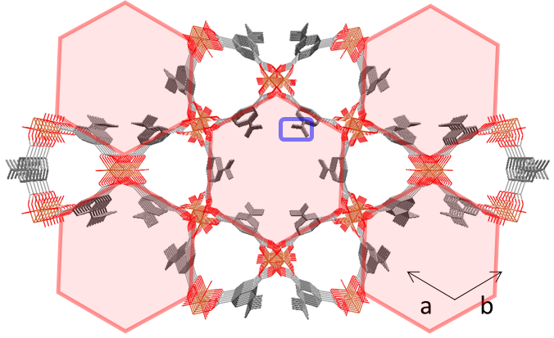
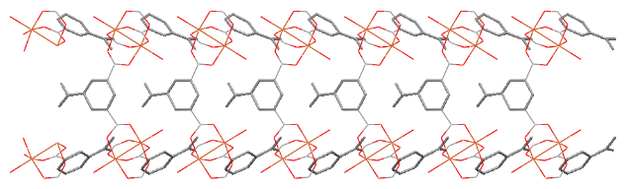
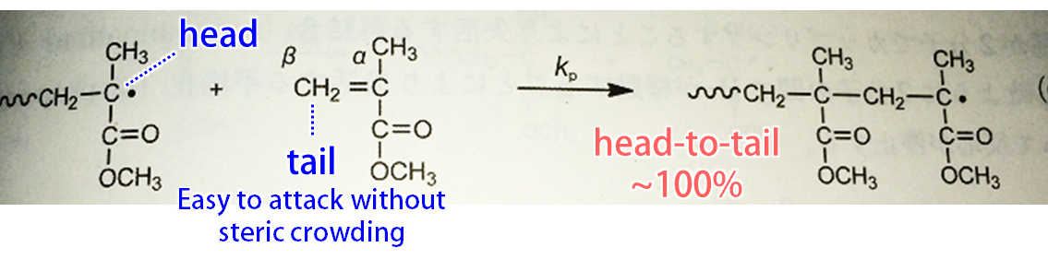
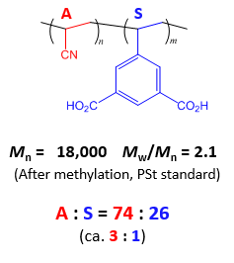
Target system for radical copolymerization
Acrylonitrile (A)
Filled in the hexagonal channel
5-vinylisophthalic acid (S)
Compose wall of the hexagonal channel
Vinyl group exists in the channel
c
Hexagonal channel in PCP framework
+ AIBN
radical copolymerization
of A and S
A
A
A
S
70℃, 48 h
Problem
How is the sequence?
A-A-S? A-A-A-S? A-A-A-A-S?

Slide 3
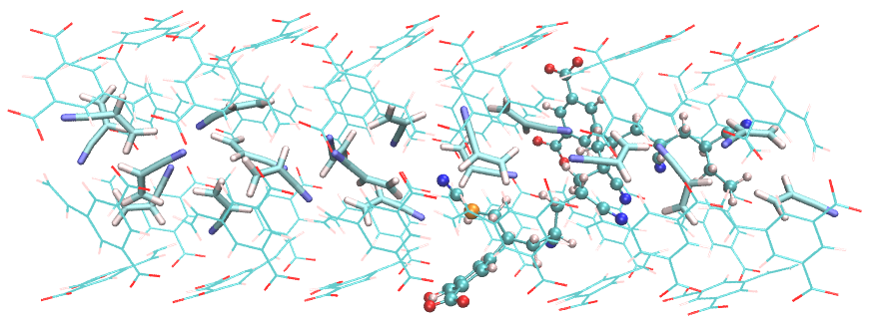
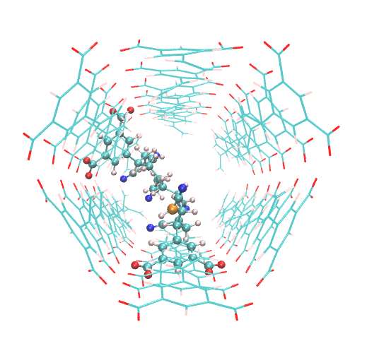
monomer S
(PCP channel surface)
New MD simulation model
S
A
A
A
A・
y
A
Met
y
monomer A
radical atom
A
S
x
～16 Å
x
6.8 Å
z
z
×6 units (previous model × 15 units)
In total, 906 atoms
MD simulation model of the hexagonal channel with GAFF force field
COO⁻ groups of S are fixed at the locations of the crystal
In real PCP, the COO⁻ groups are bound to Cu paddle wheel units
Radical chain models
Met-A-A-S-A-A-A-S-A･ (Above Figure)
～ Met-A-A-S-A-A-A-S-A-A-A-A･
4.34 A monomers/unit cell (experimental density) in the channel
6 unit cell, 26 A (6 in the radical chain, 20 in the channel)
Periodic boundary condition with box size 41.0×24.0×24.0 Å³

Slide 4
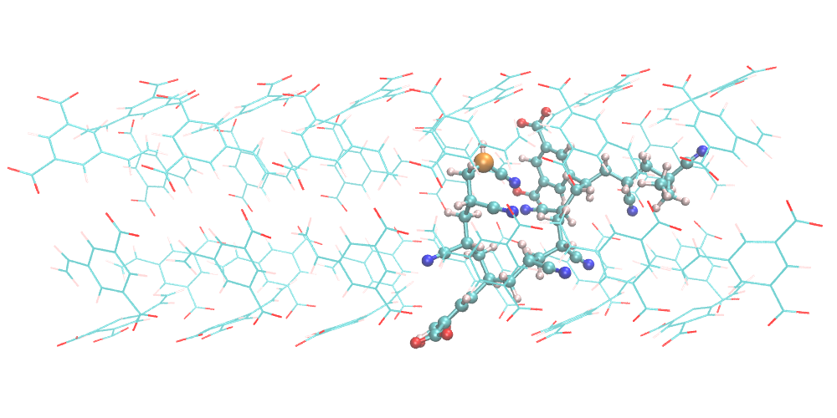
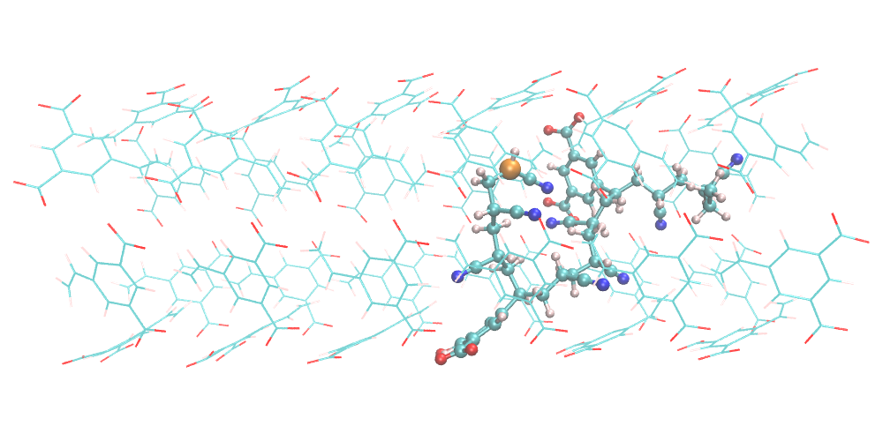
Usual MD simulation cannot sample conformation space of the radical polymer
Met-A-A-S-A-A-A-S-A-A-A･
No conformational change in the
radical polymer by usual MD simulations
↓
Cannot sample conformational space of the radical polymer
10 ns MD simulation
at 343 K

Slide 5
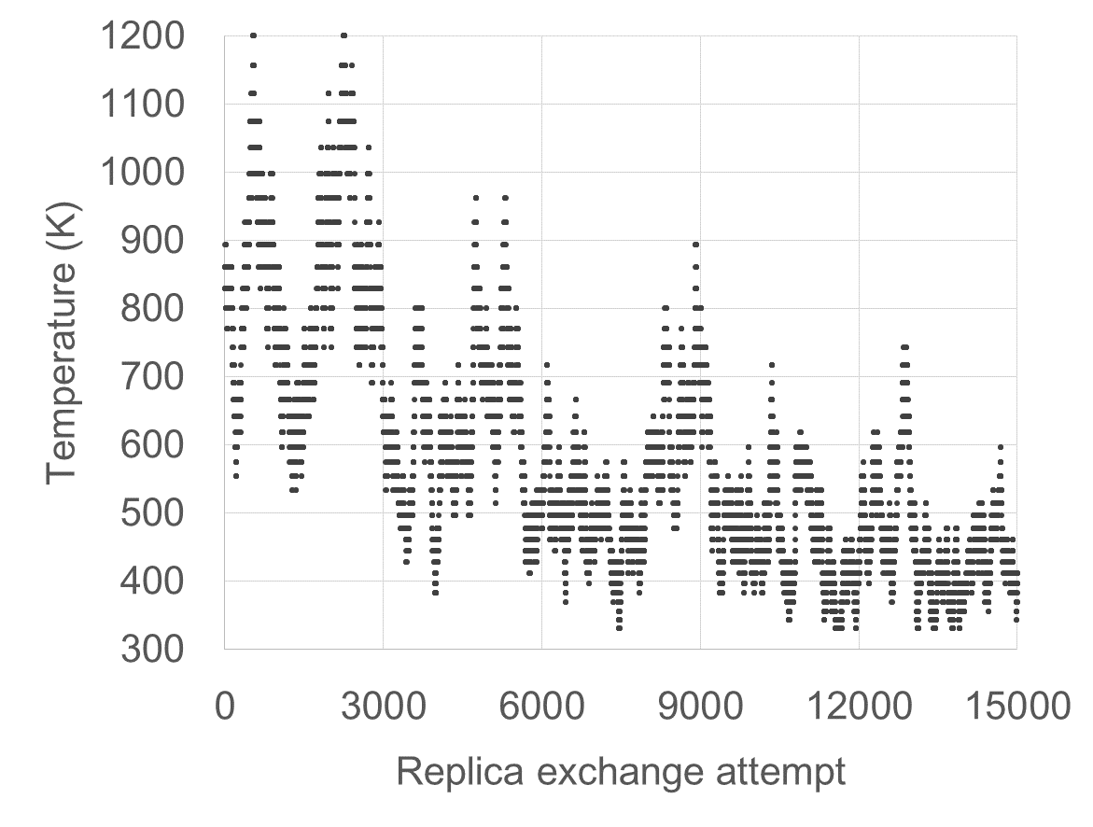
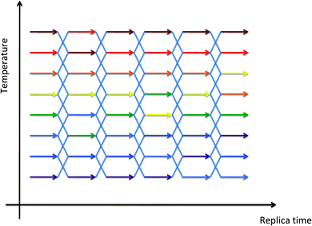
Replica exchange MD (REMD) to sample conformational space
Number of replica 36
Temperature of replicas (K) 331, 343, 356, 369, 383, 397, 412, 428, 444, 461, 478, 496, 514, 534, 554, 574, 596, 618, 642, 666, 691, 717, 743, 771, 800, 830, 861, 894, 927, 962, 998, 1036, 1074, 1115, 1157, 1200
(geometric series 等比級数)
Exchange acceptance ratio ~30%
Temperature exchange attempt every 1 ps × 15,000 exchange attempts (in total, 15 ns) and use the 343 K trajectory for analysis
Temperature of a certain replica
exchange temperature between replicas
343 K
Scheme of replica exchange MD.
Chem. Soc. Rev., 2014, 43, 5051-5066

Slide 6
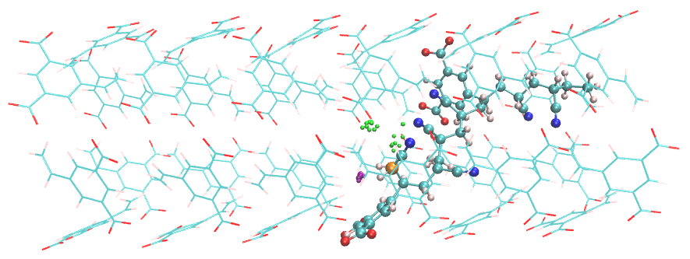
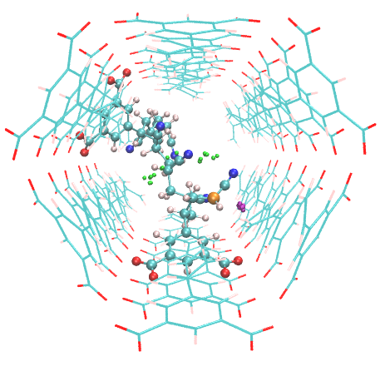
REMD result of -S-A･ model
From 75,000 snapshots of the REMD trajectory at 343 K.
(0.2 ps / snapshot)
Green spheres: C-C distance for the radical elongation reaction is within 3 Å with monomer A.
Purple spheres: 3 Å with monomer S.
-S-A･ radical terminal can approach to both monomer A and monomer S.
Contradict with experimental observation that S-A-S sequence does not appear in the product polymer.
→ QM calculation is necessary
Monomer | S | A
Number of snapshots* | 18 | 12
*within 3 Å of C-C distance

Slide 7
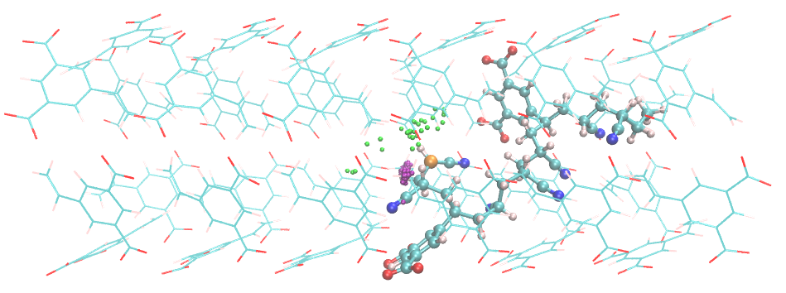
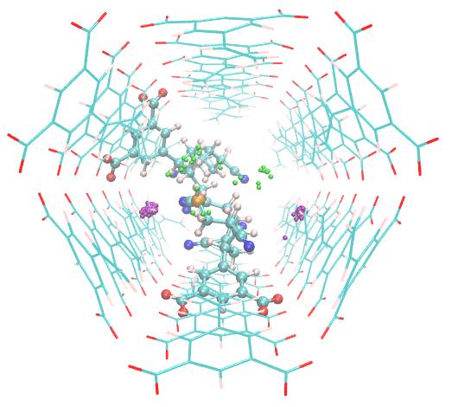
REMD result of -S-A-A･ model
From 75,000 snapshots of the REMD trajectory at 343 K.
Green spheres: 3 Å with monomer A.
Purple spheres: 3 Å with monomer S.
-S-A-A･ radical terminal can approach to both monomer A and monomer S.
Approach frequency is higher with S
Monomer | S | A
Number of snapshots | 101 | 30

Slide 8
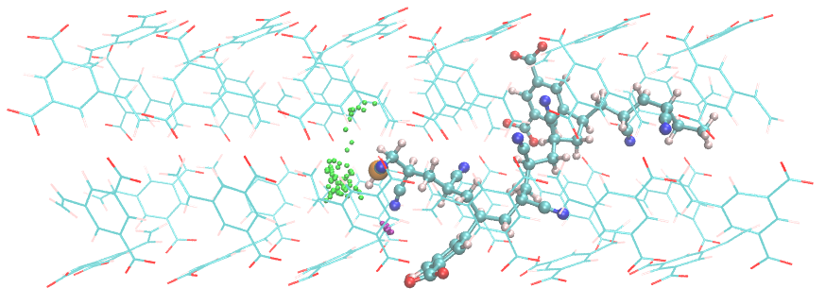
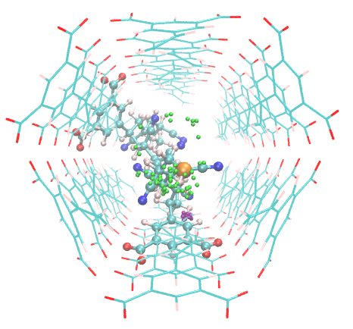
REMD result of -S-A-A-A･ model
From 75,000 snapshots of the REMD trajectory at 343 K.
Green spheres: 3 Å with monomer A.
Purple spheres: 3 Å with monomer S.
-S-A-A-A･ radical terminal can approach to both monomer A and monomer S.
Approach frequency is larger with A.
Monomer | S | A
Number of snapshots | 16 | 59

Slide 9
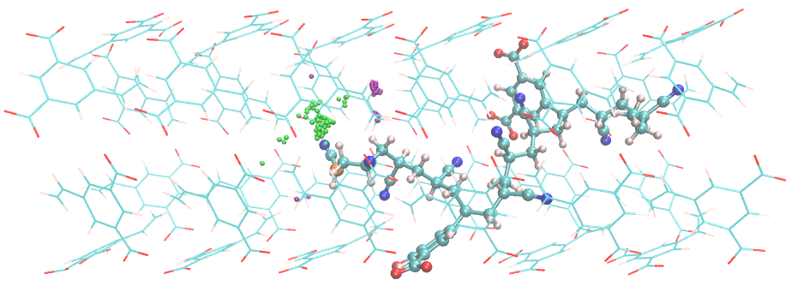
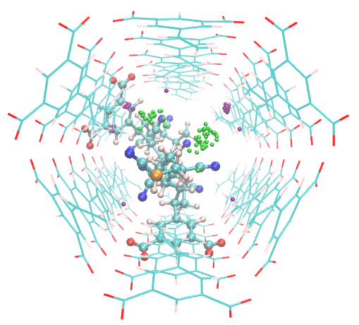
REMD result of -S-A-A-A-A･ model
From 75,000 snapshots of the REMD trajectory at 343 K.
Green spheres: 3 Å with monomer A.
Purple spheres: 3 Å with monomer S.
-S-A-A-A-A･ radical terminal can approach to both monomer A and monomer S.
Approach frequency is larger with S.
Monomer | S | A
Number of snapshots | 55 | 34

Slide 10
Summary
Usual MD simulations cannot sample wide conformational space of the radical polymer.
The conformation is almost trapped at the initial conformation.
Replica exchange MD (REMD) can be used to sample wide conformational space at the target temperature.
Radical terminals with sequences -S-A･, -S-A-A･, -S-A-A-A･, -S-A-A-A-A･ can approach to both the A and S vinyl groups.
QM calculation is necessary to analyze elongation preference
with A and S.
REMD can be used for general purposes, not only the confined radical polymer, when usual MD simulation is confined in a certain minimum conformation.
MC/REMD reaction method

Slide 11
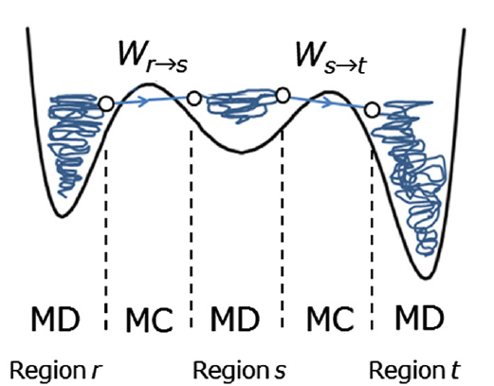
MC/MD is suitable
MC step
MC steps
MD sampling
MC/MD is not efficient.
Many kinds of MC step is necessary.
REMD sampling
MC/REMD gives efficient sampling.

