Slide 1
PMF calculation for dihedral rotation in SiH2Cp2ZrCH3(C2H4)
K. S. Sandhya
6/10/2015

Slide 2
Outline of the presentation
Project 1
Force field parameter development for [SiH₂Cp₂ZrCH₃(C₂H₄)]
Refinement of dihedral parameters using DFT and MM dihedral rotation
Preparation of ion pair complex for MD simulation
MD simulation of [SiH₂Cp₂ZrCH₃(C₂H₄)][CH₃B(C₆F₅)₃] and [SiH₂Cp₂ZrCH₃(C₂H₄)]Cl with improved parameters
PMF Analysis on the rotation of ethylene in [SiH₂Cp₂ZrCH₃(C₂H₄)][CH₃B(C₆F₅)₃] and [SiH₂Cp₂ZrCH₃(C₂H₄)]Cl
Free energy profile for the rotation of ethylene.
Project -2
Transmetallation reaction of Hf complex
Conclusions
Future plan

Slide 3
Creation of model for [H₂SiCp₂ZrMe(C₂H₄)] [CH₃B(C₆F₅)₃]
CP
PH1
ME
PH2
ZR
PRP
B
PH3
MEB
Model : η5 Cp ring and one Zr
PN
Computational details on the MD
One catalyst, one [CH₃B(C₆F₅)₃] and 764 pentane solvent
Periodic boundary conditions are applied
NVT-MD for 20ps (300K and 1atm) for equilibration
NPT-MD (300K) for molecular dynamics (50ps) simulation
M06 DFT method for optimization
Basis set for Zr –ECP with LanL2DZ, all other atoms - 6-31++G(d,p)
MK method having same level was applied to calculate ESP charge for the complexes from the optimized geometry

Slide 4
Force field parameters created
Bond | K1 | Distance [Å]
zr-c2 | 42.2 | 2.91
zr-c9 | 53.3 | 2.68
c9-ha | 396 | 1.09
c2-ha | 396 | 1.09
c5-ha | 344.3 | 1.08
c9-c2 | 589.7 | 1.32
zr-cp | 137 | 2.38
zr-c4 | 150 | 2.26
Angle | K2 | Angle [º]
si-c5-zr | 0.469 | 99.08
zr-c2-ha | 0.05 | 103.8
zr-c9-ha | 0.614 | 95.1
zr-c2-c9 | 0.041 | 66.57
zr-c9-c2 | 0.016 | 86.10
c5-si-c5 | 0.28 | 94
c4-zr-c9 | 0.02 | 87.24
c4-zr-c2 | 0.02 | 114.6
c5-zr-c2 | 0.061 | 83.84
c5-zr-c9 | 0.048 | 78.8
Dihedral angle | Multiplicity | K3 | φ [º] | Periodicity, n
c4-zr-c2-c9 | 1 | 0.75 | 0 | 1
c5-zr-c9-c3 | 1 | 0.75 | 0 | 1
Other parameters taken from Previous papers ^{a,b}
Bond | K1 | Distance [Å]
c4-hc | 340 | 1.09
zr-c4 | 200 | 2.26
si-c5 | 506 | 1.90
si-hc | 340 | 1.09
Angle | K2 | Angle [º]
hc-c4-hc | 35 | 109.5
zr-c4-hc | 150 | 109.5
si-c5-c5 | 40 | 126.0
c5-si-c5 | 70 | 109.5
hc-si-c5 | 22 | 109.5
hc-si-hc | 40 | 109.5
c5-zr-c4 | 40 | 105
Atom type | Vander Waals depth,ε [kcal/mol] | Vander Waals radius, [Å]
zr | 1.000 | 0.000
si | 1.908 | 0.086
c4 | 1.910 | 0.130
Bosnich et. al., J. Am. Chem. Soc., 1995,
117, 1352-1368
b. Brintzinger et.al., J. Mol. Struc., 1999,
485-486, 409-419

Slide 5
Optimized relaxed DFT dihedral scan on various dihedral angles
X axis Energy in kcal/mol
Y axis Dihedral angle in degree

Slide 6
MM refinement of dihedral rotation with DFT relaxed optimized scan
c4
zr
c9
c4-zr-c2-c9
c2
φ
φ clockwise
Orange DFT relaxed scan
Green MM optimized scan with
modified force field parameters
Better agreement of MM relaxed scan after
fitting empirical force filed parameters with DFT optimized
relaxed scan on dihedral rotation.
The improved parameters will be used in the MD simulations and pmf calculation

Slide 7
Empirical parameters for the various dihedral rotations
Dihedral angle | Multiplicity | K3 | φ [º] | Periodicity, n
Relative energy in
kcal/mol
zr-c9-c2-ha | 1 | 0 | 0 | 2
zr-c2-c9-ha | 1 | 0 | 0 | 2
c4-zr-c2-c9 | 1 | -0.45 | 0 | 1
c4-zr-c2-c9 | 1 | -0.2 | 0 | 2
c4-zr-c2-c9 | 1 | 0.3 | 0 | 2
c4-zr-c2-c9 | 1 | -1 | 0 | 4
c2-zr-c4-hc | 1 | 0 | 0 | 3
c5-zr-c2-ha | 1 | 0 | 0 | 2
c5-zr-c9-ha | 1 | 0 | 0 | 2
c5-zr-c4-hc | 1 | 0 | 0 | 3
hc-c4-zr-c2 | 1 | 0.1 | 0 | 3
c5-zr-c9-ha | 1 | 0 | 0 | 2
ha-c9-zr-c4 | 1 | 0 | 0 | 2
c4-zr-c9-ha | 1 | 0 | 0 | 2
c4-zr-c2-ha | 1 | 0 | 0 | 2
Etotal =½(V₁)(1+cosω)
+ ½(V₂)(1-cos2ω)
+½(V₃)(1+cos3ω)+..

Slide 8
MD simulation of [H₂SiCp₂ZrMe(C₂H₂)]Cl
And [H₂SiCp₂ZrMe(C₂H₂)] [CH₃B(C₆F₅)₃]

Slide 9
Weighted Histogram analysis (WHAM) method for the dihedral rotation
Free energy profile along a specific
Reaction coordinate.
Which is useful for
Finding transition states, intermediates
And also for relative stabilities of end points
To generate potential of mean force
(PMF)
One approach to find PMF is umbrella sampling method (US)
US means breaking the reaction coordinates up into a series of windows and then
Applying a restraint that act to force the reaction coordinate to remain close to the
Center of the window.
A series of harmonic potentials are used to constrain the reaction coordinate to various
Values. From this a series of histogram showing the sampling of reaction coordinate
values can be generated and assuming windows overlap, one can use wham to post
process the results to remove the biasing of restraints and recover PMF.
Here, WHAM software have been coupled with amber software for generating free energy
profile for dihedral rotation of ethylene monomer.

Slide 10
PMF calculation on the rotation of dihedral bond
Procedure for calculating PMF for dihedral rotation of ethylene in [SiH₂Cp₂ZrCH₃(C₂H₄)]
Relaxing the initial structure
Minimize (1000steps)
Heat (NVT, 300K, 20ps)
Relax (NPT, 300 K, 100ps)
Running the umbrella sampling calculations
run MD to each window for 150ps.
For each window from 0 to 180 degree we will do the
Minimization(2000 steps, no shake)
Relaxation (NPT, 50 ps, 1fs time step)
Data collection (NPT 100ps, 1fs time step)
Constructing the PMF

Slide 11
Free energy profile for the dihedral rotation of ethylene in [SiH₂Cp₂ZrCH₃(C₂H₄)][CH₃B(C₆F₅)₃]
Metastable
structure

Slide 12
Free energy profile for the dihedral rotation of ethylene in [SiH₂Cp₂ZrCH₃(C₂H₄)]Cl⁻

Slide 13
Project -2
Catalyst for the chain shuttling reaction
Transmetallation - I of two catalysts
cat1
cat2
Possible mechanistic step
Propagation steps of two catalysts
A
B
C
D
Propagation affords catalysts bearing two different polymers in a same pot.
Transmetallation leads to the formation of four different reactive
species from two different reactants i.e. A, B, C and D

Slide 14
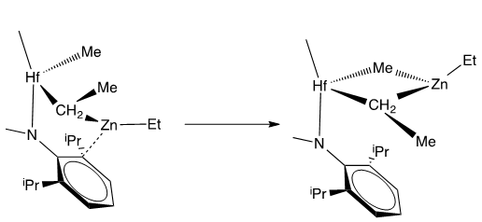
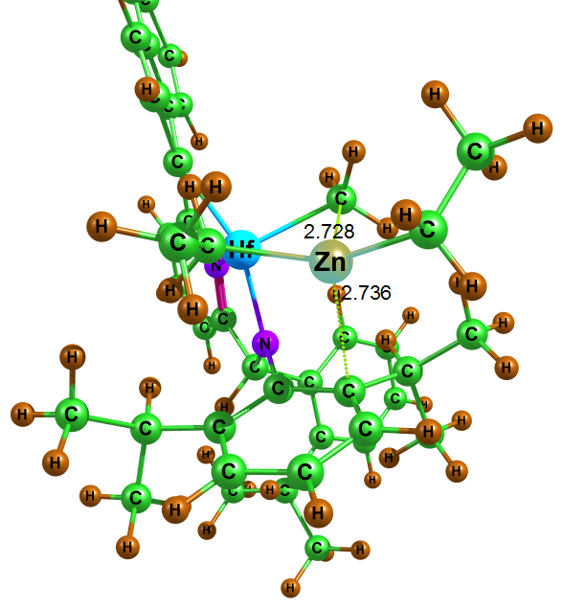
Reaction proposed for the transmetallation of Hf catalyst
TM1Hf
REA
PDT1
-40.85
TM1Hf

Slide 15
Conclusions
The improved parameters give more reliable results based on refinement of MM relaxed dihedral scan which fits reasonably good with DFT optimized scan.
Activation barrier for the rotation in the presence of CA using pmf (approximately 2 kcal/mol) is similar to the DFT relaxed optimized scan.
With Cl⁻, the activation barriers are 4 kcal/mol and 8 kcal/mol for dihedral rotation.
The dihedral rotation is easy in the presence of CA which indicate that Cl anion strongly bound to the catalyst with the short average distance of 3.4 Å. This probably decrease the easiness of ethylene rotation.
TS, reactant and product have been obtained in the first part of the transmetallation reaction of Hf complex.
Future plan
Finding the missing second part of the transmetallation reactions of Hf complex- CSP 2
MCMD simulation for the polymerization using BF4 and Al(CH₃)₄

Slide 16
Thank you………

