Slide 1
FY2017 2nd CREST WS
Jul. 24, 2017
Toward MC/MD simulation with dimeric CALB: molecular modeling and program modification
Ikuo KURISAKI

Slide 2
Today’s contents
Background of this research
Our previous studies
Preparing dimeric CALB and modifying MC/MD scripts
Plan for the next three months

Slide 3
Background of this research

Slide 4
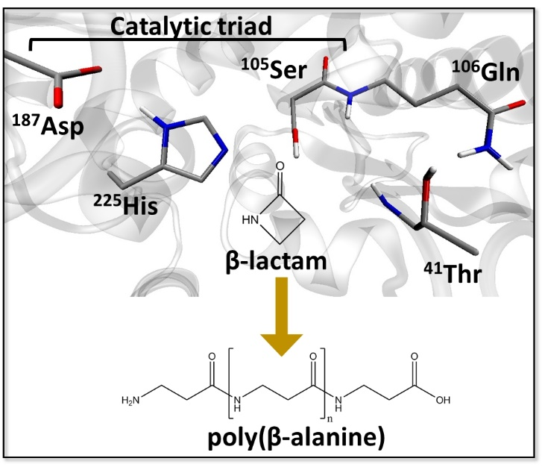
Research background
Enzyme catalyzed polymerization reaction has drawn attention in the field of green chemistry.
Candida Antarica Lipase B (CALB) has long been studied in this purpose.
This enzyme catalyzes polymerization of β-lactam to generate poly(β-alanine), nylon-3.
However, this reaction system has rooms to be improved because the product do not satisfy industrial quality, as for the length and yield.
The illustration is gifted from Dr. Barberot.

Slide 5
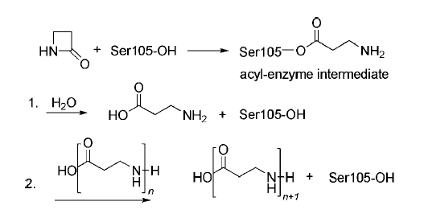
When N or C-terminal of poly (β-alanine) approaches Oγ of Ser105 in acyl-enzyme intermediate, the polymer elongation reaction occurs
(A) CALB forms acyl-enzyme intermediate via β-lactam ring opening reaction.
(B) β-alanine is generated from hydrolysis reaction of the acyl-enzyme intermediate.
(C) Poly (β-alanine) is elongated via reaction between polymer and acyl-enzyme complex.
Scheme 2. The proposed pathway of the ring-opening polymerization. The acyl-enzyme intermediate is formed and attacked. (1) By water to release β-alanine. (2) By a growing oligomer (n.1, 2, . . .) to yield the poly(β-alanine).
dimer formation
trimer formation
(A)➔(B)➔(A)➔(C)➔(A)➔(C)➔…
Ref. Schwab L. et al., Macromol. Rapid Commun., 2008, 29, 794-797:

Slide 6
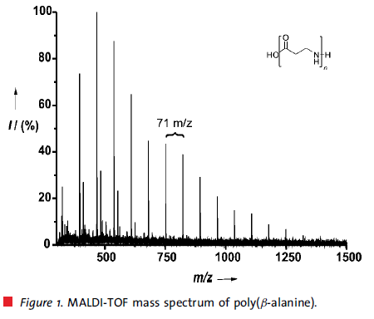
Issue we are addressing
Degree of polymerization (DP) is insufficient for industrial usage
With conventional methods:
Average DP: 24 mer; Maximum DP: 58 mer
With CALB catalyzed poly(β-alanine) synthesis:
Average DP: 8 mer; Maximum DP: 18 mer
➔ Polymer generated by using CALB is still shorter by three times.
Toward the industrial usage of CALB, ‘optimizing reaction condition’ and/or ‘redesigning CALB as biocatalyst’ are indispensable.
Insights into the reaction mechanism would provide strategies to address the problems.
6-mer
8-mer (average)
18-mer (maximum)
Ref. Schwab L. et al., Macromol. Rapid Commun., 2008, 29, 794-797:

Slide 7
Our previous studies

Slide 8
QM/MM simulation of CALB-catalyzed β−Alanine polymerization reaction
1
H₂O
CALB
OH^{Ser105}
O^{Ser105}
CALB
CALB
β-lactam
CALB -β-lactam acyl-enzyme intermediate
2
3
H₂O
H₂O
CALB
OH^{Ser105}
CALB
O^{Ser105}
β-alanine
Energetically favorable!
Path-A
Path-B
Ref. Barberot, IK et al. to be submitted.

Slide 9
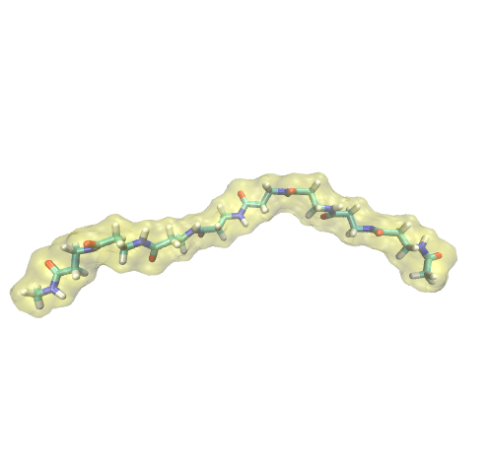
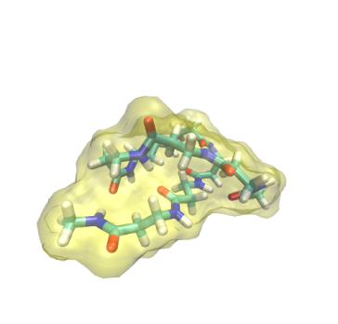
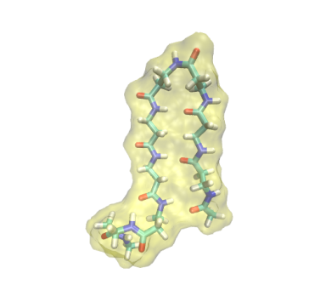
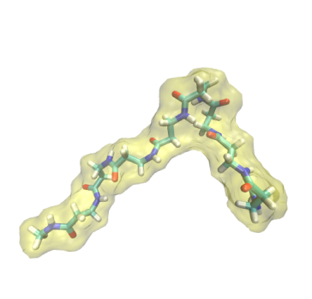
Replica Exchange MD simulation of βAla₈ in toluene @ 374 K
partially
extended
full
extended
globule
hairpin
It is unclear why 8 mer is average in CALB-catalyzed poly(β-alanine) synthesis. What does lead to the limitation?
In non-polarized solvent, a polymer mainly assumes folded conformation with intramolecular hydrogen bonds, so that our results seems to be reasonable.

Slide 10
Hydrophobicity of β-alanine leads to short polymer problem?
globule
hairpin
8-mer forms intramolecular interaction in toluene solvent. This would prevent it from accessing to the active site of CALB.
Elongation of polymer might interfere with binding to CALB. Thus, prevention of polymer folding could lead to promotion of polymer elongation.
Ref. Barberot, IK et al. to be submitted.

Slide 11
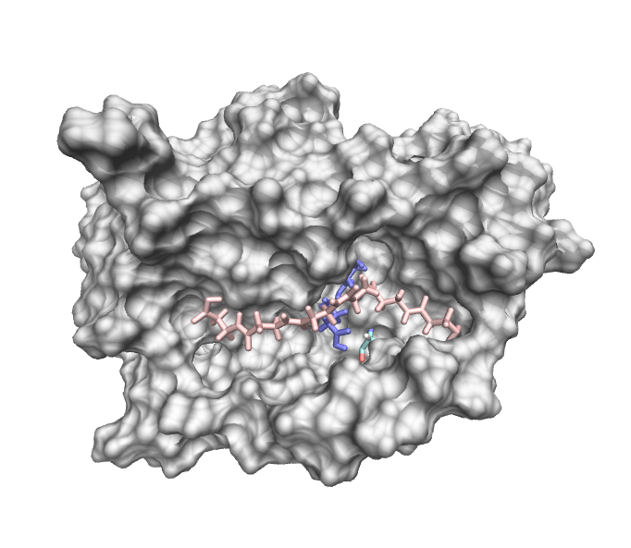
MC/MD simulation of CALB-catalyzed βAlanin polymerization reaction
Using MC/MD simulation, hexamer is generated so far. However, polymer extension does not continue anymore.
Ser105 behind the surface
15 Å
2916th cycle
N-terminal
Snapshot structure at the last cycle

Slide 12
Achievements and problems
QM/MM simulation revealed how β-alanine is generated via ring-opening reaction of β-lactam
REMD simulation provides an insight that hydrophilicity of poly(β-alanine) contributes to short polymer problem
MC/MD simulation enables us to simulate the polymerization reaction
6-mer
If we can reproduce the distribution shown the left, We could compare MC/MD results with experimental ones, and discuss the reaction mechanism with further reality.
8-mer (average)
18-mer (maximum)

Slide 13
How can we improve MC/MD simulation for CALB-catalyzed polymerization reaction?
We should miss something important in our simulation.
We have employed isolated CALB for simulations. Meanwhile, CALBs are immobilized in acrylic resin in experimental condition.
What is different between isolated and absorbed CALB?

Slide 14
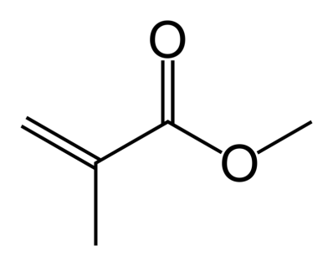
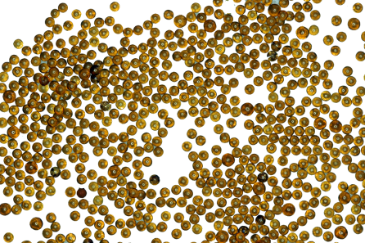
In Novozyme435, CALBs are absorbed in multiporous acrylic resin
Novozyme435 (N435) is commercially available heterogeneous biocatalysts consisting of CALB and acrylic resin (=樹脂).
The resin is made from methyl methacrylate (MMA) polymer, and has pores to absorb CALB (see left panel for MMA).
N435 is a kind of polymer beads, which has many pores and absorb CALB inside.
[1] http://www.lenntech.com/products/Lanxess-Lewatit-Resins/Lewatit-VP-OC-1600/Lewatit-VP-OC-1600/index.html

Slide 15
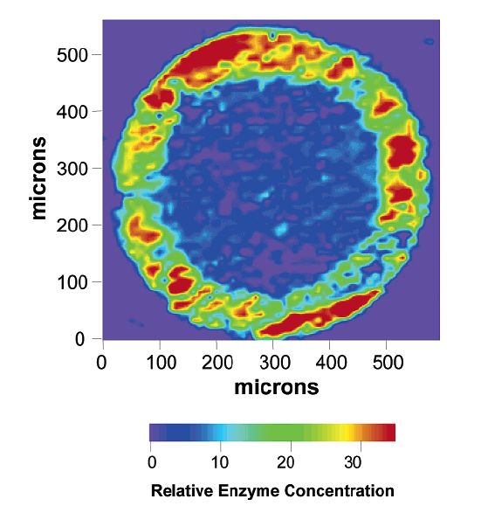
CALB is localized in an external shell of N435
Mei et al. reported structural observations of N435 with synchrotron infrared microspectroscopy
Inhomogenious distribution would be due to insufficient concentration of CALB: greater amount of CALB results that CALBs are distributed homogeneously.
CALB is localized in an external shell of the N435 beads with a thickness of 80-100 mm.
This could be high affinity between CALB and resin.
Secondary structure of CALB is sustained by absorption on a resin.
Ref. Mei Y. et al., Biomacromolelules 2003, 4, 70-74

Slide 16
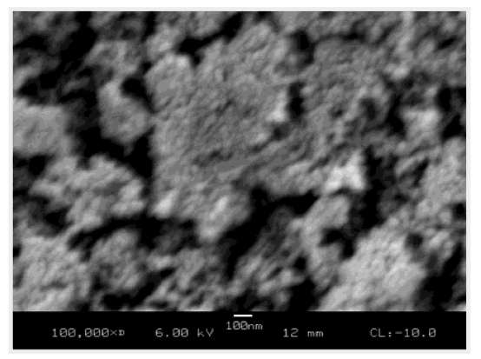
Multiple CALBs would be found in a pore?
“SEM showed that the average pore size in Novozyme435 beads is about 100 nm, more than 10 times larger than the size of the CALB molecule…”
100 ns
*”SEM” is scanning electron microscope (=走査型電顕).
**A pore is outlined by yellow.
Figure. SEM image of the center section of Novozyme435 beads
Ref. Mei Y. et al., Biomacromolelules 2003, 4, 70-74

Slide 17
Why does N435 generate 8 mer in average, and 18 mer in maximum?
Conjecture
Polymer elongation is carried out with multiple CALBs in a pore of N435 (see the right panel).
The following process could be assumed:
An oligomer is released from CALB in a pore.
It accesses to alternative CALB in the same pore.
Elongation reaction continues.
: CALB
100 ns
*This illustration is made from Figure 3 in Mei’s study.
**A pore is outlined by yellow.
Ref. Mei Y. et al., Biomacromolelules 2003, 4, 70-74

Slide 18
Preparing dimeric CALB and modifying MC/MD scripts

Slide 19
Simulation for dimeric CALB can be minimum model to verify the conjecture
For example, setting two CALBs face-to-face would support oligomer re-binding.
CALB
Active site
Polymer

Slide 20
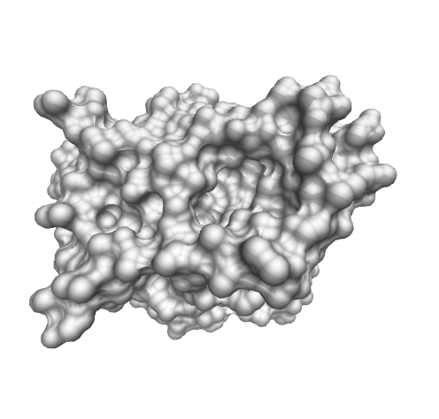
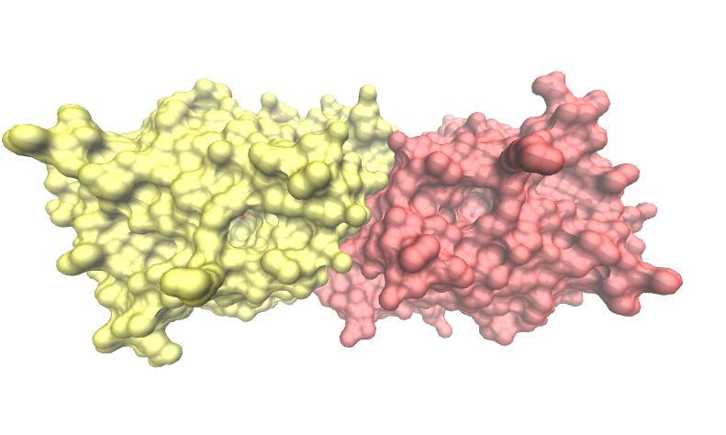
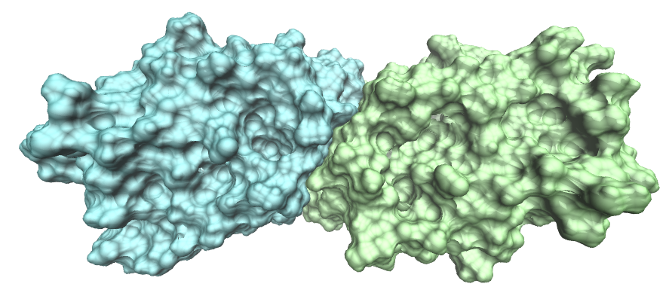
Design dimeric CALB
monomeric CALB (PDB entry: 4K6G),
which is ‘intact’ CALB and employed for MC/MD simulation
dimeric CALB (PDB entry: 3W9B),
which misses several residues in CALB
active site
Superposed on dimeric ‘3W9B’
to prepare dimeric ‘4K6G’
active site
active site

Slide 21
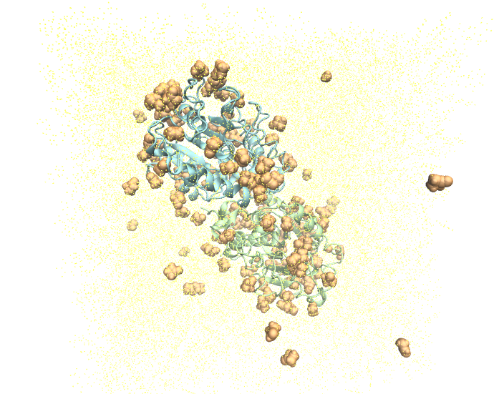
Setting up CALB system
System components
CALB: 2
β lactam: 124 (5 wt%)
water: 24 (1 wt%)
Na⁺: 2
Toluene: 3616
The number of atoms is 62692, which is c.a. 1.5-fold greater than that in monomeric CALB system.

Slide 22
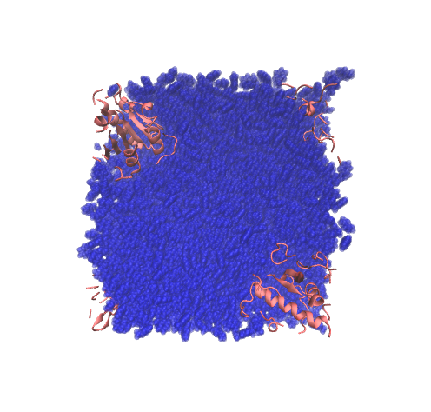
Modifying MC/MD scripts
E.g. ‘TER card’ insertion is arranged for dimeric CALB.
egrep -v "REMARK|TER|END" leapin.pdb | awk \
'BEGIN{i=320;j=320}{if(NR>=4669){if(i!=$5){print "TER";j++;… > _leapin.pdb
egrep -v "REMARK|TER|END" leapin.pdb | awk\
'BEGIN{i=640;j=640}{if(NR>=9337){if(i!=$5){print "TER";j++;… > _leapin.pdb
‘iwrap_mod_res.exe’ divides CALBs into peaces.
This process could be replaced with cpptraj.

Slide 23
Plan for the next three months

Slide 24
Modifying MC/MD scripts
Complete modification of MC/MD scripts adjusted for dimeric CALB system by the end of August
Carry out multiple MC/MD simulations and examine the performance of polymer elongation
Prepare alternative dimeric CALB system

Slide 25
Thank you for your attention

Slide 26
Supporting Information

Slide 27
Problem is the N-terminal is away from Serine 105
Ser105 behind the surface
Polymer elongation would not continue in this simulation.
This should be due to that the N-terminal of the hexamer is distant by 15 Å from Ser105.
15 Å
N-terminal
Is there an alternative strategy to promote polymer reorientation?

Slide 28
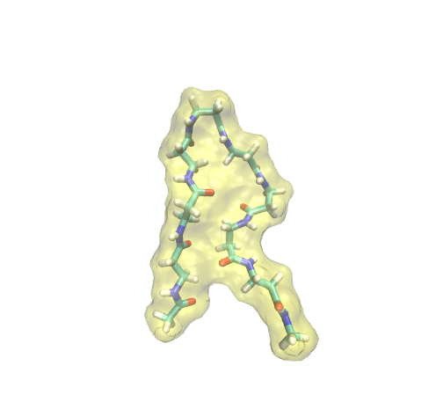
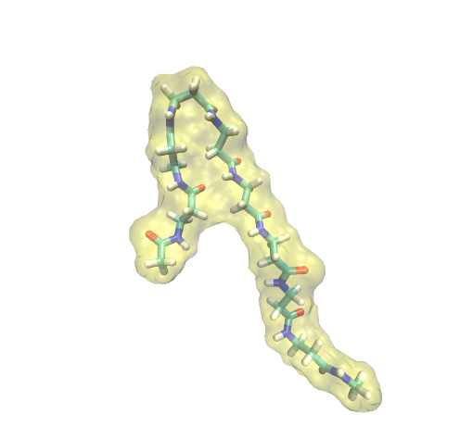
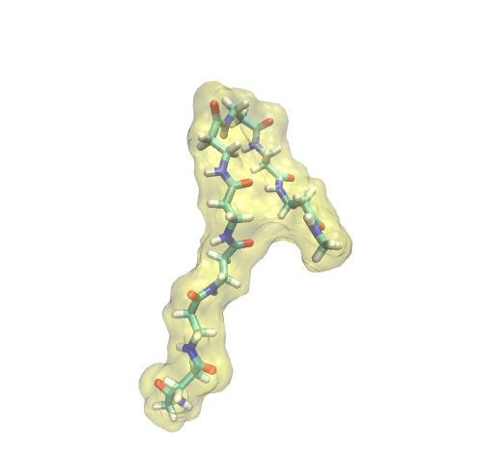
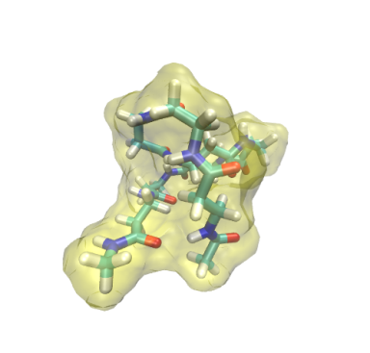
Representative conformations derived from REMD with explicit water @ 300K
extended
hairpin
turn@βAla3
turn@βAla6
globule
Averaged # of HB: 0.07
(total 45,000 conf.)
➔ Supported by the earlier experimental study¹
From FY2015 6th CREST WS
[1] J. D. Glickson and J. Applequist. J.A.C.S., 1971, 93, 3276-3286

Slide 29
Toward improving enzymatic polymerization reaction simulation
The first subject is to reproduce 8 mer by addressing the following issues.
Remembering structural characteristics of N435, prepare simulation systems
➔This would require a brief modification in ligand binding scheme.
Accelerate molecular dynamics with…
biased potential
faster MD engines (pmemd, pmemd.cuda)
➔As for the second option, we have to prepare alternative script to edit PDB file.

Slide 30
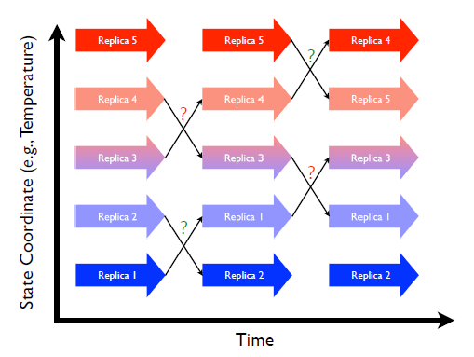
Optimization strategy
Exchange probabilities between adjacent replicas have to be similar between replica pairs.
In earlier studies, exchange probability is chosen to be around 30-40%.
Figure 21. 1.: Replica exchange schematic showing 5 replicas combined in an expanded ensemble. Large arrows represent MD trajectories of sub-ensembles while the smaller arrows represent attempted swaps between replicas in state space. Question marks represent Monte Carlo exchange attempts (green for successful, red for failed)².
[1] A. Mitsutake et al. Biopolymer, 2001, 60, 96-123; [2] Amber 14 manual.

Slide 31
Setup of temperatures REMD
In this present simulation, 54 replicas are employed for explicit solvent REMD. Each replica simulation consists of 50000 x 1ps MD run.
temperature pair | exchange probability |  | temperature pair | exchange probability |  | temperature pair | exchange probability |  | temperature pair | exchange probability
268.00 ↔ 272.00 | 0.261 |  | 324.00 ↔ 328.00 | 0.39 |  | 392.00 ↔ 398.00 | 0.326 |  | 484.00 ↔ 492.00 | 0.362
272.00 ↔ 276.00 | 0.242 |  | 328.00 ↔ 332.00 | 0.404 |  | 398.00 ↔ 404.00 | 0.343 |  | 492.00 ↔ 500.00 | 0.376
276.00 ↔ 280.00 | 0.26 |  | 332.00 ↔ 336.00 | 0.413 |  | 404.00 ↔ 410.00 | 0.359 |  | 500.00 ↔ 508.00 | 0.389
280.00 ↔ 284.00 | 0.27 |  | 336.00 ↔ 340.00 | 0.428 |  | 410.00 ↔ 416.00 | 0.377 |  | 508.00 ↔ 516.00 | 0.413
284.00 ↔ 288.00 | 0.281 |  | 340.00 ↔ 344.00 | 0.441 |  | 416.00 ↔ 422.00 | 0.388 |  | 516.00 ↔ 526.00 | 0.288
288.00 ↔ 292.00 | 0.29 |  | 344.00 ↔ 349.00 | 0.313 |  | 422.00 ↔ 428.00 | 0.406 |  | 526.00 ↔ 536.00 | 0.304
292.00 ↔ 296.00 | 0.305 |  | 349.00 ↔ 354.00 | 0.328 |  | 428.00 ↔ 435.00 | 0.324 |  | 536.00 ↔ 546.00 | 0.333
296.00 ↔ 300.00 | 0.311 |  | 354.00 ↔ 359.00 | 0.345 |  | 435.00 ↔ 442.00 | 0.337 |  | 546.00 ↔ 556.00 | 0.345
300.00 ↔ 304.00 | 0.334 |  | 359.00 ↔ 364.00 | 0.358 |  | 442.00 ↔ 449.00 | 0.361 |  | 556.00 ↔ 566.00 | 0.359
304.00 ↔ 308.00 | 0.338 |  | 364.00 ↔ 369.00 | 0.383 |  | 449.00 ↔ 456.00 | 0.366 |  | 566.00 ↔ 576.00 | 0.385
308.00 ↔ 312.00 | 0.353 |  | 369.00 ↔ 375.00 | 0.272 |  | 456.00 ↔ 463.00 | 0.384 |  | 576.00 ↔ 588.00 | 0.305
312.00 ↔ 316.00 | 0.357 |  | 375.00 ↔ 381.00 | 0.291 |  | 463.00 ↔ 470.00 | 0.393
316.00 ↔ 320.00 | 0.371 |  | 381.00 ↔ 387.00 | 0.304 |  | 470.00 ↔ 476.00 | 0.505
320.00 ↔ 324.00 | 0.38 |  | 387.00 ↔ 392.00 | 0.438 |  | 476.00 ↔ 484.00 | 0.337
Discarding initial 5 ns MD trajectories, 45,000 snapshot structures at 300 K are classified using the clustering method*.
*Algorism: K-means; Cluster number: 5

