Slide 1

The 3rd CREST-WS
Towards Understanding the Zr-FI Catalyzed Polymerization Reaction
Soumen Saha
Nagaoka Laboratory,
Graduate School of Informatics,
Nagoya University,
Japan
20/XI/2018

Slide 2
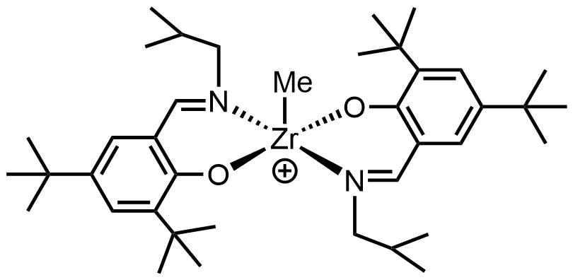
Outline
Most Preferable Conformations of Zr-FI Catalyst
      Neutral Form
      Cation
      Ion-pair
      Cation & Monomer
      Ion-pair & Monomer
Ethylene Insertion Polymerization by Zr-FI Catalyst
      Insertion
      Propagation
      Termination
Coordinative Chain Transfer Polymerization (CCTP) by Zr-FI Cation and ZnEt₂ (On going)
Cation
Anion
Monomer
Zr-FI Cation
Borate
Ethylene

Slide 3
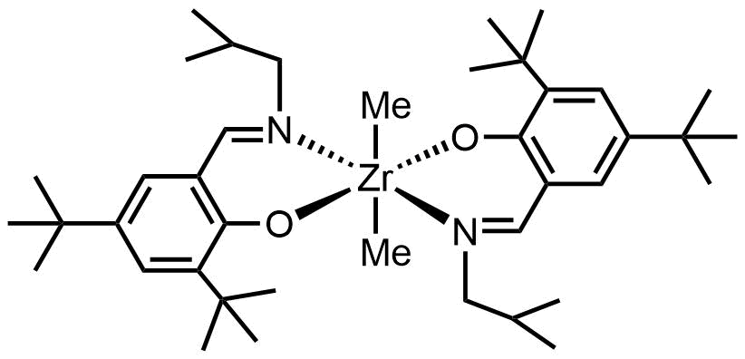
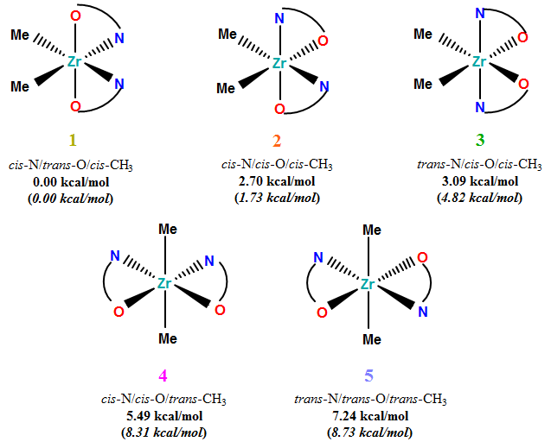
Most Preferable Conformations of Zr-FI Catalyst
One of the most influential breakthroughs were the discoveries of metal-phenoxy-imine (or FI: Fenokishi-Imin Haiishi) catalysts.^{[1,2]}
Neutral Form^{[1,2,3]}
Zr-FI Catalyst
[1]. Chem. Rev. 2011, 111, 2363. [2]. Acc. Chem. Res. 2009, 42, 1532. [3]. Saha et al J. Phys. Chem.A, 2018, 122, 2198.
M06/6-31G** (LANL2DZ +f polarization functions: Zr).

Slide 4
Zr-FI Cation
Precatalyst Activation^{[1]}
+
+
Zr-FI Cation
Strategy for Finding The Most Preferable Conformations^{[2]}
40 ns
M06/B1
[1]. Acc. Chem. Res. 2014, 47, 2545. [2]. Saha et al J. Phys. Chem.A, 2018, 122, 2198.
B1 = 6-31G** (LANL2DZ +f polarization functions: Zr);

Slide 5
Zr-FI Cation
QM Free Energy (kcal/mol)^{[1]} w.r.t. A
0.00 [73%] | 3.05 [2%] | 0.83 [26%]
M06/B1
0.00 [58%] | 1.41 [10%] | 0.48 [32%]
MP2/B1
0.00 [35%] | 1.81 [4%] | -0.45 [62%]
M06/B2
0.00 [35%] | 1.27 [7%] | -0.39 [57%]
MP2/B2†
Solvent (Heptane)
0.00 [57%] | 1.33 [11%] | 0.45 [32%]
M06/B2†
A and C are equivalent in energy.
[1]. Saha et al J. Phys. Chem.A, 2018, 122, 2198.
B1 = 6-31G** (LANL2DZ +f polarization functions: Zr); B2 = Def2-TZVPP; †M06/B2//M06/B1; ‘Red Colour’ is more stable;
[existing probability: e.g., $[1]/[2]=exp\{−(G_{1}^{∗}−G_{2}^{∗})/kT\}]$

Slide 6
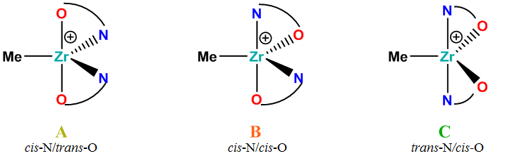
Ion-pair
Eight different possibilities have been considered.

Slide 7
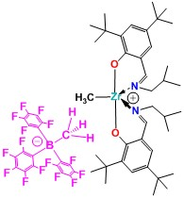
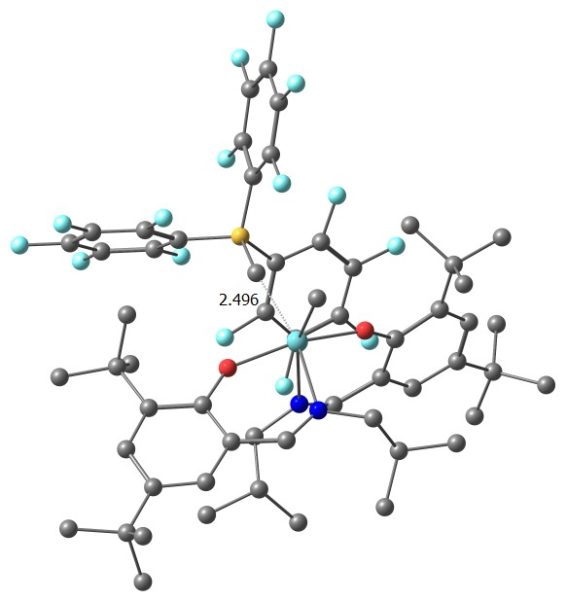
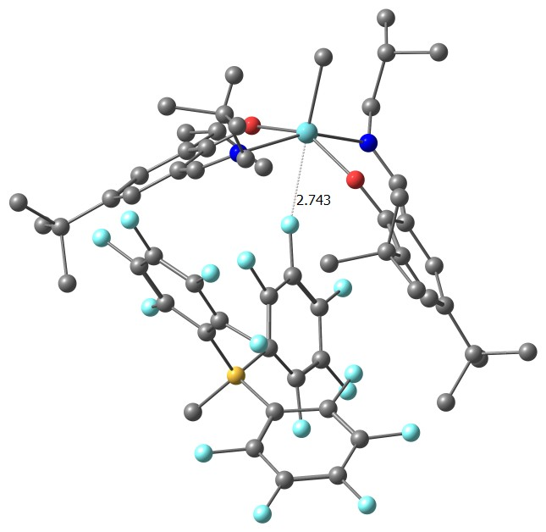
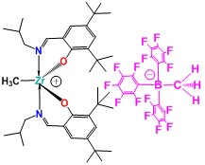
Ion-pair
Altogether 160 different structures have been generated by using MD simulations, and subsequently, QM optimization of these structures has been performed to obtain the most preferable conformation for ion-pair.
Free Energy
(kcal/mol)
M06/B1
0.00 | 1.18
Forming Hexa-coordinated Zr system.
The LJ parameters for intermolecular interaction between Zr-cation and anion
Type | Ɛ (kcal/mol) | r (Å)
Zr-H (CH₃) | 0.050 | 2.500
Zr-F | 0.250 | 2.880
B1 = 6-31G** (LANL2DZ +f polarization functions: Zr);

Slide 8
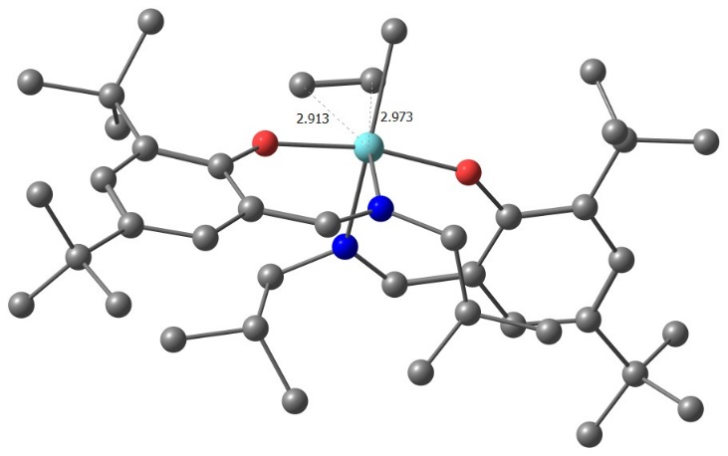
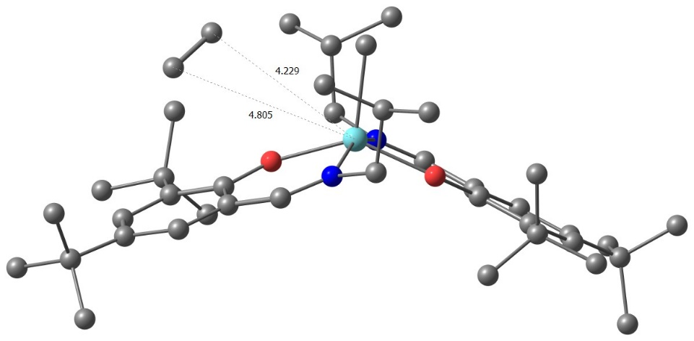
Cation & Monomer
cis-N/trans-O
trans-N/cis-O
Using FF parameters of cation A and C, we have generated 80 different structures by using MD simulations.
Free Energy
(kcal/mol)
M06/B1
0.00 | 4.17
The LJ parameters for intermolecular interaction between Zr-cation and monomer
Type | Ɛ (kcal/mol) | r (Å)
Zr-C_{Ethylene} | 5.000 | 2.973
B1 = 6-31G** (LANL2DZ +f polarization functions: Zr);
Most Stable

Slide 9
Ion-pair & Monomer
Eight possibilities have been considered.
240 different structures have been generated by using MD simulations.
Subsequently, QM optimization of these structures has been performed.

Slide 10
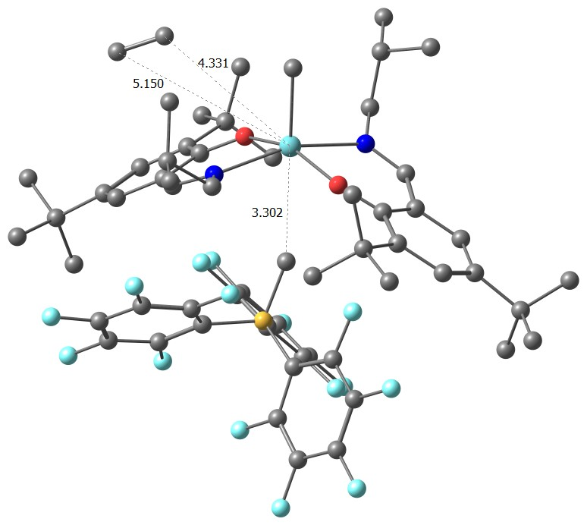
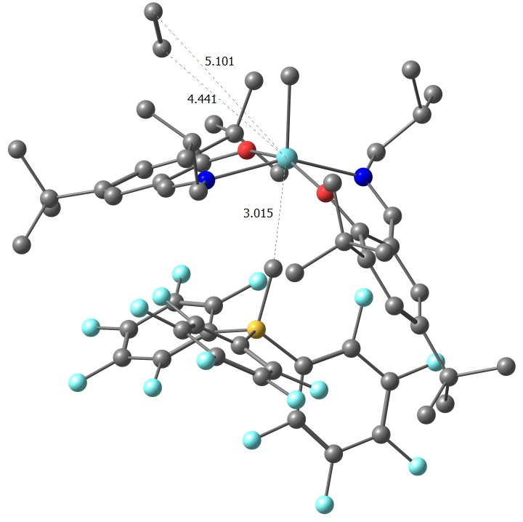
Ion-pair & Monomer
M06/B1
Free Energy
(kcal/mol)
0.00 | 1.28
Forming Hexa-coordinated Zr-system.
B1 = 6-31G** (LANL2DZ +f polarization functions: Zr);
Most Stable

Slide 11
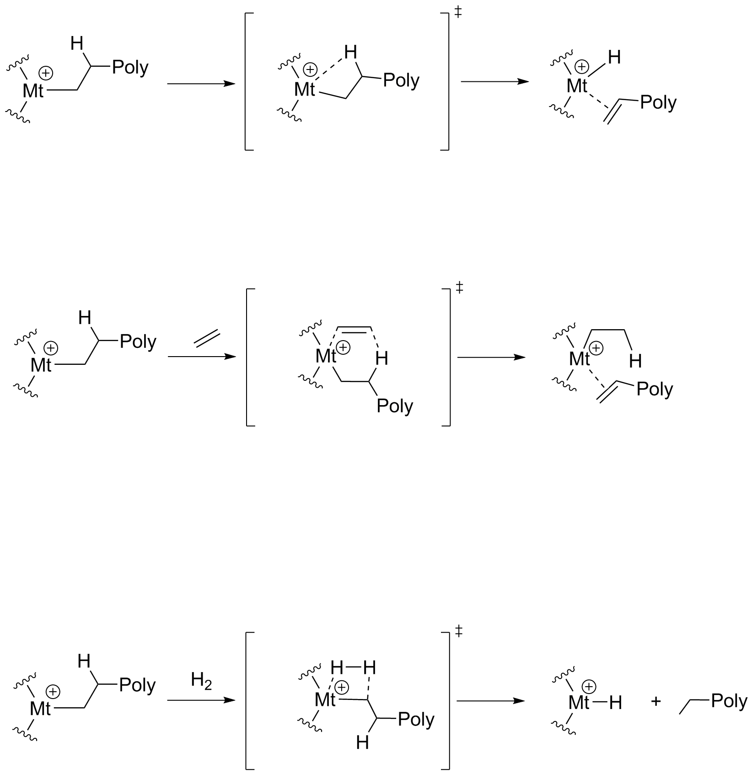
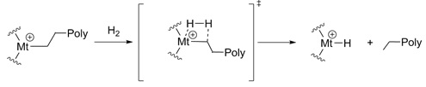
Ethylene Insertion Polymerization by Zr-FI Catalyst
Olefin Polymerization Reaction^{[1,2]}
First Insertion
Second Insertion
Termination
(Hydrogenolysis)
Termination^{[2,3]}
β-hydrogen elimination (β-hydrogen transfer to metal): Unfavorable
β-hydrogen transfer to monomer
Metal-carbon bond cleavage by hydrogen molecule (Hydrogenolysis): Commercial process
#Mt = Zr
[1] J. Chem. Theory Comput. 2013, 9, 3491. [2]. Osakada, K. Organometallic Reactions and Polymerization, 2014, Vol. 85. [3]. Rappé, A. K.; Skiff, W. M.; Casewit. C. J.; Chem. Rev. 2000, 100, 1435

Slide 12
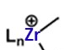
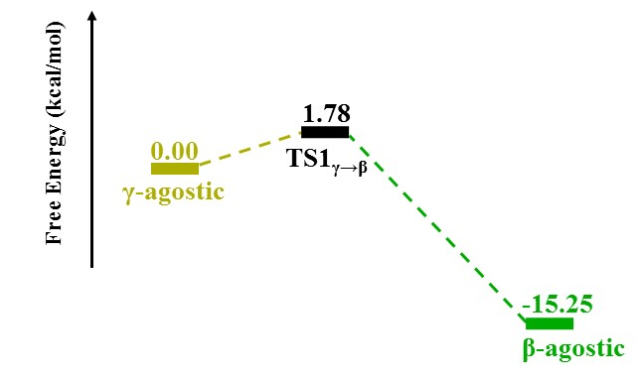
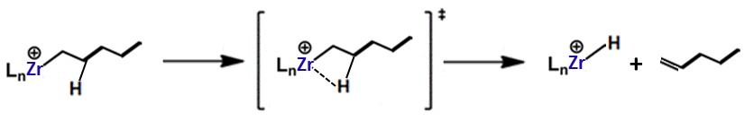
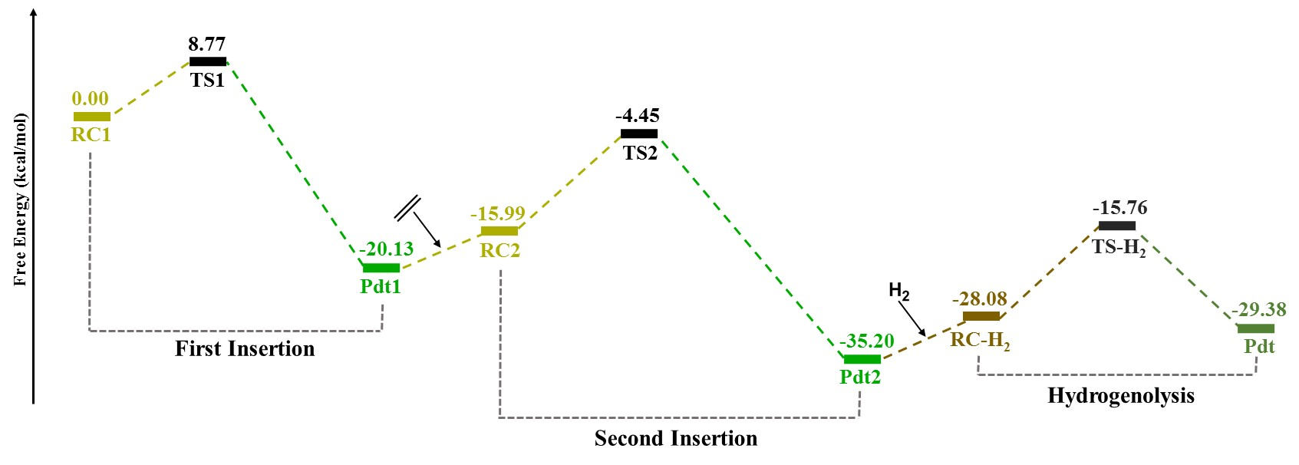

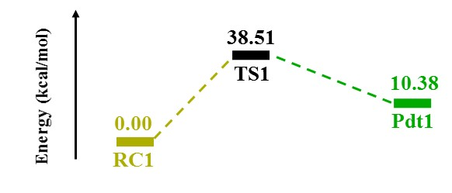

Ethylene Insertion Polymerization by Zr-FI Cation
QM Results
β-hydrogen transfer to monomer
B1 = 6-31G** (LANL2DZ +f polarization functions: Zr).
[Single point SMD calculation: Solvent= Heptane, ${∆E}_{solvent}$+ $G_{gas}^{Corr}$]

Slide 13
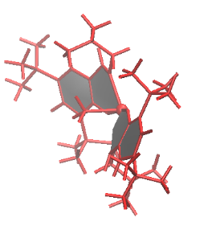
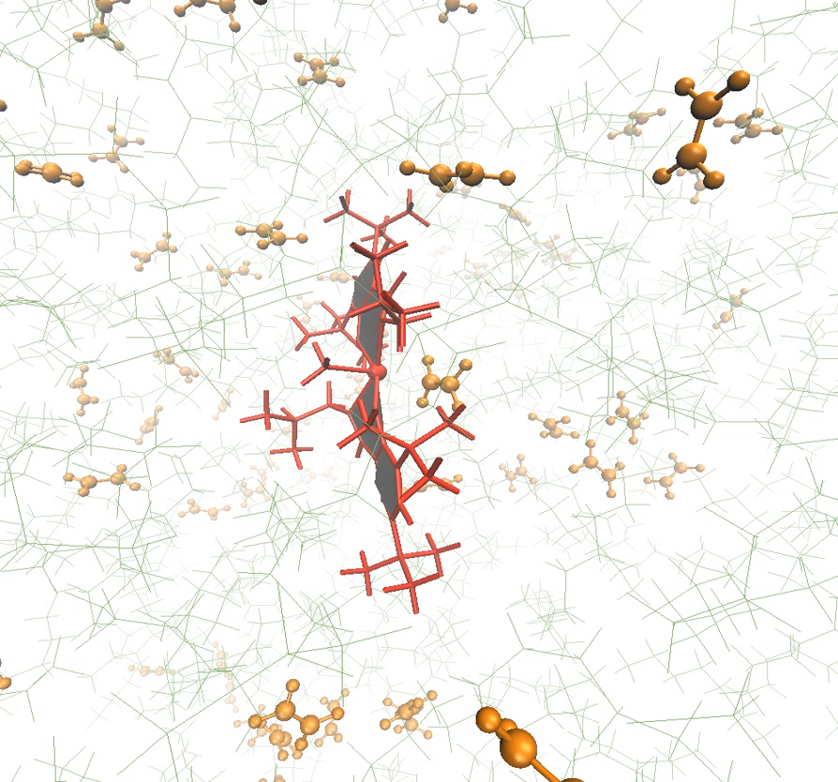


Ethylene Insertion Polymerization by Zr-FI Cation
Red Moon simulation
Cation
Ethylene
Heptane
Molecules: 1 Cation, 120 ethylene and 480 heptane molecules
Activation energy (E_{a}) in ‘Gas Phase (QM)’ : 7.06 kcal/mol

Slide 14
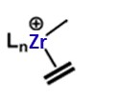
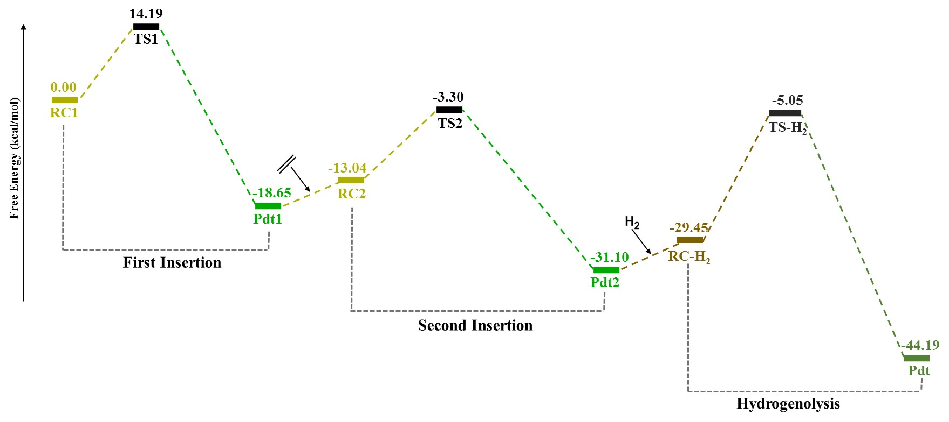
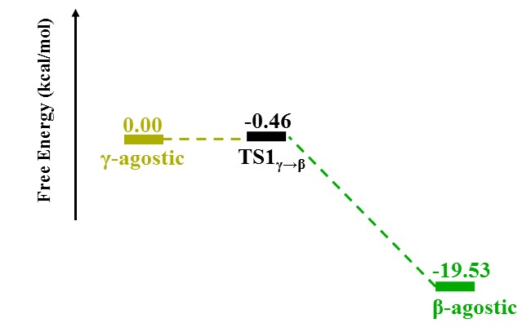
Ethylene Insertion Polymerization by Zr-FI Ion-pair
QM Results
An⁻
M06/B1 [Heptane]
B1 = 6-31G** (LANL2DZ +f polarization functions: Zr).
[Single point SMD calculation: Solvent= Heptane, ${∆E}_{solvent}$+ $G_{gas}^{Corr}$]

Slide 15
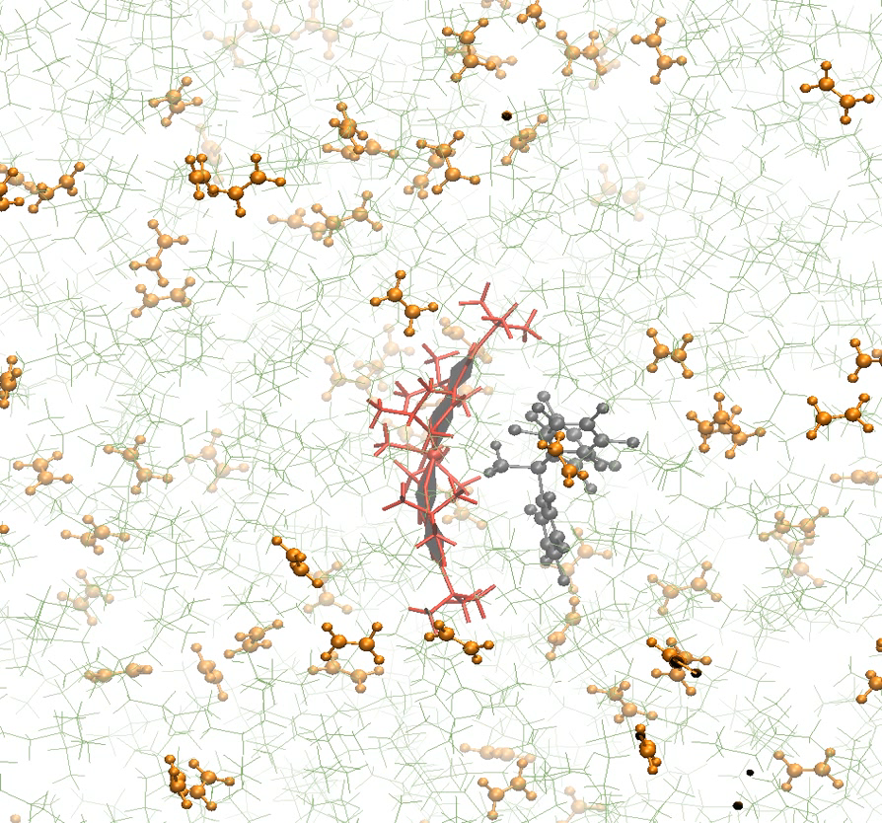
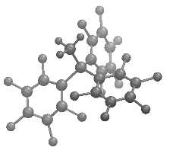
Ethylene Insertion Polymerization by Zr-FI Ion-pair
Red Moon simulation
Cation
Anion
Ethylene
Heptane
Molecules: 1 Cation, 1 Anion, 120 ethylene and 480 heptane molecules
Activation energy (E_{a}) in ‘Gas Phase (QM)’ : 8.34 kcal/mol

Slide 16
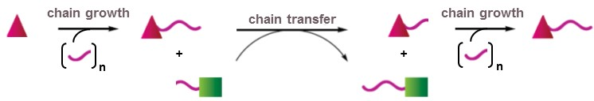
CCTP by Zr-FI Cation and ZnEt₂
Coordinative Chain Transfer Polymerization (CCTP) Reaction
Zr-FI Cation
Ethylene
Monomer
ZnEt₂
Chain Transfer Agent

Slide 17
CCTP by Zr-FI Catalyst and ZnEt₂
RC
IC
Pdt.C
Energy (kcal/mol)
4.76 (2.46)
TS1
2.51 (2.43)
0.00 (0.00)
TS2
RC
-1.74 (-2.06)
18.73 (16.20)
Pdt.C
-16.22 (-13.77)
IC
6-31G* and LANL2DZ +f polarization functions for Zr (6-31G**; LANL2DZ for Zn and LANL2DZ +f polarization functions for Zr)

Slide 18
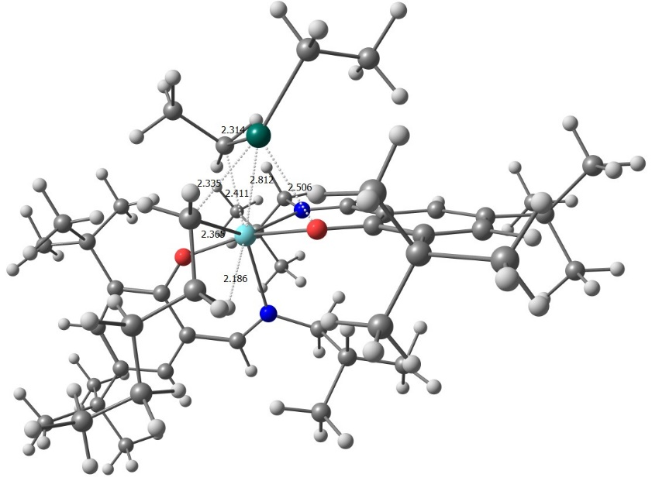
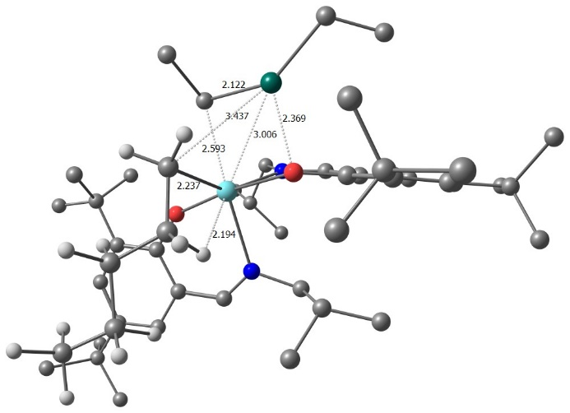
CCTP by Zr-FI Catalyst and ZnEt₂
+
Energy (kcal/mol)
R
RC
IC
Pdt.C
0.00 (0.00)
-3.42
R
TS2
-11.92
-21.50
19.11
-22.19
0.69
-22.52
Pdt.C
TS1
RC
IC
M06/6-31G**; LANL2DZ for Zn and LANL2DZ +f polarization functions for Zr.

Slide 19
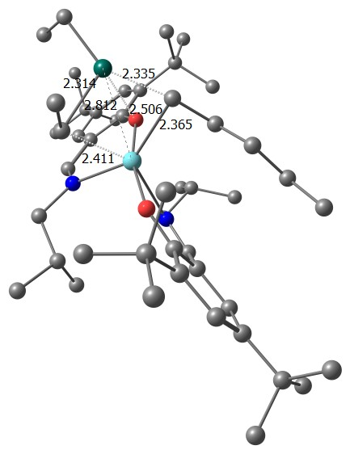
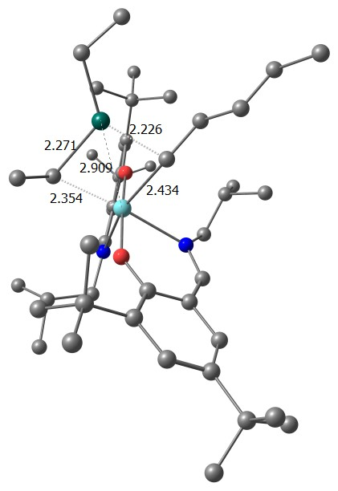
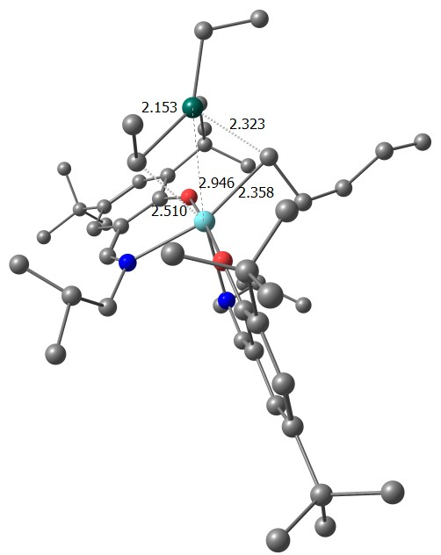
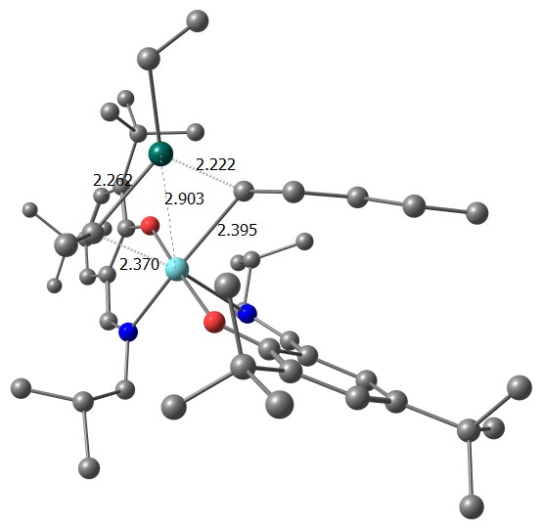
CCTP by Zr-FI Catalyst and ZnEt₂
Comparison between 4-membered and 5-membered IC
IC
5-membered IC is more stable.
0.00
IC
8.56
4.54
7.02
M06/6-31G**; LANL2DZ for Zn and LANL2DZ +f polarization functions for Zr.
Relative energy (kcal/mol)

Slide 20
Future Perspectives
Realizing the polymerization process via Red Moon simulation. Need to include the solvent phase activation energy as well as hydrogenolysis (termination) process in the Red Moon simulation.
To understand the ‘Coordinative Chain Transfer Polymerization’ (CCTP) for Zr-FI catalyst with ZnEt₂ by quantum mechanically as well as by Red Moon simulation.
Thank you …

