Slide 1
2014/October/23
Toward Understanding Tacticity in Radical Vinyl Polymerization in PCP Nanochannels
PCP細孔内ラジカルビニル重合反応生成物の 立体規則性の理解に向けて
Masayoshi Takayanagi
Graduate School of Information Science, Nagoya University

Slide 2
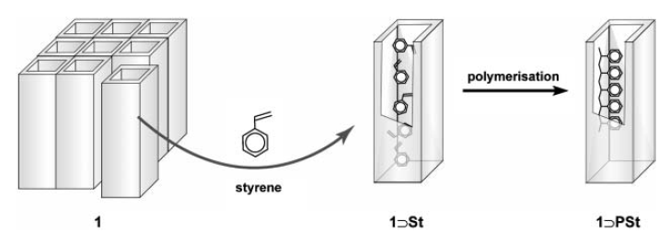
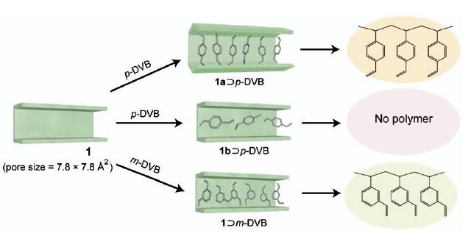
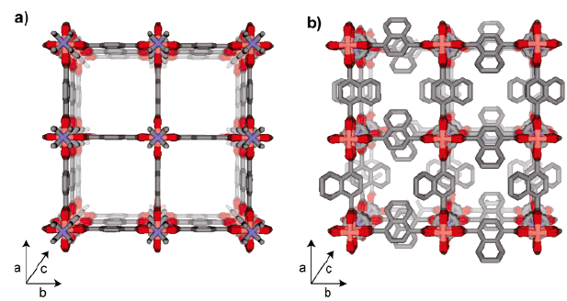
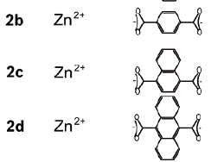
Radical polymerization in PCP channels by Uemura group (Kitagawa Lab., Kyoto Univ.)
2005 First report of radical polymerization in PCP
2007 Linear radical divinylbenzene (DVB) polymerization in PCP
Linear polymer, not possible in bulk
2b
2c
Jangle-gym like
PCP framework

Slide 3
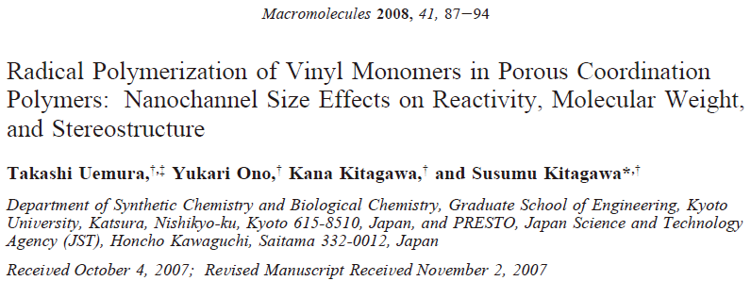
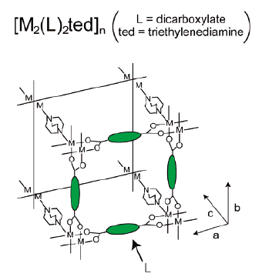
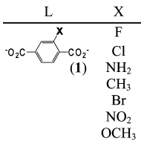
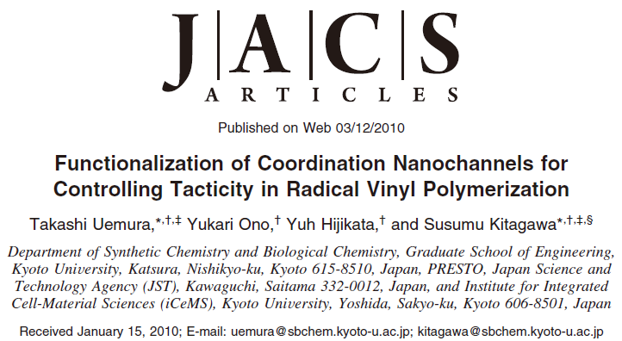
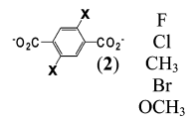
Radical polymerization in PCP channels by Uemura group (Kitagawa Lab., Kyoto Univ.)
Methyl methacrylate (MMA) monomer
PMMA
2008 Poly methyl methacrylate (PMMA) radical polymerization in PCP
Tacticity of product PMMA (meso diad ratio)
In bulk 22% In (1) X=Cl 30%
In 2b 28% In (1) X=NH₂ 27%
In 2c 30% In (1) X=CH₃ 36%
In (2) X=CH₃ 37%
In (2) X=OCH₃ 53%
2010 Control tacticity of PMMA by using different PCP components

Slide 4
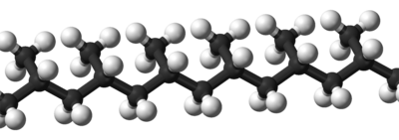
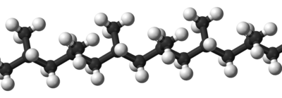
Tacticity
Meso diad (m)
Racemo diad (r)
Isotactic triad (mm)
Heterotactic triad (mr, rm)
Syndiotactic triad (rr)
Isotactic polymer
Syndiotactic polymer

Slide 5
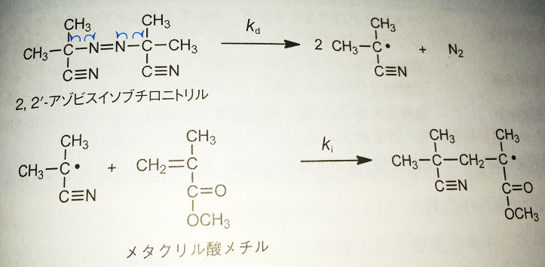
Initiation reaction of MMA radical polymerization by AIBN
AIBNによるMMAラジカル重合の開始反応
Thermal decomposition at 40-80 ℃
AIBN
MMA monomer

Slide 6
Propagation reaction of MMA radical polymerization
MMAラジカル重合の成長反応
head
tail
Easy to attack without steric crowding
head-to-tail
~100%
head-to-head
~0%
Head-to-tail product is stabilized by resonance structure

Slide 7
Termination reaction of MMA radical polymerization
MMAラジカル重合の停止反応
recombination
disproportionation
Chain transfer of MMA radical polymerization
MMAラジカル重合の連鎖移動

Slide 8
CH₃ー
Monomer
Radical
Dimer radical (model)
By DFT calculations in B3LYP/6-31G level, (roughly) investigate the electronic properties of MMA monomer/radical/dimer radical DFT basis set is not enough large for accurate predictions
Check stable conformations by optimization
Check isolated electron locations by viewing singly occupied MO (SOMO)

Slide 9
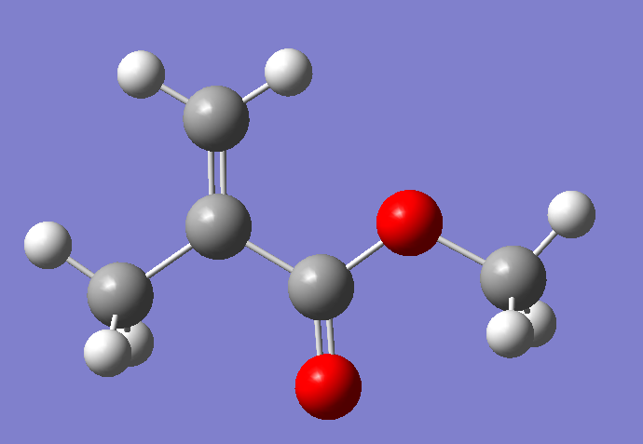
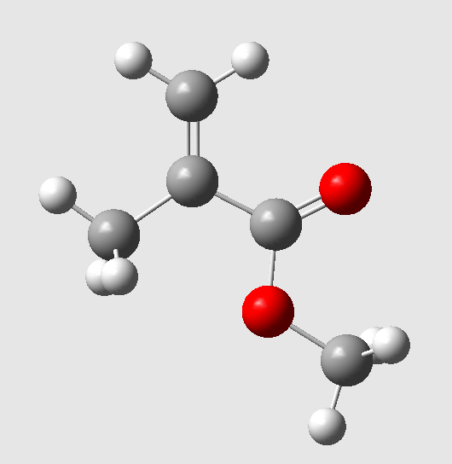
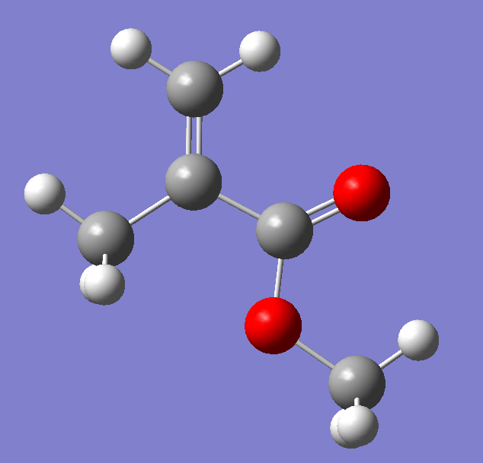
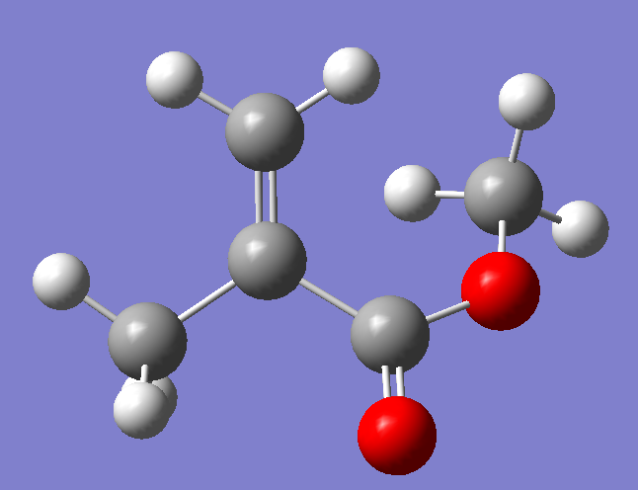
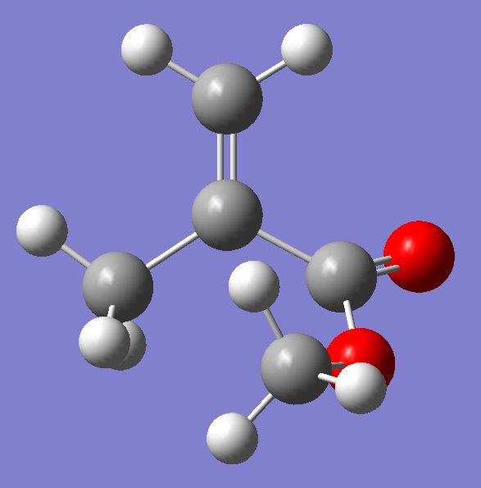
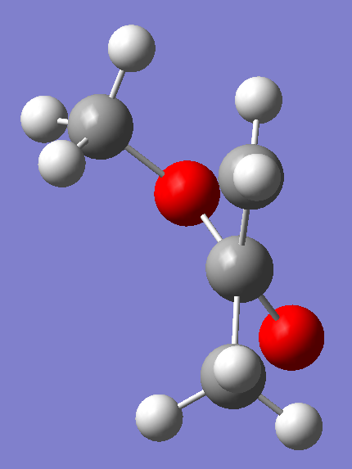
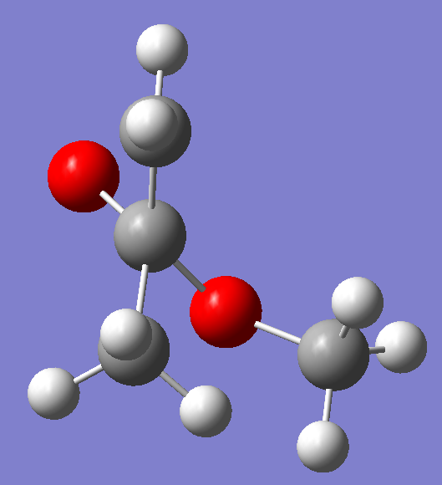
(1)
rotational barrier 7.5 kcal/mol
(2)
(2)’
0.5 kcal/mol
Most stable
0.1 kcal/mol
Opt-4
Opt-4-3
Rotamer, imaginary mode at the CH₃ group
Opt-1
all heavy atoms lie in the same plane
all heavy atoms lie in the same plane
(3)
(4)
2.7 kcal/mol
13.9 kcal/mol
Opt-3
Opt-2
Monomer, singlet state Blue number: energy difference compared to the most stable structure
B3LYP/6-31G optimization B3LYP_6-31G_MMAopt

Slide 10
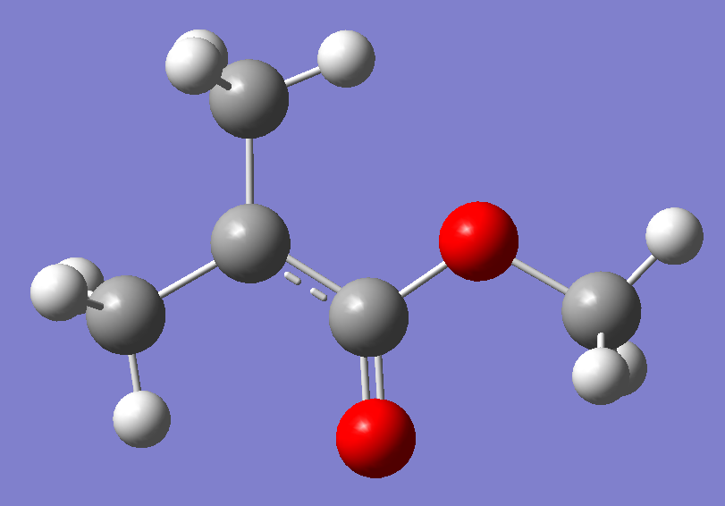
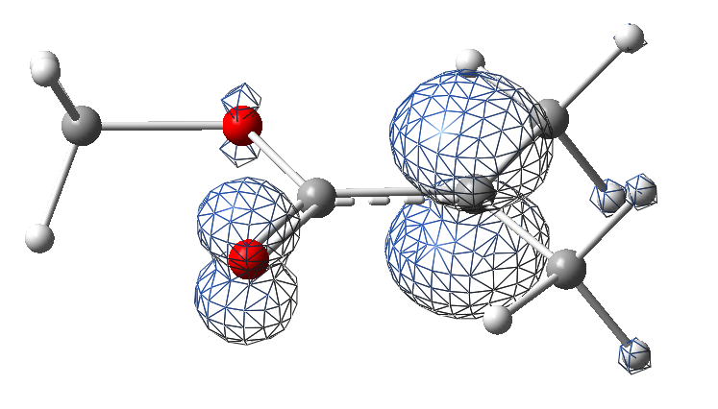
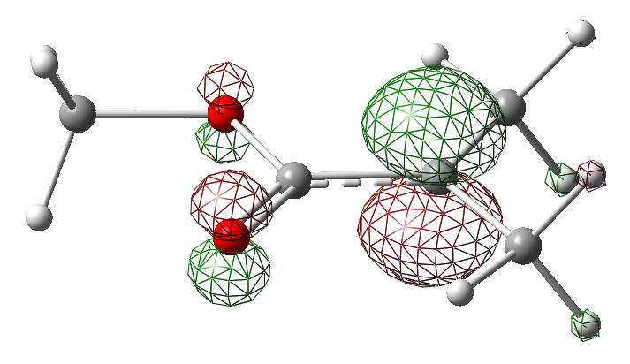
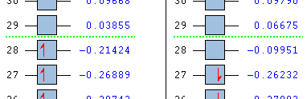
Radical
Only one stable structure
Bond distance in Å
1.496
identical
1.496
1.391
1.464
Electron density from Spin SCF Density (isoval = 0.01)
1.445
1.254
Radical, doublet state
UB3LYP/6-31G B3LYP_6-31G_MMAradical_opt
Structural difference
→ I have to prepare different forcefield parameters
Monomer
Most stable (1) structure
MO of the singly occupied molecular orbital (SOMO) (isoval = 0.1)
1.344
different
1.379
SOMO
1.509
1.486
1.468
1.241
Spin density & SOMO is localized at the radical C atom (also in the radical O atom in the resonance structure)

Slide 11
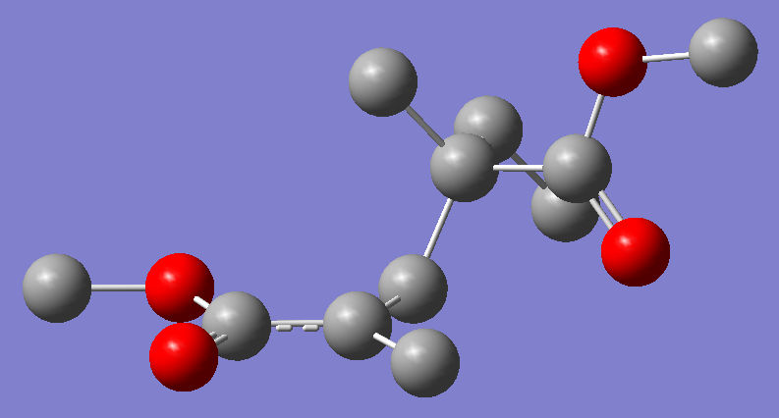
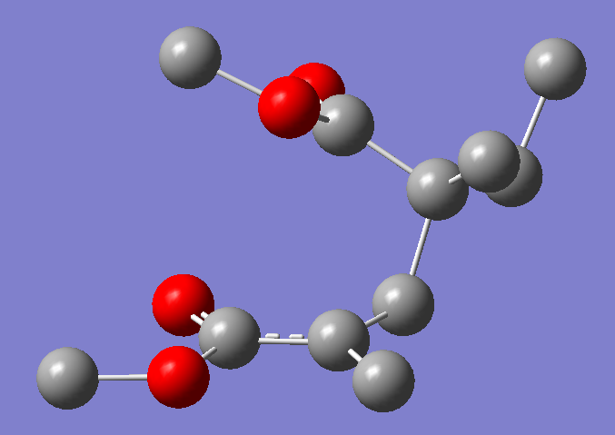
(1) Racemo diad
planar
Most stable
Opt-1
CH₃ー
planar
planar
planar
(2) Meso diad
0.5 kcal/mol
Opt-2-2
Meso diad (m)
Racemo diad (r)
Rough estimation of r :m ratio
At 70 ℃, from the Boltzmann distribution
r : m = 1 : 0.515 → r 66%, m 34%
Bulk PMMA : m 22%
Dimer radical, doublet state (Omit hydrogen atoms)
B3LYP/6-31G optimization B3LYP_6-31G_dimerMMA

Slide 12
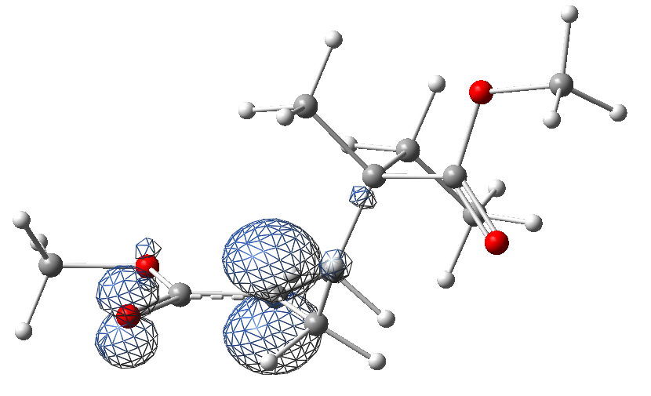
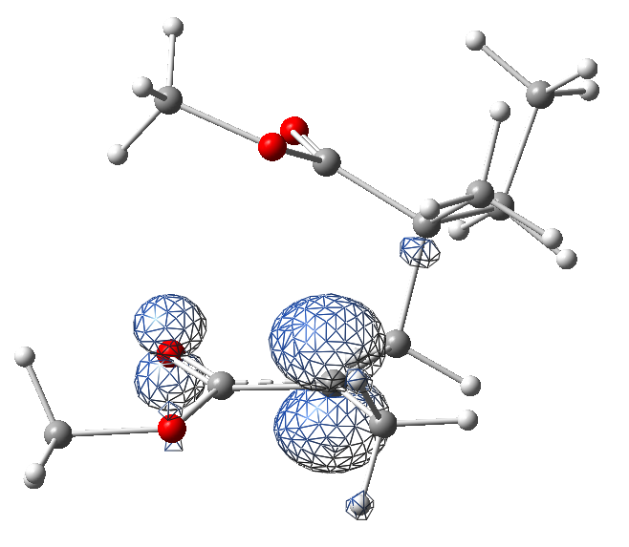
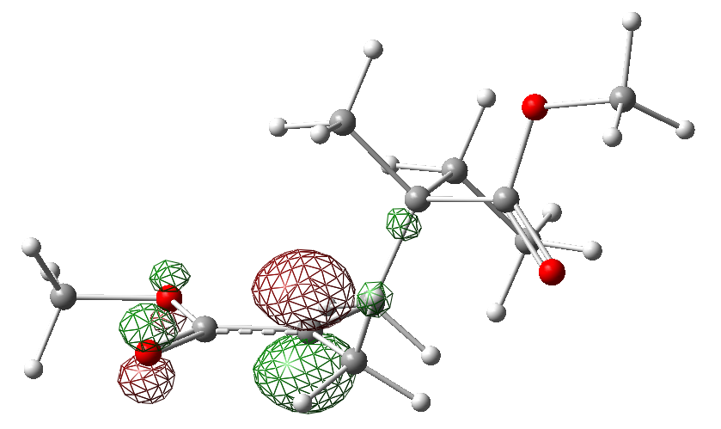
CH₃ー
Electron density from Spin SCF Density (isoval = 0.01)
SOMO
MO of the singly occupied molecular orbital (SOMO) (isoval = 0.1)
Spin density & SOMO is localized at the C atom depicted as radical ( )

Slide 13
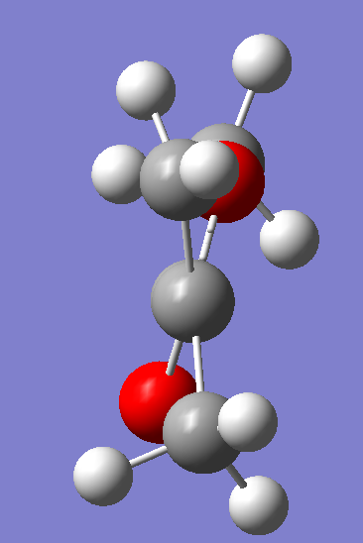
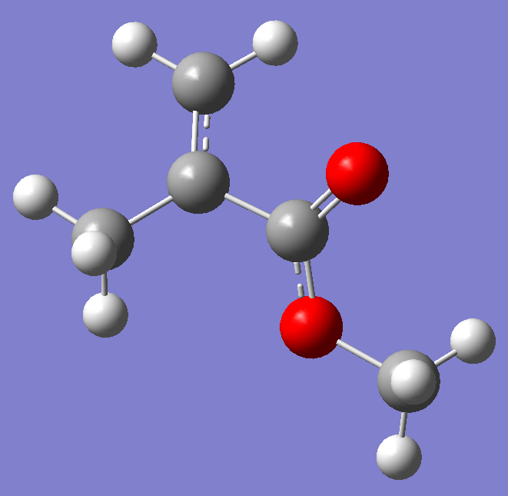
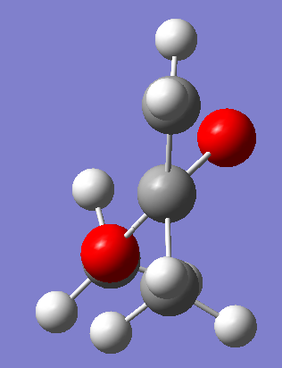
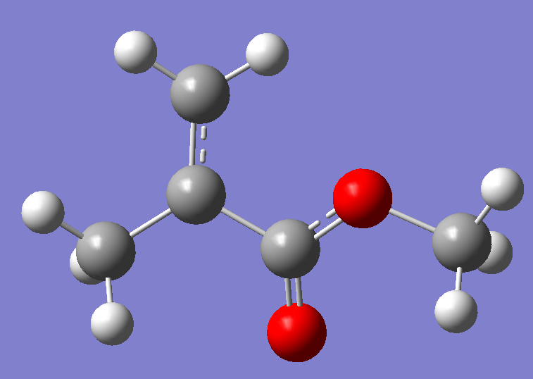
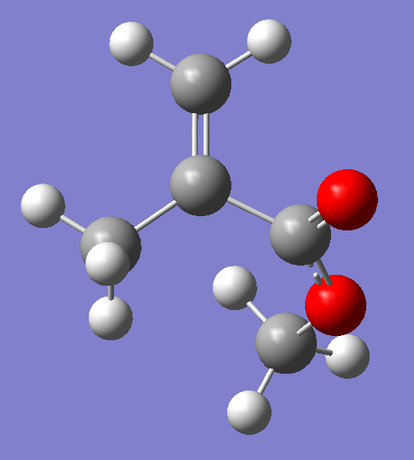
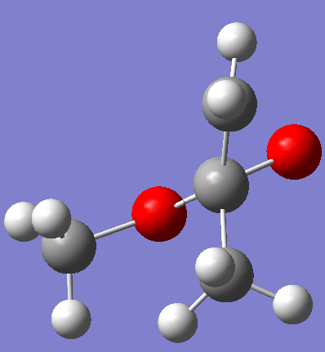
(1)
(2)
3.1 kcal/mol
Most stable
Opt-1
Opt-4
(3)
(4)
7.9 kcal/mol
Not stable, change to (1)
Opt-3
Cation (+1 charge), doublet
B3LYP/6-31G optimization
B3LYP_6-31G_MMA_cation_opt

Slide 14
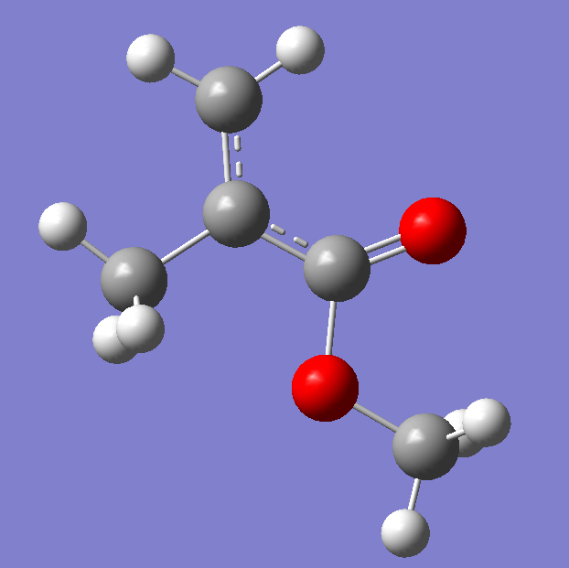
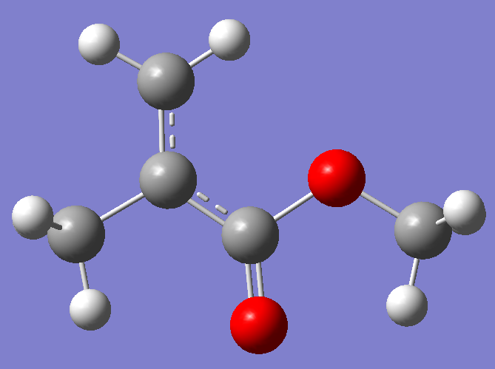
(1)
(2)
Most stable
0.5 kcal/mol
Opt-1-3
Opt-4-2
(3)
(4)
Not stable, change to (1)
Not stable, change to (2)
Anion (-1 charge), doublet
B3LYP/6-31G optimization In (1) and (2), all heavy atoms lie in the same plane
B3LYP_6-31G_MMA_anion_opt

