Slide 1
Microscopic Origin of the Salt Concentration Effect on the Formation of Solid Electrolyte Interface Layer in Fire-Extinguishing Electrolyte
March 5th, 2019
Amine Bouibes
5th CREST workshop

Slide 2
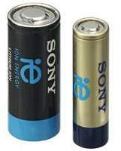
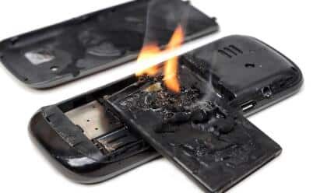
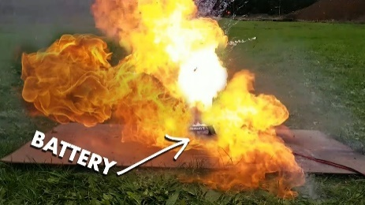
Introduction
Secondary batteries concerns
Sever safety concerns
Secondary battery
Fire
Explosion
Thermal runway into organic electrolyte
Under
an abuse condition
Increase in the reactions propagation
Increase in
temperature and pressure
Encountering
the oxygen abruptly
Generation of heat
Propagation of heat
Ejection of flammable vapour
Explosion and fire
Ultimate solution: Non flammable electrolyte
Very low flash point
Very short self-extinguishing time
[1] J. Wang; et al. and A. Yamada, Nat. Energy, 3, 22-29 (2018)

Slide 3
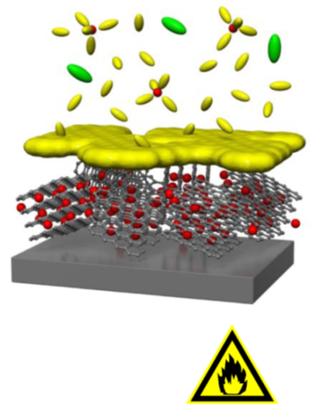
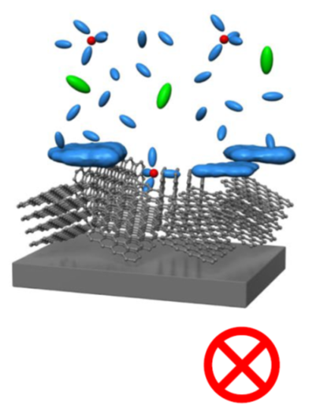
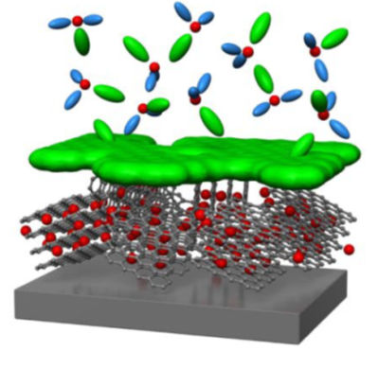
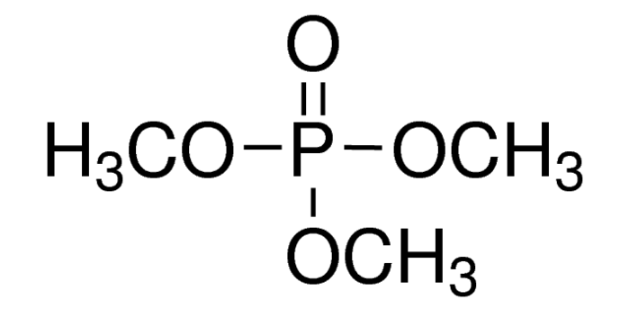
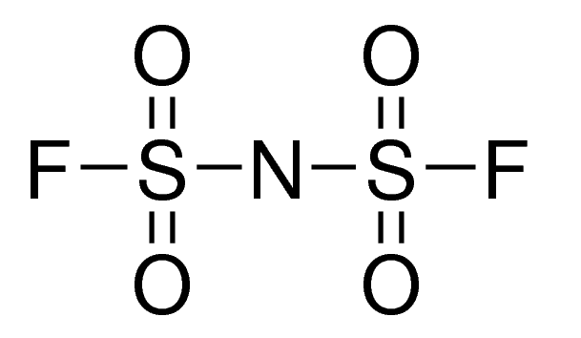
Introduction
Design a fire-extinguishing electrolyte
High salt concentration
Carbonate Solvent
Non-flammable solvent
Salt
Conventional carbonate electrolyte
Conventional non-flammable electrolyte
Non-flammable concentrated electrolyte
Solvent: Trimenthyl phosphate (TMP)
Salt: Lithium bis (fluorosulfonyl) amide (LiFSA)
-
Li⁺
[Ref] J. Wang; et al. and A. Yamada, Nat. Energy, 3, 22-29 (2018)

Slide 4
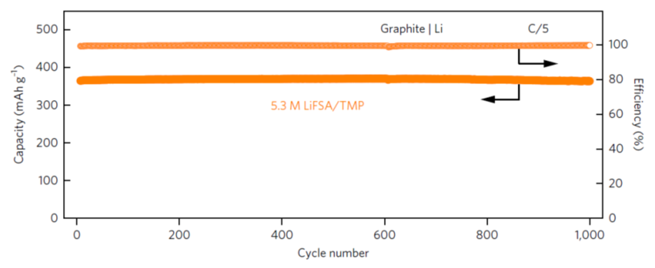
Introduction
LiFSA/TMP fire-extinguishing electrolyte
The SEI film was formed at high salt concentration.
The irreversible capacity decreased by increasing salt concentration.
At high salt concentration, safe LIB showed a high performance through a long lifetime.
Purpose: Microscopic origin of salt concentration effect on SEI Layer formation in fire-extinguishing electrolyte for safe batteries.
[1] J. Wang; et al. and A. Yamada, Nat. Energy, 3, 22-29 (2018)

Slide 5
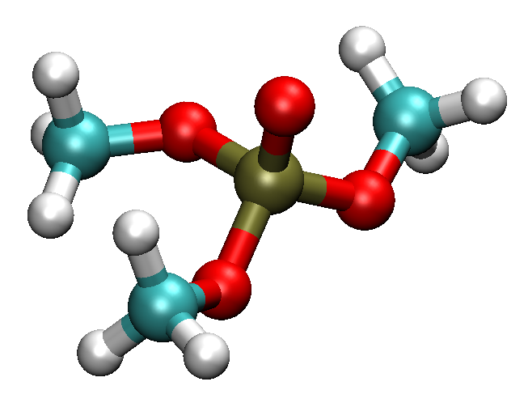
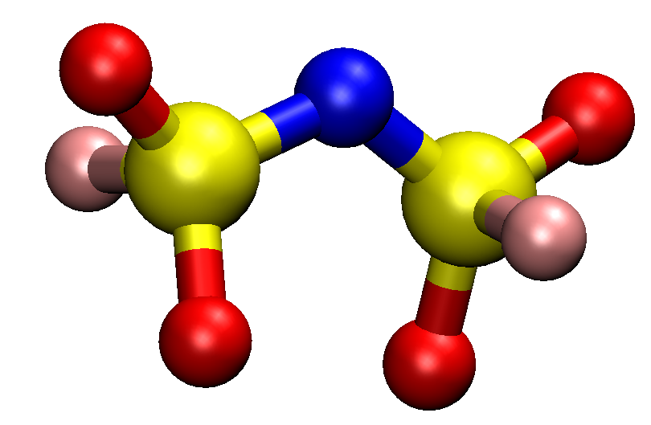

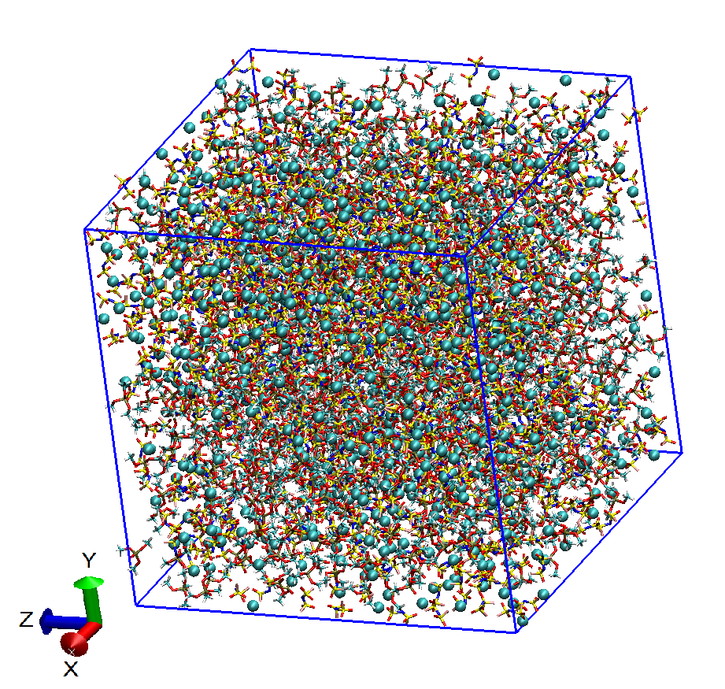
Model system
Molecule number of LiFSA/TMP electrolyte
For this purpose, we employed the LiFSA/TMP electrolyte solution at dilute (1.0 Mol.L⁻¹), moderate (2.3 Mol.L⁻¹) and very high (5.3 Mol.L⁻¹) concentration conditions.
Calculation condition:
TMP
FSA⁻
Li⁺
GAFF Force Field
Temperature: 298K
 |  |  | Salt concentration (Mol.L⁻¹)
 |  |  | 1 | 2.3 | 5.3
Number of Species |  | TMP | 800 | 800 | 800
 |  | FSA⁻ | 105 | 250 | 830
 |  | Li⁺ | 105 | 250 | 830
Molecular ratio (Li) |  | TMP/ FSA | 7.6 | 3.2 | 0.96

Slide 6
The decomposition of TMP solvent
Calculation level: m062x/def2TZVP
SMD method with ε = 20.6 (TMP solvents)
Red: Free energy of reaction
Blue: Free energy of activation
1 electron reduction
2 electrons reduction
+e⁻
-90.87 kcal/mol
(No barrier)
+e⁻
TMP⁻
DMP⁻
OCH₃⁻
-23.01 kcal/mol
-48.25 kcal/mol
(18 kcal/mol)
TMP
.
.
.
-82.56 kcal/mol
PO₄(CH₃)₂⁻
CH₃
CH₃
CH₃
(No barrier)
C₂H₆

Slide 7
The decomposition of FSA⁻ anion
Calculation level: m062x/def2TZVP
SMD method with ε = 20.6 (TMP solvents)
Red: Free energy of reaction
Blue: Free energy of activation
+e⁻
FSA⁻
-55.86 kcal/mol
FS₂O₄N⁻
F ⁻
(No barrier)
+e⁻
-103.05 kcal/mol
FS₂O₄N⁻
68.47 kcal/mol
SO₂N⁻
FSO₂⁻
-32.85 kcal/mol
TMP⁻
FSA⁻
(No barrier)
TMP
FS₂O₄N⁻
F ⁻

Slide 8
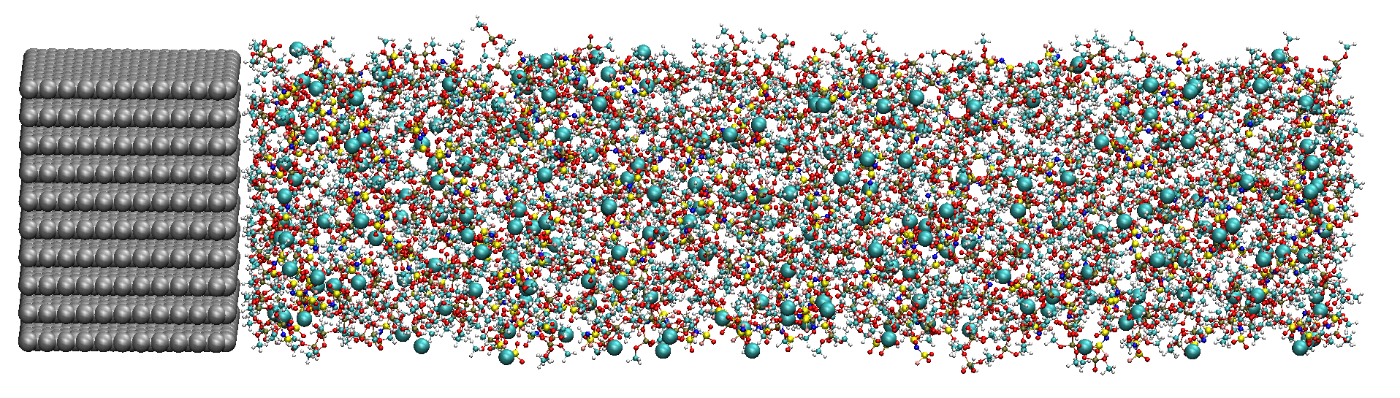
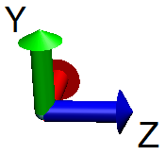
Red Moon simulation
Anode
LiFSA/TMP electrolyte
Anode surface : 3.408nm×3.7nm,
Negative charge of anode surface: -2e,
Temperature: 298 K,
10 initial configurations ,
Relaxation time 30 ps,
Mixing time 70 ps,
Aggregated salts were preferentially selected for chemical reduction.

Slide 9
SEI layer formation
Surface number densities of SEI layers and electrolyte compounds
SEI layers were obtained at 2000 MC/MD cycles.
FSA⁻ anion were preferentially reduced than TMP solvents.
The decomposition of TMP solvent was supressed by increasing salt concentration.

Slide 10
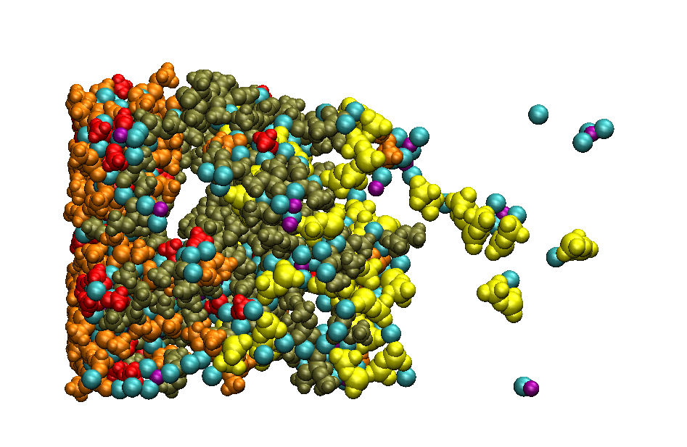
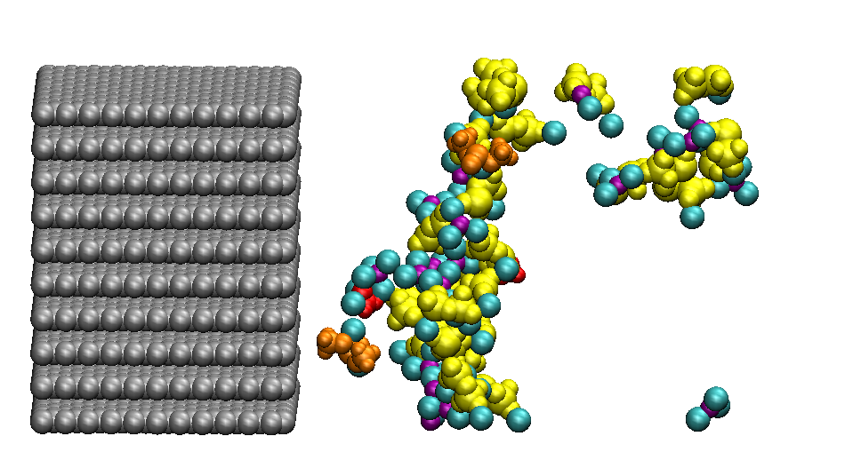
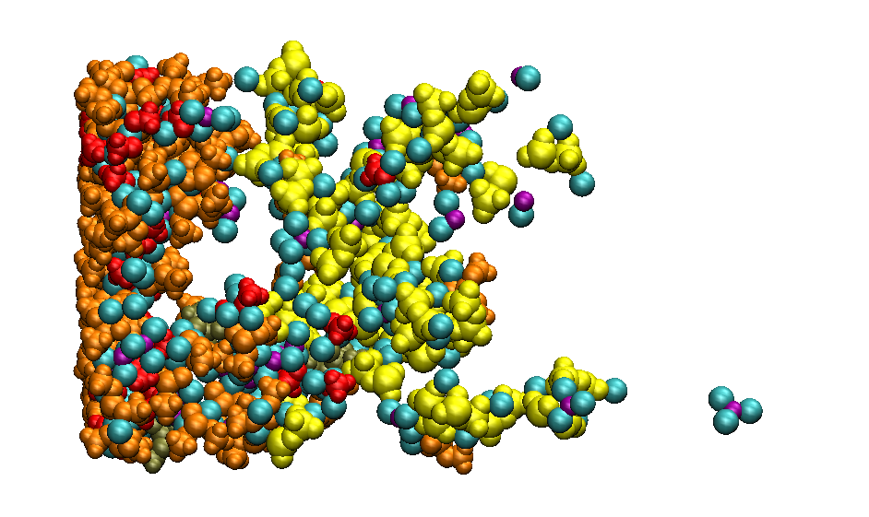
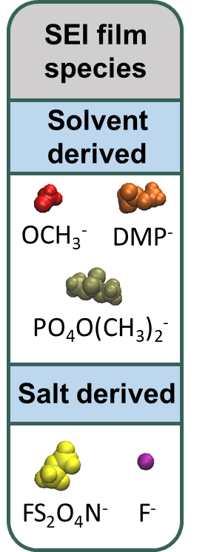
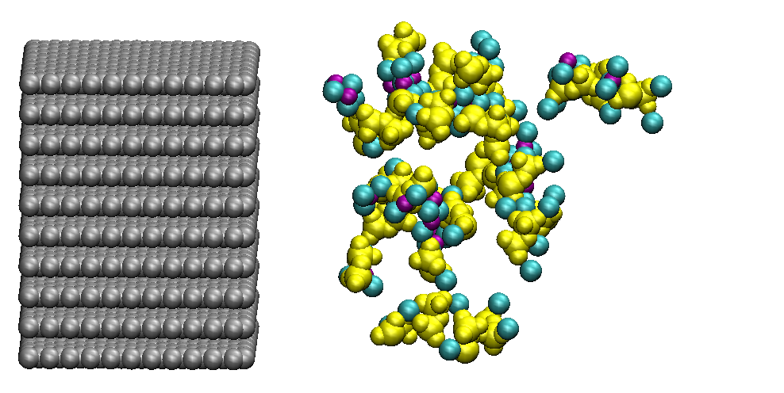
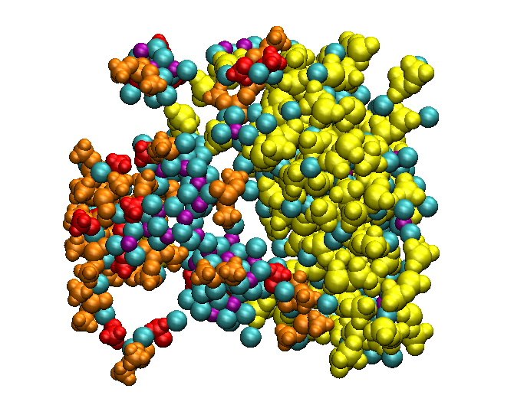
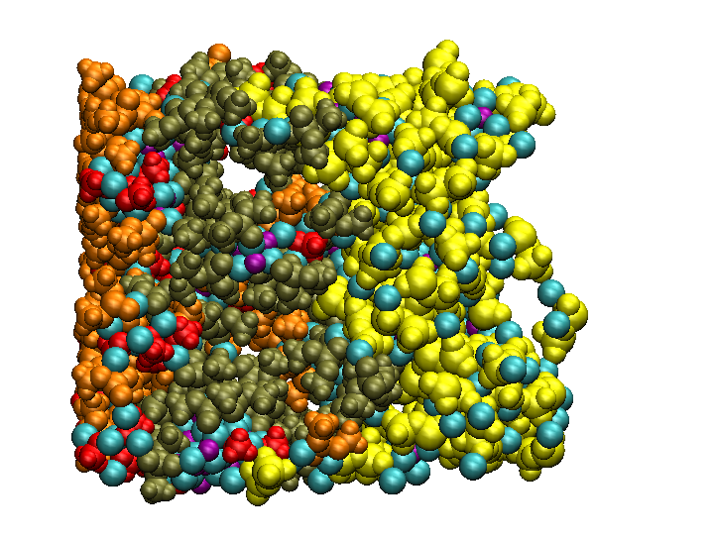
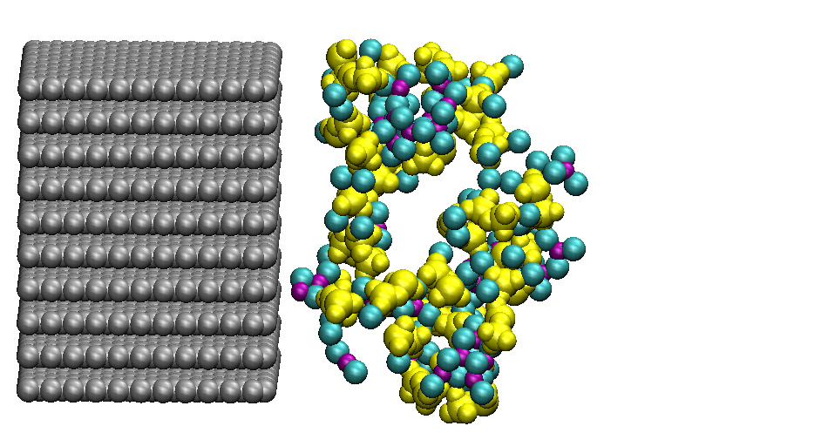
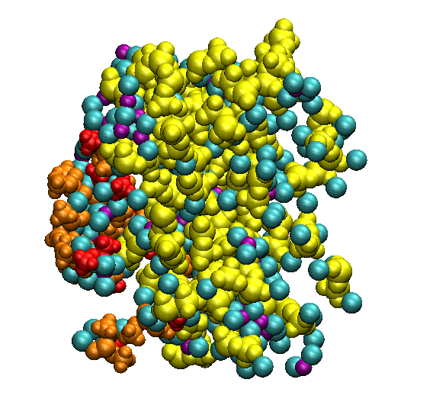
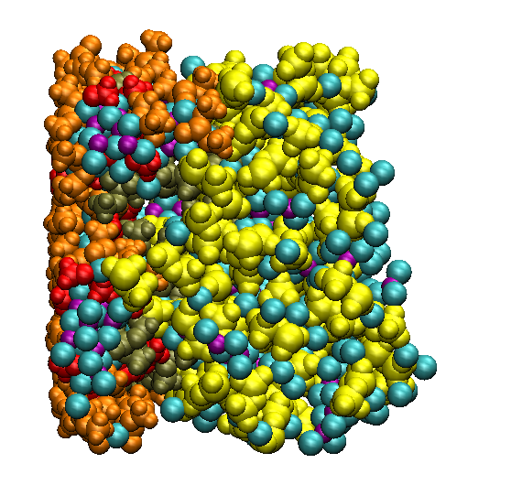
Formation process of SEI layer
1Mol concentration
Anode
2.3Mol concentration
5.3Mol concentration
200 MC/MD cycle
800 MC/MD cycle
2000 MC/MD cycle
The formation mechanism of obtained SEI layers with RM simulation was Bottom-Up, which was in good agreement with experimental observations [2].
[2] Z. Liu. Et al., J. Chem. Phys. Lett., 9, 5508 (2018).

Slide 11
SEI layer properties
Mass density distribution of SEI layer compounds
The production of DMP⁻ was not related to the salt concentration.
The production of PO₄(CH₃)₂⁻ anion was reduced by increasing salt concentration.
The production of FS₂O₄N⁻ anion was increased by increasing salt concentration.
The phase separation between FS₂O₄N⁻ anion (salt derived product) and solvent derived products was enhanced by increasing salt concentration.

Slide 12
SEI layer properties
Thickness of SEI layers
 | Salt concentration
 | 1 Mol/L | 2.3 Mol/L | 5.3 Mol/L
d (nm) | 4.64 | 4.07 | 3.66
Error | ±0.31 | ±0.26 | ±0.17
Cavity of SEI layers
 | Salt concentration
 | 1 Mol/L | 2.3 Mol/L | 5.3 Mol/L
Cavity (FAV) | 0.19 | 0.08 | 0.06
Error | ±0.04 | ±0.01 | ±0.02
By increasing salt concentration, the SEI layers became thinner and denser.
This results was in good agreement with experimental observation [3].
[3] J. Zheng. Et al., Adv. sci., 4, 1700032 (2017).

Slide 13
Salt concentration effect
Dissolution of SEI layer products
By increasing salt concentration, the dissociation products of SEI layers was supressed.
This results was in good agreement with experimental observation [3].
[3] J. Zheng. Et al., Adv. sci., 4, 1700032 (2017).

Slide 14
Salt concentration effect
Mass density distribution of SEI layer and electrolyte compounds
Pure inorganic layer
The presence of TMP solvent inside SEI layer decreased by increasing salt concentration.
The presence of FSA⁻ anion increased on SEI film surface by increasing salt concentration.
A pure inorganic layer was formed from FSA⁻ anion and its derived SEI layer at high salt concentration.

Slide 15
Conclusion
Red Moon methodology showed a high efficiency to reproduce experimental observations regarding SEI layer formation.
The dissolution of SEI layer products was supressed by increasing salt concentration.
SEI layer became thinner and denser by increasing salt concentration.
At high salt concentration, very stable inorganic layer was formed from salt anion and its derived SEI layer, leading to long lifetime of safe LIB during charge-discharge cycles.

