Slide 1
FY2016 The 4th CREST Workshop 2016, July 25
Development of MC/MD reaction program and helper programs to prepare input files
Masayoshi Takayanagi
Graduate School of Information Science, Nagoya University

Slide 2
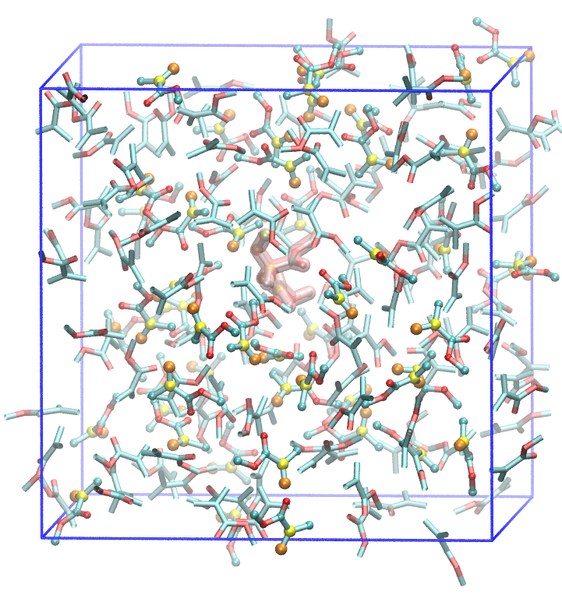
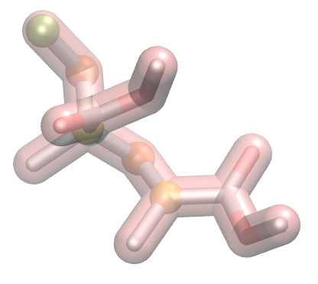
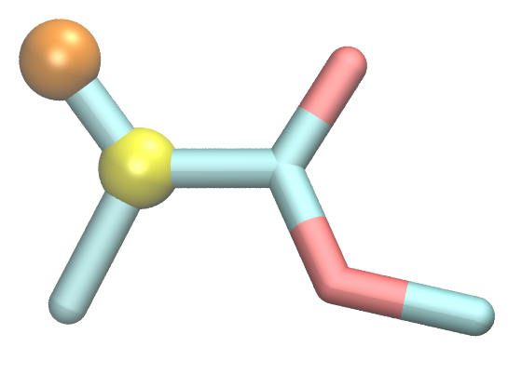
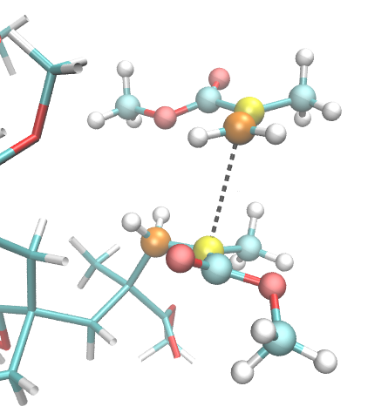
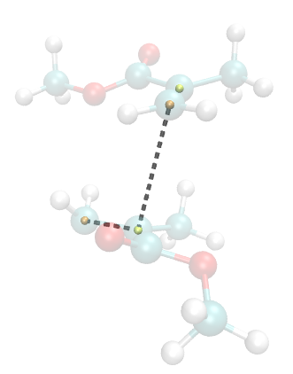
MMA radical polymerization simulation model in bulk
C3
H×2
C2
H×3
H×3
MMA dimer radical (:tmt-:mmm-:mrd)
×１
MMA monomer （:mma）
×158
:mma
ReactionFinder input script
inputTopology radMMA.top
inputInpcrd radMMA.crd true true
byStructure ReactID=1 Ea=3.0 \
"COND = distance(:mrd@C2; :mma@C3)<3.5" &&
angle(:mrd@C2; :mma@C3; :mma@C2)<120 \ "ACTION = createBond :mrd@C2 :mma@C3 KEEP KEEP; \
ModifyResByPrepin :mrd mmm.prepin; \ ModifyResByPrepin :mma mrd.prepin"
__ENDscript__
3.30 Å
98.5°
:mrd
Planes of :mrd & :mma should be parallel for reaction

Slide 3
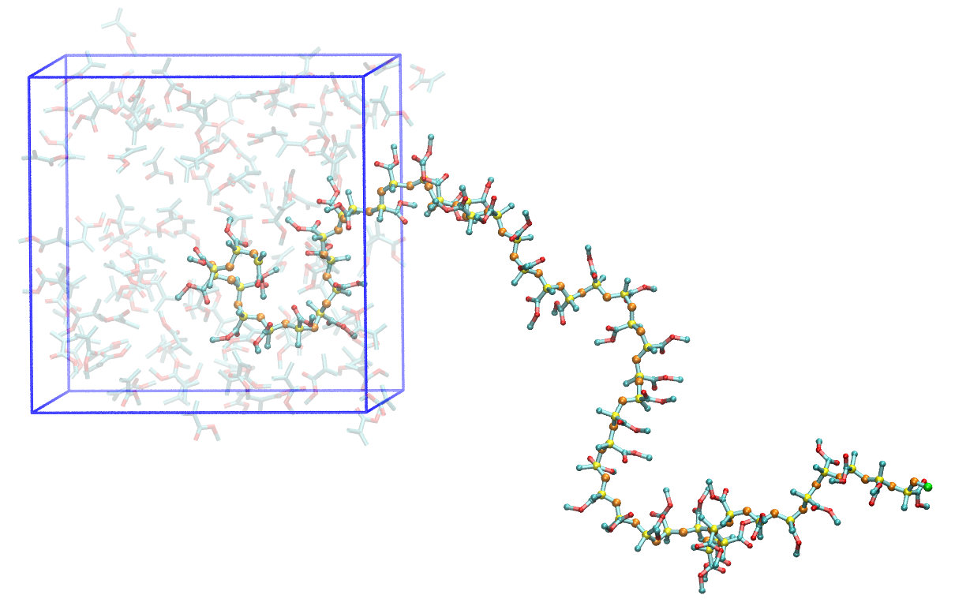
Obtained PMMA polymer (50-mer)
1 cycle: 20 ps NPT MD 343 K, 1 atm
Reaction candidate search from mdcrd (100 snapshots during 20 ps)
100 reaction cycles
No Monte Carlo procedure

Slide 4
Procedure of polymerization simulation
Start
Input files
・Initial topology file
・Initial inpcrd file
・Force field files .prepin, .forcemod files
・Python job file (mcmd.py)
MD simulation
ReactionFinder
Reaction selection considering Ea
New!
Reaction candidate
Not Found
Newly implemented functions
・Reaction selection considering the weight from parameter Ea (reaction barrier)
・Lower barrier reactions are chosen with high probability
・Monte Carlo procedure
Found
TopologyEditor
edit topology file
Quenching MD
Relax MD
Now debugging and testing...
Details will be presented in future
Monte Carlo
accept
New!
reject
Back to previous topology file

Slide 5
Test simulation of MMA radical polymerization in PCP channels
After 300 cycle
After 600 cycle
Reaction condition is identical to that in bulk polymerization distance(:mrd@C2; :mma@C3)<3.5 && angle(:mrd@C2; :mma@C3; :mma@C2)<120
1 cycle is 50 ps NVT MD Monte Carlo condition: when product polymer is more than 100 kcal/mol unstable, do Metropolis judgement (reject ratio is ~20%)

Slide 6
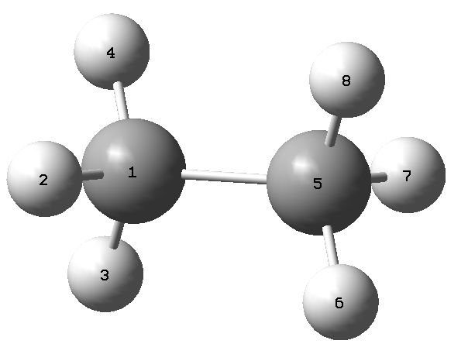
Helper program to prepare imput files for MC/MD simulations
Example program createFF.py for creating force field (FF) files of ethane
# python program to create GAFF FF files for ethane
from FFfit import *
from GAUSSIAN_files import *
import glob
# goutDir must be "gout", store Gaussian output file here
goutDir="gout"
atomName = "C1 H11 H12 H13 C2 H21 H22 H23" # Atom names
resName = ["eth"] # residue name
resRange = [[1,8]] # 1st residue from atom 1 to 8
# if single residue, give []
interResConnect = [] # explain in later example
sameAtomTypeList=[[2,3,4], [6,7,8], [1,5]] # describe atom list with identical atomic charges
# if no constraint, give []
chargeConstraints = [] # explain in later example
chargeMethod = "MK" # atomic charge calculation method, "Mulliken" or ESP charges such as "MK", "CHelpG", ...
QMlevel = "m062x/6-31+G(d)" # QM level to calculate atomic charges
cff = createForceField(isVerbose=True)
for f in glob.glob(goutDir + "/*.log"):
cff.addGout(f)
cff.setSameAtomTypeList(sameAtomTypeList)
cff.setAtomName(atomName)
cff.calcAtomicCharge(level=QMlevel, chargeMethod=chargeMethod, isGoutUpdate=False, constraints=chargeConstraints)
cff.setResidue(resname=resName, resrange=resRange, interResConnect=interResConnect)
cff.createFF()
cff.createMolInVacuum()
run: python createFF.py
G09 optimization output file
or
G09 scan output file
are acceptable

Slide 7
Input: g09 output file of ethane molecule optimization gout/EtOpt.log
Console output of createFF.py
Read gaussian log file:gout/EtOpt.log
E[final]=-79.7739842313
Execute g09 calcCharge/EtOpt-0
File calcCharge/EtOpt-0.log was opened
E(RM062X)[ 1]= -79.77398423
ESP(MK)=[-0.038337, 0.012339, 0.012321, 0.013289, -0.036309, 0.012531, 0.012083, 0.012084]
Atomic charges after conformation average =
[-0.038337, 0.012339, 0.012321, 0.013289, -0.036309, 0.012531, 0.012083, 0.012084]
Atomic charges after same atom type average =
Average atoms [2, 3, 4]
Average atoms [6, 7, 8]
Average atoms [1, 5]
After average over same atoms =
[-0.037323, 0.012649666666666668, 0.012649666666666668, 0.012649666666666668, -0.037323, 0.012232666666666668, 0.012232666666666668, 0.012232666666666668]
After rounding charges =
[-0.03732, 0.01265, 0.01265, 0.01265, -0.03732, 0.01223, 0.01223, 0.01223]
Final charges after minor adjustments to achieve constraints =
[-0.03732, 0.01265, 0.01265, 0.01265, -0.03732, 0.01223, 0.01223, 0.01223]
Total charge = -0.000000, Gaussian charge = 0
Antechamber in /share3/takayana/python/createEthane_opt/antechamber_eth
Running: /home/takayana/AMBER/amber14.avx/bin/bondtype -j full -i ANTECHAMBER_BOND_TYPE.AC0 -o ANTECHAMBER_BOND_TYPE.AC -f ac
...
END Antechamber
...
****************************************************************************************************
Create isolated model in [testInVacuum]
****************************************************************************************************
****************************************************************************************************
Execute test MD of isolated model in [testInVacuum/md]
****************************************************************************************************

Slide 8
Created force field files in directory [FF]
FF/eth.mol2 (I will make a function to create .prepin
file using this .mol2 file information)
@<TRIPOS>MOLECULE
eth
8 7 1 0 0
SMALL
No Charge or Current Charge
@<TRIPOS>ATOM
1 C1 0.0000 0.0000 0.7640 c3 1 eth -0.037320
2 H11 0.5080 0.8850 1.1600 hc 1 eth 0.012650
3 H12 0.5120 -0.8820 1.1600 hc 1 eth 0.012650
4 H13 -1.0200 -0.0020 1.1600 hc 1 eth 0.012650
5 C2 0.0000 0.0000 -0.7640 c3 1 eth -0.037320
6 H21 1.0200 -0.0020 -1.1600 hc 1 eth 0.012230
7 H22 -0.5120 -0.8820 -1.1600 hc 1 eth 0.012230
8 H23 -0.5080 0.8850 -1.1600 hc 1 eth 0.012230
@<TRIPOS>BOND
1 1 2 1
2 1 3 1
3 1 4 1
4 1 5 1
5 5 6 1
6 5 7 1
7 5 8 1
@<TRIPOS>SUBSTRUCTURE
1 eth 1 TEMP 0 **** **** 0 ROOT
FF/frcmod
Remark line goes here
MASS
c3 12.010 0.878
hc 1.008 0.135
BOND
c3-hc 337.30 1.092
c3-c3 303.10 1.535
ANGLE
c3-c3-hc 46.370 110.050
hc-c3-hc 39.430 108.350
DIHE
hc-c3-c3-hc 1 0.150 0.000 3.000
IMPROPER
NONBON
c3 1.9080 0.1094
hc 1.4870 0.0157

Slide 9
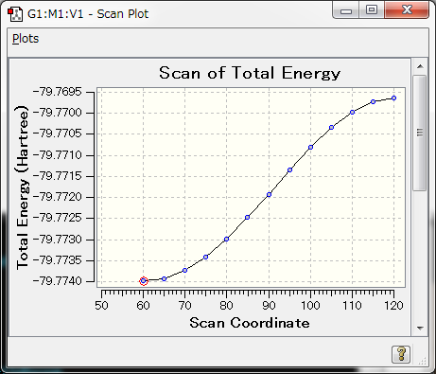
Created topology files of isolated "eth" model & MD simulation in a vacuum
testInVacuum/leapin (this leapin was automatically created and executed with tleap program)
loadAmberParams ../FF/frcmod
res1 = loadMol2 ../FF/eth.mol2
model = res1
saveAmberParm model vac.prmtop vac.inpcrd
charge model
Topology & Initial coordinate file testInVacuum/vac.prmtop, testInVacuum/vac.inpcrd
MD simulation of the isolated ethane was executed in test/InVacuum/md directory
Next example: give relaxed scan calculation output file
# m062x/6-31+G(d) opt=modredundant
Title Card Required
0 1
C -1.48201429 0.48197308 -0.00630937
H -1.12535987 -0.52683693 -0.00630937
H -1.12534145 0.98637127 -0.87996088
H -2.55201429 0.48198626 -0.00630937
C -0.96867208 1.20792935 1.25109560
H 0.10132792 1.20789925 1.25110502
H -1.32531090 2.21674487 1.25108604
H -1.32536058 0.70354187 2.12474689
D 2 1 5 6 60.0
D 2 1 5 6 S 11 5.0
relaxed scan calculation, dihedral angle 2-1-5-6 from 60° to 120° with 5° interval for 11 times

Slide 10
Calculate atomic charge for each scan structure & calculate atomic charges
Read gaussian log file:gout/ethane.scan.log
E[final]=-79.7696376898
Execute g09 calcCharge/ethane.scan-0
File calcCharge/ethane.scan-0.log was opened
E(RM062X)[ 1]= -79.76963739
ESP(MK)=[-0.08374, 0.026943, 0.027753, 0.028682, -0.081119, 0.026761, 0.028009, 0.026711]
Execute g09 calcCharge/ethane.scan-1
File calcCharge/ethane.scan-1.log was opened
E(RM062X)[ 1]= -79.77398860
ESP(MK)=[-0.033307, 0.010935, 0.01128, 0.009555, -0.022928, 0.007451, 0.008783, 0.008231]
Execute g09 calcCharge/ethane.scan-2
File calcCharge/ethane.scan-2.log was opened
E(RM062X)[ 1]= -79.77392174
ESP(MK)=[-0.023655, 0.007531, 0.008666, 0.009024, -0.034099, 0.009917, 0.010928, 0.011688]
...
Execute g09 calcCharge/ethane.scan-11
File calcCharge/ethane.scan-11.log was opened
E(RM062X)[ 1]= -79.76996748
ESP(MK)=[-0.093357, 0.029406, 0.029487, 0.030088, -0.070708, 0.02407, 0.026538, 0.024476]
Execute g09 calcCharge/ethane.scan-12
File calcCharge/ethane.scan-12.log was opened
E(RM062X)[ 1]= -79.76971978
ESP(MK)=[-0.083541, 0.027508, 0.027556, 0.029041, -0.087387, 0.028608, 0.029967, 0.02825]
Atomic charges after conformation average =
[-0.05591753846153846, 0.017328999999999997, 0.018961461538461538, 0.019022538461538466, -0.05290607692307692, 0.016573923076923076, 0.0186, 0.018336923076923077]
Atomic charges after same atom type average =
Average atoms [2, 3, 4]
Average atoms [6, 7, 8]
Average atoms [1, 5]
After average over same atoms =
[-0.05441180769230769, 0.018437666666666668, 0.018437666666666668, 0.018437666666666668, -0.05441180769230769, 0.017836948717948716, 0.017836948717948716, 0.017836948717948716]
After rounding charges =
[-0.05441, 0.01844, 0.01844, 0.01844, -0.05441, 0.01784, 0.01784, 0.01784]
Final charges after minor adjustments to achieve constraints =
[-0.05443, 0.01844, 0.01844, 0.01844, -0.05441, 0.01784, 0.01784, 0.01784]
Total charge = 0.000000, Gaussian charge = 0

Slide 11
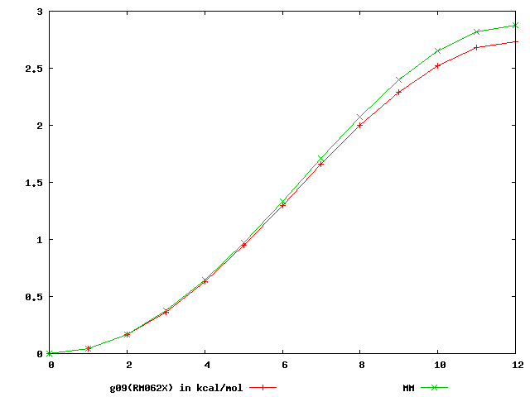
Comparison of relaxed scan of isolated molecule between QM and MM
At the end of the console output
****************************************************************************************************
Execute test MD of isolated model in [testInVacuum/md]
****************************************************************************************************
****************************************************************************************************
Draw QM & MM energy curves in [drawEcurve]
****************************************************************************************************
3 ++---+----+----+---+----+---++
+ + + + + + #B#B
| #B#*A*A
2.5 ++ B*A* ++
| ##A |
| B** |
2 ++ #A ++
| B* |
1.5 ++ #A ++
| B* |
| ##A |
1 ++ B** ++
| *A |
| A |
0.5 ++ ** ++
| *A |
+ *A + + + + +
0 A*A*-+----+----+---+----+---++
0 2 4 6 8 10 12
g09(RM062X) in kcal/mol **A***
MM ##B###
Good correspondence between QM(m062x/6-31+G(d)) and MM relaxed scans
.png file is also created
Graphs are created by gnuplot

Slide 12
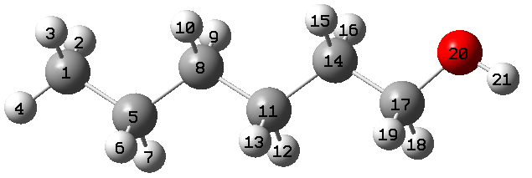
Next example: divide molecule into several residues
Prepare force field of polymer, one terminal is -OH and the other is -CH₃
total charge = 0.0
total charge of :etm is 0.0 (polymer length is variable)
total charge of :met + :toh is 0.0
:met
:etm
:etm
:toh
Parameters in createFF.py
goutDir="gout"
atomName = "CT HT1 HT2 HT3 C1 H11 H12 C2 H21 H22 C1 H11 H12 C2 H21 H22 C1 H1 H2 O1 H3"
resName = ["met", "etm", "etm", "toh"]
resRange = [[1,4], [5,10], [11,16], [17,21]] # 1st residue 1-4, 2nd 5-10, 3rd 11-16, 4th 17-21
# if single residue, give []
interResConnect = [[1,2,1,5], [2,3,8,11], [3,4,14,17]]
# between residue 1 and 2, there is a connection between atom 1 and 5
# between residue 2 and 3, there is a connection between atom 8 and 11
# between residue 3 and 4, there is a connection between atom 14 and 17
sameAtomTypeList = [[2,3,4], [6,7,9,10,12,13,15,16], [18,19], [5,8,11,14]]
# if no constraint, give []
chargeConstraints = [[0.0, 1,2,3,4,17,18,19,20,21], [0.0, 5,6,7,8,9,10], [0.0, 11,12,13,14,15,16]]
# total charge of atoms 1,2,3,4,17,18,19,20,21 (:met and :toh) is 0.0
# total charge of atoms 5,6,7,8,9,10 and 11,12,13,14,15,16 (:etm) is 0.0
chargeMethod = "MK"
QMlevel = "m062x/6-31+G(d)"

Slide 13
Console output for charge calculation
Atomic charges after conformation average =
[-0.382155538461538, 0.08054407692307694, 0.08578061538461537, 0.09281584615384617, 0.20742107692307693, -0.03235053846153846, -0.028278615384615385, 0.09477184615384616, -0.005265461538461538, -0.025401461538461536, -0.308263076923077, 0.06323607692307692, 0.045539, 0.17227176923076926, 0.010249461538461539, 0.011733923076923078, 0.2387887692307692, -0.013260461538461539, -0.010558307692307693, -0.7526738461538461, 0.455054923076923]
Atomic charges to give constraints
[[0.0, 1, 2, 3, 4, 17, 18, 19, 20, 21], [0.0, 5, 6, 7, 8, 9, 10], [0.0, 11, 12, 13, 14, 15, 16]]
After constraints =
[-0.3593039914529914, 0.10339562393162395, 0.10863216239316238, 0.11566739316239318, 0.17227160256410257, -0.06750001282051282, -0.06342808974358975, 0.059622371794871794, -0.04041493589743591, -0.060550935897435904, -0.30739093589743594, 0.06410821794871795, 0.046411141025641034, 0.1731439102564103, 0.011121602564102568, 0.012606064102564107, 0.2616403162393162, 0.009591085470085471, 0.0122932393162393, -0.7298222991452992, 0.47790647008547005]
Sum[[1, 2, 3, 4, 17, 18, 19, 20, 21]] = -0.000000
Sum[[5, 6, 7, 8, 9, 10]] = -0.000000
Sum[[11, 12, 13, 14, 15, 16]] = 0.000000
Atomic charges after same atom type average =
Average atoms [2, 3, 4]
Average atoms [6, 7, 9, 10, 12, 13, 15, 16]
Average atoms [18, 19]
Average atoms [5, 8, 11, 14]
After average over same atoms =
[-0.3593039914529914, 0.1092317264957265, 0.1092317264957265, 0.1092317264957265, 0.024411737179487178, -0.0122058685897435, -0.0122058685897435, 0.02441173717948717, -0.01220586858974359, -0.012205868589743592, 0.0244117371794871, -0.0122058685897435, -0.0122058685897435, 0.02441173717948717, -0.012205868589743592, -0.012205868589743592, 0.2616403162393162, 0.01094216239316239, 0.010942162393162393, -0.7298222991452992, 0.47790647008547005]
After rounding charges =
[-0.3593, 0.10923, 0.10923, 0.10923, 0.02441, -0.01221, -0.01221, 0.02441, -0.01221, -0.01221, 0.02441, -0.01221, -0.01221, 0.02441, -0.01221, -0.01221, 0.26164, 0.01094, 0.01094, -0.72982, 0.47791]
Sum[[1, 2, 3, 4, 17, 18, 19, 20, 21]] = -0.000000
Sum[[5, 6, 7, 8, 9, 10]] = -0.000020
Sum[[11, 12, 13, 14, 15, 16]] = -0.000020
Final charges after minor adjustments to achieve constraints =
[-0.3593, 0.10923, 0.10923, 0.10923, 0.02443, -0.01221, -0.01221, 0.02441, -0.01221, -0.01221, 0.02443, -0.01221, -0.01221, 0.02441, -0.01221, -0.01221, 0.26164, 0.01094, 0.01094, -0.72982, 0.47791]
Total charge = -0.000000, Gaussian charge = 0

Slide 14
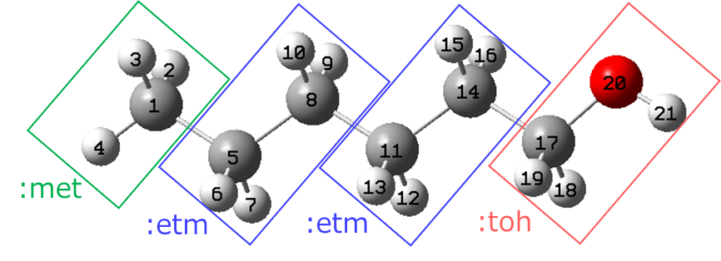
Add cap hydrogen for antechamber input
Create PDB file of each residue & give the PDB file to antechamber program
If I give :met as it is (i.e. CH₃), antechamber cannot correctly recognize atom types (atom type of the C atom is judged as "c2" (sp2 carbon), wrong!)
Thus, when the residue has connection with other residue (as described in interResConnect parameter), give "cap hydrogen" atom in the PDB file and execute antechamber.
After antechamber creates .mol2 file, delete cap hydrogen atom information from the .mol2 file.
etm.mol2 file including cap atom (HX1, HX2)
@<TRIPOS>ATOM
1 C1 2.5150 0.5090 -0.0000 c3 2 etm 0.000000
2 H11 2.5090 1.1670 0.8790 hc 2 etm 0.000000
3 H12 2.5090 1.1670 -0.8790 hc 2 etm 0.000000
4 C2 1.2470 -0.3420 0.0000 c3 2 etm 0.000000
5 H21 1.2520 -1.0020 -0.8790 hc 2 etm 0.000000
6 H22 1.2520 -1.0020 0.8790 hc 2 etm 0.000000
7 HX1 3.4150 -0.0890 -0.0000 hc 2 etm 0.000000
8 HX2 0.3400 0.2440 0.0000 hc 2 etm 0.000000
@<TRIPOS>BOND
1 1 2 1
2 1 3 1
3 1 4 1
4 1 7 1
5 4 5 1
6 4 6 1
7 4 8 1
etm.mol2 file after deleting cap atoms
@<TRIPOS>ATOM
1 C1 2.5150 0.5090 -0.0000 c3 1 etm 0.024430
2 H11 2.5090 1.1670 0.8790 hc 1 etm -0.012210
3 H12 2.5090 1.1670 -0.8790 hc 1 etm -0.012210
4 C2 1.2470 -0.3420 0.0000 c3 1 etm 0.024410
5 H21 1.2520 -1.0020 -0.8790 hc 1 etm -0.012210
6 H22 1.2520 -1.0020 0.8790 hc 1 etm -0.012210
@<TRIPOS>BOND
1 1 2 1
2 1 3 1
3 1 4 1
4 4 5 1
5 4 6 1

Slide 15
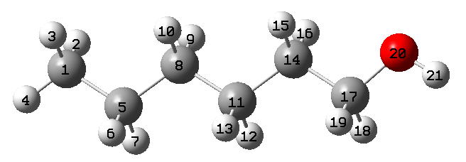
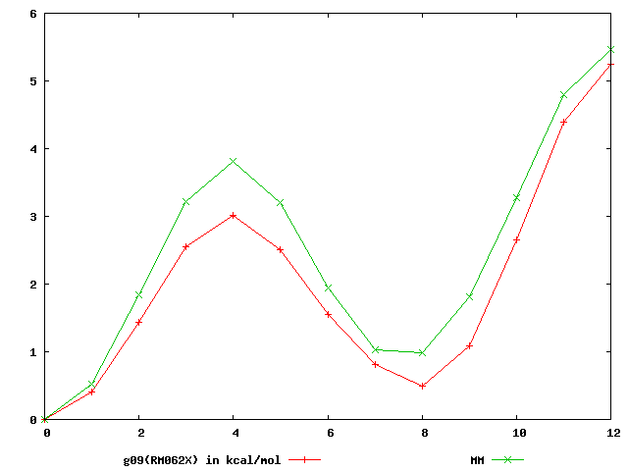
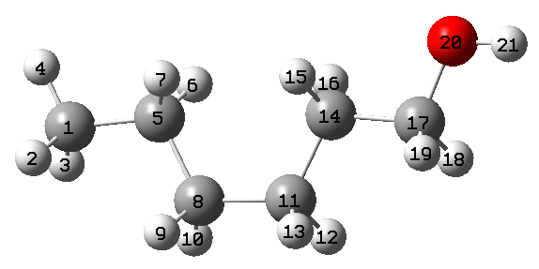
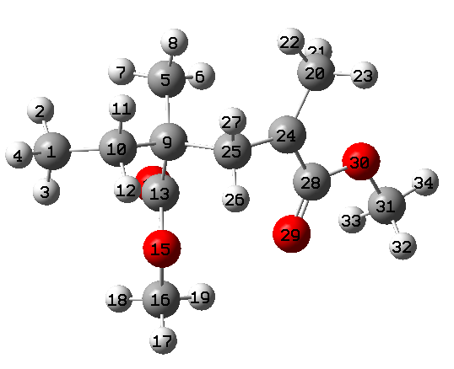
Compare DFT (m062x/6-31+G(d)) & MM relaxed scan curves Dihedral angle D = 5-8-11-14 was rotated
MM
D = 180°
DFT
D = 180°
D = 0°
D = 0°
Good correspondence
Next example: PMMA radical force field preparation
:mmm
:mrd
Rotate several dihedral angles with G09 scan calculations, in total ~170 conformers.
DFT level um062x/6-31+G(d)
Total charge (:mmm) = 0.0
Total charge (:tmt + :mrd) = 0.0
:tmt
charge = 0
multiplicity = 2

Slide 16
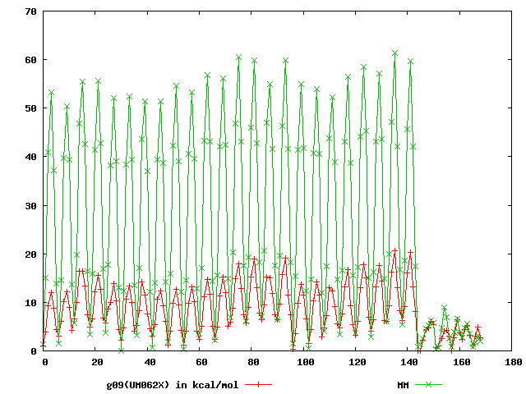
MM
radical
DFT
GAFF force field cannot correctly describe rotational barriers of PMMA radical
This large deviation come from the rotation 20-24-28-29, including radical atom 24.
GAFF gives c2 type (sp2 carbon) to the radical atom 24, but type c2 is not appropriate for the radical atom.
Next, I will make a program to automatically fit the parameters to fit with DFT results.

