Slide 1
Mon. May 30th
FY2016’s 2nd, CREST Workshop
Microscopic effects of salt concentration
on SEI film formation in Na-ion batteries
with acetonitrile solutions
Norio Takenaka^{1,2}
Graduate School of Information Science, Nagoya University¹,
Elements Strategy Initiative for Catalysts and Batteries (ESICB), Kyoto University²

Slide 2
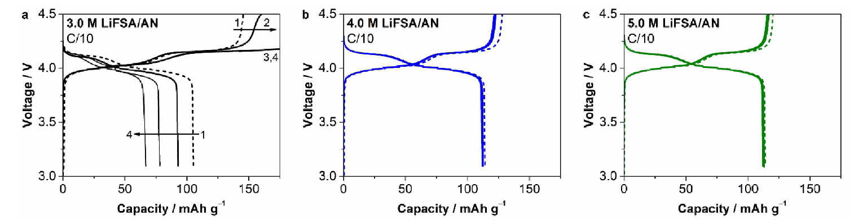
Purpose of this study
Fig. 1. Charge-discharge curves with 3, 4 and 5 M LiFSA/AN electrolyte.
Salt concentration has been recently proposed as an important control parameter of reduction stability of electrolytes [1-3].
Fig. 1 shows the cycle performance becomes wrong with 3 M LiFSA/AN electrolyte in LIB [3].
In this study, the dependency on the salt concentration of SEI film formation has been investigated by using hybrid MC/MD reaction method.
[1] Y. Yamada et al., J. Am. Chem. Soc., 136, 5039 (2014).
[2] Y. Yamada et al., J. Electrochem. Soc., 162, A2406 (2015).
[3] Y. Yamada et al., ChemElectroChem, 2, 1687 (2015).

Slide 3
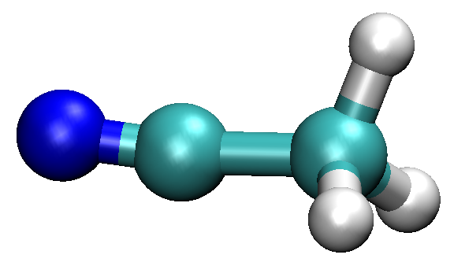
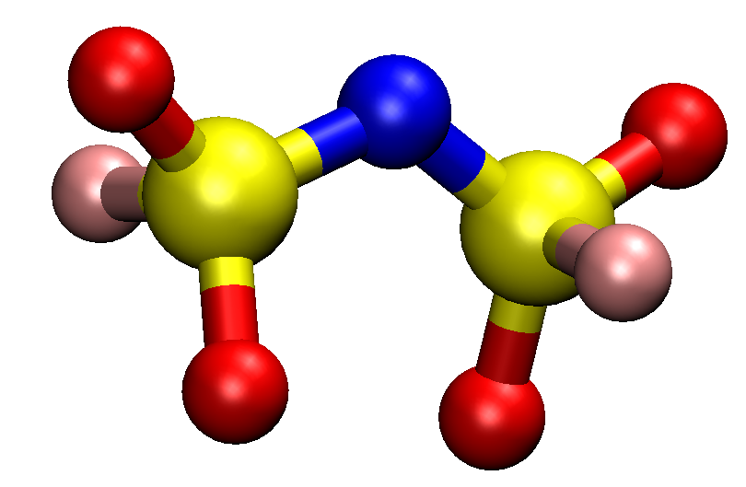
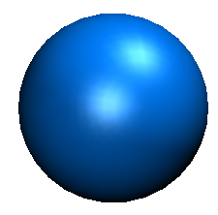
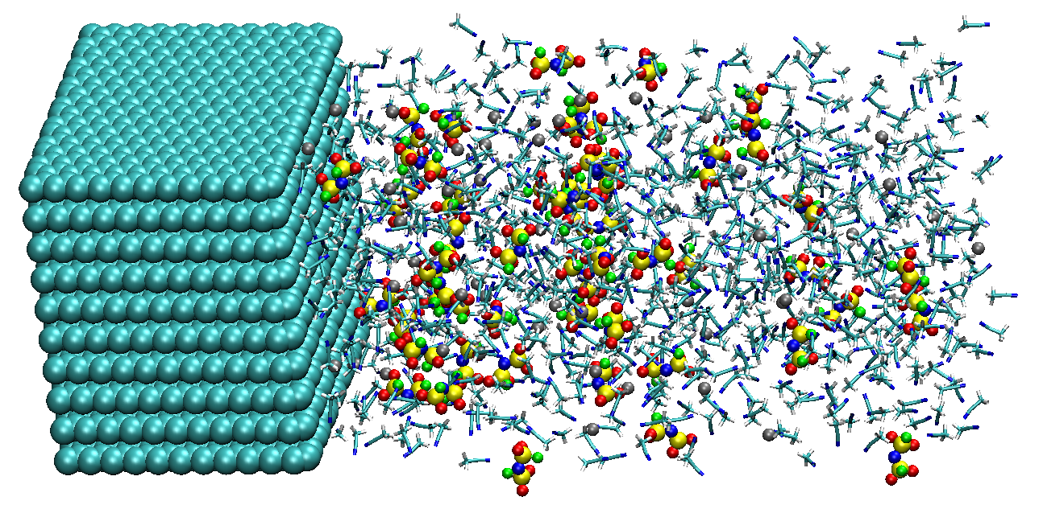

Model system
For this purpose, I employed the AN-NaFSA electrolyte solution at (a) low (1.0 M), (b) high (3.0 M) and (c) very high (4.5 M) concentration conditions.
: Acetonitrile (AN)
: Na⁺
: FSA⁻
(bis(fluorosulfonyl)amide)
Carbon anode
Electrolyte
Molecule number of electrolyte:
Low (1.0 M)
800 AN, 52 Na⁺, 50 FSA⁻
(b) High (3.0 M)
800 AM, 177 Na+, 175 FSA⁻
(c) Very high (4.5 M)
800 AN, 277 Na⁺, 275 FSA⁻
x
y
Negative charge: -2e
z

Slide 4
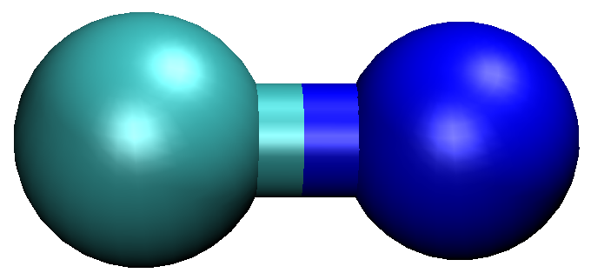
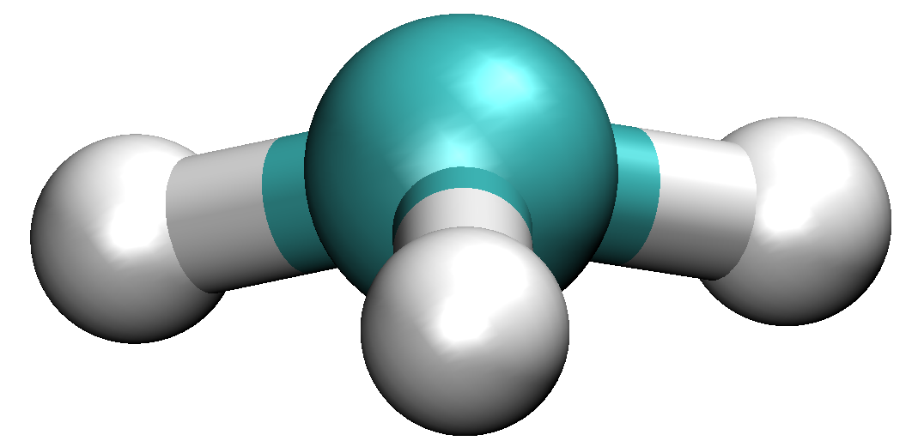
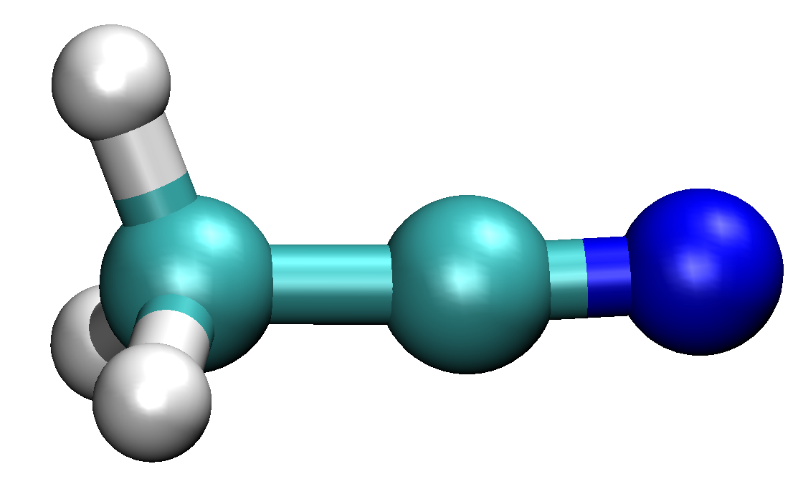
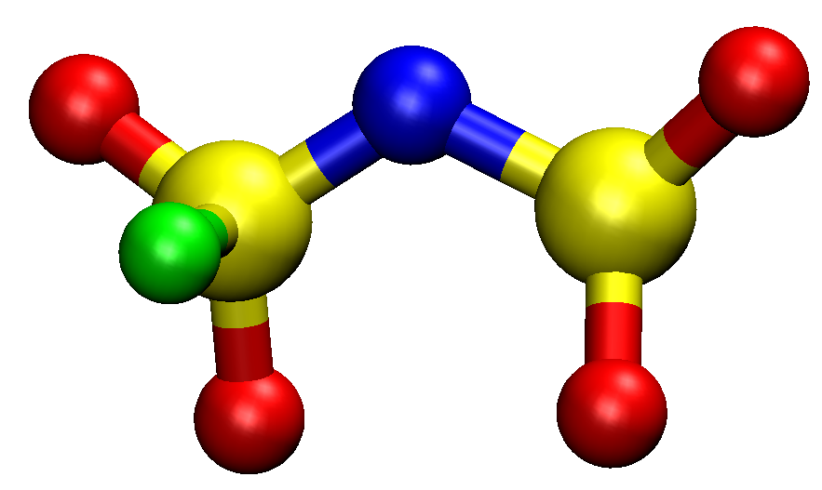
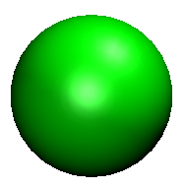
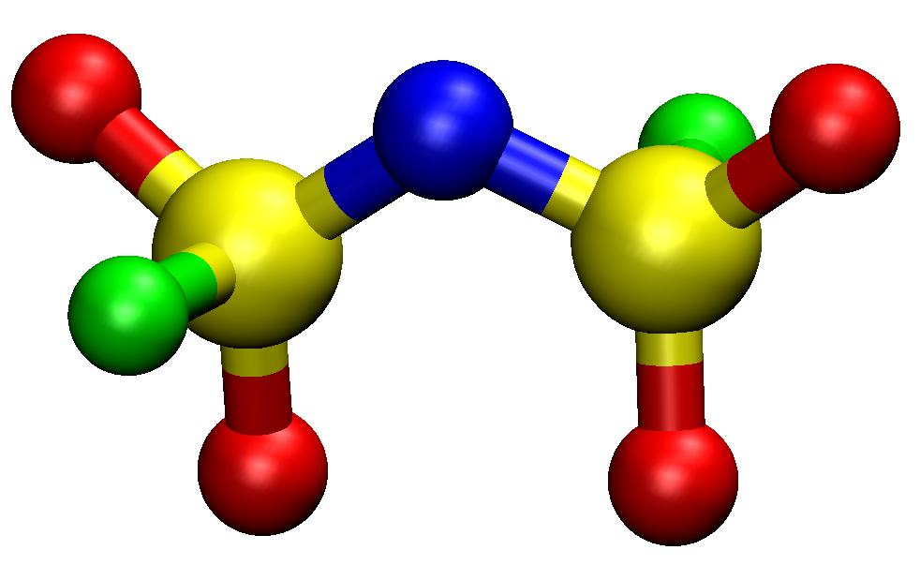
Elementary reactions for MC/MD simulation
26.8 kcal/mol
-54.4 kcal/mol
+
+ e⁻
+ e⁻
CN⁻
CH₃⁻
+ FSA
CH₃CN
47.1 kcal/mol
-13.6 kcal/mol
CH₃CN⁻
17.8 kcal/mol
-15.2 kcal/mol
+
+
17.8 kcal/mol
-15.2 kcal/mol
F⁻
CH₃CN
dec-FSA⁻
+ CH₃CN⁻
FSA
+ e⁻
+
Red: Potential energy difference
64.9 kcal/mol
Blue: Free energy difference
with SMD model
-28.8 kcal/mol
F⁻
dec-FSA⁻
Calculation level: B3LYP/cc-pvdz
4

Slide 5
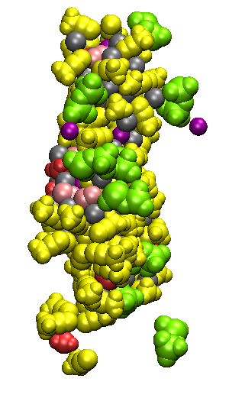
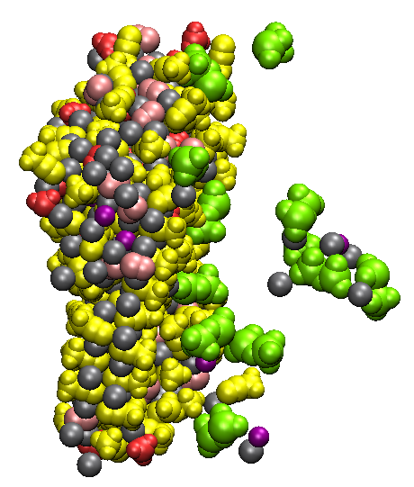
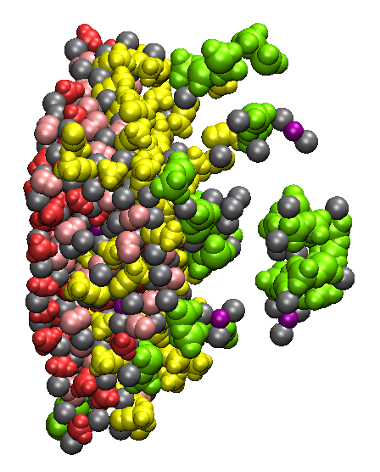
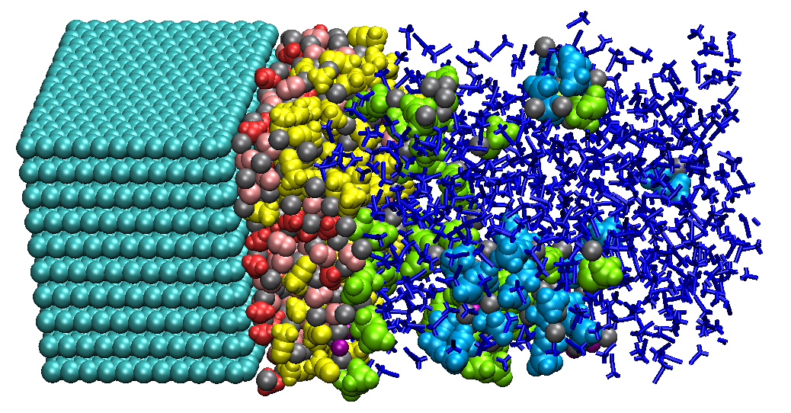
SEI film formation at low concentration (1.0 M)
(a) 200 cycle
(b) 500 cycle
(c) 1000 cycle
(e) 2000 cycle
At the low concentration, the reaction products were drift away from the anode surface, showing that the aggregation is insufficient.
5

Slide 6
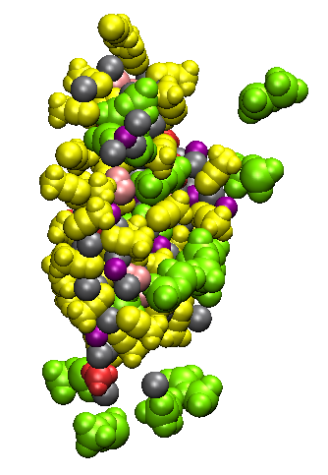
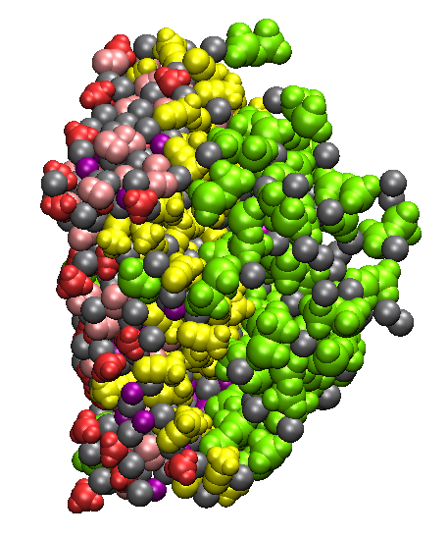
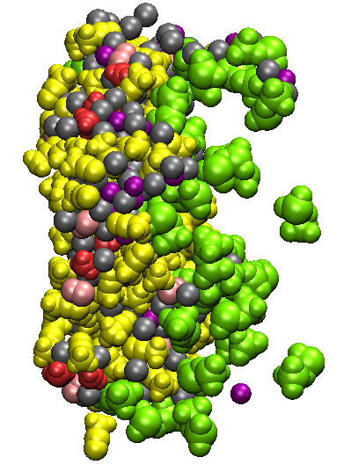
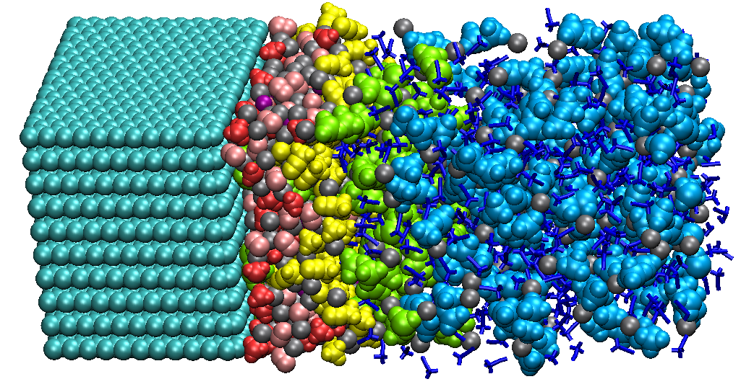
SEI film formation at high concentration (3.0 M)
(a) 200 cycle
(b) 500 cycle
(c) 1000 cycle
(e) 2000 cycle
At the high concentration, the dissolution of reaction products were suppressed. This can be one of important salt concentration effect.
6

Slide 7
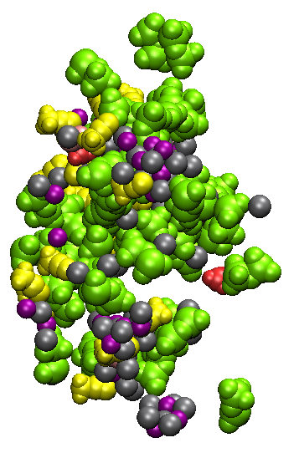
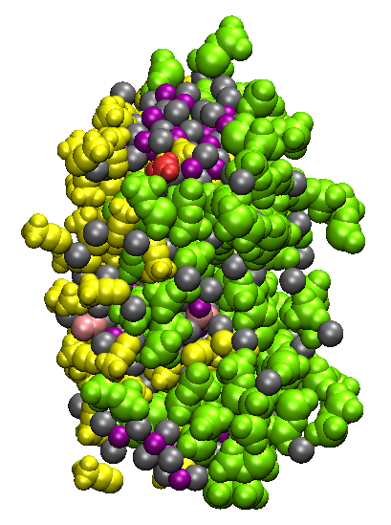
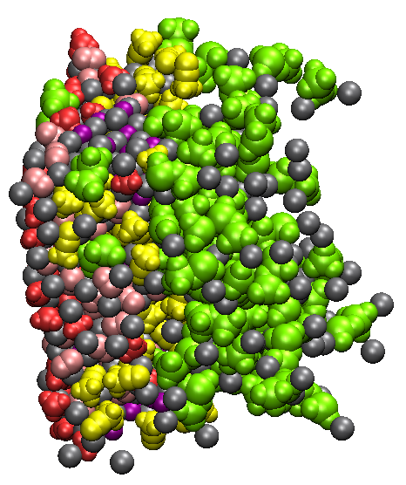
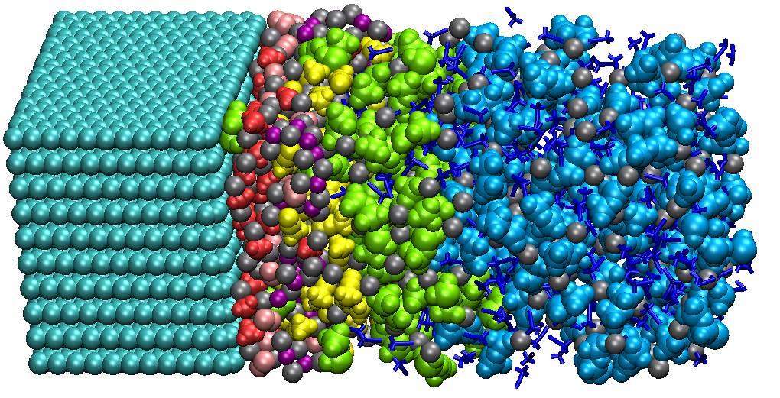
SEI film formation at very high concentration (4.5 M)
(a) 200 cycle
(b) 500 cycle
(c) 1000 cycle
(e) 2000 cycle
As the salt concentration increases, the surface became smoother because the dec-FSA⁻ anions form the stable film.
7
Notes:
Next, I further increased the salt concentration. In this case, the amount of dec-FSA anions which are colored green increased during the SEI film formation, and the surface became smoother than the lower concentration.

Slide 8

Changes in surface number densities
(They are obtained by different 10 initial configurations.)
Blue: AN (solvent), Light blue: FSA⁻ (salt), Yellow: AN－, Green: dec-FSA－, F－, Red: CN－, CH₃－
[nm⁻²]
MC/MD cycles
MC/MD cycles
MC/MD cycles
Low concentration
(1.0 M)
(b) High concentration
(3.0 M)
(c) Very high concentration
(4.5 M)
As the salt concentration increases, the FSA salts were reduced earlier than the solvent AN.
At the same time, the amounts of reduction products from the salts increased, while those from the solvents were almost same in all concentrations.
8

Slide 9

Mass density distribution of reaction products
(They are obtained by different 10 initial configurations.)
AN－
AN－
AN－
CN－
CN－
CN－
[gcm⁻³]
CH₃－
CH₃－
CH₃－
dec-FSA－
dec-FSA－
dec-FSA－
F－
F－
F－
0
1
2
3
4
5
6
7
8
0
1
2
3
4
5
6
7
8
0
1
2
3
4
5
6
7
8
z [nm]
z [nm]
z [nm]
Low concentration
(1.0 M)
(b) High concentration
(3.0 M)
(c) Very high concentration
(4.5 M)
The CH₃ and CN anions were mainly distributed near the anode surface.
As the salt concentration increases, the peak hight of dec-FSA anions clearly increased, meaning that the SEI film becomes denser.
9

Slide 10
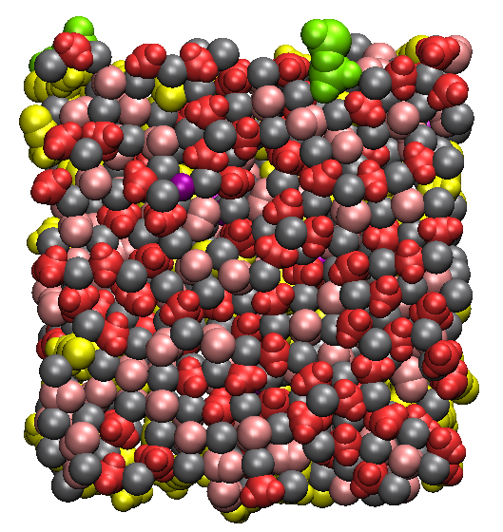
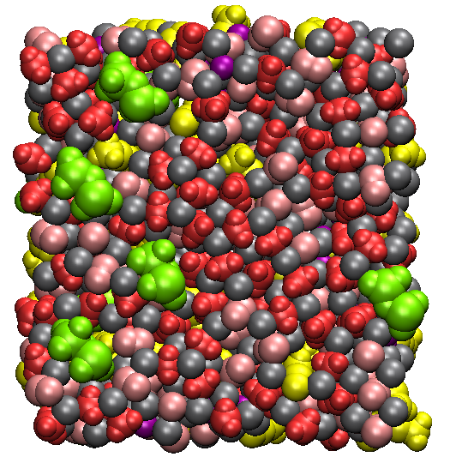
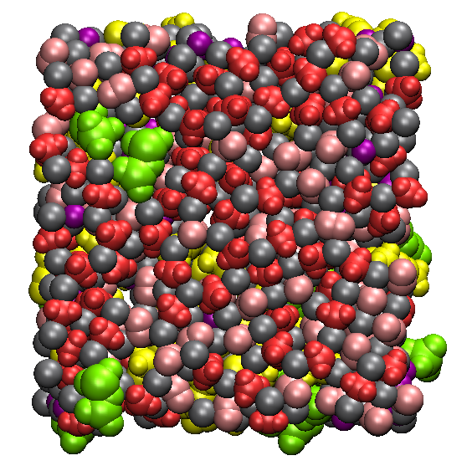

Interface structure in SEI film (Front view)
Interface structure (0 ≦ z ≦ 2 nm)
y
y
y
x
x
x
(a) Low concentration
(b) High concentration
(c) Very high concentration
In all concentrations, there is no cavity in the SEI film near the anode surface. Therefore, it is considered that the ion conduction mechanism is different from the previous cases when the PC solvent were used.
10

Slide 11
Summary
In this study, the salt concentration effect on the SEI film formation was investigated with AN/FSA electrolytes using the hybrid MC/MD reaction method.
At the low concentration, since the aggregation of reaction products was insufficient, they were found to drift away from the SEI film.
As the salt concentration increases, the dissolution of reaction products was clearly suppressed. This is because the reduction of salts form the stable and dense film.
However, there is no cavity which Na⁺ can pass through inside the SEI film. Therefore, the next research target is to understand the ion conduction mechanism inside the SEI film with AN electrolyte solution.

